Slide 1
Building a Better RAFT Improving Access to Emergency Rental Assistance in Massachusetts
Metropolitan Area Planning Council

Slide 2
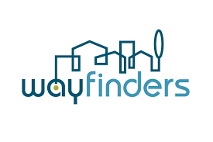
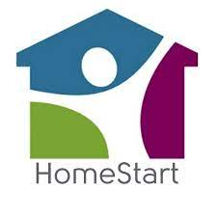
Research Partners
Stakeholder Advisory Group
Notes:
The Working Group
Citizens Housing and Planning Association

Slide 3
Background
Defining Terms
Residential Assistance for Families in Transition (RAFT):
An emergency rental assistance program funded by the Department of Housing and Community Development (DHCD) that provides short-term financial assistance to low-income families who are homeless, facing eviction, or losing utilities.
Regional Administering Agencies (RAAs):
RAAs are nonprofit organizations that administer RAFT and other state and federal housing subsidy programs. RAAs accept, review, and approve RAFT applications; they also provide support to applicants through the process.
Community-Based Organizations (CBOs):
​CBOs are nonprofit organizations that provide broad service support and education to certain populations, whether defined by geographic location, language group, ethnicity, circumstances such as homelessness, or other characteristics. CBOs support clients applying for RAFT by providing technology access, interpretation and translation, mediation with landlords, and more.
​
Neighborhood Emergency Housing Support:
December, 2021 through May, 2022
Grant program that provided financial support to 22 CBOs to spread the word about and help residents apply for RAFT and other emergency housing payment assistance programs during COVID. Led by CHAPA with funding support from TBF and United Way.​
​
​

Slide 4
Why this Research
Housing policy is at an inflection point — now is the time to learn from the challenges and successes of COVID-19-era emergency rental assistance programs to envision a new normal in housing policy
Photo credit: Alex Koppelman
Notes:
With this research we are focusing narrowly on learning from the successes and challenges of community-based organizations supporting households seeking rental assistance, and organizations or entities that worked closely with CBOs along the way.
We aimed to center the experiences of CBOs and tenants, with a focus on the impact on the experiences of BIPOC, immigrant, and low-income households

Slide 5
Research Questions
Role of community-based organizations:
What role(s) did CBOs play in helping residents access ERA?​
​
Outreach:
What specific outreach and assistance strategies and tools were used by CBOs? Which seemed to be more or less successful?​
​
ERA Application Process:
What were the major challenges in getting and distributing ERA funds and how can they be addressed through program and policy solutions?​
​
Notes:
Role of CBO: What role(s) did CBOs play in helping residents access ERA?
What actions does the CBO take that are most effective in helping residents access ERA? How do they help renters get assistance?
How does the ERA application process with CBOs differ from working without a CBO?
What other benefits do renters get from working with a CBO?
Outreach: What specific outreach assistance strategies and tools were used by CBOs? Which seemed to be more or less successful?
How did successful outreach strategies vary by CBO?
Were CBOs able to reach households that wouldn't have applied without their help?
Who was reached and served by the CBOs and who was not reached/served?
What household factors/characteristics facilitated access to a CBO?
ERA Application Process: What were the major challenges in getting and distributing ERA funds and how can they be addressed through program and policy solutions?
What are the procedural or institutional pain points that CBOs faced when helping residents access ERA? What ideas/vision do they have for program redesign?
What are the most common pain points that households experience when applying for ERA, with and without CBO assistance?

Slide 6
Phase 1: Research Foundations
Identifying Challenges and Defining Success
Stakeholder Advisory Group
Literature review
Data analysis
Data sharing forum
Notes:
Literature review – academic lit, reports and papers from non-profits, CBOs and other housing advocacy orgs or think tanks, and government sources
Data sources – data collected through the Neighborhood Emergency Housing Support (NEHS) program; Census Housing PULSE survey

Slide 7
Survey Results
Source: U.S. Census Bureau Household Pulse Survey (HPS) Phase 3.3 & 3.4

Slide 8
Survey Results
Source: CHAPA CBO Survey
Notes:
Uncoorperative landlords – why woudn't you want this money? Can't learn the why from the survey.
Also able to learn things from the CBO survey about the demographics and characteristics of households that applied with the help of CBOs; the dollar amount of arrearages; preferred languages; time spent with the CBOs, and more.

Slide 9
Survey Results
Source: CHAPA CBO Survey
Notes:
Uncoorperative landlords – why woudn't you want this money? Can't learn the why from the survey.
Also able to learn things from the CBO survey about the demographics and characteristics of households that applied with the help of CBOs; the dollar amount of arrearages; preferred languages; time spent with the CBOs, and more.

Slide 10
Phase 2: Research Implementation
Experiences, lessons learned, and a vision for housing policy in Massachusetts
Qualitative research to capture the experiences, lessons learned, and strategy ideas for future rental assistance programs
Final policy recommendation development

Slide 11
Deepened understanding
“My landlord’s family is very much against submitting the W9 form. Because of this, my case can’t proceed...I still can’t get the relief.”
– Tenant focus group participant
“The applications should be language accessible and not just plugged in on Google Translate, where they didn't make sense. ”
– CBO focus group participant
"Your ultimate goal is to help the tenants. If that’ the case, wouldn’t it be better just to verify with the tenants?”
– Tenant focus group participant
Photo credit: Everett Haitian Community Center
Notes:
We spoke with 34 stakeholders through focus groups, including 18 tenants, as well as CBOs, RAAs, and landlords. We offered tenant focus groups in English, Spanish, Portuguese, Haitian Creole, and Mandarin, based on the client base of our stakeholder CBOs. The non-English focus groups were held in-language, meaning we had a facilitator speaking directly with the tenants, rather than through an interpreter.
We treated this information and the things people were saying as real data. Translated, coded, robust and reproducible; trying to document these experiences in a new way. Elevate these experiences in a way that's not anectodal but is documented.
Conversations provided unexpected insight: the only way to learn these details is to have conversations with people.

Slide 12
The case for community organizations
“We work directly with [our region’s RAA]...And our likelihood of getting these applications approved is close to 100...We have reached thousands and thousands of families in the city.”
– CBO focus group participant
“In the future [we hope that] the legislators who write these policies...actually sit with people like you who are doing this research...That they sit down with CBOs and advocates. Really to be with them as they design this, so that it really makes sense.”
– CBO focus group participant
“When you have connection and relationship with community-based organizations in other areas, they may have an understanding of what's happening in that area that you may not be aware of and able to give some content and context to what is happening.”
– RAA focus group participant
Notes:
Funders wanted us to demonstrate the value of CBOs. We want the CBOs to have to do less so that they can focus on those most marginalized individuals and on really adding value rather than spending all their time on this terrible application process. Stakeholder groups coming from different worlds, and facilitating communication among the groups is key.

Slide 13
Policy Recommendations
Remove excessive barriers to access
Increase the capacity of the program and partners
Improve transparency of the program operations and outcomes
Build relationships within the rental assistance ecosystem
Address housing instability more broadly (outside of the scope of this project)
Photo credit: Adobe Stock
Notes:
Individual rec's to highlight:
End the Notice to Quit requirement for applications
Translate application and reference materials into all high-demand languages
Explore direct-to-tenant payment model to alleviate documentation barriers
Proof of U.S. Citizenship – convene experts
Clearly define program goals and report data on household outcomes
Formalize community-based organizations into RAFT programming and fund them at the level needed to maintain RAFT support staff
Increase RAFT rental assistance budget and extend assistance to cover future rent in addition to arrears
Bring community-based organizations and Regional Administering Agencies into policy and program design, and formalize a feedback and iteration process

Slide 14
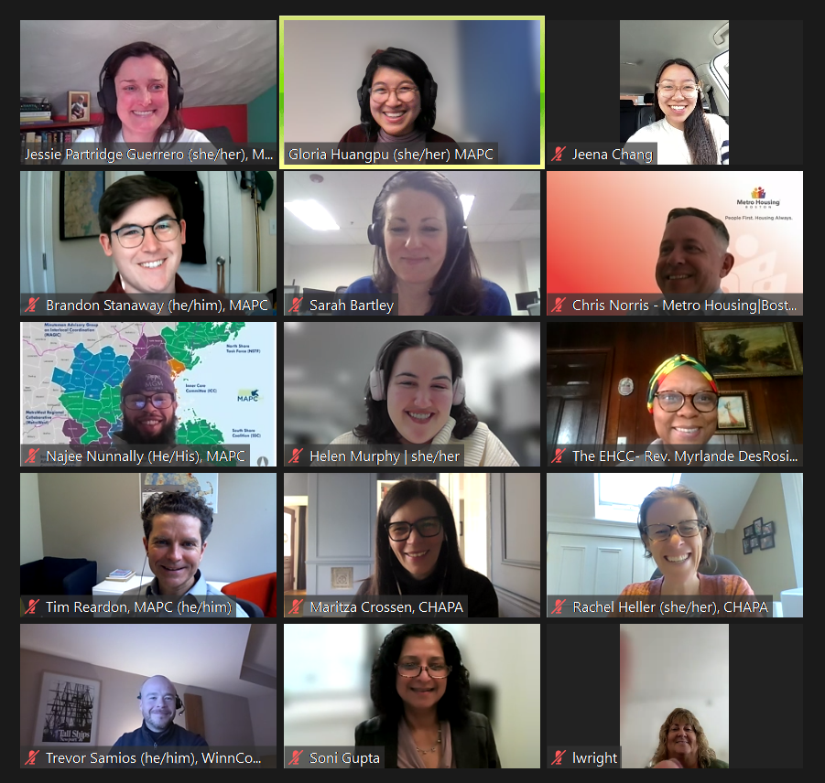
Reflections
Talking with the people experiencing policies and programs is essential for building strong and effective systems – this should be part of our "new normal."
Value in having a diverse stakeholder group.
Mixed-methods approach can highlight major cross-cutting themes, and uncover findings that might not emerge otherwise.
Iteration between quantitative and qualitative data can strengthen approach and findings.
In-language focus group facilitation allows for accessible and unfiltered conversation—and is expensive.
Worth taking the time to vet questions for accessibility to targeted audiences.
Notes:
RELEASE EVENT!! Check TBF events calendar

Slide 15
Thank you!
Brandon Stanaway Socioeconomic Analyst I bstanaway@mapc.org

