Slide 1
Data Justice for Pittsburgh’s Black Neighborhoods
Project overview - November, 2023
Robert Gradeck
Notes:
15 sec

Slide 2
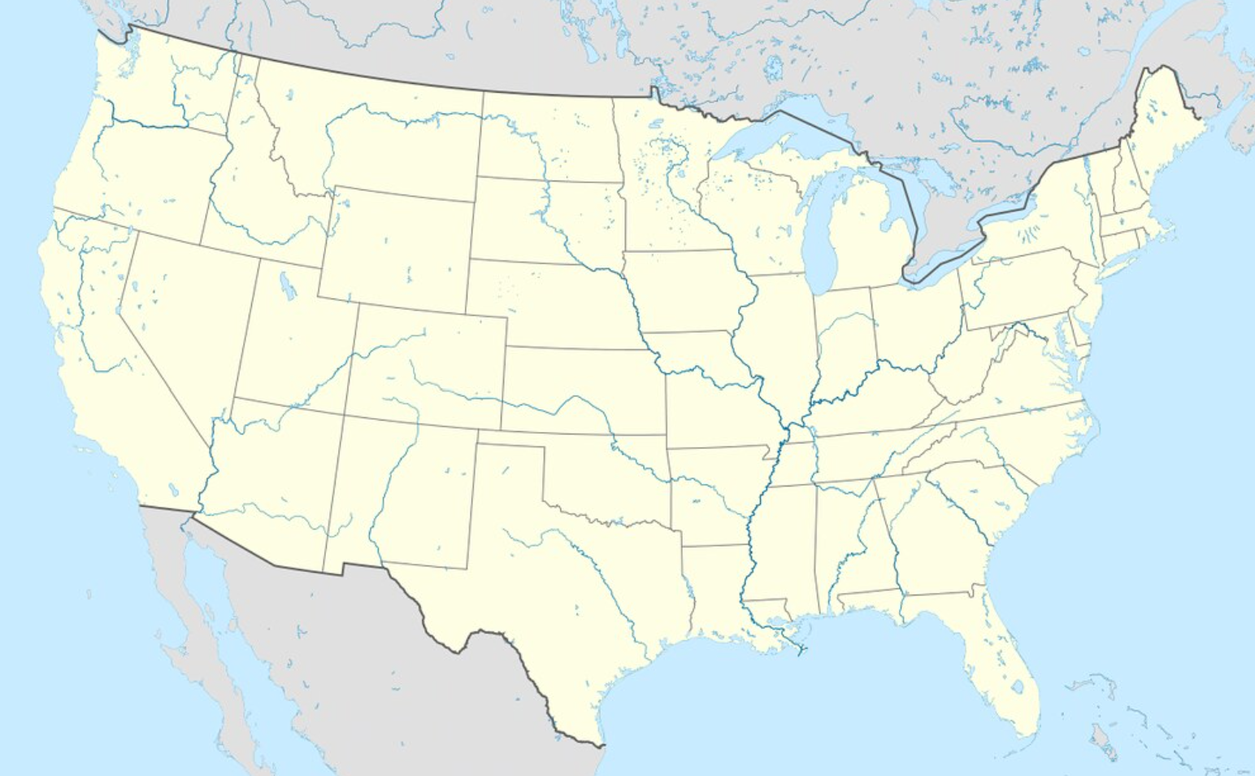
The Black Equity Coalition was one of four teams awarded $1.1 million over three years
MADE = Modernized Anti-Racist Data Ecosystems
Notes:
15 sec

Slide 3
This project brings together very familiar partners with many different affiliations…
Notes:
15 sec

Slide 4
Our Overall Objectives
Shift power to community members in the City of Pittsburgh’s design of data systems and use of data
Create an infrastructure for resident power-building and accountability at all stages of the data life cycle.
Address neighborhood health challenges tied to the built environment through data-informed action.
Activate and strengthen the capacity of the Black Equity Coalition to serve as a health-focused civic data intermediary that is led by members of the Black community.
Build community health, environmental, and data literacies.
Notes:
20 sec

Slide 5
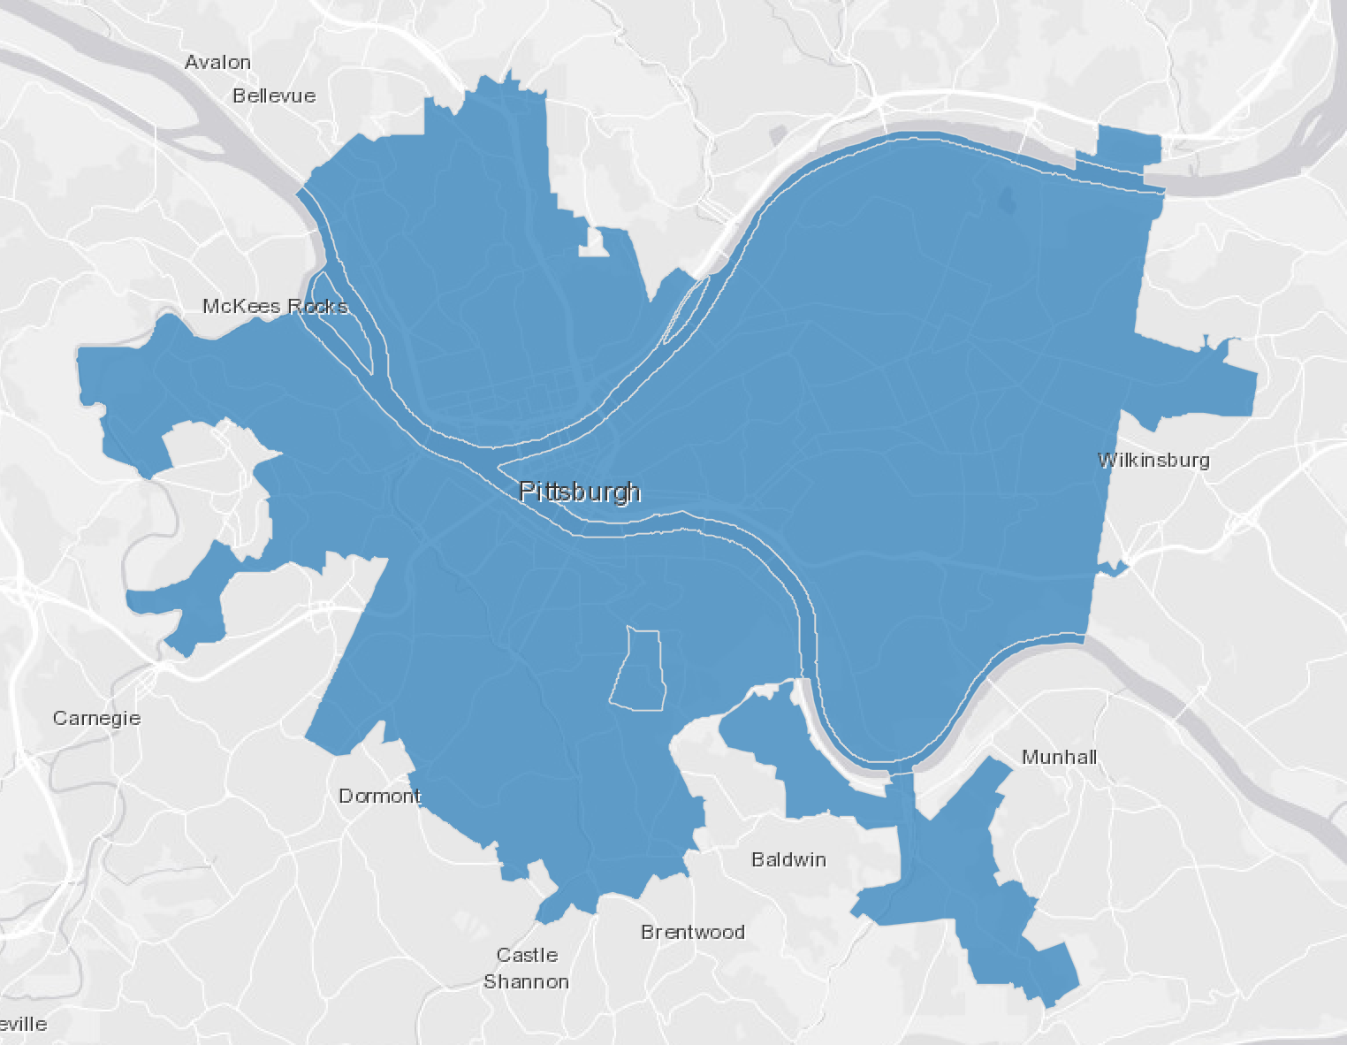
Our work will take place at two scales….
City-Wide
Institutionalize participatory data governance
Neighborhood Level
Power-building and accountability
Notes:
10 seconds

Slide 6
This initiative supports the BEC Data Justice Working Group’s Mission, Vision, and Values
Mission: Provide, analyze, and advocate for data to improve health outcomes and reduce inequities experienced by Black residents in Allegheny County.
Vision: Systems, institutions, and individuals within the public health ecosystem use data to improve the quality of life and well-being of Black communities.
Values: We believe that data systems should be designed on anti-racist principles and be equitable and just. We value transparency, holding people, institutions, and systems accountable, taking action, acting with integrity, and encouraging public participation in data system design and data use.
Notes:
20 sec

Slide 7
Citywide Mini-Public
This initiative will establish and institutionalize a “mini-public” deliberative body to engage in decisions that the City makes about data and technology, and co-design databases, data systems, data standards, processes, and policies that will serve as the foundation of the City’s emerging data governance process.
Notes:
10 sec

Slide 8
Benefits in having residents partnering with the City in making data decisions
Community members will have power to influence investments and practices in ways that align with their needs, identities, and perspectives.
Better ensure that investments in data and data systems fill data divides and center collective priorities over individual benefits.
Provide people that are often data subjects and objects of surveillance with the power to prevent, contest and dismantle oppressive systems.
Help community members understand data contexts, along with trade-offs and constraints faced by the City.
Building public trust in the City’s data governance process and social license to use data requires the City to shift power to community members in deliberation and decision-making about data systems. It also requires transparent public communication.
Notes:
20 sec

Slide 9
Details
To develop confidence, relationships, norms, and shared vocabularies, and equip people to fully participate, the activities will start with data literacy workshops.
Deliberation among members of the mini-public + City staff will take place through structured, small group activities
Members can demonstrate facilitative leadership by establishing their own ground rules and community agreements as they work for consensus.
Where broader community input is needed, the members of the mini-public can design and hold community events, conduct surveys, etc.
A communications strategy will enable accountability
Notes:
20 sec
For more on mini-public deliberative body structures, please see these two reports:
Civic Participation in the Datafied Society
Innovative Citizen Participation and New Democratic Institutions
More and more initiatives emphasize the importance of meaningfully bringing people into the decision-making process involving data.
Connected by Data project in the UK
Global Partnership for Sustainable Development Data

Slide 10
Neighborhood Power-Building
Support a group of residents as they use data to build power and improve social determinants of health. The focus of this work will be on the connection between health and the built environment.
Notes:
10 sec

Slide 11
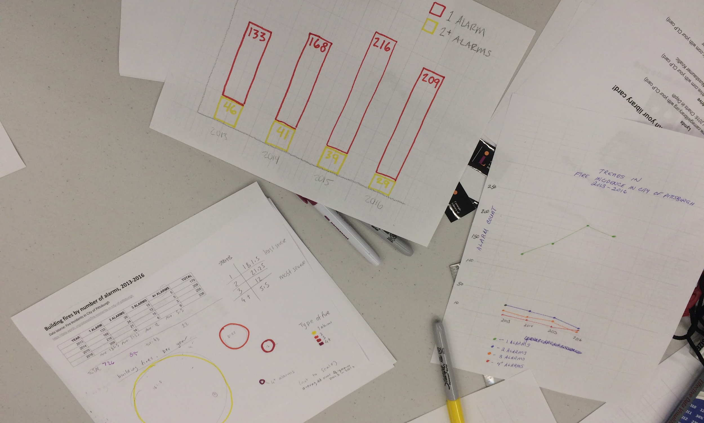
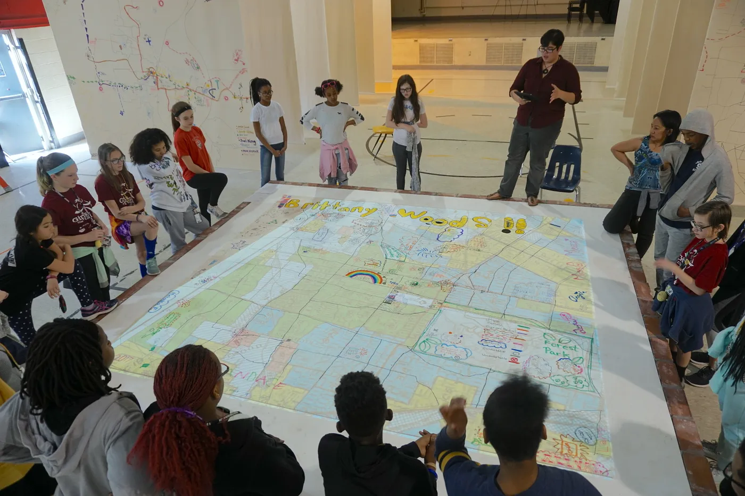
Inspiration - two efforts that have convened people in conversation using data
Regional Data Center - Data 101 St. Louis Map Room
https://blprnt.medium.com/in-the-map-room-cd6b06bf2139
Notes:
10 sec

Slide 12
Benefits of focused work to develop and implement a health improvement plan in one neighborhood
Build health and environmental literacy, enabling residents to link mitigation strategies to health outcomes.
Increase confidence in resident’s ability to understand and work with data and exercise power through data collection, data analysis, storytelling, and advocacy.
Residents will acquire additional context about how government processes operate, and develop a better sense of how programs and initiatives at the City can be leveraged to benefit their community.
Enable community residents to participate in decision making, improve coordination among parties, generate feedback loops between residents, government agencies and social service providers, elevate the importance of local tacit knowledge, and create opportunities for accountability.
Trust will increase between residents and the City and social service organizations along with the quality of the neighborhood’s built environment, and
Our model for using data around a shared table will spread to additional communities.
Notes:
20 sec

Slide 13
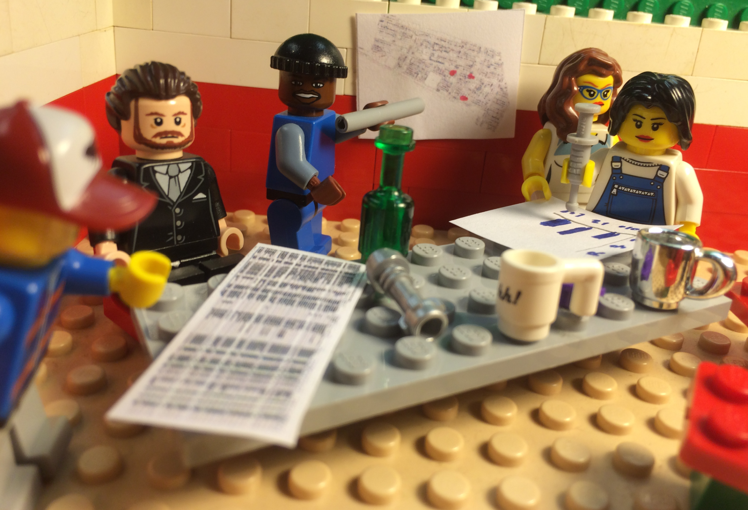
Residents will work with data in a series of workshop activities designed to build confidence and power and spark conversation
Paper-based
Use of contextual data guides
Collect data to fill data divides and create a counter-narrative
Local subject matter experts will participate
DRAMATIZATION
Notes:
20 sec
Some examples of how residents have claimed power through data collection:
Property condition surveys
Soil tests
Infrastructure audits
Resident surveys
Photo voice projects

Slide 14
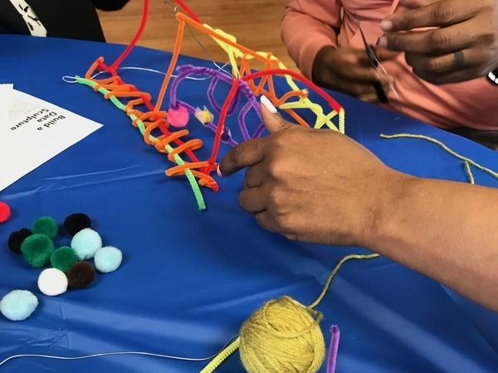
An artist can also work with residents to elevate their lived experience through art and storytelling
Indigenous, local and tacit knowledge isn’t as valued alongside quantitative data
Art can help residents share their vision for the community
Their work can be highlighted in a public display/gallery show along with other artifacts from the planning process.
Notes:
20 sec

Slide 15
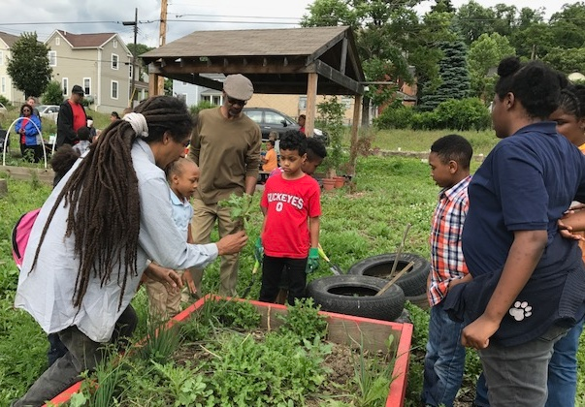
The Health Improvement Plan Will be Action-oriented, and may address these topics:
Assets;
Vacant land;
Abandoned housing;
Code enforcement;
Transportation;
Shade trees;
Community gardens;
Home repair programs;
Stormwater management;
Environmental hazards;
Recreation;
Lighting; and
Beautification.
Grow Pittsburgh
Notes:
15 sec

Slide 16
We’ll also focus on accountability
Residents will regularly meet with City staff and other service providers to guide implementation.
Meetings will provide a vehicle for holding public agencies accountable.
At these meetings, the group will:
revisit priorities;
review progress;
analyze data;
coordinate actions,
share feedback; and
celebrate wins.
Notes:
15 sec

Slide 17
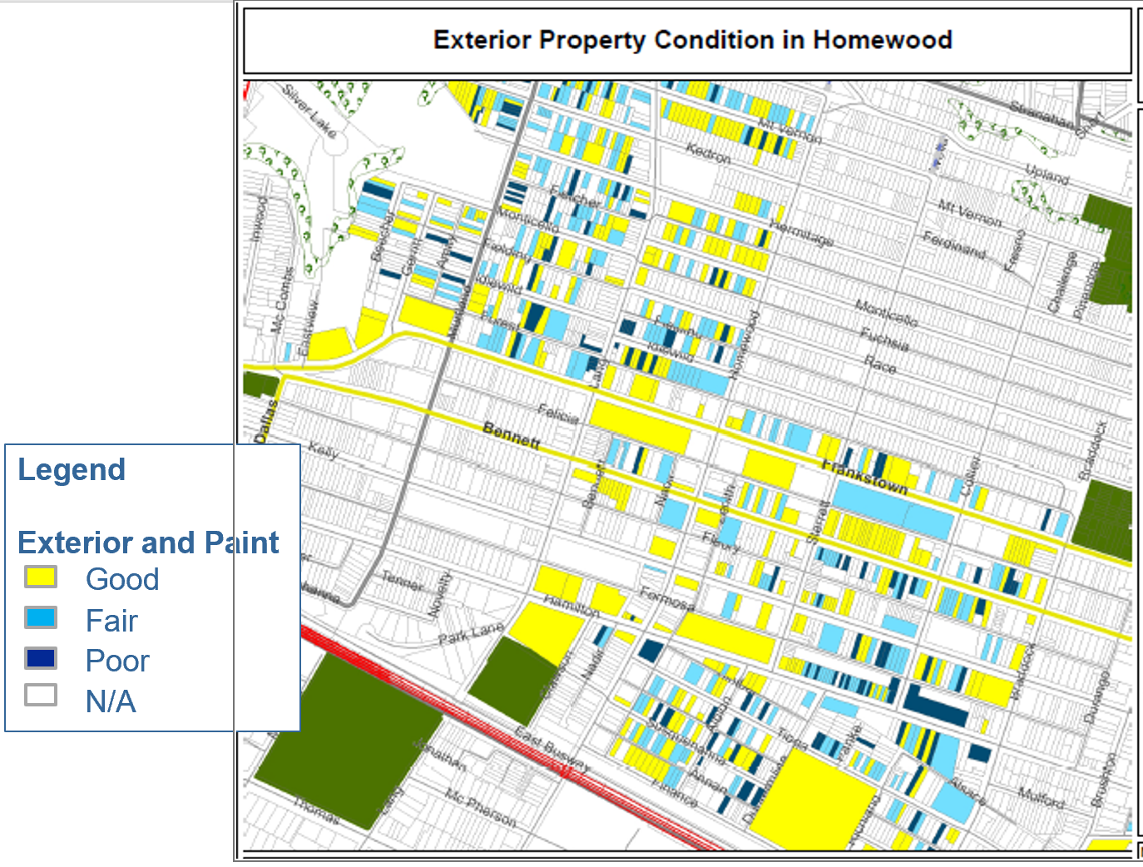
Inspiration: Cleveland’s Neighborhood Stabilization Team and Homewood’s “Dirty Thirty” effort.
In Cleveland, neighborhood leaders met monthly with City staff to coordinate actions to address the foreclosure crisis, and hold the City accountable
In Homewood, residents and students worked together to collect property condition data. Working in coordination with one another, residents contacted the City through 311 and other channels to demand action on properties in the worst condition.
https://www.youtube.com/watch?v=vif2_9xIXDs
https://www.neighborhoodindicators.org/sites/default/files/publications/nnip-nrcjune2013.pptx
Notes:
15 sec

Slide 18
Timeline
Year 1: Overall planning and staffing
Year 2: Launch mini public and neighborhood planning efforts
Year 3: Continue mini public activities and neighborhood plan implementation
Notes:
10 sec

Slide 19
We’ll share lessons we’ll learn along the way
FYI - there may be an additional round of funding to new grantees in the future.
Notes:
10 sec

