Slide 1



Connecticut Voter Data Analysis
Jason Cheung, Senior Data Analyst
2023 NNIP Conference

Slide 2
Data Sources

Slide 3

Data Sources
Connecticut Secretary of the State (SOTS)

Slide 4

Data Sources
Connecticut Secretary of the State (SOTS)
United States Census Bureau

Slide 5

Who’s in the Voter Data?
Registered Voters 2023

Slide 6
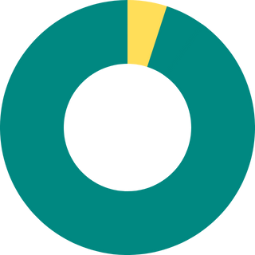
Who’s in the Voter Data?
Lived and voted in a different town in 2019
Registered Voters 2023

Slide 7

Who’s in the Voter Data?
Lived and voted in a different town in 2019
Voted in Hartford 2019
Registered Voters 2023

Slide 8
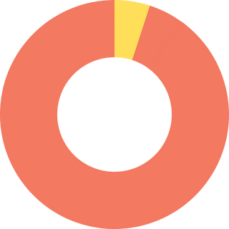
Who’s in the Voter Data?
Lived and voted in a different town in 2019
Moved out of Hartford
Voted in Hartford 2019
Registered Voters 2023

Slide 9
Findings & Insights

Slide 10

Low Voter Participation

Slide 11
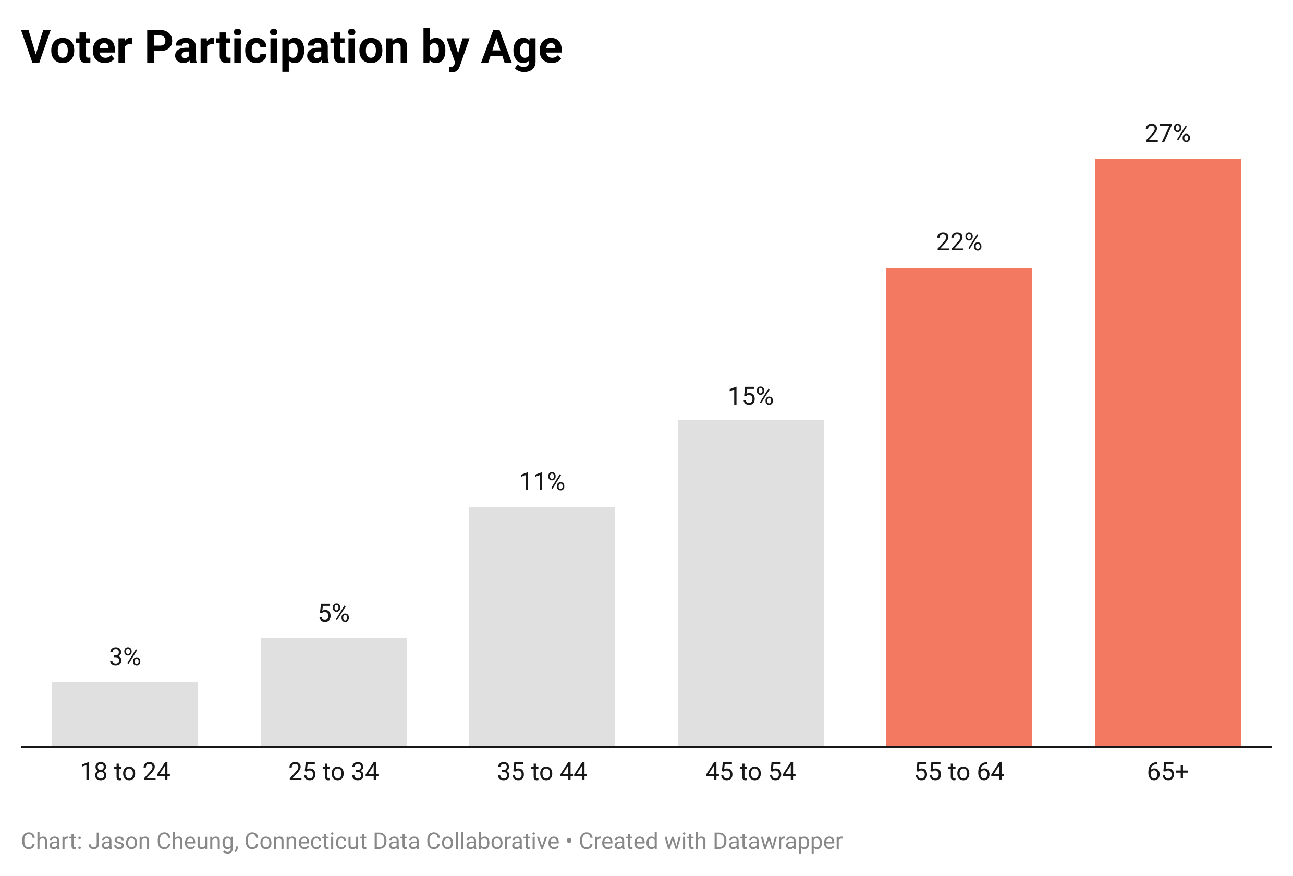
Voter Participation Increased With Age

Slide 12
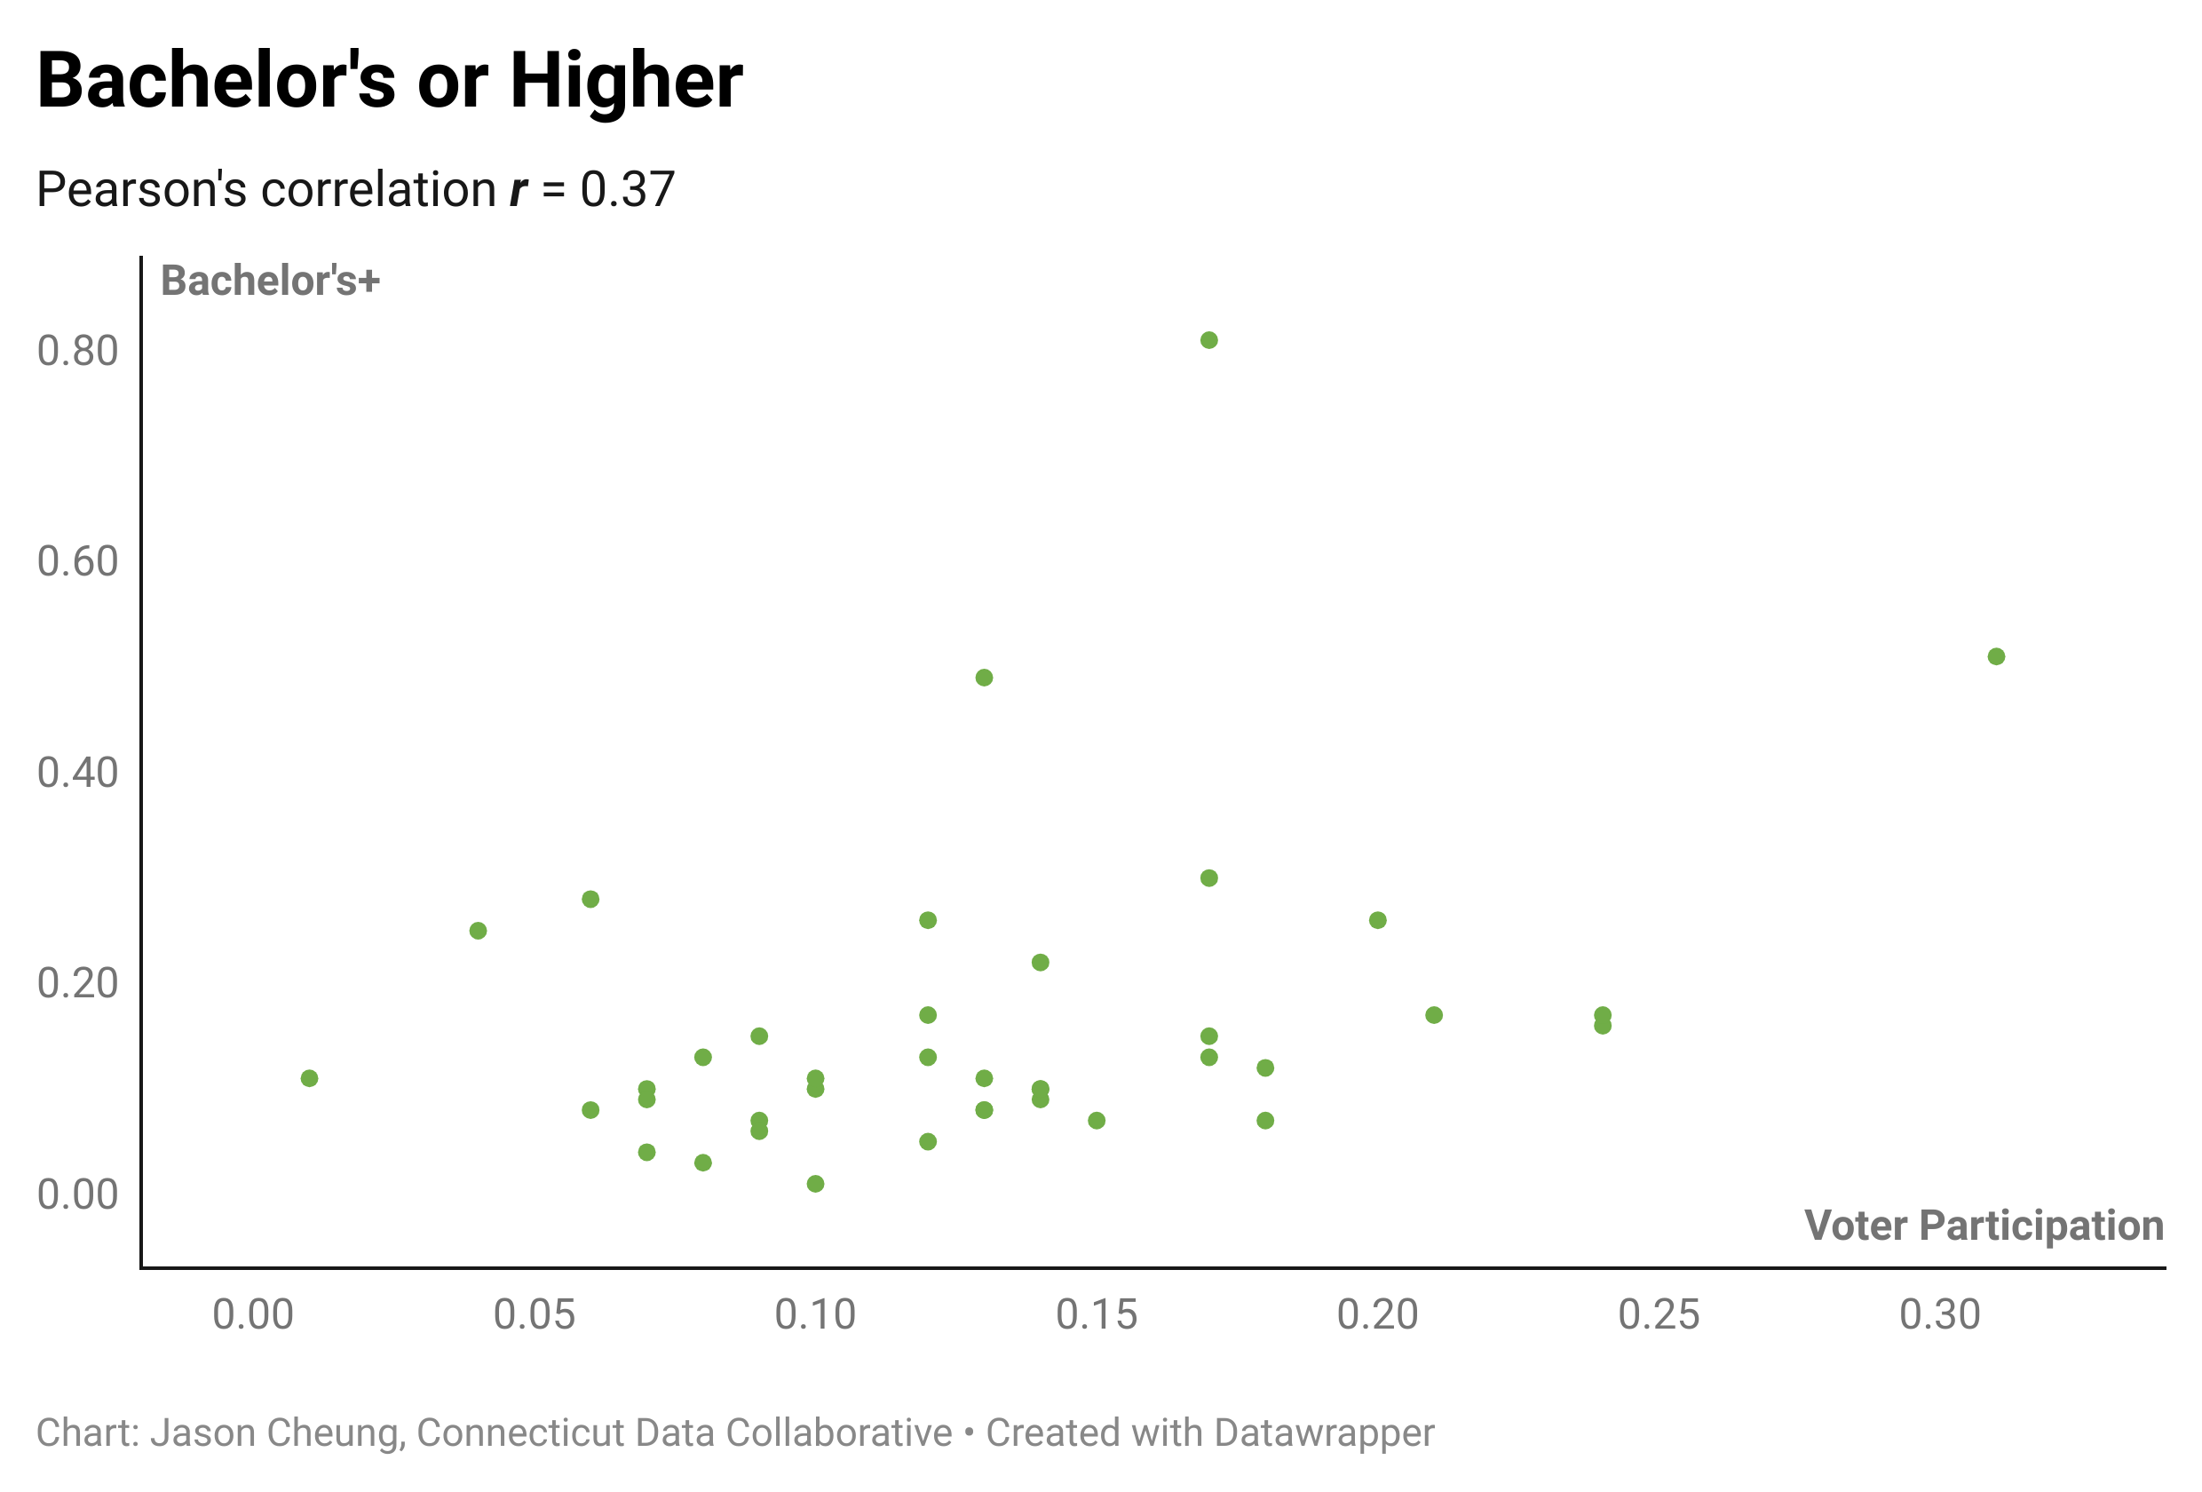
Socioeconomic Factors

Slide 13
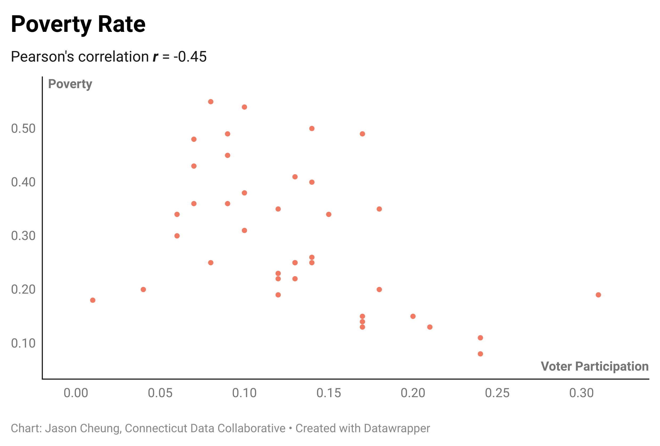
Socioeconomic Factors

Slide 14
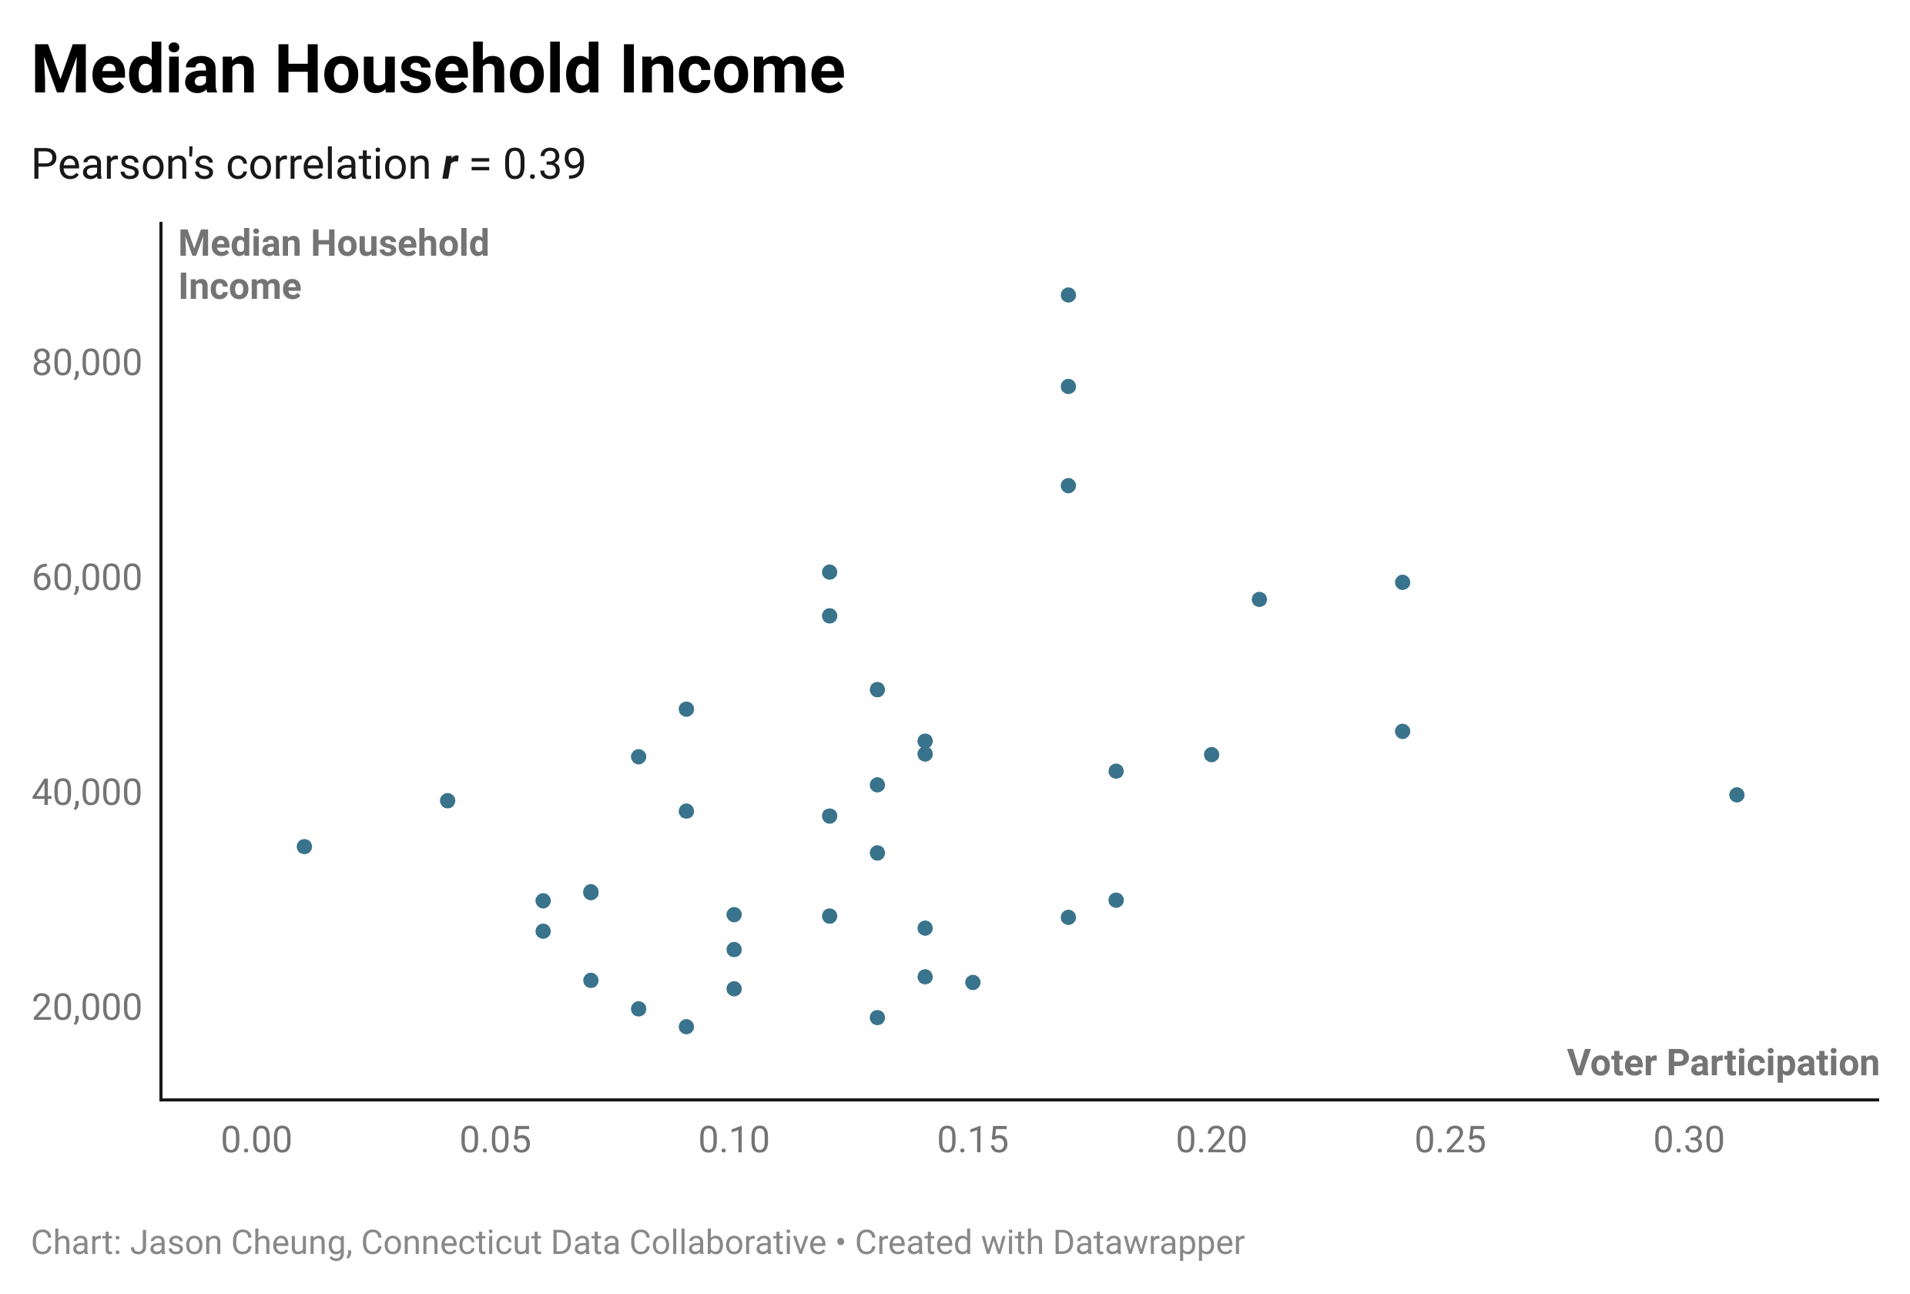
Socioeconomic Factors

Slide 15
Who Doesn’t Like a Nice Dashboard?

Slide 16
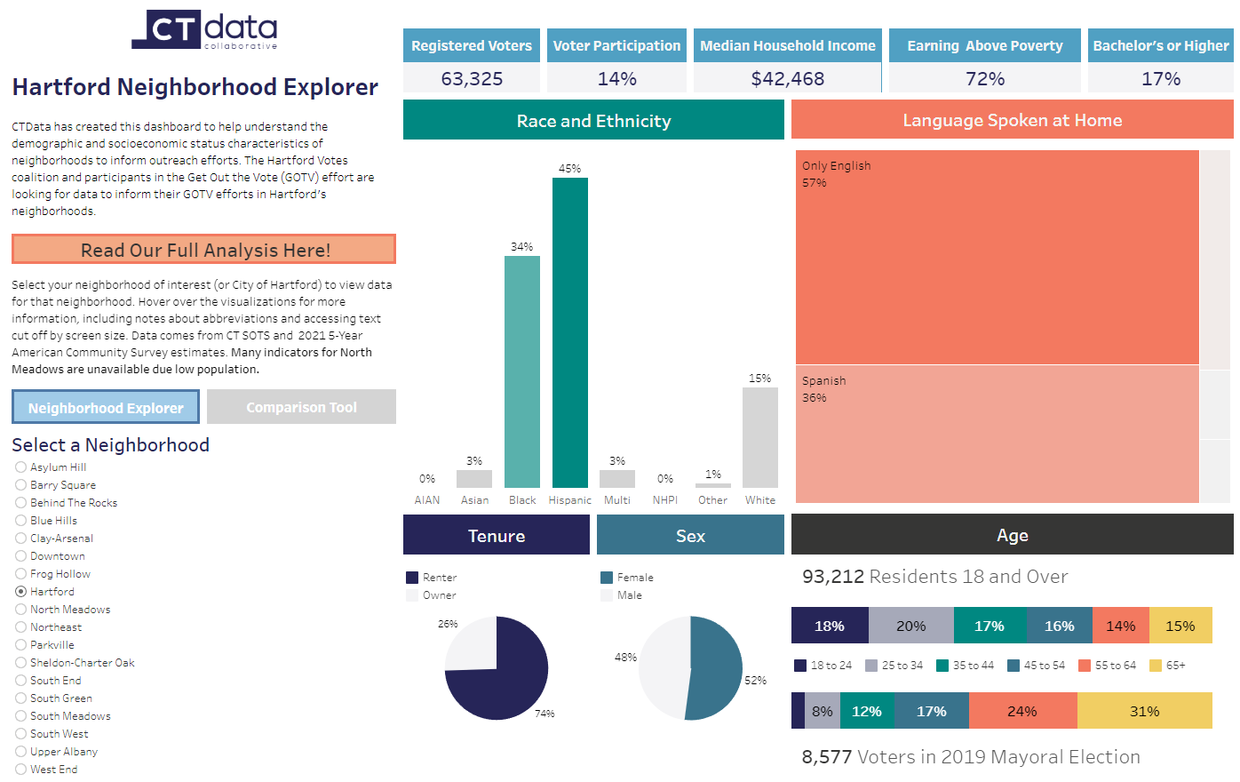

Slide 17
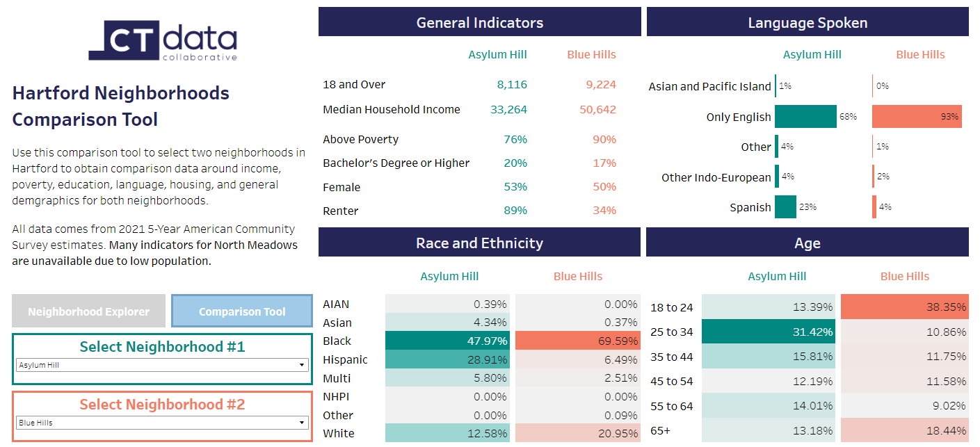

Slide 18
Thank you!
CTData.org
@CTOpenData

