Slide 1
Dashboards for Decision Support
Sharon Kandris
The Polis Center at
Indiana University-Purdue University Indianapolis
NNIP Meeting May 18, 2017
Notes:
I am focusing on the evolution of our web-based data tools that we’ve developed to democratize data (not all the general content such as the about us, reports, news, etc., which is important too, just not my focus for this presentation

Slide 2
Our Approach

Slide 3
Engagement and Collaboration
Critical first step:
Defining a clear “use case” - the decision making process you are trying to inform
Based on that, identify key stakeholders:
Potential users
Partners
Funders
Future champions
Notes:
Almost every campus has a community engagement as part of it’s mission. And our center is one of the more externally facing units where community engagement and collaboration are key to our work. But until we really embraced the principals of community engagement as we’ve been developing these dashboards have we truly been successful at meeting the needs. Creating these dashboards with the community of users, not for – engaging them in the process of defining the need and building the solution.
Identifying a particular use case is important – what is the PRIMARY function of the dashboard. It’s fine to have other beneficiaries, but first and foremost, it needs to meet a particular need. Trying to be everything to everyone is most likely to result in failure
The use case also drives who you identify as stakeholders. We establish a different advisory committee for each dashboard/use case – selecting representatives that are very pertinent to that particular use case

Slide 4
Advisory Committees are Key for Us
New committee for each tool/use case
Feedback on every stage in the process
Conduit to other target audiences/stakeholder groups
Builds champions from the beginning
Ensures it meets the needs of intended users
Notes:
A lot of time spent discussing what data to include, how those data need to be displayed on the dashboard based what questions trying to answer with the data, etc.

Slide 5
Committees Also Helps Prioritize
Notes:
Input on priorities
once you start down the road, you can all kinds of bells and whistles and you have to manage expectations and balance needs with reality of what it takes to implement (scope). The committee can be helpful in prioritizing what are the most critical – once you have the input of how much effort it will take to implement.

Slide 6
Development and Feedback Cycle
Advisory Committee Input
Envision
Clarify Requirements
Develop Wireframes
Create
Graphical Design
Develop Tool
Beta Test
Publish Tool
Notes:
Advisory group of stakeholders
I gave a presentation last spring in San Antonio that walks through of each of these steps in detail for our IndyVitals tool, so I’m not going to elaborate much on this here but encourage you to check that out on the NNIP website if you want to learn more about our approach.
Feedback cycle and general approach – define use case, req, wireframes, design, beta, test, rollout
Refining goals
Requirements – data, functionality, look and feel
Prioritizing features and data
Ongoing input in design process
Conduit to other target audiences/stakeholder groups
Championing the product
E.G., when rolled out our IndyVitals took, one of the adv committee members was and ED of a CDC; he already was using the site and thiking about ways his org and others like his could; so when we did an hour segment on our local public radio program, he was able to talk about those examples

Slide 7
Indianaimpact.org
Organizational decision making process

Slide 8
Indiana Association of United Ways
United Way Organizational Decision Process:
United Ways around the state
Is UW’s work/funding is making a positive impact on the communities it serves?
How should it focus its efforts?
Small UW organizations, little to no data capacity
Secondary:
Provide nonprofits with access to data to support program planning, grants, and decision making
Notes:
Indiana Association of United Ways (IAUW) is committed to supporting the needs of 62 United Ways and funds in Indiana. It has identified the need for a simple online community report card that allows its members (mostly non-data experts) and nonprofits to get a quick snapshot of how the community is doing and to determine whether their work in the areas of health, education, and income is making a positive impact on the communities they serve.

Slide 9
United Way Framework
United Way Framework:
Education – e.g.,
Early childhood
Staying on track in middle school (math, language arts)
Graduate on time
Pursue higher ed
Health
Income
Not measuring against targets, but key questions:
Are we getting better?
How do we compare?
Community context - demographics
Notes:
This framework is based on United Way of America’s framework – all Uws in the state use this general framework and need access to roughly the same measures
So we identified specific indicators along with
Many of these folks was used to drive what data to include on the dashboard – don’t have the staff

Slide 10
Advisory Committee
Indiana Association of United Ways
Staff from small United Ways
Staff from large United Ways
Data priorities
4 iterations of dashboard

Slide 11
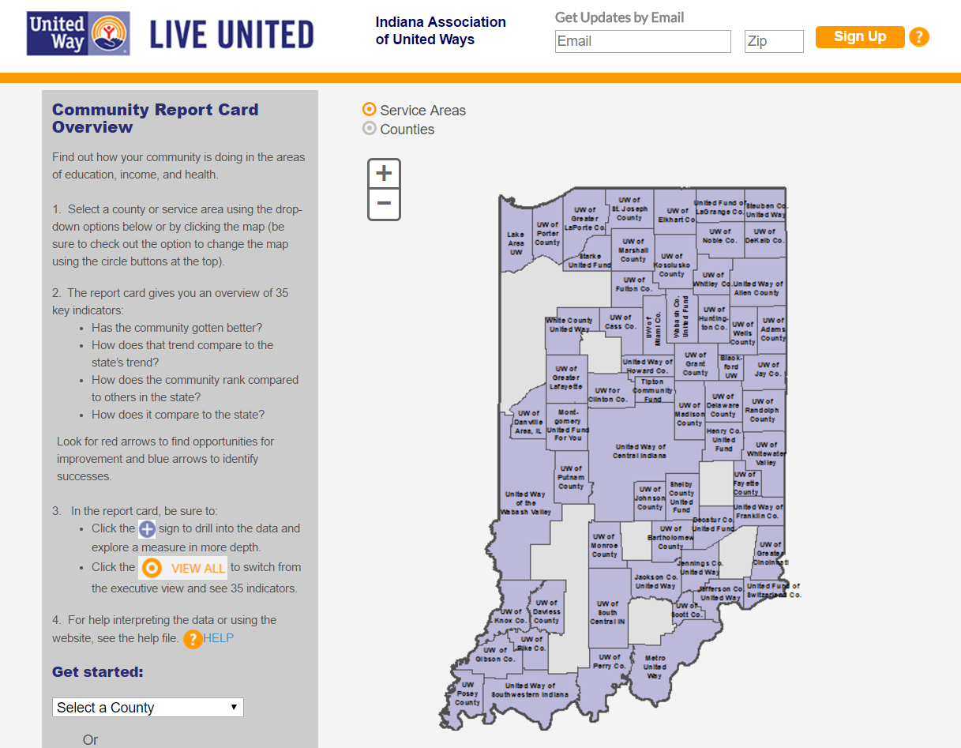

Slide 12
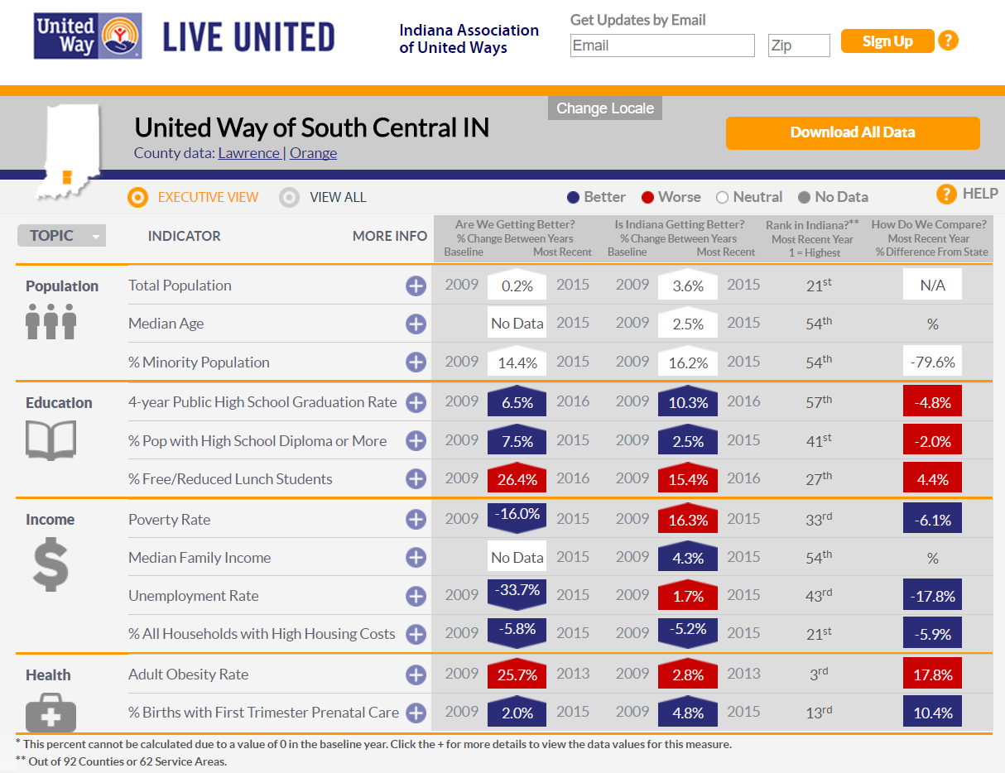

Slide 13
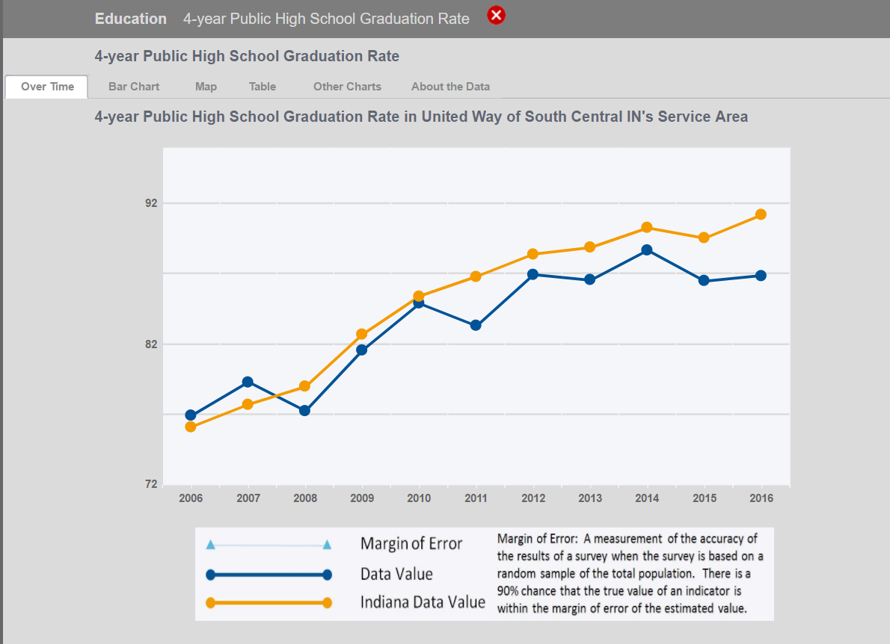

Slide 14
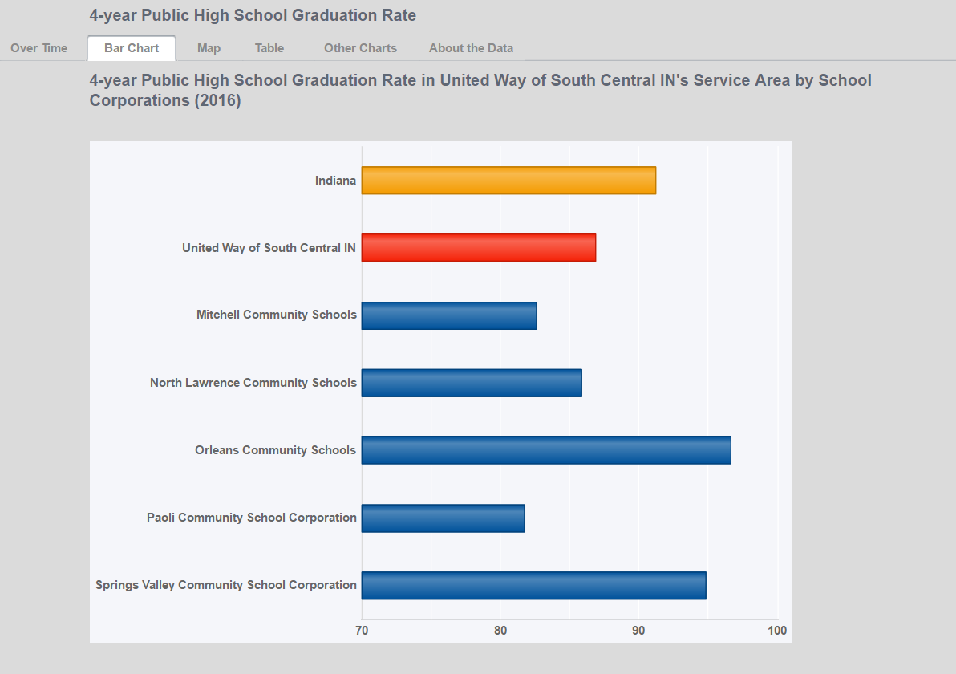

Slide 15
Indyvitals.org
Community decision making process

Slide 16
Plan2020
Get everyone doing place-based work on the same page, access to the same story for each ‘place’
Measure the impact of Plan 2020 and its partners at a neighborhood level, specifically measuring health and sustainability.

Slide 17
Framework
Star Communities rating system for sustainability
Built environment
Economy & jobs
Equity & empowerment
Health & safety
Education
Etc.
Notes:
Indianapolis office of sustainability working to improve this
Plan2020 intended to improve communities in these areas
This was the starting point for the data to be included on the dashboard

Slide 18
Use Case: Personas
Interested Citizen – simple dashboard
Staff at an organization – deeper dive to understand disparities and inequities
Policy Maker – Understanding relationships between metrics (how poverty relates to education)

Slide 19
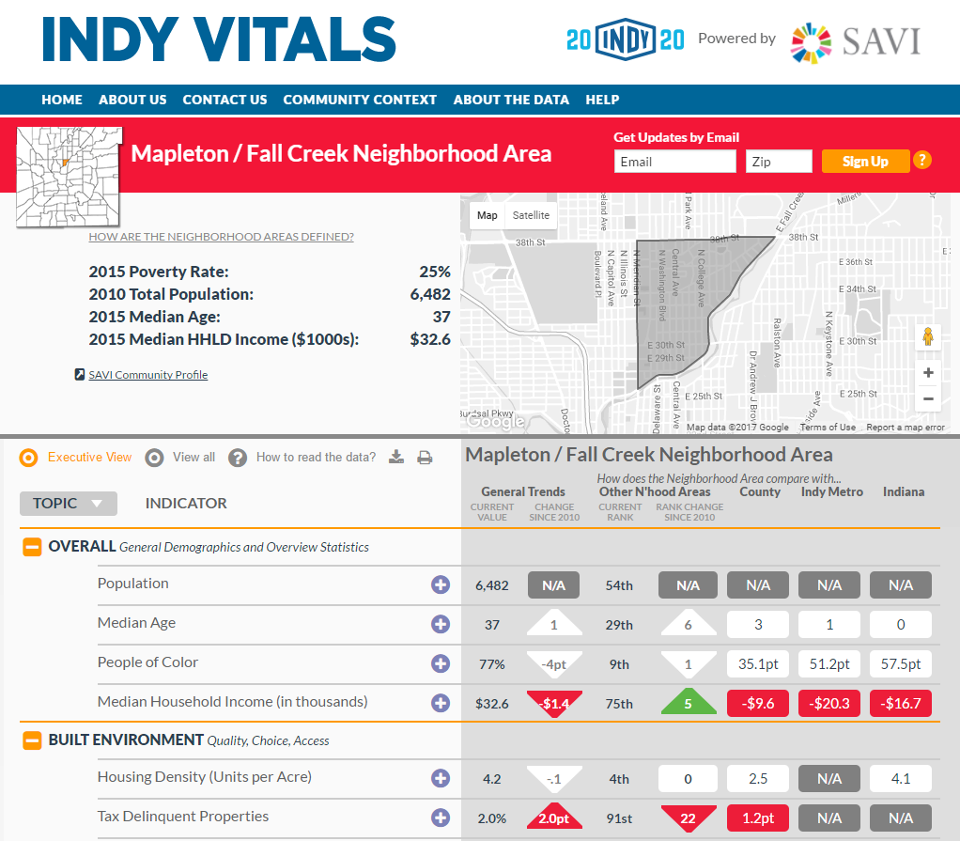

Slide 20
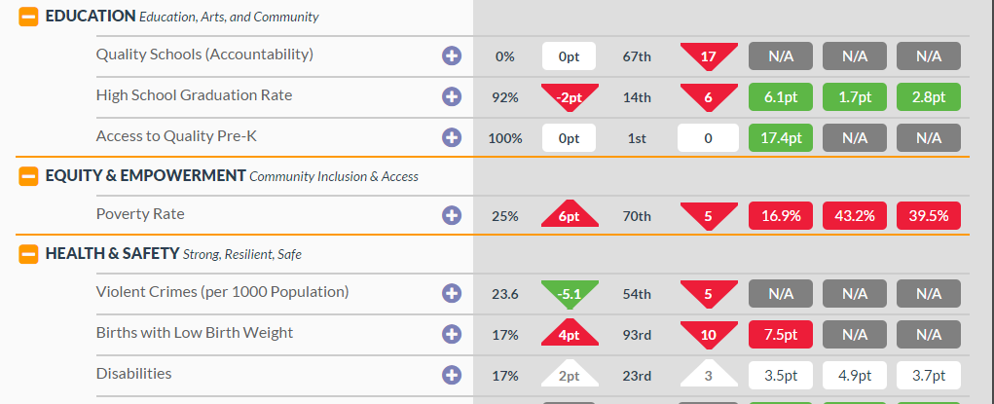

Slide 21
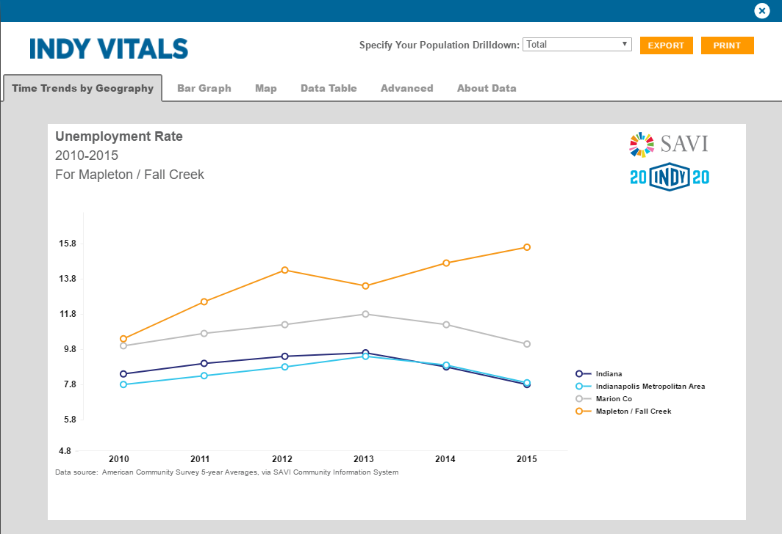
Deeper Dive - Trends

Slide 22
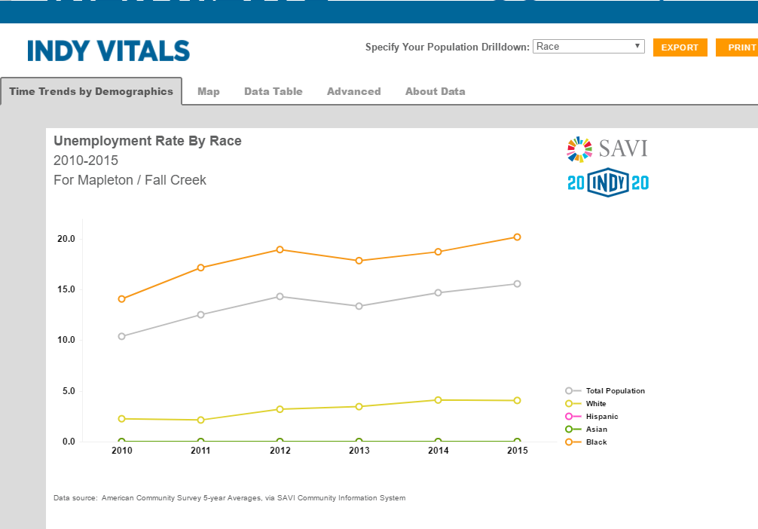
Deeper Dive - Disparities
Race
Income
Education Level
Gender

Slide 23
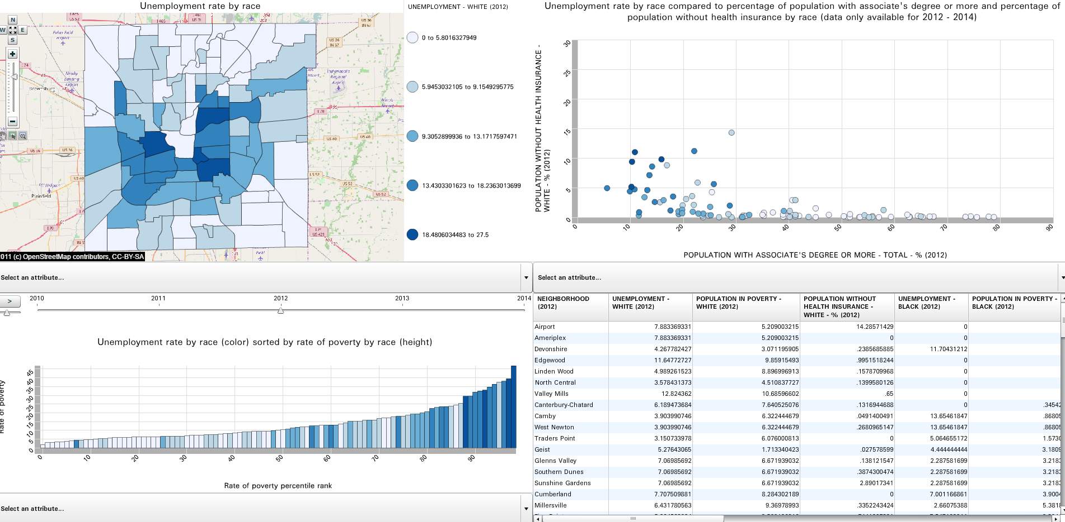
Advanced View – Exploring Relationships

Slide 24
A Collective impact initiative
Measuring Progress Toward Goals

Slide 25
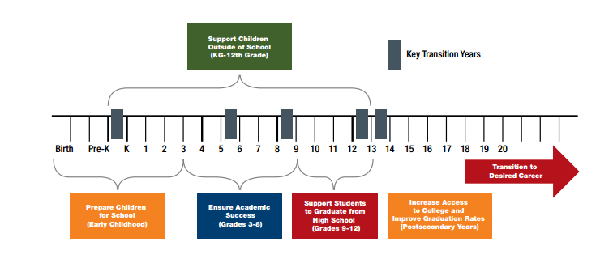
Education Alliance
Cradle to career collective impact initiative

Slide 26
Dashboard to Measure Progress
Implementation teams for each segment of the continuum
Data to assess need and identify priorities
Data to measure progress toward goals

Slide 27
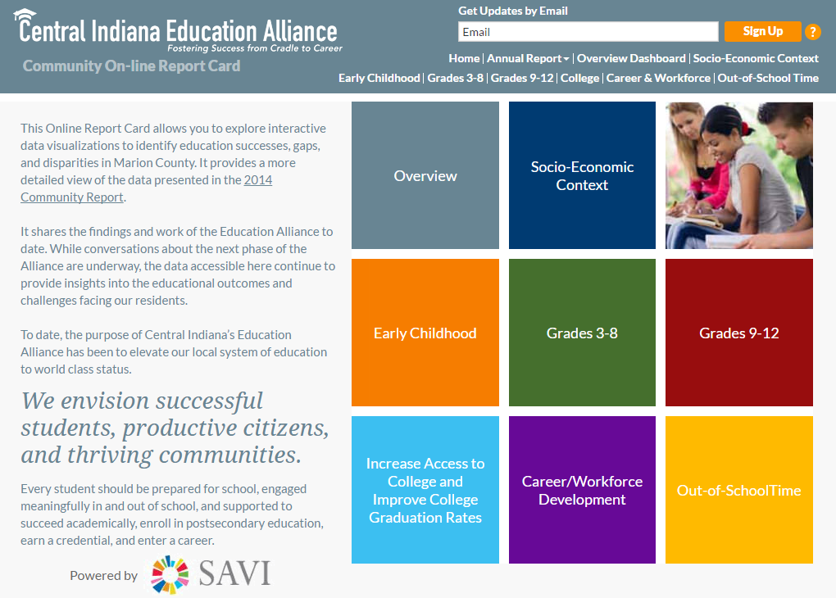

Slide 28
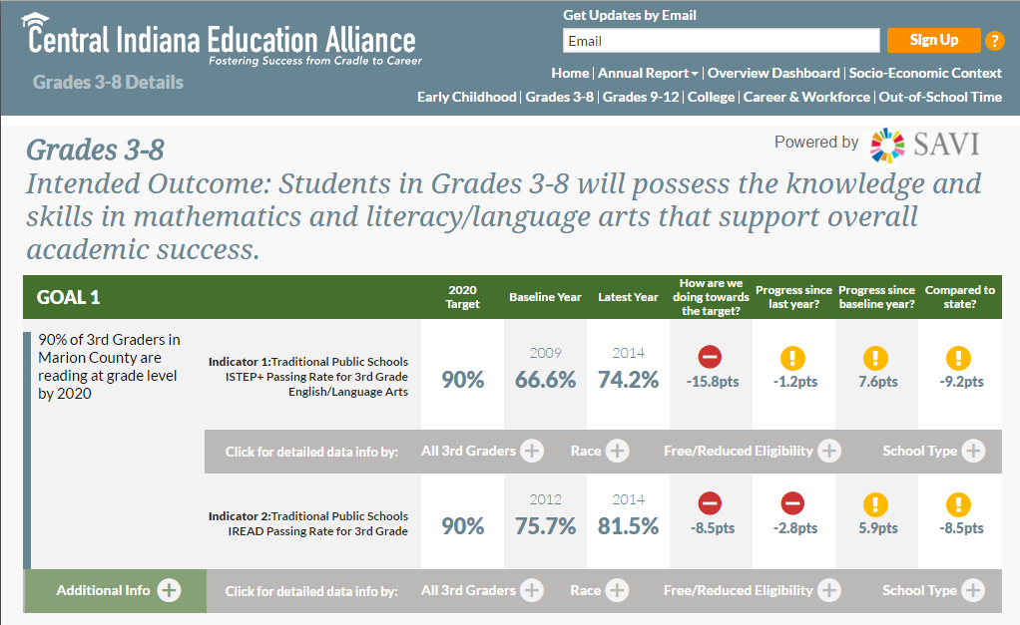
Education Alliance Report Card
Notes:
Quickly run through these templates (not discussing in detail)

Slide 29
Lessons learned

Slide 30
Lessons – Managing Expectations
Change takes time, measuring community change is hard
The dashboard/data is a starting point for conversation, not the end
Starting point for establishing community priorities
Understanding needs, resources, gaps
Identifying what else you need to know that the data cannot tell you – the rest of the story
Notes:
Pitfalls
Vested partners/ownership – e.g., the Ed Aliance experience - A lot to invest in something that isn’t moving forward
Understanding and imparting the data limitations
Educating stakeholders on how to interpret the data and translate into decisions
How will you maintain the data?
e.g., our dasbhoards are fed by our SAVI data warehouse – data calculated on the fly for the specific geo

Slide 31
Lessons
Ensure there are vested partners/owners before you build a dashboard
Updating the data is import
Communicating data limitations
Create awareness about the value add: Data availability is increasing exponentially, but we make it meaningful and put it in context

Slide 32
Lessons – Technology Development
New technology options
Rapidly changing environment
Adaptable and more responsive to new technologies
Learning new “agile development” approach

Slide 33
Lessons – After it’s built, now what
Capacity building: Make sure stakeholders understand how to interpret the data and translate into decisions
Notes:
Capacity building – no matter how easy you think the dashboard is, people are still learning how to interpret even the most basic charts and maps, and can struggle with how to turn that into informed decisions
(going back to civic engagement principals)
IAUW – workshop for UWs
IndyVitals – workshops for CDC, neigh orgs, anyone involved in place-based initiatives

Slide 34
Sharon Kandris
Associate Director
The Polis Center at IUPUI
skandris@iupui.edu

