Slide 1
City of Atlanta: Gentrification Vulnerability Analysis
Bernita Smith, Director | Erik Woodworth, Data Scientist

Slide 2
Neighborhood Typology Analysis*
Phase I: Vulnerability
Phase II: Demographic Change
Phase III: Housing Market Conditions
*
Adapted from neighborhood typology methodology in Portland, Oregon Gentrification and Displacement Study (2013, pp. 59-62)

Slide 3
Phase I: Vulnerability Analysis
A gentrification vulnerability score for each census tract was determined using a rank system in which a score of 0 or 1 (below or above the city-wide average, respectively) was assigned for four different attributes:
Percent nonwhite
Percent renters
Percent without BA degree
Percent of households below 80% of HUD-adjusted median family income (HAMFI)
The attribute scores were then summed, producing a value between 0 and 4. Whereas a summed value of 0 denotes no vulnerability, a summed value of 3 or 4 denotes high or very high vulnerability.

Slide 4
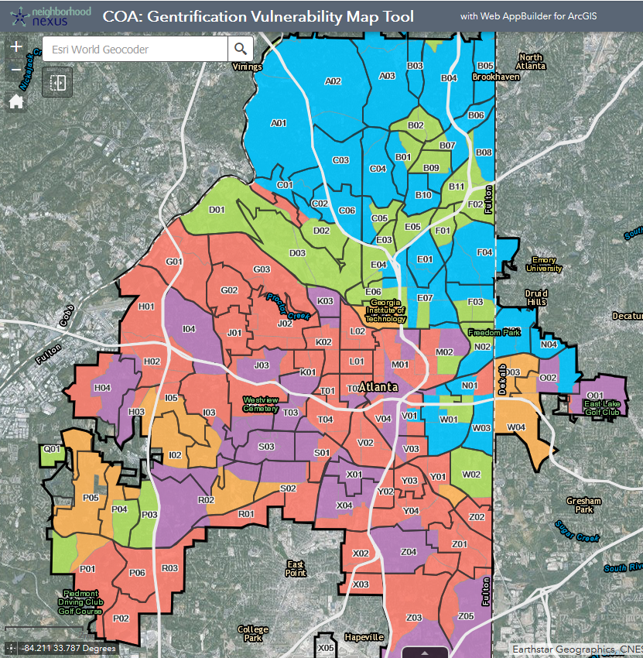
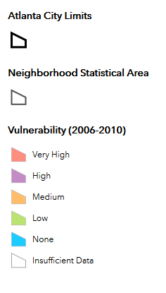
Laureus
Study Area

Slide 5
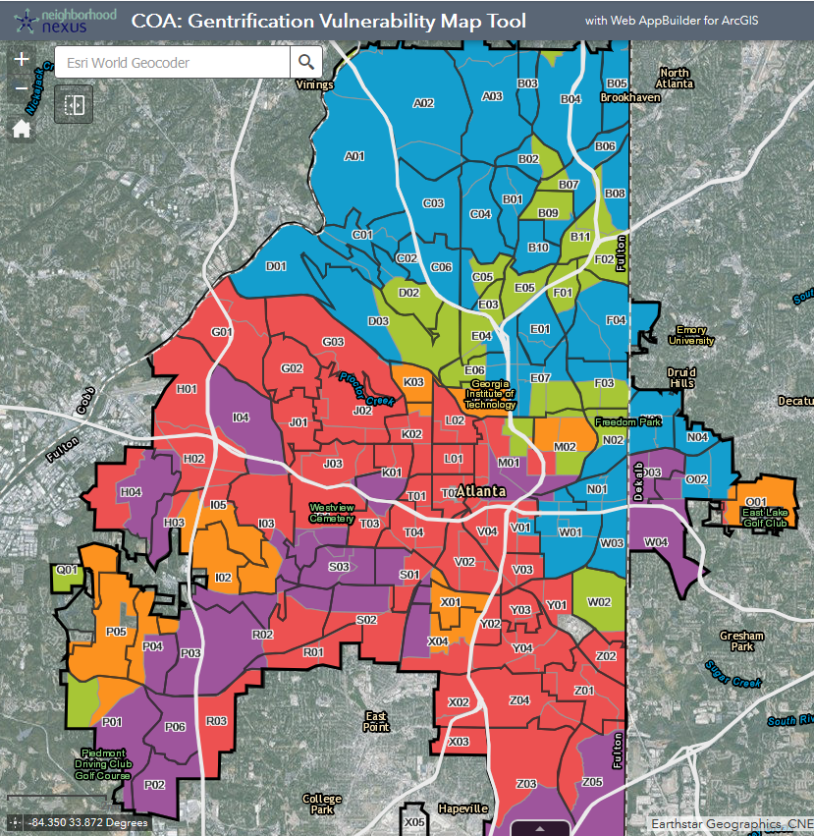
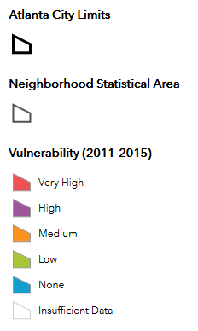
Laureus
Study Area

Slide 6
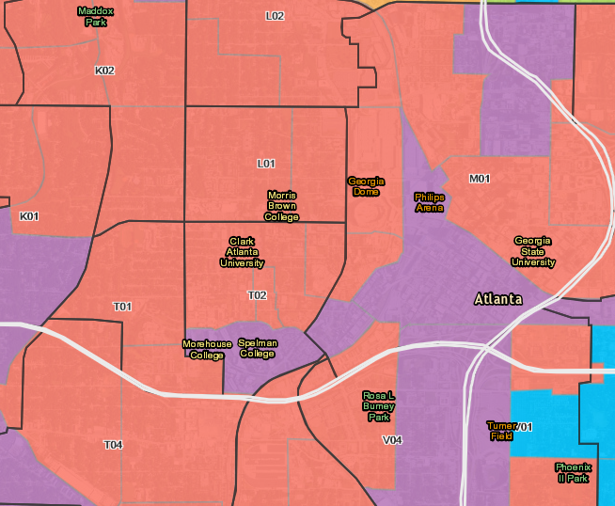

Slide 7
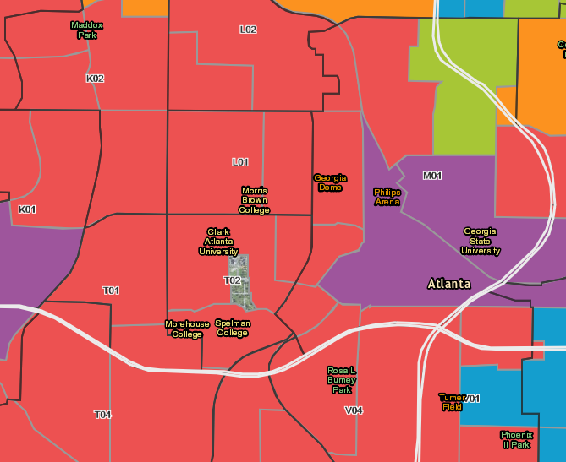

Slide 8
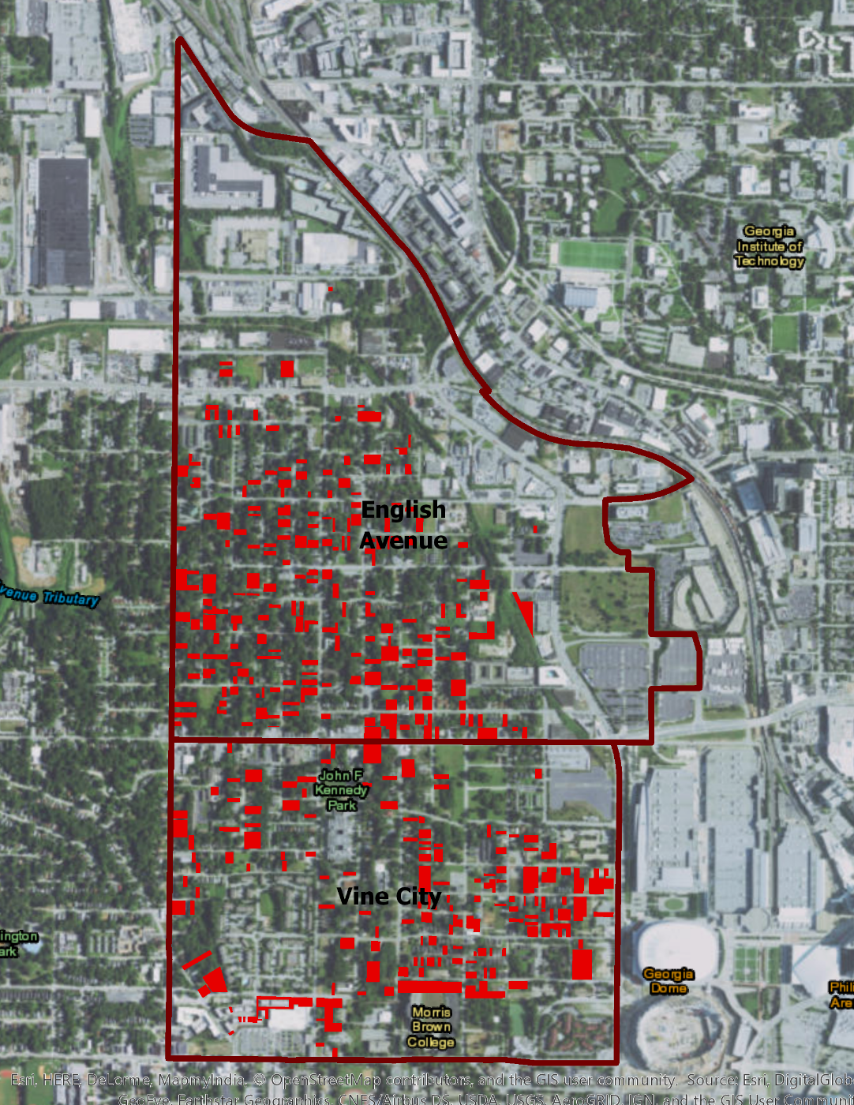
Gentrification Vulnerability
in Neighborhoods
Near New Georgia Dome

Slide 9
Gentrification Vulnerability
in Neighborhoods
Near New Georgia Dome

Slide 10
Gentrification Vulnerability
in Neighborhoods
Near New Georgia Dome

Slide 11
Gentrification Vulnerability
in Neighborhoods
Near New Georgia Dome

Slide 12
Questions?

