Slide 1
Merging local health & wellbeing data
Camille Seaberry
DataHaven
New Haven, CT

Slide 2
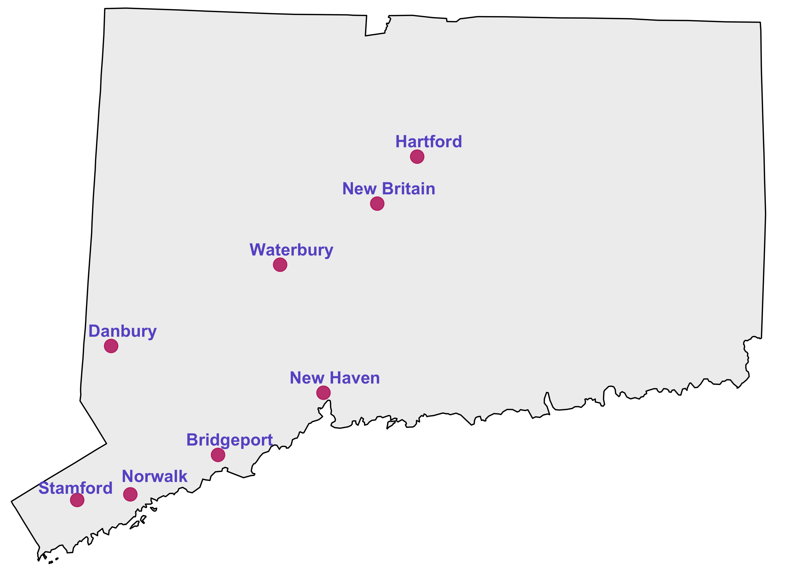
500 Cities Project
Collaboration between Robert Wood Johnson Foundation, CDC, CDC Foundation
Census tract-level data on 500 largest cities in the US
8 Connecticut cities
28 public health measures

Slide 3
Interactive data visualization
Does this make data more approachable? Especially to communities it’s about?

Slide 4
CT: high wealth, high inequality
Median household income
Connecticut | $70,331
New Haven | $37,192
Hill neighborhood (06519) | $24,304
Woodbridge (border suburb) | $133,412

Slide 5
Connecticut has more concentrated poverty (and wealth) than most metros
2015 DataHaven report

Slide 6
Two urban Connecticuts
Higher-need tracts vs lower-need tracts:
2x denser
3x poverty rates
1/2 median household income
Higher-need tracts home to 76% of New Haven residents, 90% of Hartford residents

Slide 7
health disparities in the two urban connecticuts

Slide 8
Example: self-reported poor mental health

Slide 9
health disparities in the two urban connecticuts

Slide 10
Bringing together public health data + wellbeing data gives more holistic understanding of our communities

Slide 11
2015 DataHaven community wellbeing survey
Over 16,000 survey participants
Covers all 169 towns in CT
Captures unique measures, e.g.:
Underemployment
Financial security
Ability to afford basic needs

Slide 12
Wellbeing in the two urban connecticuts

Slide 13
Two New Havens?
Health disparities (stroke, diabetes)
Gaps in views of THE SAME services (trust in police, responsiveness of local government)
Regardless of zip code, see poor job prospects

Slide 14
And yet…
Signs of resilience: 76% satisfaction with area in New Haven higher-need zips
Linking data can highlight community assets
i.e. Don’t stigmatize higher-need communities!

Slide 15
Takeaway question: How can we use data mashups to build equitable communities?

