Slide 1
The Data Center – Infographics: Disseminating digestible data to engage and inform the community
NNIP Ignite Session
Notes:
No comments.

Slide 2
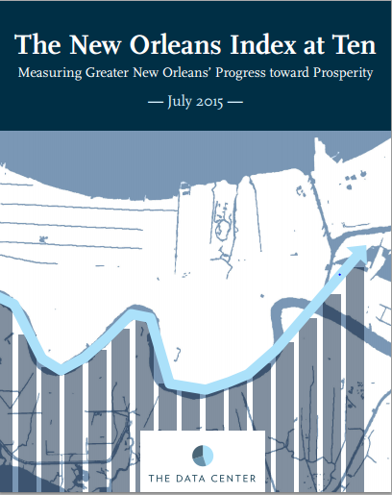
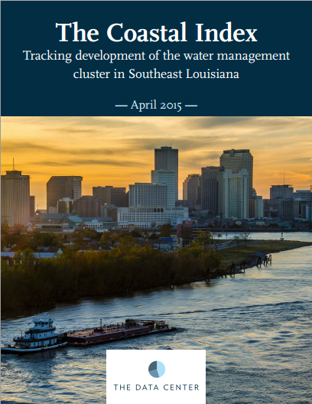
We have been producing Index reports to bring awareness of key indicators in order to build foundational knowledge about the strength and vibrancy of greater New Orleans.
Dr. George Dr. Allison Plyer
Ben

Slide 3
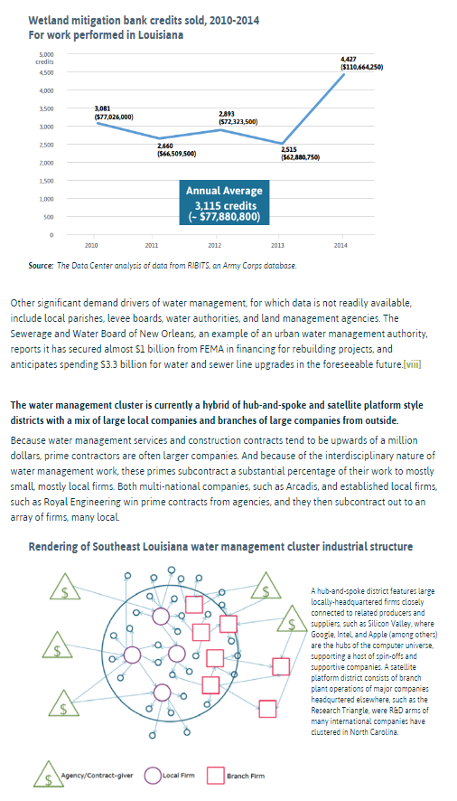
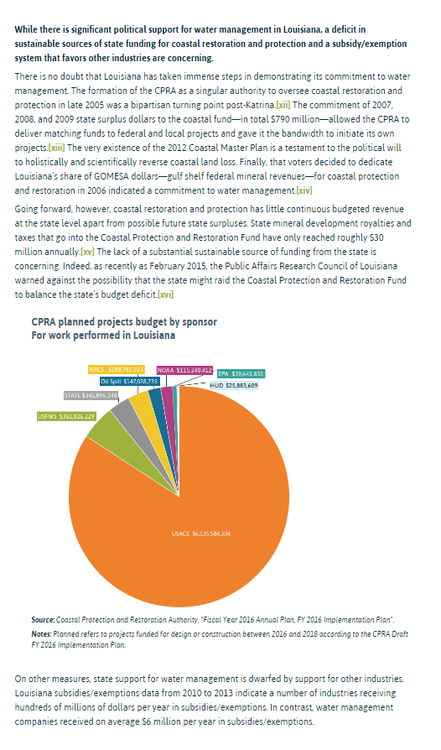
Comprehensive but dense reports
Most people will not read them in their entirety

Slide 4
Community has always been at the core of The Data Center’s mission
How people consume information has changed in the digital age
Create engaging and more digestible formats of information

Slide 5
Capitalizing on the continued interest in and how people use parts of our reports, our strategy focused on unpacking & better disseminating these valuable results.
Dr. George Dr. Allison Plyer
Ben

Slide 6
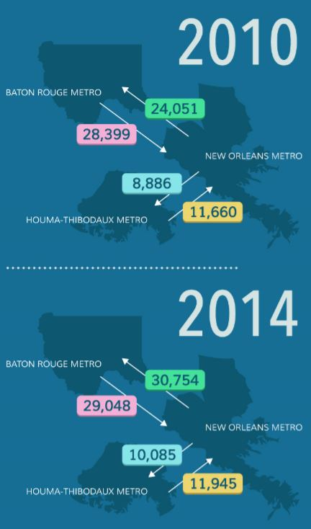
Infographics

Slide 7
They All Tell a Story
Water management is a promising cluster for business and job growth
More water management contracts should go to Louisiana-based businesses and/or to outside businesses that establish branch offices in the state
Greater philanthropic support for environmental organizations, as well as, maximizing our environmental social capital is needed to spur innovation and collaboration in the water management sector
Equitable workforce development initiatives in the water management sector can provide a skilled workforce and boost prosperity in the region
Increase efficiency and ease of cross-metro commuting

Slide 8
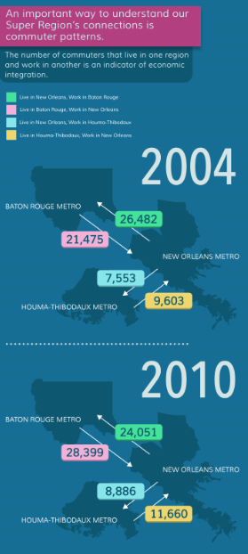
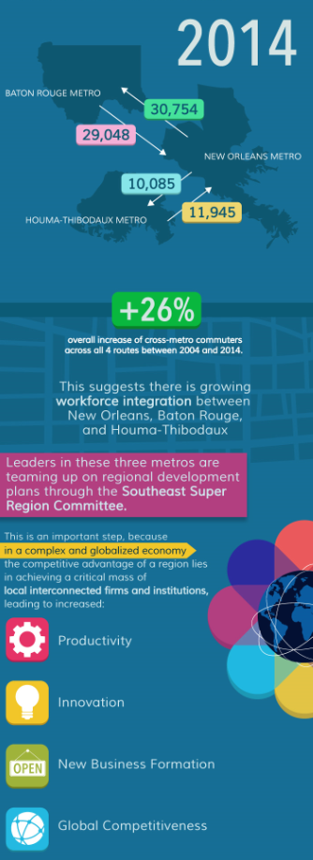
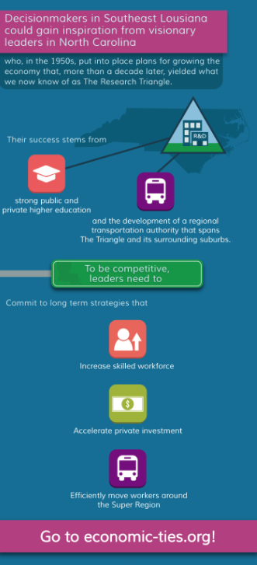
Connecting Our Region

Slide 9
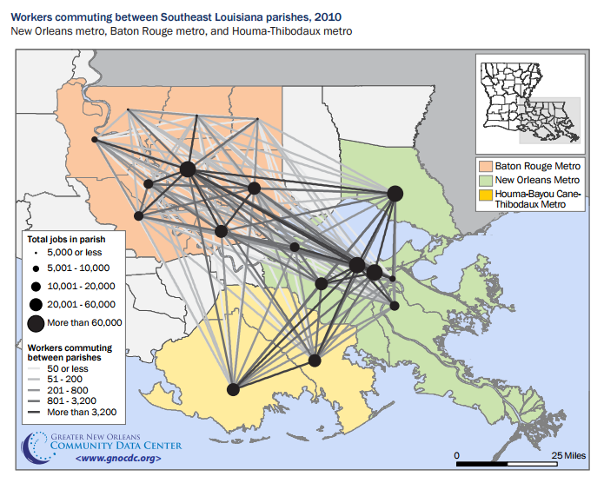
Connecting Our Region
Original report explored the economic ties in the three metro regions.
Conclusions were widely reported and resulted in the formation of a “Super Region” committee.
Section on commuting patterns received traction and many requests for updates.
Infographic allowed opportunity for these updates.
Resulting infographic presented years later to Super Region committee as evidence for transportation investment.

Slide 10
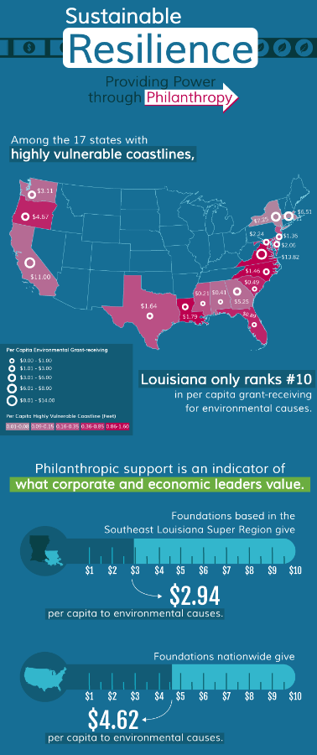
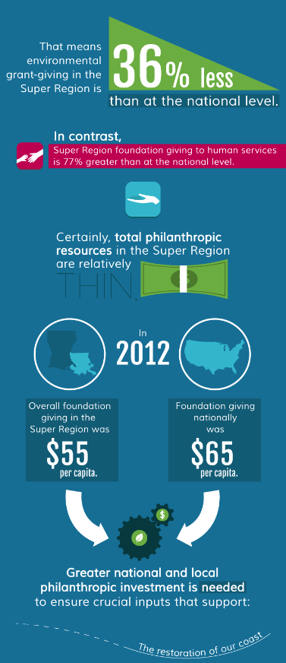
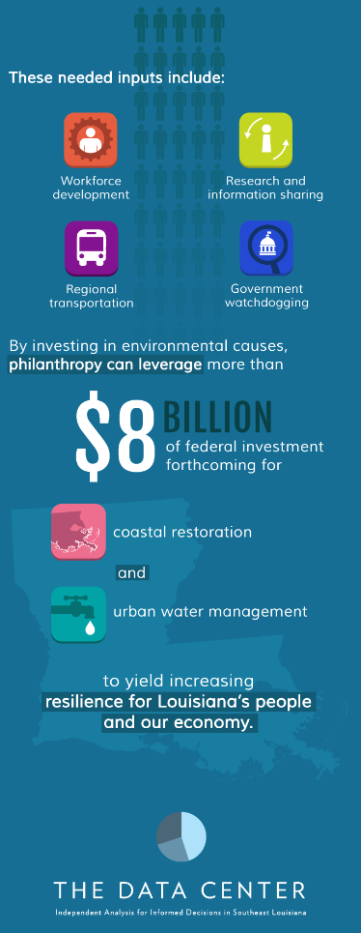
Environmental Philanthropy

Slide 11
Environmental Philanthropy
Water cluster identified with focus on philanthropic role in increasing civic clout for water management.
Louisiana has a unique environmental circumstance, requiring context and targeted action.
Addressing challenges explored in The Coastal Index and highlighting place for action.

Slide 12
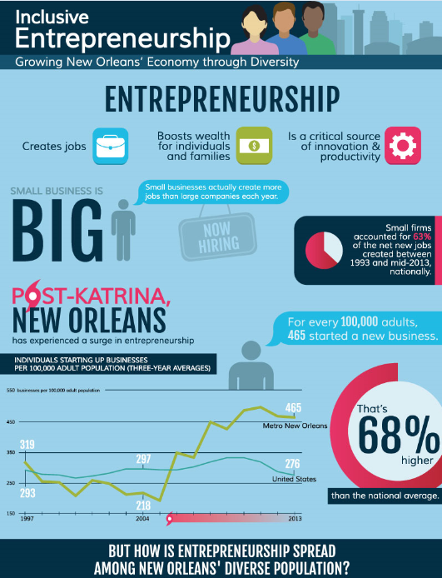
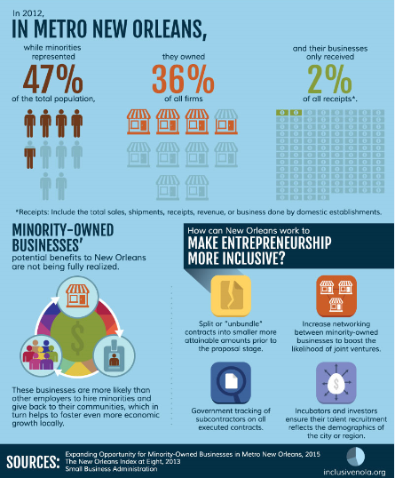
New Orleans Entrepreneurship

Slide 13
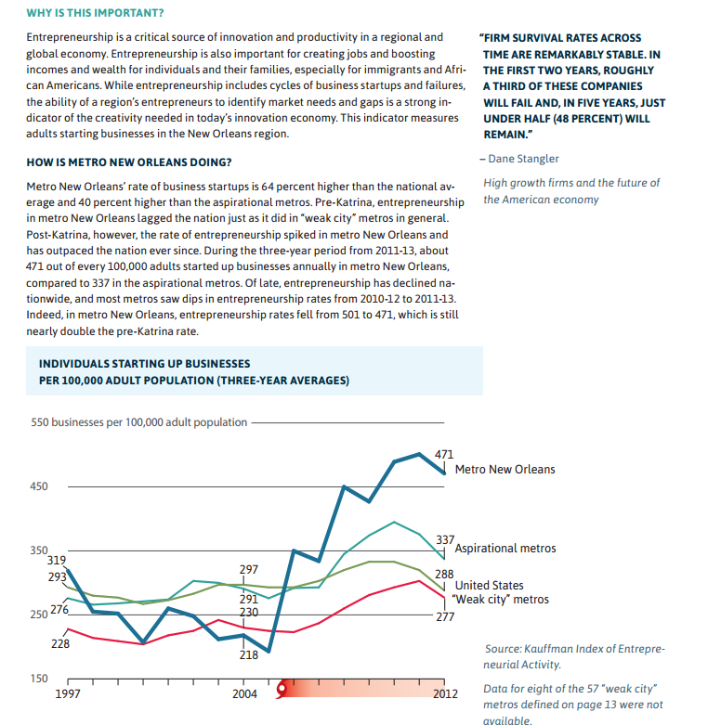
New Orleans Entrepreneurship
Incorporated user feedback and use cases into design.
Update of start up rates one of most requested indicator updates from original report.
Findings from report used consistently in New Orleans business community, infographic allows for update but with added context from additional reports.
Infographic disseminated during recent “New Orleans Entrepreneur Week”, receiving further traction and used for framing panel discussions.

Slide 14
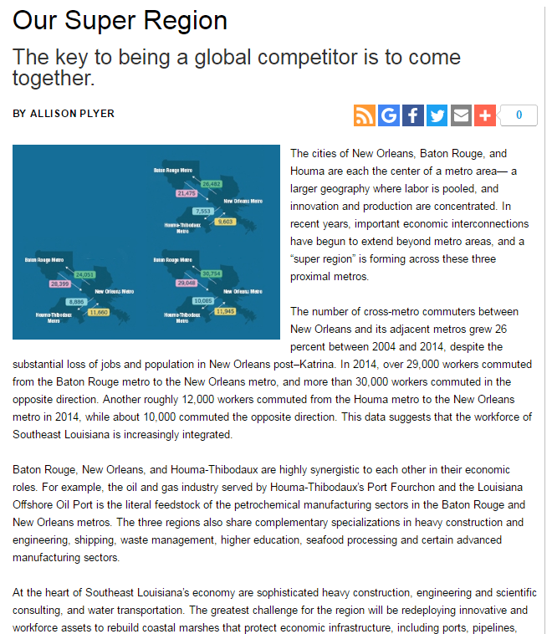
Moving Forward
A combination of infographics, briefs, and articles to provide context so that people can better “connect the dots.”
Continued stakeholder reviews and stakeholder involvement.
Social media strategies to promote infographics.
For more information please visit http://www.datacenterresearch.org/

Slide 15
Summary
The Data Center always strives to present data in the easiest way for stakeholders and community members to use – Democratizing data!
Various stakeholders have incorporated these infographics in their meetings and presentations, whether internally or to a congressional committee.
Strive to continuously improve how we disseminate our products.
“I learned more from that infographic in 2 minutes that I have all year on the subject. This is so accessible and encouraging. How do we connect this opportunity to those who need jobs and can expand their business in the region?” – Regional Foundation Consultant

