Slide 1


Card Sort to Improve Information Architecture
Louise Carter, Public Health-Seattle& King County

Slide 2
Notes:
Example of search challenges

Slide 3
Notes:
The result? “Preventable causes of death.” Of course!

Slide 4
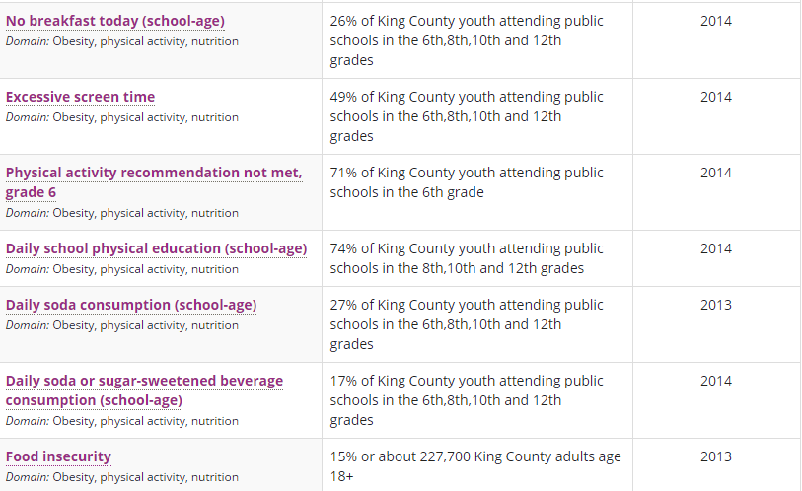
Notes:
More “preventable causes of death” (31 total)

Slide 5
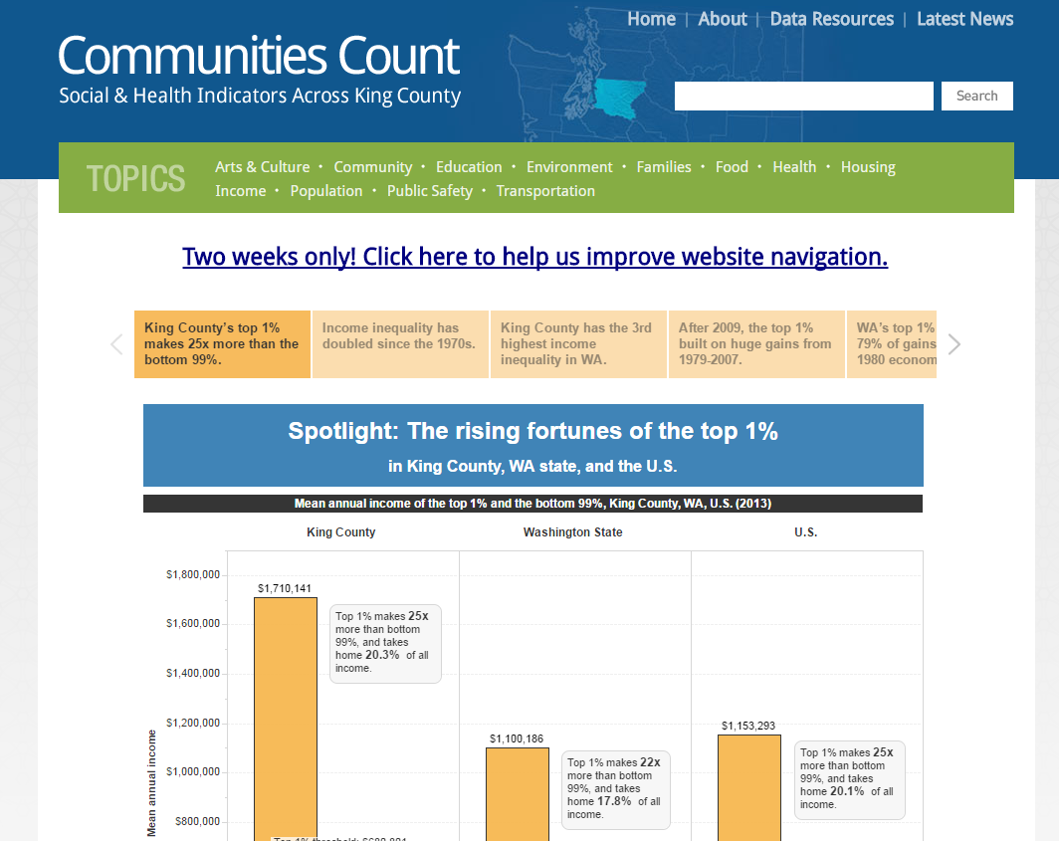
Notes:
Launch card sort: 2 weeks, broad outreach, multiple reminders

Slide 6
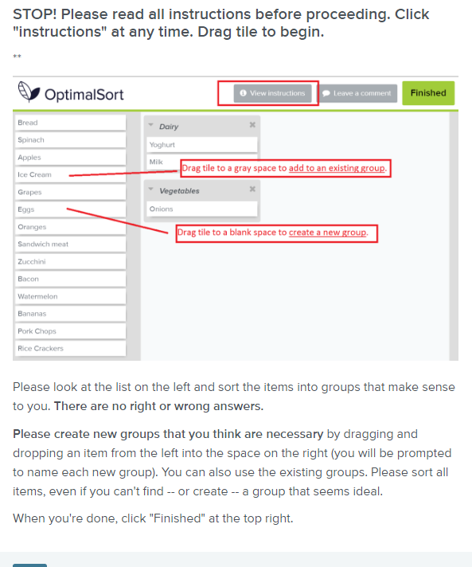
Notes:
Instructions customized after pretest. Chose “open sort” option. Asked few questions. Restricted cards & categories.

Slide 7
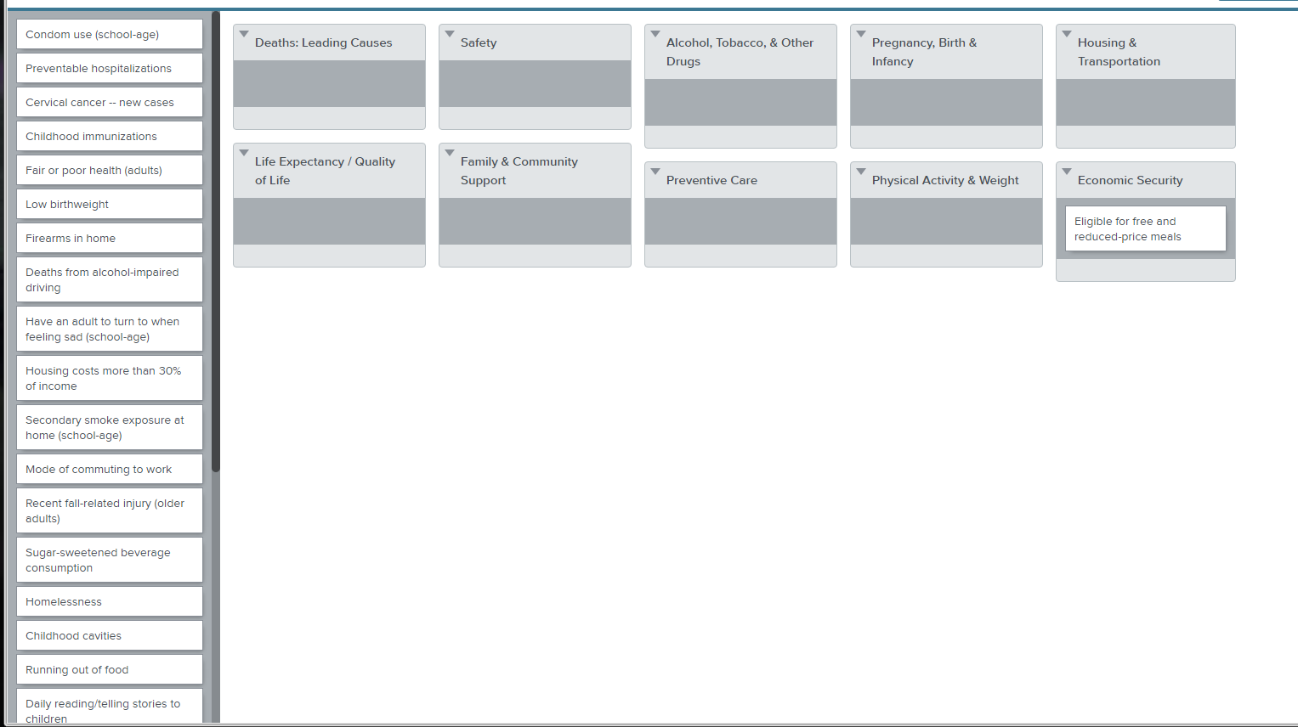
Notes:
29 cards; 10 categories, with option to add/name additional categories.

Slide 8
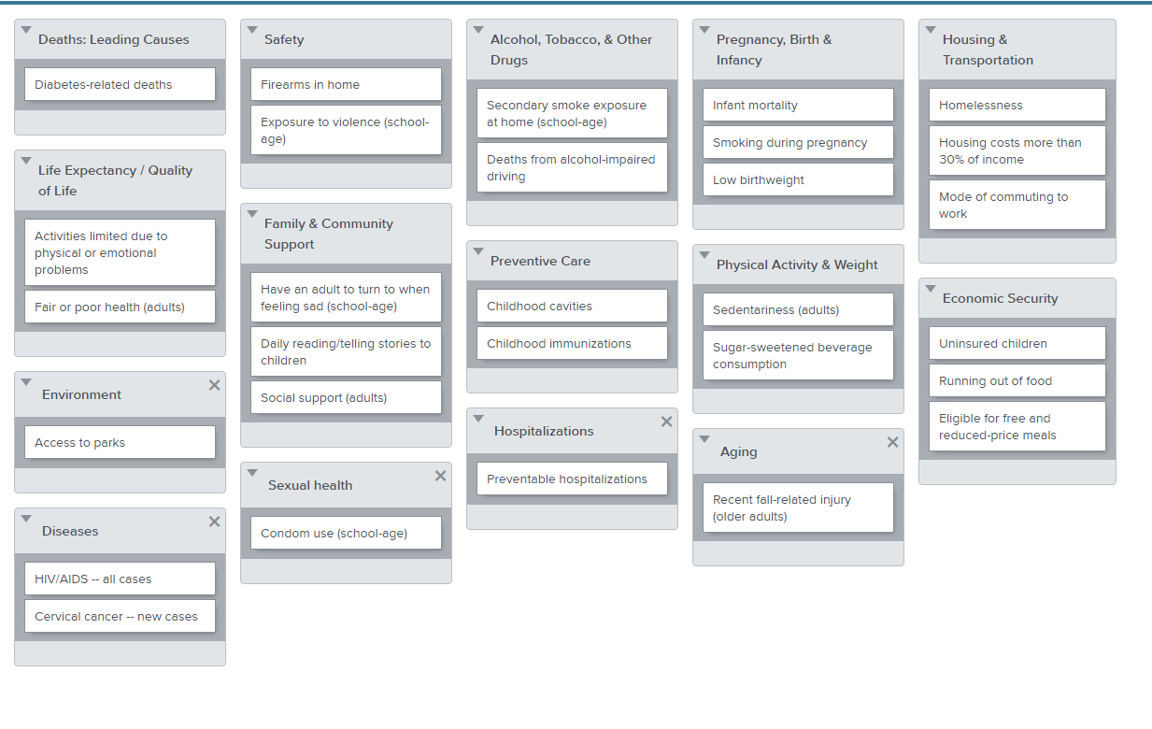
Notes:
Sample: 100% assigned; 5 new categories

Slide 9
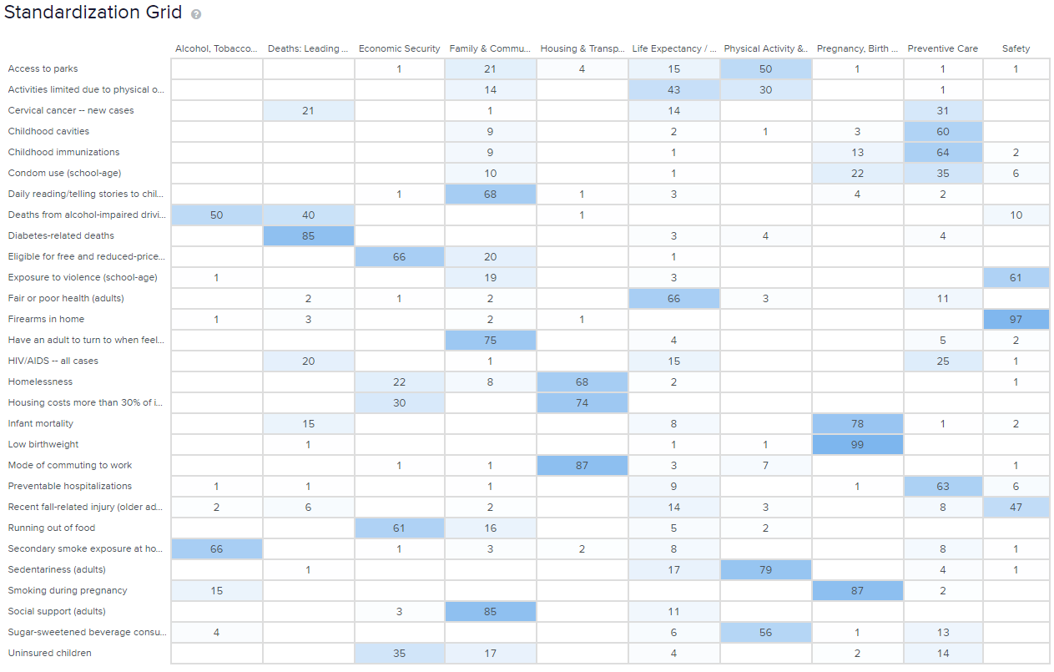
Notes:
146 people participated; 95 completed; median time = 8.98 minutes (range 3.55 to 43.42); participants representative of users

Slide 10
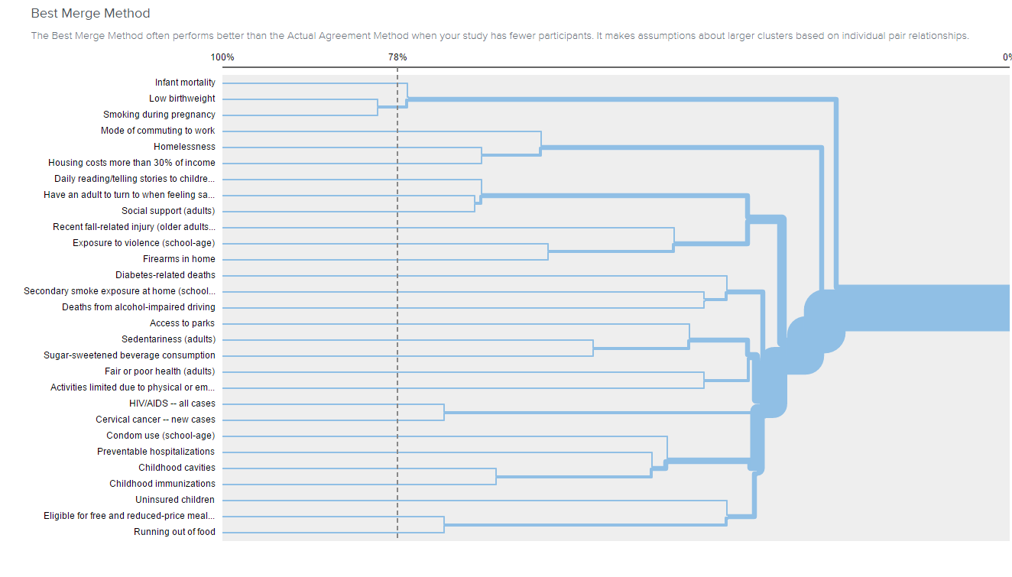
Notes:
Two types of dendograms available

Slide 11
A closer look at indicators in “Family & Community Support”
All ages or age unspecified
  Social support (85)
  Access to parks (21)
  Children with no health insurance (17)
  Running out of food w/out money to buy more (16)
  Activities limited due to physical, mental, or emotional problems (14)
  Childhood cavities (9)
  Homelessness (8)
  Firearms in home (2)
Pre-school-age children
  Daily reading/telling stories to children (67)
  Childhood immunization series (9)
School-age children
  Have an adult to turn to when feeling sad (75)
  Eligible for free and reduced-price meals (20)
  Exposure to violence (19)
  Condom use (10)
  Secondary smoking exposure at home (3)
Notes:
Detail about one surprising finding

Slide 12
Notes:
We’re hyperlinking extensively; we’re also placing several indicators in multiple categories

Slide 13
Notes:
Example of multiple (and revised) categories

Slide 14
Take-home messages
Pretest instructions, questions, word choices
Match audience to actual / intended users
Keep it short
Power of original named categories
Spend time with the results
Notes:
Worthwhile exercise. Offers some internal leverage.

Slide 15
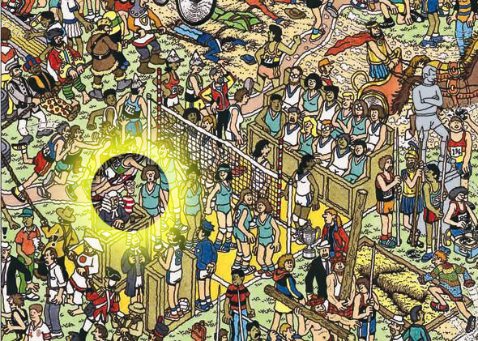
Notes:
With improvements on multiple fronts (including search functions), users should be able to find the data they need.

