Slide 1


So, someone just asked you for a dashboard...
What now?
Bob Gradeck
University of Pittsburgh
NNIP Baltimore Partner Meeting, May 2017

Slide 2
Taxonomy of Dashboards

Slide 3
Performance management/decision support
Framework: Performance management and decisionmaking framework
Use: Inform routine decisions and actions
Key characteristic: Instant feedback
Data: Dynamic
Frequency of use: Daily or weekly
Measures: Input and activity

Slide 4
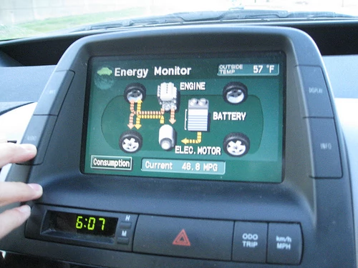

Slide 5
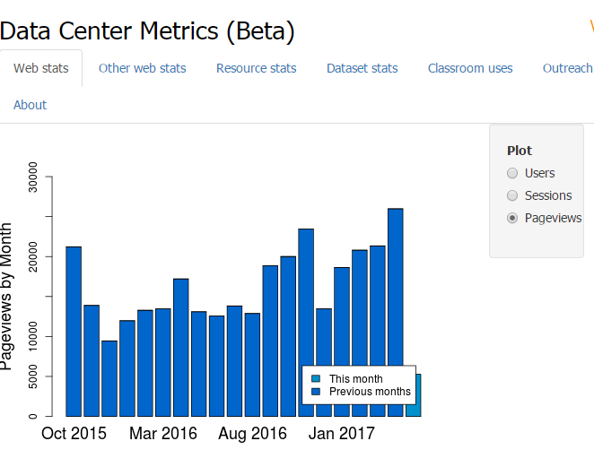
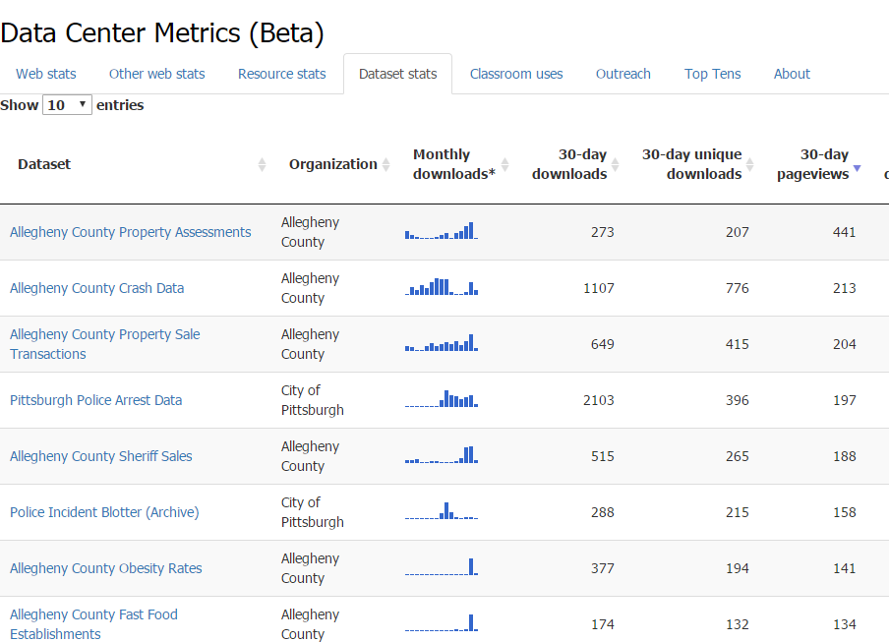

Slide 6
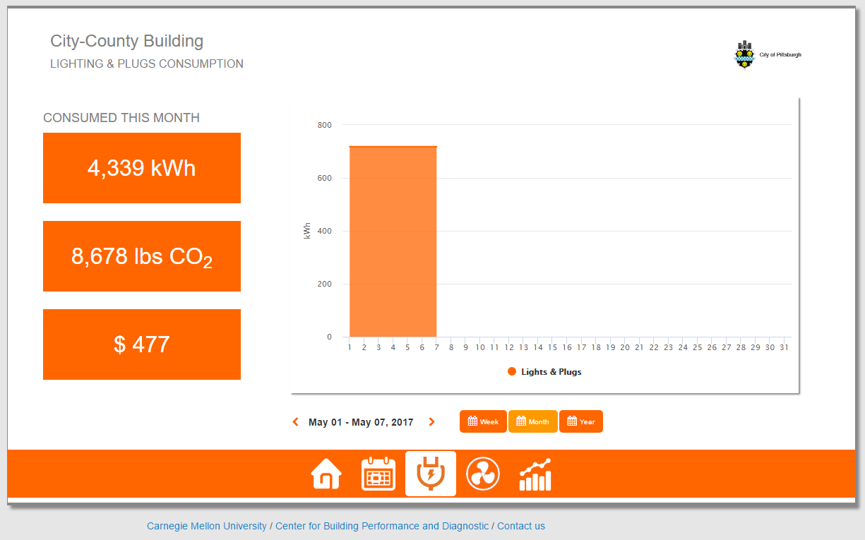
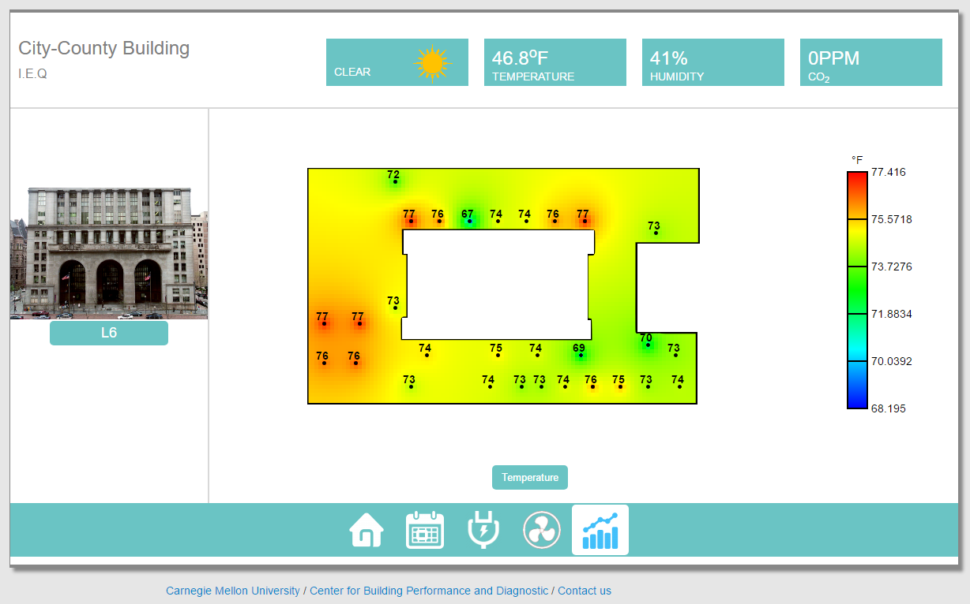

Slide 7
2. Collective impact
Framework: Collective impact or logic model
Use: Track progress and outcomes toward a larger goal
Key characteristic: Tied to a process - show community progress from a baseline
Data: Snapshots
Frequency of use: Monthly or semi-annual
Measures: Outcomes

Slide 8
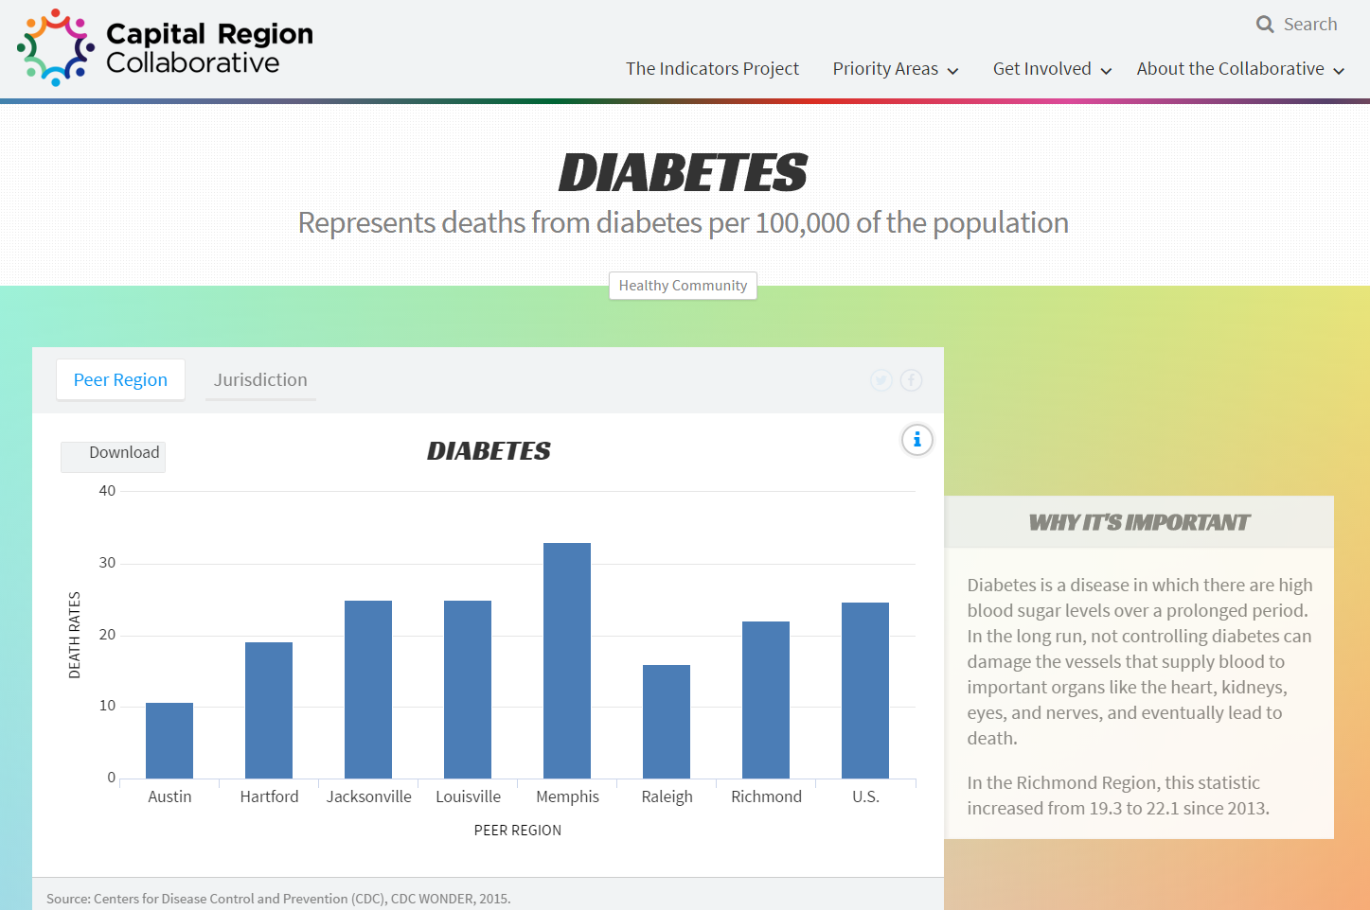
Notes:
Richmond

Slide 9
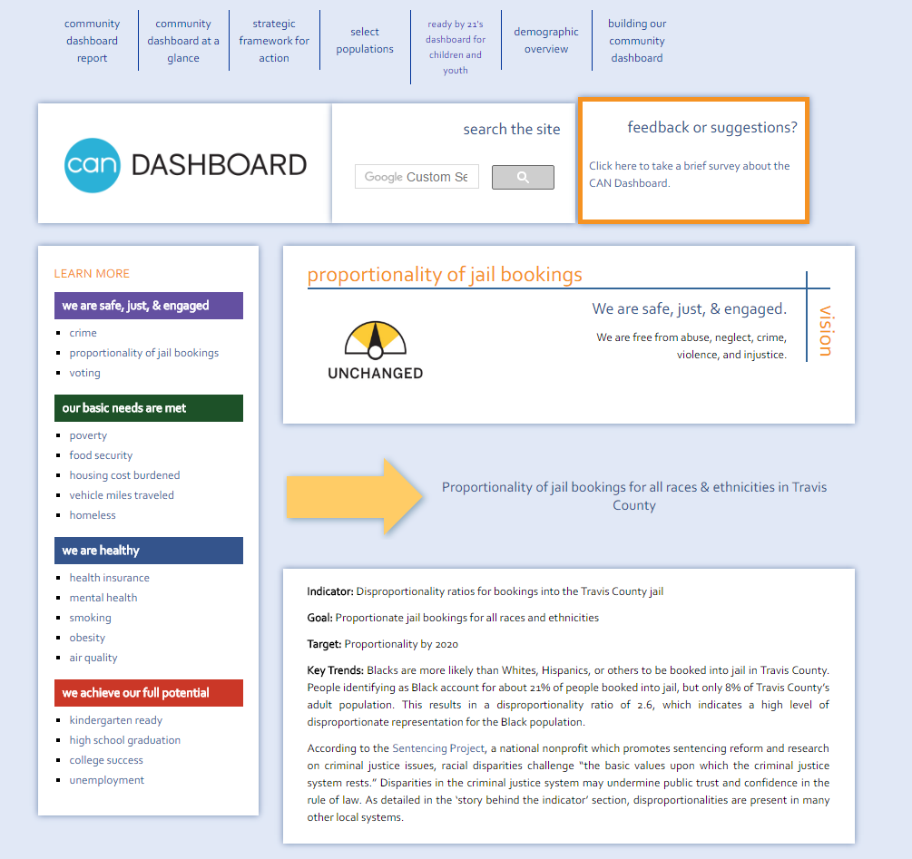
Notes:
http://www.cancommunitydashboard.org/drilldowns/jail-bookings.php Austin

Slide 10
3. Data viewer
Framework: View information
Use: Access to community statistics or record-level data
Key Characteristic: Exploration of community information
Data: Snapshots or dynamic data
Frequency of Use: Daily or monthly
Measures: Minimal framing

Slide 11
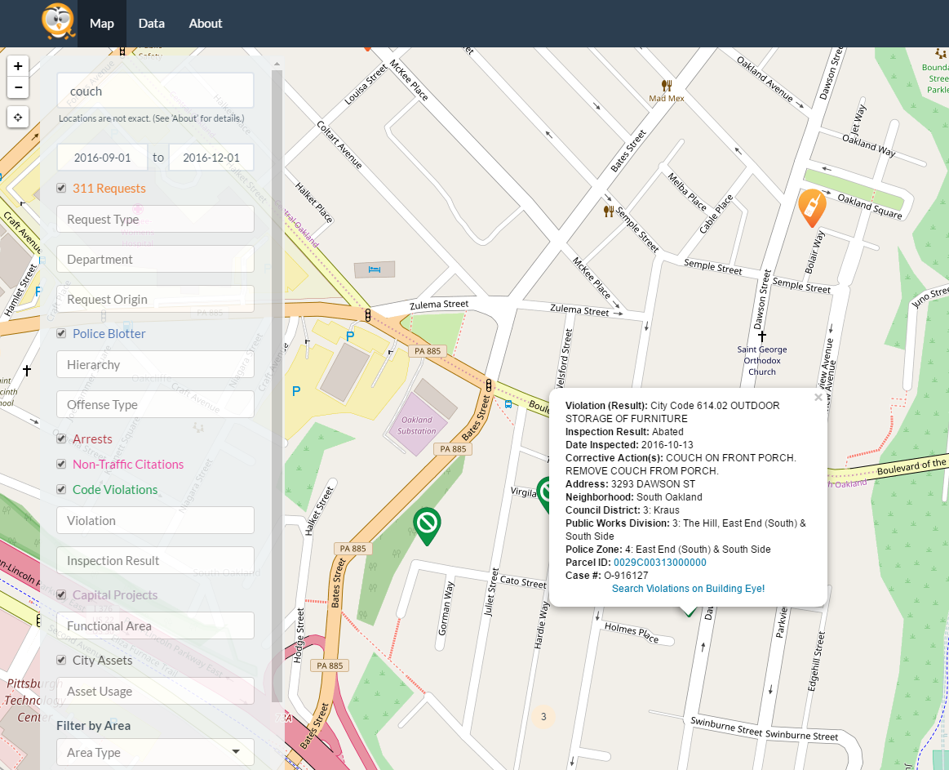

Slide 12
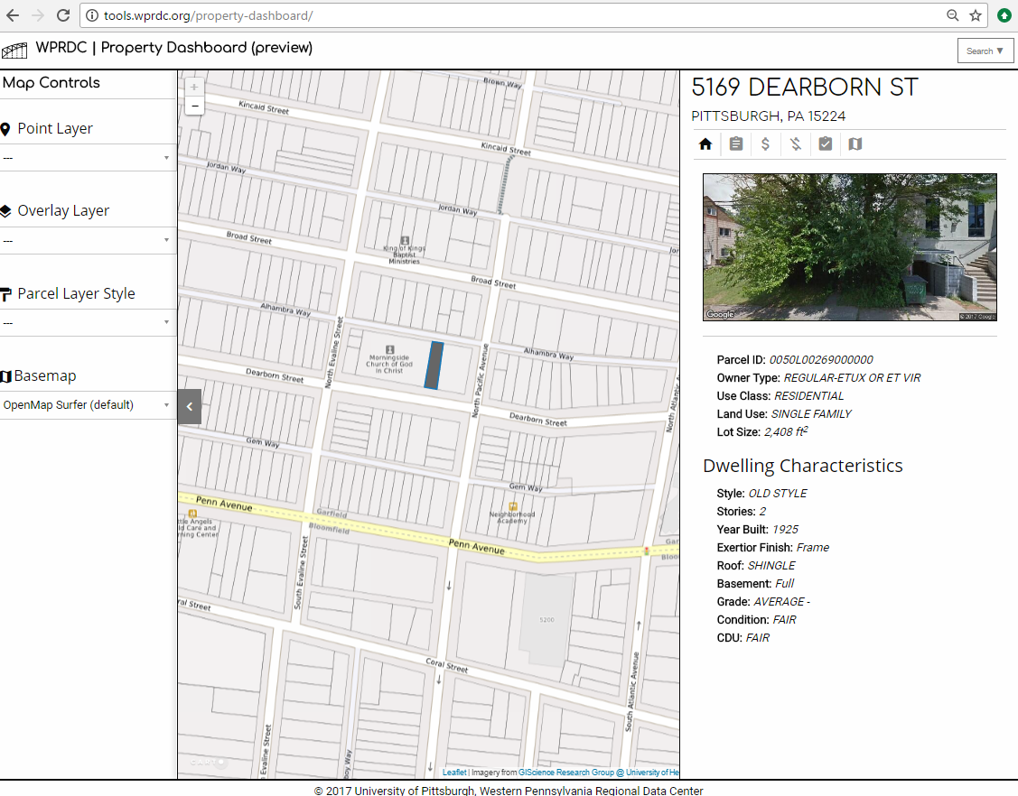

Slide 13
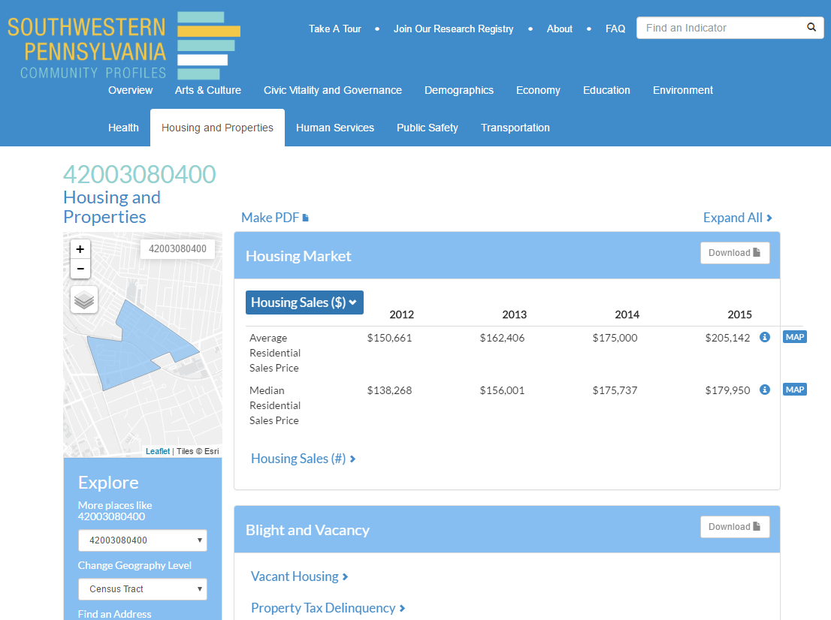

Slide 14
10 Questions to Ask when Someone Asks You for a Dashboard
Notes:
Help refine and scope idea, choose type of product, design

Slide 15
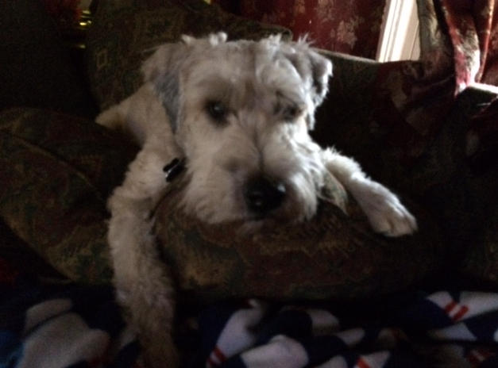
What’s the goal or purpose of the tool?
Support or inform decisions?
Track community outcomes?
Provide information?
Notes:
Questions can help to scope the project or help with design...

Slide 16
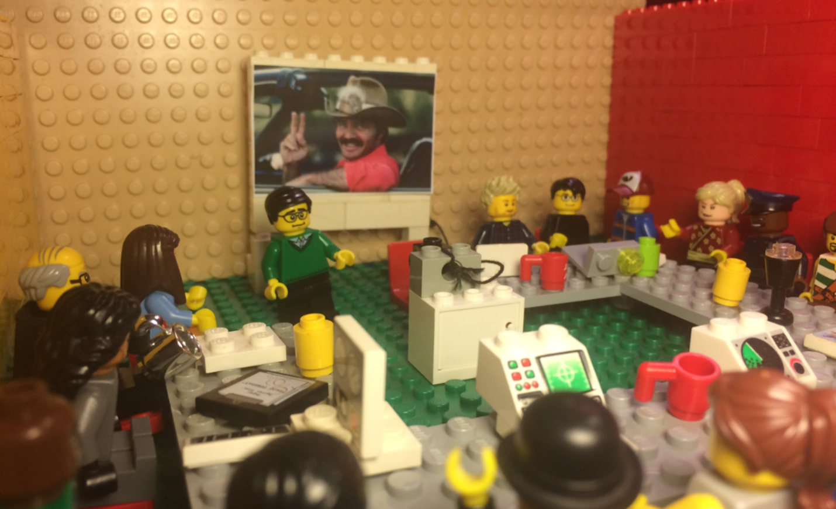
2. Will the dashboard be tied to a larger context, process, or framework?
Performance management
Business decisions
Collective impact
Issue-specific

Slide 17
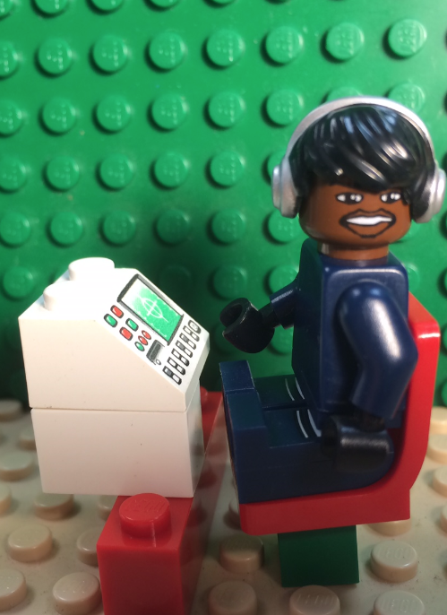
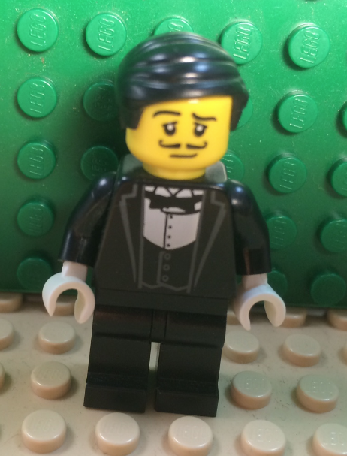
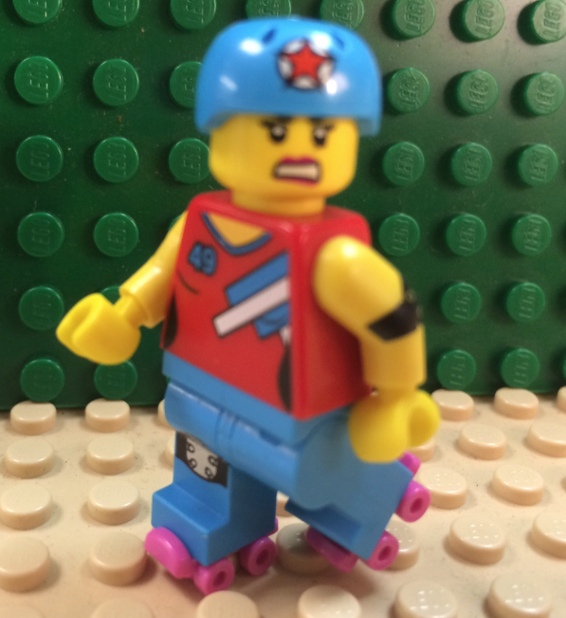
3. Who will use the tool?
User personas
User responsibilities
Skills
Data literacy
Devices
Biases

Slide 18
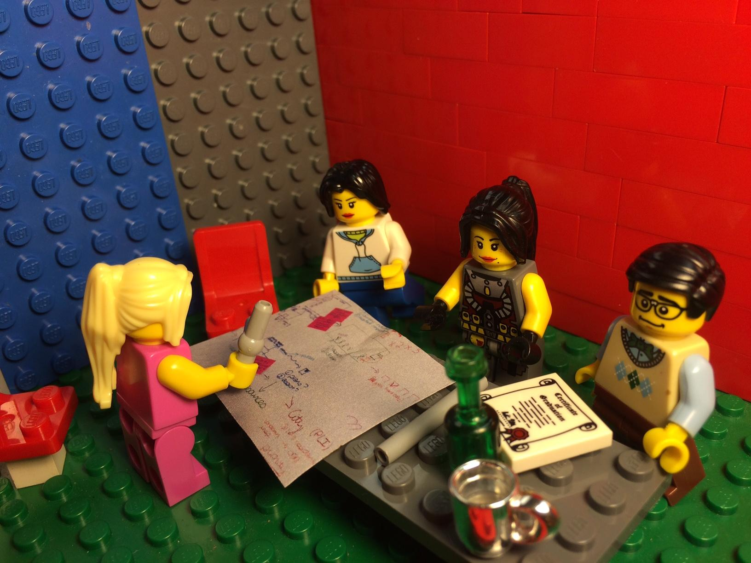
4. How do users currently make decisions or track progress?
Diagram current processes
Information sources
Information flows
Frequency

Slide 19
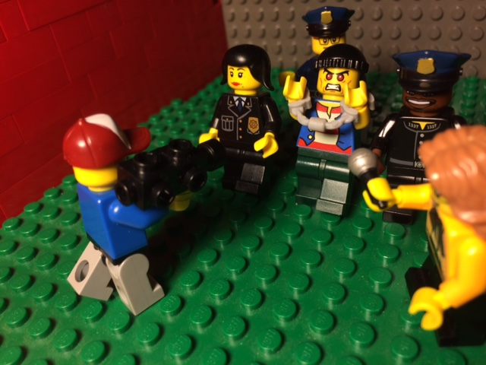
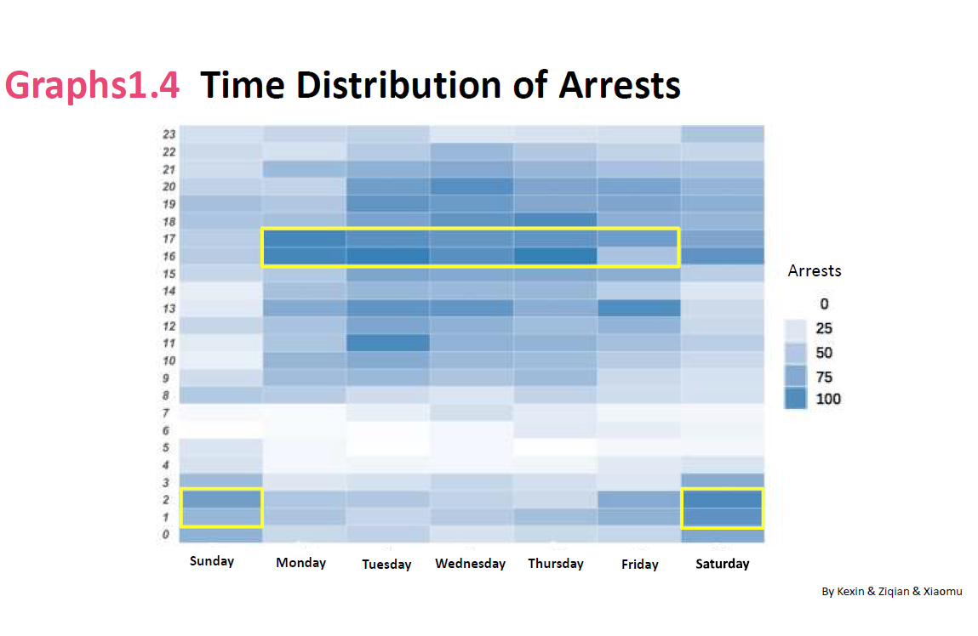
5. Will users know what to do as a result of this information?
What actions are expected?
What guidance can be offered?
Can users move the needle?
Notes:
Graphic from Pitt GSPIA Class

Slide 20
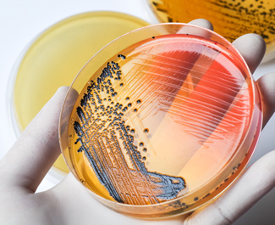
6. What is the organization’s culture?
Is information treated as an asset?
What are users’ incentives?
What if data makes someone “look bad?”
Notes:
https://www.cdc.gov/foodcore/successes.html

Slide 21
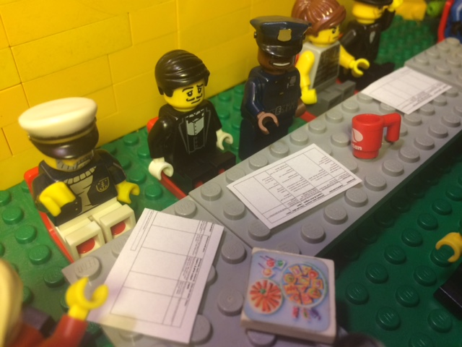
7. Where will the data come from, and how often does it change?
Who decides what’s in and out
Sources

Slide 22
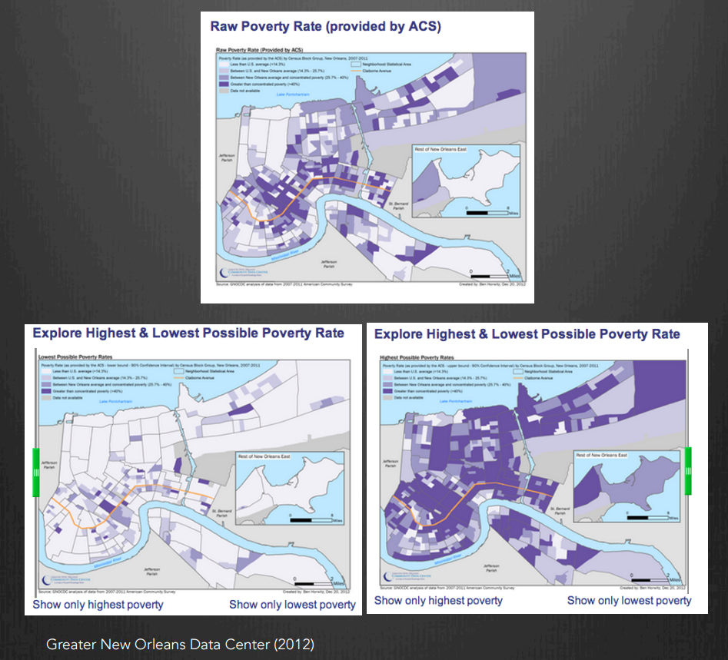
8. Is the information reliable and easy to interpret?
Quality issues
Cleanup needs
Training
Documentation
Tool tips
Notes:
https://www.ncrn.info/sites/default/files/attachments/events/Griffin%20NCRN%20Webinar%20Final%20.pdf

Slide 23
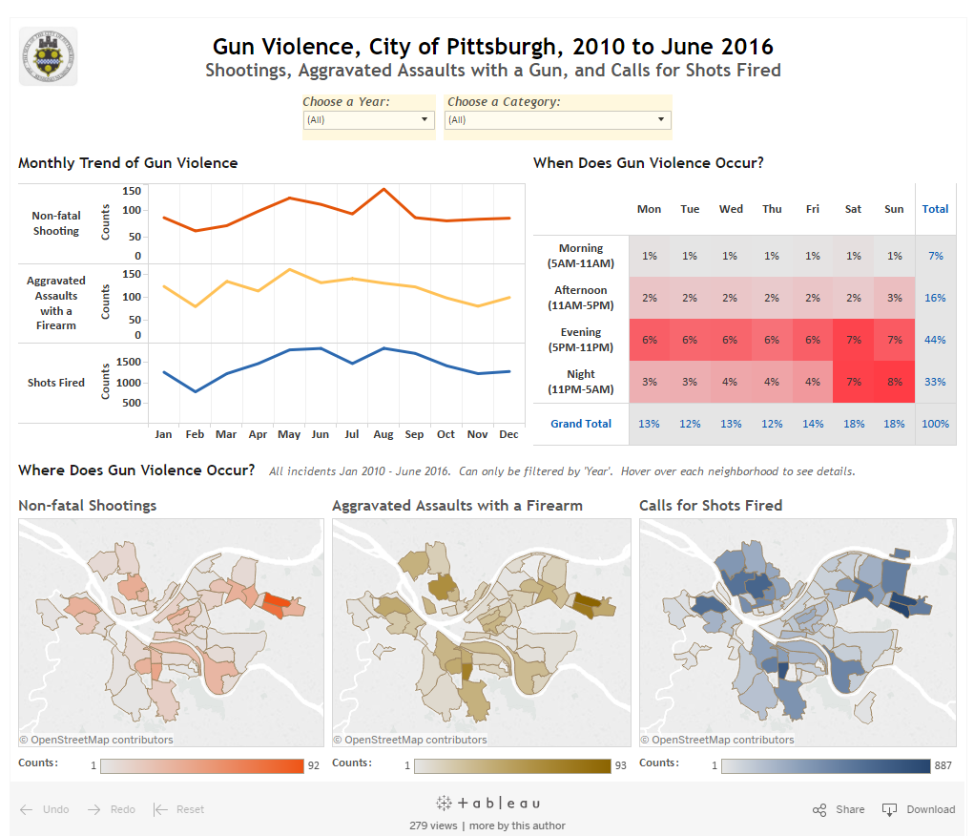
9. What other products or processes have you explored?
Off the shelf technology options
Is a custom dashboard necessary

Slide 24
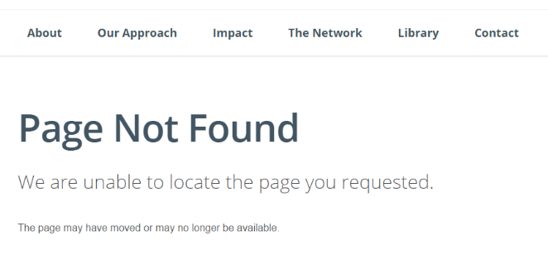
10. How committed are you to maintaining the tool?
Participation in community process
Manage and process data
Manage technology
Training

Slide 25
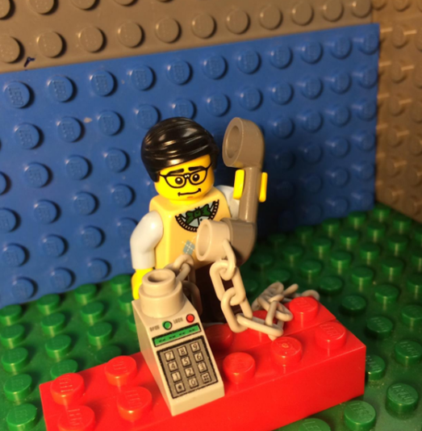
Contact Me
Bob Gradeck
412-624-9177
rmg44@pitt.edu
@BobGradeck
@wprdc
www.wprdc.org
Notes:
Actual photo

