Slide 1
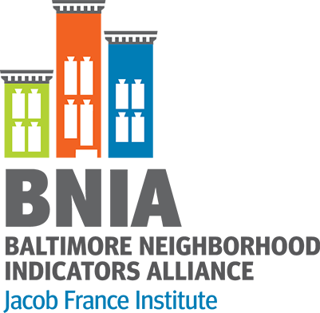
Data Driven Advocacy in Baltimore
The Baltimore Neighborhood Indicators Alliance – Jacob France Institute
Seema D. Iyer, PhD
NNIP Meeting
June 13, 2019

Slide 2
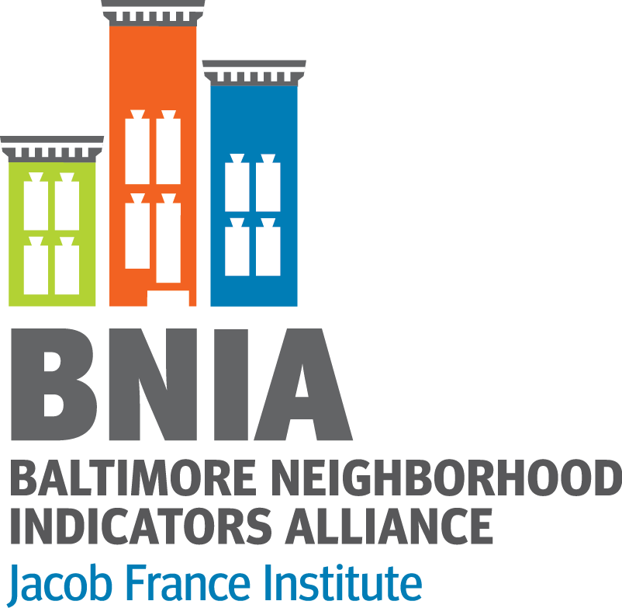
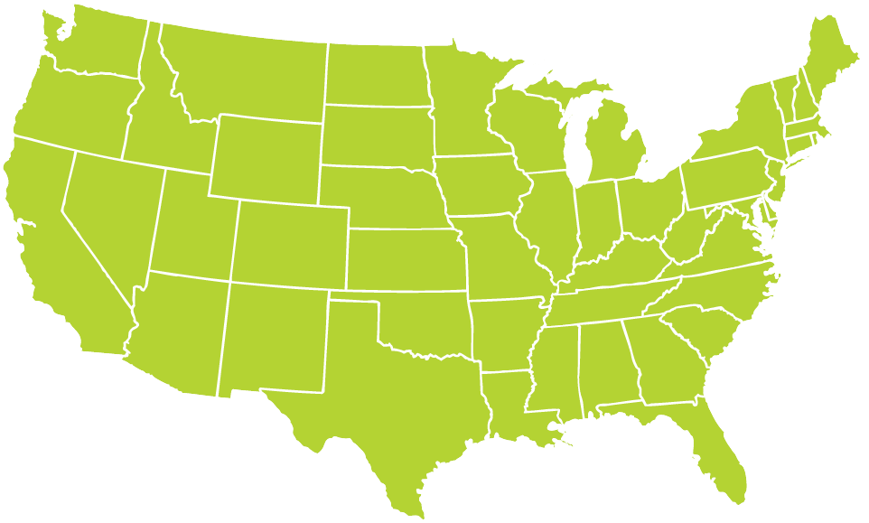
About BNIA-JFI
@bniajfi #VitalSigns17
Began in 2000 by local stakeholders, now based within Jacob France Institute at University of Baltimore
Prepare the annual “Vital Signs” report and open-data portal of quality of life indicators for Baltimore’s neighborhoods
“One-stop-shop” for comprehensive, non-partisan data indicators and training
Multiple topic areas
Longitudinal data (2000 – 2016)
Member of the National Neighborhood Indicators Partnership hosted at the Urban Institute
30+ cities focusing on data democratization
http://www.neighborhoodindicators.org

Slide 3
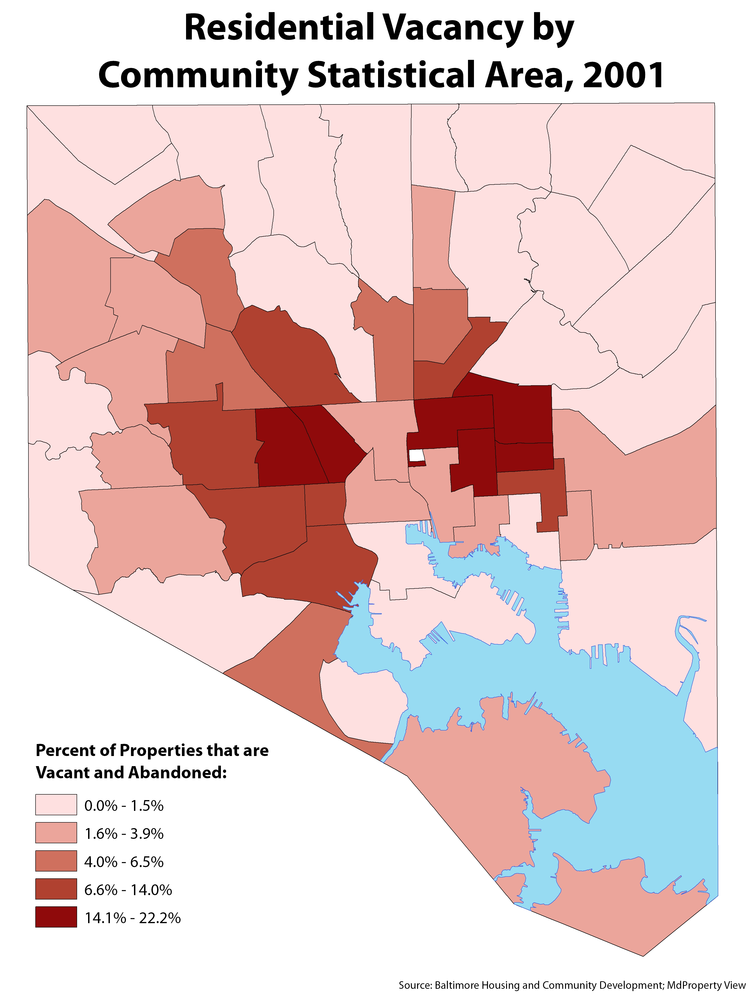
Vacant and Abandoned Housing

Slide 4
Solutions Not Forthcoming Because Who’s in Charge?
Relational Nature of Urban Governance
Ed Petriese

Slide 5
Using Data to Provide Policy Solutions
Completed several projects:
Sustainable Communities Regional Housing Plan
Byrne Criminal Justice Innovation Grant
Grow Baltimore Recommendations
Address the scale of the 25,000+ housing assistance waitlist.

Slide 6
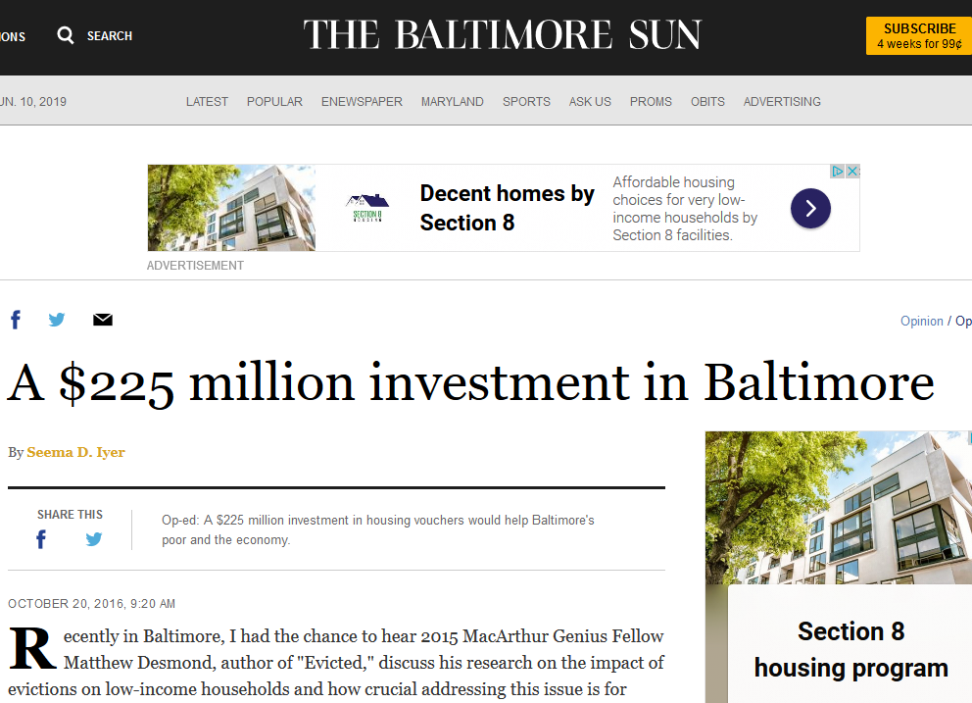
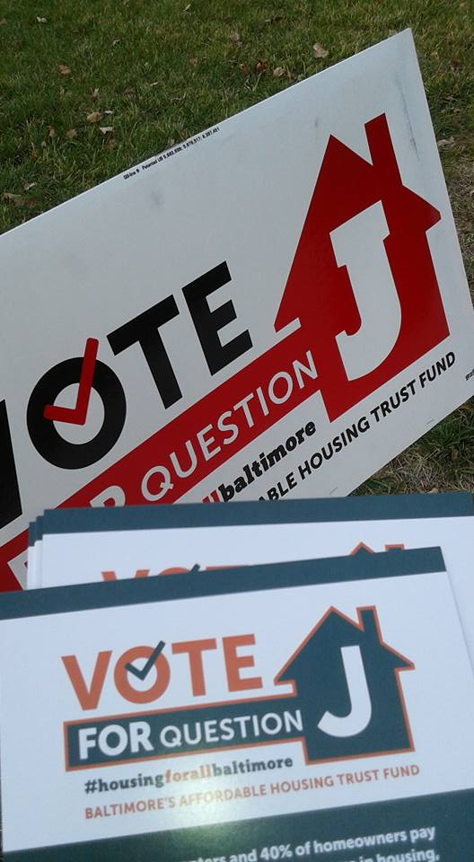
Getting Involved
Let people know we had a point of view
Get engaged in existing processes
Be very clear when it’s the organization advocating and when it’s you personally
Give the same recommendations to everyone to remain non-partisan
Passed 2016

Slide 7
Advocates Play a Critical Role in Urban Governance and Decision-Making
Thank you!

