Slide 1

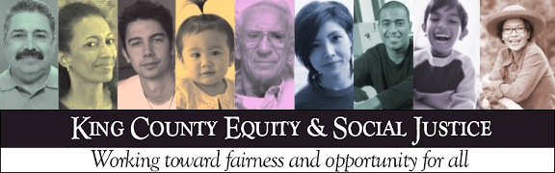
King County’s journey in advancing and institutionalizing equity
NNIP - April 2016 – San Antonio
Matias Valenzuela, PhD
Director
Office of Equity and Social Justice
Office of King County Executive Dow Constantine

Slide 2

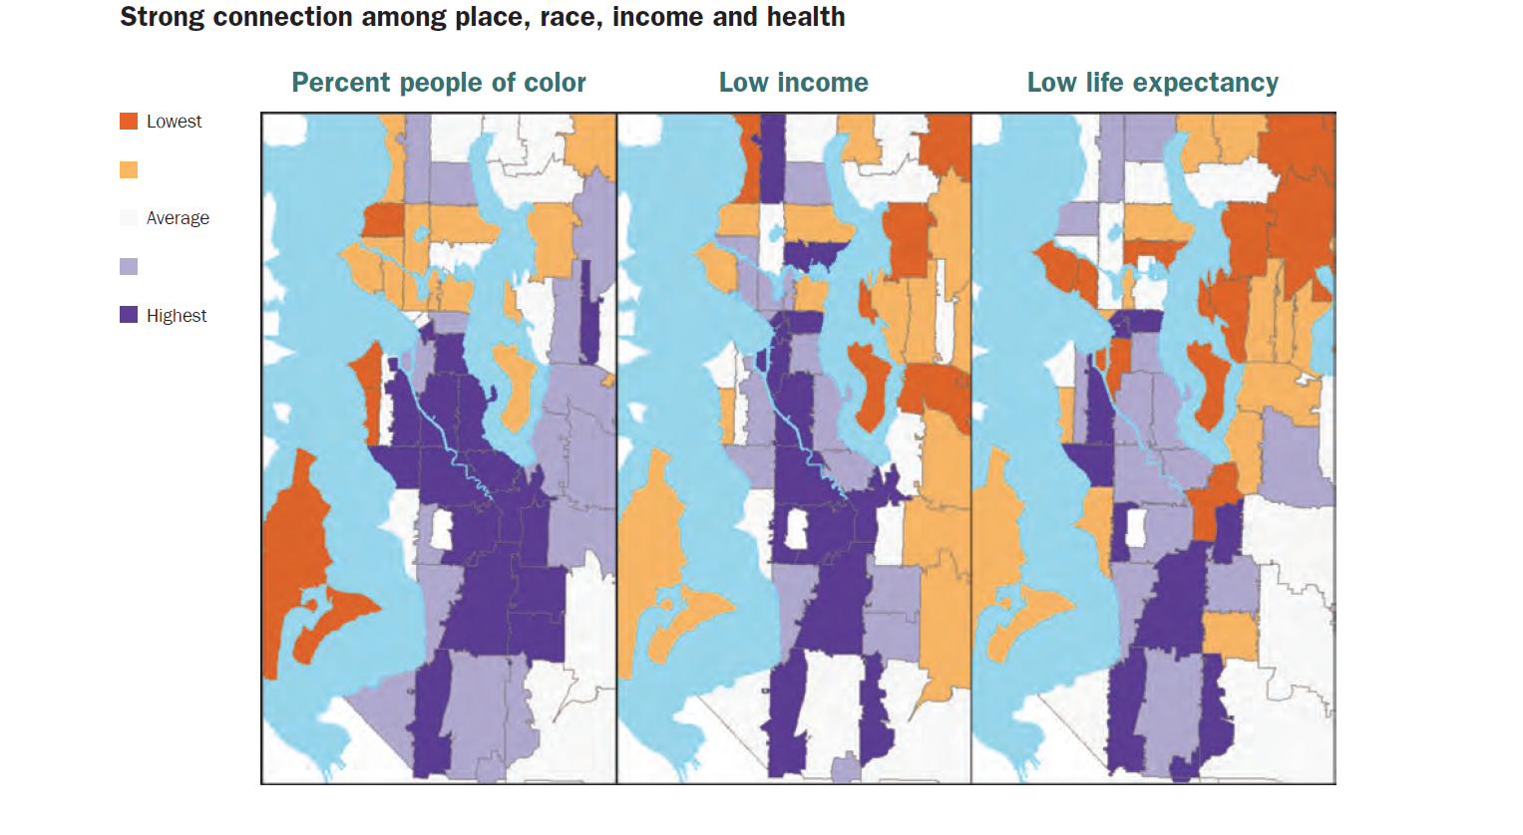
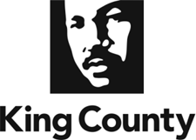

Slide 3
King County Strategic Plan and
Equity & Social Justice Ordinance
Notes:
“Fair and just” - guiding principle for County Strategic Plan
ESJ Ordinance 16948 unanimously approved by KC Council
Establishes definitions and identifies approaches
Creates inter-agency team with all agencies and branches of County government
Reports annually on ESJ measures and results to King County elected leadership, employees and the public.

Slide 4
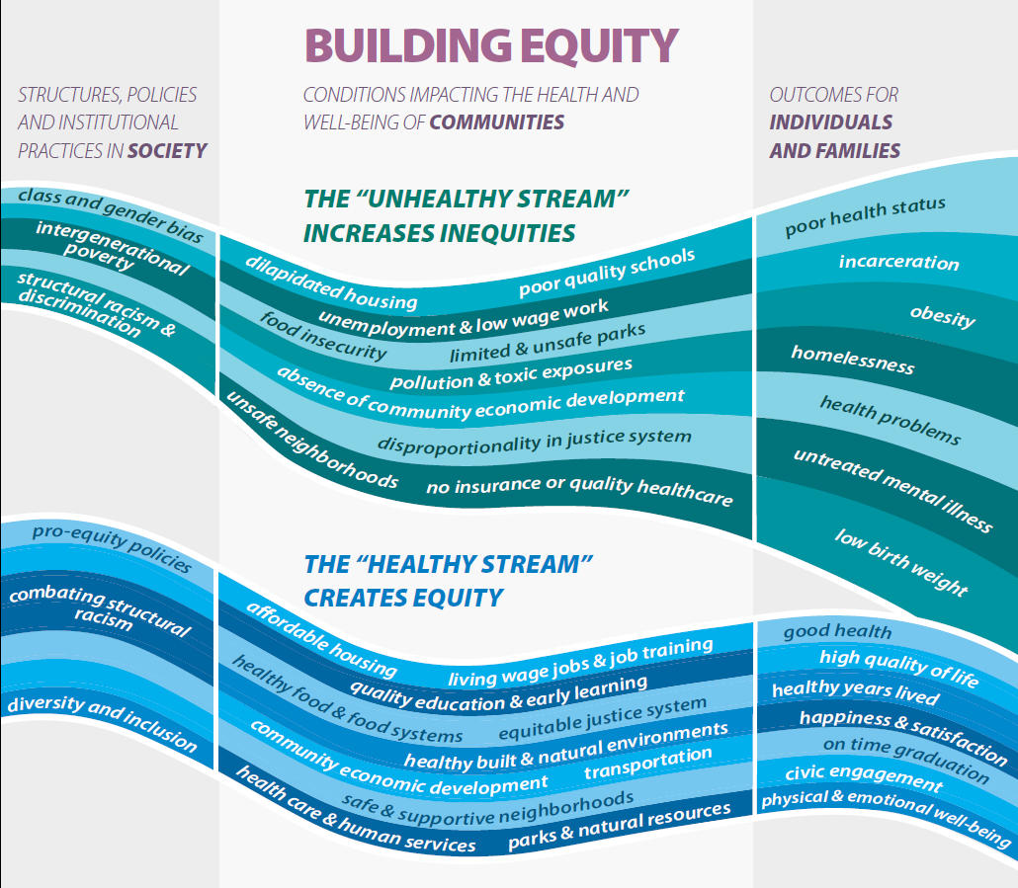
Notes:
King County uses this stream to describe its vision for advancing equity.
Government policies have historically aimed at the right side of this stream, designing policies and programs to treat problems at the individual level.
Inequities like the ones in King County, however, are linked to the underlying conditions where people live, learn and work. The middle of the stream includes these determinants of equity, and our vision is that all people have access to these determinants.
The left side of the stream represents the political and institutional systems and factors that produce an inequitable distribution of the determinants of equity among communities.
Actions that change these underlying systems and conditions have a larger impact inequities than programs that attempt to change individual behaviors.

Slide 5


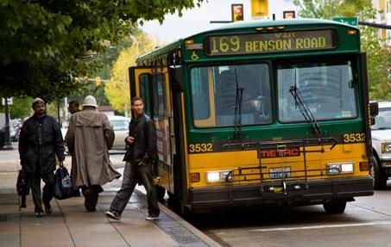

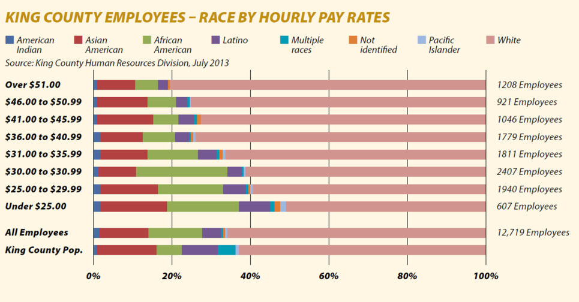
County wide activities
policies and decision-making
organizational practices
community engagement
Budgets and business plans
Human resources and hiring
Transit strategic plan and fare

Slide 6

King County Equity & Social Justice www.kingcounty.gov/equity
  Tools, including Equity Impact Review Tool, Community Engagement Guide
Contact:
Matias.Valenzuela@KingCounty.gov
Director, Office of Equity and Social Justice

