Slide 1
Equity in Community Data
NNIP San Antonio, April 2016
Steve (Spike) Spiker
Director of Research + Technology
Urban Strategies Council
@spjika

Slide 2
Data Driven Cities: an ecosystem
Accessible data
Data analysis in a local context
Clear communication of data & results
Build community capacity to use data
Engage stakeholders using data as a driver of discussion
Tools to measure impact
Notes:
20 plus years of this work has highlighted the need for more than just data in a vacuum. We’ve developed a framework that needs to be supported if we are to create a future where data driven decisions are the norm in our cities and communities. Data driven mind you, not data obsessed.

Slide 3
Equity Framework
Agree on definition
Measure outcome disparities
Agree on outcomes/accountability
Engage your community
Focus on eliminating disparities
Targeted Universalism
Continuous assessment
Notes:
Data driven because the core of public decisions and understanding impact is data- data that can be turned into actionable knowledge and with action, advocacy, becomes power- the power that equalizes money and levels the playing field.
One of our cores has been the democratization of data- to support planning, advocacy, decision making.

Slide 4
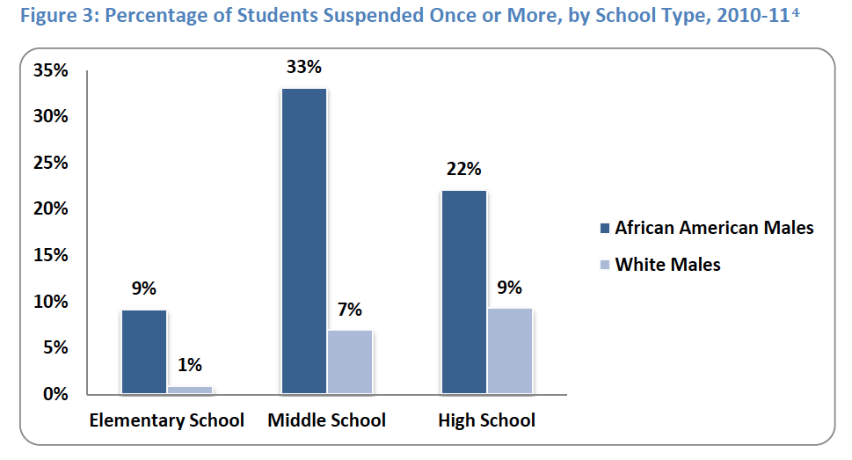

Slide 5
