Slide 1
Research funded by the John S. and James L. Knight Foundation
Notes:
1. Not new—Portland has been a consistent YCE magnet since 1980
Portland has recorded an impressive ability to attract and retain YCE migrants despite its economic growth
YCEs come here from areas ‘up’ and ‘down’ the urban hierarchy
Empty-nesters and retirees are moving and staying here too
Immigrants are an (increasing) important part of the talent story

Slide 2
Notes:
1. Not new—Portland has been a consistent YCE magnet since 1980
Portland has recorded an impressive ability to attract and retain YCE migrants despite its economic growth
YCEs come here from areas ‘up’ and ‘down’ the urban hierarchy
Empty-nesters and retirees are moving and staying here too
Immigrants are an (increasing) important part of the talent story

Slide 3
81%
57%
36%
15%
Notes:
1. Not new—Portland has been a consistent YCE magnet since 1980
Portland has recorded an impressive ability to attract and retain YCE migrants despite its economic growth
YCEs come here from areas ‘up’ and ‘down’ the urban hierarchy
Empty-nesters and retirees are moving and staying here too
Immigrants are an (increasing) important part of the talent story

Slide 4
Notes:
1. Not new—Portland has been a consistent YCE magnet since 1980
Portland has recorded an impressive ability to attract and retain YCE migrants despite its economic growth
YCEs come here from areas ‘up’ and ‘down’ the urban hierarchy
Empty-nesters and retirees are moving and staying here too
Immigrants are an (increasing) important part of the talent story

Slide 5
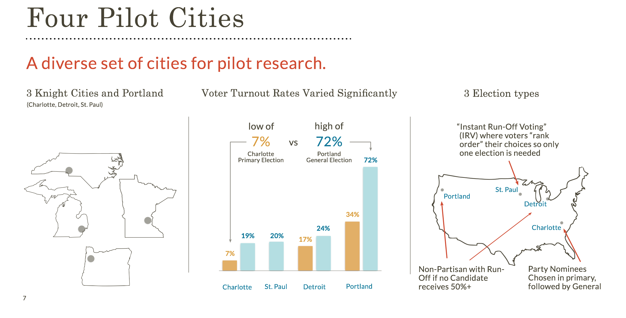
Notes:
1. Not new—Portland has been a consistent YCE magnet since 1980
Portland has recorded an impressive ability to attract and retain YCE migrants despite its economic growth
YCEs come here from areas ‘up’ and ‘down’ the urban hierarchy
Empty-nesters and retirees are moving and staying here too
Immigrants are an (increasing) important part of the talent story

Slide 6
Notes:
1. Not new—Portland has been a consistent YCE magnet since 1980
Portland has recorded an impressive ability to attract and retain YCE migrants despite its economic growth
YCEs come here from areas ‘up’ and ‘down’ the urban hierarchy
Empty-nesters and retirees are moving and staying here too
Immigrants are an (increasing) important part of the talent story

Slide 7
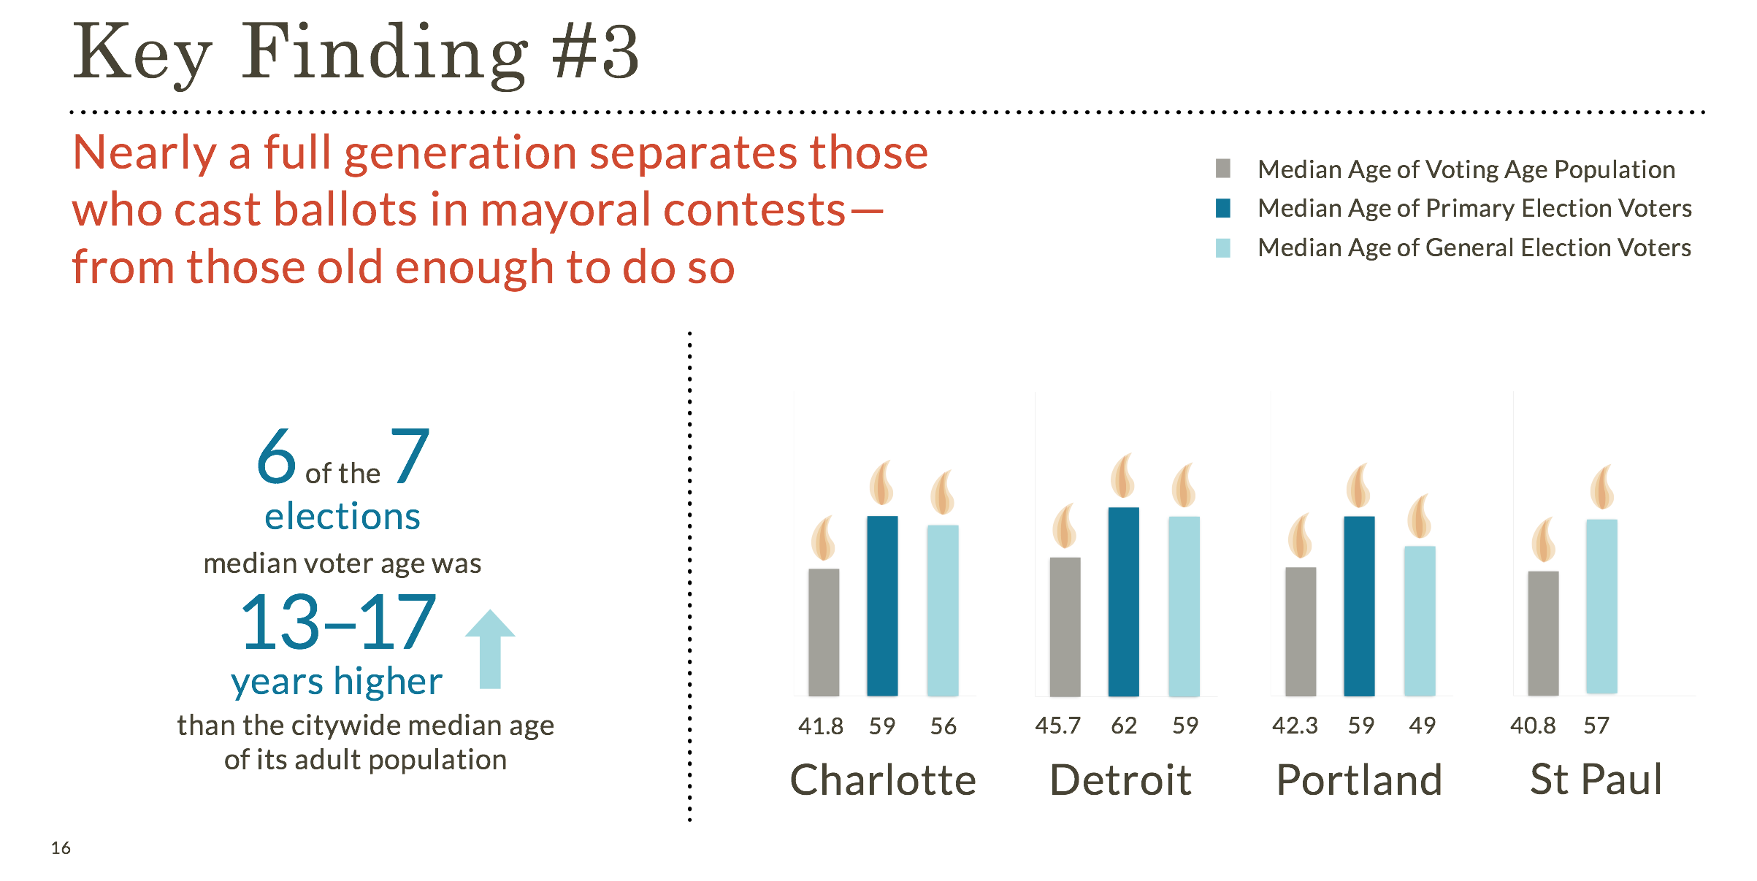
Notes:
1. Not new—Portland has been a consistent YCE magnet since 1980
Portland has recorded an impressive ability to attract and retain YCE migrants despite its economic growth
YCEs come here from areas ‘up’ and ‘down’ the urban hierarchy
Empty-nesters and retirees are moving and staying here too
Immigrants are an (increasing) important part of the talent story

Slide 8
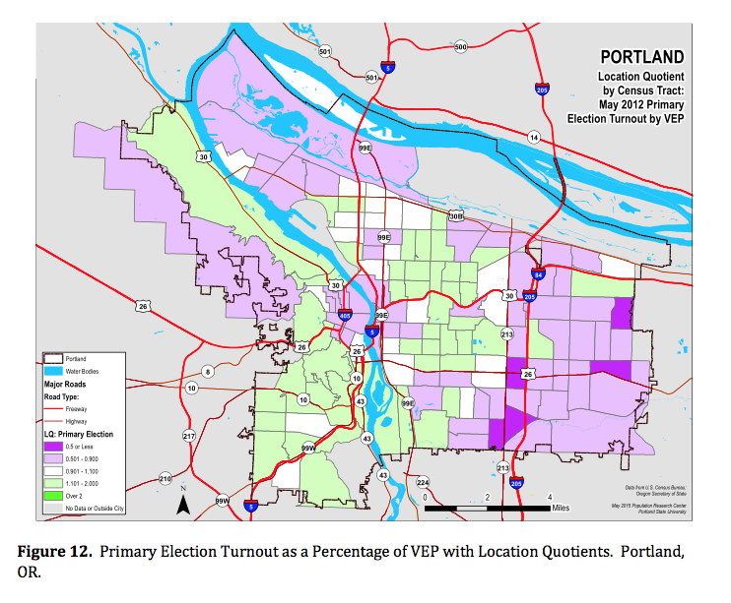
Notes:
1. Not new—Portland has been a consistent YCE magnet since 1980
Portland has recorded an impressive ability to attract and retain YCE migrants despite its economic growth
YCEs come here from areas ‘up’ and ‘down’ the urban hierarchy
Empty-nesters and retirees are moving and staying here too
Immigrants are an (increasing) important part of the talent story

Slide 9
Who Votes for Mayor? Phase II
48 additional cities
2011-2015 mayoral voting cycles
Addressing 2 specific research questions:
To what extent are voters who cast ballots in municipal elections roughly representative—or not—of a city’s overall population?
Which demographic groups are over or underrepresented at the ballot box, and by how much? Put another way, which demographic groups—and to what degree—play an inordinately large (or small) role in choosing who governs a city?
Deliverables
Mayoral Election Profile 1-pager
Open-source data download and visualization
Notes:
1. Not new—Portland has been a consistent YCE magnet since 1980
Portland has recorded an impressive ability to attract and retain YCE migrants despite its economic growth
YCEs come here from areas ‘up’ and ‘down’ the urban hierarchy
Empty-nesters and retirees are moving and staying here too
Immigrants are an (increasing) important part of the talent story

Slide 10
Notes:
1. Not new—Portland has been a consistent YCE magnet since 1980
Portland has recorded an impressive ability to attract and retain YCE migrants despite its economic growth
YCEs come here from areas ‘up’ and ‘down’ the urban hierarchy
Empty-nesters and retirees are moving and staying here too
Immigrants are an (increasing) important part of the talent story

Slide 11
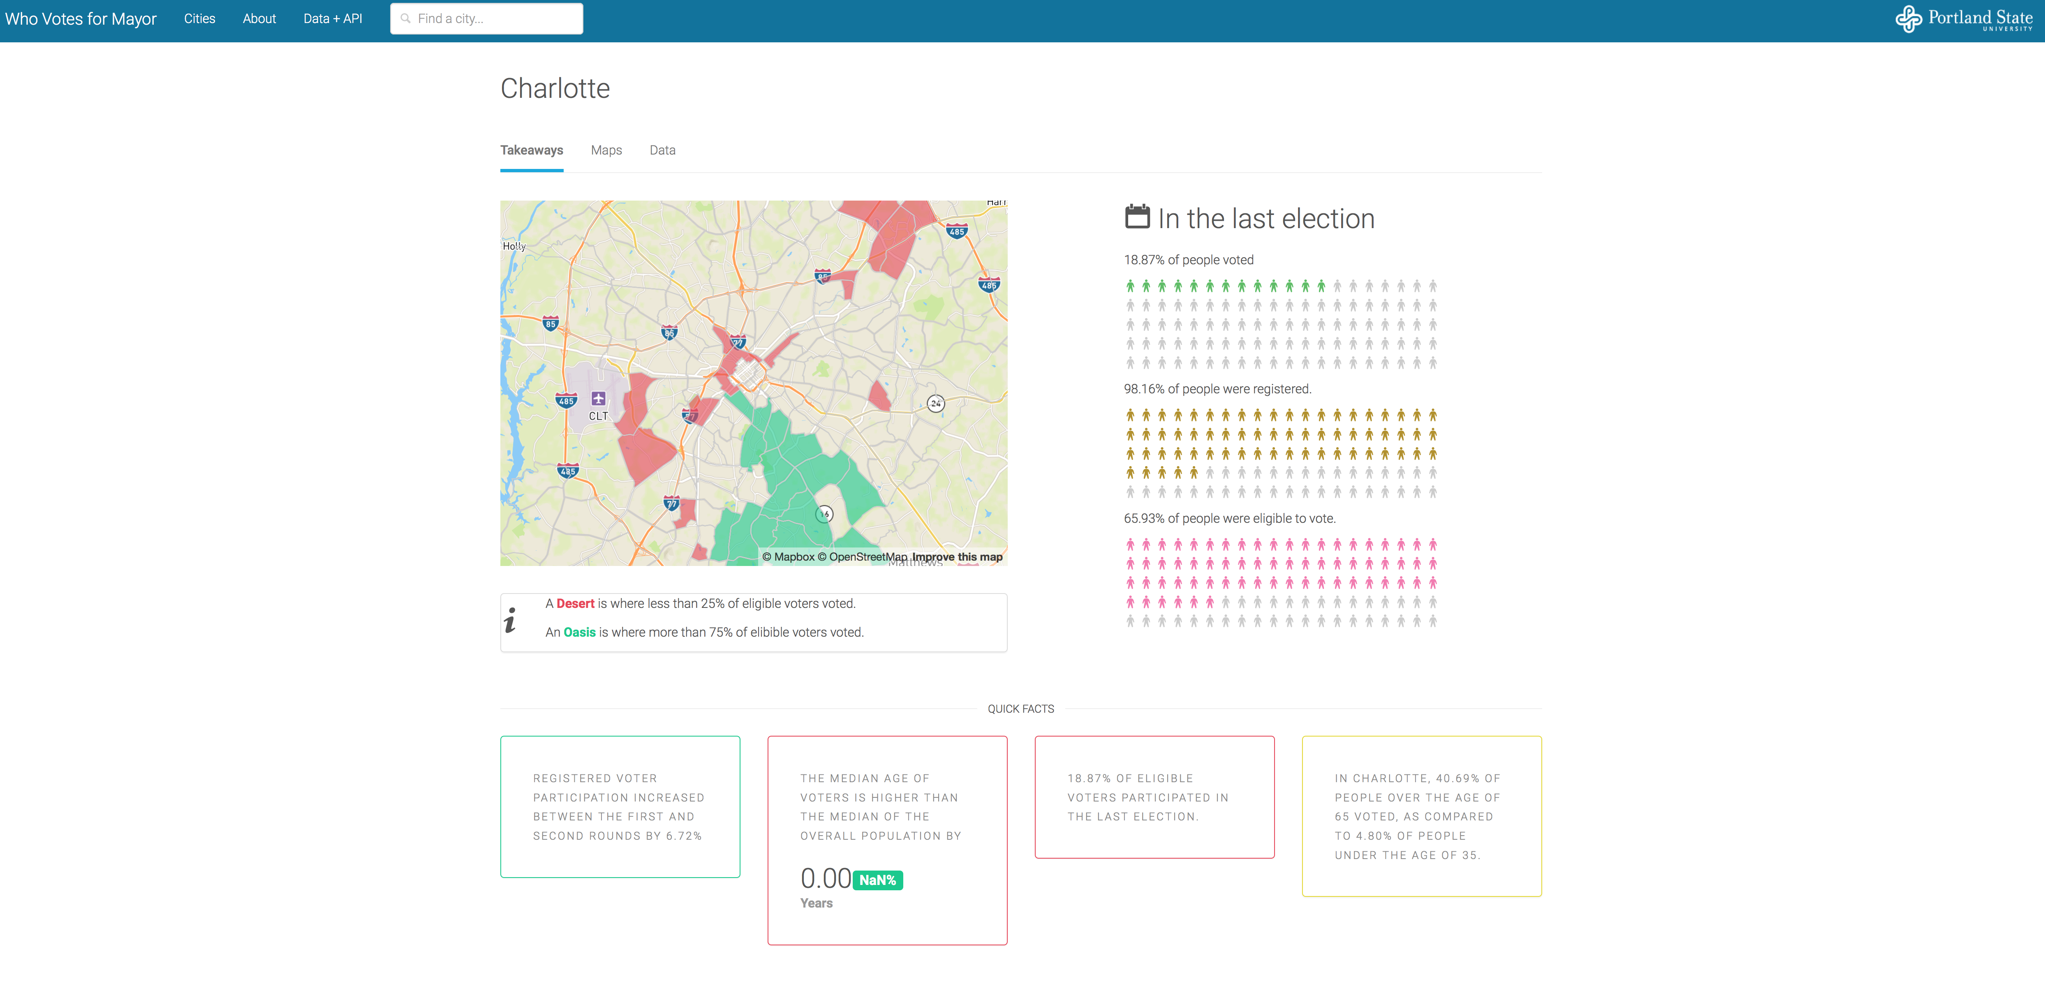
*Work still in progress
Notes:
1. Not new—Portland has been a consistent YCE magnet since 1980
Portland has recorded an impressive ability to attract and retain YCE migrants despite its economic growth
YCEs come here from areas ‘up’ and ‘down’ the urban hierarchy
Empty-nesters and retirees are moving and staying here too
Immigrants are an (increasing) important part of the talent story

Slide 12
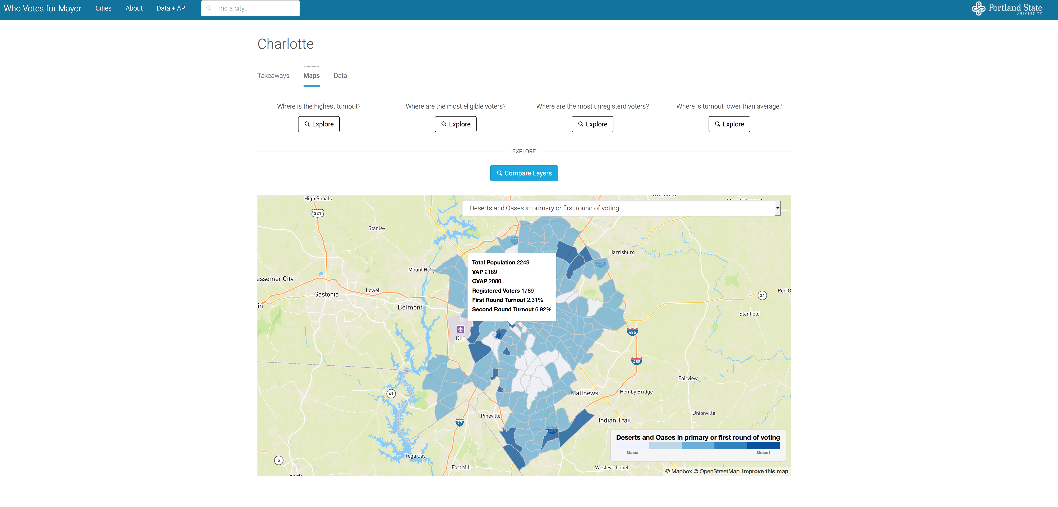
*Work still in progress
Notes:
1. Not new—Portland has been a consistent YCE magnet since 1980
Portland has recorded an impressive ability to attract and retain YCE migrants despite its economic growth
YCEs come here from areas ‘up’ and ‘down’ the urban hierarchy
Empty-nesters and retirees are moving and staying here too
Immigrants are an (increasing) important part of the talent story

Slide 13
Implications and Takeaways
Voting data
To what extent is your state’s voting data comparable to others?
How accessible (and specifically, what variables are available) is your state’s voting data?
Recordkeeping format (i.e., point-in-time historical record)
U.S. Census Bureau data
Challenges of marrying voting data with census geographies, and data reliability issues (i.e., geographic scale)
Other technical issues
MOE calculations
Voting-specific turnout calculations
Geocoding accuracy
Notes:
1. Not new—Portland has been a consistent YCE magnet since 1980
Portland has recorded an impressive ability to attract and retain YCE migrants despite its economic growth
YCEs come here from areas ‘up’ and ‘down’ the urban hierarchy
Empty-nesters and retirees are moving and staying here too
Immigrants are an (increasing) important part of the talent story

Slide 14
Recommendations
Policy
Using data analysis to: 1) examine the (un) representativeness of a city’s electorate, 2) highlight underrepresentation among specific groups, and; 3) make recommendations to increase voter participation
Example: Motor Voter Laws
Data
Recordkeeping and accessibility
Notes:
1. Not new—Portland has been a consistent YCE magnet since 1980
Portland has recorded an impressive ability to attract and retain YCE migrants despite its economic growth
YCEs come here from areas ‘up’ and ‘down’ the urban hierarchy
Empty-nesters and retirees are moving and staying here too
Immigrants are an (increasing) important part of the talent story

Slide 15
Research funded by the John S. and James L. Knight Foundation
Notes:
1. Not new—Portland has been a consistent YCE magnet since 1980
Portland has recorded an impressive ability to attract and retain YCE migrants despite its economic growth
YCEs come here from areas ‘up’ and ‘down’ the urban hierarchy
Empty-nesters and retirees are moving and staying here too
Immigrants are an (increasing) important part of the talent story

Slide 16
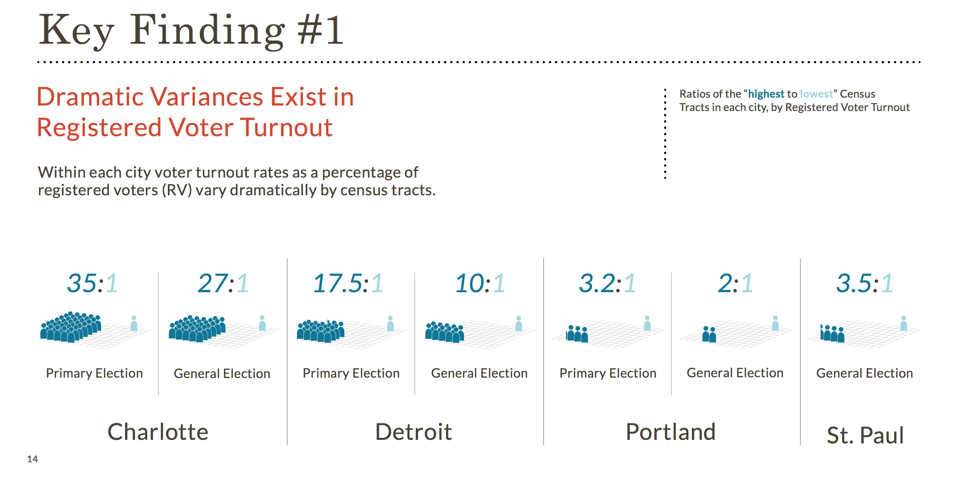
Notes:
1. Not new—Portland has been a consistent YCE magnet since 1980
Portland has recorded an impressive ability to attract and retain YCE migrants despite its economic growth
YCEs come here from areas ‘up’ and ‘down’ the urban hierarchy
Empty-nesters and retirees are moving and staying here too
Immigrants are an (increasing) important part of the talent story

Slide 17
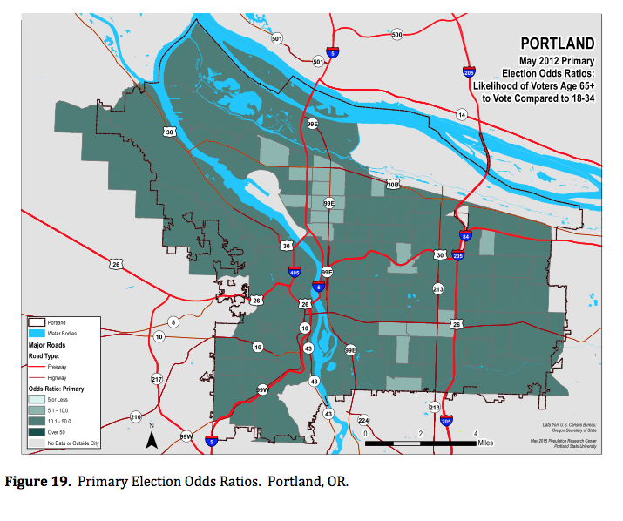
Notes:
1. Not new—Portland has been a consistent YCE magnet since 1980
Portland has recorded an impressive ability to attract and retain YCE migrants despite its economic growth
YCEs come here from areas ‘up’ and ‘down’ the urban hierarchy
Empty-nesters and retirees are moving and staying here too
Immigrants are an (increasing) important part of the talent story

Slide 18
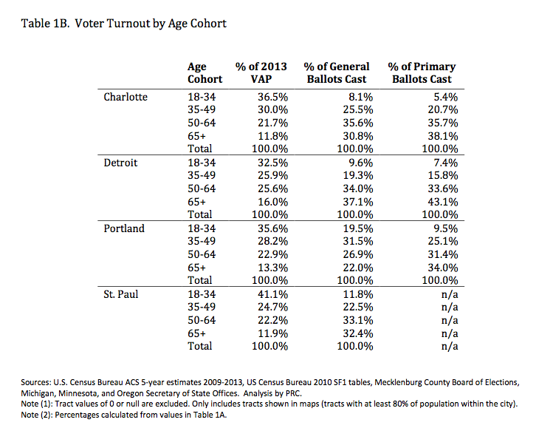
Notes:
1. Not new—Portland has been a consistent YCE magnet since 1980
Portland has recorded an impressive ability to attract and retain YCE migrants despite its economic growth
YCEs come here from areas ‘up’ and ‘down’ the urban hierarchy
Empty-nesters and retirees are moving and staying here too
Immigrants are an (increasing) important part of the talent story

Slide 19
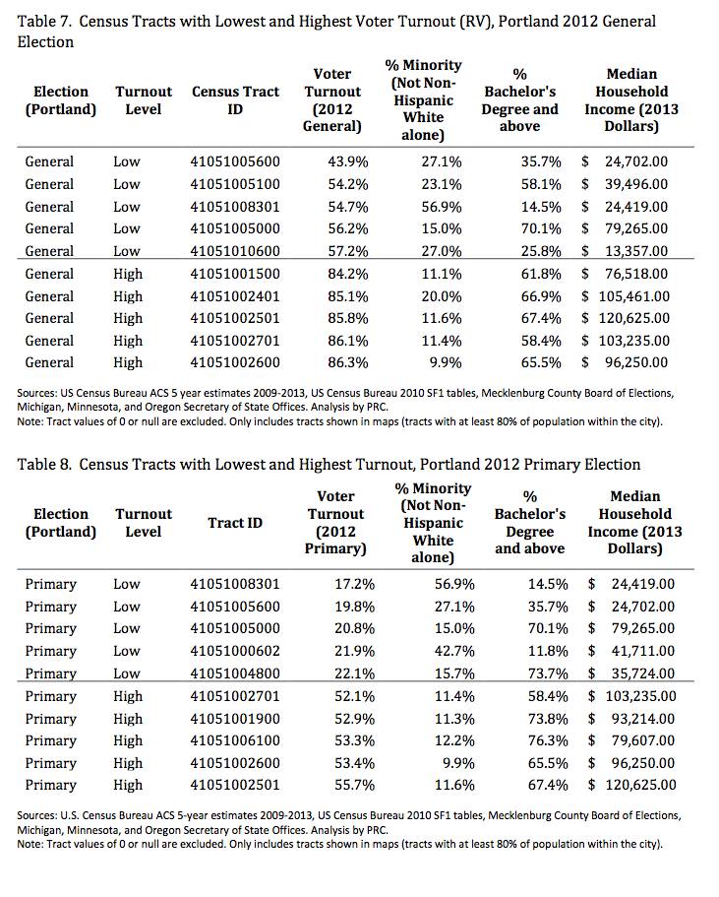
Notes:
1. Not new—Portland has been a consistent YCE magnet since 1980
Portland has recorded an impressive ability to attract and retain YCE migrants despite its economic growth
YCEs come here from areas ‘up’ and ‘down’ the urban hierarchy
Empty-nesters and retirees are moving and staying here too
Immigrants are an (increasing) important part of the talent story

