Slide 1

Notes:
Lots of talk on voter turnout decreasing in local elections. So we thought we should map it and see how’s its actually looking for Bexar county

Slide 2
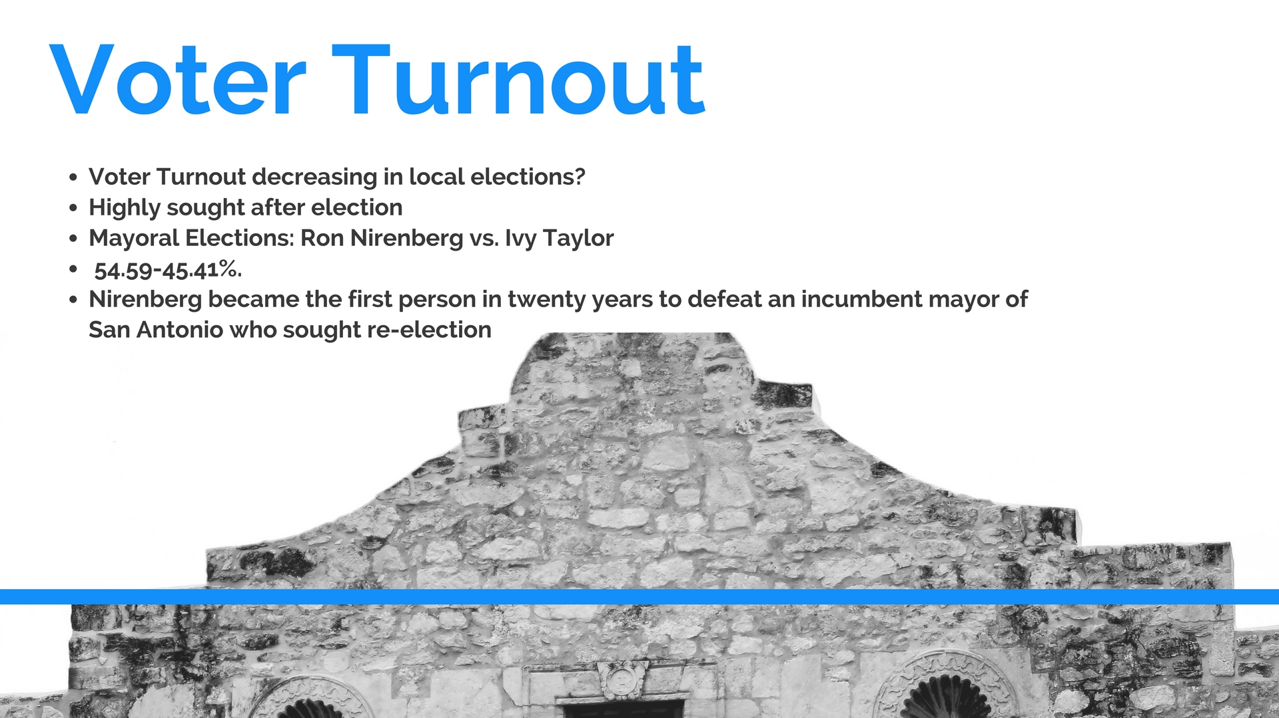

Slide 3
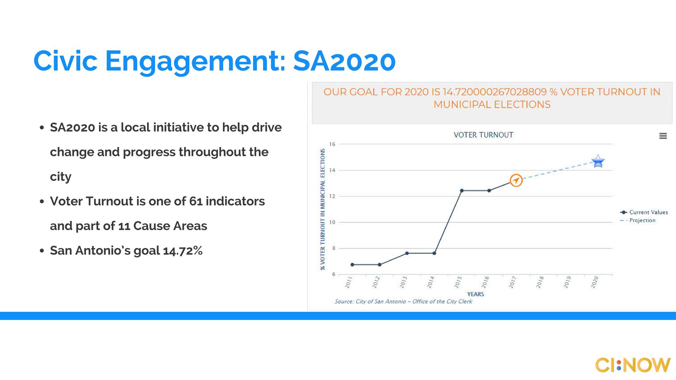
Notes:
-SA202 tracks San Antonio municipal elections, not all of Bexar county.
-CI:NOW mapped all of Bexar county

Slide 4
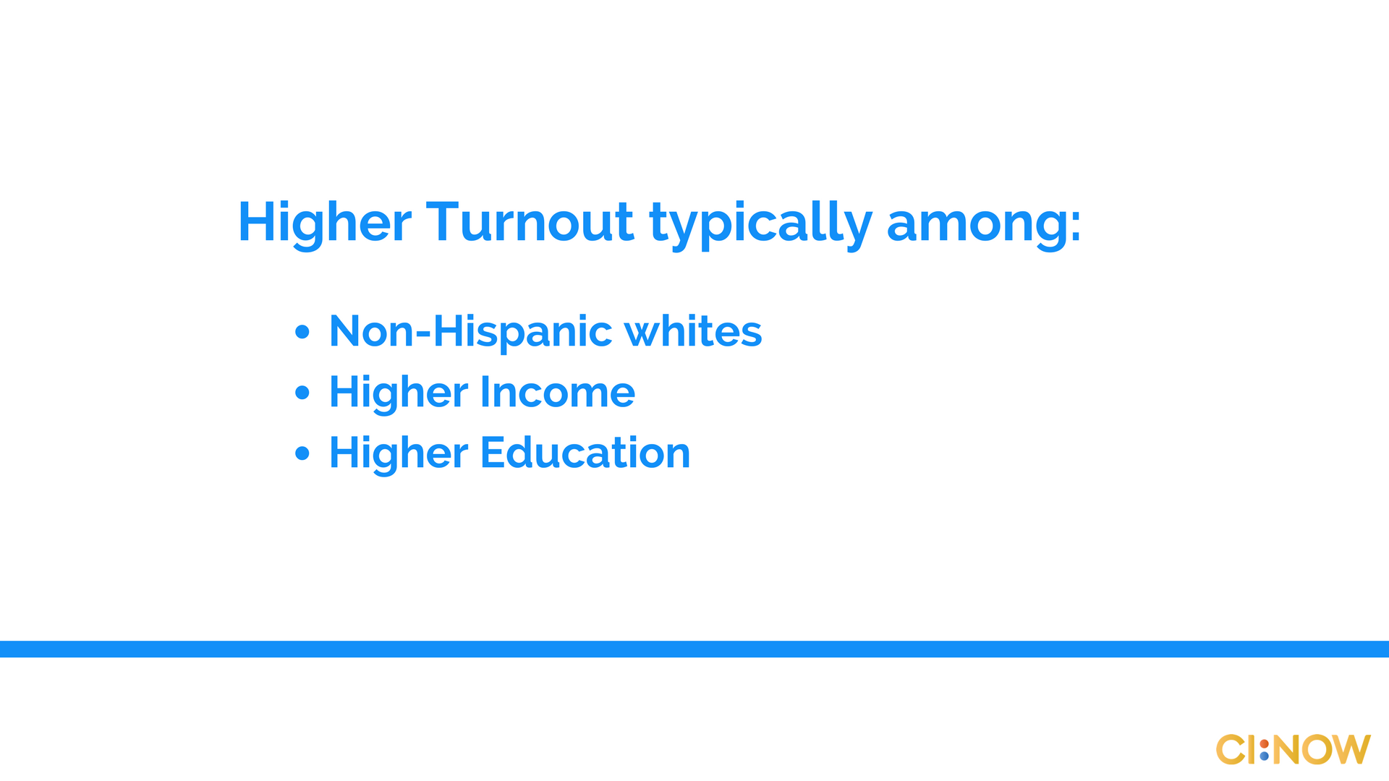
Notes:
-Portland NNIP partner: some groups vote in higher #’s

Slide 5

Notes:
Demographics by zipcode
& how did the county vote

Slide 6
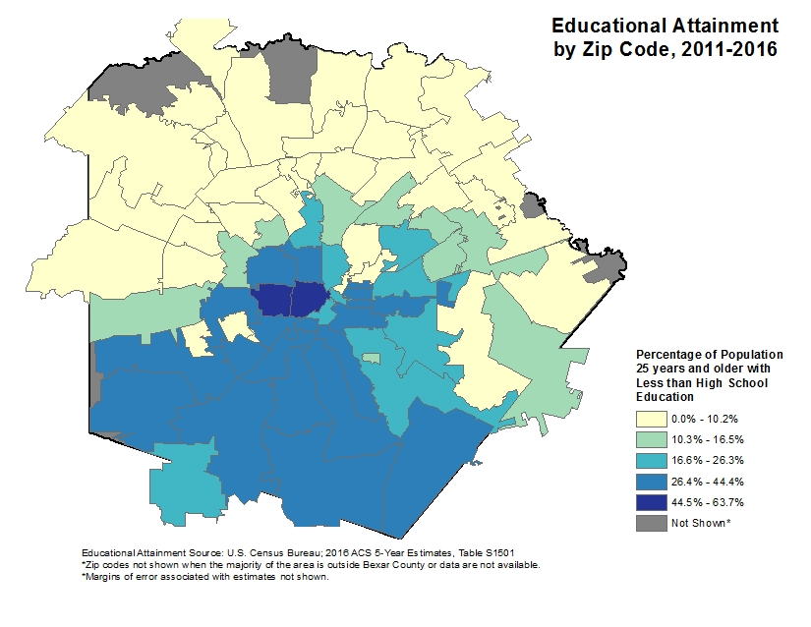
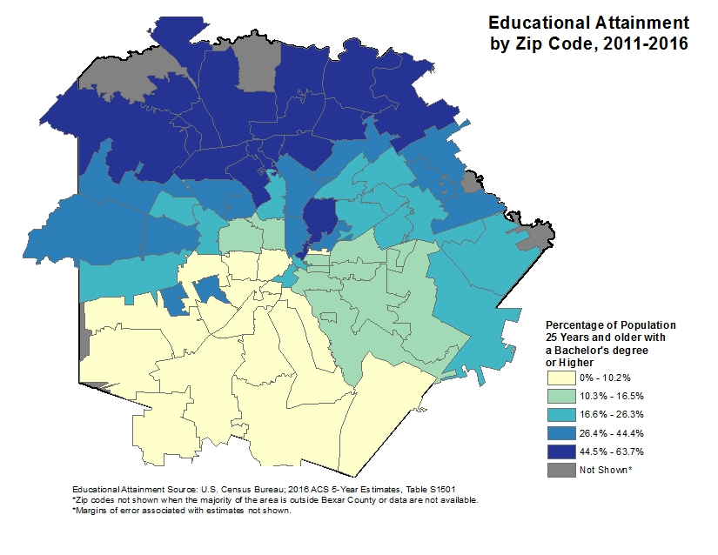

Notes:
Contextual maps

Slide 7
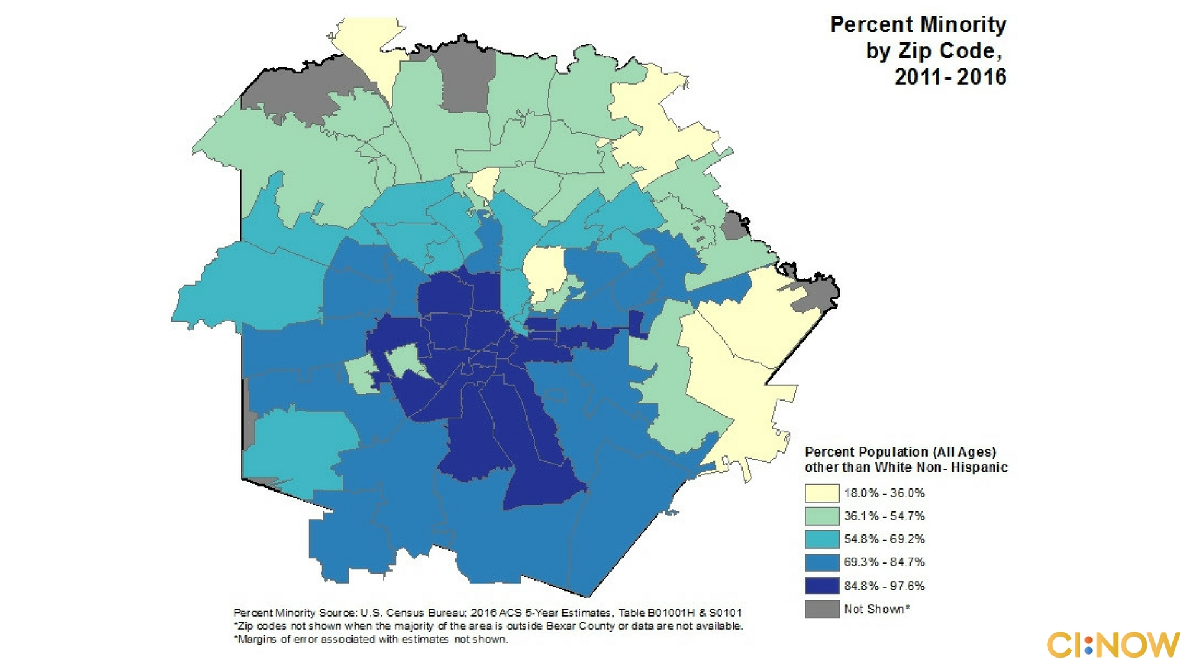

Slide 8
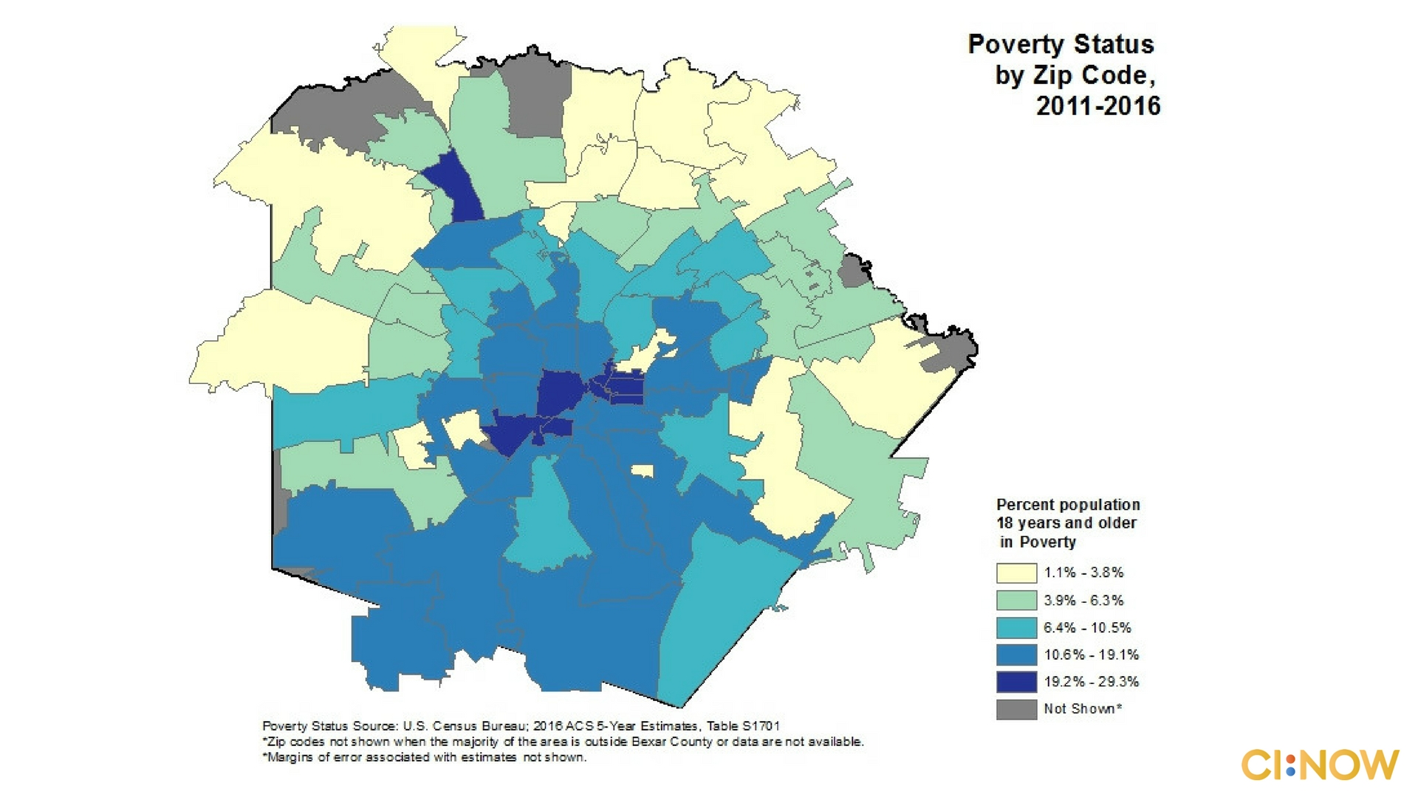

Slide 9
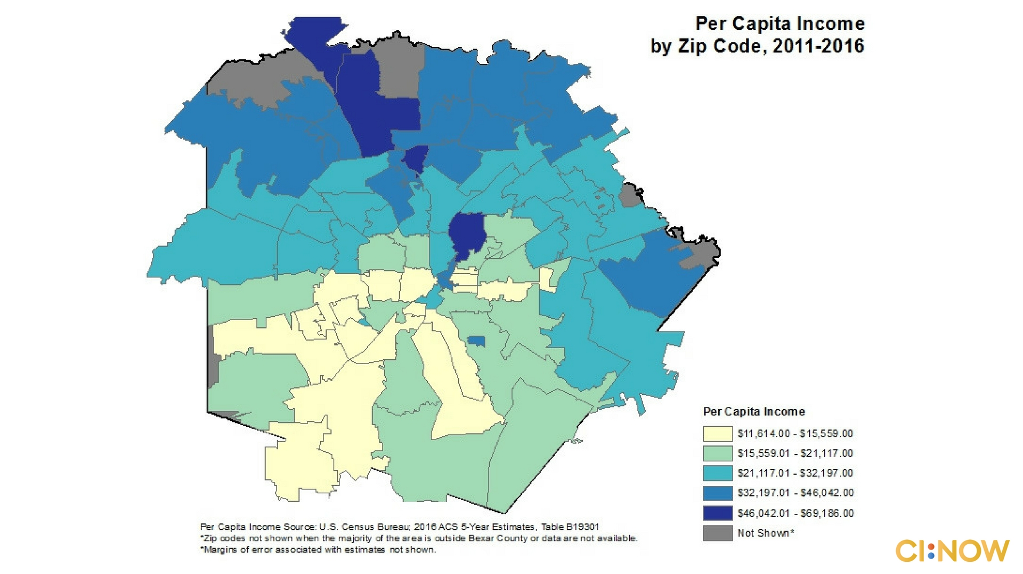

Slide 10
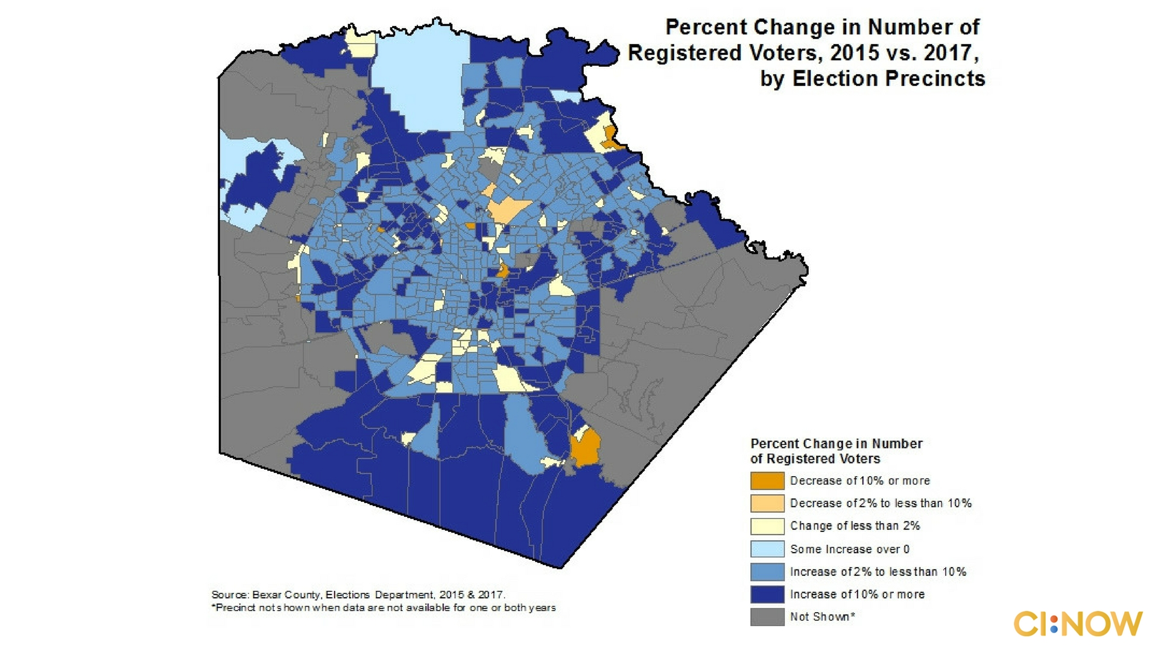

Slide 11
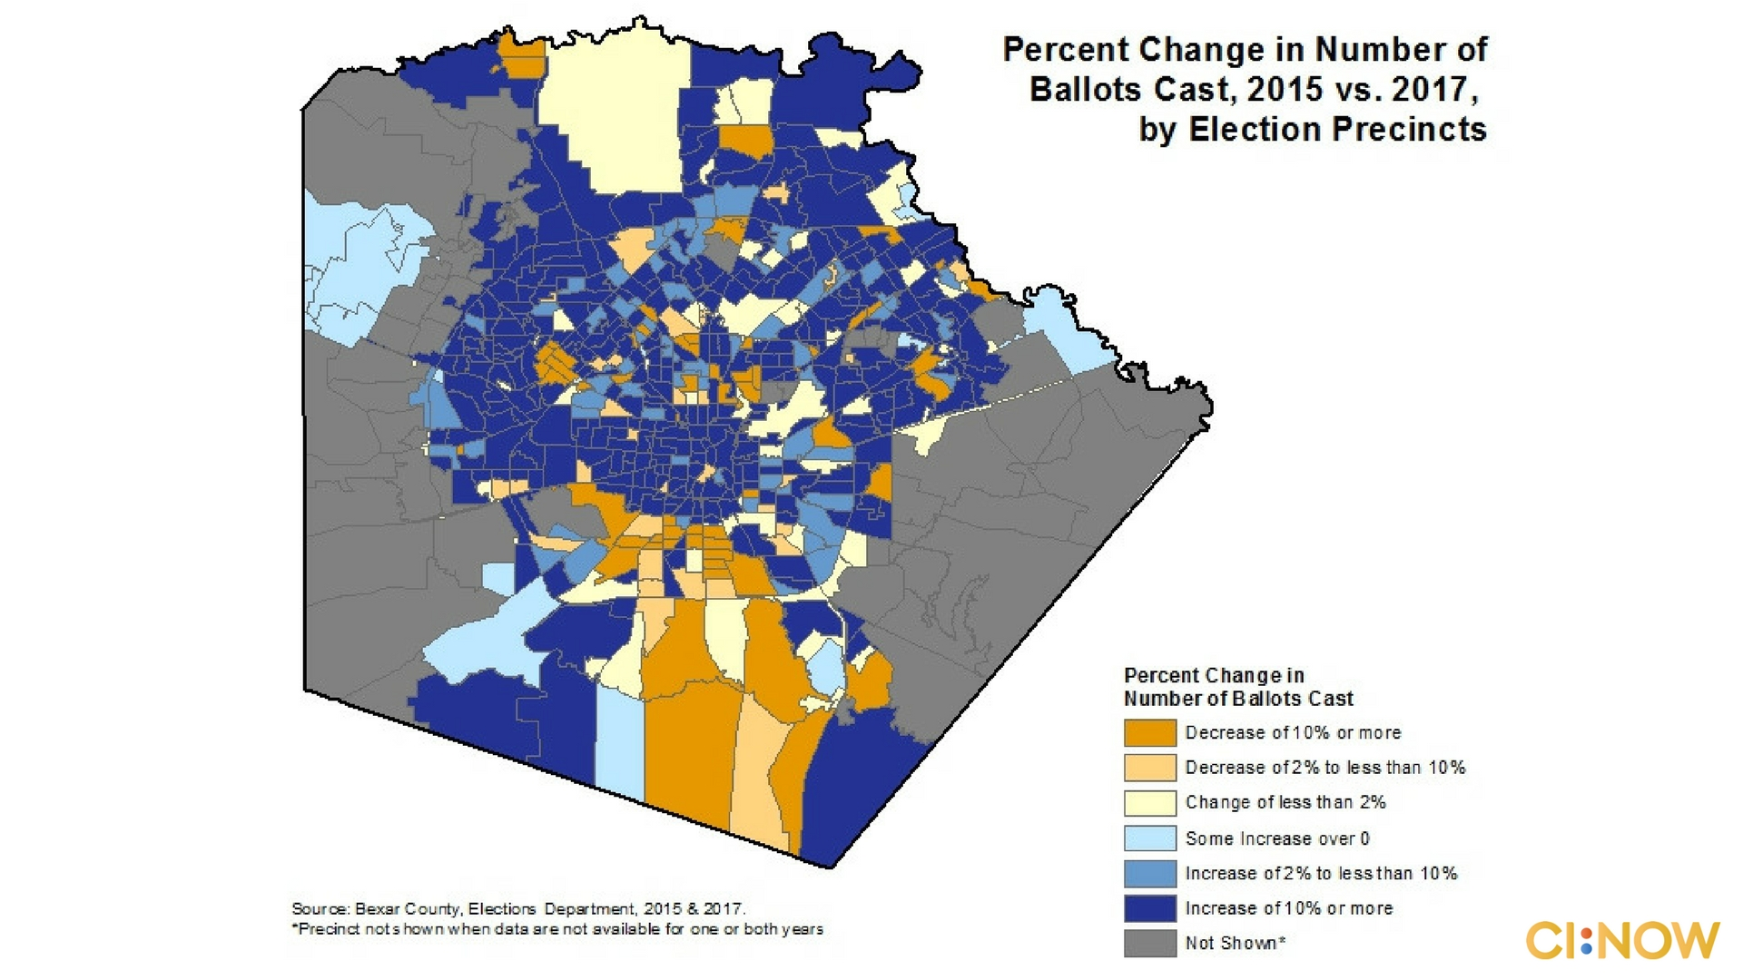

Slide 12
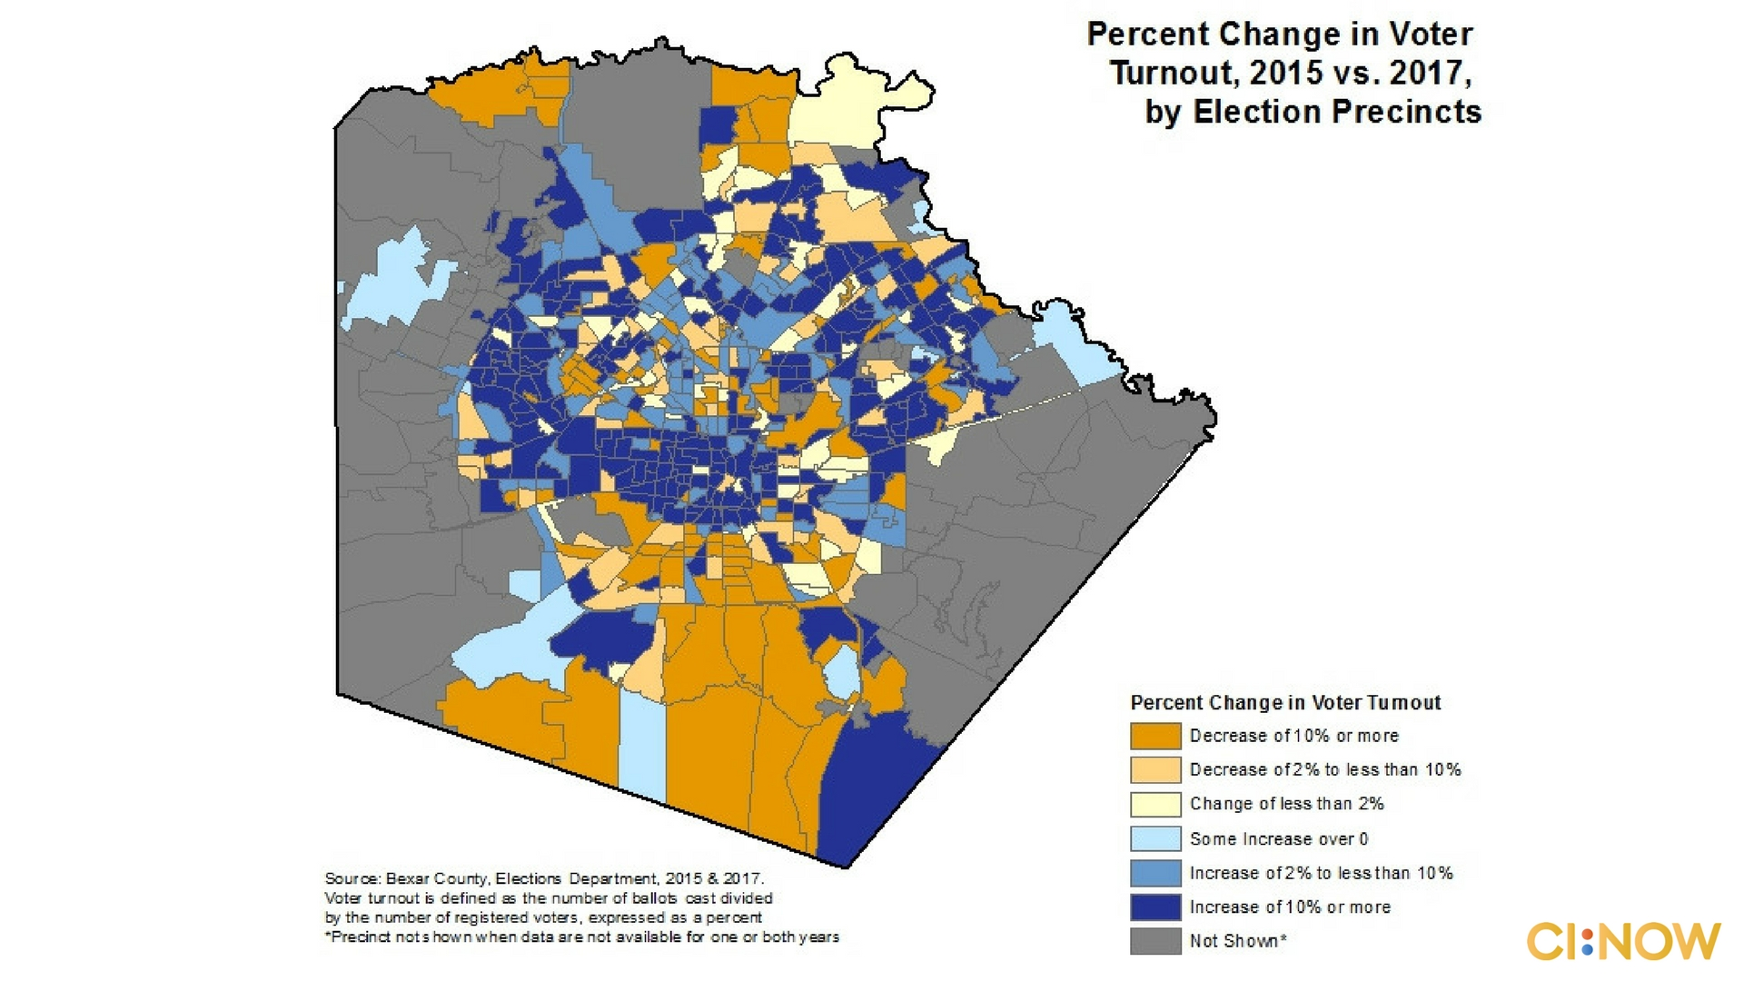

Slide 13
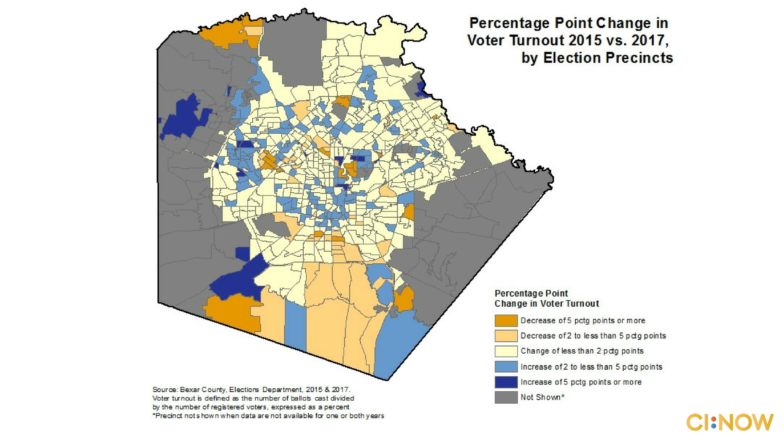

Slide 14
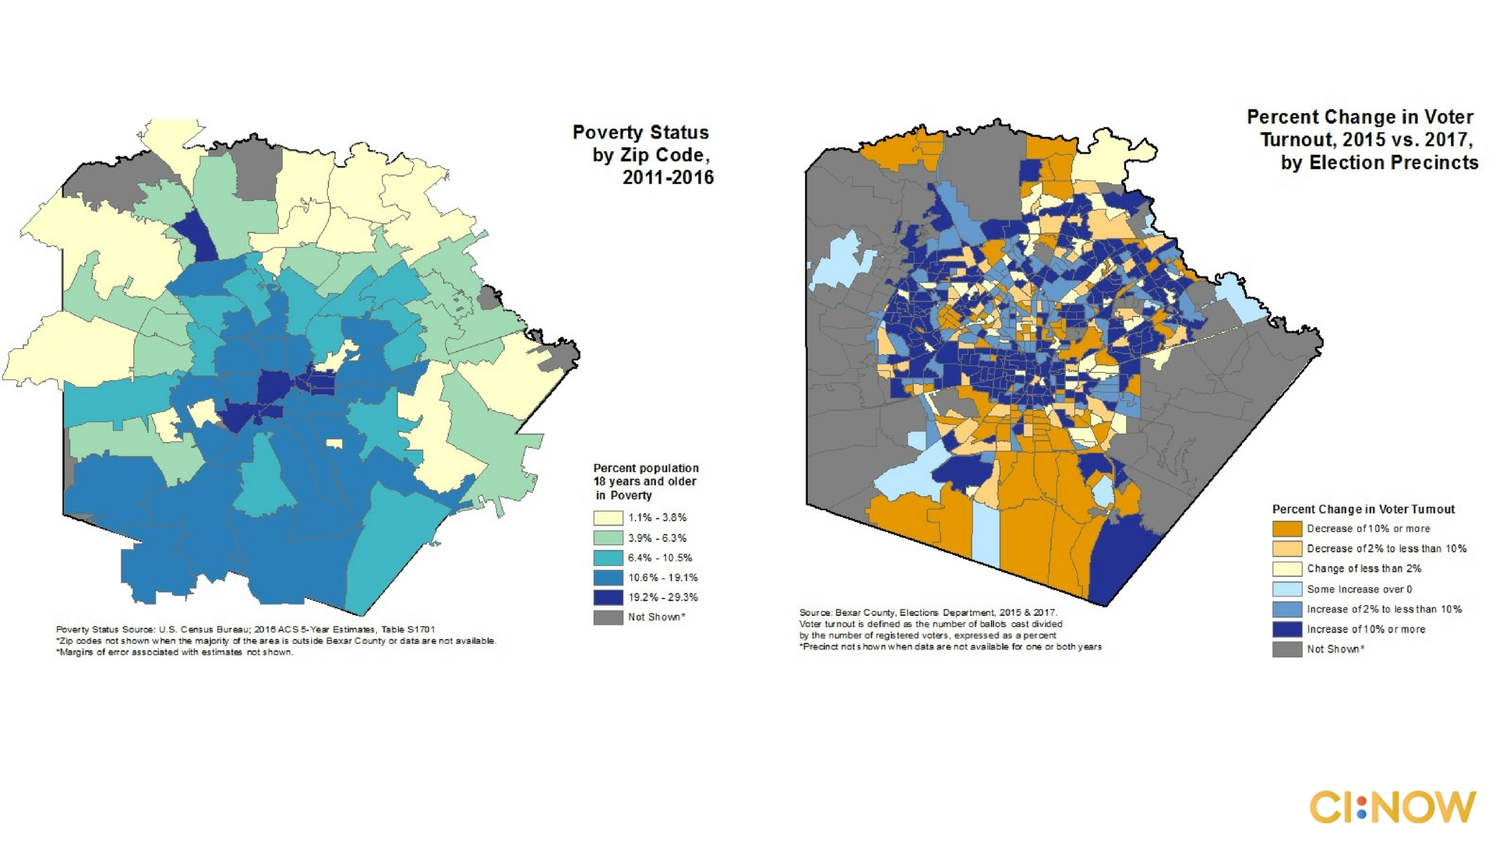

Slide 15
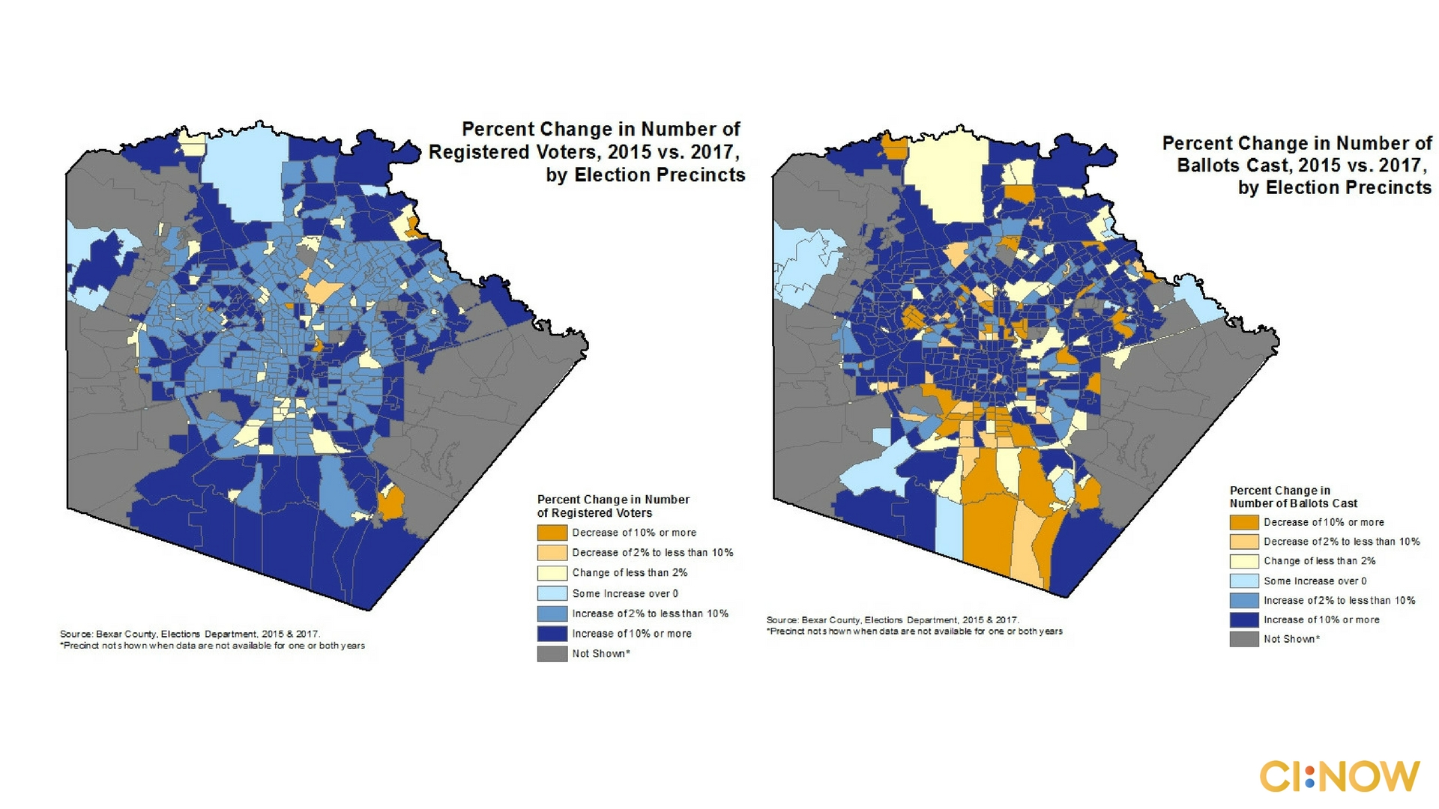

Slide 16

Notes:
In conclusion we are seeing a growing number of registered voters, however there is still more work to be done-now we need to get our voters to actually vote!

