Slide 1
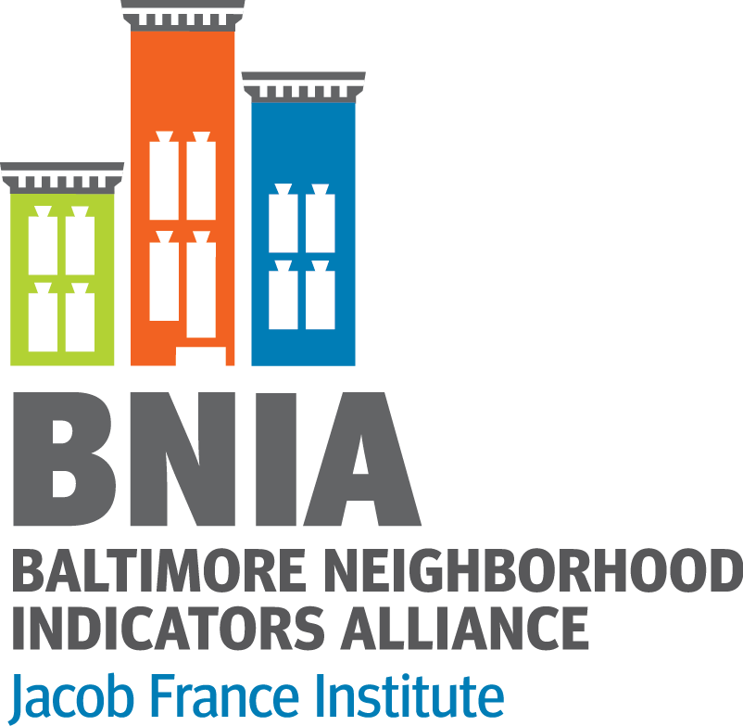
Organizational Strategic Planning (or We are 16, Going on 17…)
@bniajfi #VitalSigns16
Seema D. Iyer, PhD
May 2018 NNIP Meeting in Atlanta

Slide 2
About BNIA-JFI
@bniajfi #VitalSigns16
Started in 2000 as a project within our Association of Grantmakers (ABAG)
Odette Ramos Executive Director
Moved to Citizens Housing and Planning Association (CPHA) in 2004
Mary Washington Executive Director
Moved to the Jacob France Institute (JFI) at the University of Baltimore in 2007
Matthew Kachura Program Manager
I’ve been director of BNIA since 2011

Slide 3
Highlights of BNIA-JFI 2012 Strategic Plan
Public History Project
full documentation of the organization’s origins and development
brochure celebrating the 10-year history of BNIA-JFI
video documenting the history of the organization.
Engagement of Steering Committee
Indicator Roundtables
During July 2012, a series of 5 roundtable conversations on new indicators

Slide 4
BNIA-JFI Steering Committee Member Organizations
Annie E. Casey Foundation
Association of Baltimore Area Grantmakers
Baltimore City Department of Planning
Baltimore Housing
Citizens Planning and Housing Association
Associated Black Charities of Maryland
Morgan State University
Johns Hopkins University
Baltimore City Public Schools
Baltimore CitiStat Office
University of Maryland, College Park
University of Baltimore
Family League of Baltimore City
Community Law Clinic
United Way of Central Maryland
Maryland Department of Housing and Community Development
Baltimore City Office of Neighborhoods
Baltimore Community Foundation
Baltimore City Health Department
Baltimore City Police Department
Baltimore Development Corporation
Southeast Community Development Corporation
Blue Water Baltimore
Abell Foundation
Baltimore Education Research Consortium
Belair-Edison Neighborhoods, Inc.
Garwyn Oaks-Northwest Housing Resource Center
Pigtown Main Street
Community Development Network
Neighborhood Design Center
Enoch Pratt Library
Impact HUB
Baltimore Office of Promotion and Arts

Slide 5
Highlights of 2012 BNIA-JFI Strategic Plan
Research & Development of Neighborhood Indicators
Greater Coordination among Local Data Providers and Users
Convening Role for Local Measures of Neighborhood Sustainability
Community Outreach via Social Media, Education and Training
Greater Accessibility via Open-Source, Online Interactive Data Searching

Slide 6
1. Research & Development of Neighborhood Indicators
Vital Signs indicators should serve as a common or shared measurement system
Kindergarten Readiness
Healthy Food Availability
Life Expectancy/Mortality
Analysis of Administrative Data Sets
Better data for communities and city agencies

Slide 7
2. Greater Coordination among Local Data Providers and Users
Analysis of Federal sources of Small-Area data
USPS Vacancy Data
Housing Choice Voucher
Greater Coordination among Area Institutions for Research-Based Community Indicators
Urban Waters—Green Patterns Mapping
Arts and Cultural Mapping- GEOLOOM Co>Map

Slide 8
3. Convening Role for Local Measures of Neighborhood Sustainability
Energy Use, Energy Efficiency and Energy Assistance
Weatherization
Baltimore Energy Initiative
Connecting People and Place (NNIP Cross-Site Project)

Slide 9
4. Community Outreach via Social Media, Education and Training
Baltimore Data Day
Facebook and Twitter @bniajfi
Use of the data in college curricula and research agendas
Learning Community

Slide 10
Baltimore Data Day Attendees

Slide 11
5. Greater Accessibility via Open-Source, Online Interactive Data Searching

Slide 13
Strategic Plan 2017

Slide 14
What’s New?
Grew from 3.5 to 7.5 staff
New Governor in 2014, new Mayor in 2016
2015 Baltimore Uprising
Open Baltimore Portal
Lots more competition!!
“Fake News”

Slide 15
Ask Staff I WISH… IT WOULD BE GREAT IF…
We had more time write things down
Comprehensive community outreach strategy
More tech solutions to increase efficiency
More online tools for disseminating open data
Higher profile academic publications
More staff to help with data cleaning and organization
Partner with other organizations on issues leveraging everyone’s best resources
Automated data processing methods/scripts
Flashy graphics
Idea sharing among staff
Be continuously relevant
More time to construct methodologies

Slide 16
Strengths
Mission
Alliance/Relationships
Reputation/Trust
Quality Data
Brand
Good Use of Technology
Influence

Slide 17
Weaknesses
Awareness
Money/Resources
Data Presentation
Data Accessibility
Real Time Data
Communicating the Message

Slide 18
Opportunities
Civic Technology
Visibility
Equity
Local Government
Schools/Grassroots Organizations
Research
Training

Slide 19
Threats
Loss of Funds
Data Misuse
Data Security
Partner landscape/Competition
Narrative about Urban Neighborhoods
Political Landscape

Slide 20
2017 BNIA Goals
Living Data
Alliance of Data Champions
Data Capacity Building/Education
Demonstrable Impact
Measuring BNIA Impact
Baltimore Neighborhood Research Agenda
Define BNIA Approach
Place-Informed Decision Making
Community Champions
“Local Experts Nationally Known”

Slide 21
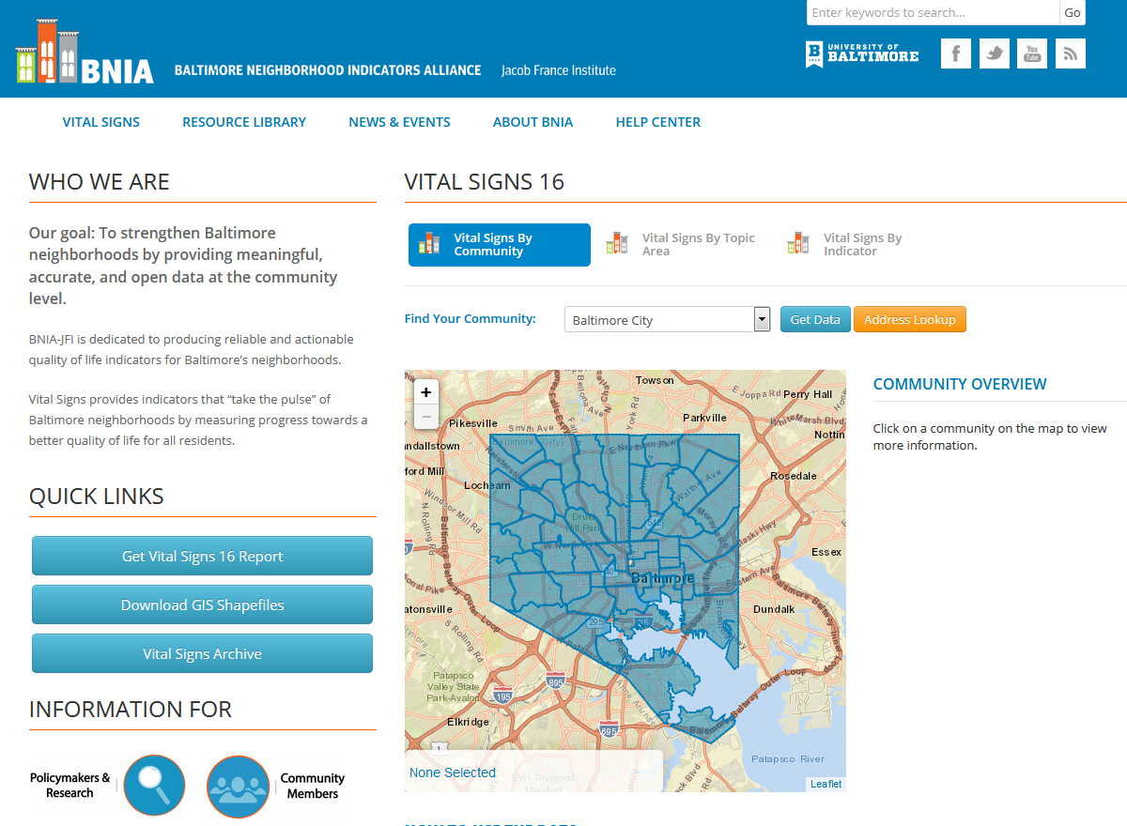
@bniajfi #VitalSigns16
http://www.bniajfi.org

Slide 22
Contact
@bniajfi #VitalSigns16
http://www.bniajfi.org
bnia-jfi@ubalt.edu
@bniajfi Twitter/Facebook

