Slide 1
NNIP Showcase Presentation Northwest Open Data Portal (NODE) and Social Vulnerability Index
Randy Morris Nick Chun

Slide 2
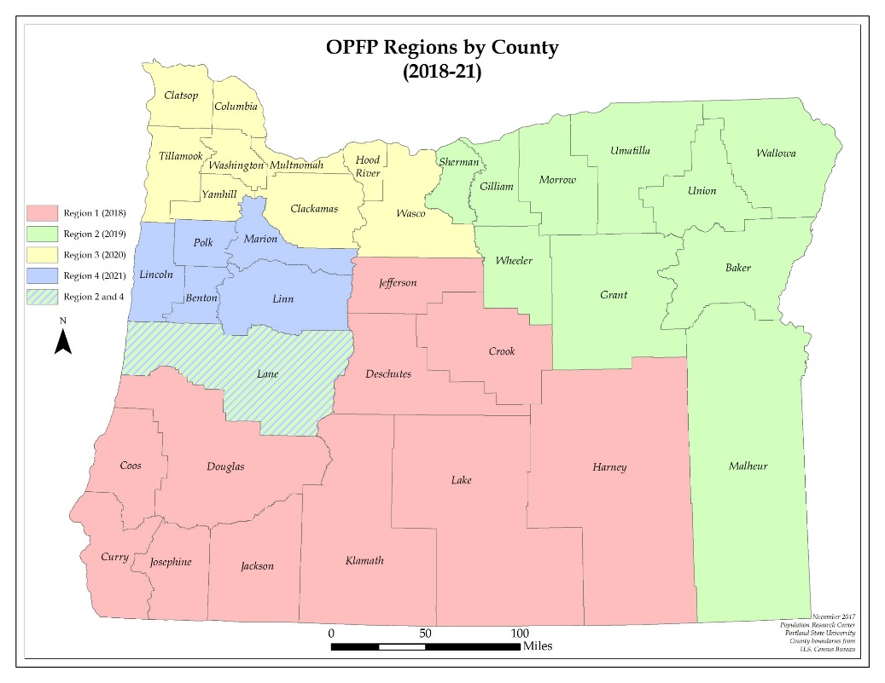
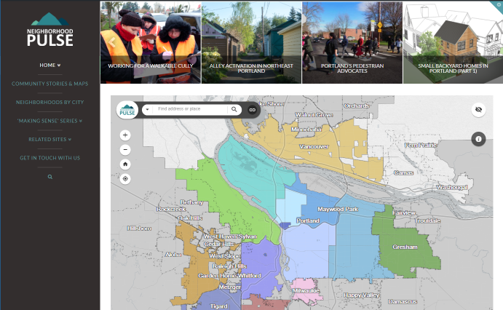
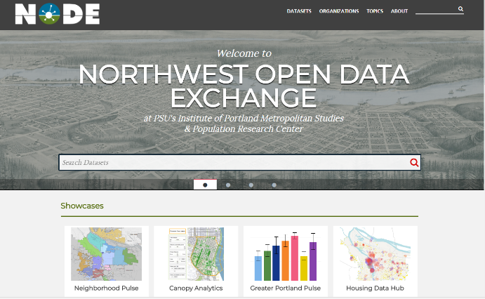
Oregon Population Forecast Program (OPFP)
IMS’Neighborhood Pulse & NODE

Slide 3
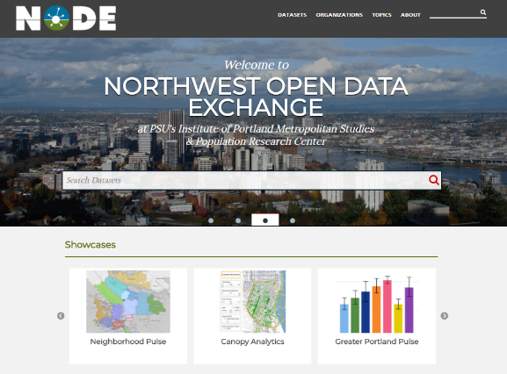
opendata.imspdx.org

Slide 4
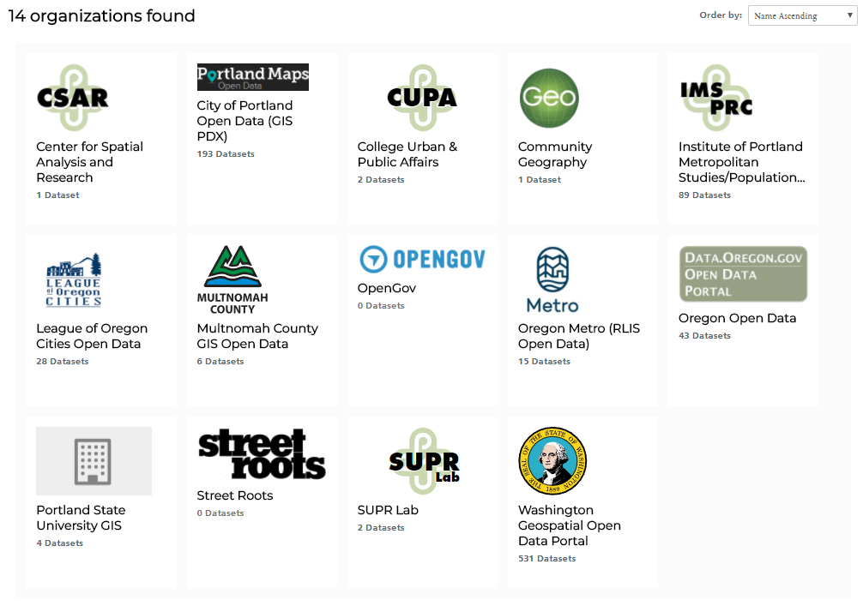
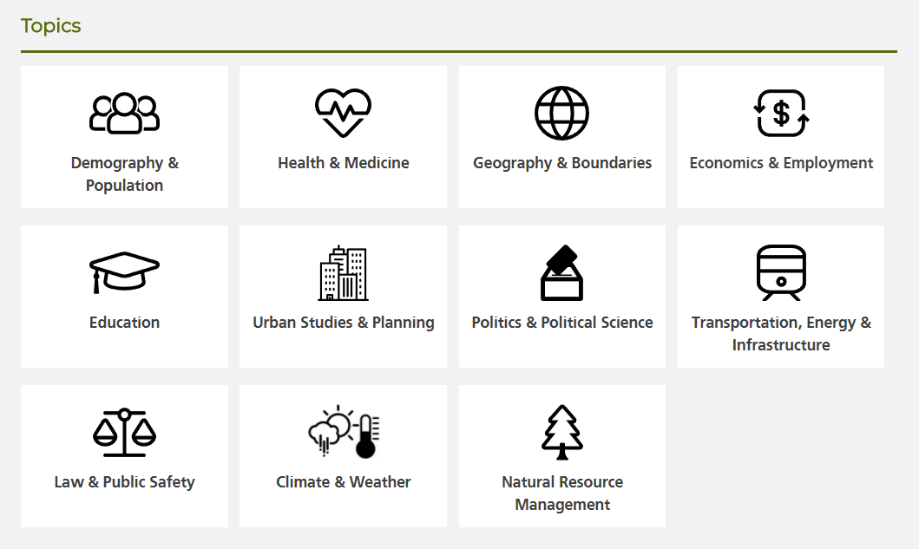
Three-tiered rollout
Internal data organization
University research data sharing
Community open data
Early university partnerships
opendata.imspdx.org

Slide 5
Regional open data harvesting
opendata.imspdx.org

Slide 6
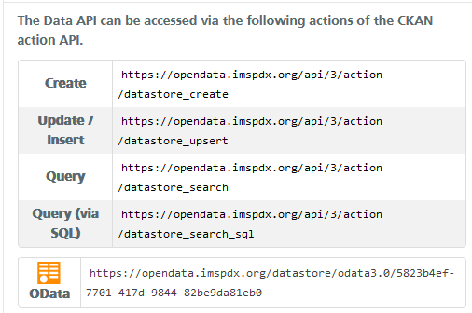
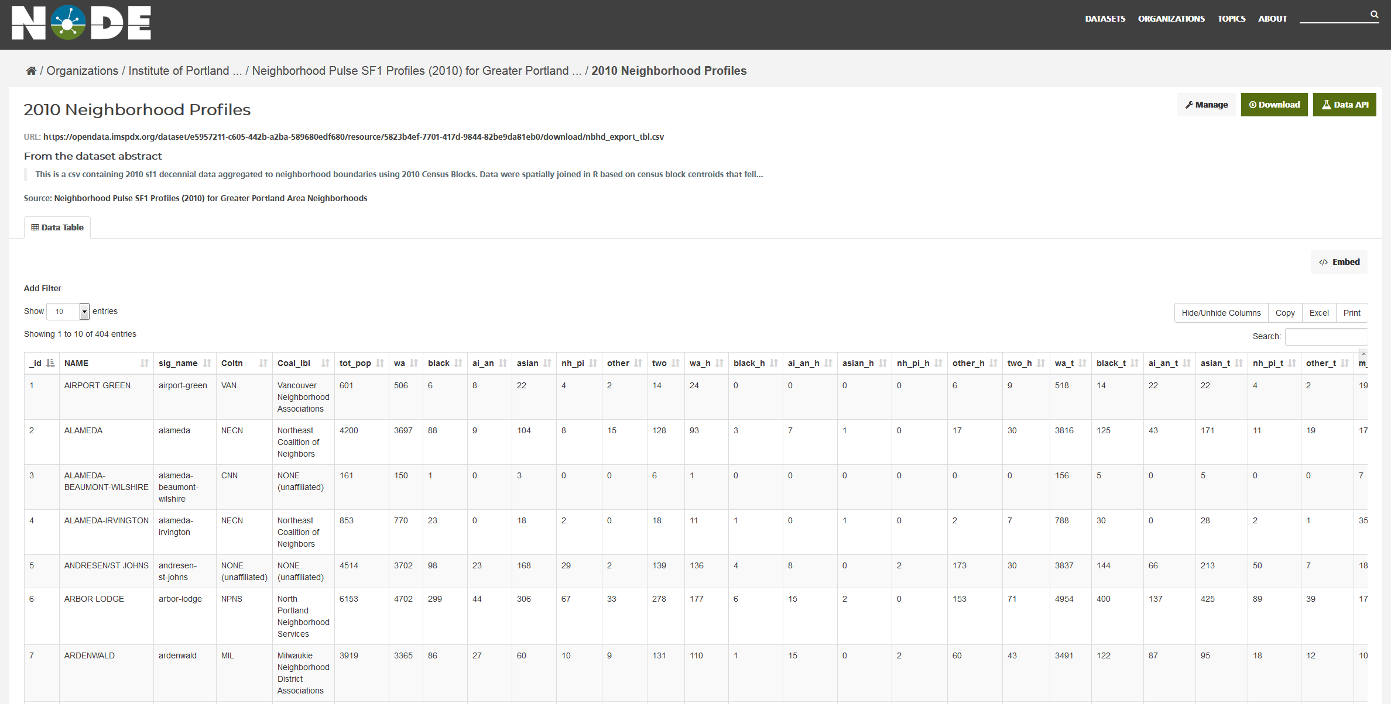

Slide 7
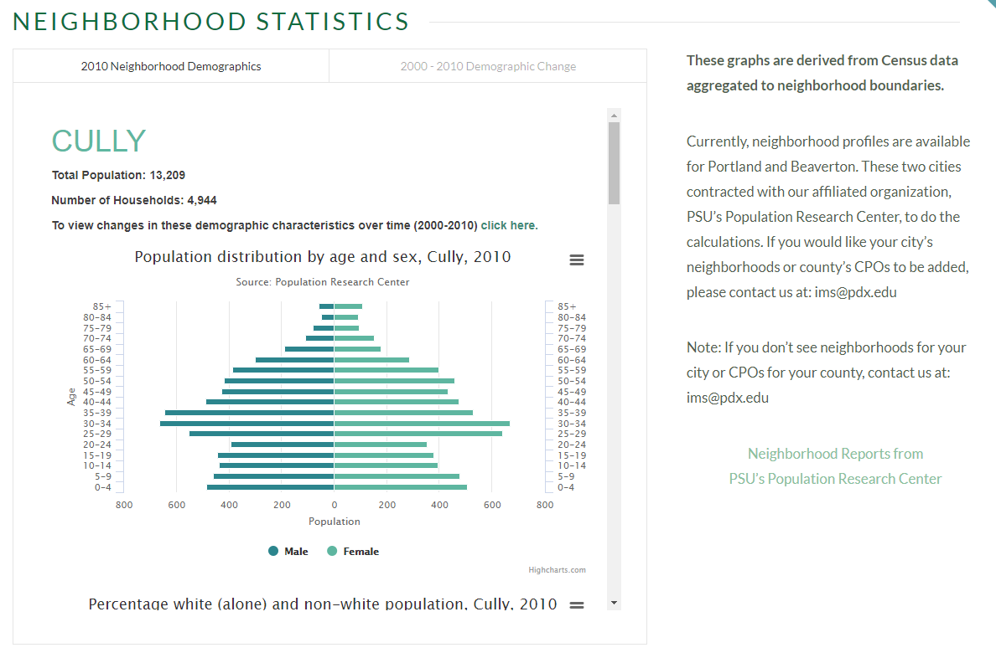
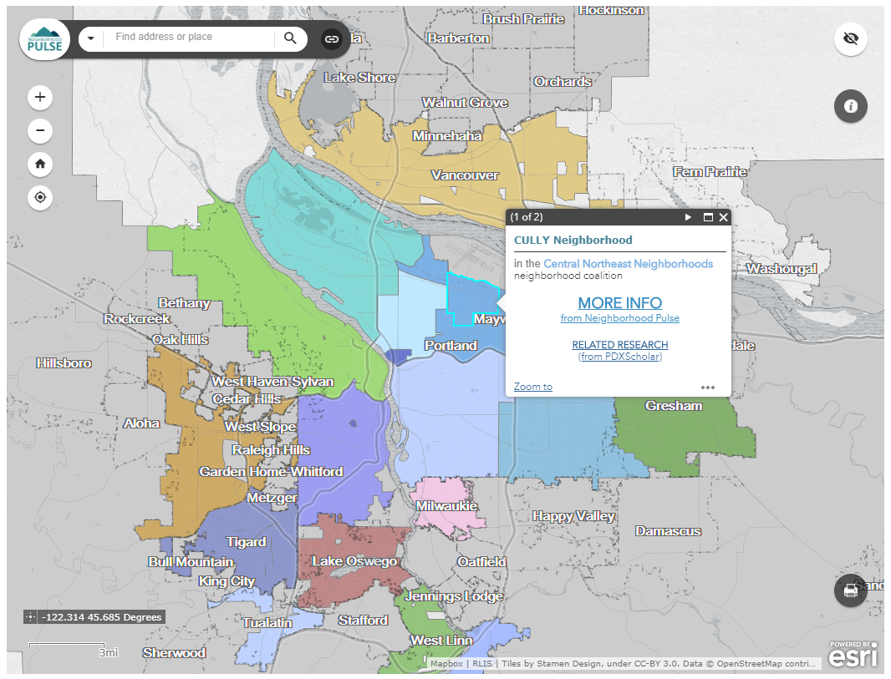
neighborhoodpulse.imspdx.org

Slide 8
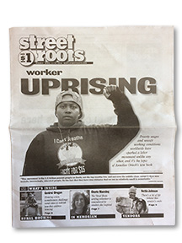
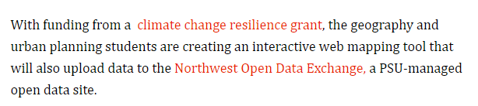

Slide 9
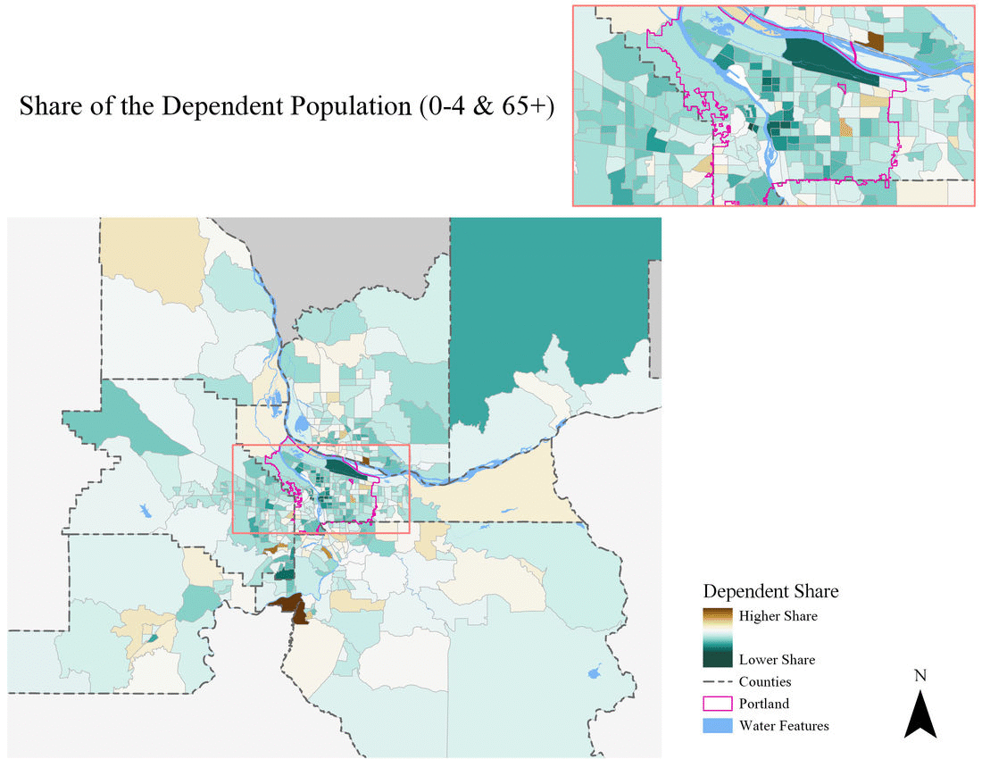
Social Vulnerability Index (SVIs)
A composite variable of 7 socio-economic indicators
Represent an average “rank” of vulnerability
Policy tool for various programs
Goals
Reproducibility
Accessibility
Empowerment

Slide 10
Indicators
Share of the Dependent Population (0-4 & 65+)
Share with a bachelor’s degree (negatively weighted)
Share of the population that is White; Not Hispanic (negatively weighted)
Unemployment rate
Share of the population with a disability
Share of renters that are cost burdened
Share of homeowners that are cost burdened

Slide 11
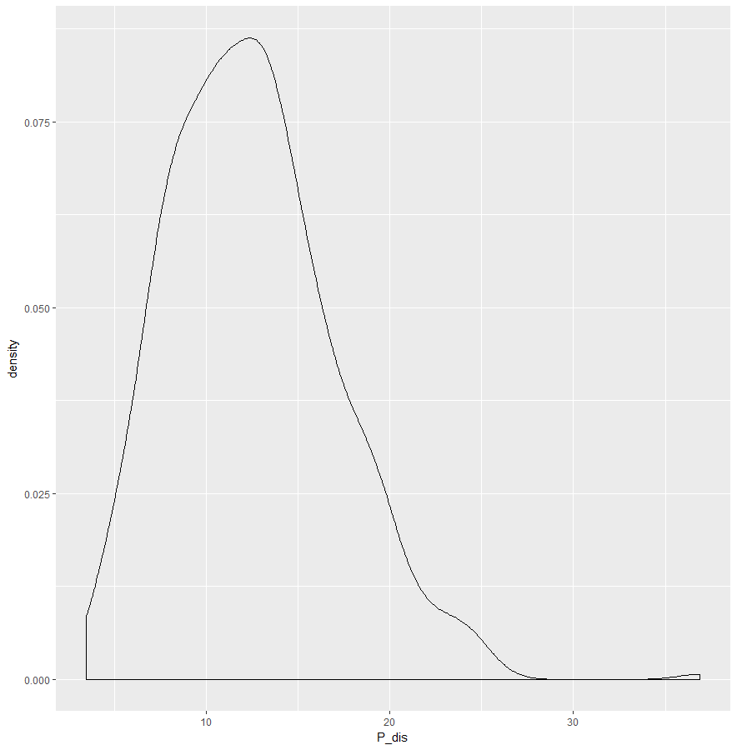
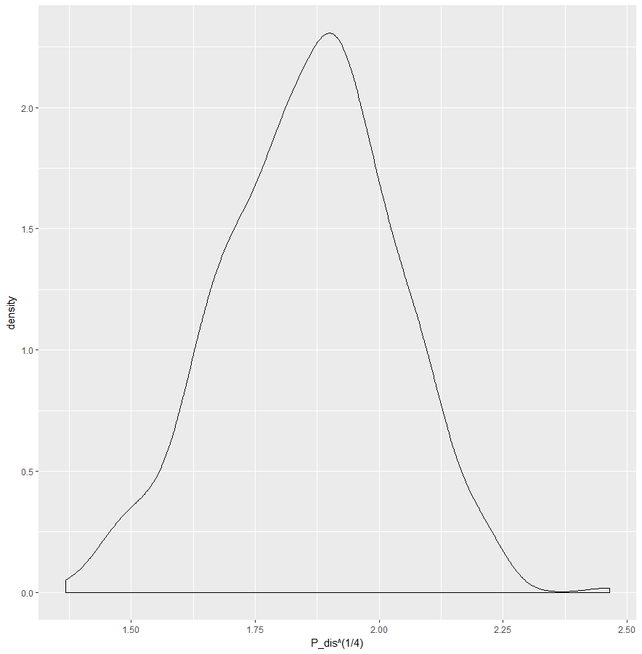
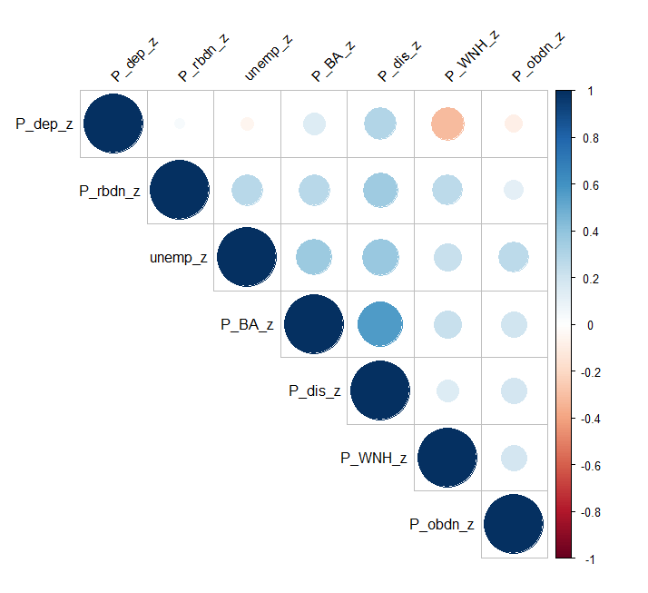
$$z_{i}= \frac{x_{i}−μ}{σ}$$
$$z_{vul}= \frac{\sum_{i=1}^{n}{z_{i}}}{n}$$

Slide 12
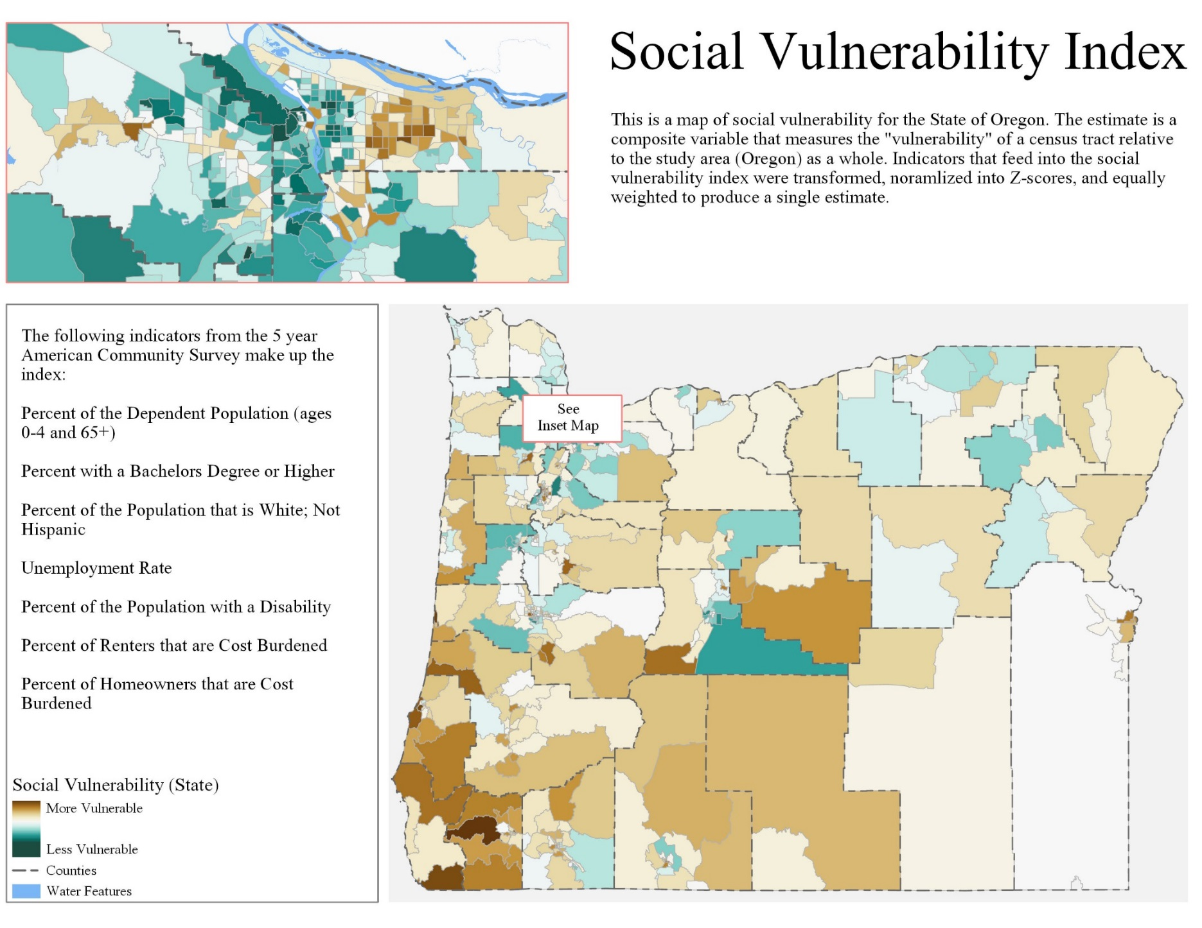

Slide 13
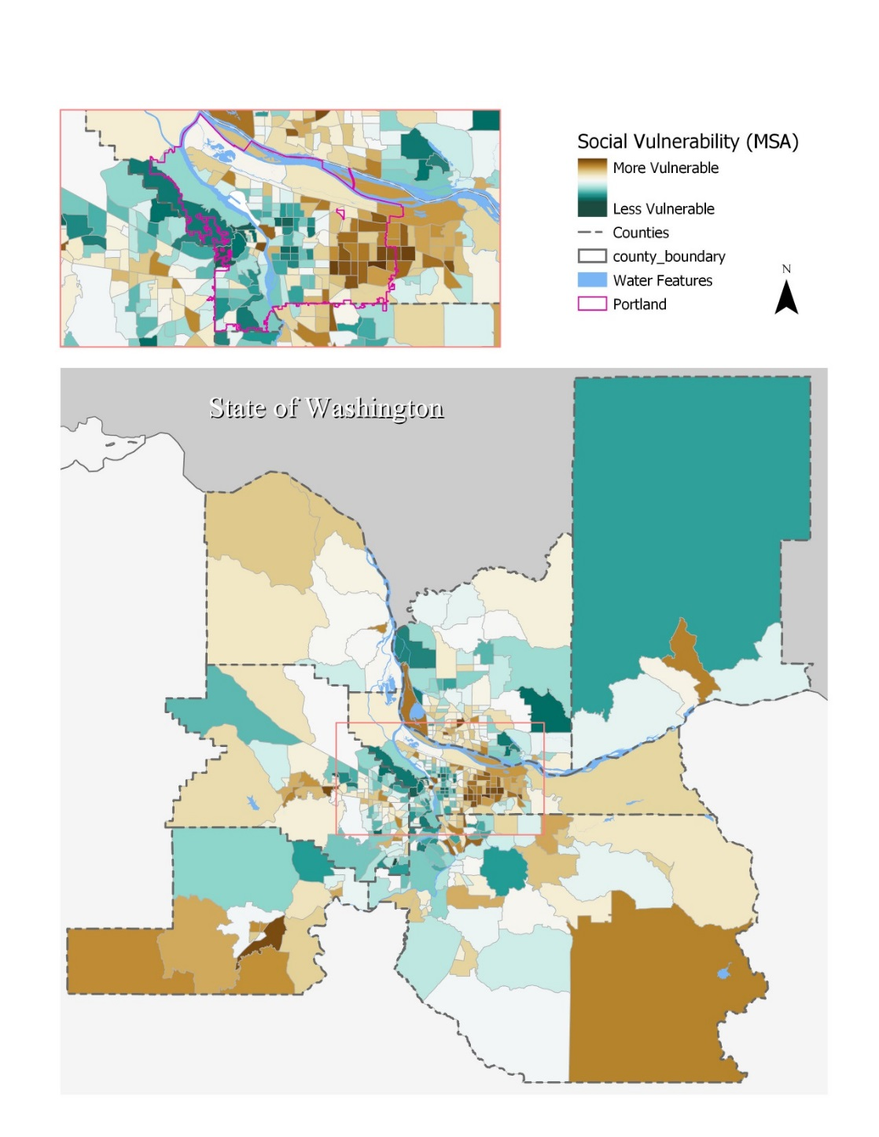
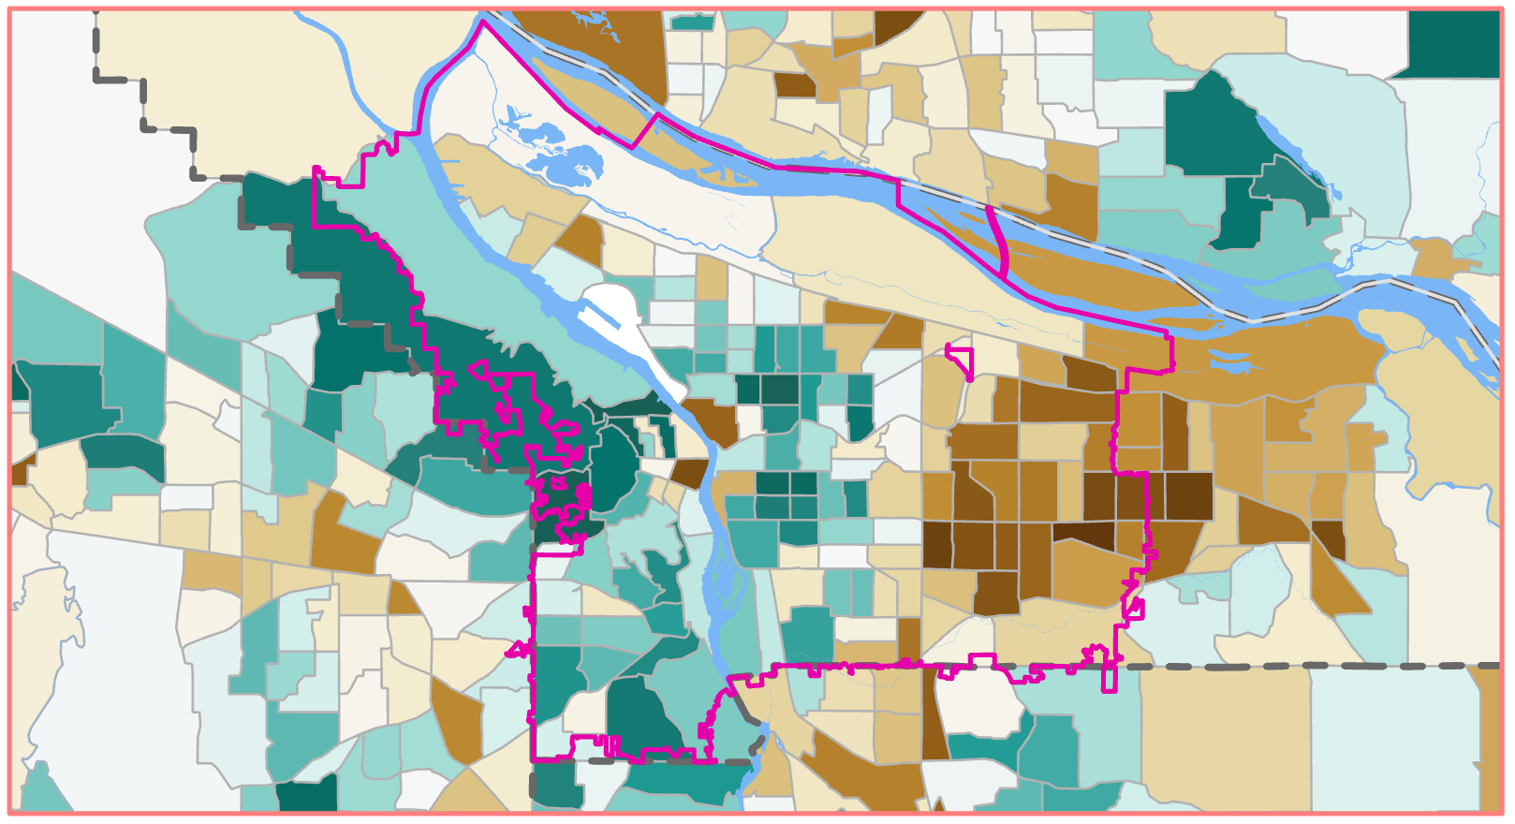

Slide 14
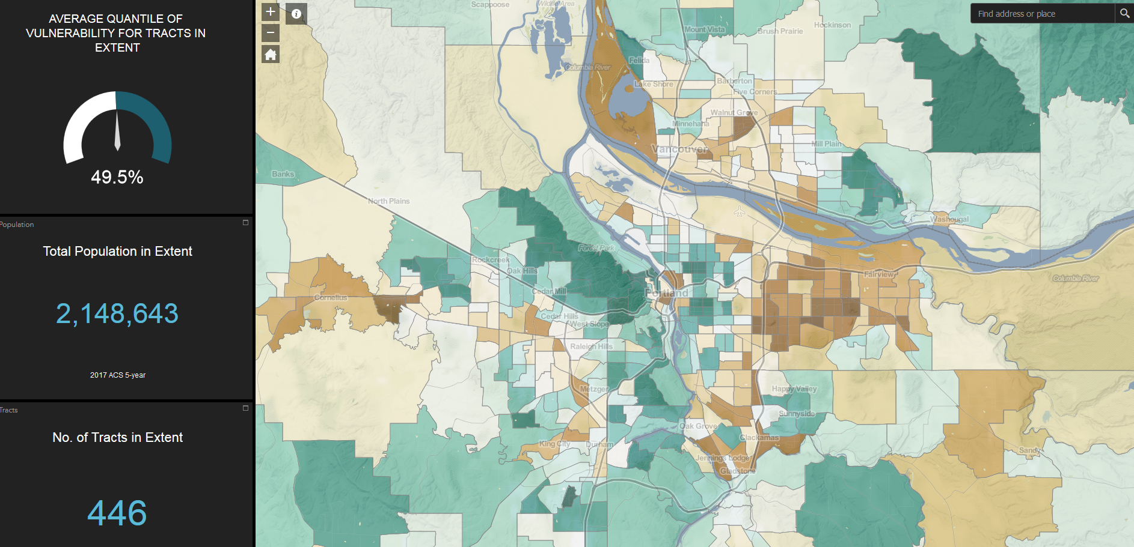
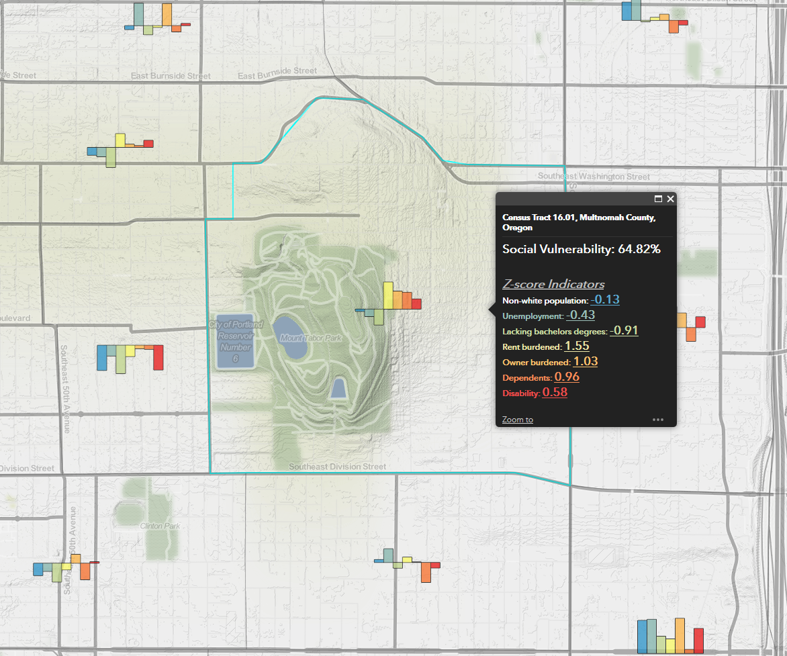
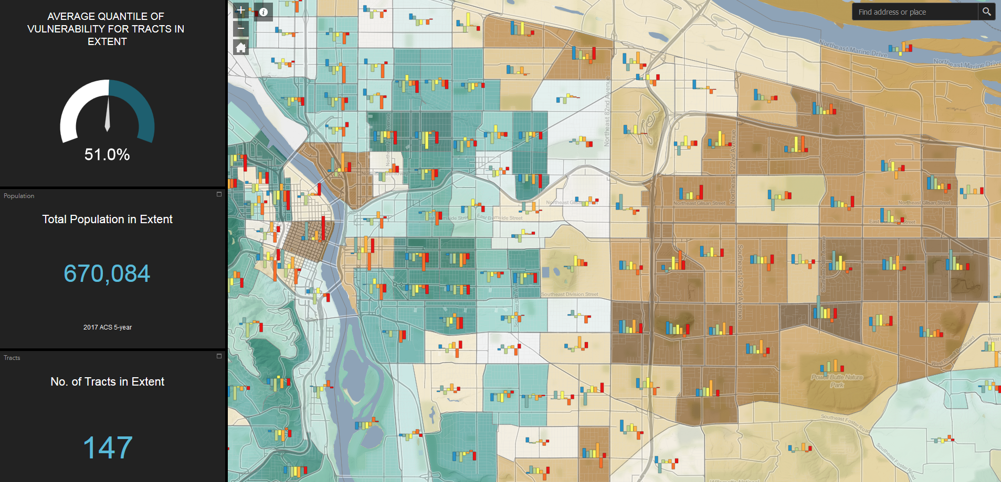

Slide 15
Thank you! Northwest Open Data Portal (NODE) and Social Vulnerability Index
Please feel free to give us any feedback you may have after this session!
Nick Chun
Randy Morris

