Slide 1
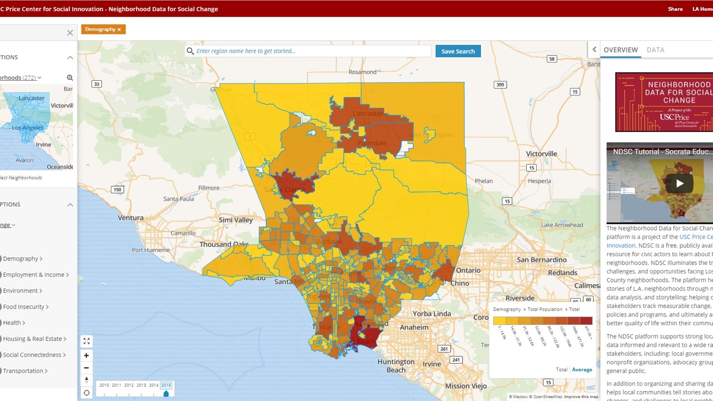
Neighborhood Data for Social Change
Caroline Bhalla, Managing Director

Slide 2
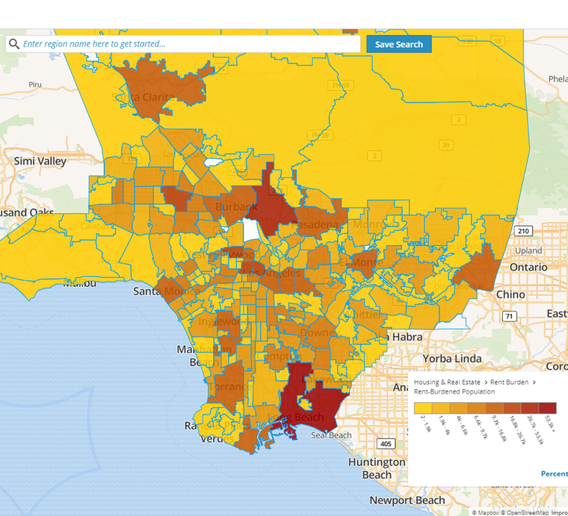
Core Functions of NDSC
Neighborhood & city mapping and navigation
Create your own neighborhood
Learn more about data
Data Stories
www.la.myneighborhooddata.org @NDSC_LA

Slide 3
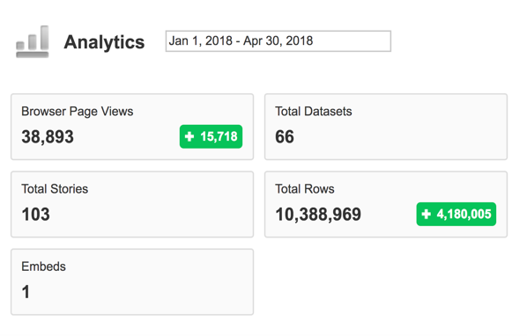
Launch of NDSC

Slide 5
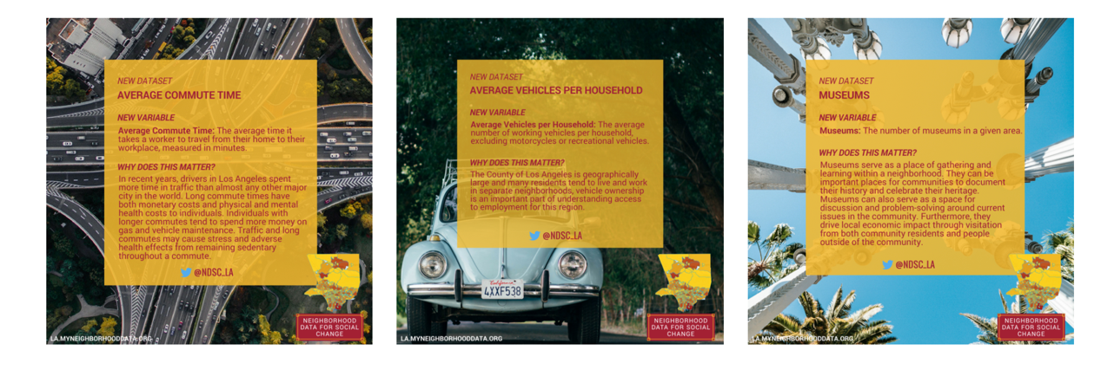
Storytelling with Data
www.la.myneighborhooddata.org @NDSC_LA

Slide 6
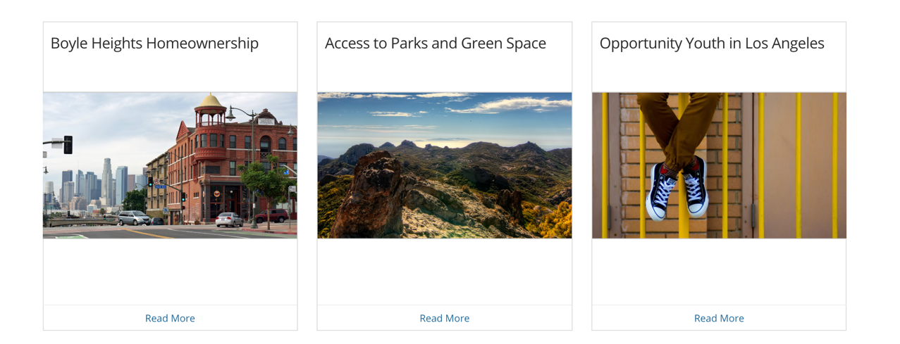
Data Stories
www.la.myneighborhooddata.org @NDSC_LA

Slide 7
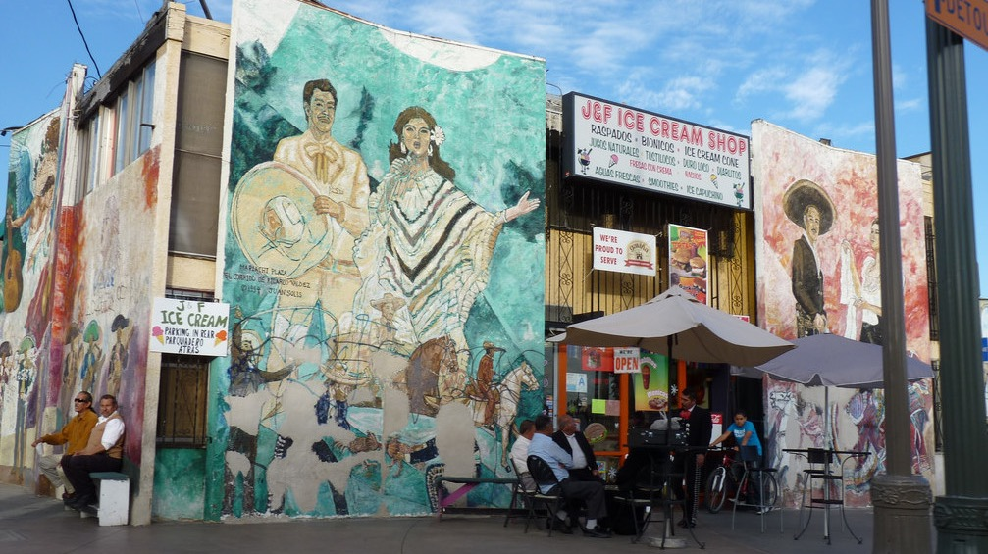
BOYLE HEIGHTS RESIDENTS FACE SIGNIFICANT OBSTACLES TO HOMEOWNERSHIP

Slide 8
OPPORTUNITY YOUTH IN LOS ANGELES

Slide 9
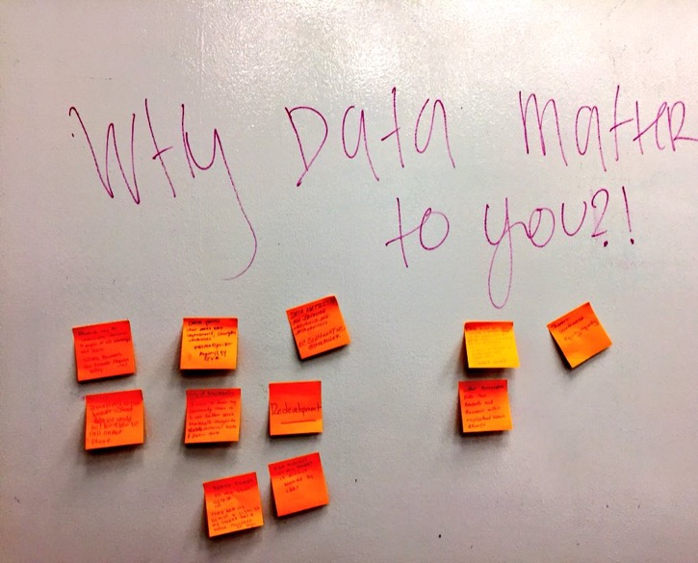
NDSC Community Trainings
Free community training workshops
Participants learn to access data for specific neighborhoods and cities within Los Angeles County
Trainings are held on the 3rd Wednesday of every month, both at USC and at various locations throughout Los Angeles County

Slide 10
Notes:
7 trainings so far

Slide 11
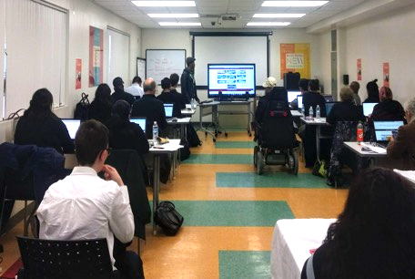
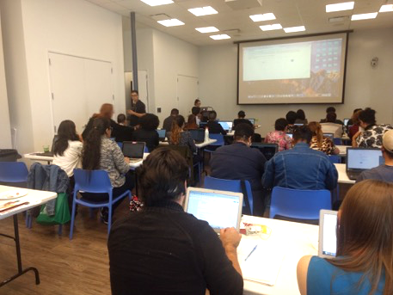

Slide 12
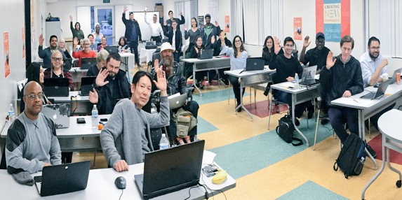
NDSC Partnerships
Partnering for trainings

Slide 13
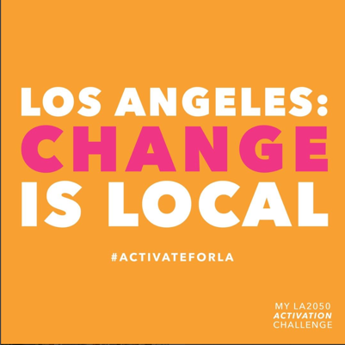
LA 2050 Activation Challenge

Slide 14
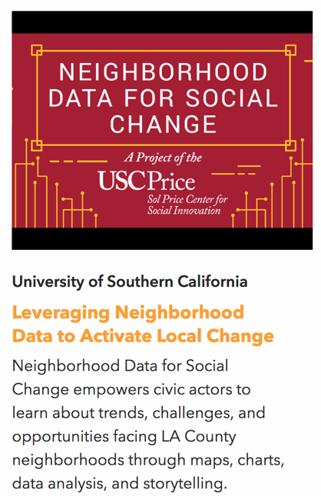
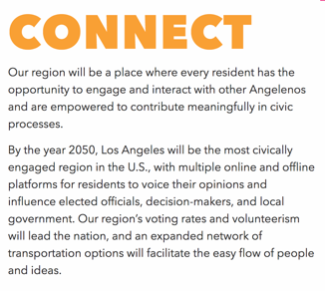

Slide 15
Stay Connected
@NDSC_LA
@PriceSocialInnovation
www.la.myneighborhooddata.org

