Slide 1
AMANI SAFETY INITIATIVE

Slide 2
8739
5221
3488
P E O P L E
R E G I S T E R E D V O T E R S
H O U S I N G U N I T S
WHAT WE KNOW ABOUT
A M A N I
274
212
32
3 0 - 6 0 - 9 0 D A Y P L A N
V A C A N T
P R O P E R T I E S
R E S I D E N T S W I T H A B A C H E L O R S
D E G R E E
F A I T H - B A S E D O R G A N I Z A T I O N S
6
2
S C H O O L S
P A R K S
S E T T A R G E T S

Slide 3
8739
5221
3488
P E O P L E
R E G I S T E R E D V O T E R S
H O U S I N G U N I T S
WHAT WE KNOW ABOUT
A M A N I
274
212
32
3 0 - 6 0 - 9 0 D A Y P L A N
V A C A N T
P R O P E R T I E S
R E S I D E N T S W I T H A B A C H E L O R S
D E G R E E
F A I T H - B A S E D O R G A N I Z A T I O N S
6
2
S C H O O L S
P A R K S
S E T T A R G E T S

Slide 4
PART 1 CRIME: AMANI JAN 1 - DEC 31ST, 2007-2017
1,500
1,403
WHAT DOES
THE CRIME DATA SAY?
1,255
1,128
1,148
1,125
1,246
1,179
1,116
985
985 809
890
754
750
Overall crime is down
But there has been a 24% increase in aggravated assault
375
And nearly 40% of the aggravated assaults are domestic violence related
0
2007 2008 2009 2010 2011 2012 2013 2014 2015 2016 2017
10 yr average
Total Part 1 Crime

Slide 5
30th Street Industrial Corridor Amani United
Community Advocates 53206 Drug Free Initiative
COA Youth &Family Center Data You Can Use, Inc.
Dominican Center Hepatha Lutheran LISC Milwaukee
Milwaukee Police Department Milwaukee County District Attorney's Office
Safe & Sound Inc.
Sojourner Family Peace Center
Who are
the Partners in
Amani?

Slide 6
% of the Population African American?
# of Burglaries
Total Population?
# of Owner Occupied Units?
% of housing stock built in 1939 or earlier?
# of schools?
# of Liquor Licenses?
# of Registered voters?
% living below the poverty level
# of Homicides
# of Faith-Based Organizations
What’s Your Best Guess?

Slide 7
MILWAUKEE POLICE DEPARTMENT - AMANI GEO-BOUNDARY VIOLENT CRIME DENSITY - JAN. 1ST TO DEC. 31ST 2015-2017
WHAT ARE HOT SPOTS?
CONCENTRATED VIOLENT
CRIME

Slide 8
What was the purpose of the survey?
To learn what residents of the Amani neighborhood think about:
Neighborhood conditions
Crime and Safety
Police legitimacy
To collect baseline data on important issues to see if things change over time

Slide 9
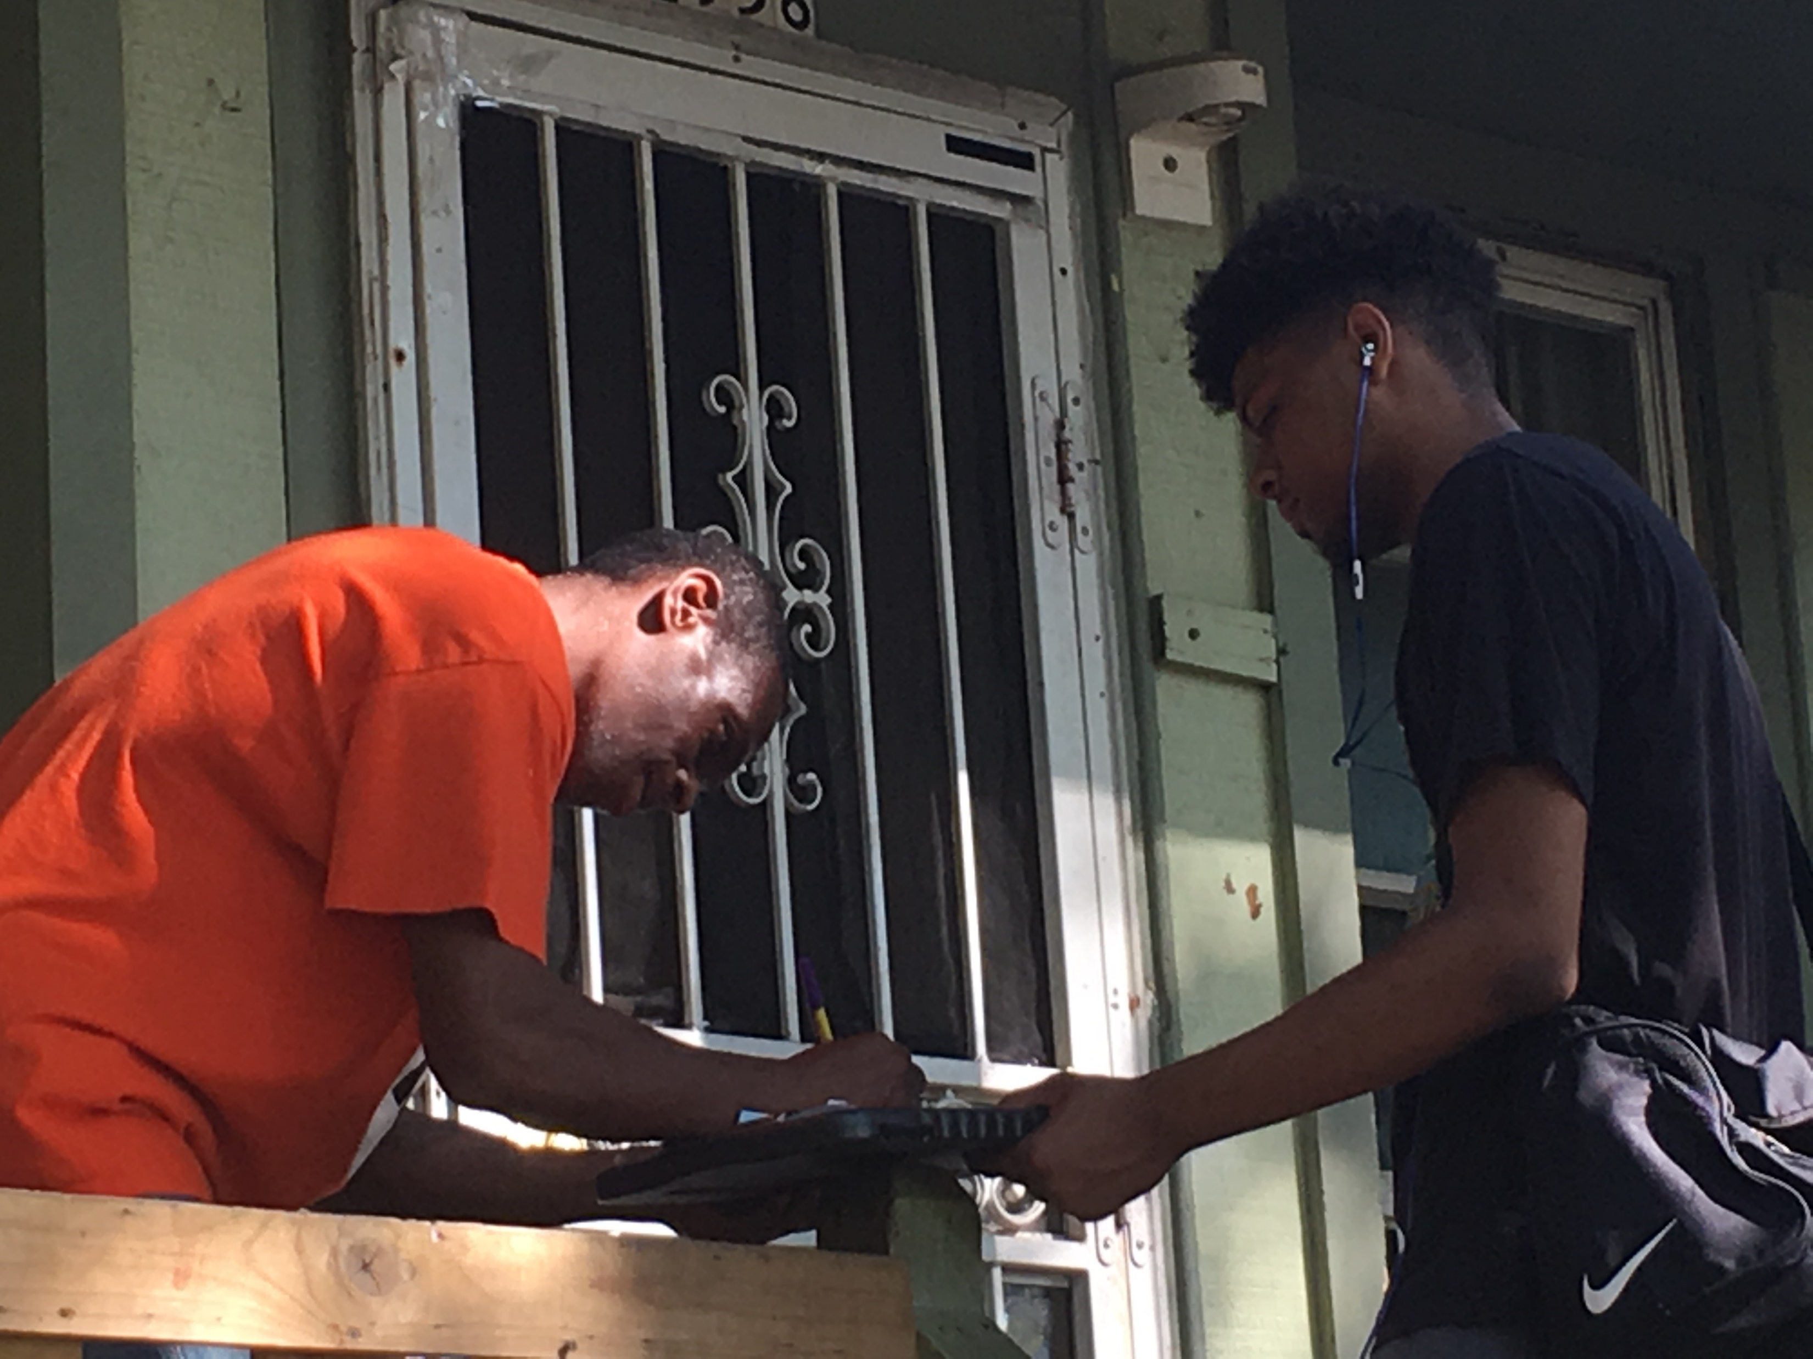
Who conducted the survey?
Neighborhood Ambassadors
Volunteer Residents and Partners
Community organizers

Slide 10
Who responded to the survey?
4 5 %
long-time residents (more than 10 years)
3 6 %
living less than 3 years in Amani
1 3 %
age 16-24
5 9 %
age 25-54
2 7 %
over age 55

Slide 11
% of Amani residents concerned about
92
SPEEDING AND RECKLESS DRIVING
78
LETTING CHILDREN GO OUT AT NIGHT
87
RUNNING RED LIGHTS AND STOP SIGNS
78
SHOOTINGS IN THE NEIGHBORHOOD
52
ROBBERY IN THE NEIGHBORHOOD
62
DRUG DEALERS IN THE NEIGHBORHOOD

Slide 12
WHAT ABOUT TRAFFIC SAFETY?
2017
TRAFFIC CRASHES

Slide 14
KNOW DATA KNOW CHANGE

Slide 15
Amani Data Chat Check List-- Work with Britney to schedule data chat and recruit participants. Britney’s contact info is Conduct the data chat as a stand-alone, a pop-up or in conjunction with another event. Become familiar with the slides and the data – what do YOU think is most interesting? Get materials ready Large Map of Amani Hot Spot lay-overs 3 Poster boards and Laminated data sheets Choose slides of interest and arrange on board (slides are numbered on the back) Post-it notes for ideas Summary of Amani Survey sheets “What’s YOUR priority” sheets Signup sheet for people who want to receive more information Pens/pencils Candy (optional but good) Safety Signs—Slow Down Maps of Amani -- paper size You’ll need a table and 2-3 easels to hold boards. Binder with full survey results Please be sure to return all slides to Britney. Amani data chat checklist

Slide 16
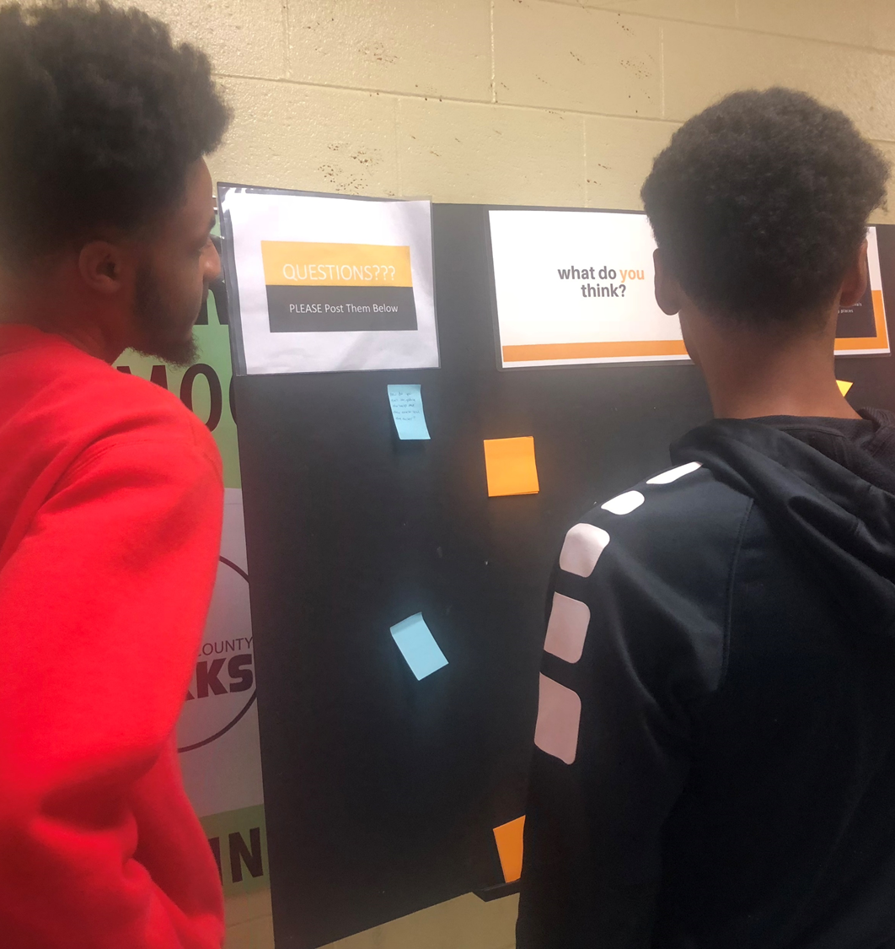
Where do you stay?

Slide 17
What do you think?

Slide 18
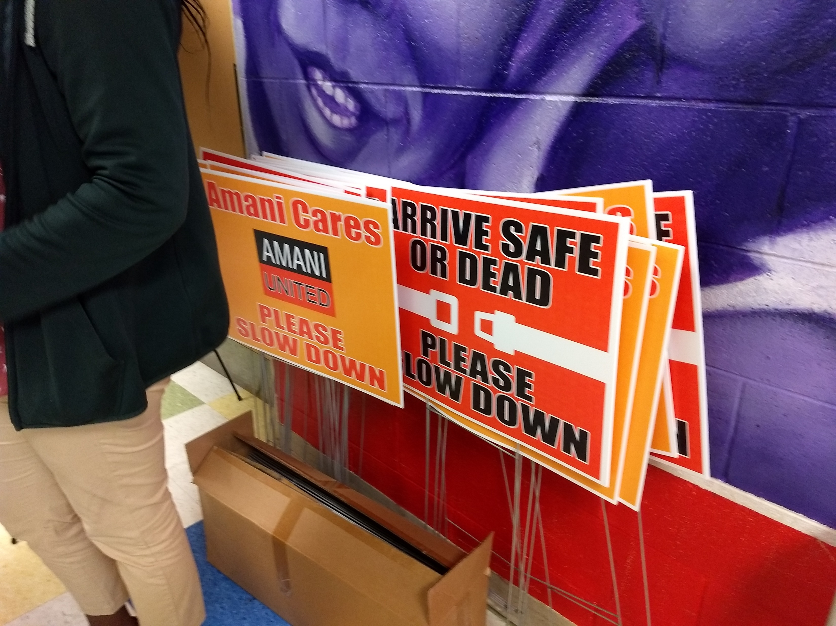

Slide 19
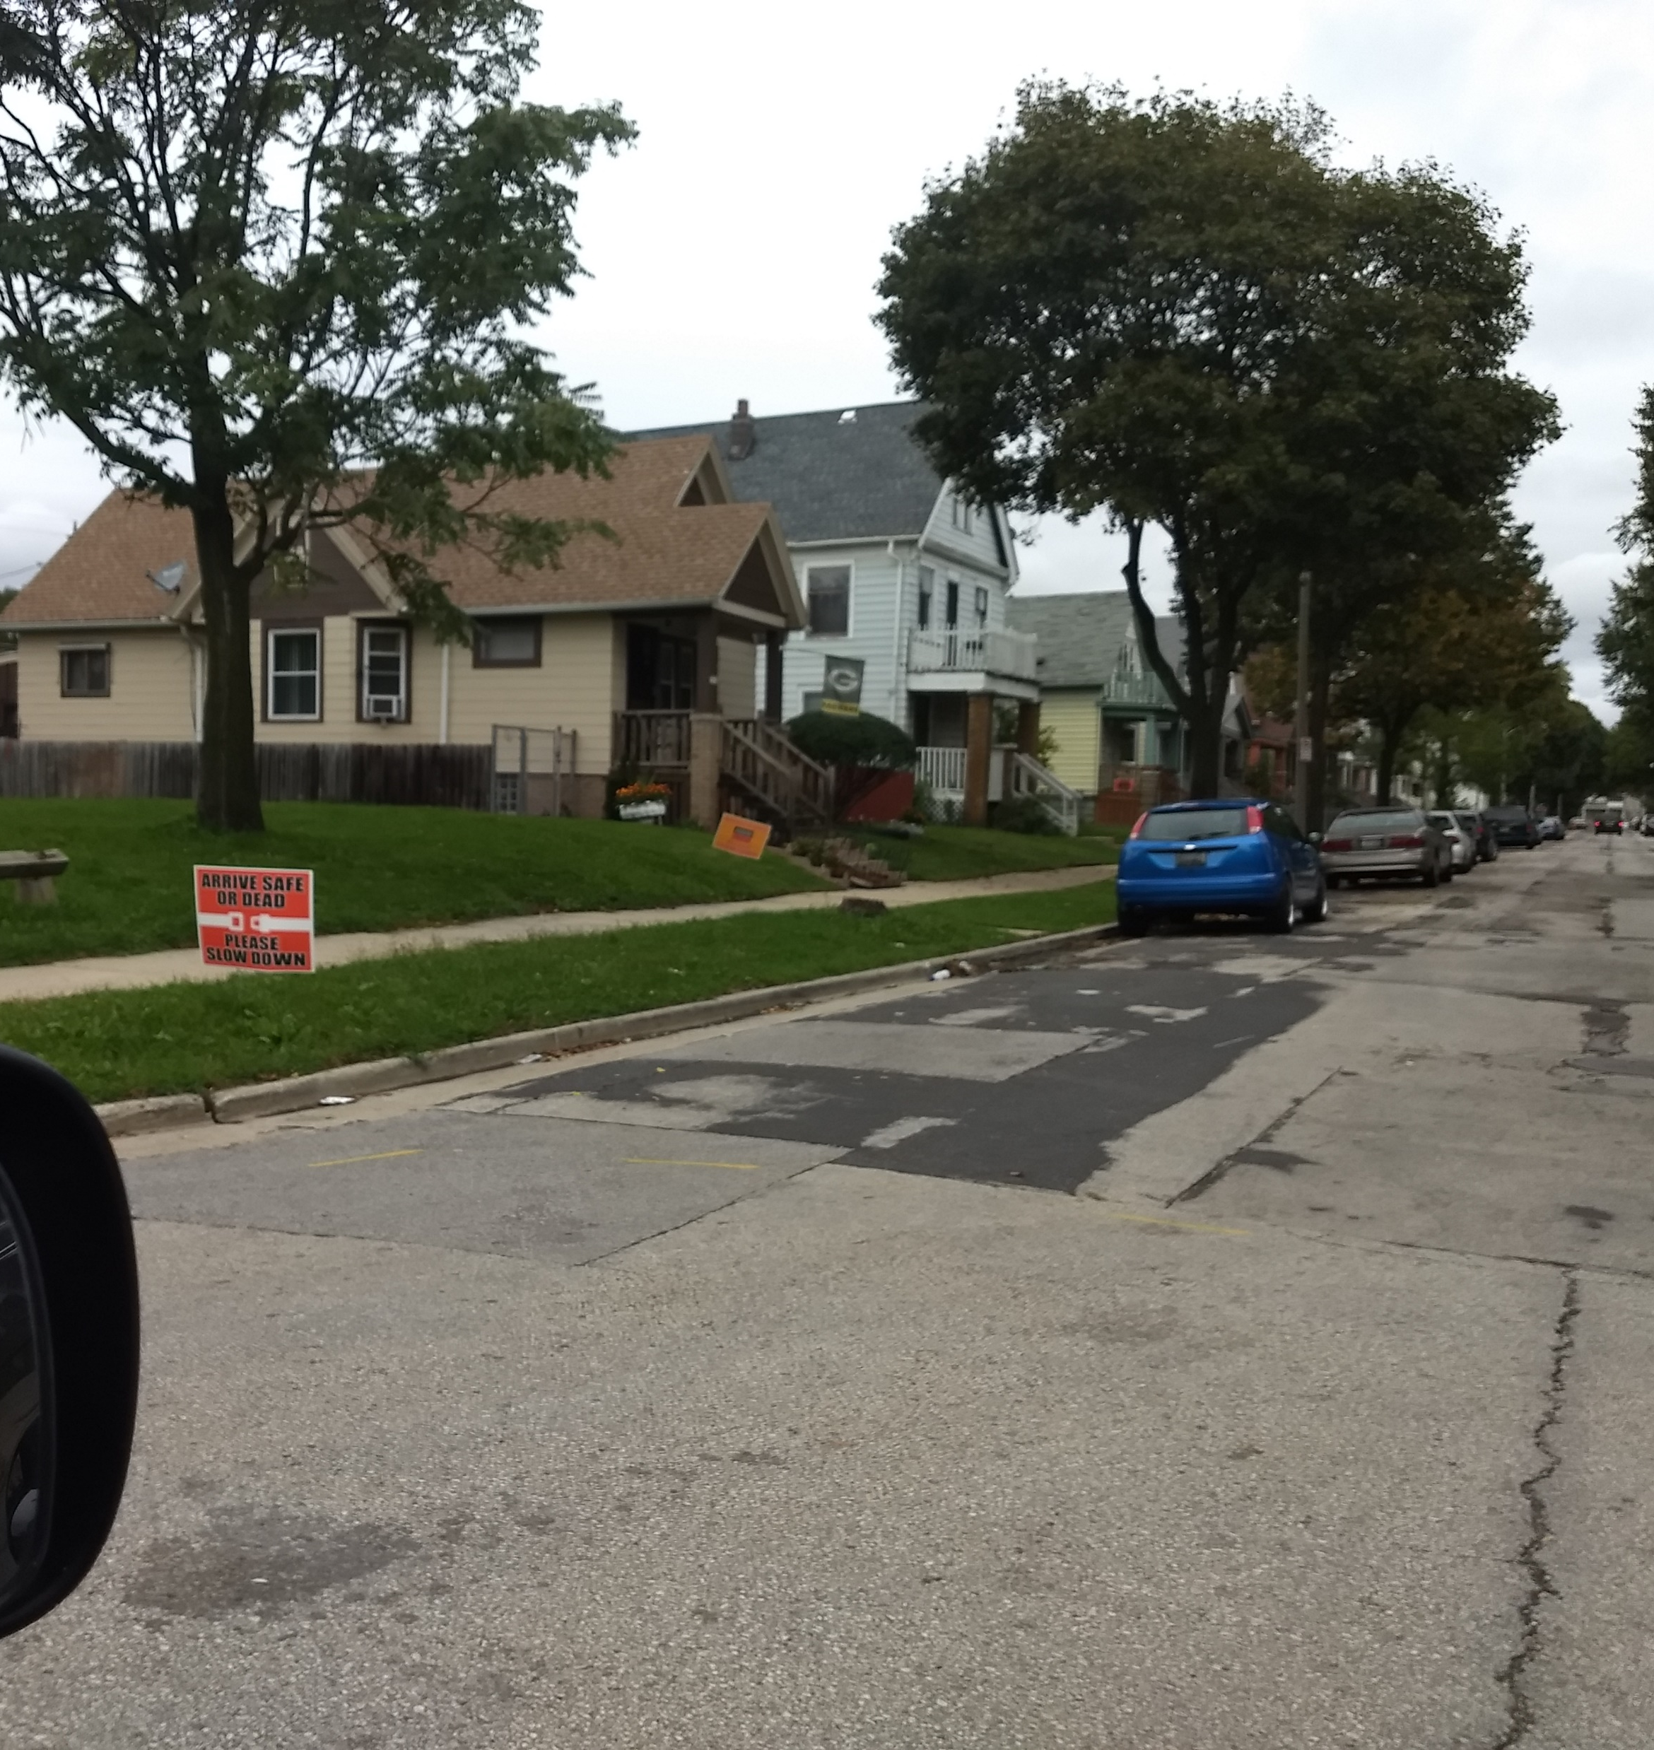
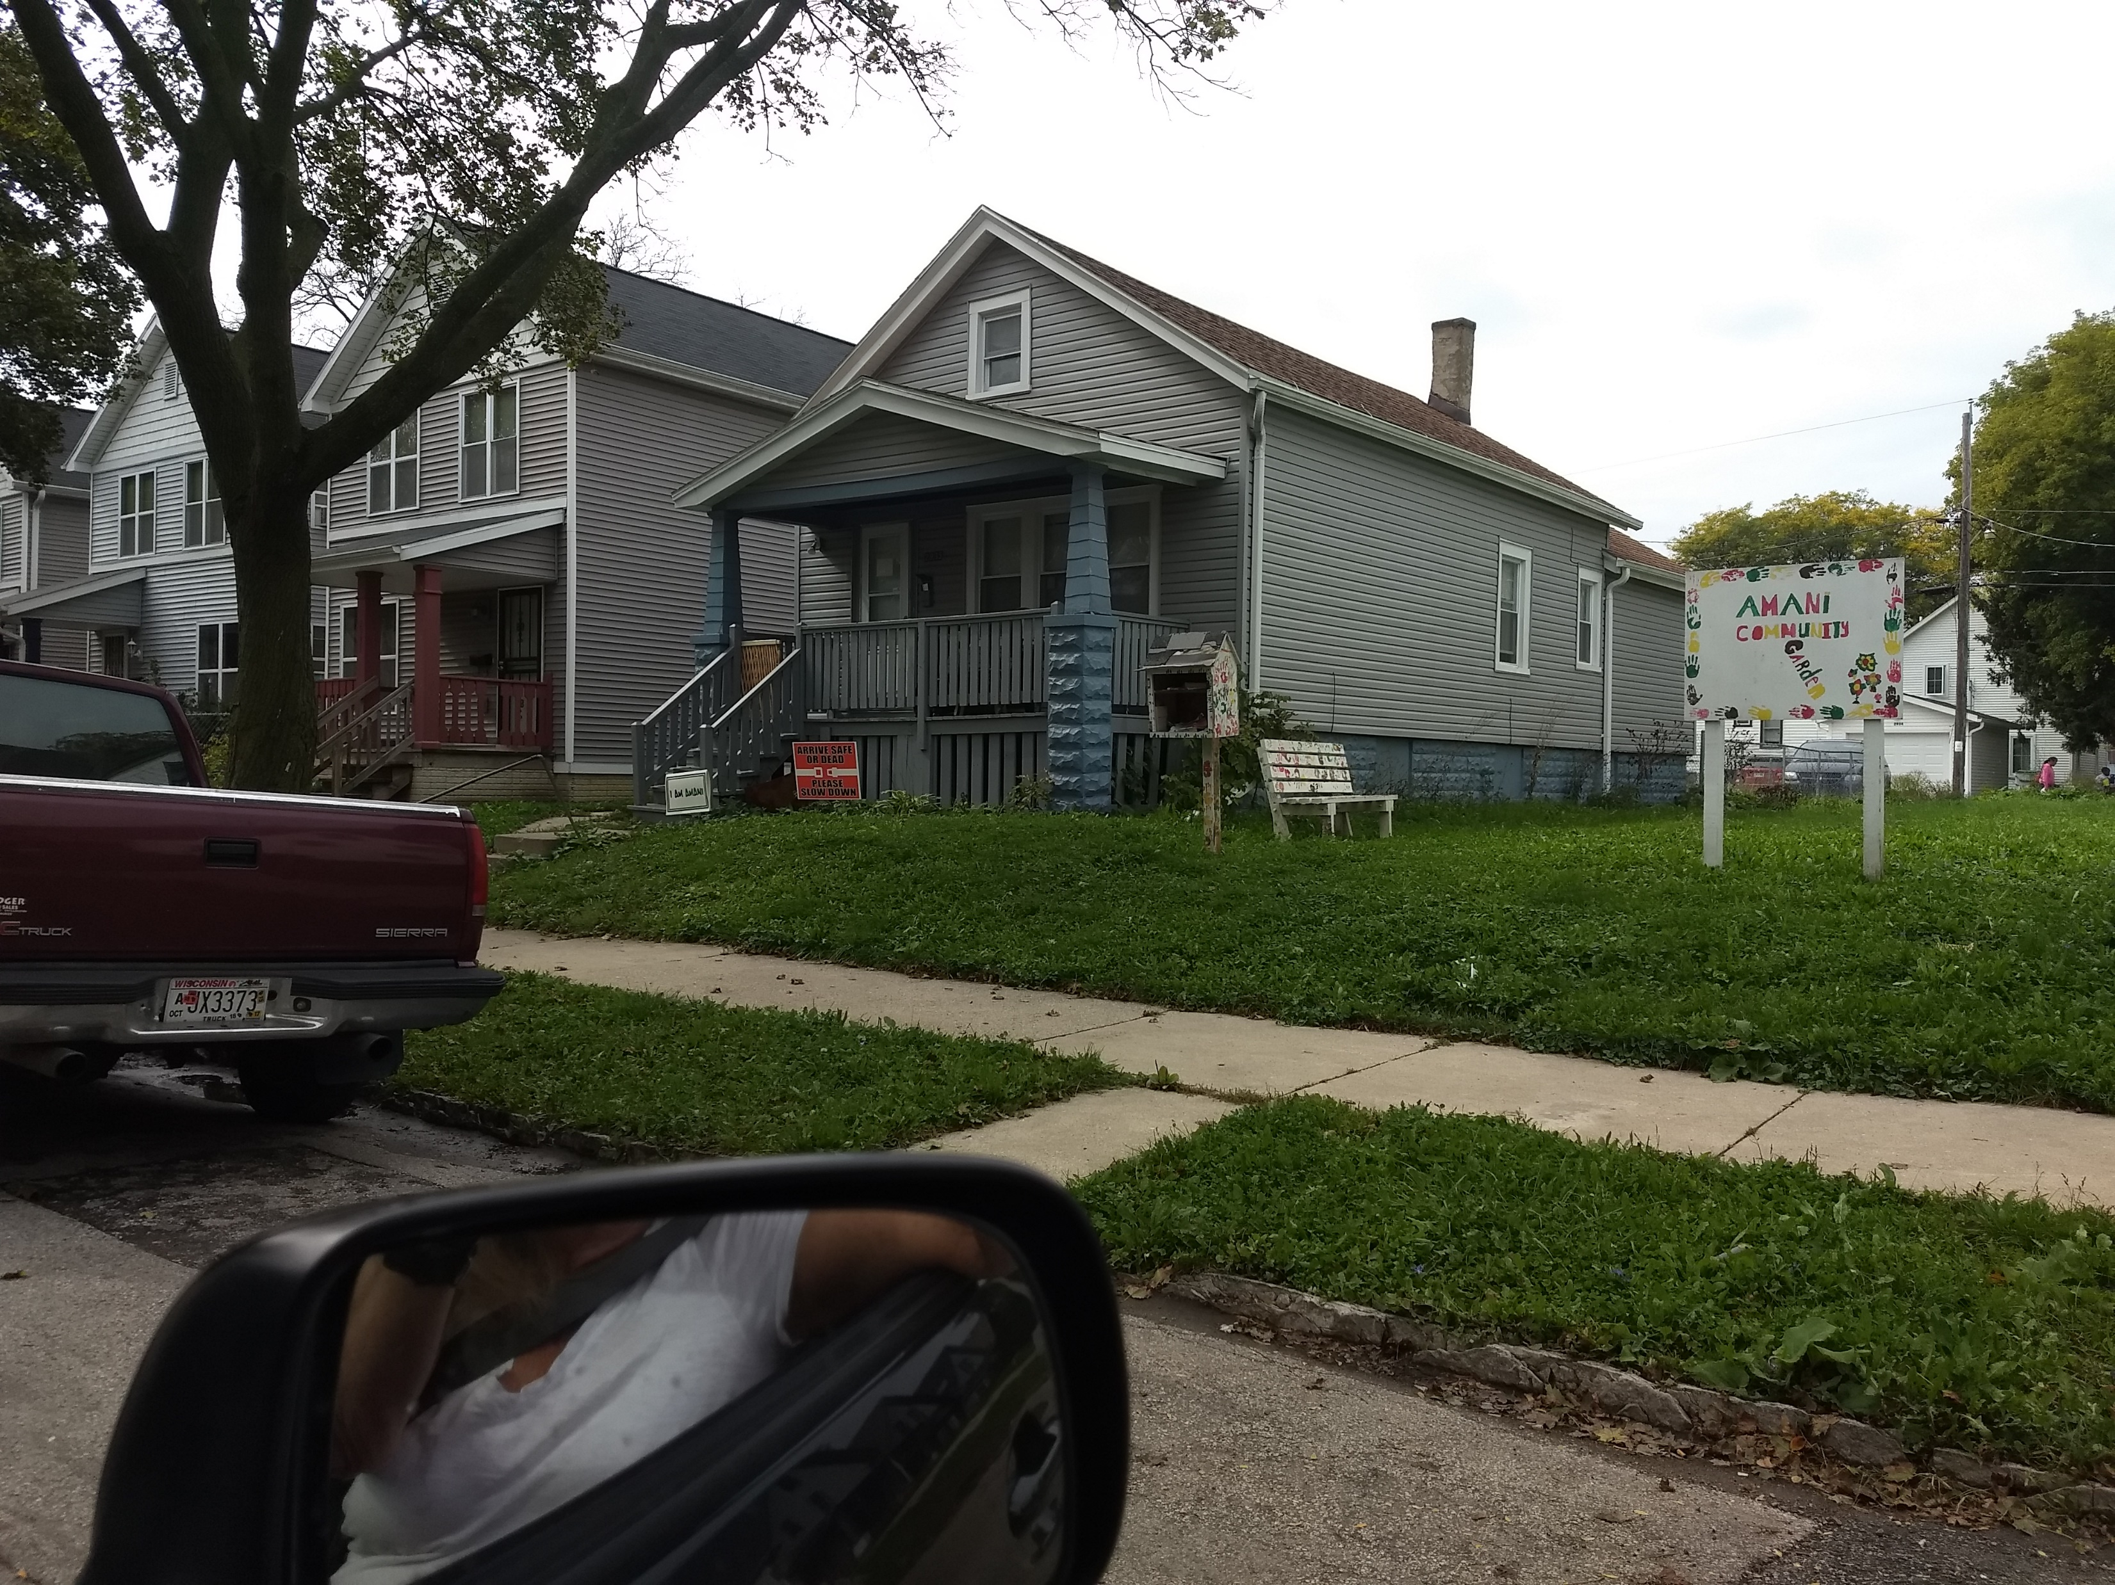
Early Action--Slow Down Signs
Next Up–
Data Chat Pop-Ups in the Hot Spots

Slide 20
Thanks
To the people and partners of Amani
Carrie Koss Vallejo, Gerardo Mares, Cassandra Leopold
Link to the avatars
Link to the survey itself
Questions?? Katie@DataYouCanUse.org

