Slide 1
Data Guides for Data
Beyond Metadata
Bob Gradeck
October, 2018

Slide 2
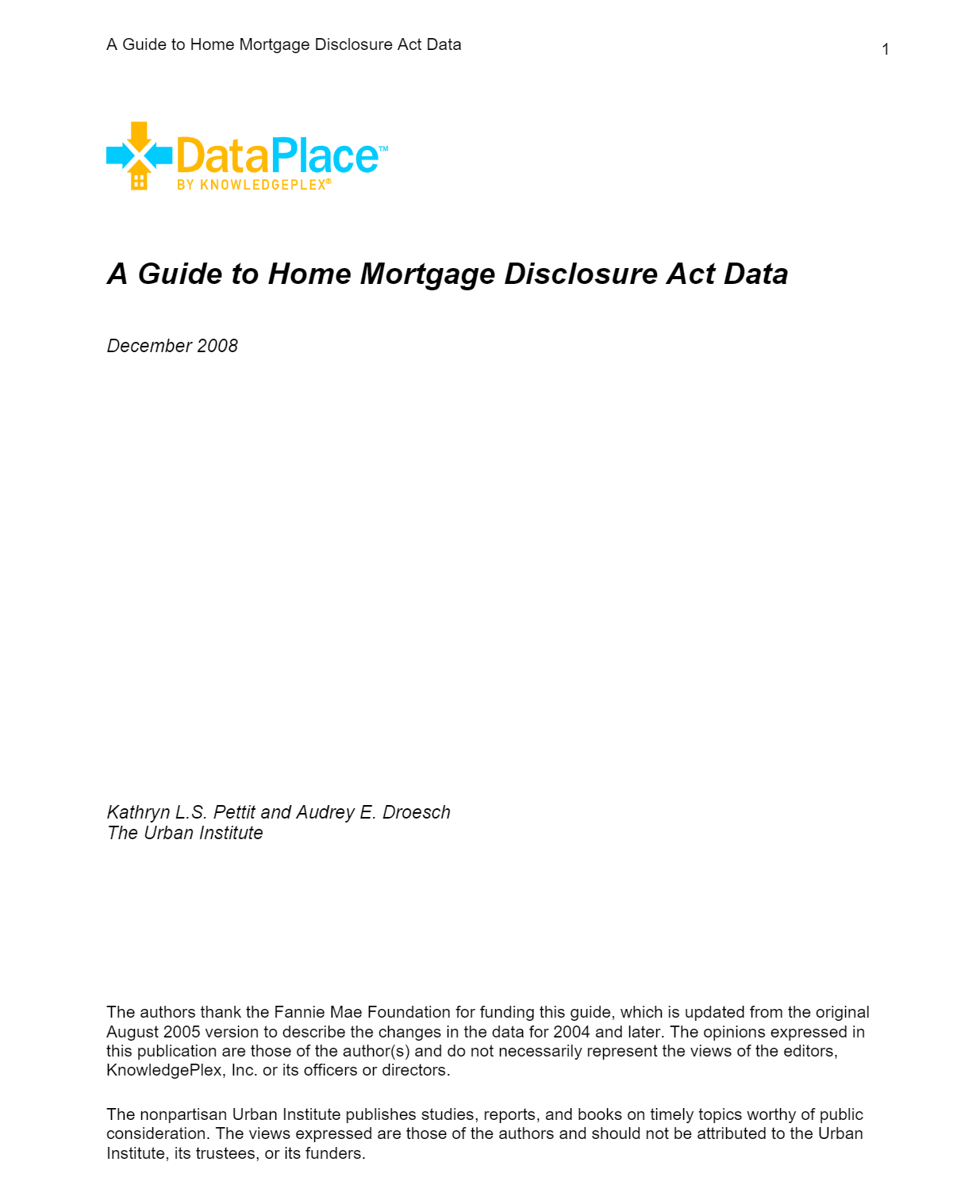
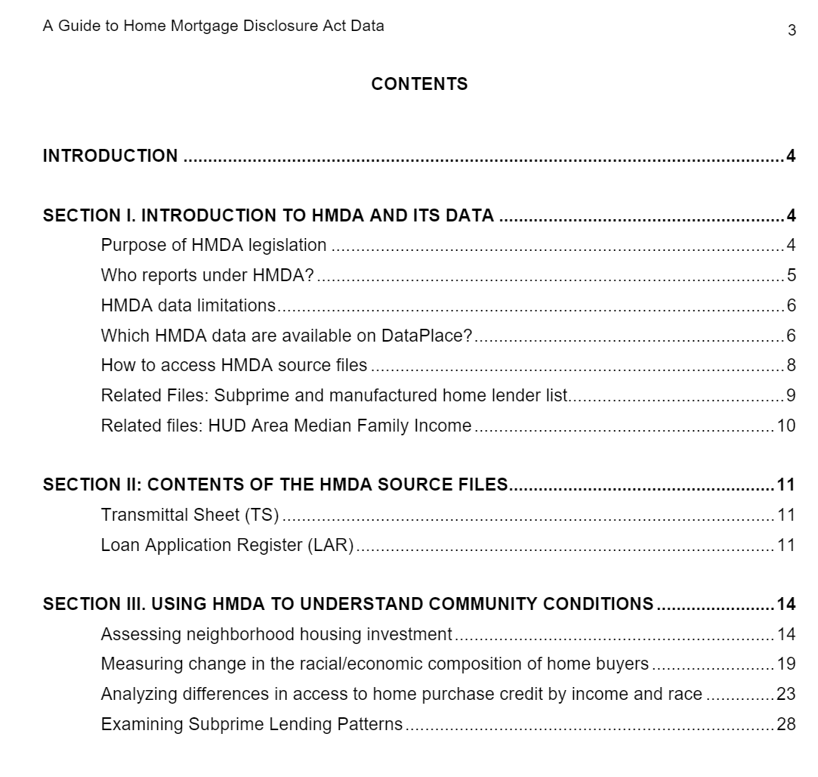
Notes:
“A Guide to Home Mortgage Disclosure Act Data”, The Urban Institute, https://www.urban.org/research/publication/guide-home-mortgage-disclosure-act-data

Slide 3
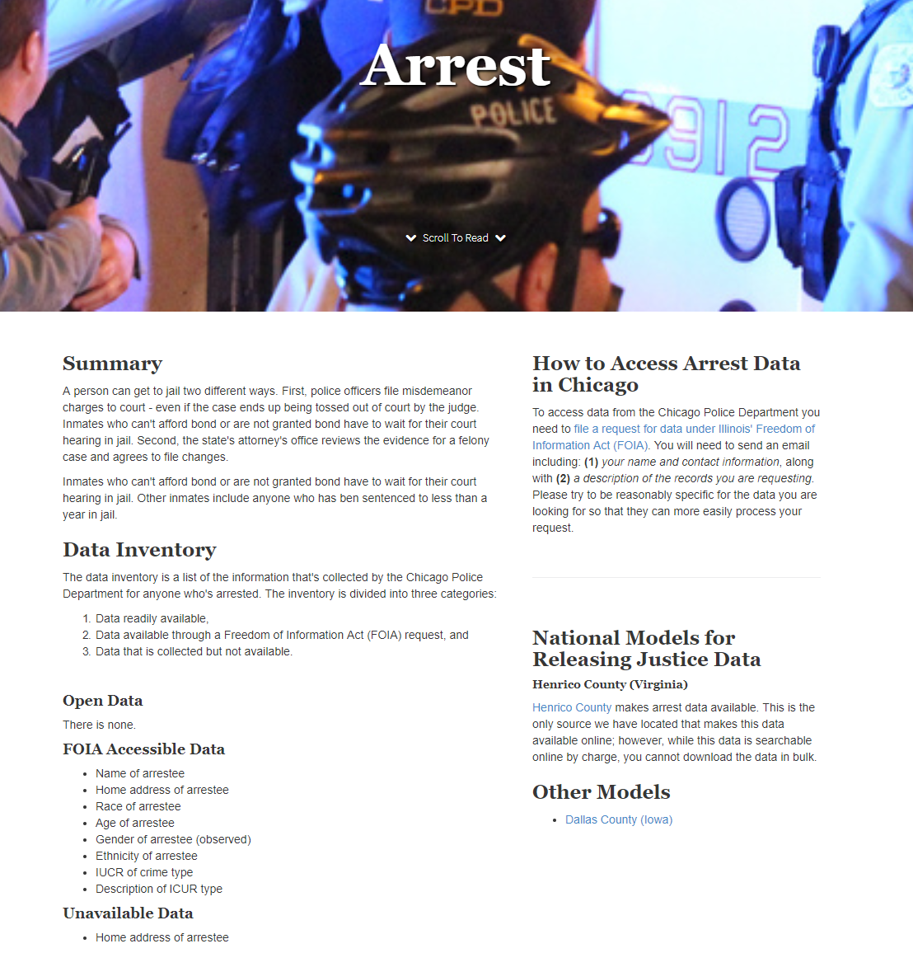
Notes:
“Crime and Punishment in Chicago” Smart Chicago Collaborative, http://crime-punishment.smartchicagoapps.org/

Slide 4
Notes:
“Guide to writing “readme” style metadata” Research Data Management Service Group, Cornell University, https://data.research.cornell.edu/content/readme

Slide 5
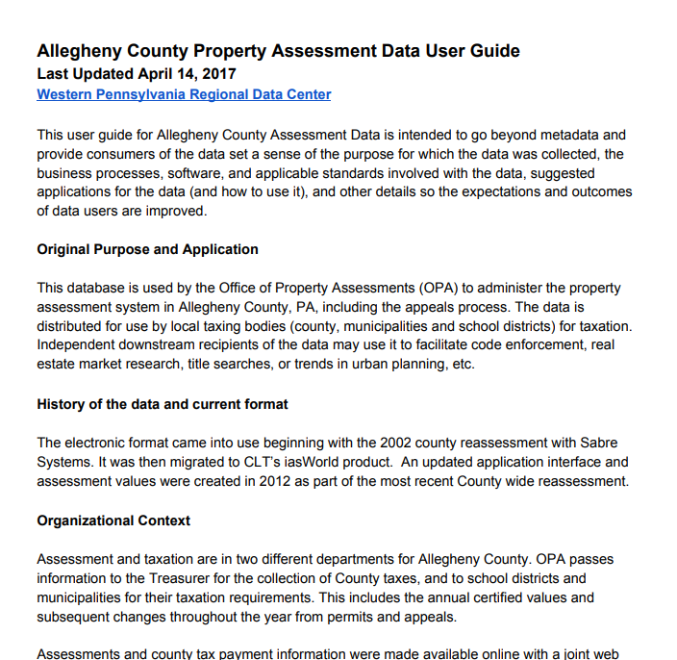
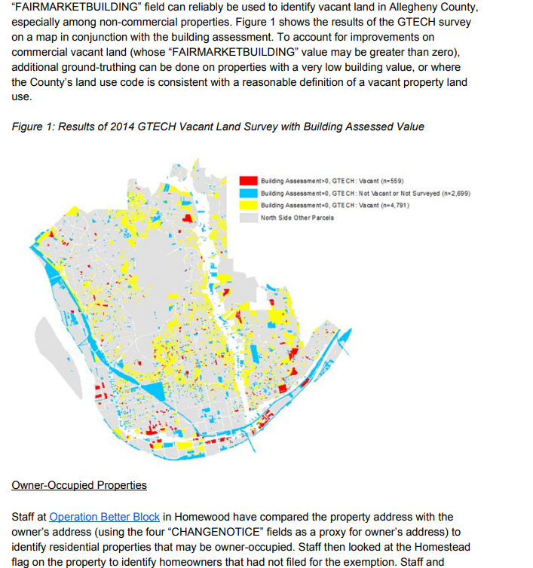

Slide 6
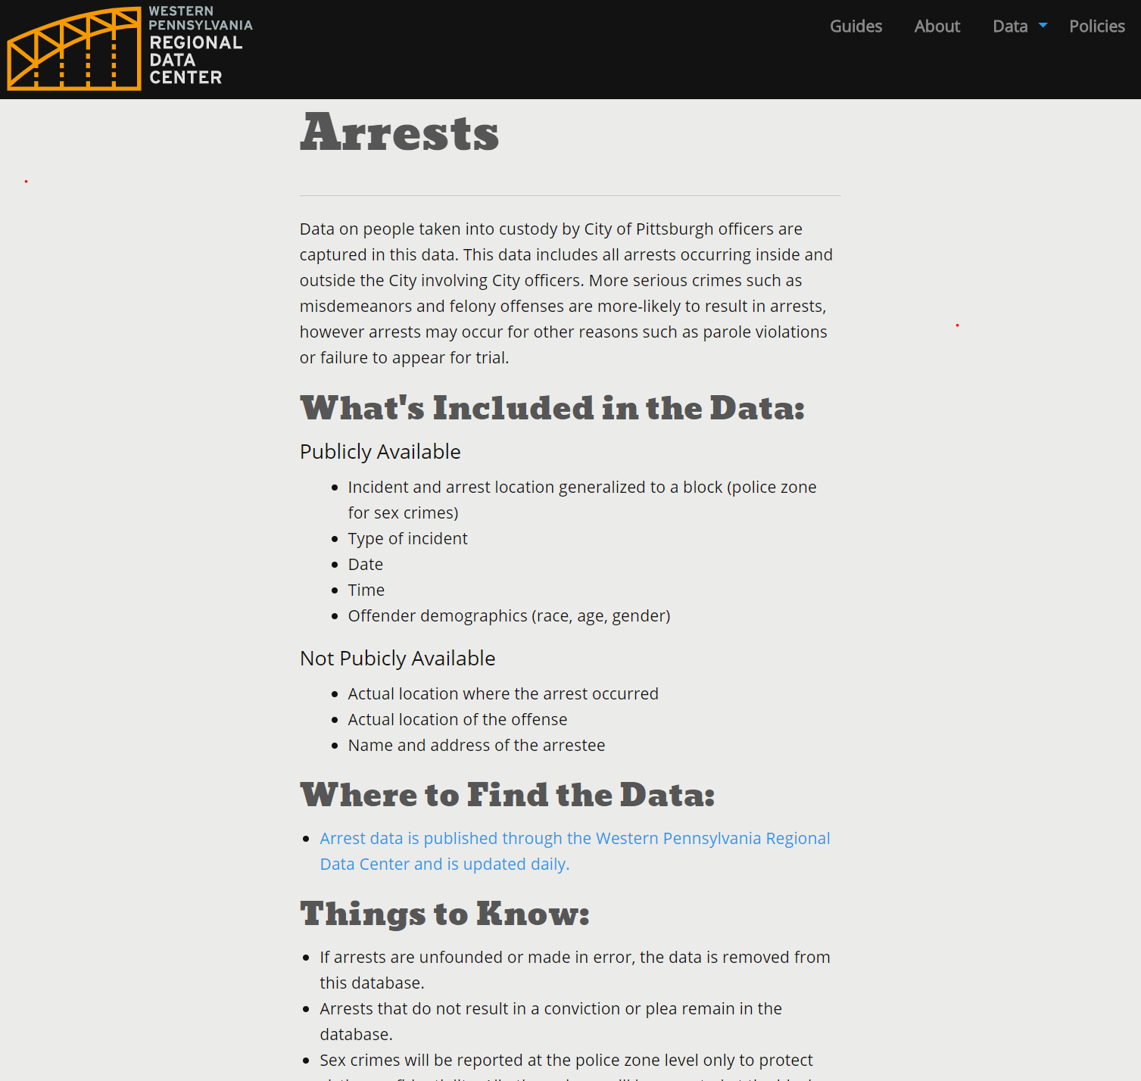
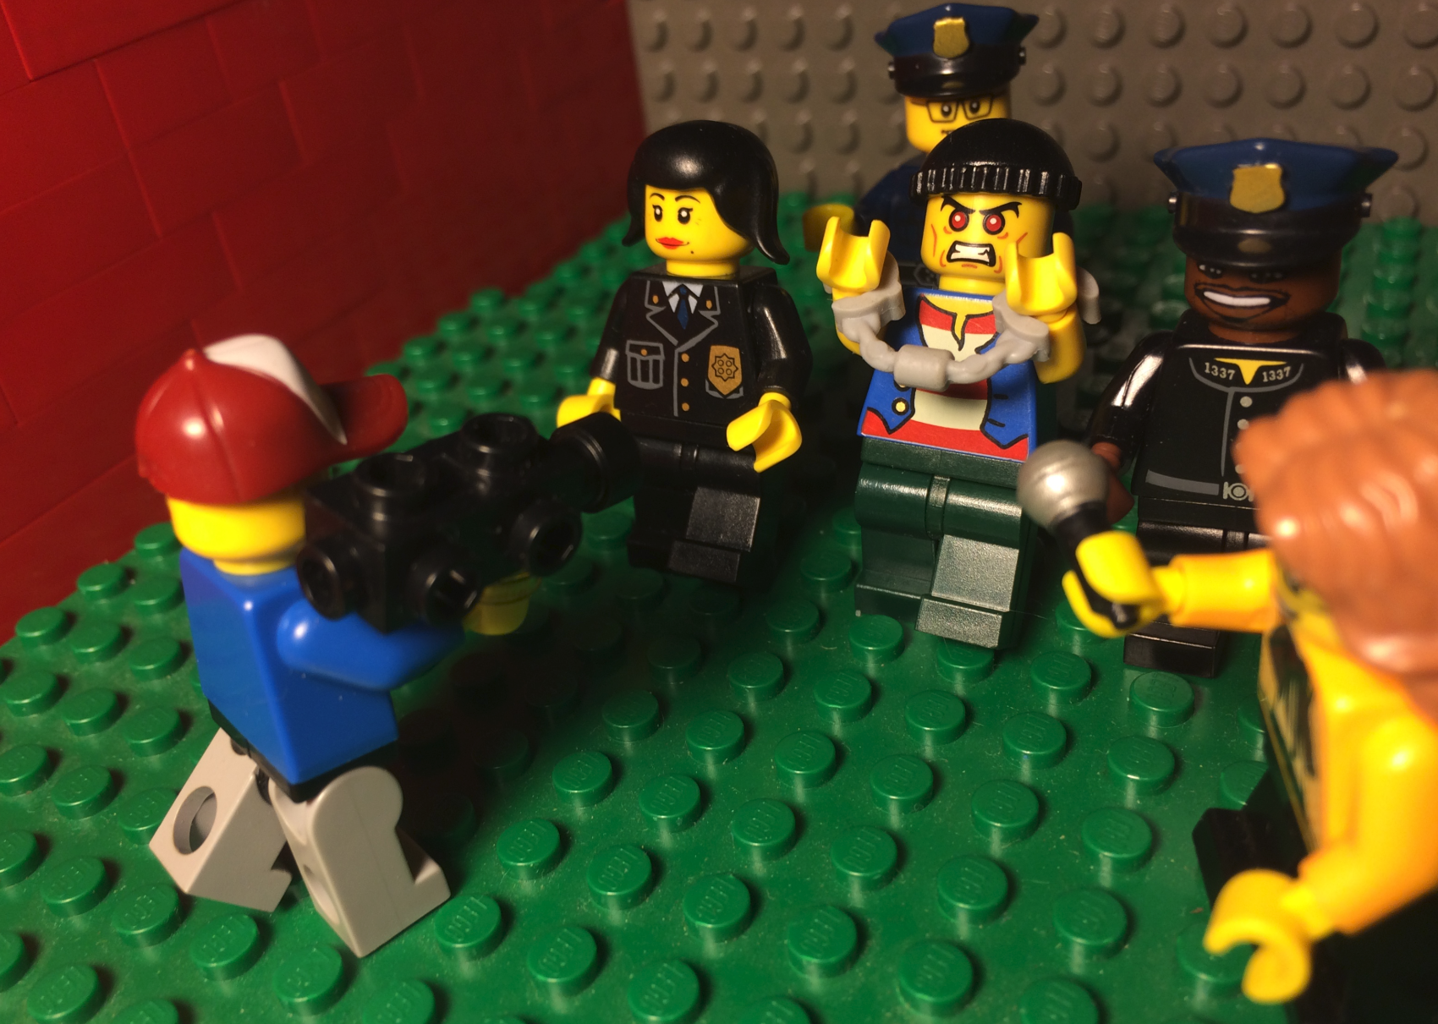

Slide 7
Purpose and Process What can go into a data guide?
The overall purpose for the data (why it exists);
Regulatory environments;
Business processes;
Software and devices involved;
Data standards;

Slide 8
Context: What can go into a data guide?
Organizational context (including culture, structure, budget, and data/computer literacies);
Limitations and ethical considerations;
Data standards;
Current and suggested data uses/applications.

Slide 9
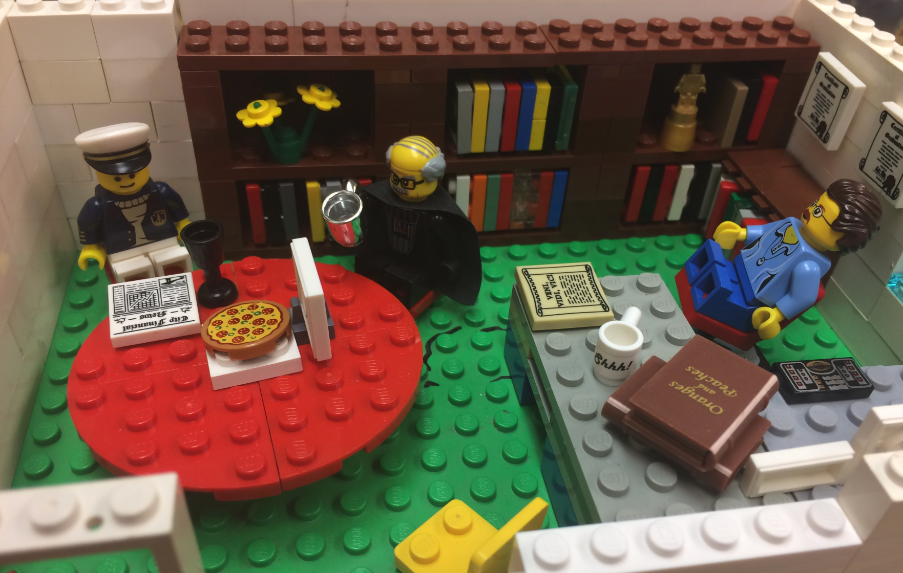
Process for creating a guide
Work with the data
Dig into data standards
Learn about business processes
Interview data stewards

Slide 10
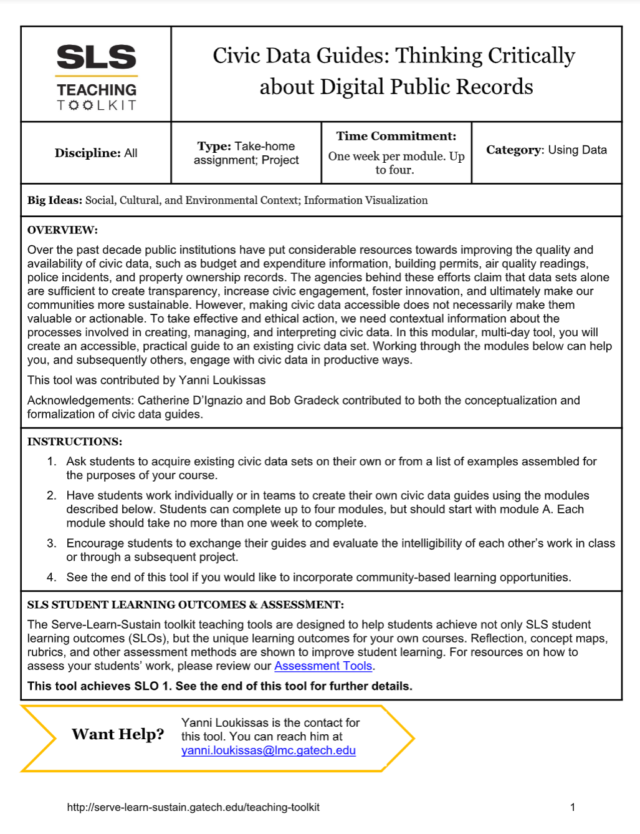
Who can create a data guide?
Data intermediaries
Data users
Students
Librarians
Open data program managers
Notes:
Source: “Civic Data Guides (student creation manual): Thinking Critically about Digital Public Records” Yanni Loukissis, Georgia Institute of Technology,

Slide 11
Thanks!

