Slide 1
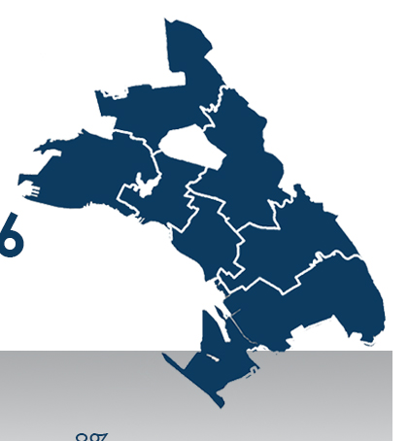
Rethinking Violence Prevention in Oakland, CA
October 2018

Slide 2
USC is coordinating a city-wide community engagement process around violence prevention in Oakland to:
Provide recommendations to guide what DVP should do to better target homicides, domestic violence, and sex trafficking (funded by Measure Z).
Inform the RFP about the characteristics of DVP Chief’s position
Validate Chief’s job description through a participatory community research approach
Notes:
The DVP was created last year and will be staffed with 3 positions: the Chief, the XX and an analyst. The chief position is a the same level of the chief of the police Department and the Fire Department.
Peter Kim, Interim Director of the City’s new Department of Violence Prevention and Manager of the Oakland Unite Division of the Human Services Department
Oakland Unite’s programs target our highest risk community members and neighborhoods, with a particular focus on interrupting violence now as it is occurring and preventing future violence.
- The DVP will be funded by Measure Z

Slide 3
The Research
Quantitative Data Analysis
Qualitative Data Analysis
Open Source Data
27 community research fellows
Gun Violence
Domestic Violence
CSEC
Impacted by violence
Surveys
Focus Groups
Interviews
Law Enforcement
Public Health Data
Health Care Providers
BART
Same questions….different formats
Same demographic sheet

Slide 4
Quantitative Data
Oakland

Slide 5
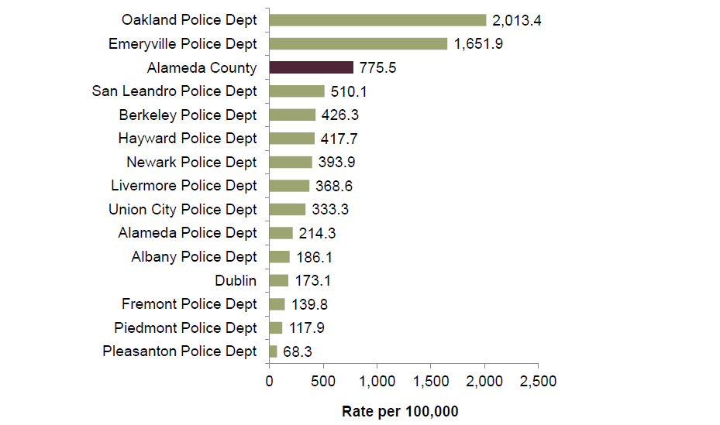
In 2012,Oakland had the highest rate of crime compared to other jurisdictions
Source: Addressing Domestic Violence as a Public Health Issue in Alameda County, September 2015, Alameda County Family Justice Center, Janet Brown. Last retrieved September 2018.

Slide 6
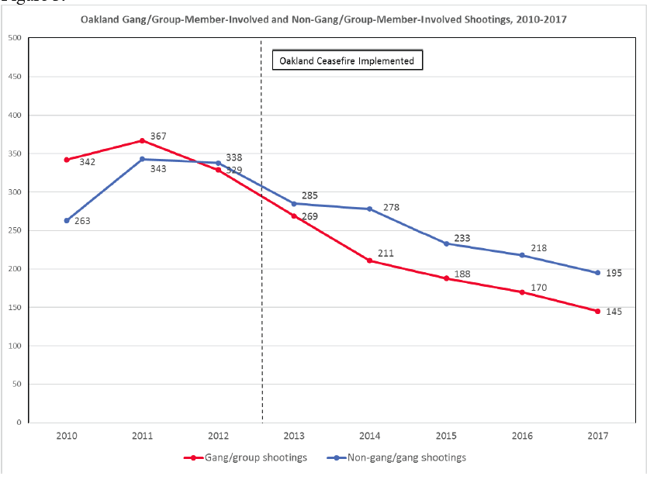
Between 2010 and 2017,there were a remarkable decline in number of shootings committed by gang involved or non-gang involved incidents
Source: Oakland Ceasefire Impact Evaluation: Key Findings, August 2018 P.4

Slide 7
Homicides in Oakland, 2010-2017
Mostly African Americans
More men than women
On the street or sidewalk
On Sunday nights after 8:00 pm
On flatlands around gang territories
Youth 19-24 yo & adult youth 25-34 yo
Homicides were steady, Rape increased
Source: https://openjustice.doj.ca.gov/data

Slide 8
Group and gang-related violence territories
Source: https://thecapartnership.org

Slide 9
Domestic Violence in Oakland
African American
6 times more likely to be victims of DV than White neighbors
5 out of 10 offenders were known to the victim in 2017
48% of incidents committed by someone known to victim
5% family 7% acquaintances 2% intimate partners 34% other, known to victim
52% strangers to the victim
Using weapons in DV has declined over the years
There have been over 3000 domestic violence-related calls for assistance every year over the past ten years
Source: https://openjustice.doj.ca.gov/data

Slide 10
Qualitative Data
Oakland

Slide 11
Characteristics of interviewees….So far (125/300)
80% African Americans
43% 18-34 youth and adult youth
10% homeless or living in shelters
51% renters
55% making $10K-$30K
29% have certain disability
Source: USC 2018

Slide 12
Initial findings/themes
More money in education, less money in over-policing
Address violence upstream (children and family/domestic abuse)
Address both victims and offenders (hurt people hurt other people)
Support integration of trauma-informed/healing-centered principles in systems and practices
Many don't feel connected and need more resources at community level for resident-led ideas and innovations
Social media conflicts are a MAJOR cause for youth violence

Slide 13
In your own words, define violence
Violence is a motivating factor for fear…….. its just fear that keeps people in a certain mentality, certain state of mind.
To make people feel unsafe
keep myself busy, positive activities, and positive reinforcement from support systems
What did you need to heal?

Slide 14
What we have learned from the process as an organization and as an individual
We indirectly prepared 27 Oakland residents to be ambassadors of their communities ….. “Community accountability”…
Qualitative data makes quantitative data alive
Violence is beyond the physical interaction it is a state of mind
To reach a narrative change, we need to work on a culture change
Define Violence: we are all impacted -to certain extents- by violence: “I lived oppression (violence) that I didn’t realize it was oppression”

Slide 15
Thank You
Oakland
raniaa@urbanstrategies.org

