Slide 1
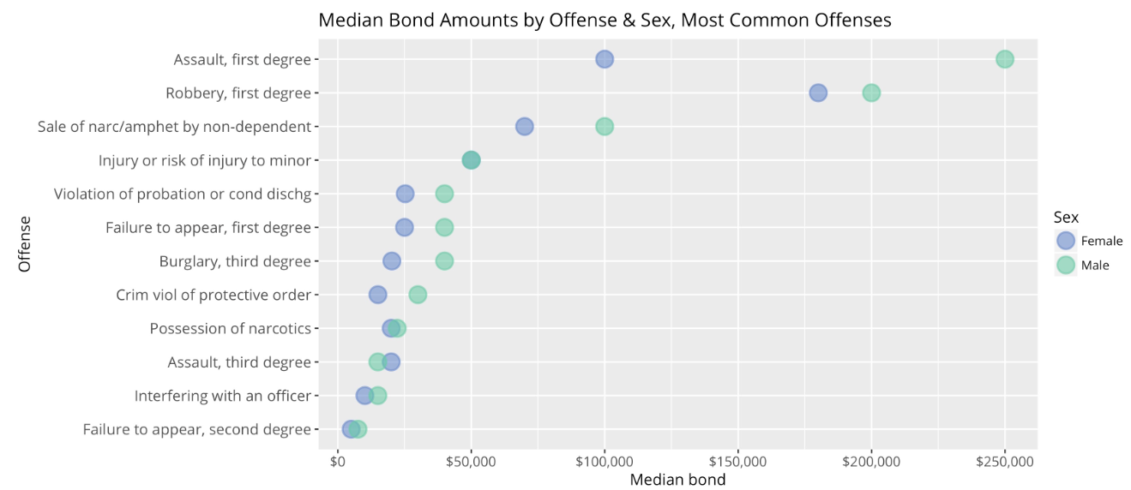
Applying new hyperlocal data on criminal justice and public safety
Mark Abraham
Executive Director
Email: info@ctdatahaven.org
Tel: 203-500-7059
Twitter: @ctdata @urbandata
Chart: DataHaven (Camille Seaberry), https://ctviewpoints.org/2016/10/25/criminalization-of-poverty-new-data-on-women-in-connecticut-jails/

Slide 2
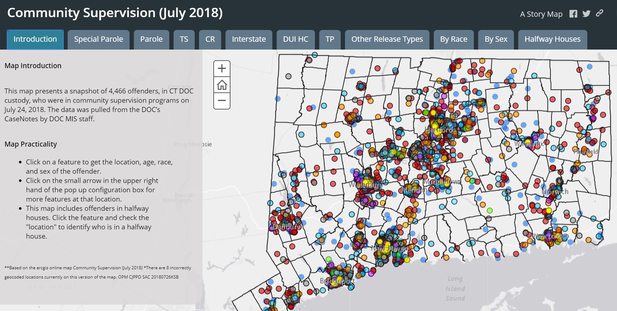
Data in Context
Notes:
Tweets on growing inequality

Slide 3
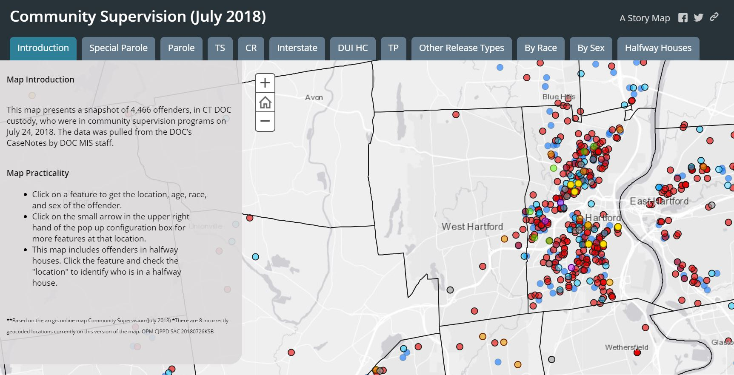
Data in Context
Notes:
Tweets on growing inequality

Slide 4
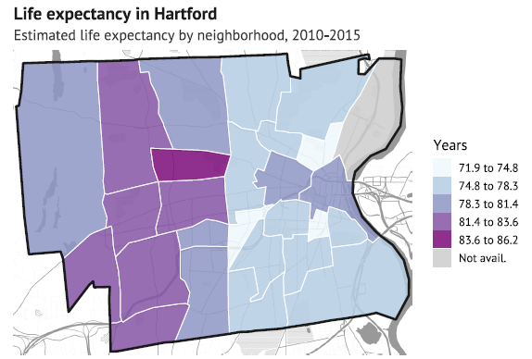
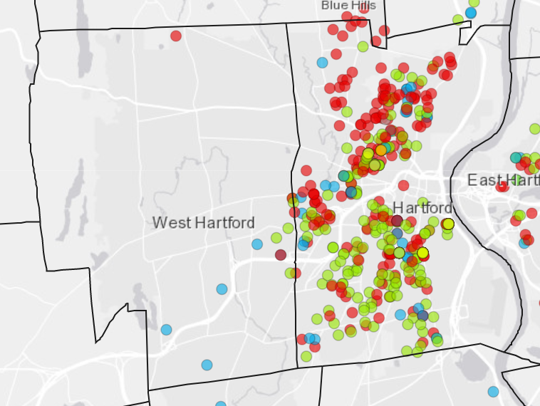
Data in Context
Estimated Life Expectancy
CTDOC Community Supervision Population: Race/Ethnicity
Notes:
Tweets on growing inequality

Slide 5
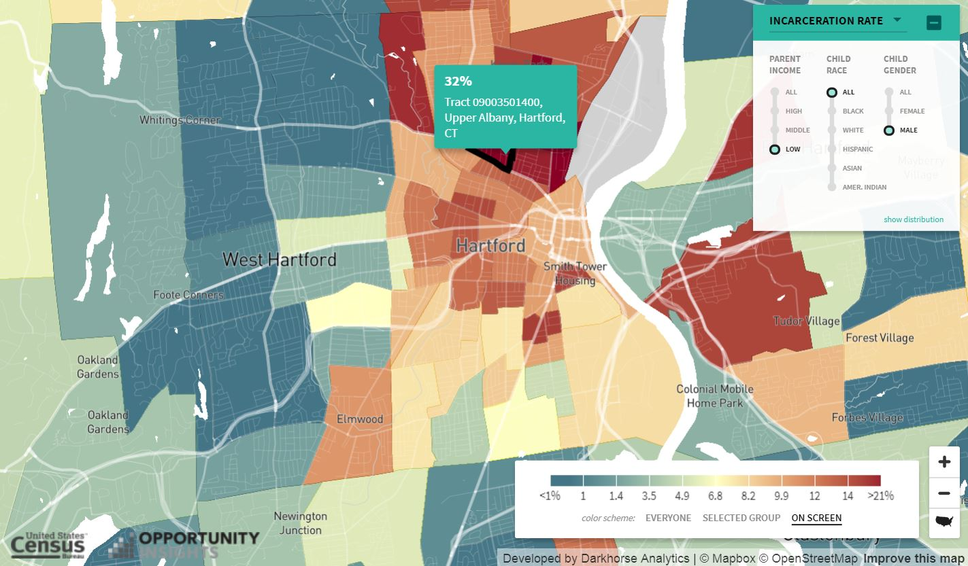
Data in Context
Opportunity Atlas
Notes:
Tweets on growing inequality

Slide 6
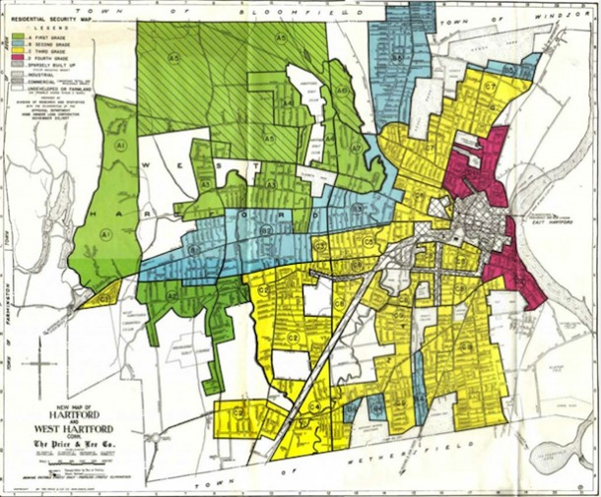
Data in Context
“No persons of any race other than the white race shall use or occupy any building or any lot…”
- Dryad’s Grove development, West Hartford, July 1941

Slide 7
Optimal Child Development
Graduation rate
Educated Kids
Healthy Families
Secure Families
Early reading, Healthy infants,
poverty, economic stress, housing
Civic Engagement
Effective Decision-making
Racial Equity and Social Justice
Population Outcomes

Slide 8
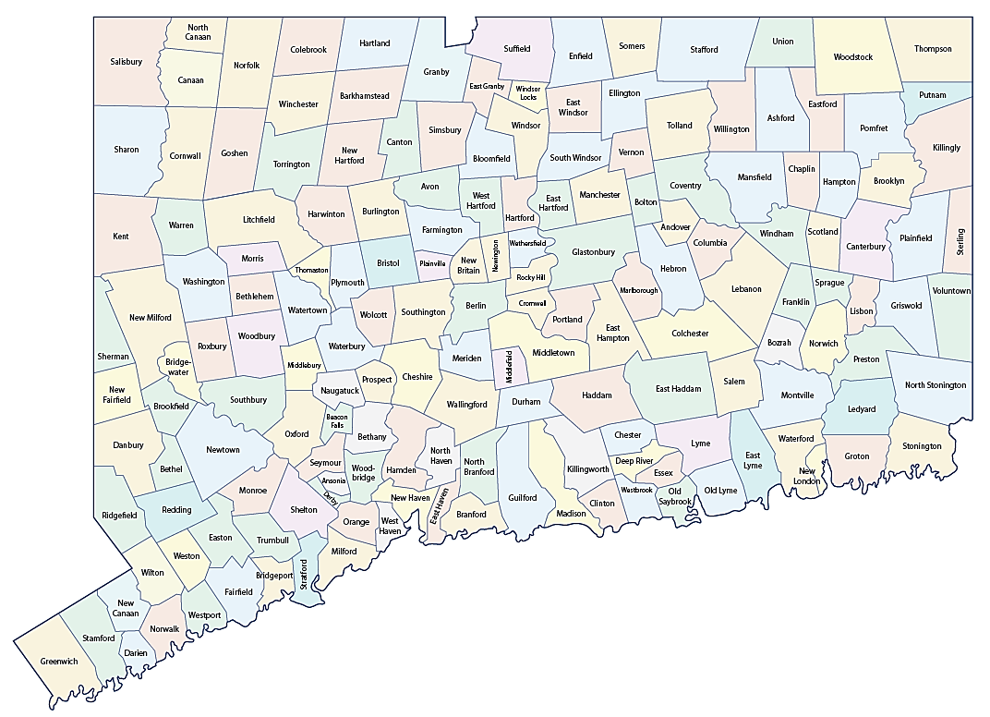
Measurement as a Unifier: Over 90 Public and Private Funders of the DataHaven Community Wellbeing Survey
Investors include every hospital, community foundation, large city/town, and public health district in CT
Over 35,000 live, in-depth interviews with randomly-selected adults in every zip code in Connecticut

Slide 9
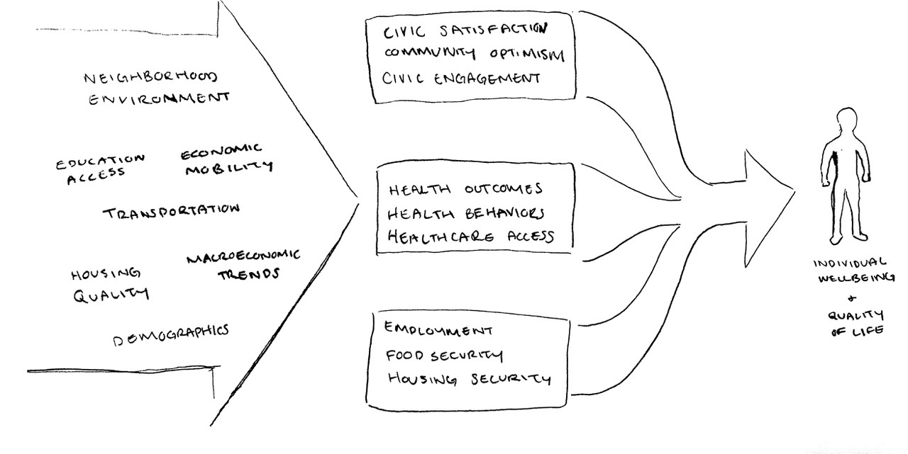
Measurement as a Unifier: Survey Development Process with over 125 Advisory Council members

Slide 10
Measurement as a Unifier: Survey Development Process with over 125 Advisory Council members

Slide 11
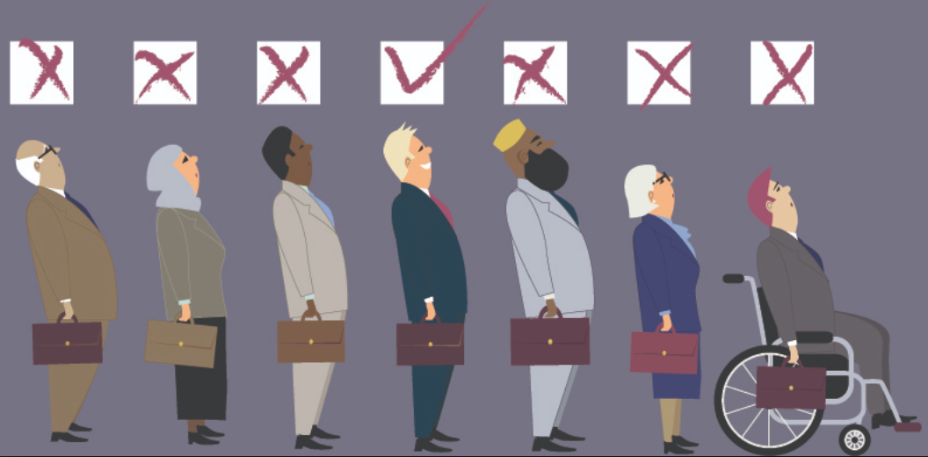
Experiences of Discrimination (EOD)
Have you ever been unfairly stopped, searched, questioned, or threatened by the police
Also asked about: unfairly fired/denied promotion/not hired; unfairly prevented from moving into a neighborhood; receiving services (health care) worse than what other people get, etc.
What do you think is the main reason for these experiences?
How many times did this happen in the past 3 years? Where did this happen (multiple option)

Slide 12
Experiences of Discrimination (EOD)
Have you ever been unfairly stopped, searched, questioned, or threatened by the police
Also asked about: unfairly fired/denied promotion/not hired; unfairly prevented from moving into a neighborhood; receiving services (health care) worse than what other people get, etc.
What do you think is the main reason for these experiences?
How many times did this happen in the past 3 years? Where did this happen (multiple option)

Slide 13
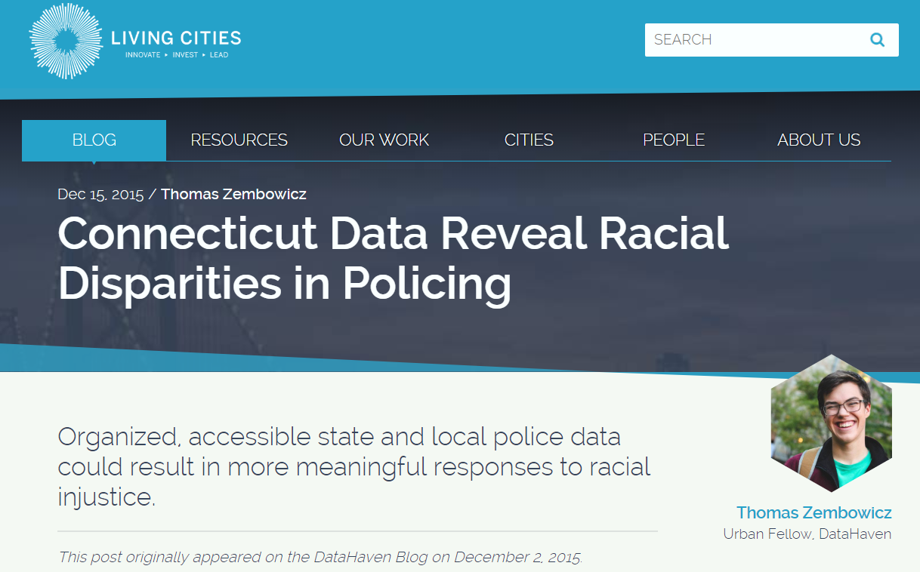
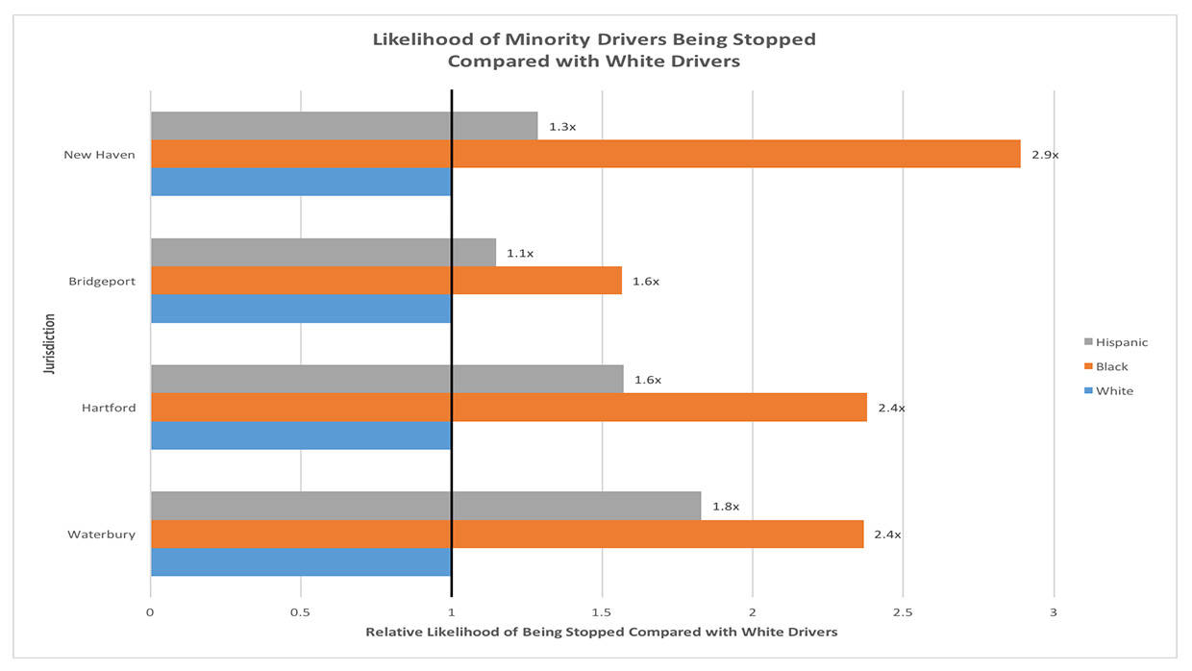
Compares with administrative data
DataHaven article, https://www.livingcities.org/blog/1003-connecticut-data-reveal-racial-disparities-in-policing

Slide 14
Other Public Safety-Related Questionnaire Items
The job done by the police to keep residents safe
Feel safe to go on walks in neighborhood at night (part of walkability scale)
How likely do you think it is that a typical young person in your neighborhood will…. Graduate college, be in a gang, get a job with opportunities for advancement, get arrested for a felony
Impact of opioid epidemic

Slide 15
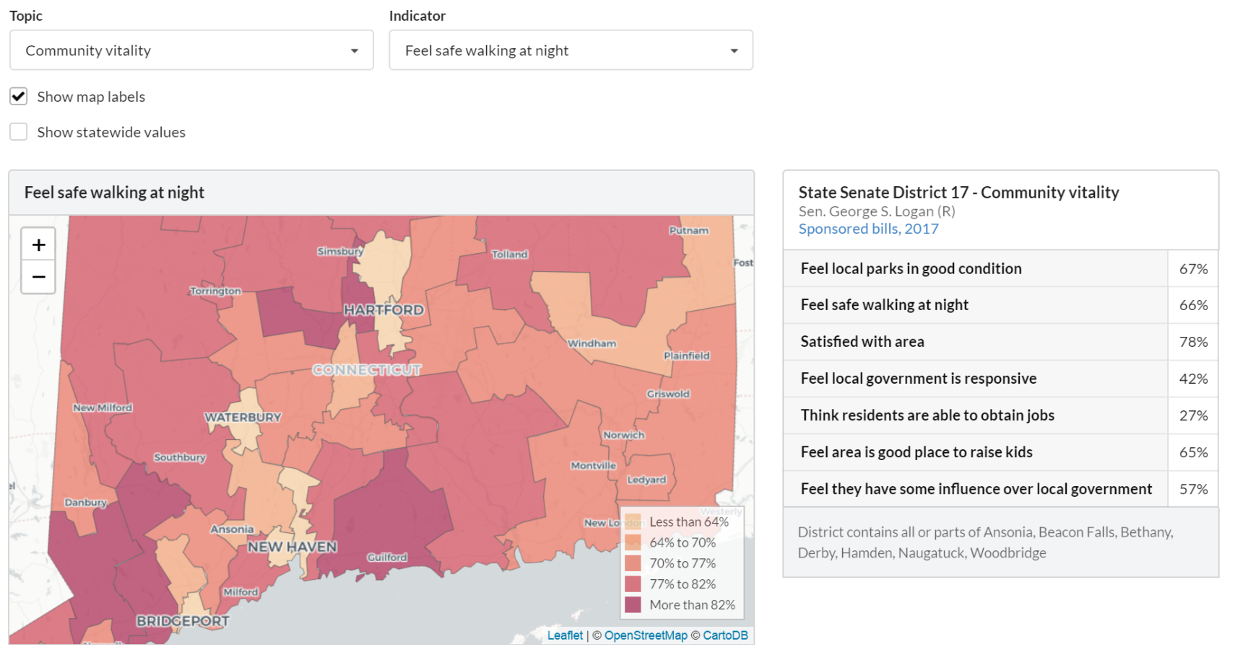
2018 DataHaven Statewide Legislative District Profiles (ctdatahaven.org)
Notes:
Allows look at happiness
1 hour commute equivalent to 40K per year

