Slide 1
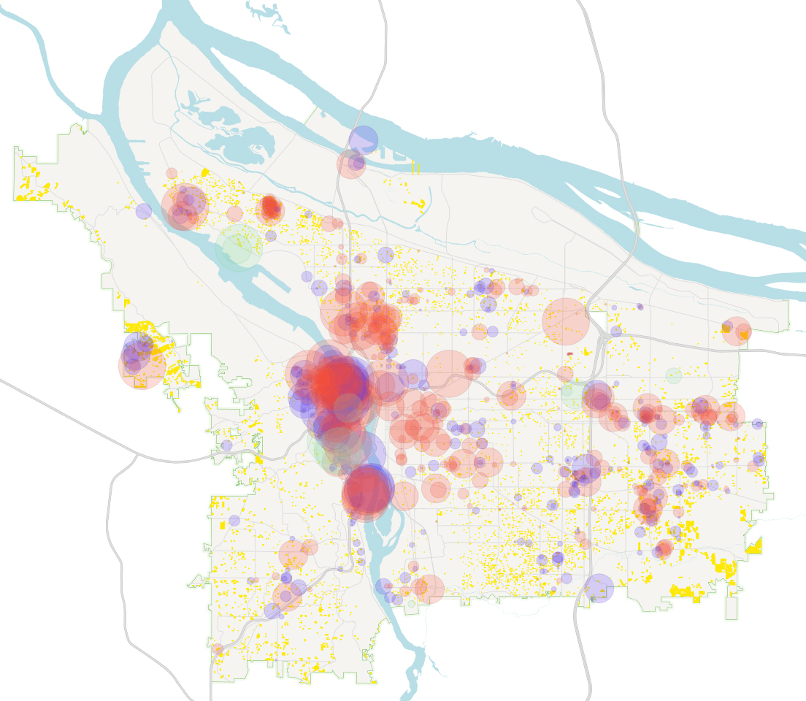
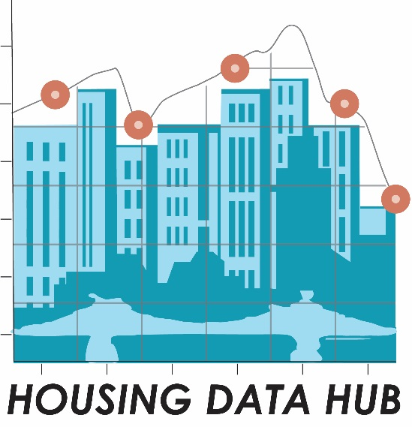



Greater Portland Pulse Housing Data Hub
Sheila A. Martin, PhD
Director, Institute of Portland Metropolitan Studies
October 12, 2017
Notes:
In October of 2015, the Portland City Council issued a State of Emergency Declaration regarding Housing and Homelessness in Portland.
Anyone who was the housing market didn’t need the declaration to understand the emergency.
We were observing rising rents and rising tents.
The community was responding by debating a number of issues: how to quickly increase supply, how to increase funding for affordable housing, how to protect tenants from displacement.
So the Board of the IMS at its annual retreat that year asked, ”how might IMS support our leaders, our community members, and our nonproifts in understanding this complex problem and addressing this crisis?
So the housing data hub was borne

Slide 2
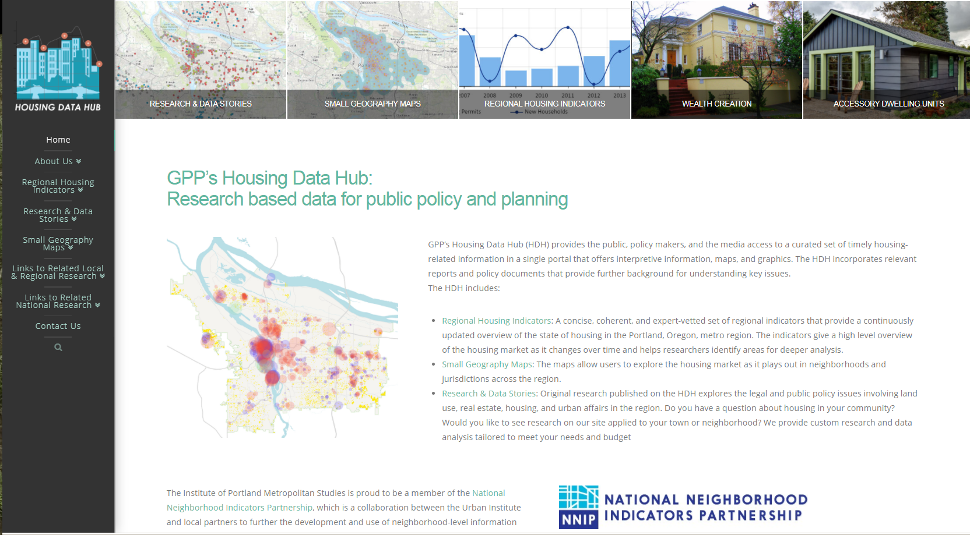
https://gpphousing.imspdx.org/
Notes:
The housing data hub builds on the strenths of IMS and the Popuilation research Center. It builds out the work we’ve done with Greater Portland Pulse and Neighborhood to expand the variety and depth of data about housing available to the community.
One thing we were hearing from people was that they were both overwhelemed with dataabout the housing crisis and also unable to find the data that they really needed.
So we started by listening to people about what questions they wanted to address with data and how they would like to use data to tell stories about how the housing crisis is affecting people.

Slide 3
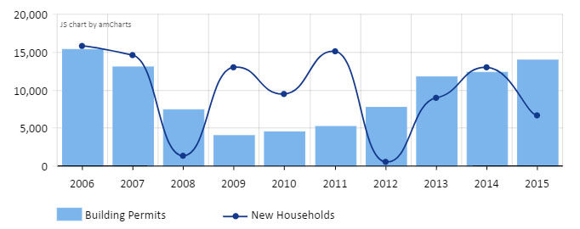
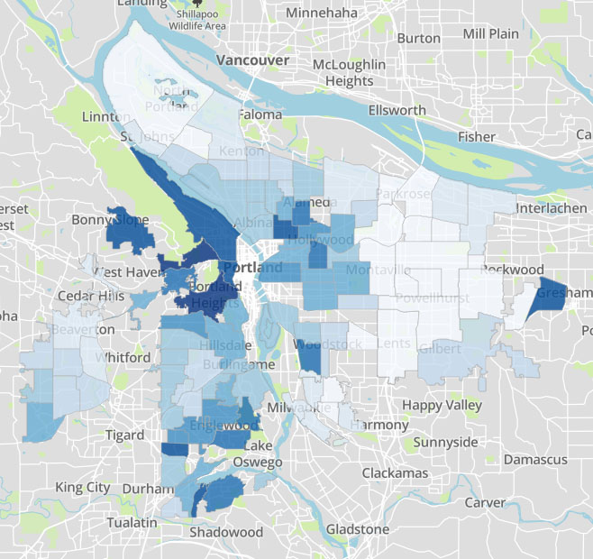
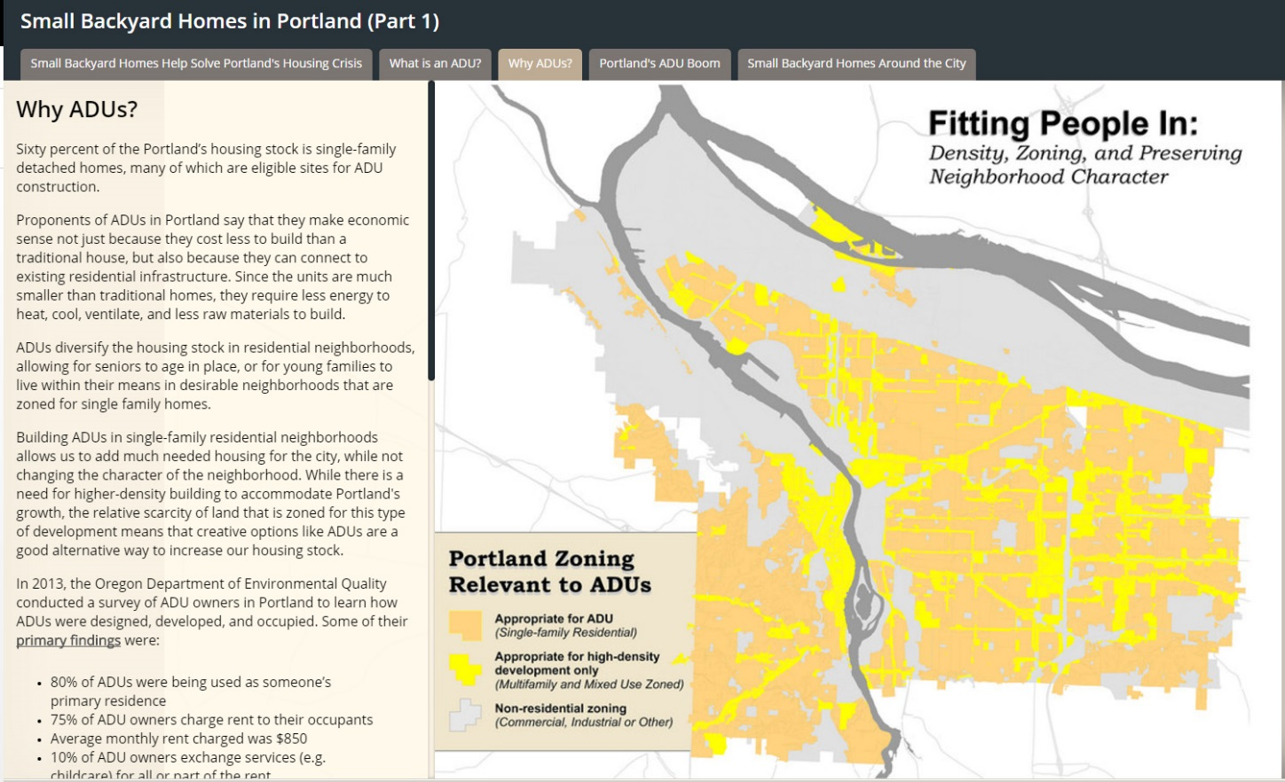
Indicators Tracked Over Time
Small Geography Maps
Original Research & Data Stories
Notes:
The Housing Data Hub incorporates the three methods of data delivery:
- indicators tracked over time,
- small geography mapping, and
- original research and storytelling.
The result, is a research platform that allows us to explore multiple facets of the regional housing market.
The geography that we use on the Housing Data Hub is the Portland metropolitan Region. Because that is the region that our Institute pays attention to, its important for us to address issues of Spatial differences in the housing market, differences across jurisdictions in housing policy, and how populations across the region are faring in the housing crisis.

Slide 4
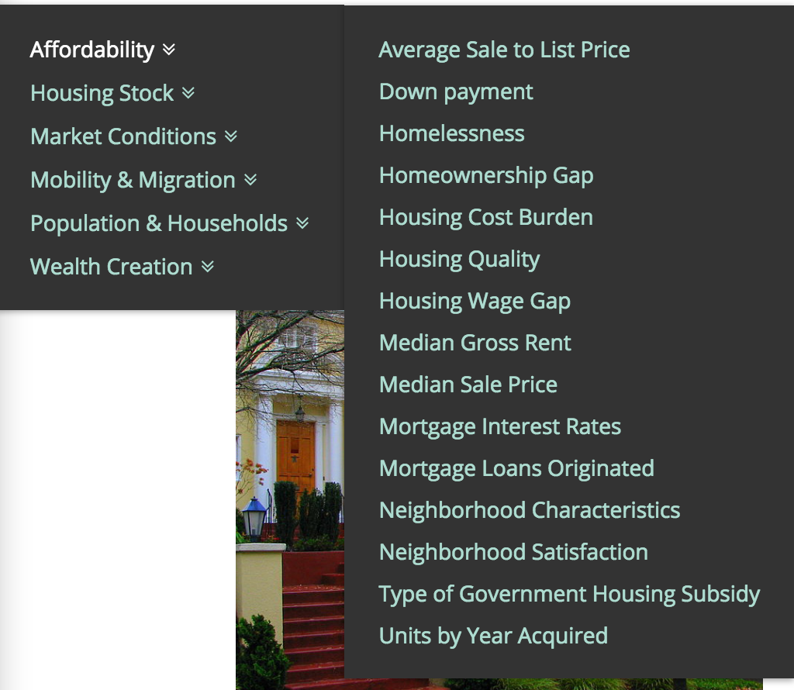
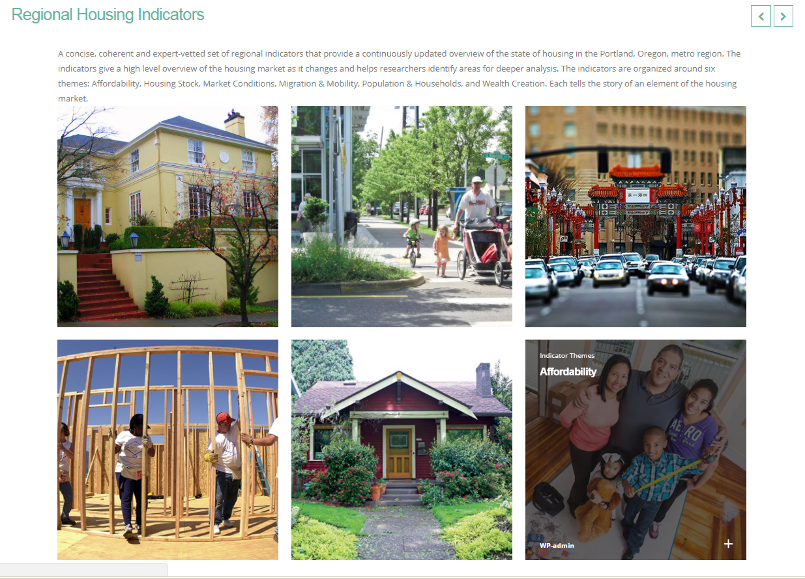
Regional Housing Indicators
Notes:
The first piece directly builds on the work we did with greater Portland Pulse. It expands the data on GPP to include more than forty regional indicators tracked over time for the seven county MSA. They can be access through the website. They are grouped into six categories.
Housing Stock looks at the physical characteristics and location of the area’s current and future housing.
Affordability & Wealth Creation helps us understand who has access to housing and who is profiting from the housing market.
Population & Households provides data about the individuals and families that need housing in our region
Mobility & Migration tells us where those households are coming from and how people move throughout the region to access housing, employment, education, and recreation.
Market Conditions examines the health of the region’s housing market.

Slide 5
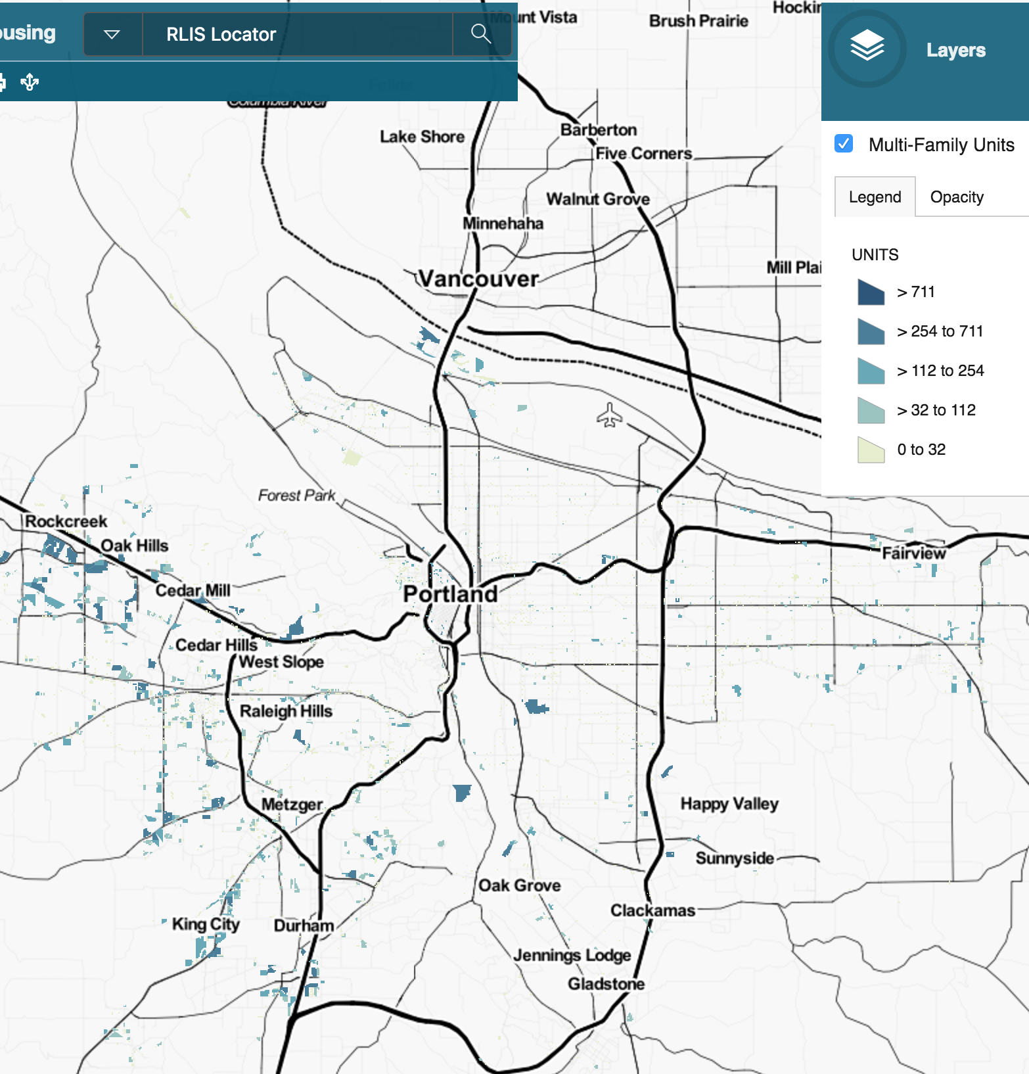
Small Geography maps
Small Geography maps allow us to visualize how housing trends play out spatially within the region’s neighborhoods.
Notes:
The small geogrpahy maps are new to Greater Portland Pulse.
One of the things we heard from people as we presented GPP was that regional indicators were great, but they wanted to know what was going on in their neighborhood. Our answer to that was Neighborhood Pulse, which we’ve been working on for a couple of years now. The Housing Data Hub gives us an opportunit to combine these two spatial scales, region and neighborhood, in a single site that focuses specifically on housing.

Slide 6
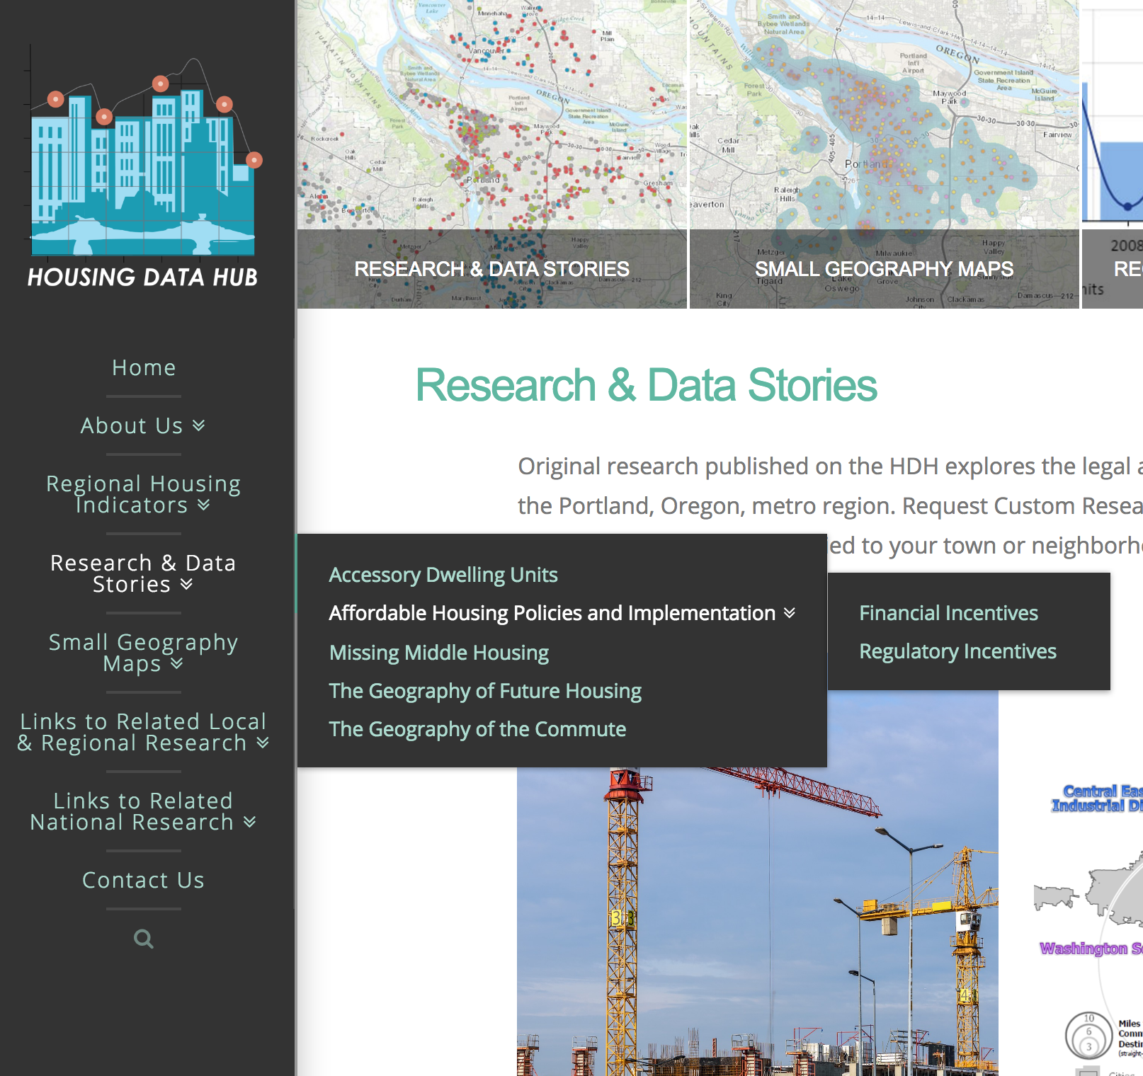
Research and Data stories
Combine indicators, maps, and text to tell a richer story about a housing issue.
Notes:
Research and Data Stories is the section in which we use data maps and text to deliver informative content about housing policy issues. WE have developed a few of these: one about accessory dwelling units, one with maps about permits. And one section is focused on policies and implementation across the region. We will be adding content to this site as we develop the data and maps for other purposes, for example, for our magazin, Metroscape, or as a result of custom research that we do for clients.

Slide 7
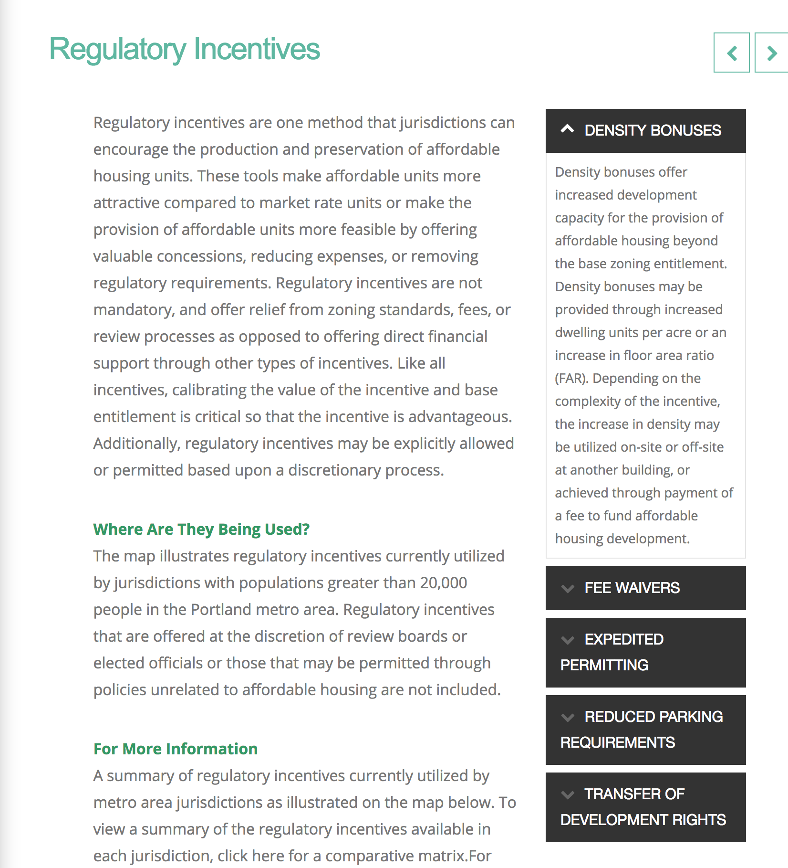
Affordable housing Policies and Implementation
Comparative information about housing policies in jurisdictions across the region

Slide 8
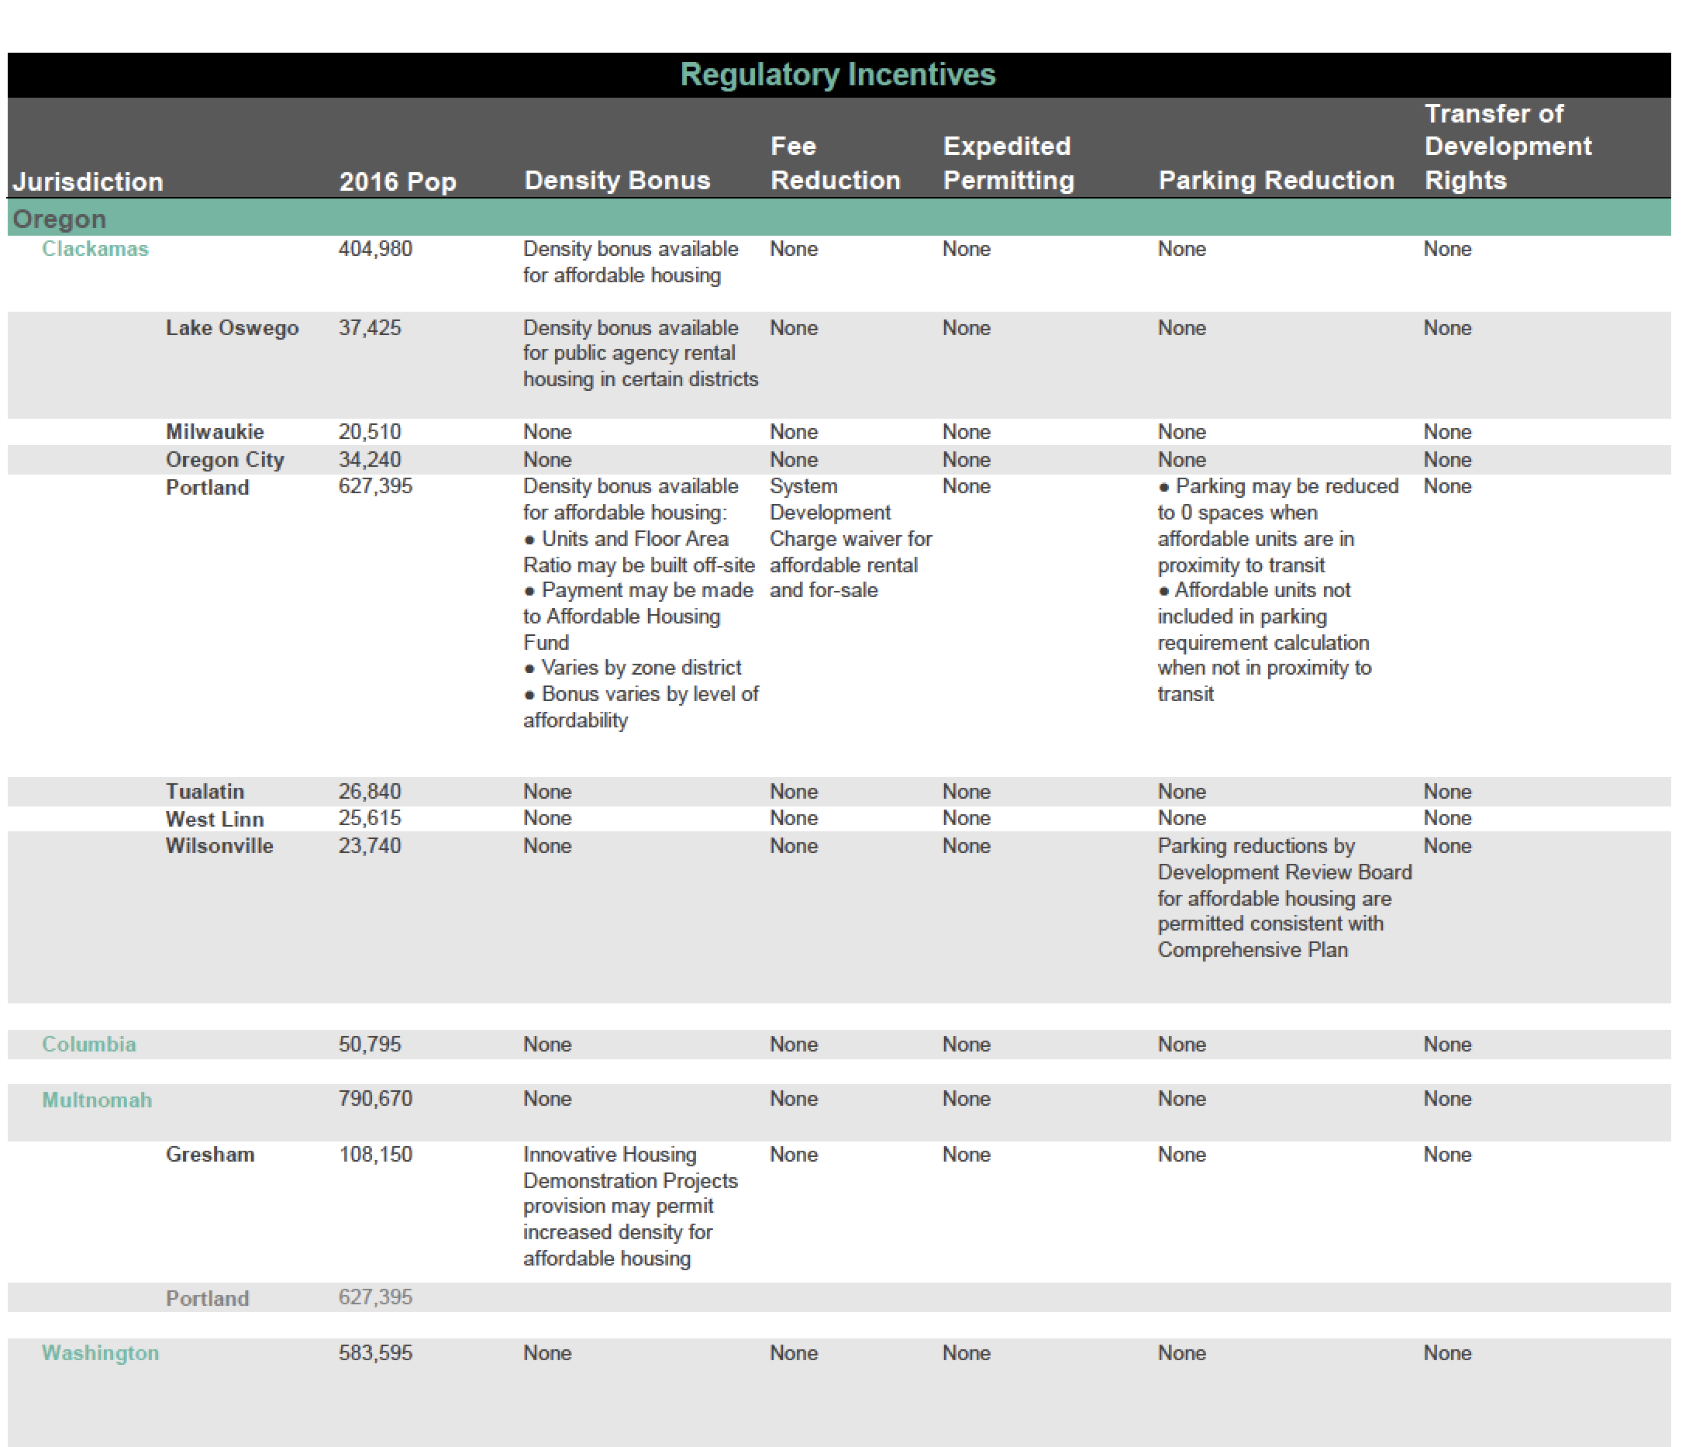
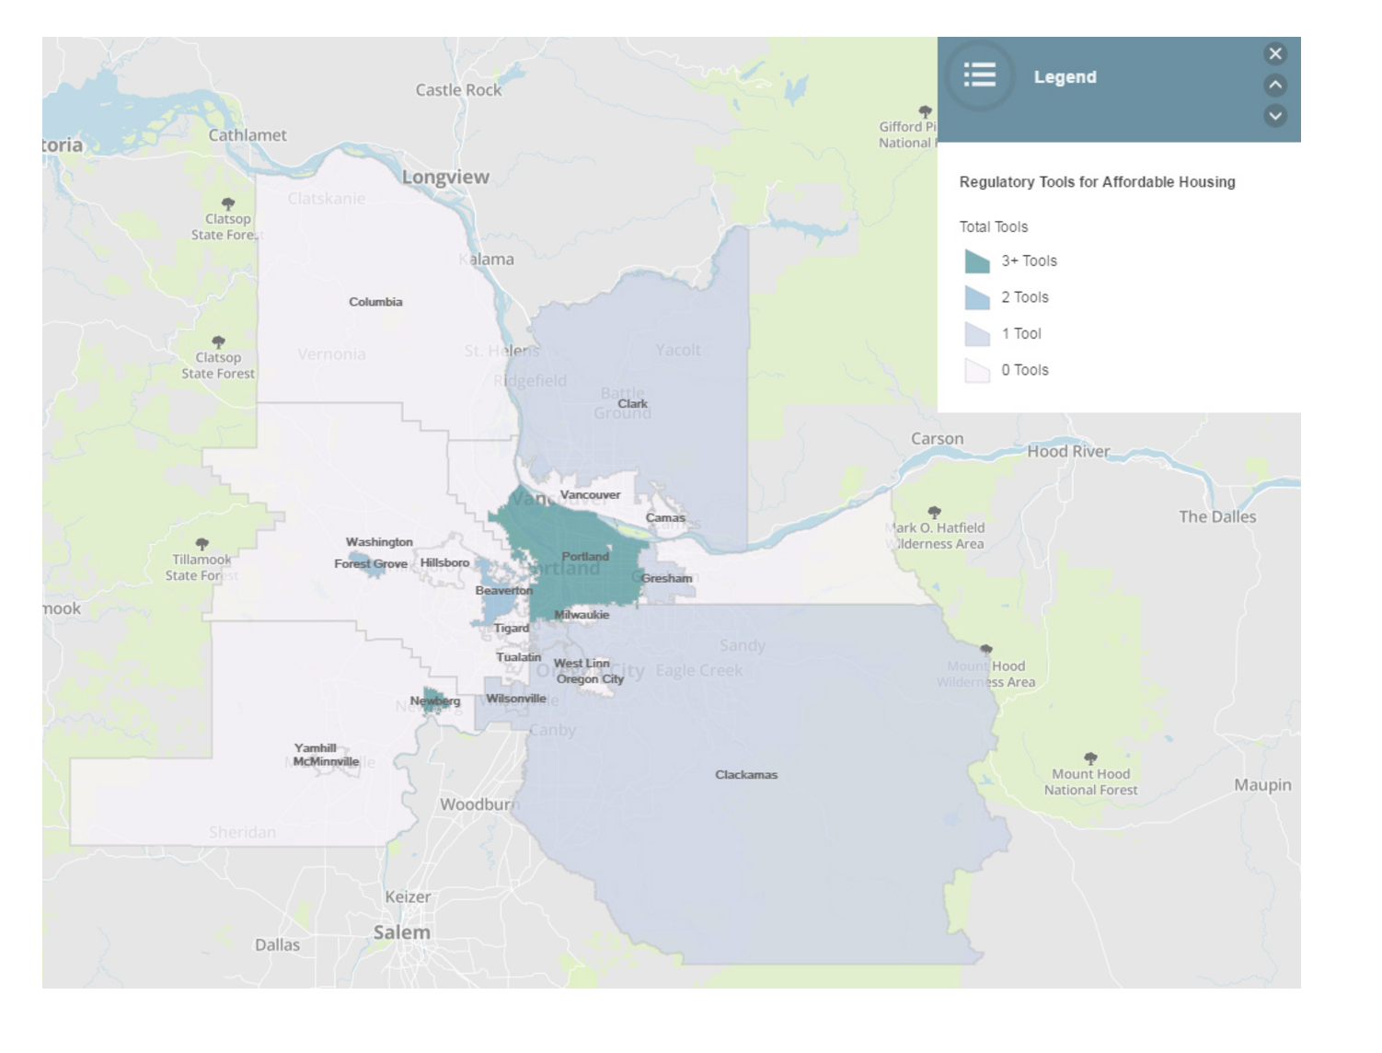
Comparative analysis of policies
Notes:
You can click on the map and fin dout what kinds of policies they have enacted.

Slide 9
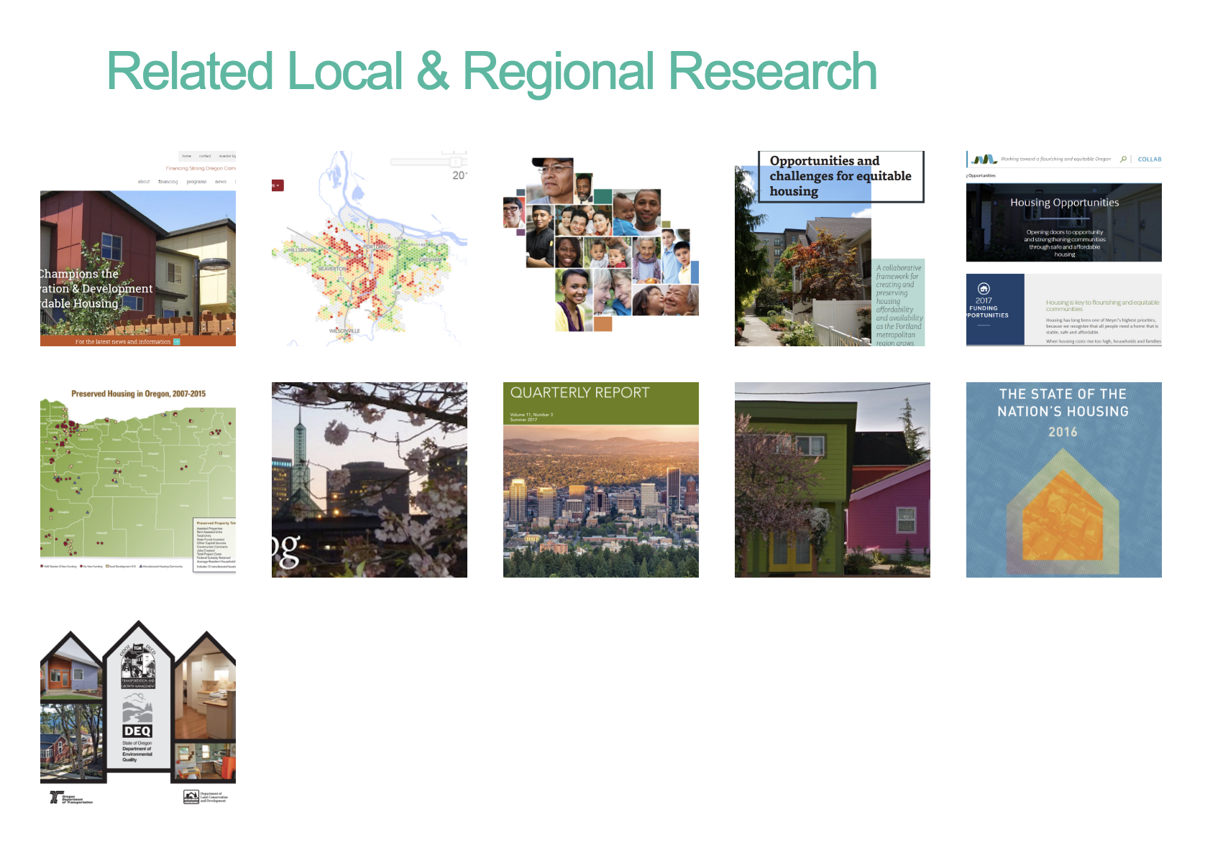
Notes:
There is a great deal of work happening locally and we’ve done our best to compile some of the most requested reports about housing issues in our region and relevent natonal reports. Of course, we can’t put them all in here, so we’re going to have to come up with some kind of filder. Not sure what that is.

Slide 10
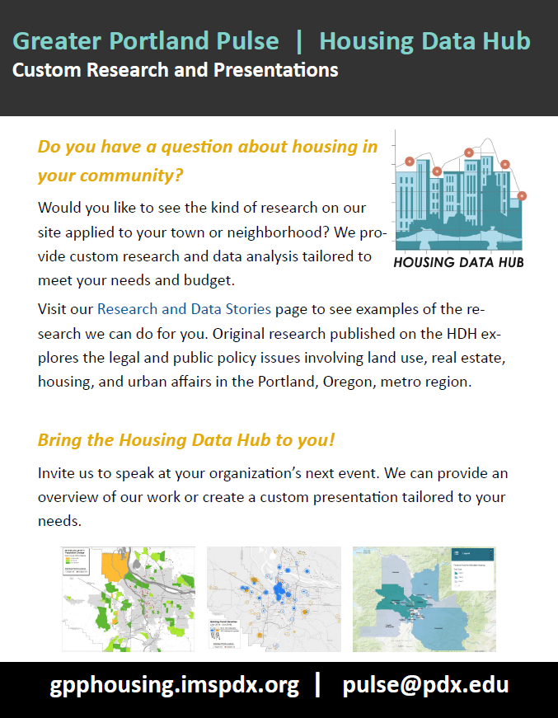
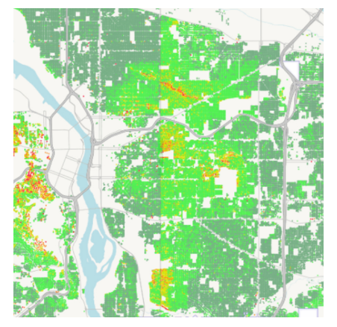
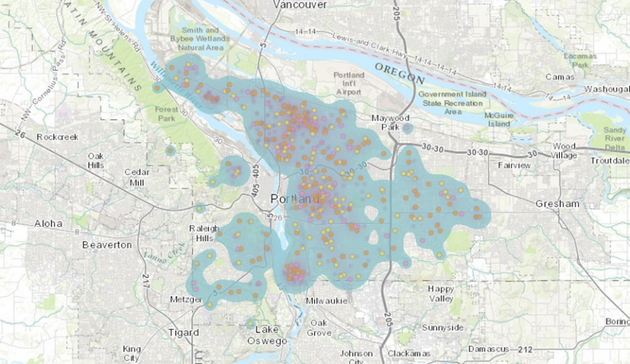
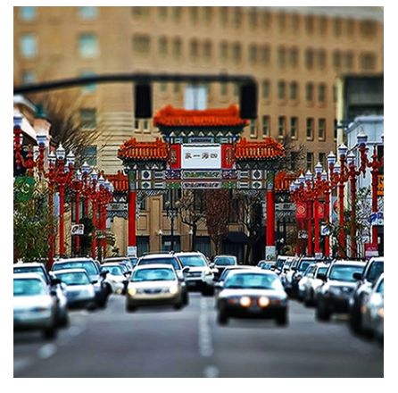
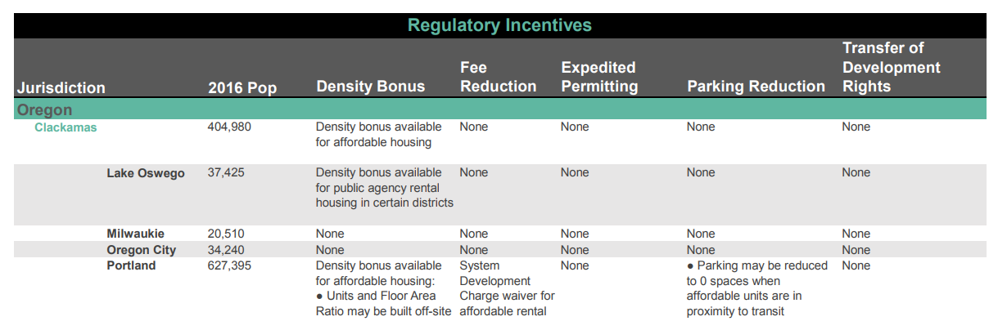


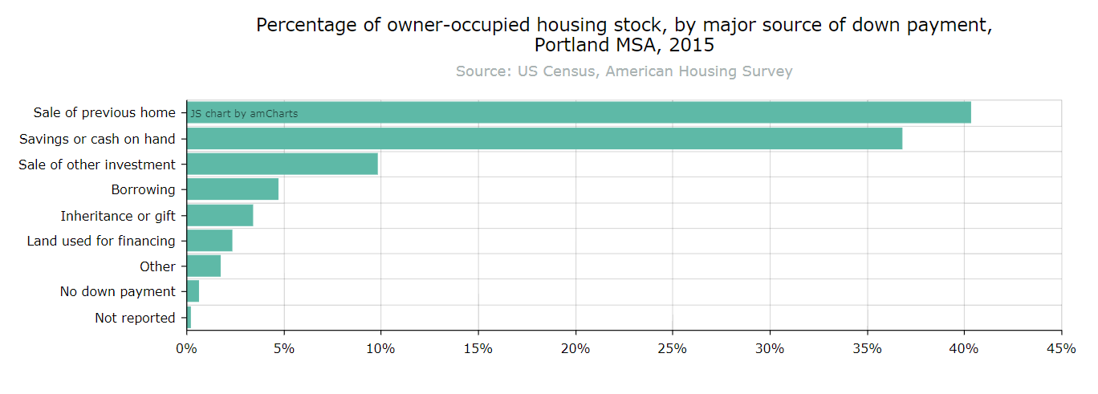
Notes:
And this is the place where we tell people that they should have us come and speak and of course how are we going to pay for this? Hopefully by doing custom research. Cause currently nobody is paying for this.

