Slide 1
ACS Play-Doh Factory
Norma I. Garza, DrPH

Slide 2
What is the ACS Play-Doh Factory?
The direct result of the ACS Data camp session in Baltimore
Interactive tool that allows you to build, run, save and share ACS queries
Includes custom geographies with aggregate and MOE calculations
Simple and modern interface
Self registration to use tool
Notes:
Intent was to build a tool to help us and make available for any NNIP partner to use

Slide 3
Why the ACS Play-Doh Factory
Partner asked City Council District Profiles
Extremely time consuming and costly
Sort 366 Census Tracts by City Council District
Overlap of Census Tracts
Aggregate data by geography
Aggregate data by variable

Slide 4
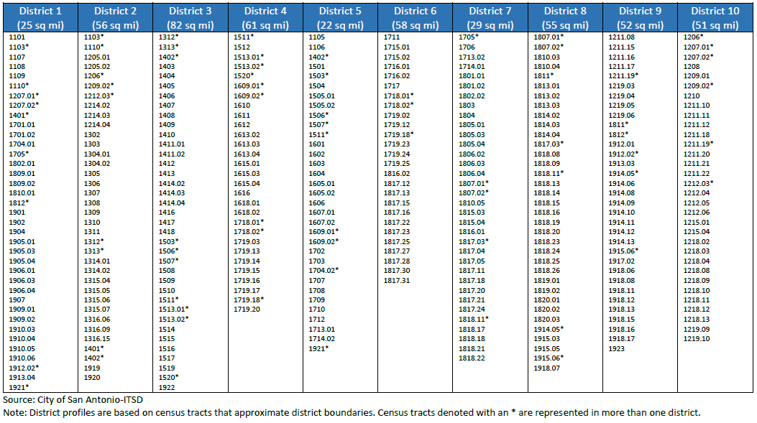
Census Tracts by City Council District

Slide 5
Request
Population by Age
Population Below Poverty
Insurance
Employment Status
Educational Attainment for Population 25+
Less than HS
Bachelor’s Degree or Higher
Notes:
“Brain Gain” (Return Migration)

Slide 6
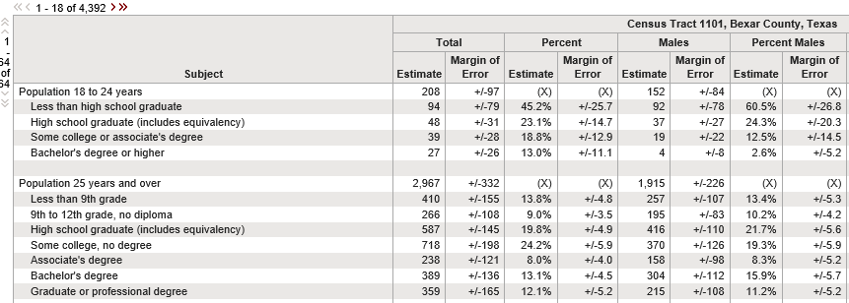
S1501 Educational Attainment

Slide 7
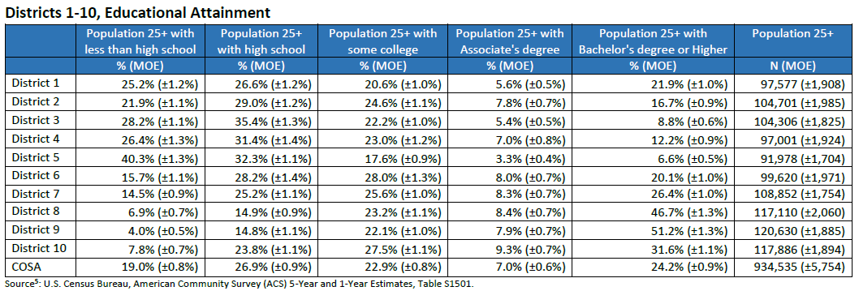
Education Attainment

Slide 8
Login Screen
Notes:
For map is 5yrs

Slide 12
Notes:
Change to blue color ramp

Slide 14
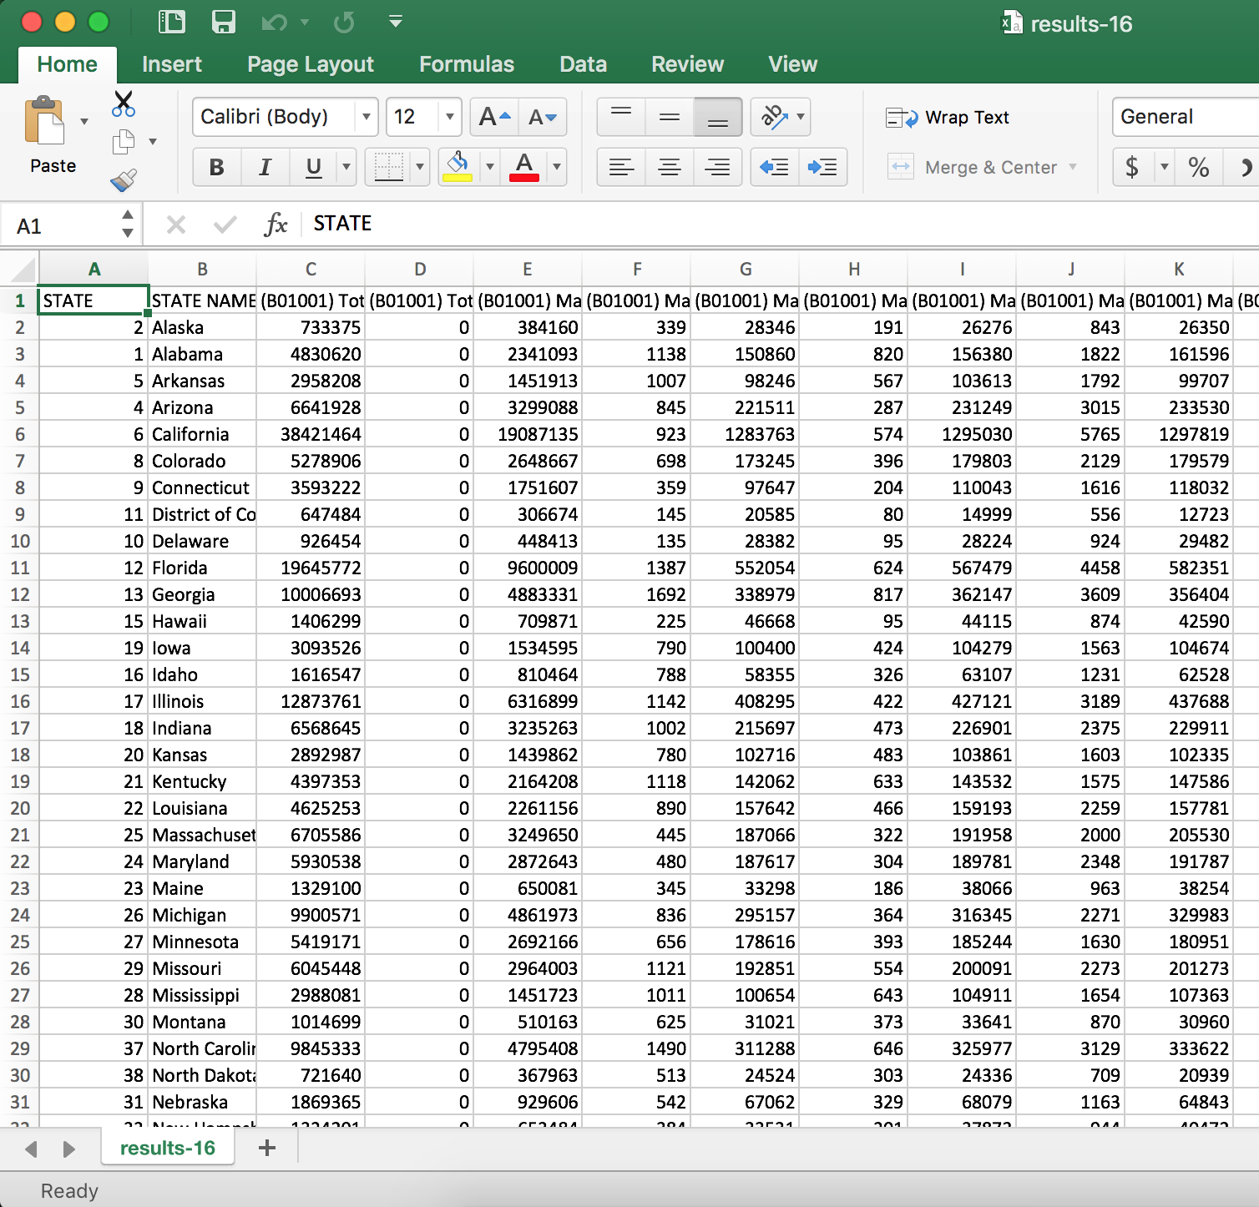

Slide 15
Moving forward
Aggregate across variables (columns) with MOE calculations
Percent and %MOE calculations
Saving queries and sharing with others
Save time and increase productivity
Reduce errors and make QA easier by constructing the list or query just once
We’re proposing a camp session for discussion and hope to learn whether anyone thinks they’d use this

