Slide 1
VoiceGR
Jodi Petersen, PhD
Director, Community Research Institute

Slide 2
What is VoiceGR?
Broad scale community survey on a variety of topics
Neutral data source
Goals
Open community use
Disaggregate information
Benchmark progress
Increase access to data
Inform decision making

Slide 3
How does it work?
Multiple data collection methods
2001: began as a telephone survey (N=500)
2015: online and community events
Input from multiple stakeholders on question content
Partner with local organizations for survey administration
Results displayed via online data tools

Slide 4
Respondents
Over 5000
Representative of Grand Rapids as a whole in:
Age
Race/Ethnicity
Geography
Notes:
SAMPLE
Last year’s results
Basic needs?
Discrimination?

Slide 5
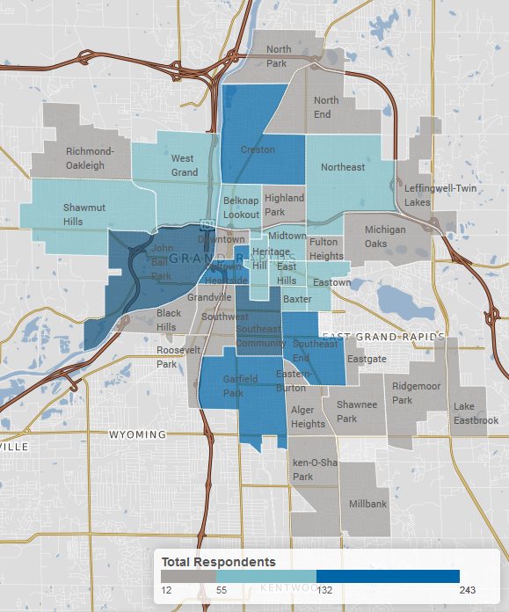
Respondent Home Location

Slide 6
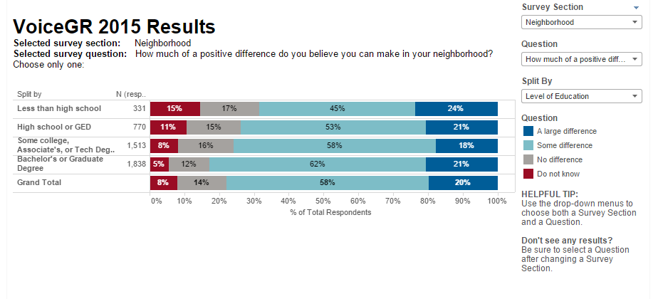

Slide 7
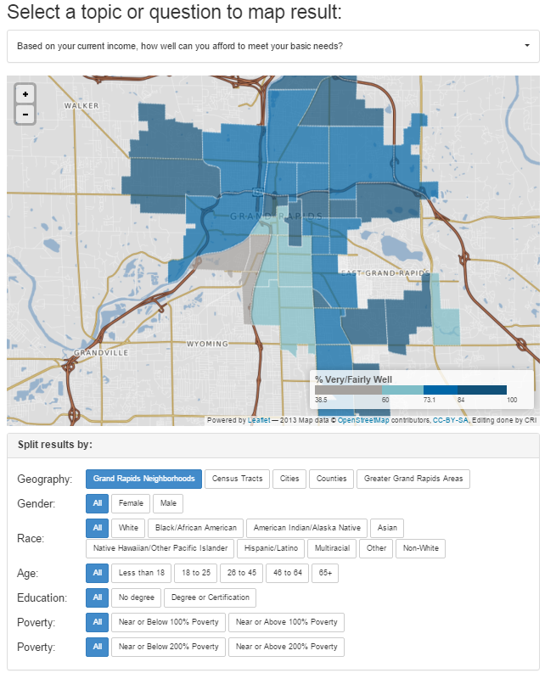

Slide 8
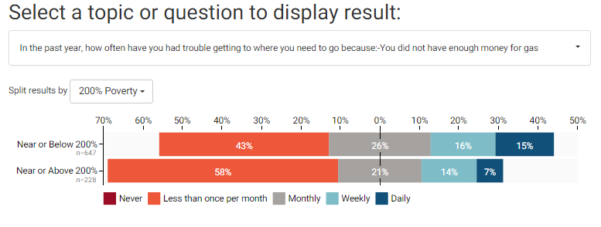

Slide 9
Big Themes
No one exists in a vacuum
Disaggregating data is key
We need to be specific in what we ask and how we interpret information
Notes:
SAMPLE
Last year’s results
Basic needs?
Discrimination?

Slide 10
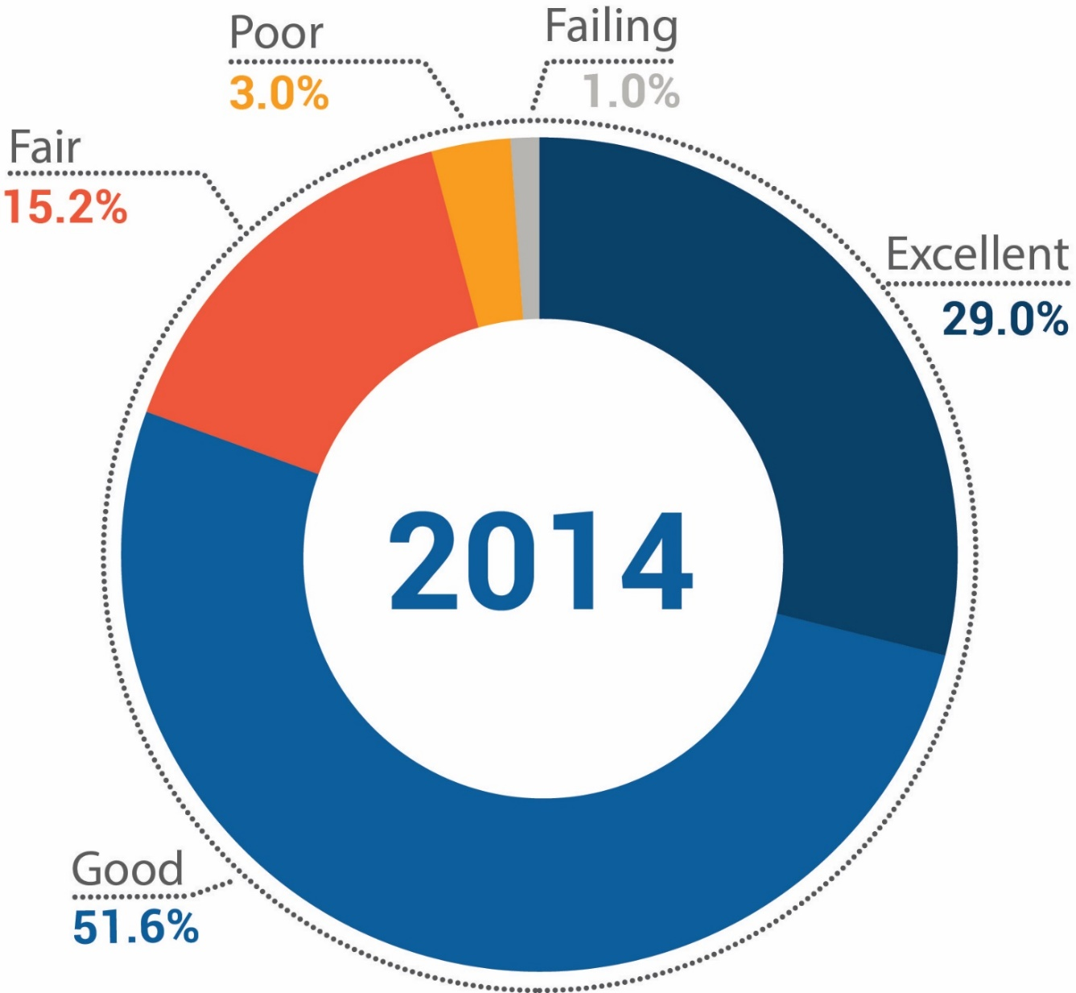
Rating of the City as a Place to Live
Notes:
Ratings of Grand Rapids as a place to live 2014

Slide 11
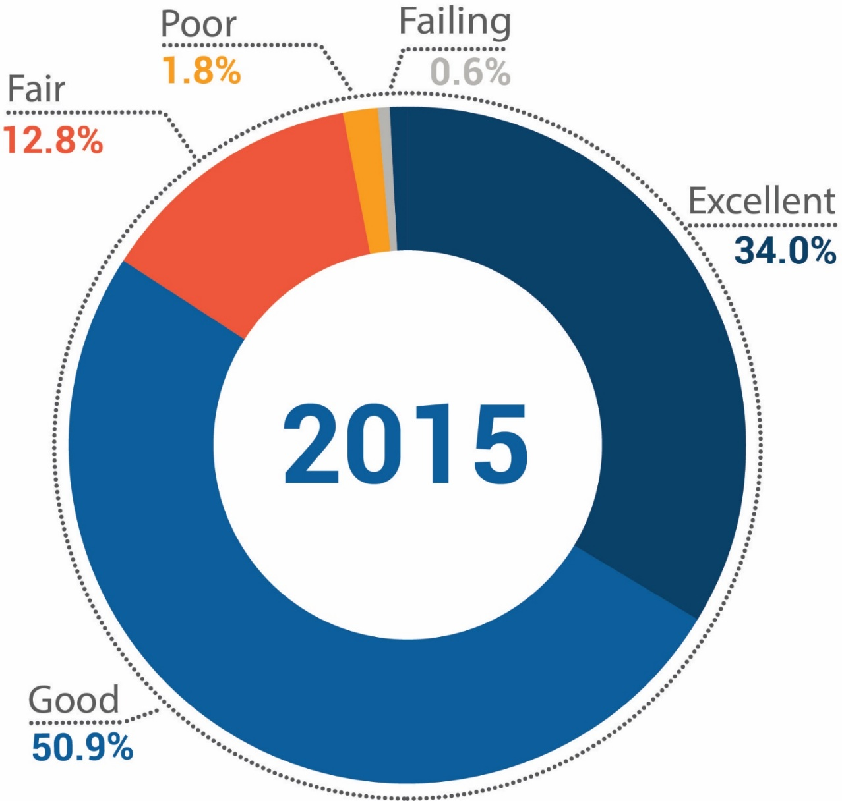
Rating of the City as a Place to Live
Notes:
Ratings of Grand Rapids as a place to live 2015

Slide 12
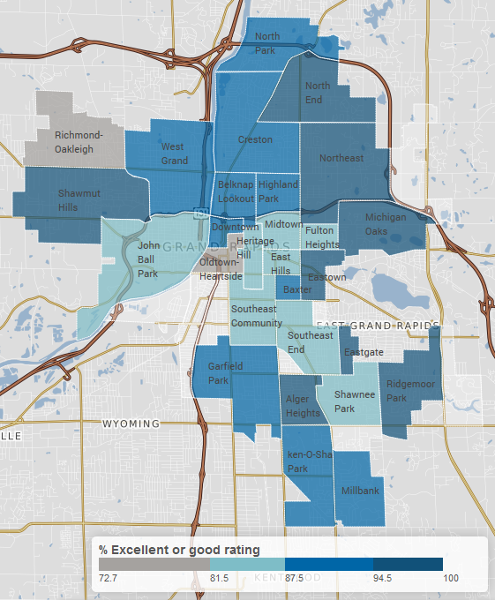
Rating of the City as a Place to Live

Slide 13
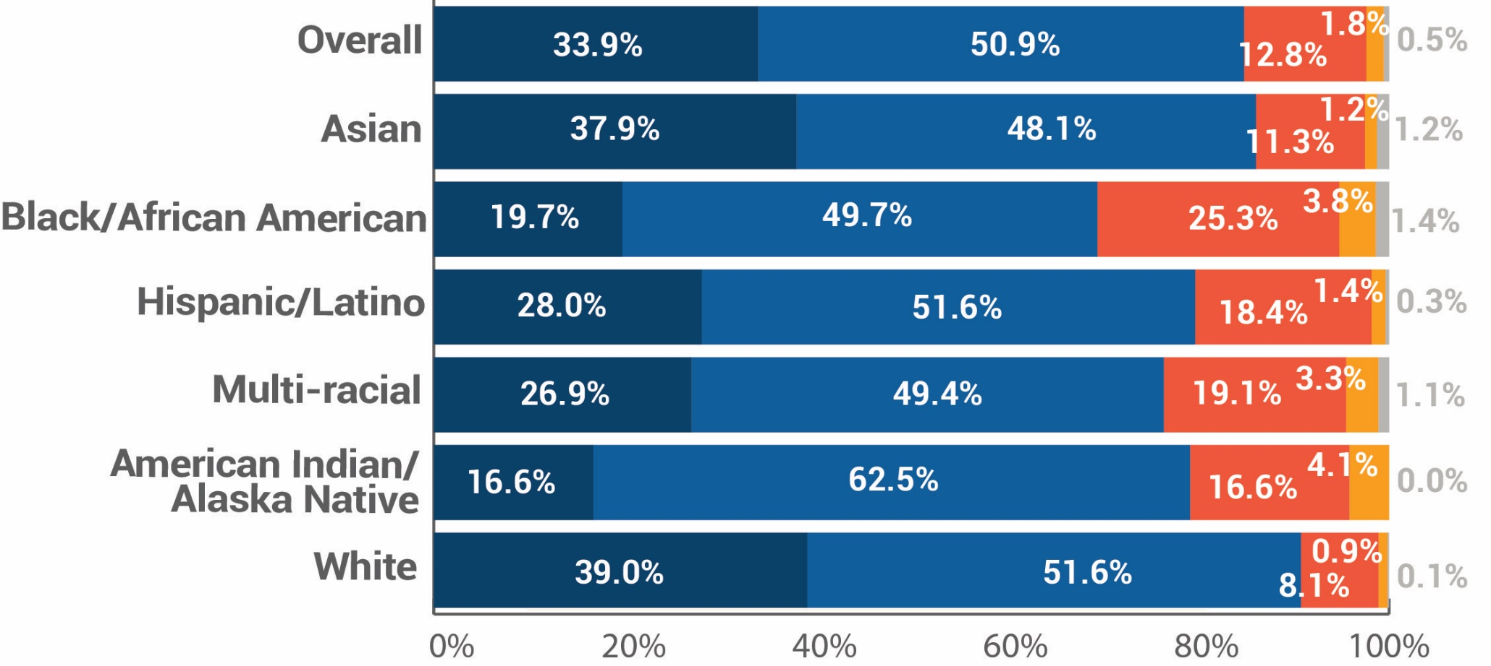
Rating of the City as a Place to Live
Notes:
Ratings by race

Slide 14
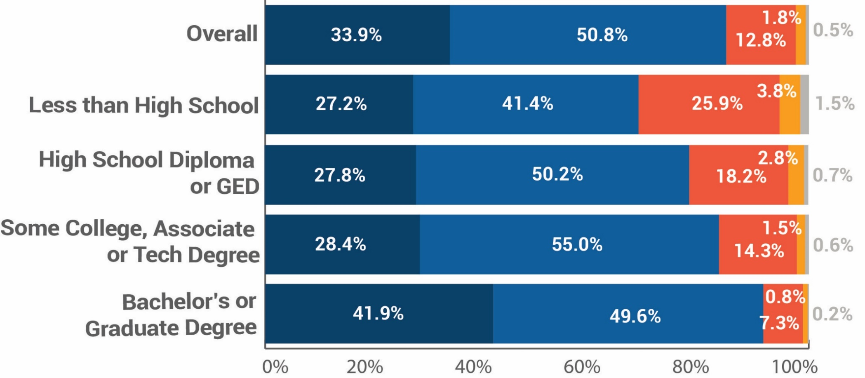
Rating of the City as a Place to Live
Notes:
Ratings by education

Slide 15
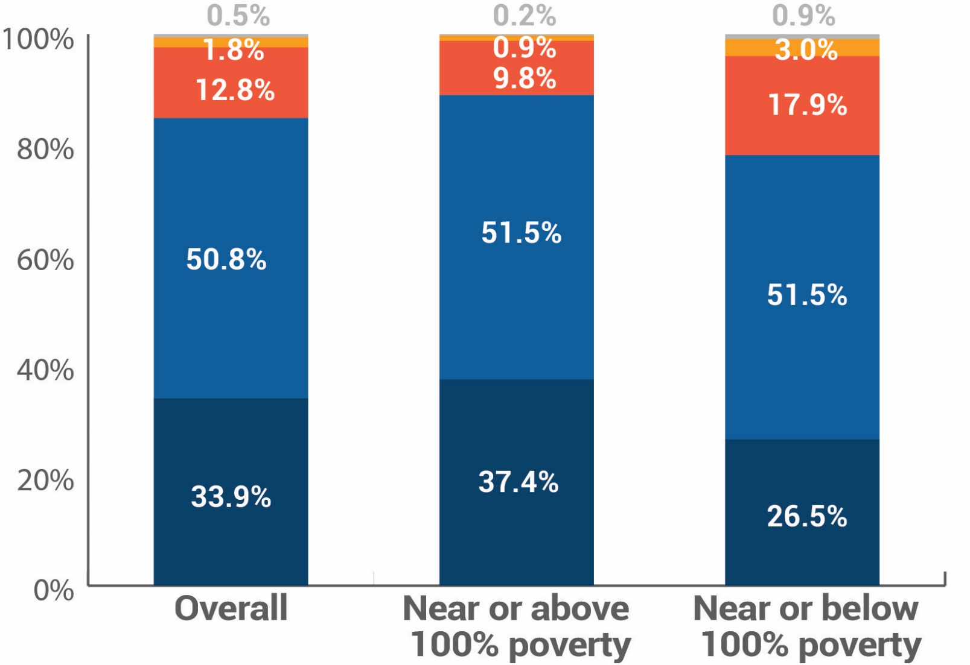
Rating of the City as a Place to Live
Notes:
Ratings by poverty status

