Slide 1
Changing the Game: The Power of Indicators
Spencer Cowan, Senior Vice President
April, 2016
Woodstockinst.org /// @WoodstockInst

Slide 2
Establishing the Context
Social Security was not meant as a sole-source retirement plan
supplemented by pension and savings
Pensions becoming rare
fewer employers offering any plan
replaced by defined contribution plans
Workers are not saving enough
Issue gaining national attention
but no national solution, left to states

Slide 3
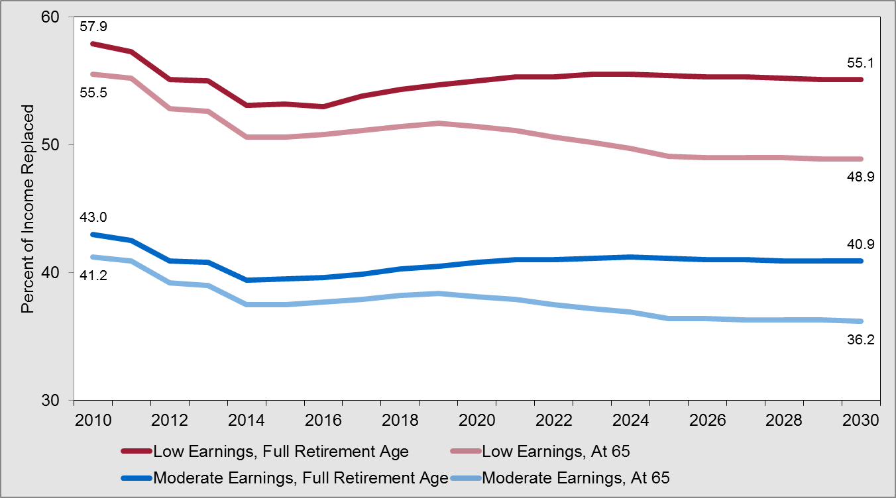
SS Replacement Rate
Source: Social Security Administration

Slide 4
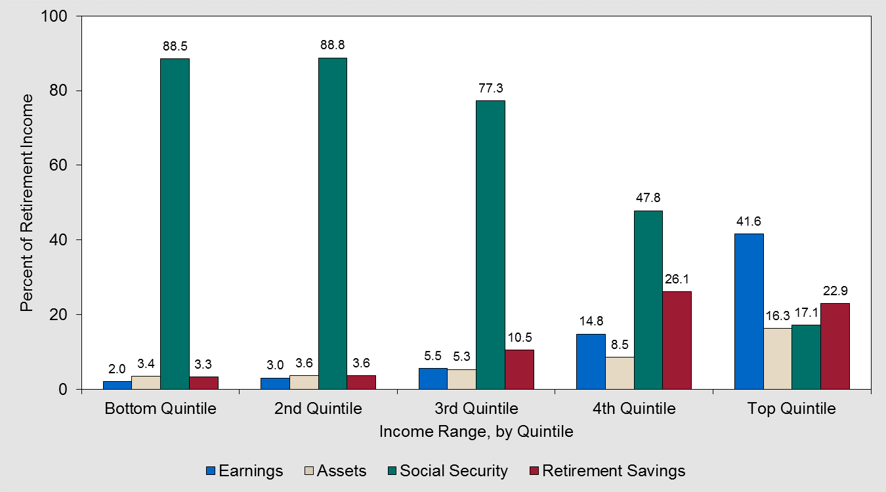
Retirement Income Sources
Source: Employee Benefits Research Institute, 2010 data

Slide 5
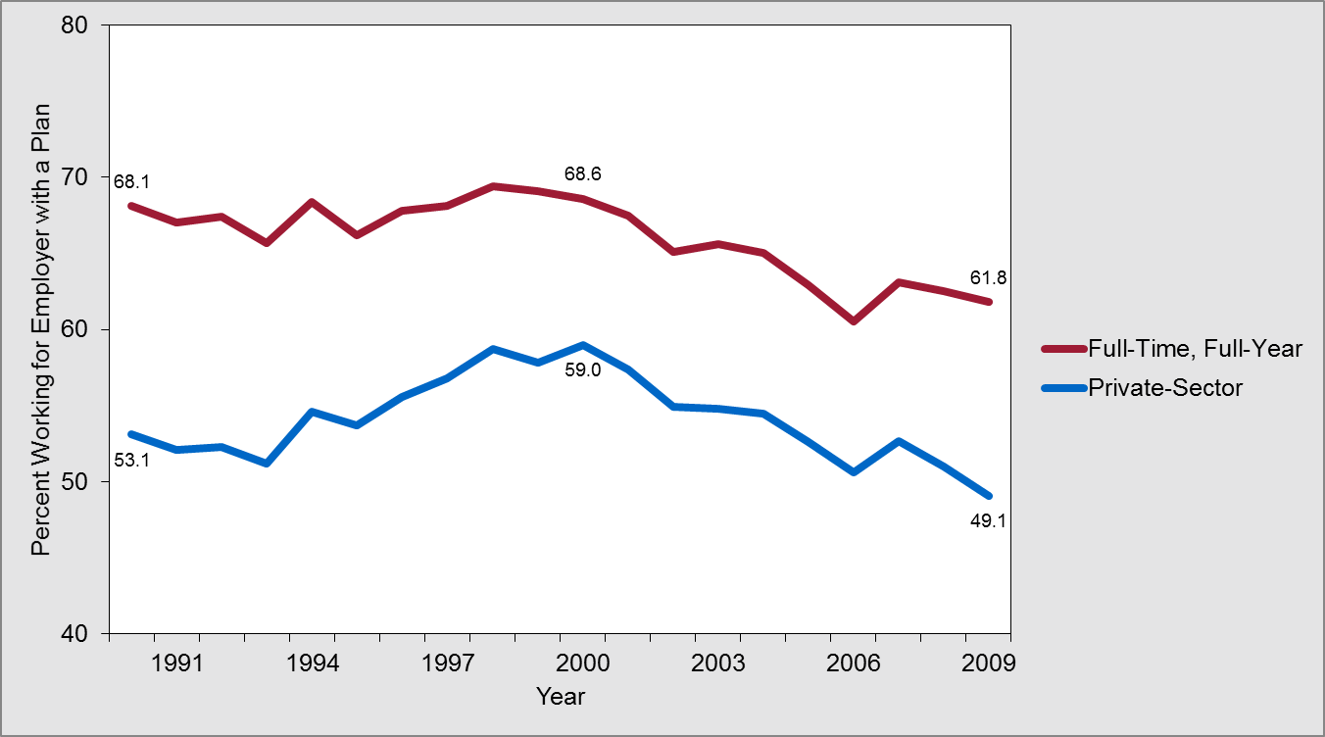
Access to a Plan at Work
Source: Employee Benefits Research Institute, 2010 data

Slide 6
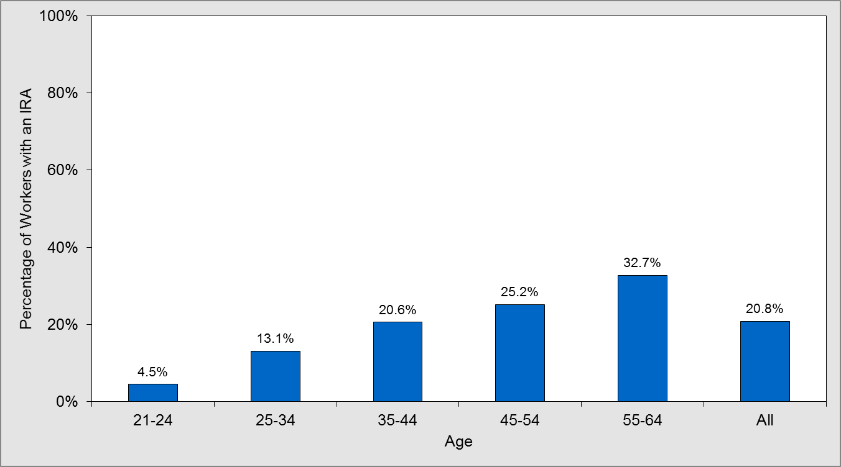
Retirement Accounts by Age
Source: Employee Benefits Research Institute

Slide 7
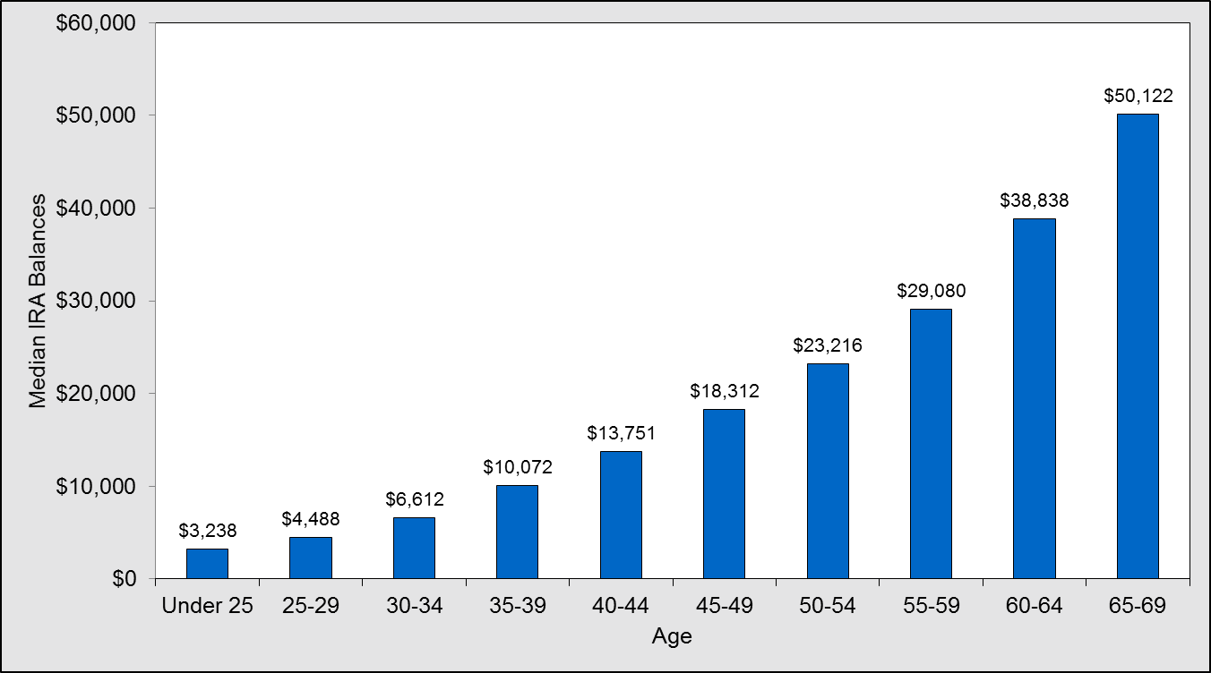
Amount in Accounts by Age
Source: National Institute on Retirement Security

Slide 8
Policy Implications
If nothing is done
many retirees will face decreased standard of living
many adults will need to help support their aging parents
government will face increased pressure to bolster the social safety net
business will face diminished investment from retirement plans

Slide 9
Neighborhood Indicators
Over 2.5 million private-sector workers (53.4%) in Illinois do not have access to a retirement savings plan at work
315,600 in accommodation/food services
357,600 in health care/social assistance
305,500 in retail trades
Broken down by legislative district

Slide 10
Legislative District Data
Neighborhood | # Private-sector Workers | # Without Access to a Plan | Pct. without Access to a Plan
Senate District 1 | 49,057 | 26,928 | 54.9%
Senate District 2 | 68,589 | 37,446 | 54.6%
Senate District 3 | 63,009 | 34,433 | 54.6%
Senate District 4 | 63,824 | 34,294 | 53.7%
Senate District 5 | 78,639 | 42,519 | 54.1%
Senate District 6 | 107,653 | 58,182 | 54.0%
State of Illinois | 4,694,599 | 2,507,059 | 53.4%

Slide 11
Automatic IRA Proposal
Auto-enrollment IRA
contribution by payroll deduction
all employers with 10 or more employees
Run by a state-appointed board
Funds pooled together
managed by private investment company
Default 3% payroll deduction
in age-targeted fund
three other options

Slide 12
The Negotiation Process
Illinois Secure Choice Savings Program
rebranding from auto-IRA
Cost estimates
minimal cost to employers
least expensive alternative
Build a coalition
nonprofits, some business associations, some financial institutions
Compromises to win over legislators

Slide 13
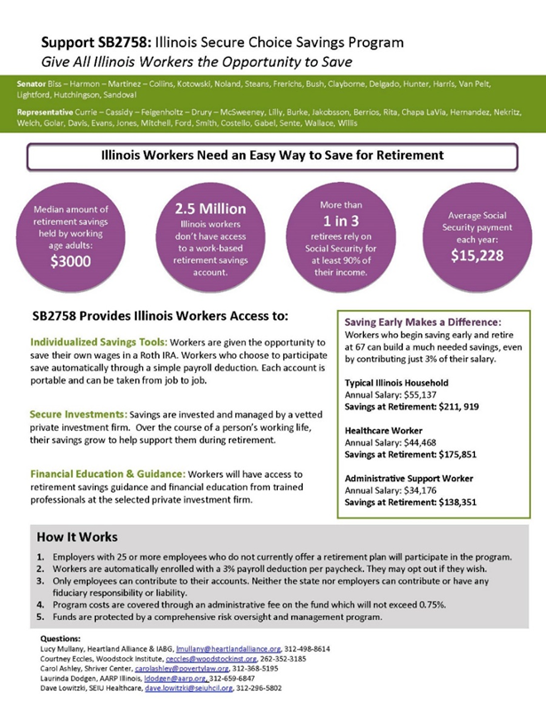
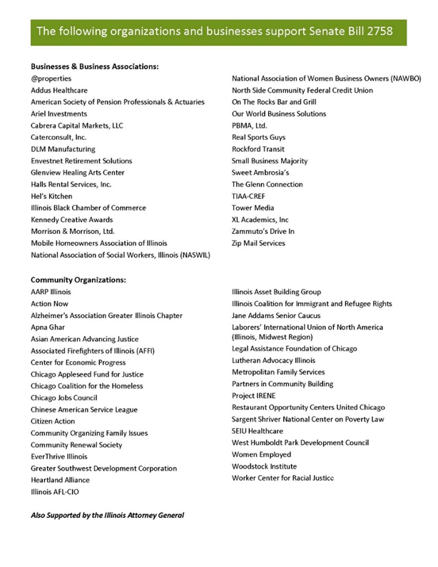
Secure Choice Factsheets

Slide 14
The Final Bill
Illinois Secure Choice Savings Plan
signed into law January 4, 2015
Mandatory for larger employers (25+)
if more than 2 years old and don’t offer a retirement plan
Plan is a Roth-type IRA
not deductible, tax-free withdrawal
no current state tax receipt impact
no employer contribution allowed to avoid ERISA

Slide 15
Conclusion
Indicators to define the problem
establish the policy context
define the dimension of the problem
establish the metric to be changed
Indicators as a tool for advocates
as part of policy advocacy
to influence policy makers
to be used in conjunction with political skills to change the trajectory

