Slide 1
Online Community Assessment and Planning Tool
Sharon Kandris
The Polis Center at
Indiana University-Purdue University Indianapolis

Slide 2
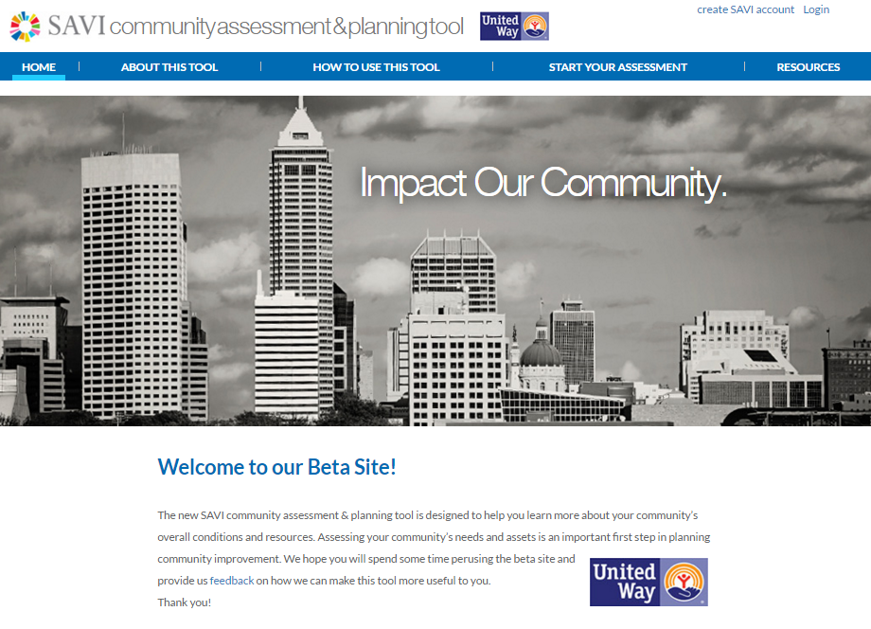

Slide 3




TACO Tuesday?
TACO = Tools for Assessing Communities Online
Sharon Kandris
Demetrius Glover
VP Strategic Information

Slide 4
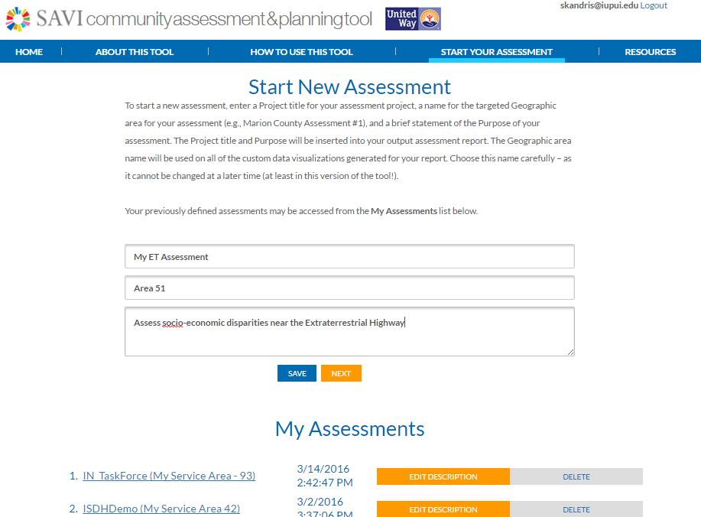
Assessment Name
Your Geo Name is used in all data viz
Geography
Purpose
Save multiple assessments

Slide 5
Step 1: Define Scope
Step 2: Assess Needs
Step 3: Identify Assets
Step 4: Define Gaps and Opportunities
Step 5: Print Report

Slide 6
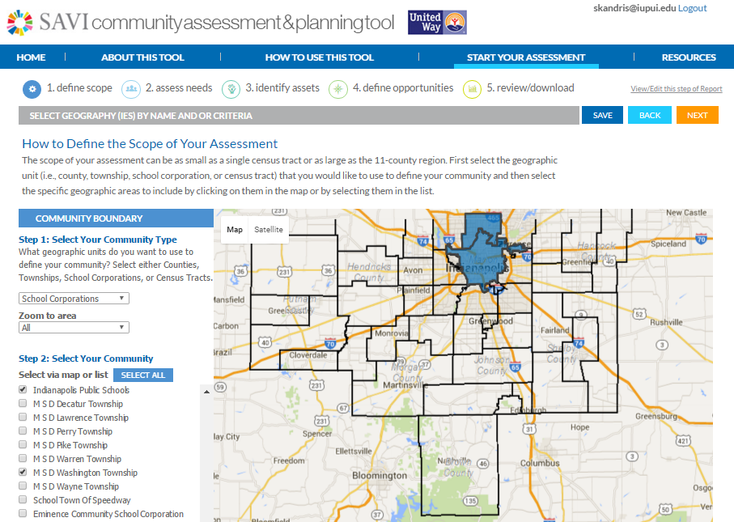

Slide 7
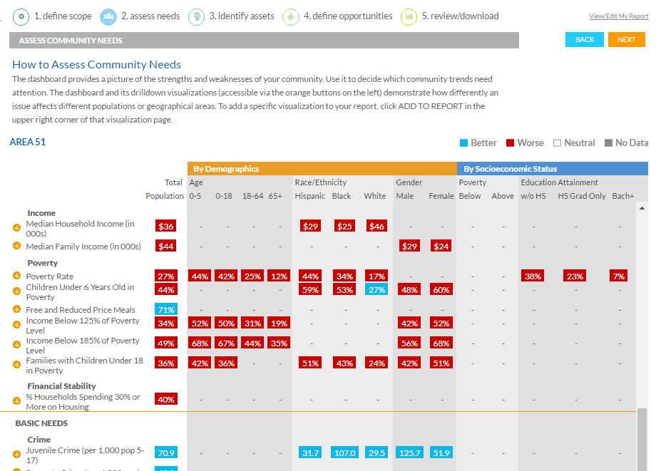

Slide 8
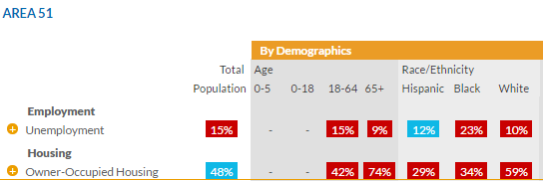

Explore Disparities by Age, Race, Gender, Income, and Education Level

Slide 9
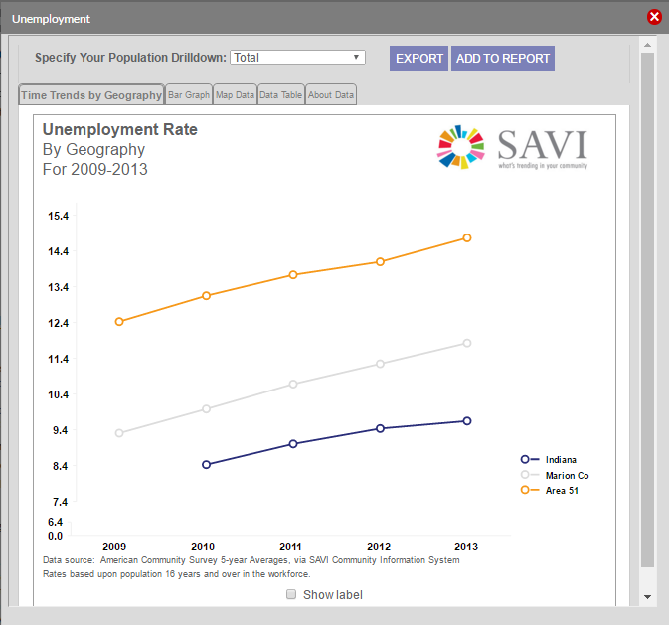
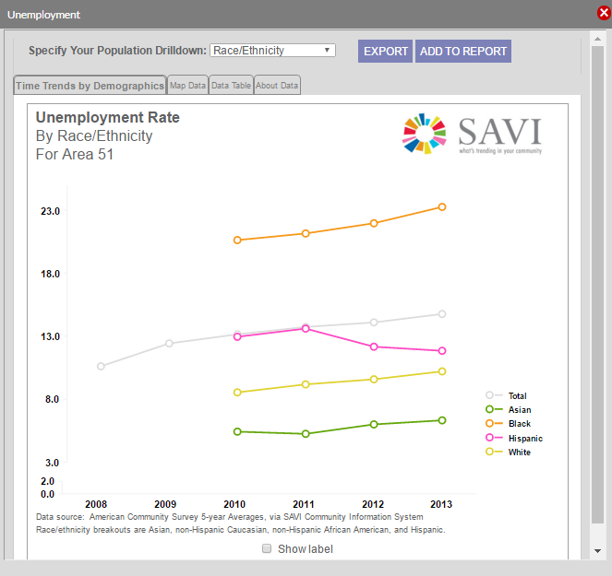
Explore Trends and Disparities
Change Race, Gender, Educ, Income
Your Geo Name
By
Race
Your Geo Name

Slide 10
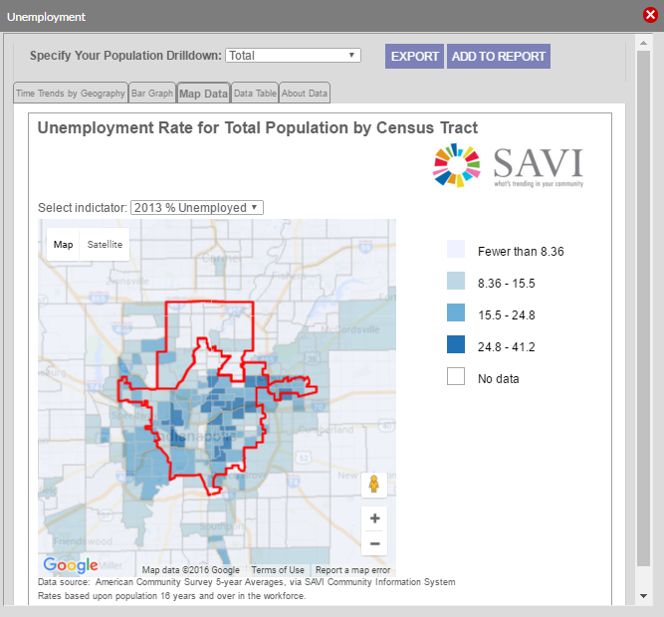
Does Geography Matter?
Add any viz to your assessment report

Slide 11
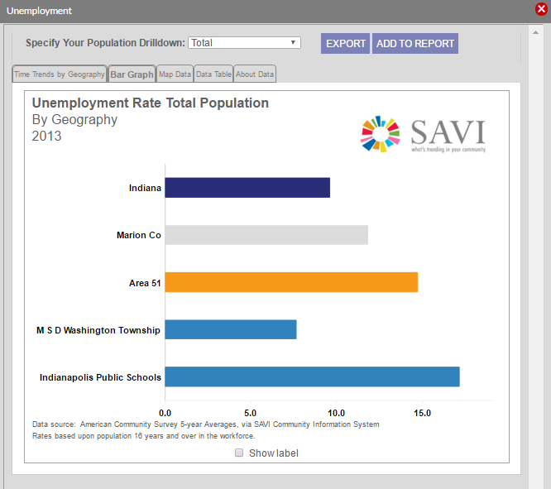
Sub-geos of Your Assessment Area
Your Assessment Area
The geos you selected to build your Assessment Area

Slide 12
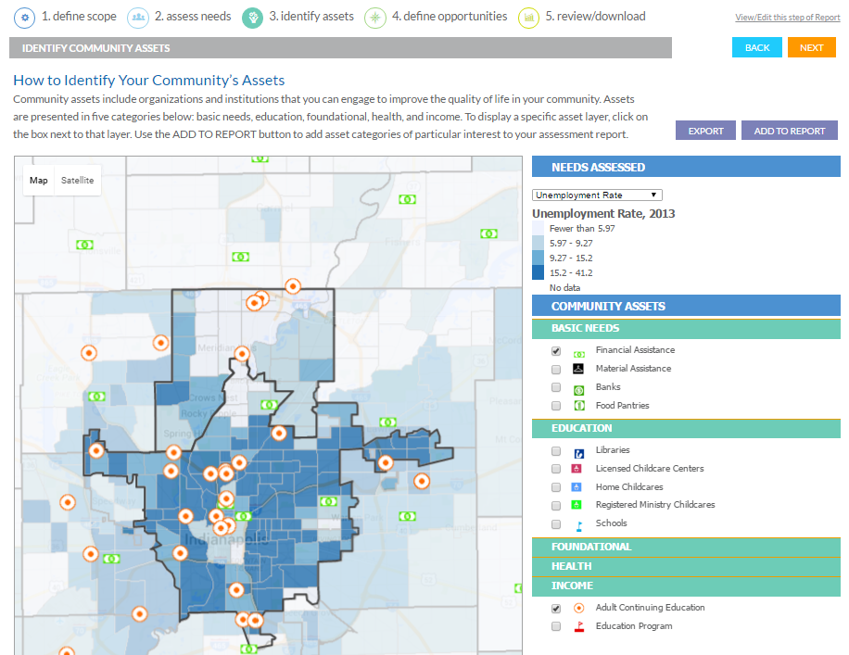

Slide 13
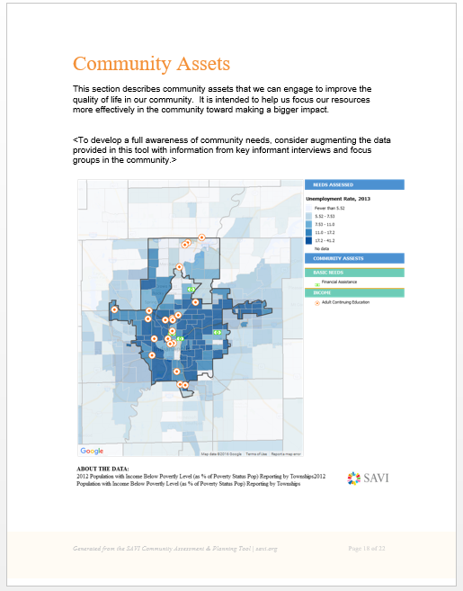
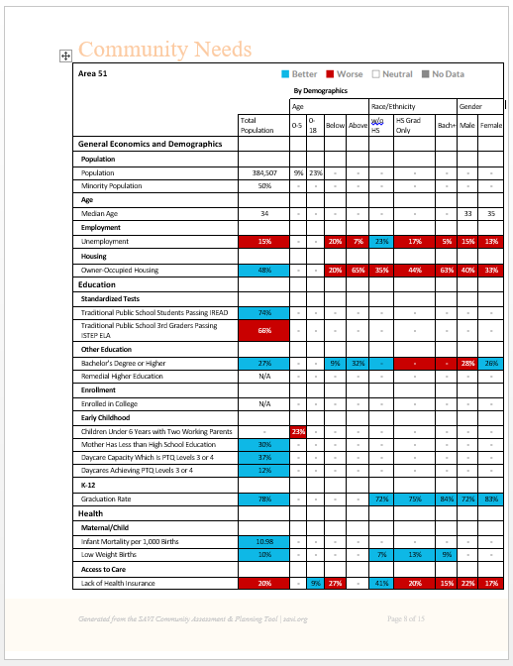
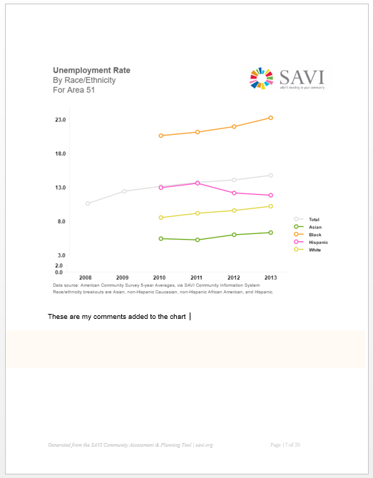
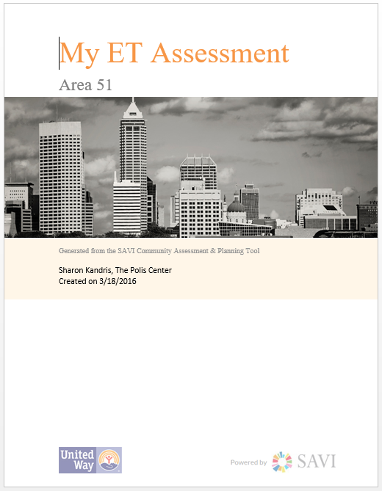
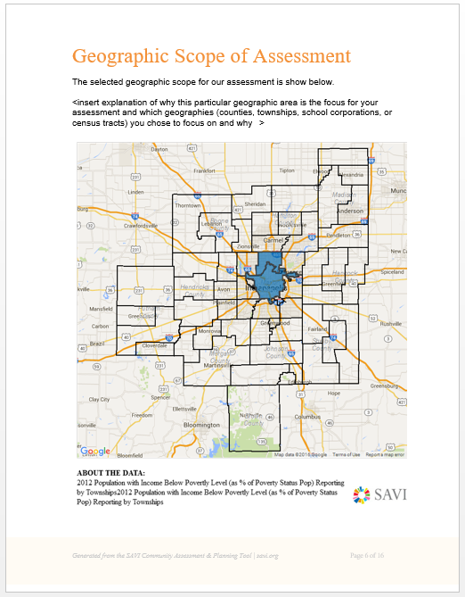

Slide 14
  The user friendly, report is “phenomenal”
  --United Way Research Staff
This tool would have saved me hundreds of hours doing assessments all these years!
--Consultant and United Board Member
Public Version Coming July 2016

Slide 15
What’s Next? Improved Data
New 3-year grant:
Assets: capacity, services, performance, availability, eligibility, etc. (Better gap analysis)
Real-time needs: 211 Helpline calls
Needs and Outcomes: Building an IDS of client data from 90 nonprofits in Central Indiana funded by United Way

