Slide 1
What’s Next for Baltimore Vital Signs?
Using Data to Promote Equity and Empower Communities
NNIP Meeting 2016 San Antonio
Seema D. Iyer, PhD
Associate Director, Jacob France Institute
#VitalSigns13
@bniajfi
www.bniajfi.org

Slide 2
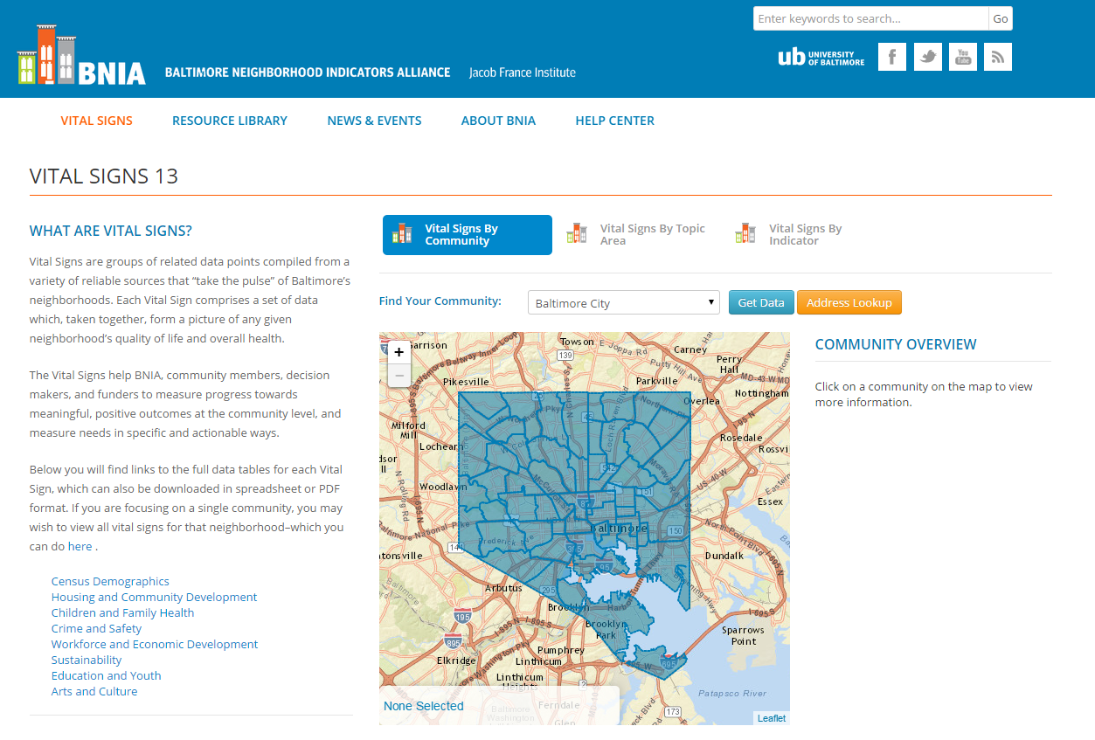
Project funded by the Annie E. Casey Foundation
Available at the CSA data FREE on BNIA-JFI website

Slide 3
After Freddie Gray

Slide 4
Population Decline
Baltimore City lost 330,000 between 1950 and 2010.
Most people/media attribute the loss to crime and poor education
Community Statistical Area (CSA) | Pop 2000 | Pop 2010 | Pop Change | % Pop Change
Baltimore City | 651,154 | 620,961 | -30,193 | -4.6
Greenmount East | 11,561 | 8,184 | -3,377 | -29.2
Allendale/Irvington/S. Hilton | 19,129 | 16,217 | -2,912 | -15.2
Clifton-Berea | 12,496 | 9,874 | -2,622 | -21.0
Greater Rosemont | 21,877 | 19,259 | -2,618 | -12.0
Sandtown-Winchester/Harlem Park | 17,495 | 14,896 | -2,599 | -14.9
Canton | 7,010 | 8,100 | 1,090 | 15.5
Cross-Country/Cheswolde | 11,796 | 13,034 | 1,238 | 10.5
Downtown/Seton Hill | 4,767 | 6,446 | 1,679 | 35.2
Harbor East/Little Italy | 3,523 | 5,407 | 1,884 | 53.5

Slide 5
Population Change & Vacant Housing
Sandtown-Winchester/ Harlem Park

Slide 6
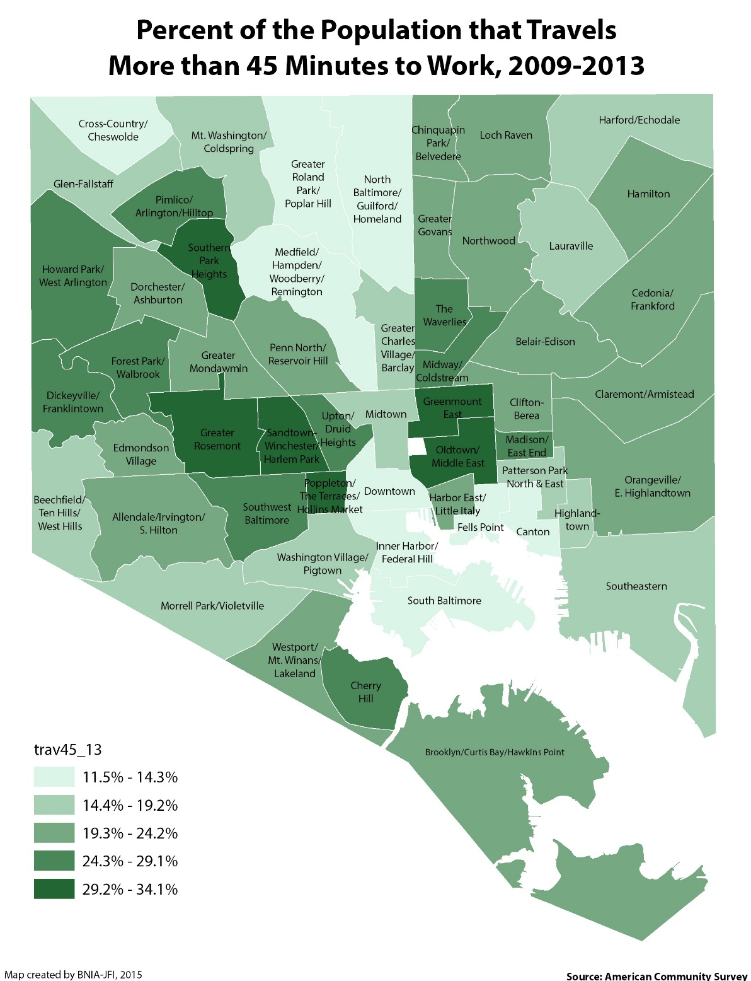
Accessibility
20.2% of City residents commute more than 45+ minutes
Highest CSA:
Sandtown-Winchester/ Harlem Park (34.1%)
Greater Rosemont (33.6%)
Greenmount East (31.2%)
Oldtown/Middle East (30.8%)

Slide 7
Neighborhood Context
Vacant and abandoned housing is an Environmental Justice issue that disproportionately impacts vulnerable populations
Long commute times are a major barrier to truly achieve Regional Equity for everyone in every neighborhood
Data becomes more valuable over time
Need data to truly strengthen civil society and improve democracy
Access to information by itself doesn’t change people’s minds; need to present the data in a compelling way

Slide 8
Questions?
#VitalSigns13
@bniajfi
www.bniajfi.org

