Slide 1
The Impact of High Intensity Volunteers in RI
An NNIP cross-site project on Integrated Data Systems
funded by the Annie E. Casey Foundation
NNIP – San Antonio
Kim Pierson
Notes:
10-15 mins
ProvPlan, a partner in the National Neighborhood Indicators Partnership (NNIP), participated in the “Connecting People to Place: Improving Communities through Integrated Data Systems” (IDS) demonstration project. The goal of the national cross-site project, funded by the Casey Foundation, was to connect IDS data to place-based and neighborhood indicators to inform decision-making at the local level and to support solutions in neighborhoods.
ProvPlan studied civic engagement levels and trends in the city of Providence. Existing data from Rhode Island’s IDS, the RI DataHUB, was linked at the individual level to historic voting records from the Rhode Island Secretary of State’s Office as well as to volunteer (AmeriCorps) data. Linking these datasets allowed ProvPlan to explore innovative civic engagement indicators over time and understand how civic engagement levels are impacted by such factors as education level, participation in the workforce, and neighborhood factors. ProvPlan also looked at whether voter disenfranchisement is concentrated in particular neighborhoods and how voting trends varied by neighborhood.

Slide 2
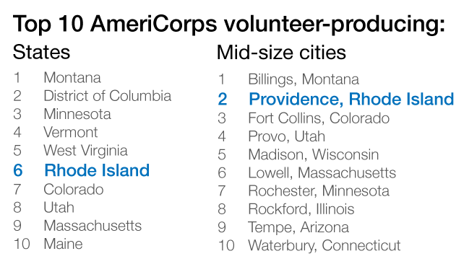
Volunteerism through AmeriCorps
Notes:
A project initially targeting two initiatives with “high intensity volunteers” – AmeriCorps and Inspiring Minds – became an AmeriCorps only project.
Inspiring Minds was not ultimately included in the story because the sporadic engagement from the organization and data quality issues.
This worked out okay because we were having a tough time defining a cohort when the two programs were so different and when they were only a fraction of “volunteer” opportunities in Providence/Rhode Island.
The AmeriCorps program, funded by the federal Corporation for National and Community Service (CNCS) and administered in the state by Serve Rhode Island, is designed to meet critical needs in areas such as education, the environment, and public safety.
RI ranks 6th among the 50 states for per capita AmeriCorps participation, and Providence ranks 2nd in the nation among midsize cities (1). Since the state's program began in 1994, more than 4,600 AmeriCorps volunteers have provided 5.2 million hours of service to RI communities, valued at $122 million.

Slide 3
Volunteerism through AmeriCorps
Why AmeriCorps? National service programs like AmeriCorps offer several features that set them apart:
Federal funding to address local issues
Training and structure
AmeriCorps offers an Education
Minimum service is 300 hours
Notes:
Why concentrate on AmeriCorps volunteers in Rhode Island?
Although any form of volunteerism is valuable, national service programs like AmeriCorps offer several features that set them apart:
-They make use of federal funding to address issues facing local neighborhoods.
-They offer training and structure to build skills and help ensure effectiveness.
-In addition to a living allowance, AmeriCorps offers an Education Award--funding that volunteers can use toward college tuition.
-AmeriCorps offers programs requiring varying levels of service, but the minimum is 300 hours; volunteers who serve at that level (termed high-intensity volunteers) are more likely to provide value and to reap the benefits of service.

Slide 4
Our Work
Secure MOUs
Obtain data (ServeRI)
Integrate data into our IDS
Analyze data
Iterative process with stakeholder meetings to sift out meaningful content and story trajectory (“Data Story” process)
Collaborative process for finalization and dissemination
Notes:
Our community outreach efforts began in Spring 2015 with the launch of two data story teams. The first was organized around the original youth development thread and the second was around the volunteer thread. Separately, each team held four meetings, on April 1st, May 13th, June 17th, and July 15th. Both groups were instrumental at informing the shape and format of the analyses and products. They provided essential context as well as feedback about what could and couldn’t be said about certain populations. When we presented data that ran counter to their assumptions, they were receptive and it even appeared to increase their engagement and interest in the project and products.

Slide 5
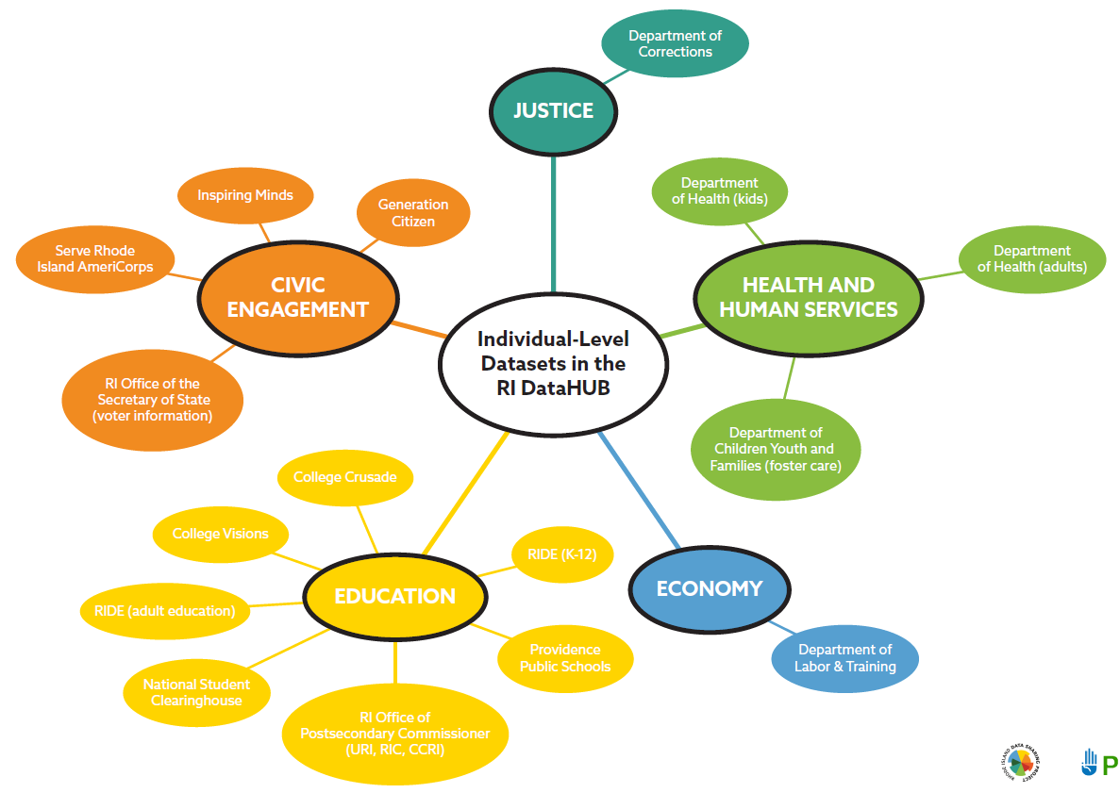
The RIDataHUB
Notes:
For the volunteer data story, we linked the volunteer data set (ultimately AmeriCorps volunteers) with data from
-the RI Department of Education (RIDE),
-National Student Clearinghouse (NSC),
-RI Department of Labor and Training (DLT), and
-the RI Secretary of State (RISOS).

Slide 6
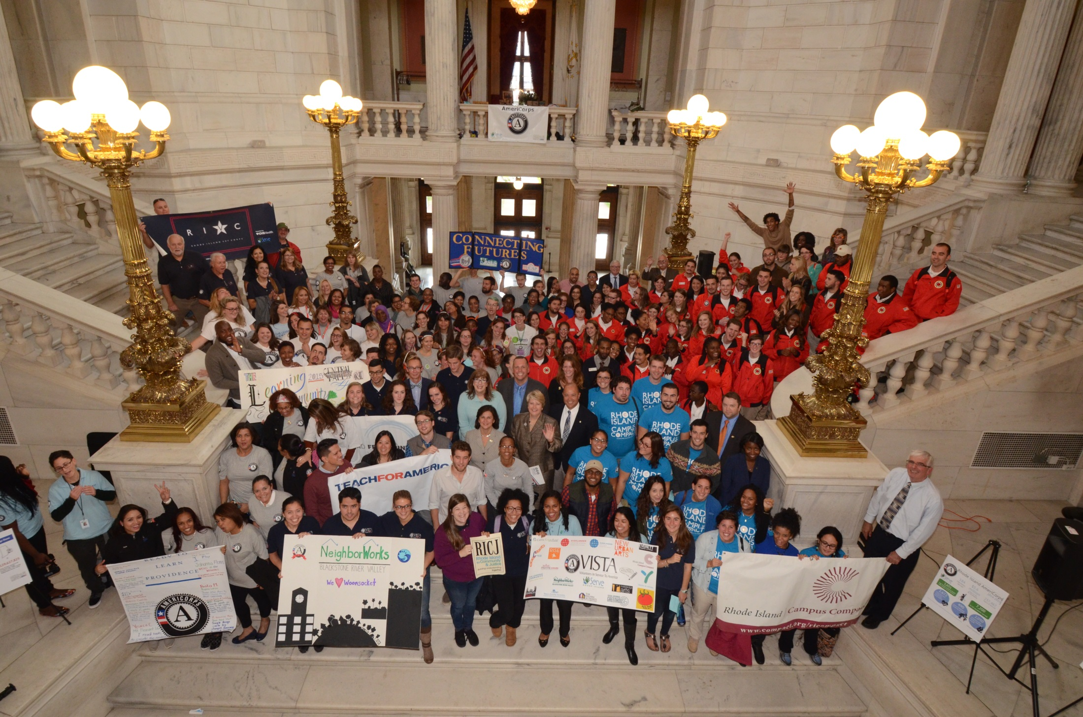
Our Cohort – Millennial “High Intensity” Volunteers
This story focuses on 1,247 volunteers who have:
Served in RI within the past 10 years
Were born in 1985 or later
Have served at least 300 hours
Notes:
After much discussion, this cohort was chosen because it had the best linkage opportunities with postsecondary and workforce data.
The minimum of 300 hours was selected because it is the “minimum” time for AmeriCorps education awards and the data story group agreed that it represented a substantial time commitment worthy of distinction from Inspiring Minds volunteers (which ended up being dropped anyway).

Slide 7
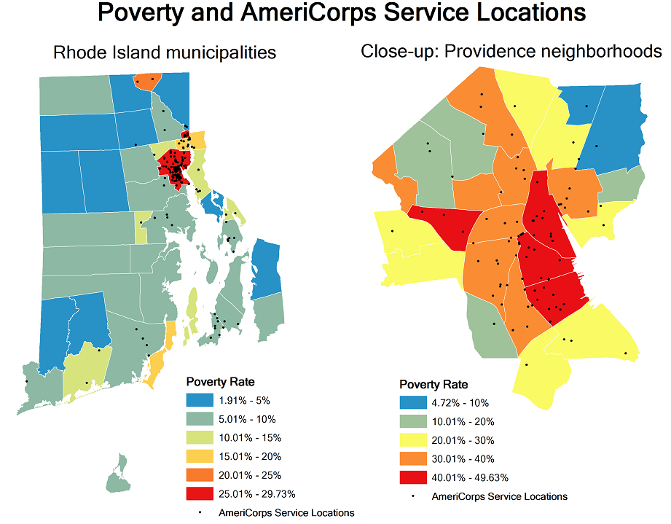
Findings
55% of the AmeriCorps from RI were from 1 of the 4 urban core cities
Notes:
Linkage to Providence neighborhoods was of particular interest because it countered a prevailing assumption that the program runs into that the volunteers come from relatively wealthy college-educated backgrounds.
Many volunteers grew up in Providence, served in Providence, and stayed in the area after service or returned after college.
53% of the AC volunteers from RI were from 1 of the 4 urban core cities (Providence, Pawtucket, Central Falls, or Woonsocket). Many of these AC volunteers came from impoverished Providence neighborhoods and served in these same neighborhoods providing valuable services in areas that are most in need. By focusing their recruitment strategy on these neighborhoods, AmeriCorps hopes to employ volunteers who are uniquely qualified to address local issues.

Slide 8
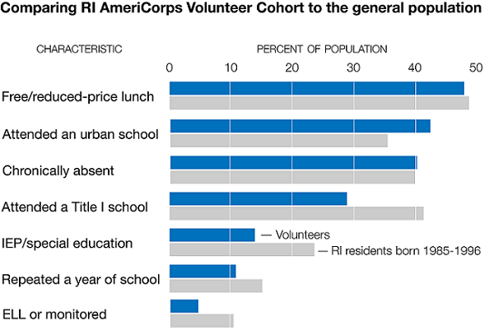
Findings
Countered the stereotype of well-off volunteers with time on their hands (“gap year”)
Notes:
Far from the stereotype of well-off volunteers with time on their hands, these volunteers are the very people most likely to benefit from the training and funding AmeriCorps provides. Of our millennial cohort,
-46% attended an urban school
-nearly 30% attended a Title I school (with at least 40% of students from low-income families).
-53% qualified for free or reduced-price lunch while they were in school--higher than the statewide rate (48% in 2012).

Slide 9
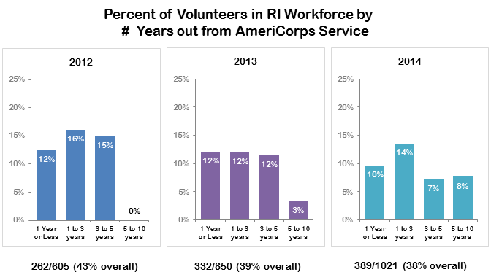
Findings
Workforce Implications: Drawing Skilled Workers to Remain in RI

Slide 10
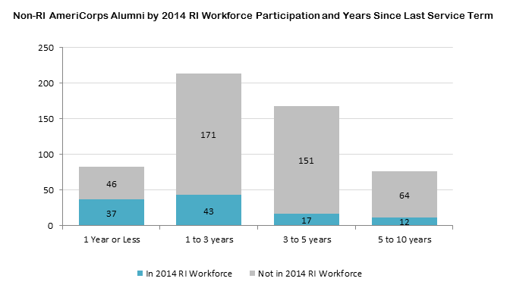
Findings
Workforce Implications: Drawing Skilled Workers to Remain in RI
Notes:
Direct economic benefit of AC investment: drawing skilled workers to remain in state

Slide 11
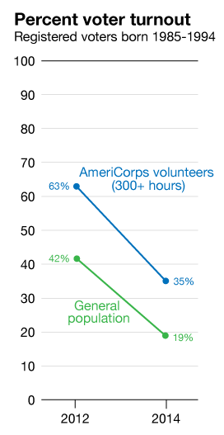
Findings
The AmeriCorps cohort was more engaged than their peers in the general population for voting
For those cohort members that were registered to vote 63% turned out to vote in 2012 compared to 42% turnout of voter of the same age.
Notes:
The AC volunteers also contribute to the state’s long-term economic and civic health by remaining in state for college and careers and acting as engaged members of the community. There are many measures of engagement in one’s community. AmeriCorps volunteers have engaged in direct service to some of the highest need areas in Rhode Island. Voting is another measure of community engagement. The numbers in non-presidential general election of 2014 dropped for both groups which mirrors national elections trends
In recent years, hundreds of young volunteers from financially and academically disadvantaged backgrounds have gained resources, training, and motivation to succeed in school and become productive members of the workforce.
The high-intensity volunteers who serve through AmeriCorps provide valuable services in neighborhoods that are most in need. They also contribute to the state’s long-term economic and civic health by going to college in the state, persisting in college through graduation, remaining in the state to work, and acting as engaged members of the community.

Slide 12
Implications of Our Finding on Partners’ Work
ServeRI (AmeriCorps):
Sustained funding
Ed Award matching
Tailor towards workforce development
K12 leaders to encourage participation
Expanded access to the RI DataHUB for community-based partners through the integration of their data
Notes:
ServeRI (AmeriCorps):
Advocate for sustained funding for AC in RI
Build relationships with local colleges and universities particularly around Ed Award matching
Tailor their volunteerism experience for workforce development based on the employment and industry trends of former AC volunteers in RI
Work with K12 leaders to encourage participation
Expanded access to the RI DataHUB for community-based partners through the integration of their data and neighborhoods data into the IDS
The volunteerism data story team was eager to link the data in an effort to learn more about the characteristics and post-service experiences of their volunteers. They intend to use the information garnered from the linked profiles of their AmeriCorps (AC) members to advocate for sustained funding for AC in RI, to build relationships with local colleges and universities particularly around Ed Award matching, and to tailor their volunteerism experience for workforce development based on the employment and industry trends of former AC volunteers in RI.
ServeRI plans to affect neighborhood-level change by 1) working with K-12 leaders to inform students of available AmeriCorps programs and encourage them to participate; 2) encouraging higher education leaders to match the federal Ed Award to help make in-state education affordable for dedicated students; and 3) proposing preferential criterion employers can implement to elevate candidates who have national service participation which benefits the employers as well as employees who have served.

Slide 13
Challenges Faced/Lessons Learned
A commitment to collaboration and data sharing does not always mean a commitment…
Relationships are key
Imperative to have actionable partners at the table
Relationships are key
Partners can facilitate new partnerships
Relationships are key
Notes:
Overall Takeaways for Greatest Impact
-Although we were successful in reaching out to key youth development programs and obtaining their buy-in for the project during the first phase of the project, when it came time to sign MOUs, share data, and participate in the Data Story process, the programs struggled with leadership transitions, limited internal capacity, and data systems and quality issues. In the end, just two of the five youth development programs and both of the volunteer programs we initially identified as data partners for this project contributed their data for integration into the IDS.
Inspiring Minds data, while integrated into the RI DataHUB, were not ultimately included in the story because the sporadic engagement from the organization prohibited us from getting enough clarity on particular interpretations of their data.
. In addition, the department that handles the election and candidate data was also undergoing staff transition and suffered from long vacancies.
-Without our actionable partner at the table, application and impact of this work fell flat.
stronger relationship with the RISOS and conversations have led to more conversations about obtaining DMV data, which would be very useful as we seek to understand which individuals are still in the state. The DMV and Voter data also provide helpful attributes for matching datasets without as many linking variables
Based on the work with both data story teams, we think there is very real support for this type of work in the future. That said, the trust established during the project is more precarious with some stakeholders than others. It seems clear that if these efforts to engage a wider group than have been “at the table” in the past are not continued, that trust earned over the course of this project will dissolve. In addition, it will be very important to address data limitations before engaging some stakeholders who may have less patience for and experience with data projects.
The two biggest obstacles for our project were the lack of capacity and staff turnover in organizations most interested in the neighborhood-level data (Inspiring Minds, New Urban Arts, Youth in Action, and Year Up). As the IDS and data intermediary, we’re just far enough removed that we couldn’t drive this work to the same extent as the stakeholders could have, and for those who were able to participate, did. Similar to the DLT issue (page 2), if the community partners were not engaged, we had little leverage to motivate their staff to participate or provide the promised data.
Another key obstacle that isn’t new to the neighborhood indicators world was that many of the data providers had questionable address data and no address history. We also ran into data quality issues with the voter datasets that could have been addressed if we had been able to work with the RISOS systems staff earlier in the project. Overall, for IDS data to address a neighborhood-level issue, it is critical that the data be relatively timely (which may mean that it needs to already be integrated; the DLT data integration really set us back which also created a queue putting the Voter, AmeriCorps and other necessary datasets behind that), easily aggregated to a neighborhood level, and trusted by the stakeholders involved.
Knowing what we know now, we would have approached this project differently in several respects.
Politics matter
While the youth development angle was of great interest to community stakeholders we really wanted to engage, we were unable to overcome the challenges of staff turnover and lack of capacity at key data partners. Therefore, we would probably have reached out to different partners more directly interested in the political engagement aspect of civic engagement.
Don’t overcommit, especially when wading into unchartered waters for your organization
In addition, we might have limited the scope of the project to a single thread of civic engagement rather than trying to tackle both volunteerism and youth development/youth political engagement. It proved too difficult to weave the two threads together and spread our own internal capacity more thin that it would have otherwise. Even with the smaller number of new datasets to integrate we ran into bottlenecks and competing priorities for internal application development and use
Benefits:
Enabled us to enhance the IDS to more easily generate neighborhood data, as well as the opportunity to obtain neighborhood level data from other non-IDS sources that we can publish to our Community Profiles site

Slide 14
Other Civic Engagement Work -- Voting
Neighborhood Young Voter Participation in Prov brief
Voting Habits of Rhode Island’s Young Adults
Data Story
Quiz
Notes:
The issue brief data analyses use individuals ages 18 to 24 in the voter registration datasets from the 2012 and 2014 elections.
Their addresses were geocoded and linked to other neighborhood level variables. We used these two groups because we wanted to ensure timely data and be able to say something about both a presidential and non-presidential election.
The 18 to 24 population was of great interest to the stakeholders gathered for the youth development data story as well as the Secretary of State’s office. Youth who were not registered to vote were not included in the analyses. The majority of analyses were simple descriptive statistics for comparisons, choropleth mapping, and scatterplots. The issue brief included some correlations as well (education, income and unemployment are all directly correlated with voter turnout).

Slide 15
Youth Voting - Summary
Factors such as language, education attainment, and poverty do not affect turnout among Providence’s 18- to 24-years-olds as strongly as they do among adults over age 25.
Low income and poverty were associated with lower turnout among youth voters
Recommendation: Online registration and expansion of early voting
Mail-in ballots have lingual, educational, and economic correlations. Most notably, young voters with low-income indicators--ever qualified for free/reduced lunch--are less likely to cast ballots by mail.
Recommendation: Educating students about the ability to vote early
Notes:
Factors such as language, education attainment, and poverty do not affect turnout among Providence’s 18- to 24-years-olds as strongly as they do among adults over age 25.
Low income and poverty were associated with lower turnout among youth voters at the neighborhood level in both the 2012 and 2014 elections.
Recommendation: Measures such as online registration and expansion of early voting options, which make voting easier for those with work and family obligations, may impact young voters in low-income areas.
Mail-in ballots, used by RI voters who are not able to be in present on Election Day, have lingual, educational, and economic correlations. Most notably, young voters with low-income indicators--especially those who had ever qualified for free/reduced lunch--are less likely to cast ballots by mail.
Recommendation: Educating students about the ability to vote early may help reduce this gap.

Slide 16
Recommendations for Engaging RI Young Adults
Target voter turnout efforts by neighborhood characteristics.
Multiple languages
Polling times and locations
Voting procedures
School-based education
Voter education campaigns at schools and colleges.
The lack of association between turnout and attainment of a bachelor’s degree
High provisional ballot rates among those who attended a RI public school
Increase access to early voting options. Rhode Island is one of just 14 states that do not offer early in-person voting
Notes:
Target voter turnout efforts to specific neighborhoods and neighborhood characteristics. Providing election information in multiple languages will help engage young voters in areas with a large number of limited-English households. Information on polling times and locations and voting procedures may benefit those in neighborhoods with factors tied to high provisional ballot rates and low use of mail-in ballots.
school-based information campaigns offer a consistent way to reach young voters.
The lack of association between turnout and attainment of a bachelor’s degree means there’s plenty of room at the college level to boost turnout.
High provisional ballot rates among those who attended a RI public school similarly offer an opportunity to educate students about election procedures.
Increase access to early voting options. Rhode Island is one of just 14 states that do not offer early in-person voting,[9] which allows voters to cast ballots up to 45 days before an election, often on weekends or at “satellite” locations that may be more convenient. Among young adults surveyed who were registered but didn’t vote in the 2010 election, being too busy / work conflict was the most common reason cited.

Slide 17
www.DataSparkRI.org
www.RIDataHUB.org
Kim Pierson kpierson@provplan.org

