Slide 1
Civic Engagement & Participation
Jeff Matson
jmatson@umn.edu
NNIP San Antonio
4/7/16

Slide 2
Outline
MN Presidential Primary Caucus (March 1)
Geo:Code 2.0
Social Media and Open Source web mapping

Slide 3
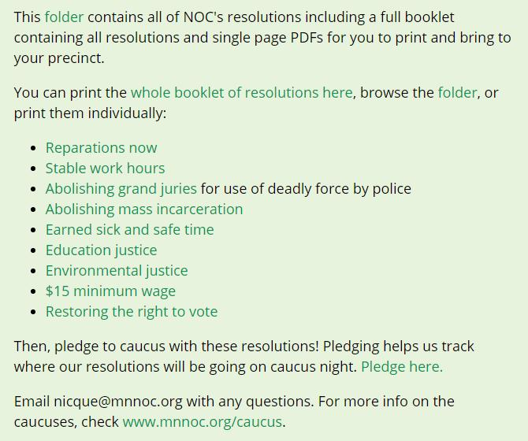
Neighborhoods Organizing for Change
Notes:
Organizing Campaign around Democratic Caucuses
Increase participation and delegates of color
People’s Platform (progressive equity-based agenda)

Slide 4
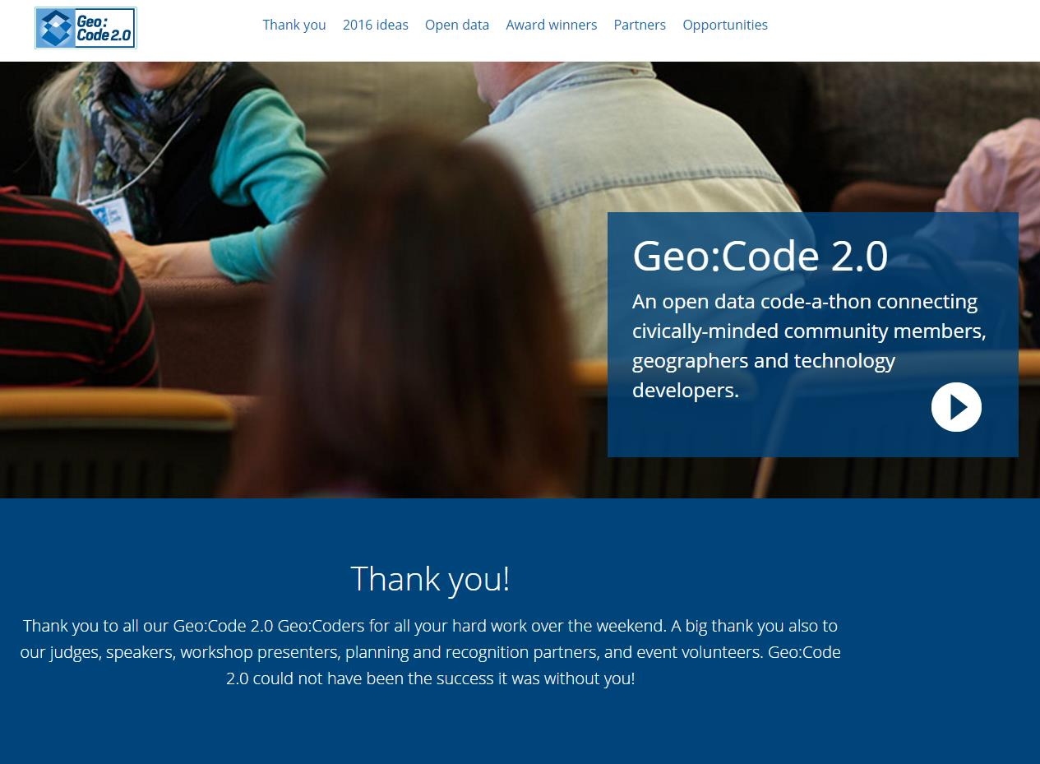
Geo:Code 2.0
Notes:
Nice convergence of events – just days after the caucus, we co-sponsored a code-a-thon
CURA & Metro Counties sponsored hack-a-thon
Twitter-based data collection (#NOCthecaucus)
Led to discovery of Google Form

Slide 5
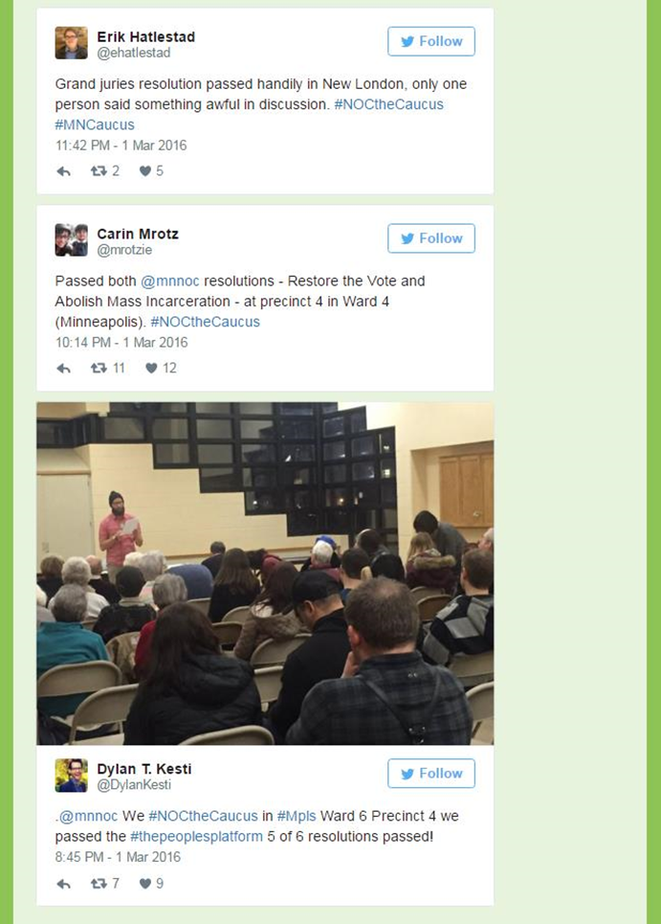
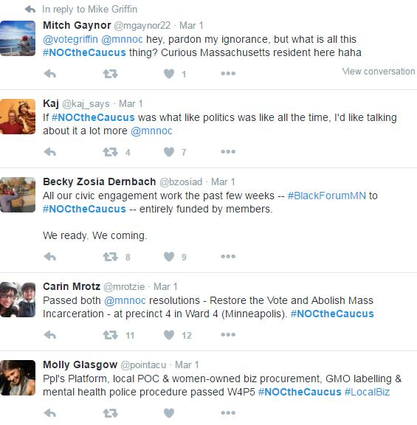
#NOCtheCaucus
Notes:
Nice convergence of events – just days after the caucus, we co-sponsored a code-a-thon
CURA & Metro Counties sponsored hack-a-thon
Twitter-based data collection (#NOCthecaucus)
Led to discovery of Google Form

Slide 6
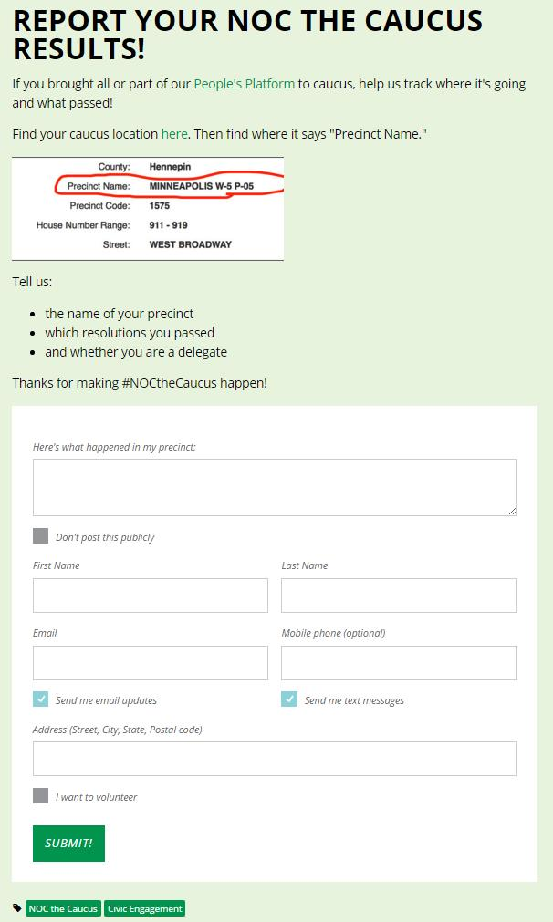
Data Prep
MOU – data agreement
Standardize and properly format Ward & Precinct
Remove duplicates
Create fields for each issue area

Slide 7
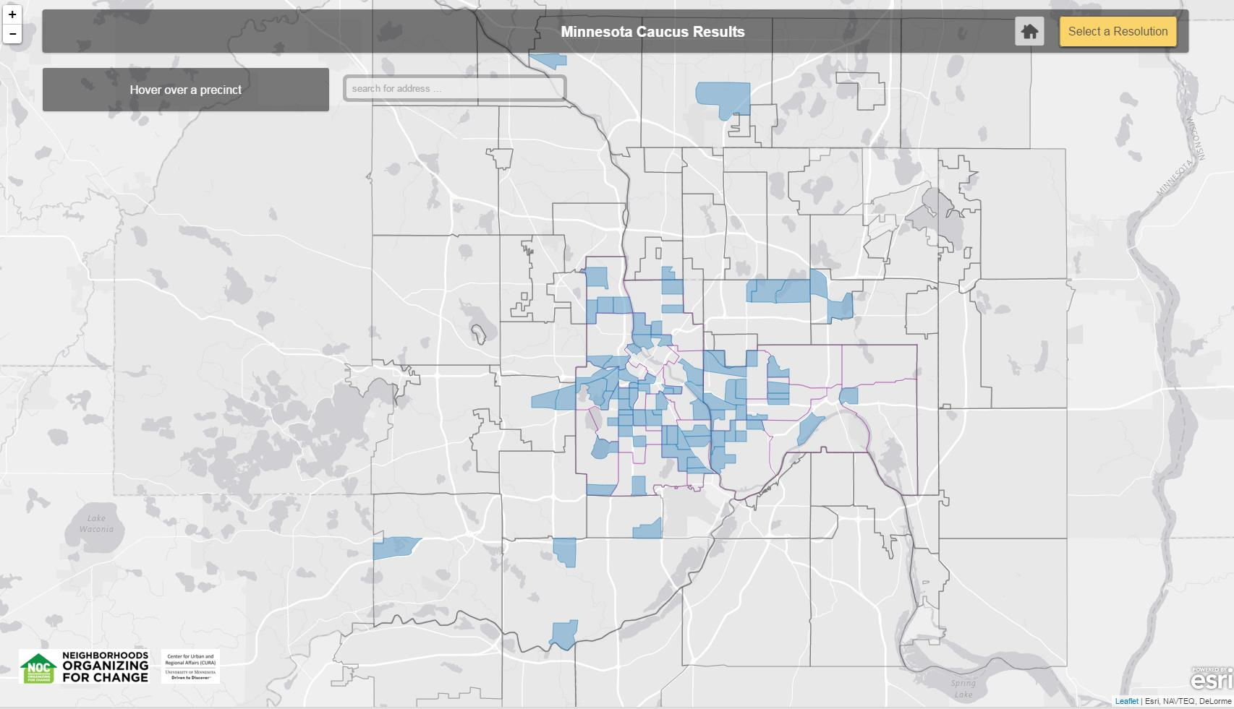

Slide 8
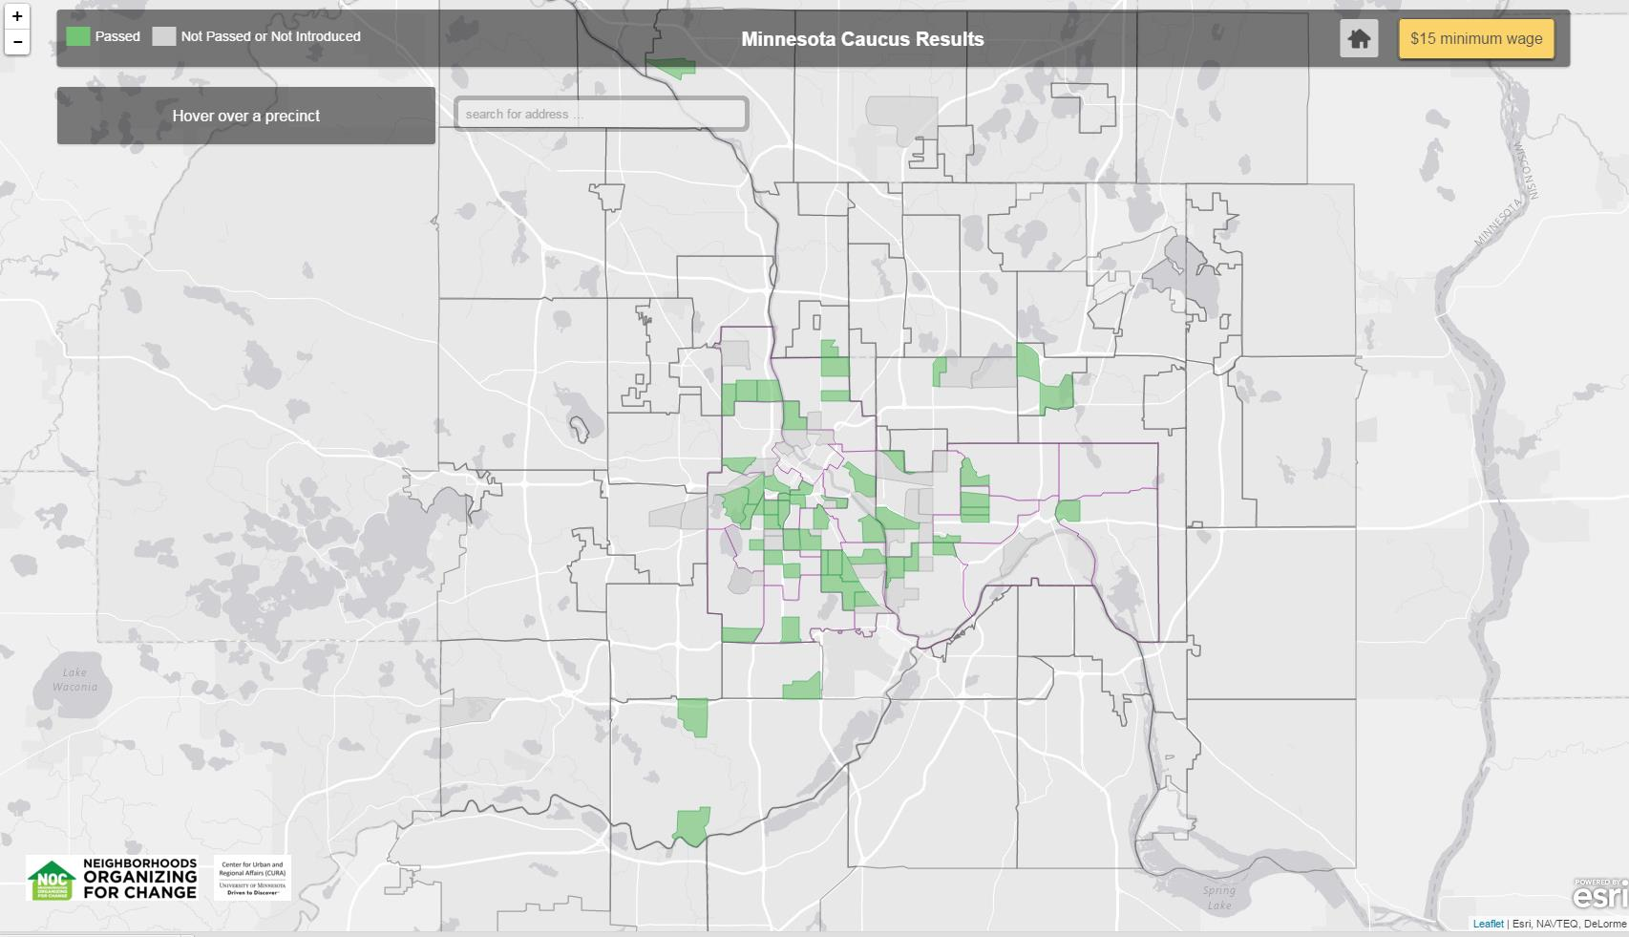

Slide 9
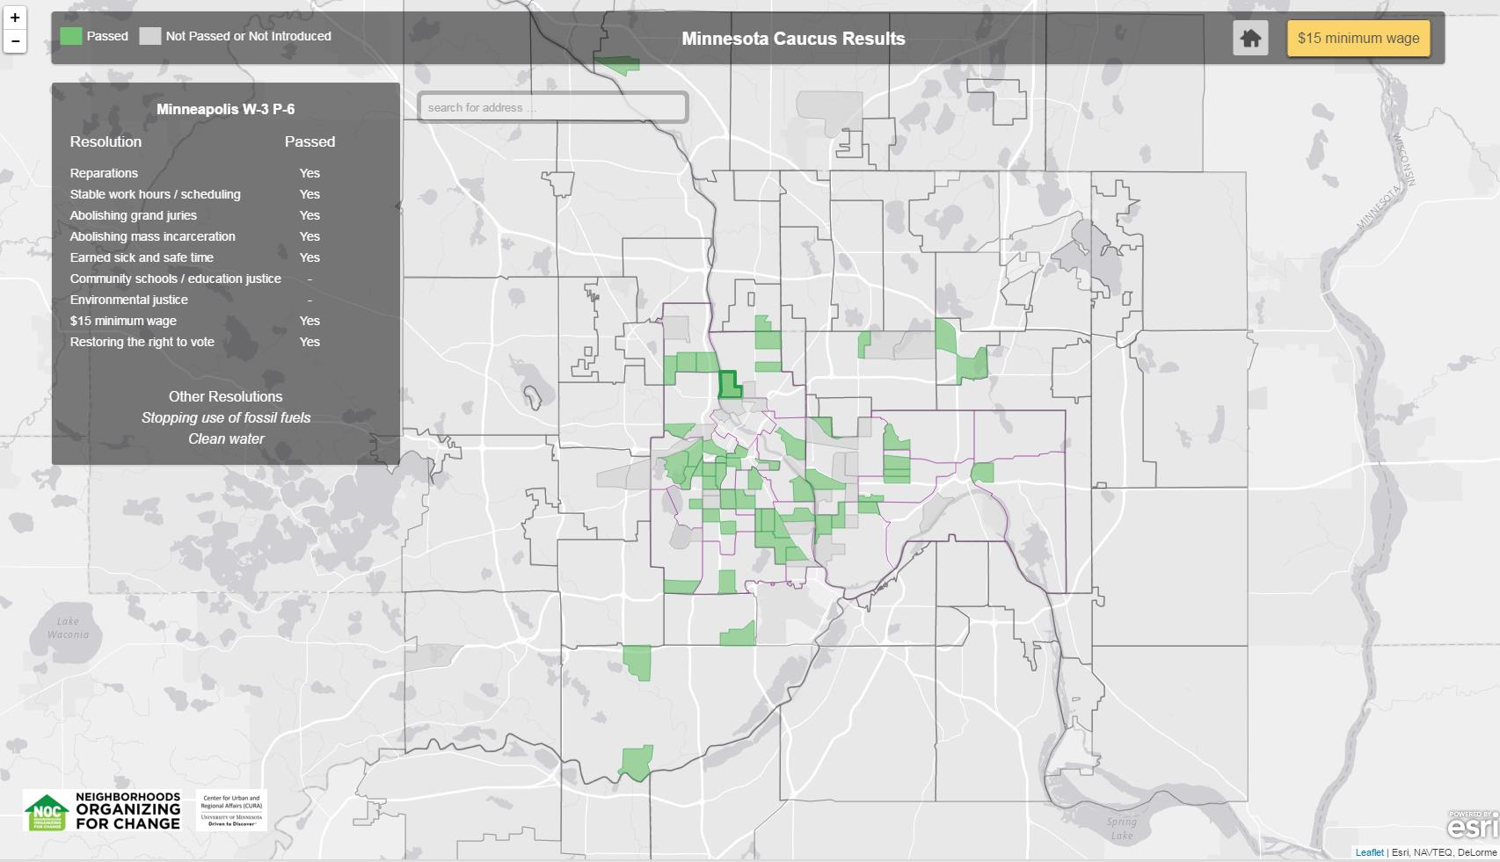

Slide 10
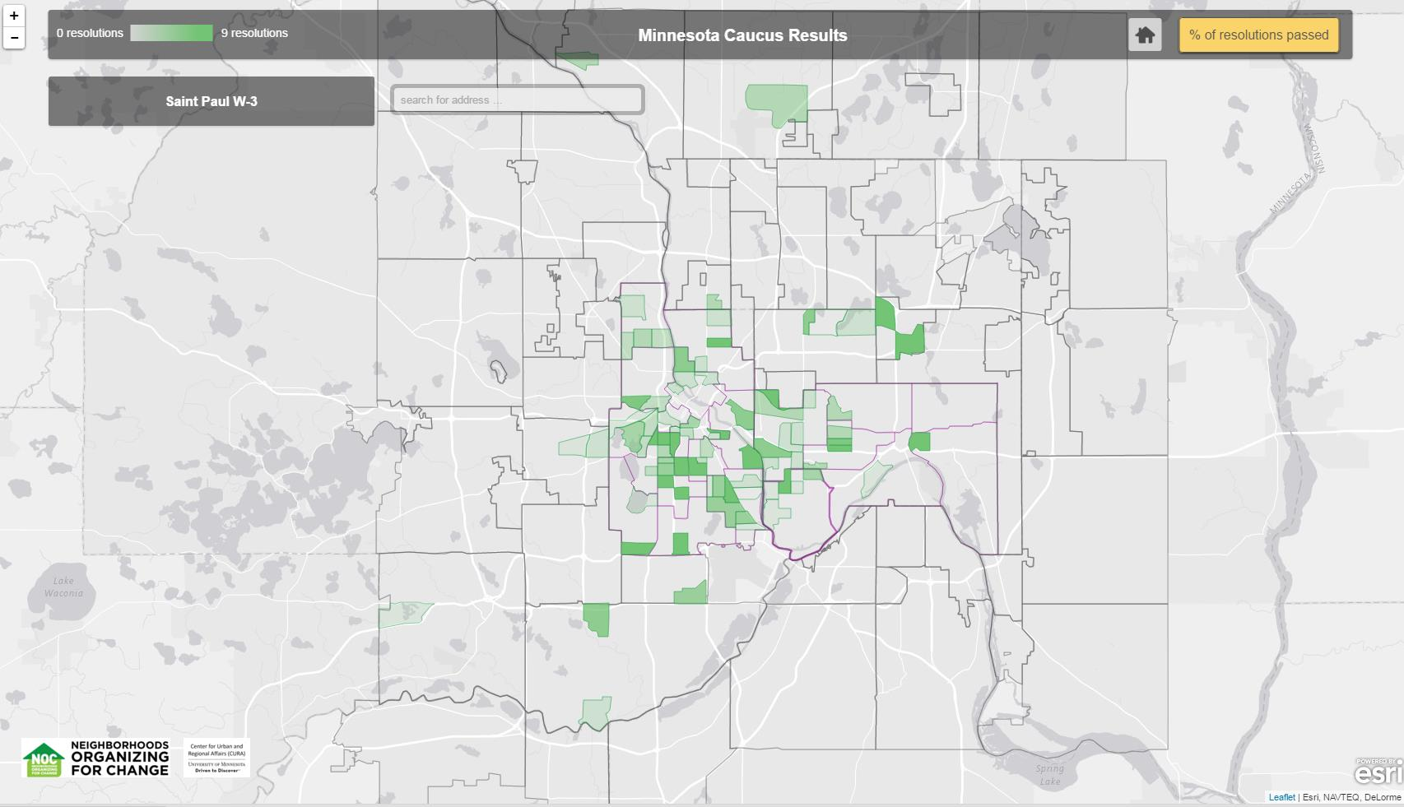
Notes:
Additions to the web map include: summing data by Ward and state house and senate district

Slide 11
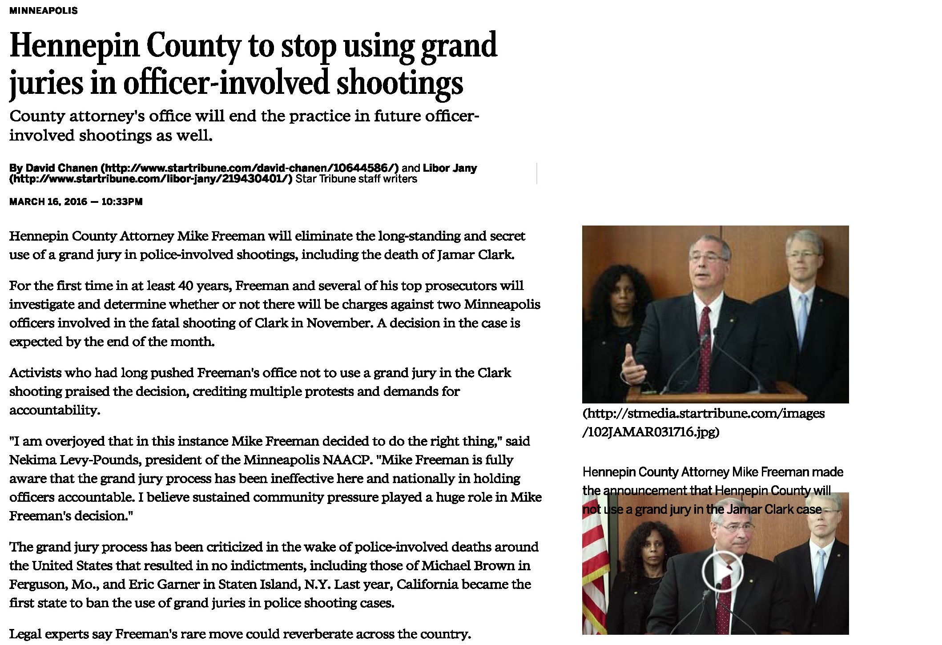
Immediate Impact
Notes:
Within weeks of the caucus two resolutions are already moving through the political system

Slide 12
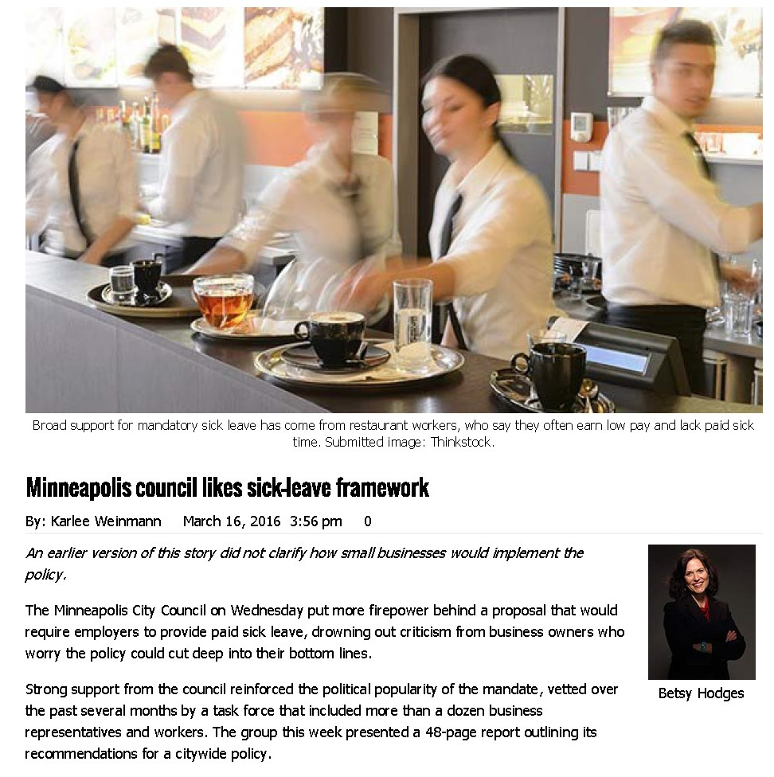
Immediate Impact
Notes:
Within weeks of the caucus two resolutions are already moving through the political system

Slide 13
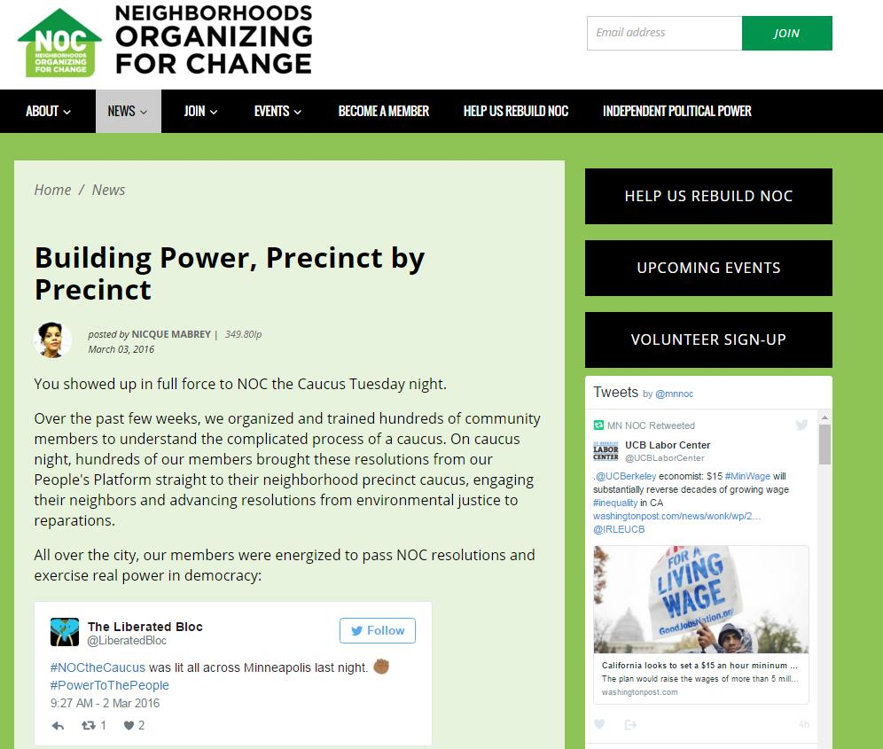
So What? / Next Steps
Notes:
Build support for organizing campaign, help with outreach, hold elected officials accountable, transparency
Good organizing and engagement strategy, results belong to the community
Good example of crowdsourcing data collection and use of social media
Advantage of being part of a larger center is that we can bring many resources to bear on an issue:
organizers, data viz and mapping people, student-led research (if any should out of this), …
Question for all of you: Where else can we apply this strategy?

Slide 14
Thank you!
Jeff Matson
jmatson@umn.edu

