Slide 1
What We Do, Where We’re Going
Data-wize

Slide 2
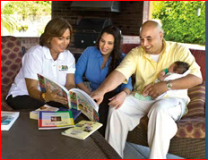
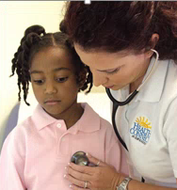
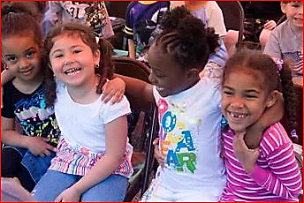
We Invest in Programs. Collect Data.

Slide 3
Advocate.
Give Children a Voice.

Slide 4
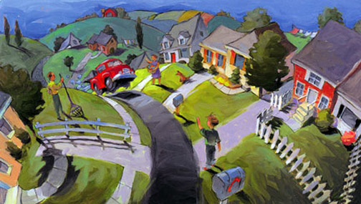
We Must be Data-Informed...
To Know and Support Our Neighborhoods and Our Providers

Slide 5
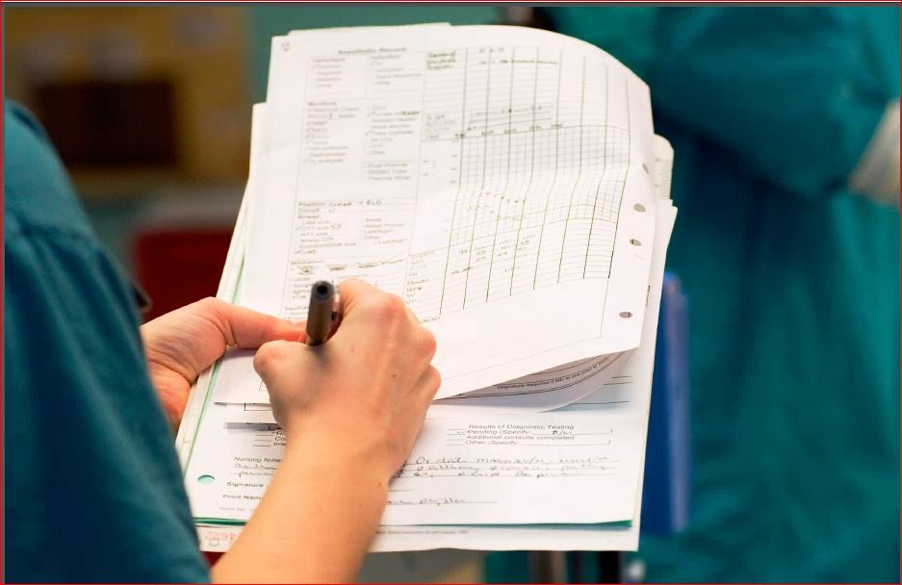
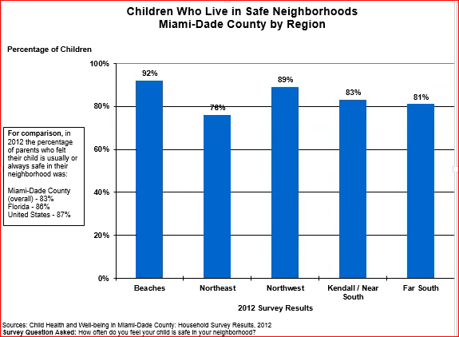
We Use Surveys, Observations…

Slide 6
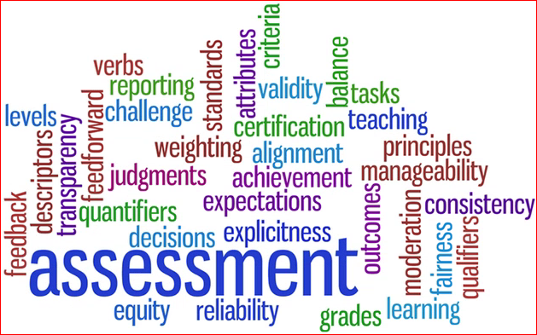
Assessments and Evaluations.

Slide 7
Surveys of Households with Children

Slide 8
Results are Used to
Inform Planning.
Target Investment.
Gauge Progress.
Focus Advocacy.
Advance Policy.

Slide 9
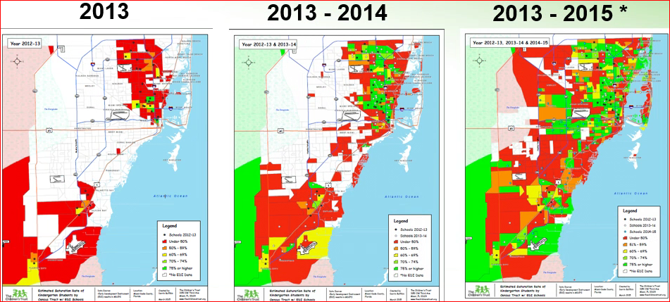
Implementation of the Early Development Instrument…

Slide 10
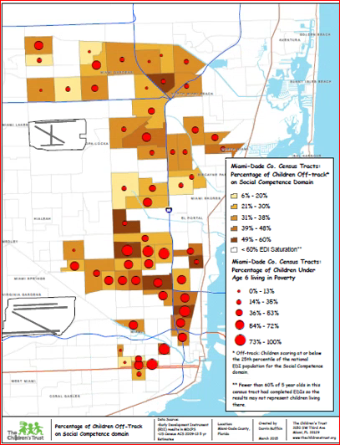
Will Engage Communities with Data and Maps.

Slide 11
Summary of The Trust’s funded programs. How much?
How well? Better off?

Slide 12
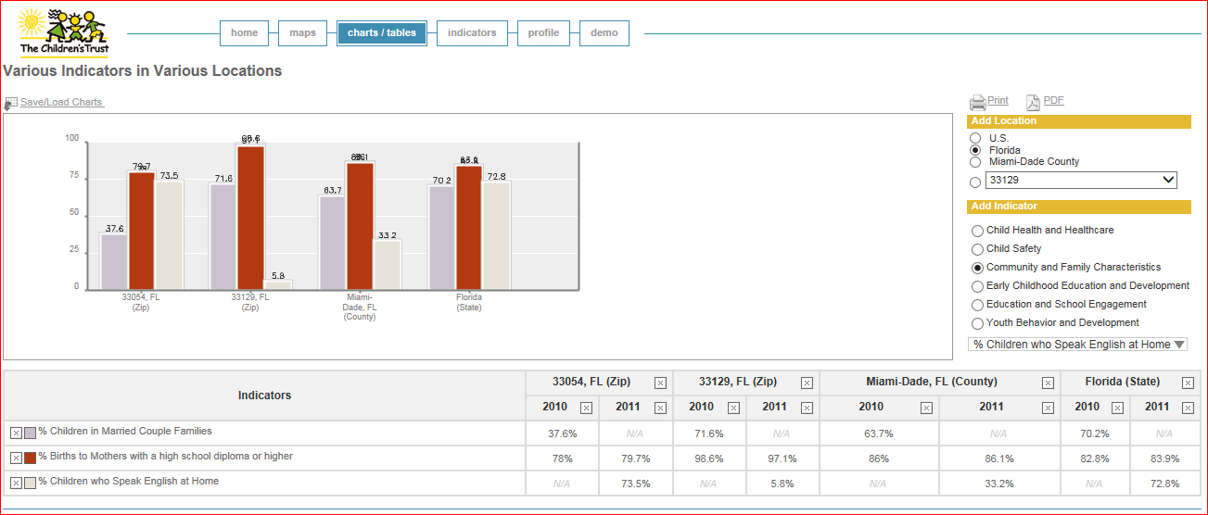
Compare Indicators, Visualize Maps
With KidStats & Maps

Slide 13
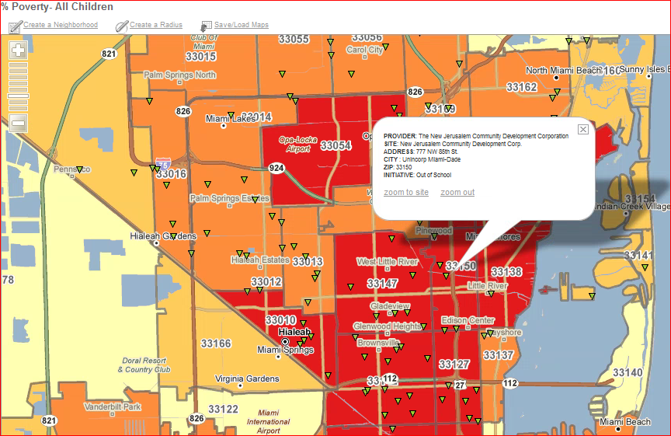
https://www.thechildrenstrust.org/research/kidstats

Slide 14
What’s on the Horizon?

Slide 15
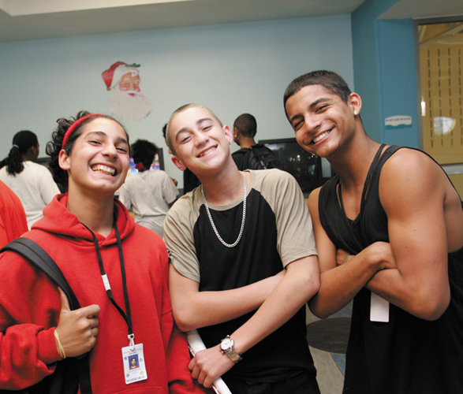
Possibilities of an Integrated Data System

