Slide 1
Twin Cities Housing Market Index
Jacob Wascalus
Senior Project Manager
Federal Reserve Bank of Minneapolis
Notes:
Hi everyone,
My name is Jacob Wascalus. I work for the Federal Reserve Bank of Minneapolis. I’m here today to tell you about the Twin Cities Housing Market Index.
The Housing Market Index was developed in by the University of Minnesota’s Center for Urban and Regional Affairs and the Minneapolis Fed.
Disclaimer: The views I express here today are my own and are not necessarily those of the Federal Reserve Bank of Minneapolis or the Federal Reserve System.

Slide 2
What Is the Housing Market Index?
Notes:
The housing market index, which we also refer to as the HMI, provides a block-level analysis of housing market strength for a user-defined geography, such as a neighborhood.
It basically compares the housing market on each block in a neighborhood to that neighborhood’s average.

Slide 3
What Are the Variables?
Notes:
The analysis standardizes and combines four variables into an index.
Those variables include
Value retention
Long-term vacancy
Owner-Occupancy, and
Physical Condition
The analysis produces a map wherein each block is assigned a color based on its composite score. The color scale goes from Stronger, which is green, to Weaker, which is brown. Average in the middle. It’s white.

Slide 4
Variable 1 of 4: Value Retention
Notes:
I briefly want to describe each of the variables.
One is value retention, which calculates the change in estimated market value of the homes on a given block from its pre-recession high point to its current value.
Basically, with this variable, we’re looking to see how well the houses on a specific block have bounced back from the housing market collapse compared to the all of the houses in the neighborhood.

Slide 5
Variable 2 of 4: Owner-Occupancy
Notes:
Another is owner occupancy.
This variable looks at the percentage of homes on a block that are currently occupied by owners and compares that to the owner occupancy rate of the entire neighborhood.

Slide 6
Variable 3 of 4: Physical Condition
Notes:
The third variable we look at is physical condition — which assesses the current structural integrity of the homes on a given block compared to all of the houses in a neighborhood.
The municipal employees who conduct these surveys look at the exterior of all buildings, for things like cracks in the foundation, the age of the roof, and condition of the windows.

Slide 7
Variable 4 of 4: Long-Term Vacancy
Notes:
Finally, we look at vacancy.
This variable determines the percentage of homes on a given block that are vacant and boarded, compared to the neighborhood average.
I think what makes this tool so accurate is that the data for each variable comes from municipal sources.
It’s all parcel-level data.

Slide 8
Variables Are Combined into an Index
Notes:
As I mentioned, those four variables are then standardized through a z-score transformation and combined to create the index.
In the example here, you can see that the blocks with a stronger housing market are located in the southern part of the neighborhood, and the weaker blocks are in the northeast.
Blocks with average strength housing markets are closer to the center.

Slide 9
Selecting the Geography
Notes:
You can conduct the analysis at different geographic levels.
For instance, you can run the analysis at pre-defined geographies, like neighborhoods, which we’ve already loaded up.
But users can also create custom geographies that don’t follow the contours of a neighborhood.
The only requirement is that a selected geography must contain at least 40 contiguous blocks.

Slide 10
Selecting the Year
Notes:
We’ve loaded data for 2014 and for 2016, so right now you can look at analyses for both of these years.
We’ll probably add 2018 when the time comes.
But a really cool feature we included in this tool is the ability to see the change between 2014 and 2016, so you can see how a block’s housing market strength has changed between the two years.

Slide 11
Displaying information
Notes:
A user can click on a block to see all of the variable data from 2014 & 2016.
This is useful if a person wants to compare the variables over time.
In this block, you can see that the long-term vacancy rate in 2014 was 0 percent, and in 2016 it increased to 3.2%.

Slide 12
Selecting the Basemap
Notes:
One really cool feature we added was the ability to use different base maps.
We included 10 different types including an open street map, a satellite map, and a background of standard gray, which I had been using earlier.

Slide 13
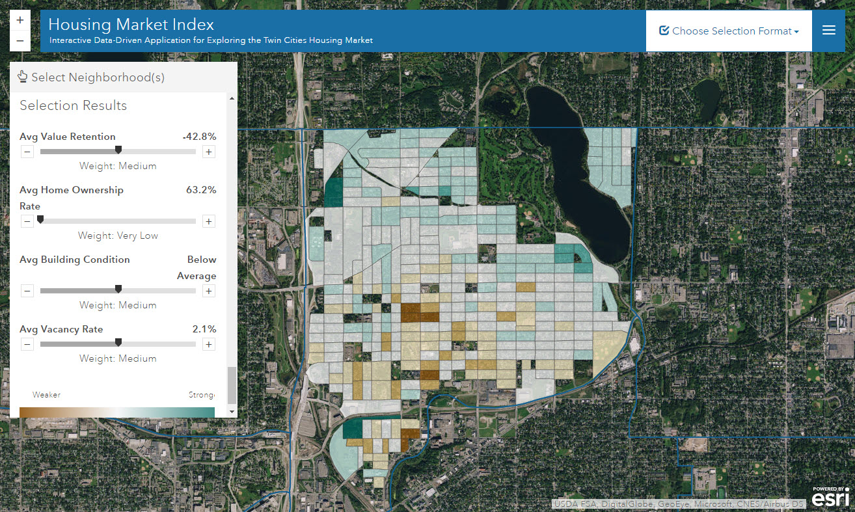
Variable Weights
Notes:
Our default is to give equal weight to each of the four variables.
But for those who wish to emphasize or deemphasize specific variables, such as homeownership, they can use these sliders to adjust variable weights. When one variable weight is increased, the other three variable weights will decrease.

Slide 14
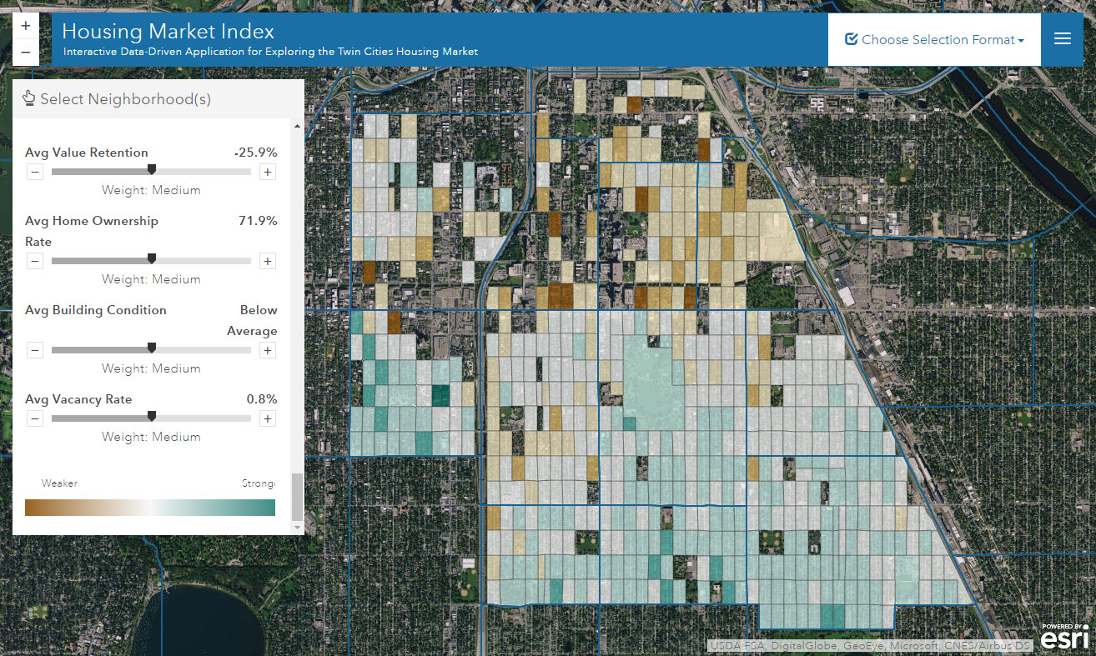
How Can the HMI Be Used?
Notes:
How can the HMI be used?
Many of the neighborhoods in the Twin Cities are not uniform and homogenous, and a tool like the HMI can reveal those housing market differences.
So a city government department (Minneapolis or St. Paul, in this case) or any interested party can use it to make better-informed decisions about how and where to spend money on housing investments.
This is important because like cities across the country, Minneapolis and St. Paul are always operating their housing programs with tight budgets.

Slide 15
Thank you!
http://maps.umn.edu/cura/hmi/
Notes:
Thank you for the opportunity to speak to you today, etc.
If you have any questions, please don’t hesitate to ask me or Jeff Matson after the Ignite session.

