Slide 1


Rebranding ProvPlan’s InfoGroup
Notes:
We think our experiences with re-branding have not been unique, and are worth sharing for other partners whose identity or mission may be evolving.

Slide 2
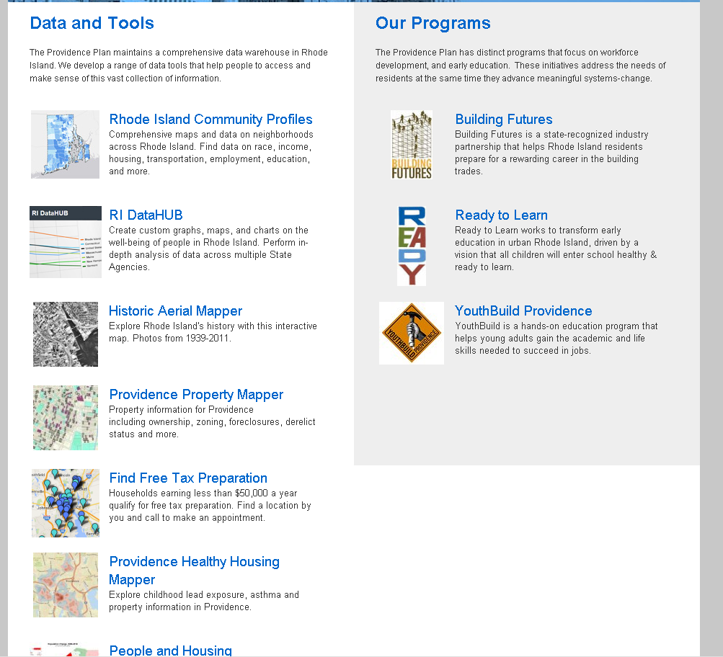
Notes:
You’ll see on the right side of the screen the programmatic aspect of ProvPlan. Our 3 programs have distinct identities, leadership, and even logos.
On the left side is the work InfoGroup does, which is the name ProvPlan is generally associated with. Yet we didn’t have our own coherent identity, mission, or scope.

Slide 3
WHY?
InfoGroup data work: “data Switzerland”
ProvPlan programmatic work: advocacy-related
Notes:
Moreover, we wanted to clearly separate our data work from ProvPlan’s programmatic work. This is partly political: the programmatic work has an advocacy component whereas we need to remain relatively separate from those discussions.

Slide 4
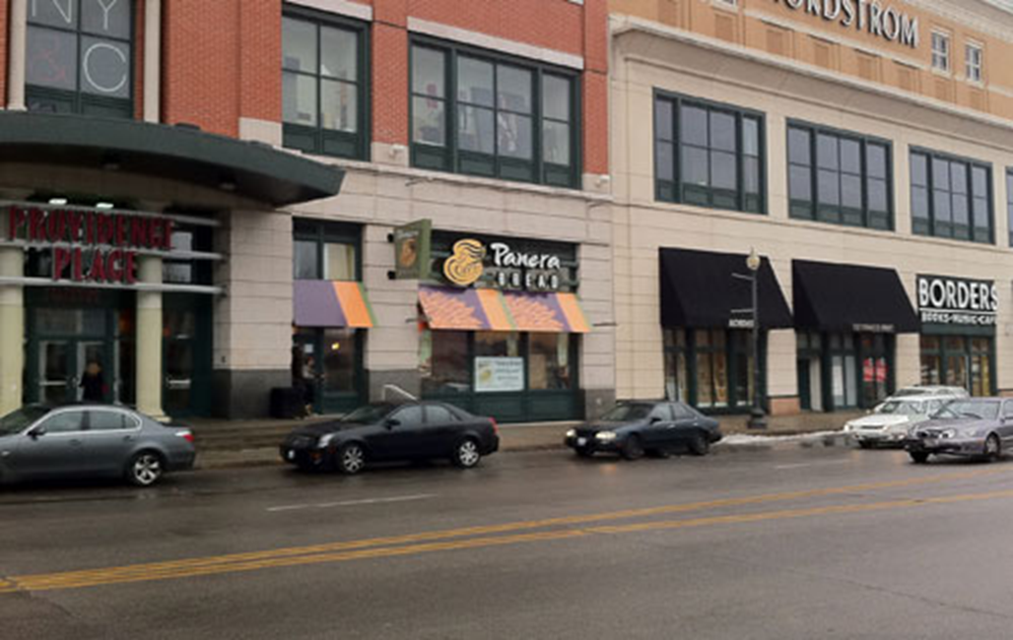

WHY?
“Can I see the Providence Plan?”
“Is this Providence Place?”
Notes:
These are the kinds of questions that ProvPlan staffers have fielded…The Providence Place is a mall ☺

Slide 5
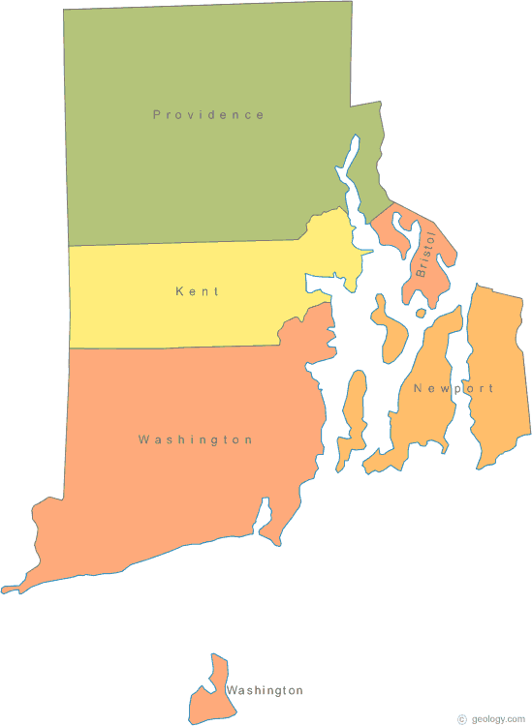
WHY?
The work is now statewide!
Notes:
Maybe most importantly, our work is now statewide. There are a lot of NNIP partners with metro-specific names doing increasing amounts of work outside that metro.

Slide 6

HOW?
Identify our core values and mission
New name
New website, Twitter, Facebook
Notes:
How did we approach the re-branding process?
Overtly identifying our core values and mission has been really difficult sometimes. Are we providing a public service? Are we providing “information products”? What stuff should we get paid for?

Slide 7
Analytical
Competent
Tenacious
Vibrant
Intelligent
Geeky (2)
Innovative (3)
Quiet
Accessible (3)
Accurate (2)
Relevant
Timely
Creative
Smart (5)
Reliable (2)
Interesting
Trustworthy (2)
Quirky
Mission-driven
Detail-oriented
Engaging
Resourceful
Valued
Clever
Focused
Appropriately aggressive
Notes:
We didn’t do the full-on focus groups and that level of information-gathering, but we did query internal folks—staff, the board. These were the descriptors people wanted to see associated with DataSpark.

Slide 8
HOW?
Identify our core values and mission
New name
New website, Twitter, Facebook
Notes:
The name was a tricky one. This was our keeper. We liked the feeling of action and genesis we associated with it.
The cutting room floor is kind of fun to see.

Slide 10

HOW?
Identify our core values and mission
New name
New website, Twitter, Facebook
Notes:
These discussions about values and mission colored the whole process– do we put staff bios up on our new website to emphasize our human capital, or are we more of a faceless public service enabling access to data owned by the people?

Slide 11
WHAT IF?
We lose positive brand associations?
We confuse people?
We can’t keep up with social media demands?
Notes:
The what-ifs were significant, especially the loss of positive associations with our name and past work. We thought a lot about this little aspect of our logo: “an initiative of ProvPlan”

Slide 12
WHAT IF?
We lose positive brand associations?
We confuse people?
We can’t keep up with social media demands?
Notes:
We’ve gone for a slow and gradual rollout, broadening the circle of partners to whom we mention the rebranding. We wanted this to be seen as an identity evolution/maturation rather than an abrupt shift.

Slide 13
WHAT IF?
We lose positive brand associations?
We confuse people?
We can’t keep up with social media demands?
Notes:
With about one Facebook post per week and about one Tweet per day, our ProvPlan Klout score has been in the high 40s. But to launch ourselves as DataSpark, we were advised to make one Facebook post and 3-5 Tweets per day!

Slide 14
PARTING THOUGHTS…
Legitimizing social media time commitments
Utility = Followers x (Retweets + Favorites + Mentions)
Time Spent?
Notes:
To data analysts, social media can sometimes feel secondary. The re-branding process has helped us take communications a bit more seriously even if we don’t yet have a way to understand the direct causal relationship between time spent and utility.

Slide 15
PARTING THOUGHTS…
We welcome further discussion of these issues!
Please find Megan, Tim, or Joel.

