Slide 1
A change of perspective: "Can I drink my beer here?" vs. "Is it safe to bring my kids here?"
Notes:
Riverside Park is located in East Little Havana. The neighborhood is a densely populated immigrant neighborhood near downtown Miami.

Slide 2
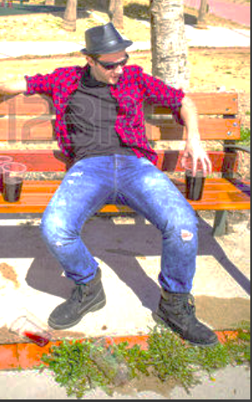
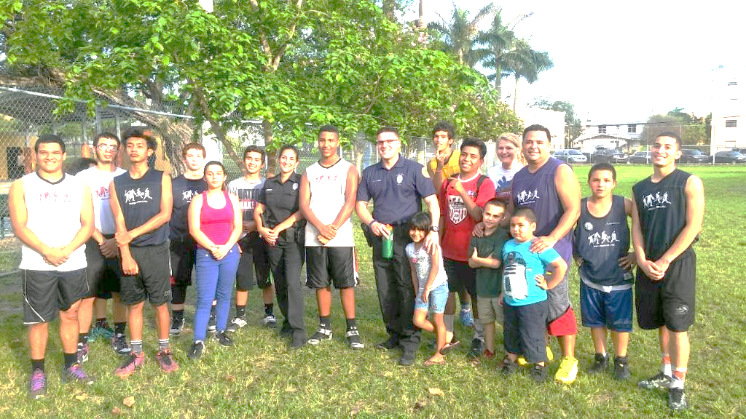
Community Ownership
Misuse
Vs.

Slide 3
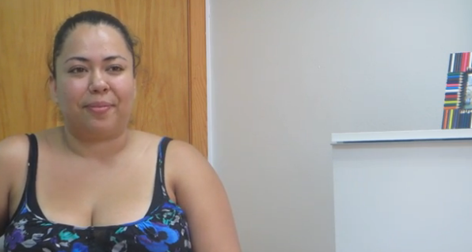
“There is nothing for teens to do here, there is this park but everybody is scared of it you can’t go to the park, you know it’s filled with bad things.” – Jennifer, mother of two boys in Little Havana
Notes:
This interview was done during our “listening phase” in Little Havana, the mom’s unsolicited statements regarding Riverside Park confirmed what our staff was hearing from other residents, at community meetings, and observing in the physical environment.
Jennifer says that teens have nothing to do in Little Havana. So getting trouble is easy.

Slide 4
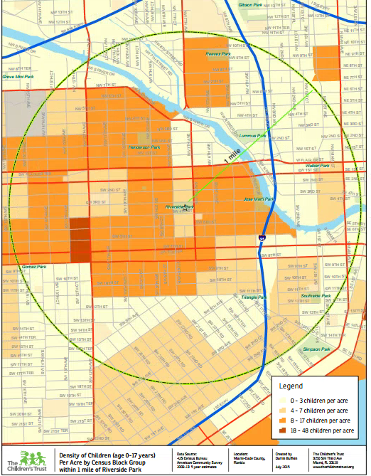
High Levels of Child Density near the park. Over 13,000 children living within one mile of Riverside park. Generally speaking, East Little Havana has very little green space.
Notes:
As we moved towards action at Riverside Park the team looked at data showing the high density of children and families in the neighborhood with little usable family green spaces. Over 13,000 children under the age of 18 within mile and the park had incredibly low utilization.
One mile radius.

Slide 5
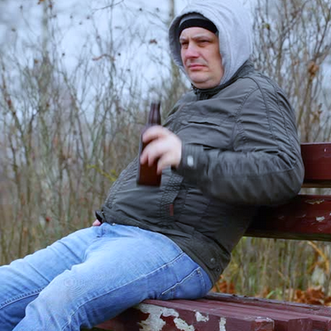
Can I drink my beer here?
Notes:
During part of our work at the Park a man actually approached one of our staff and asked “Puedo tomar mi cerveza aqui” When our staff responded no, he quickly turned and left to find another spot to drink his beer.

Slide 6
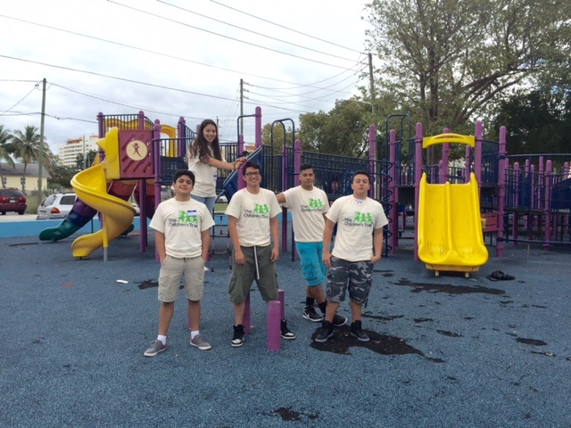
Riverside Park Survey Collection Day – A resident-centered, data- driven approach
Notes:
Discussions started between CF, TCT, City Parks and Recreation and Marlins in October of 2015 which launched a workgroup focused on Riverside Park hosted by Connect Familias and with meetings facilitated by TCT. The workgroup has been meeting bi monthly since that time. The first goal of the workgroup was to listen to residents and gather information about what residents wanted in Riverside Park. We did a walking “survey Collection day” working with high school students from the East Little Havana neighborhood to collect the surveys (students received a 50 target gift card for a full days work) Student’s received safety training, and training on data integrity and how to properly ask a survey question from local anthropologist Corrina Moebius who lives in the ELH neighborhood.

Slide 7
81%
of respondents reported that SAFETY CONCERNS prevent them from using Riverside Park more often.
Notes:
There were many concerns but safety was the primary one. Others major concerns were lights and access to bathroom and water.

Slide 8
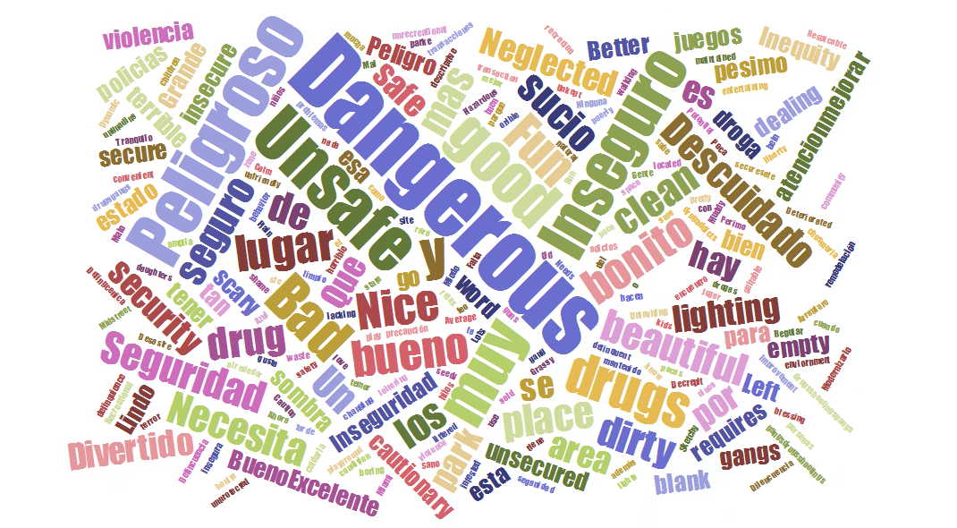
Respondents “first word” for describing Riverside Park

Slide 9
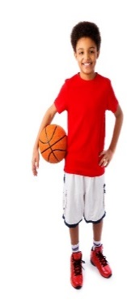
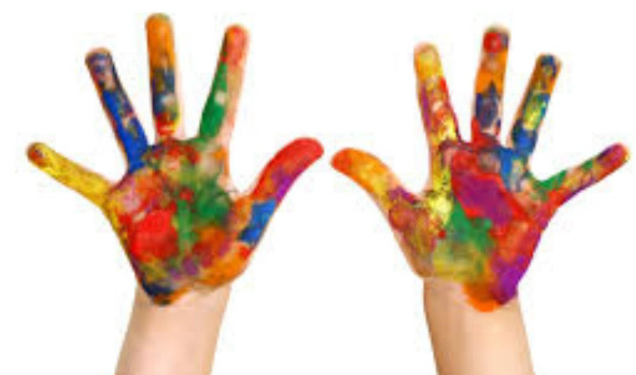
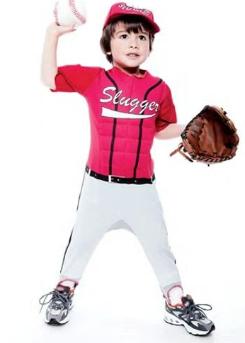
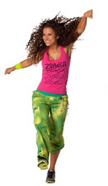
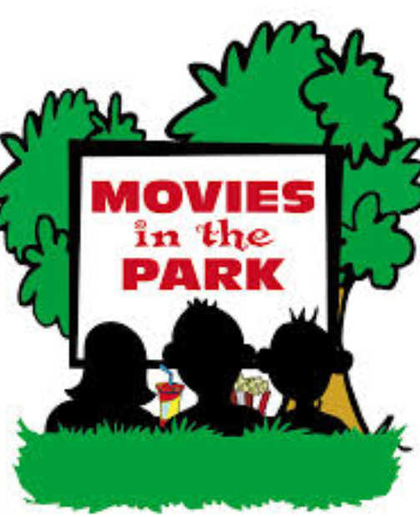
1
2
3
4
5
Parents Top 5 Activity choices for kids
1
5
Farmers Market
2
3
4
Zumba
Yoga
Top 5 Activity choices for families
Notes:
Top kid choices

Slide 10
People Want to be Engaged
233 (74%) Respondents indicated specific ways they were personally willing to help improve the park.
Notes:
We are working on ways to further engage residents who want to be involve, we plan to move our meetings into the park and put them later in the evening in order increase resident involvement and ownership.

Slide 11
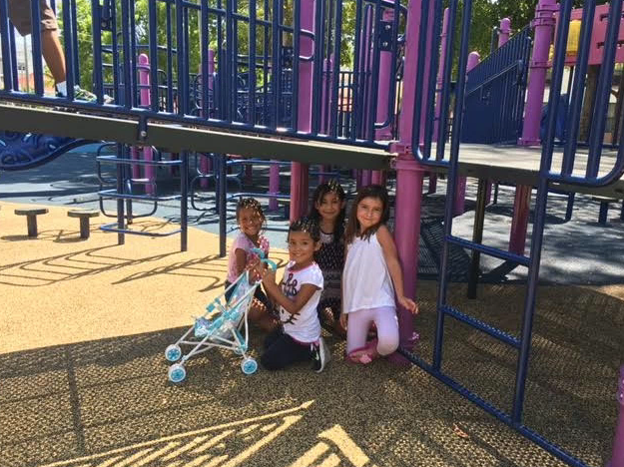
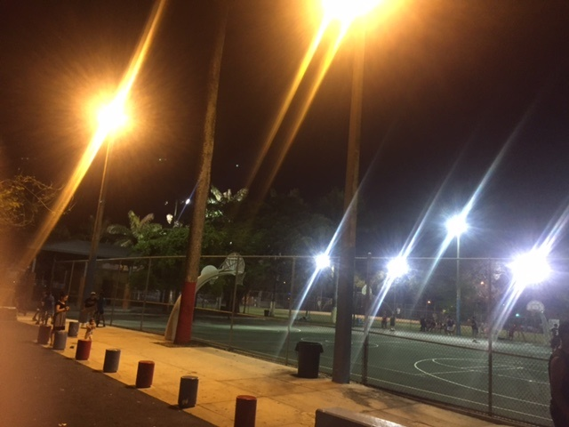
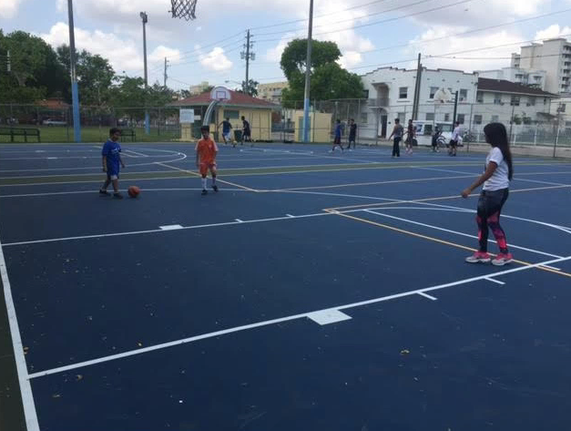
Capital and Infrastructure Improvements
Notes:
Playground resurfacing, basketball courts resurfacing, lights are now on until 10:00 pm.
2 Part time recreational aids have been hired.

Slide 12
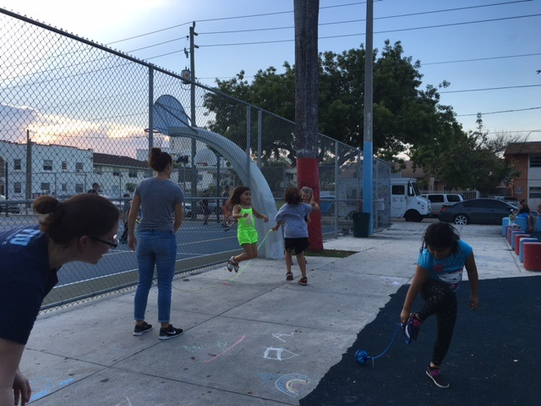
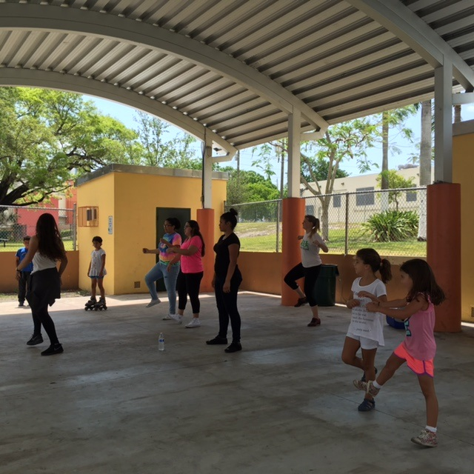
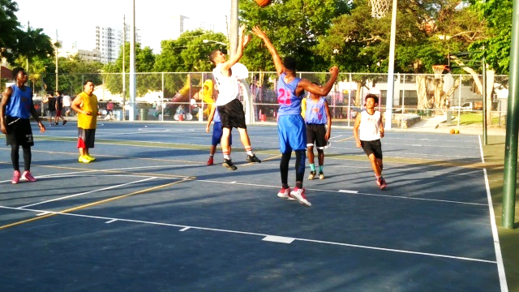
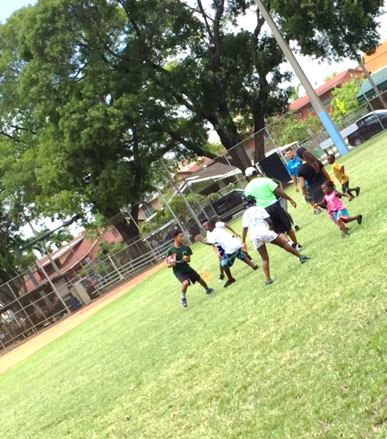
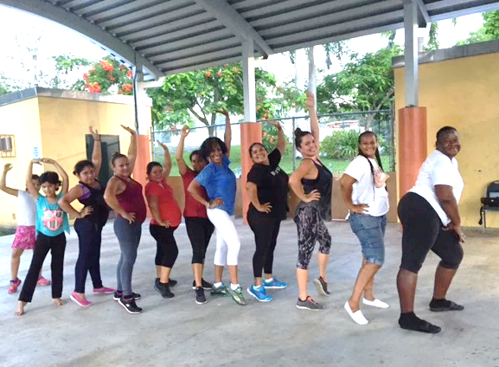
Increased Informal Use
Formal Programming added to the park
Notes:
We have seen really good success in inviting neighbors to play and just creating some critical mass at the park.
We have had a young women involved in the survey collection who started her own dance. We have been very regular about showing up to the park Tuesday and Thursday evenings with a few folks who are intentionally there to play.. We have seen a huge increase in informal play during these times.

Slide 13
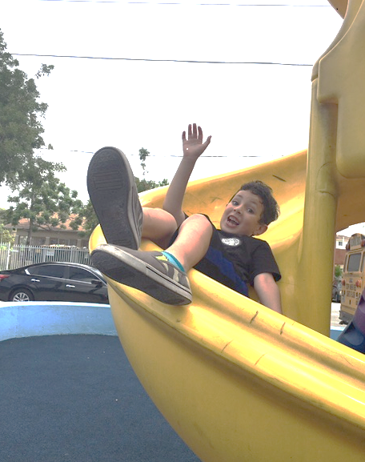
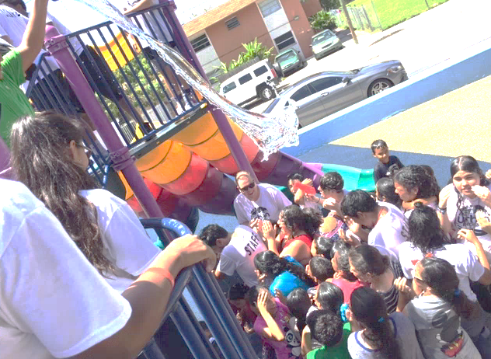
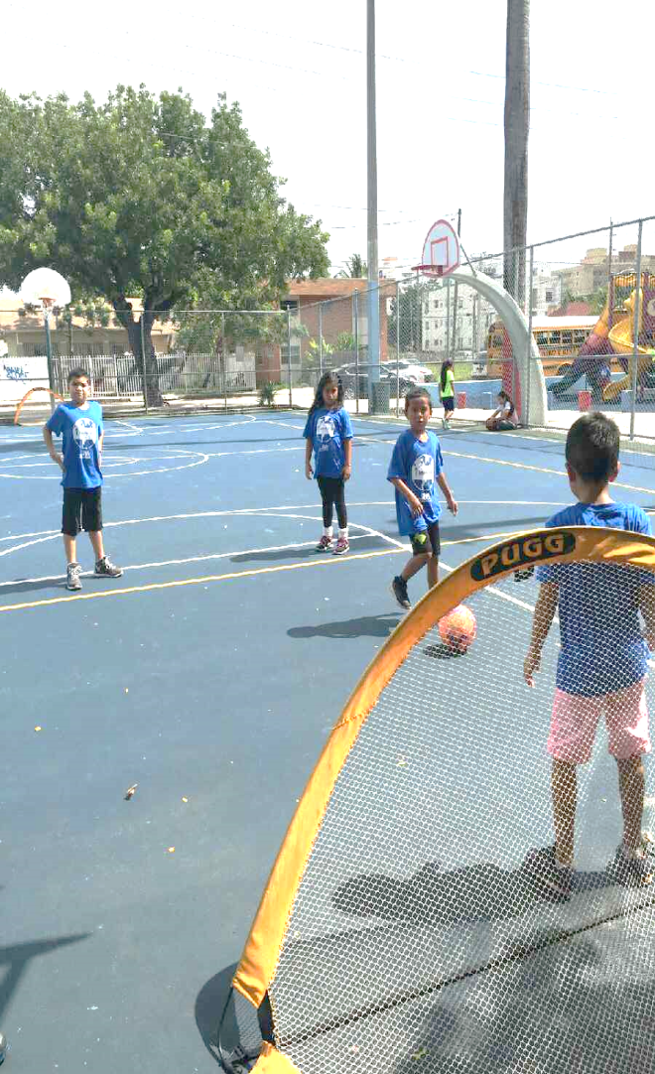
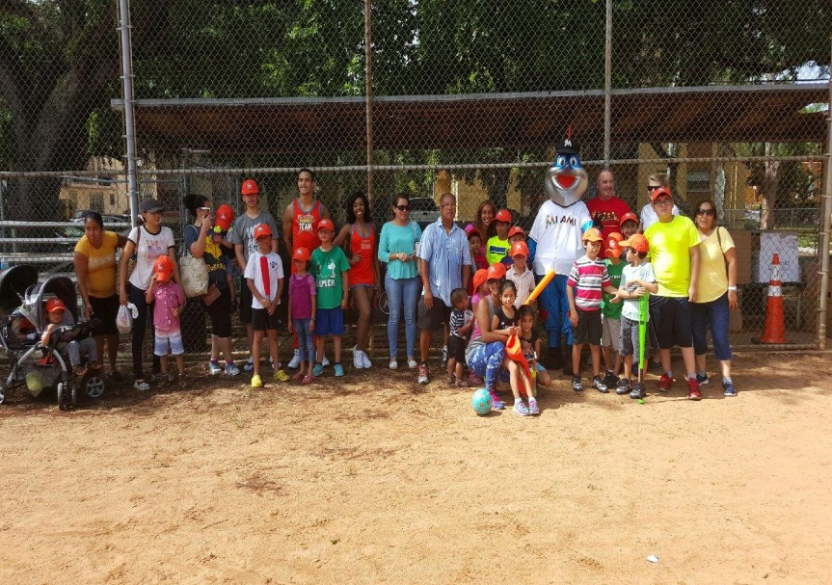
Existing programming moved into the park
Notes:
Leadership Learning Center and Urban Promise moved camp activities into the park and local CBO’s are starting to move community activities into Riverside Park.

Slide 14
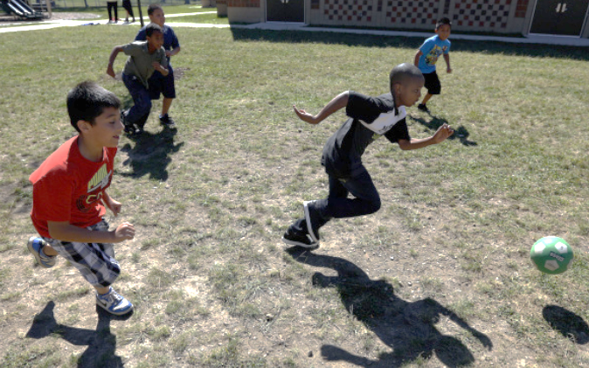
“You can’t smoke pot here, my kids are playing soccer.” – Local Mom
Notes:
As it has become a more usable area, have seen increased resident engagement in ensuring the safety of the park. Recently during one of our informal play times, a group of boys was playing soccer and about 100 feet away 3 boys were smoking pot. The mother of one of the boys playing without hesitation called the police to deal with the delinquency. After the police had escorted the boys away from the park the mom discussed the situation with the police.

Slide 15
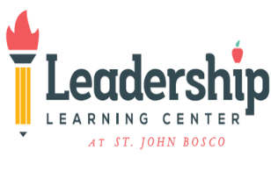
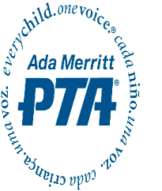
In response to neighborhood concern, Riverside Workgroup or “Vecinos de Riverside” began meeting in December 2015 to increase Safety and Engagement in Riverside Park, located at the heart of East Little Havana.
The workgroup is facilitated by the Children’s Trust Community Engagement staff, it is open to all. Attendees and contributors to the group include:
Residents
UM Public Health
The Children’s Trust
Ada Merritt PTA
Urban Promise
Leadership Learning Center
The Health Foundation and Live Healthy Little Havana
Connect Familias
Miami Lighthouse for the Blind
City of Miami Parks and Recreation
City of Miami Police
The Marlins
Alliance for a Healthier Generation
WE RUN MIAMI
FAB Sports

