Slide 1
Schools + Neighborhoods
Bridging the Gap
With Data From the
Quality of Life Explorer
Notes:
Consolidated School System (Charlotte + 5 towns). Huge.
Offering a tool to evaluate current zones and share information quickly using the new/improved QOL Explorer while
allowing for public engagement with the data and tool (not happening behind any curtains)

Slide 2
Perfect Timing
Notes:
The timing is impeccable:
QOL Explorer was just released with new data and functionality
CMS needs to examine redistricting when
We have a community-wide task force looking at economic opportunity throughout Charlotte.
The issue of school resegregation has emerged as part of the community conversation; to understand schools, we must understand neighborhoods.

Slide 3
The Exercise
31
High
39
Middle
91 Elementary
145,000
Students
Charlotte-Mecklenburg Schools must examine districting every 6 years
Notes:
CMS model is a combination of home schools and magnet choices
160-some schools:
In the last two years, added 4,100 students
+ 3 elem schools
+ 3 high schools
There are two outcomes: a few angry parents or a bunch of angry parents, so it is a contest to upset as few people as possible.

Slide 4
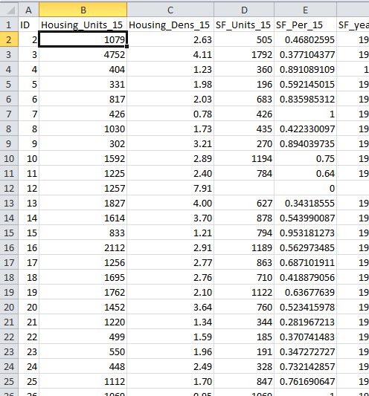
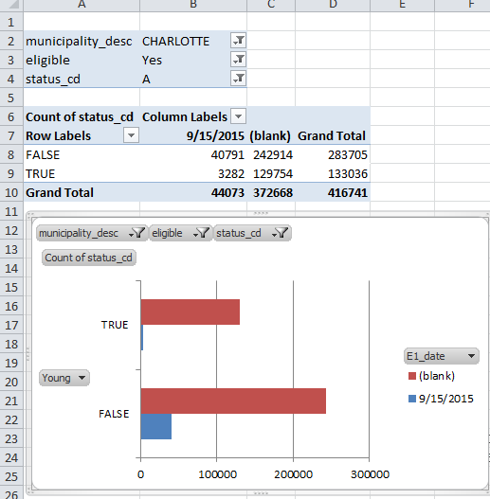
Data
“We’ll be prepared. For What?”
Notes:
With any process: An ounce of preparation is worth a pound of cure – get good data!
Who DOESN’T love pivottables/>??
Without knowing the exact ending:
Well-prepared tabular data and dynamic tools offers easier, fastermore flexible analysis

Slide 5
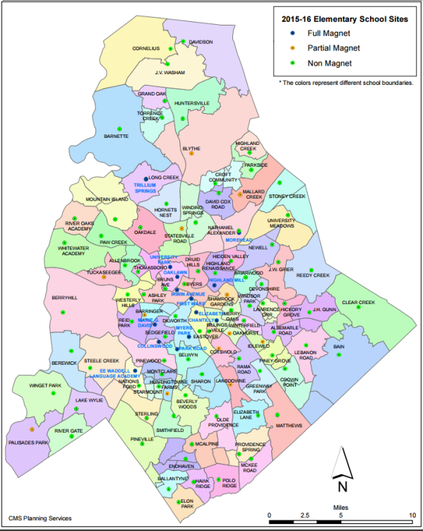
What about Maps?
Elementary Zones
High School Zones
Notes:
I’m a geographer, so everything I get my grubby hands on turns into a map.
Well-organized data in tabular form are great!
What about maps? School zones and neighborhoods are inherently geographic and thus need maps.
It’s easy to say what conditions are in neighborhoods with just numbers, it’s a bit more difficult to visualize it

Slide 6
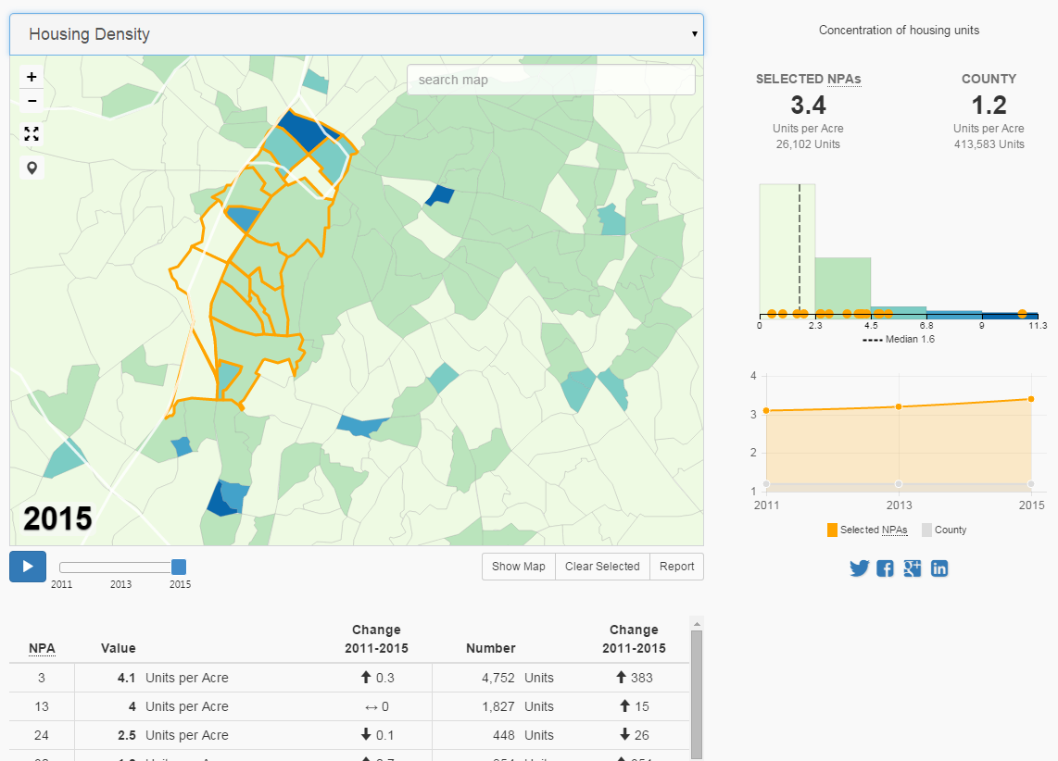
Notes:
We don’t know the answer
However, QOL Explorer is built on a platform which offers easy-to-use functions:
Easy use to find information.
82 variables
Context
Comparison
Infinite combinations – save the best for last

Slide 7
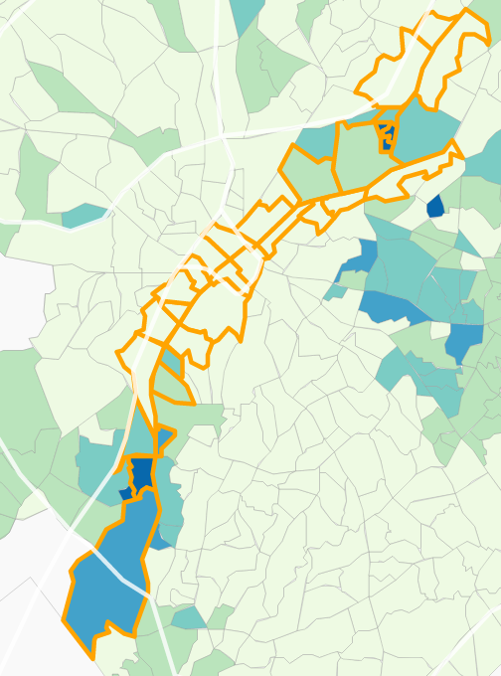
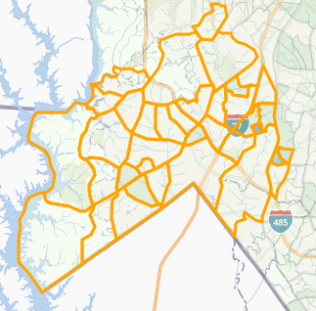
QOL Explorer
New functionality to approximate areas
Council districts
Transit corridors
School feeder areas
… and anything else we didn’t think of:
Light Rail Corridor
Police Division
Notes:
New functionality allows us to do things we’ve never been able to before: create own areas with re-calculation of variables @ block group-ish level
We used to say we don’t define quality of life; you do.
Now we say we won’t even restrict the extent in which you want to explore it

Slide 8
An Evaluation Tool
One-stop-shop for existing conditions
QOL Explorer can help close the “gap” between data on schools and data on neighborhoods.
Public participation to inform voices in the participation
Notes:
QOL can add context and another way of looking at what data are available for all – policy makers to parents - and bridging the gap between the understanding of the relationship between neighborhoods and schools.
Example (next slide)

Slide 9
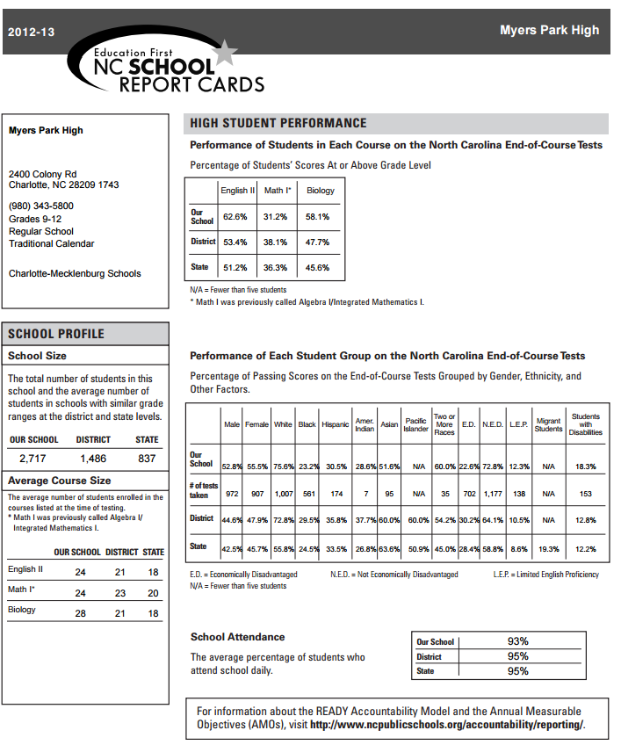
Data On Schools
Notes:
CMS has loads of data on students that are used in reporting and evaluation – including where these students live (when they aren’t at school!)

Slide 10
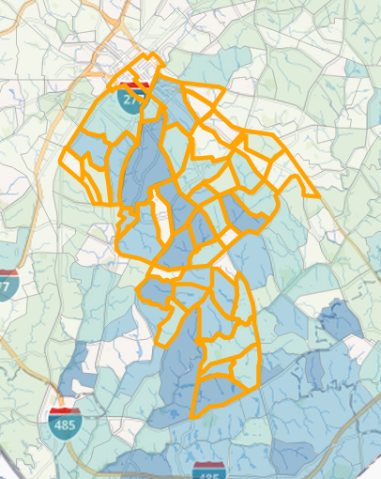
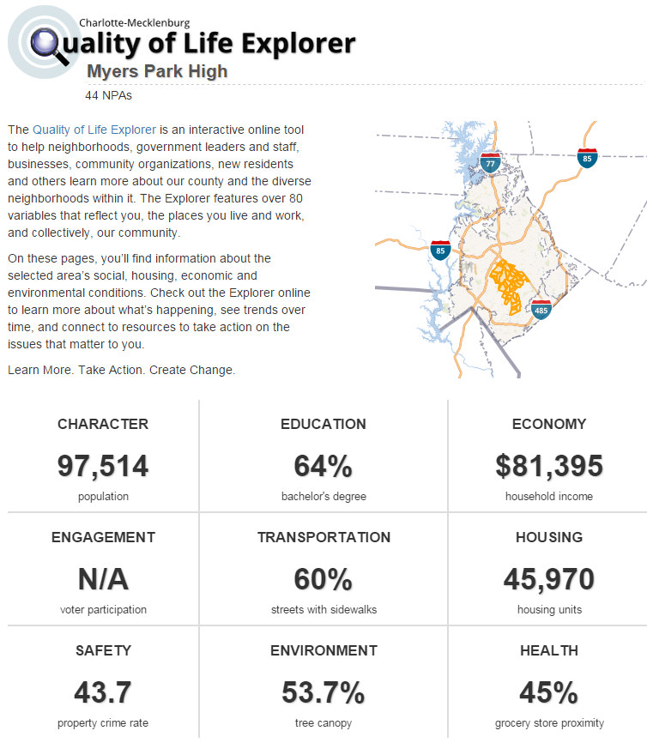
Data on Neighborhoods
Notes:
Add QOL data that is
82 variables
And we have reports that put all of this information in a simple package
WITH
On The fly One-click custom reports

Slide 11
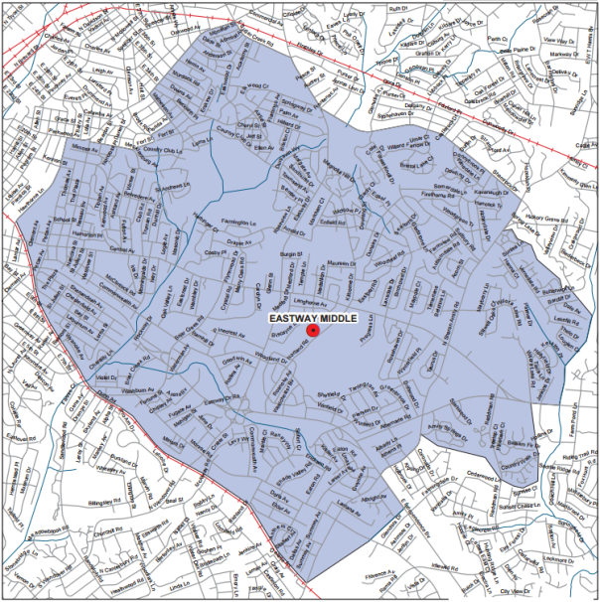
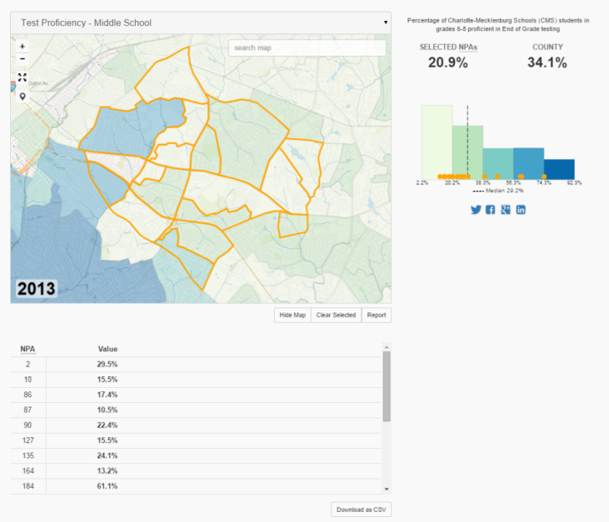
Alignment
What do we know about the neighborhoods that feed Eastway Middle School?
Notes:
This slide is another example of how closely aligned NPAs are to school boundaries.
This can be replicated 160 times and shared via simple URLs

Slide 12
Neighborhood-School Partnerships
Initiative to:
Facilitate partnerships between schools and neighborhoods
Improve Quality of Life in neighborhoods
Notes:
One way we (As city) are using this info working to bridge gap: NSP to strengthen school-community ties.
AND
Reports can be used for strategic planning for partnerships to develop programs and initiatives that are specific to a school/cause

Slide 13
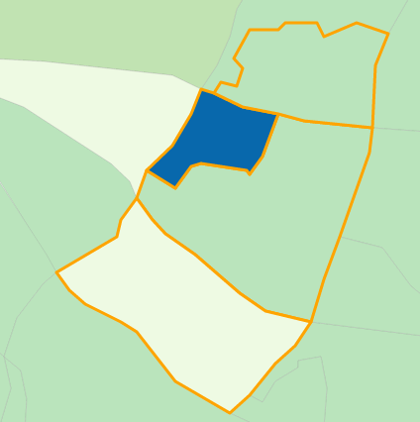
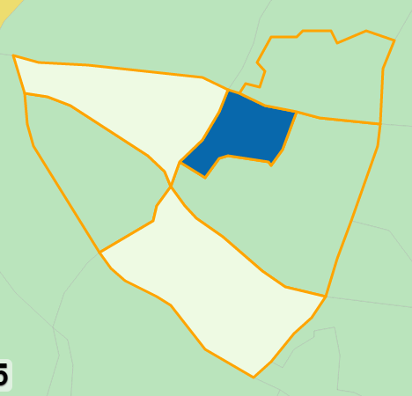
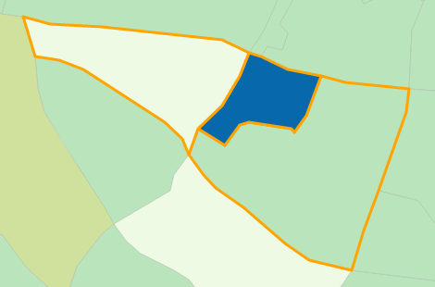
Pivot
Pivot areas to
Generate reports
Share data
… quickly
Notes:
QOL Explorer enables: Add or delete neighborhoods and see immediate changes in numbers thanks to dashbaord on-the-fly recalculation
Aka pivot mapping
We can use QOL in these and other situations because of its functionality: pivotmapping, reporting, sharing.

Slide 14
Lastly
Share
Links directly to reports or Explorer
Promote
This is perfect for community engagement
Align
Efforts already underway that use these data
Notes:
Share through links, directly to school zones new or proposed.
We have supplied CMS the links to current zones
Promote the use of the tool to the community, this tool.
The task force is already willing to help and use these data.

Slide 15
Notes:
QOL can make quick work of evaluation the 160-some different zones,
and that will make at least someone happy – even if its just an analyst

