Slide 1
Positive-Sum Games
Using a Summer Internship Program to Catalyze Community Impact
Noah Urban, Data Driven Detroit
October 2015
Notes:
We faced two challenges when thinking about an internship program:
Number of requests – we received at least a dozen unsolicited requests for internships in the Fall of 2014. Clearly, there were a lot of people interested in interning, but we wanted to make sure we could go about this in a thoughtful way.
Money/Resources: To put on a structured program (and compensate the interns appropriately), we needed to secure additional resources in order to support staff time and programming.

Slide 2
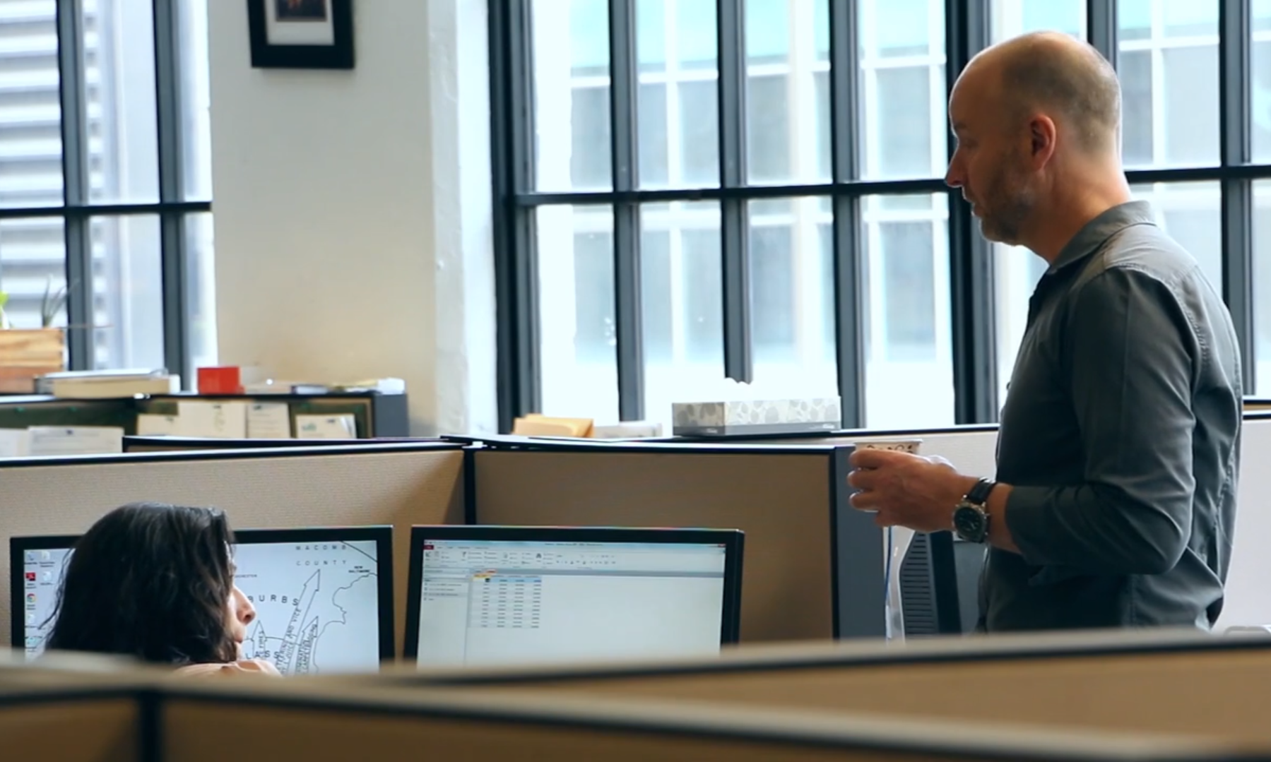
A Coordinated Response to Inquiries
Notes:
We got together a team of staff members who structured a framework for a pilot program over the course of several months. Over this time, we formulated a strategy for conducting and branding the program that would be very helpful in structuring the program and securing funding.

Slide 3
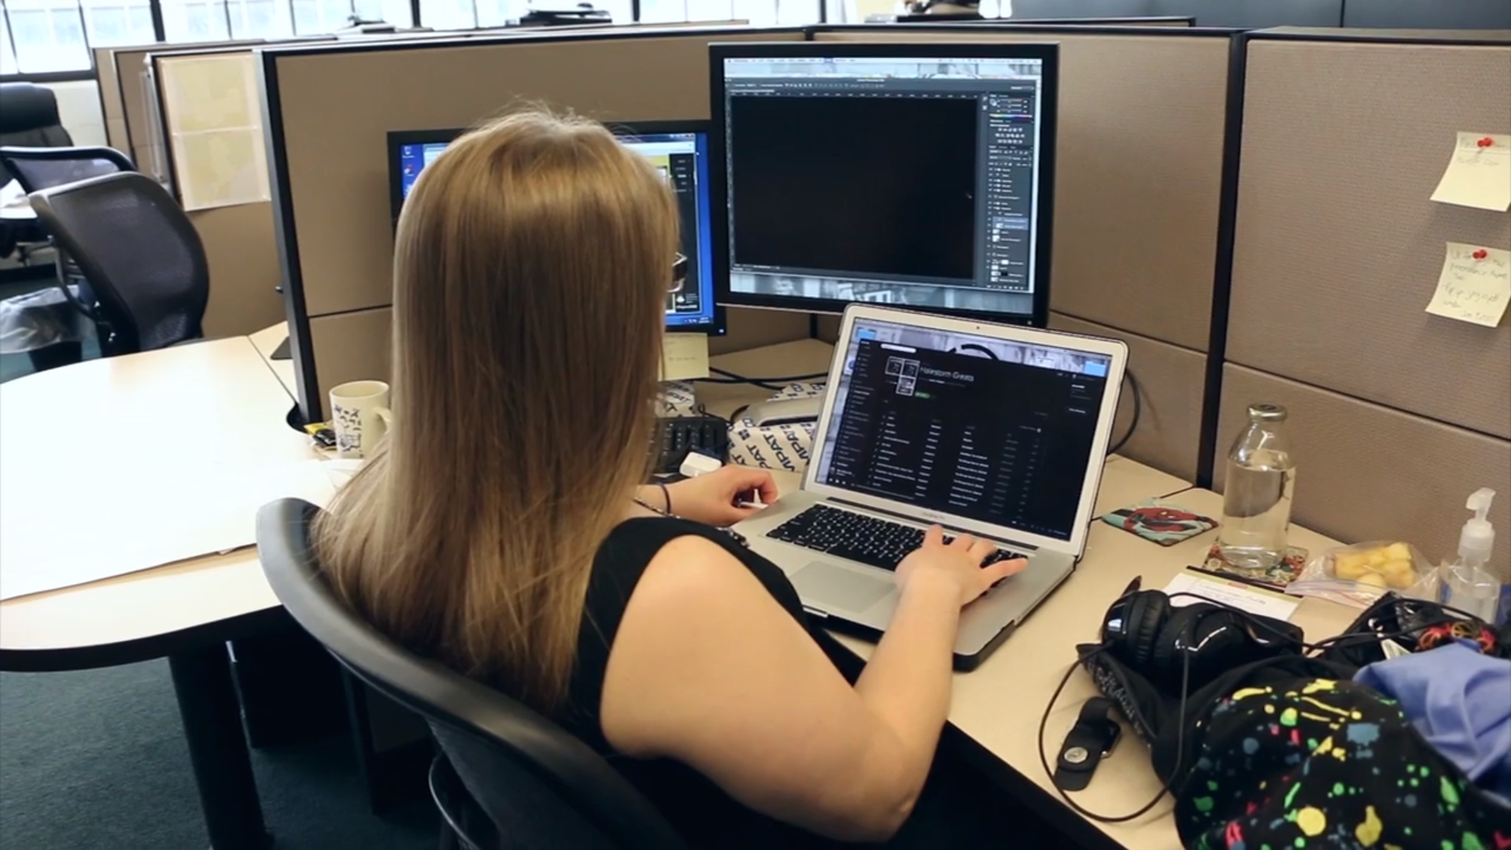
Branding the Program
Notes:
We decided to brand the internship program as a career-readiness initiative. In the proposal, we included significant amounts of time for programming, mentorship, and tutorial-related activities. Finally, we included a phase for post-program evaluation, allowing the interns to contribute (over time) toward building and refining the program.

Slide 4
Designing The Application Process
Notes:
We proposed four positions for the program – two data analysis interns, one marketing intern, and one web development intern. We also designed the application process for the program to have a community-oriented focus.

Slide 5
Designing The Application Process
Notes:
We achieved this focus through requiring applicants to submit a 300-word proposal for a community-oriented project of their own interest. If they were selected for the program, the interns would spend around half of their time working to bring their project to fruition.

Slide 6
Finding a Partner
Notes:
Branding the program with these community and career-development orientations also helped us formulate a strategy for discussing the program with potential partners. We partnered with the Max M. and Marjorie S. Fisher Foundation and the NextGen Board to implement the pilot phase of the program.

Slide 7
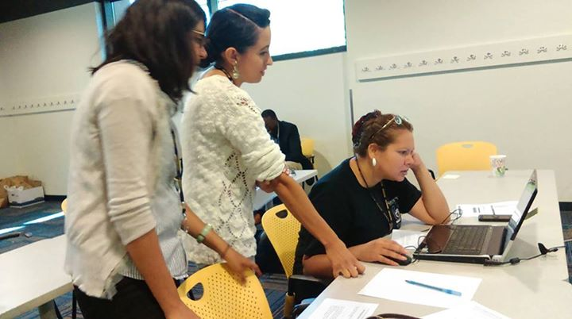
Executing the Program
Notes:
During the program, we made every possible effort to involve the interns in existing project work, in addition to their individual projects. This allowed them to gain experience in writing, conducting workshops, and general data analysis activities.

Slide 8
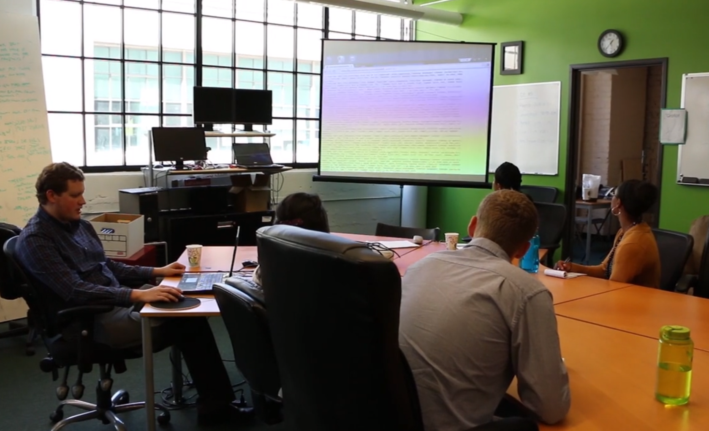
Executing the Program
Notes:
Through our perspective of career readiness, we were also able to provide intensive, twice-a-week tutorials on data management and GIS. In addition to being a significant investment in the interns themselves, these tutorials allowed us to refine a basic curriculum for conducting future data-related outreach and bringing new hires up to speed on how D3 works.

Slide 9
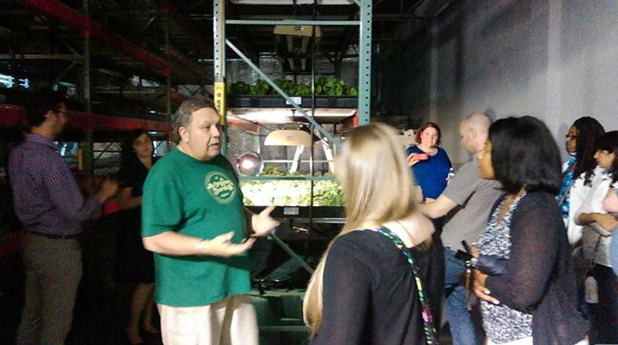
Executing the Program
Notes:
Finally, we had included additional programming opportunities in the grant, and so we were able to conduct programming such as tours and guest speakers that helped connect the interns further with the Detroit community. These events were particularly popular among interns from outside of the Metro Detroit area.

Slide 10
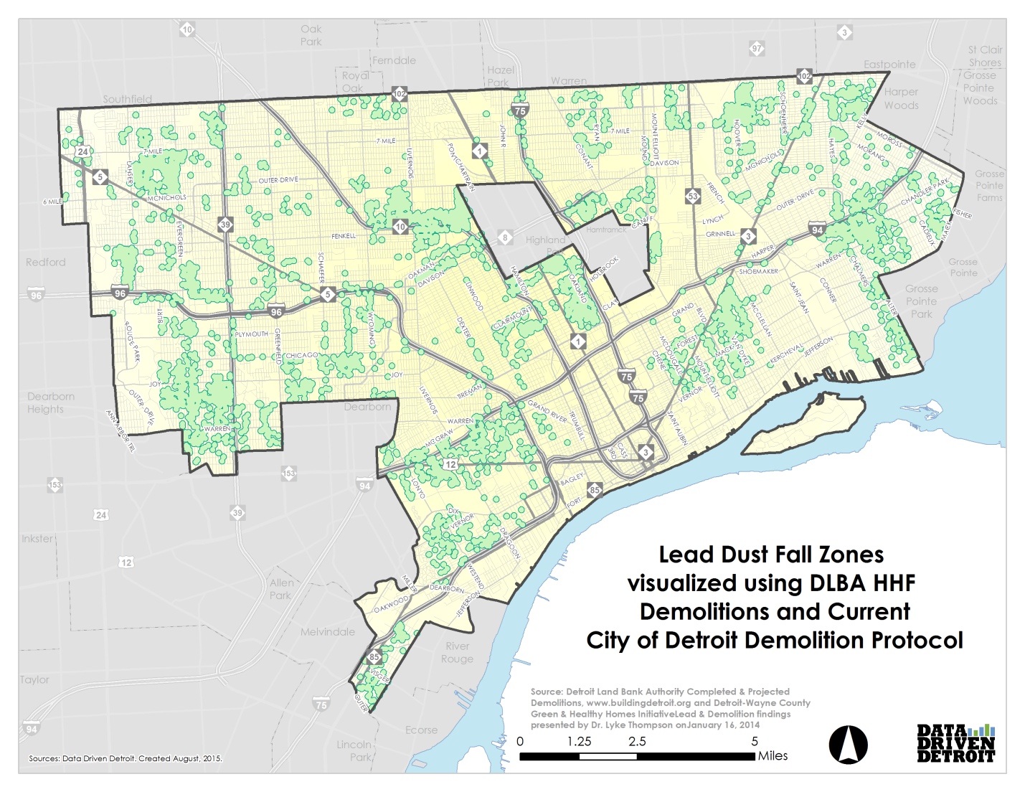
The Projects
Notes:
One of our data analysis intern’s projects focused on lead dust fall from demolition activity in Detroit, with a particular emphasis on the potential health risks to children and women of childbearing age.

Slide 11
The Projects
Chief of Police James Craig
1st Assistant Chief of Police
Lashinda Stair
Assistant Chief of Police
James White
Assitant Chief of Police
Eric Jones
Assistant Chief of Police
Steve Dolnut
Deputy Chief
David LeValley
Captiain
Todd Bettison
Director of Human Resources
Gail Oxendine
Captain
Dennis Perkins
Lieutenant
Melissa Gardner
Police-Recruiting
Deputy Chief
Cecila Washington
Legal Advisor
Notes:
Another worked on the Police Data Initiative, conducting an impressive level of outreach with the police department. In only a few months, she’d been able to meet with an entire network, and secure at least one dataset for D3.

Slide 12
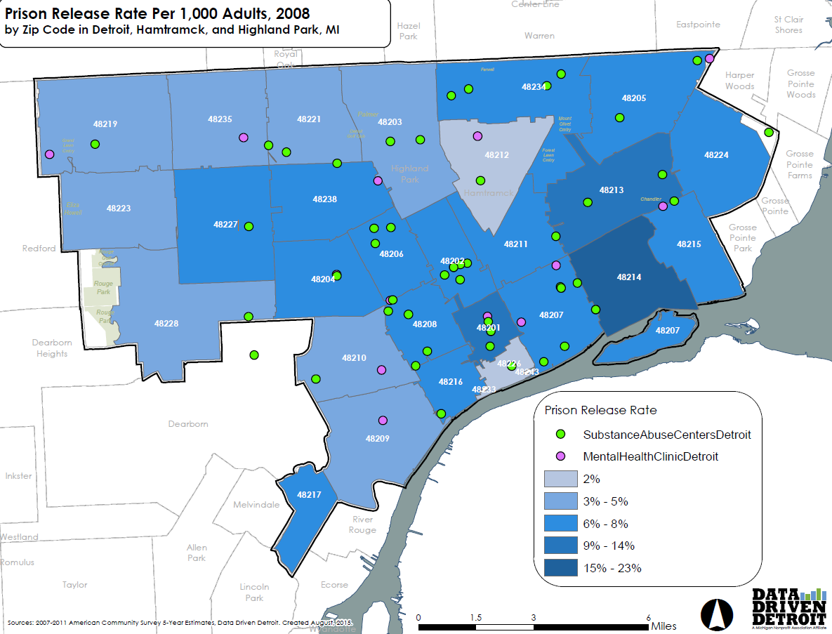
The Projects
Notes:
Our third data analysis intern focused on recidivism, mapping prison release rates and substance abuse centers to determine gaps in coverage, finding that the zip code with the highest rate of release actually contained no treatment centers.

Slide 13
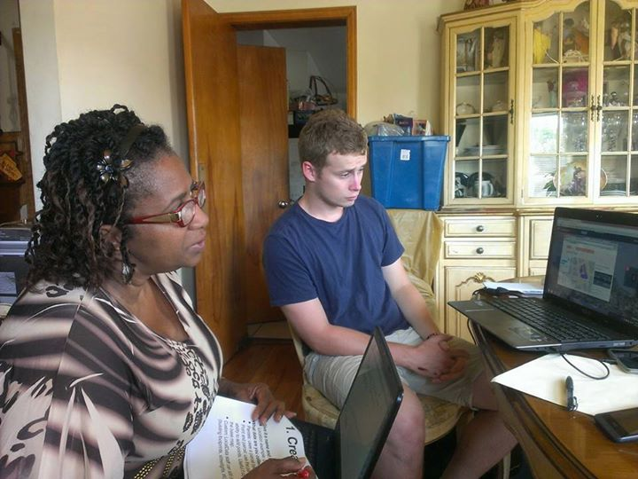
The Projects
Notes:
Our marketing intern conducted an outreach strategy in the Morningside community, focused on placing data and mapping tools in the hands of community leaders. This project is also scalable to other neighborhoods in Detroit.

Slide 14
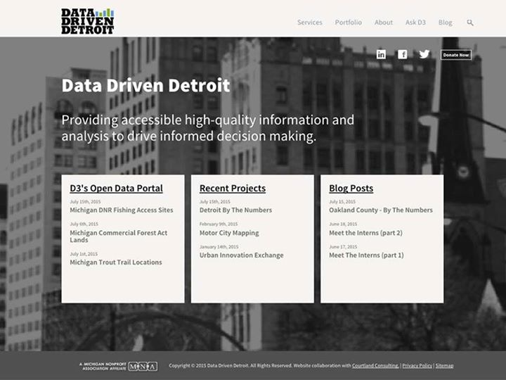
The Projects
Notes:
Finally, our web development intern assisted in launching an updated website with far more intuitive search functions to allow users to access our digital library.

Slide 15
www.DataDrivenDetroit.org
@D3Detroit
AskD3@DataDrivenDetroit.org
TechTown
440 Burroughs #330
Detroit, Michigan 48202
Notes:
We’ve posted the products for all of the interns, as well as some video and materials documenting the first year on our website (datadrivendetroit.org). Be sure to visit it, and let us know if you have any questions about how we implemented and/or evaluated the program!

