Slide 1
Equitable Development Planning: 11th Street Bridge Park Monitoring Neighborhood Change Panel, NNIP Meetings, Cleveland, September 15, 2016 Presented by Peter Tatian, NeighborhoodInfo DC

Slide 2
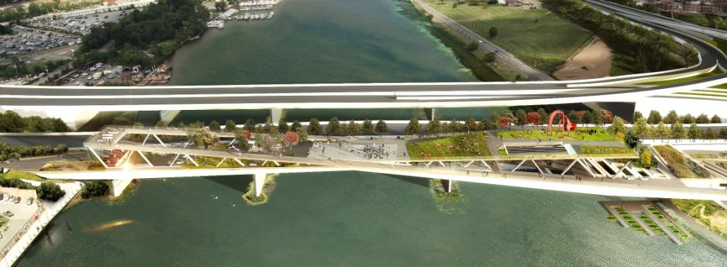
11th Street Bridge Park Selected design: OMA + OLIN
Image courtesy 11th Street Bridge Park
Notes:
Expected to open in 2019, now in preconstruction phase

Slide 3
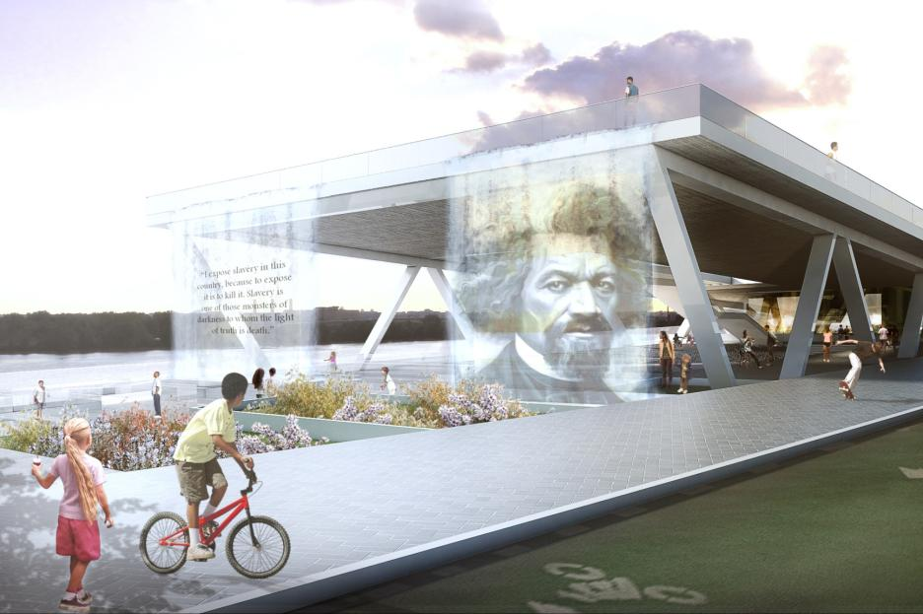
Image courtesy 11th Street Bridge Park

Slide 4
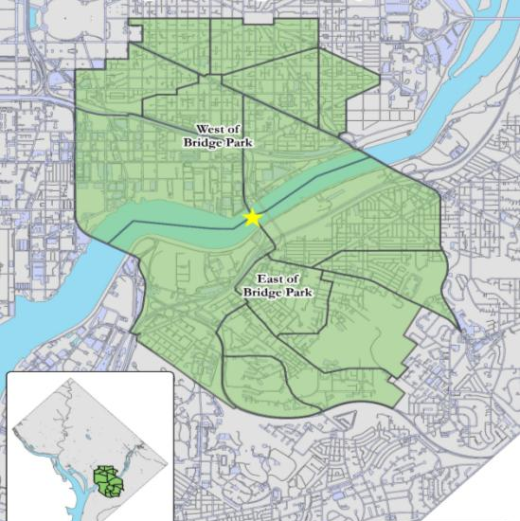
Equitable Development Plan
Image courtesy 11th Street Bridge Park
Notes:
Grew out of residents concerns about impact of BP
Looking at similar developments in other parts of the country
DC LISC helped underwrite BP dir’s salary, assigned ½ time program officer to assist BP w/mgt, research, and TA
Baseline data looked at conditions and disparities, west vs east BP
unemployment rate 6.6% vs. 20.7%
child poverty 20% vs 53%
Median home values $654,000 vs $263,000

Slide 5
Equitable Development Plan
Workforce Development Strategies
Construction phase hiring
Post-construction phase hiring
Small Business Development Strategies
Support small businesses operating on Bridge Park
Leverage Bridge Park to build and sustain small businesses in community
Ensure Bridge Park is deeply connected to business corridors
Housing Strategies
Disseminate information regarding housing opportunities to residents
Work with city agencies, nonprofits to preserve existing affordable housing and build new affordable housing
Partner with housing community to support and advocate for policies that preserve and create affordable housing
Notes:
Equitable development task force
Series of meetings, including two open community meetings on both sides of the river to solicit recommendations
Final equitable development plan (released Nov 2015) included recommended strategies in three areas

Slide 6
Notes:
Follow up with NeighborhoodInfo DC to measure implementation of the plan
Logic model summarizing strategies developed in economic development strategy

Slide 7
Category | Baseline Data (population level for Bridge Park area) | Source
Workforce | % persons 16-64 years in labor force % persons in labor force who are employed (employment rate) % persons below federal poverty level % persons by race/ethnicity % persons 25+ years with a HS diploma or equivalent % persons 25+ years with some postsecondary education # persons receiving TANF benefits # persons receiving SNAP benefits | American Community Survey (at Census tract level); Neighborhood-Info DC warehouse
Small Business | # of businesses in main business corridor # of unused spaces in business corridor # of small businesses owned by residents of Bridge Park area # of violent crimes reported # of property crimes reported | Dunn and Bradstreet; MPD (both at Census tract level)
Notes:
Baseline indicators that can be used for starting measurement

Slide 8
Category | Baseline Data (population level for Bridge Park area) | Source
Affordable Housing | # of building permits issued for residential construction/rehab # of affordable units from Preservation Catalog # of renter households # of homeowner households % homeowner households (homeownership rate) % renters with severe housing cost burden % homeowners with severe housing cost burden # of home sales median sales price of SF homes/condominiums % of residential property owned by area residents # of mortgage-financed home purchases by race/ethnicity of buyer # of mortgage-financed home purchases by income of buyer | DCRA; DC Preservation Catalog; Real property data; HMDA

Slide 9
Bridge Park “Data Room”
How NeighborhoodInfo DC will provide data support for the Bridge Park Equitable Development Strategy team for planning, tracking, and communicating about equitable development activities in the target areas
Support within NeighborhoodInfo DC warehouse for Bridge Park areas
Compile, process, and store internal administrative data for Bridge Park
Produce custom neighborhood profiles for target areas
Produce enhanced digital features and content

Slide 10
Contact and resources
Peter Tatian, ptatian@urban.org, @PeterTatian
Bridge Park, http://www.bridgepark.org, @DCBridgePark
Bridge Park Equitable Development Plan: http://bridgepark.org/sites/default/files/Resources/EDP%20Final%20-%20UPDATED.pdf
Urban report on Bridge Park Equitable Development Process and Plan:
http://www.urban.org/research/publication/equitable-development-planning-and-urban-park-space-early-insights-dcs-11th-street-bridge-park-project

