Slide 1
Detroit
Planning ahead for equitable development
Erica Raleigh (D3), Sept. 2016

Slide 2
Detroit Context
2010-2014 mortgage/tax foreclosures: 110,000+
2016 properties eligible for tax foreclosure: 20,000
Q3 2015 vacant/no stat addresses: 110,000 (30%+)

Slide 3
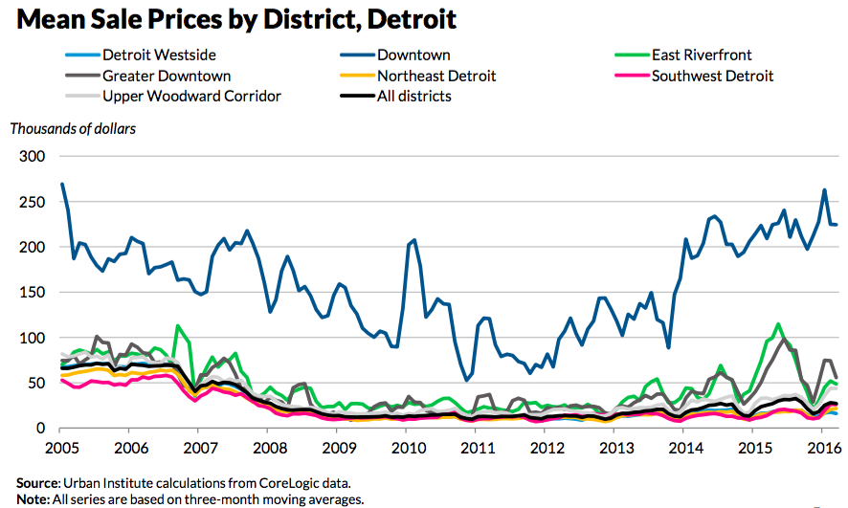

Slide 4
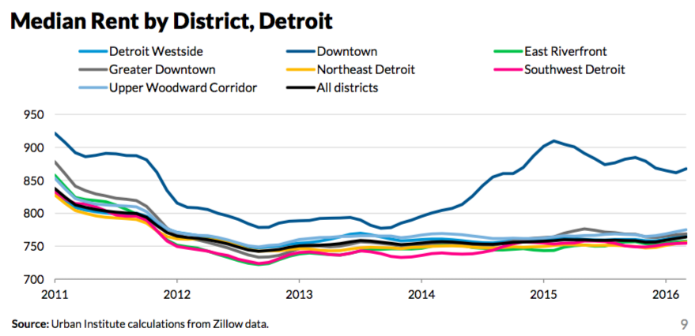

Slide 5
Detroit Context
2014 purchase mortgages: < 500
Urban Institute noting:
  44% corporate buyers in 2014
  54% quit claims (land contracts?) in 2014

Slide 6


Slide 8
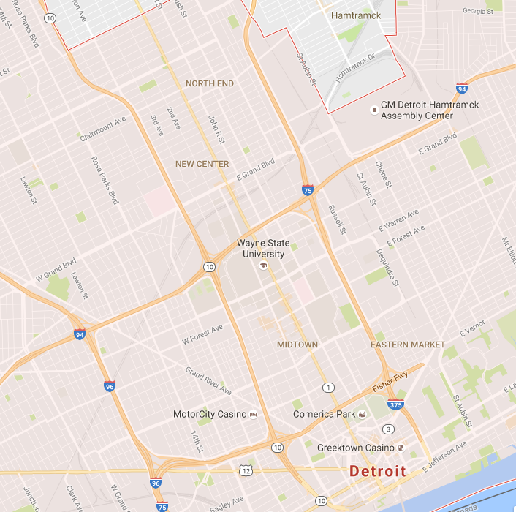

Slide 9
Turning the Corner
How can we monitor neighborhood change closer to real time, understand how people feel about it, and provide the information to people who can do something about it?

Slide 10
Our Local Work
Cross Site Learning
Community Advisory Board
Quantitative Sources Research
Qualitative Research

Slide 11
Quantitative
Detroit advantages:
  Motor City Mapping project
  City’s move toward open data
Disadvantages:
  Despite better property data, lacking “people” data

Slide 12
Quantitative Progress
Researched over 50 potential data exhaust streams
Ideal seems to be a combo:
  Utility shut offs / transfers
  Property value & rent levels
  Business opens / closes by type
  Credit card spending
May have enough to test causal model and identify leading indicators

Slide 13
Qualitative Plans
Focus groups
  Residents in neighborhoods anecdotally experiencing neighborhood change
Interviews
  Established business owners in the same neighborhoods

Slide 14
Thanks!
Erica Raleigh
Erica@DataDrivenDetroit.org
www.datadrivendetroit.org
@D3detroit

