Slide 1

Monitoring Neighborhood Change
Jeff Matson
jmatson@umn.edu
NNIP Cleveland
9/14/16

Slide 2
The Myth of Gentrification
Notes:
MinnPost story on IMO Report
https://www.minnpost.com/cityscape/2016/01/if-twin-cities-gentrification-myth-what-s-real-problem
Pioneer Press Story
http://www.twincities.com/2016/01/19/in-twin-cities-gentrification-not-really-hurting-the-poor-umn-study-says/
Southside Pride
http://southsidepride.com/poverty-pimps-and-the-gentrification-scam/

Slide 3
Initial Research
Scale matters
Mixed methods
    Variety of data sources
    Interviews lead to new data
Data is often a lagging indicator
    Depends how you use it

Slide 4
Qualitative Analysis
Who was interviewed?
What did we learn?
    Change here is slow and subtle
    May not involve displacement
    Not all development is good
    Policy must be intentional
Next steps?
Turning the Corner

Slide 5
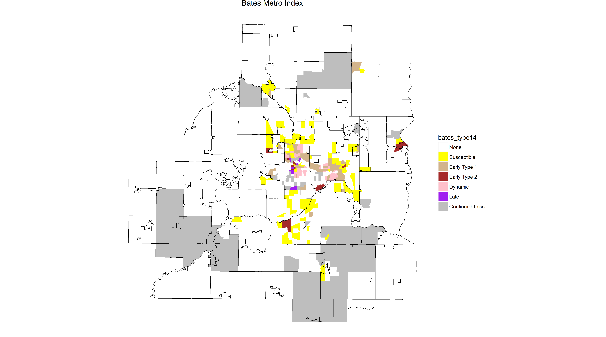
Scale Matters

Slide 6
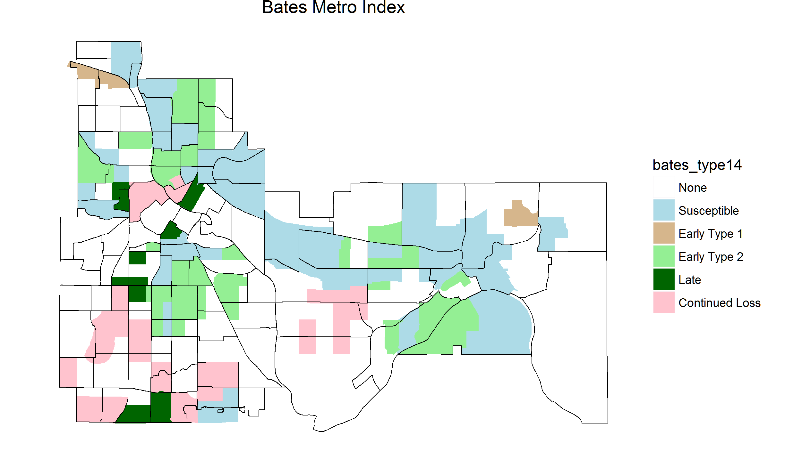
Scale Matters

Slide 7
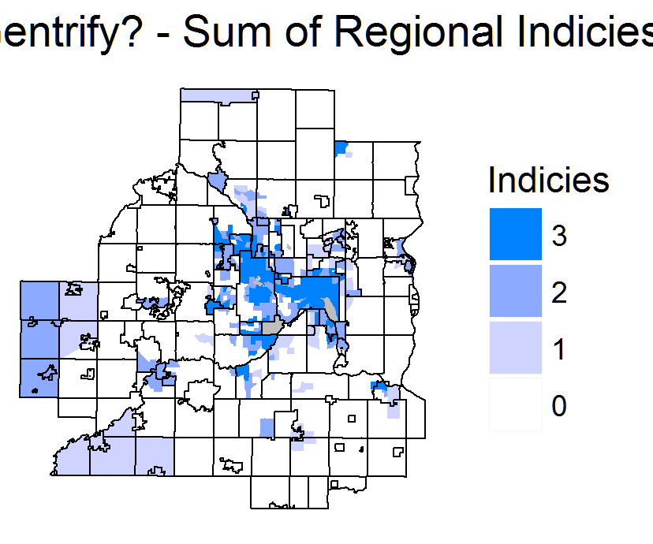
Multiple Indices
Notes:
We looked at a number of different indices – Bates, Freeman, Ding
Looked at where they coincided

Slide 8
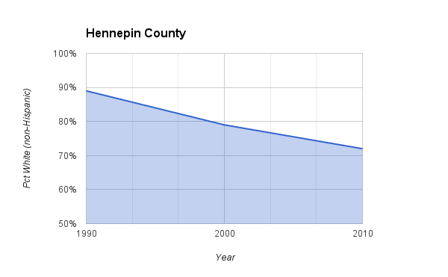
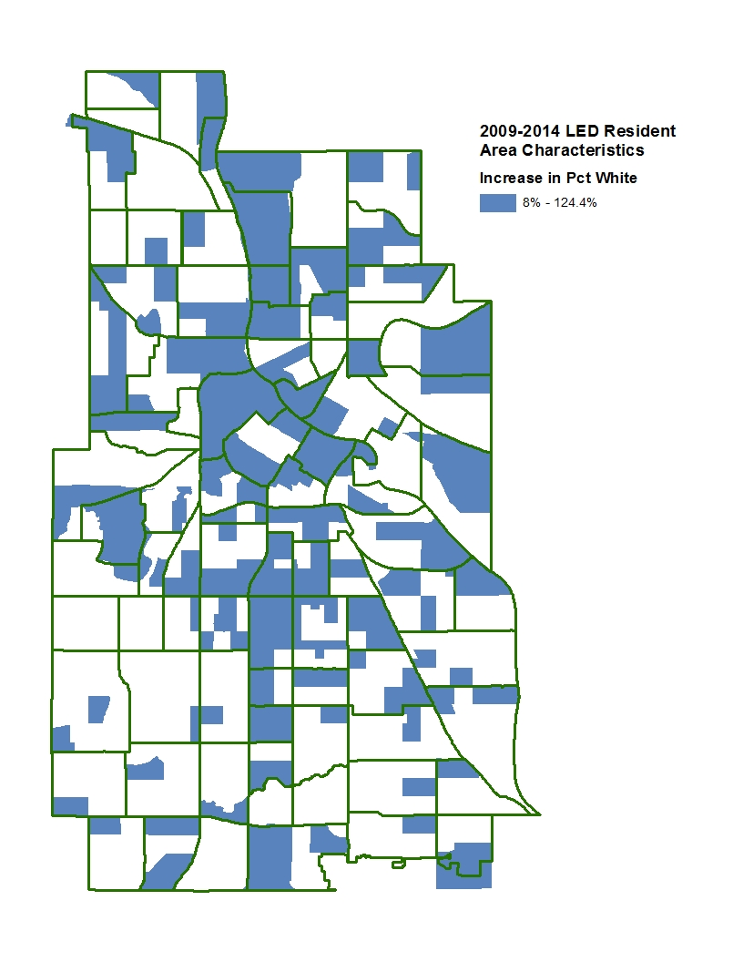
Demographic Trends

Slide 9
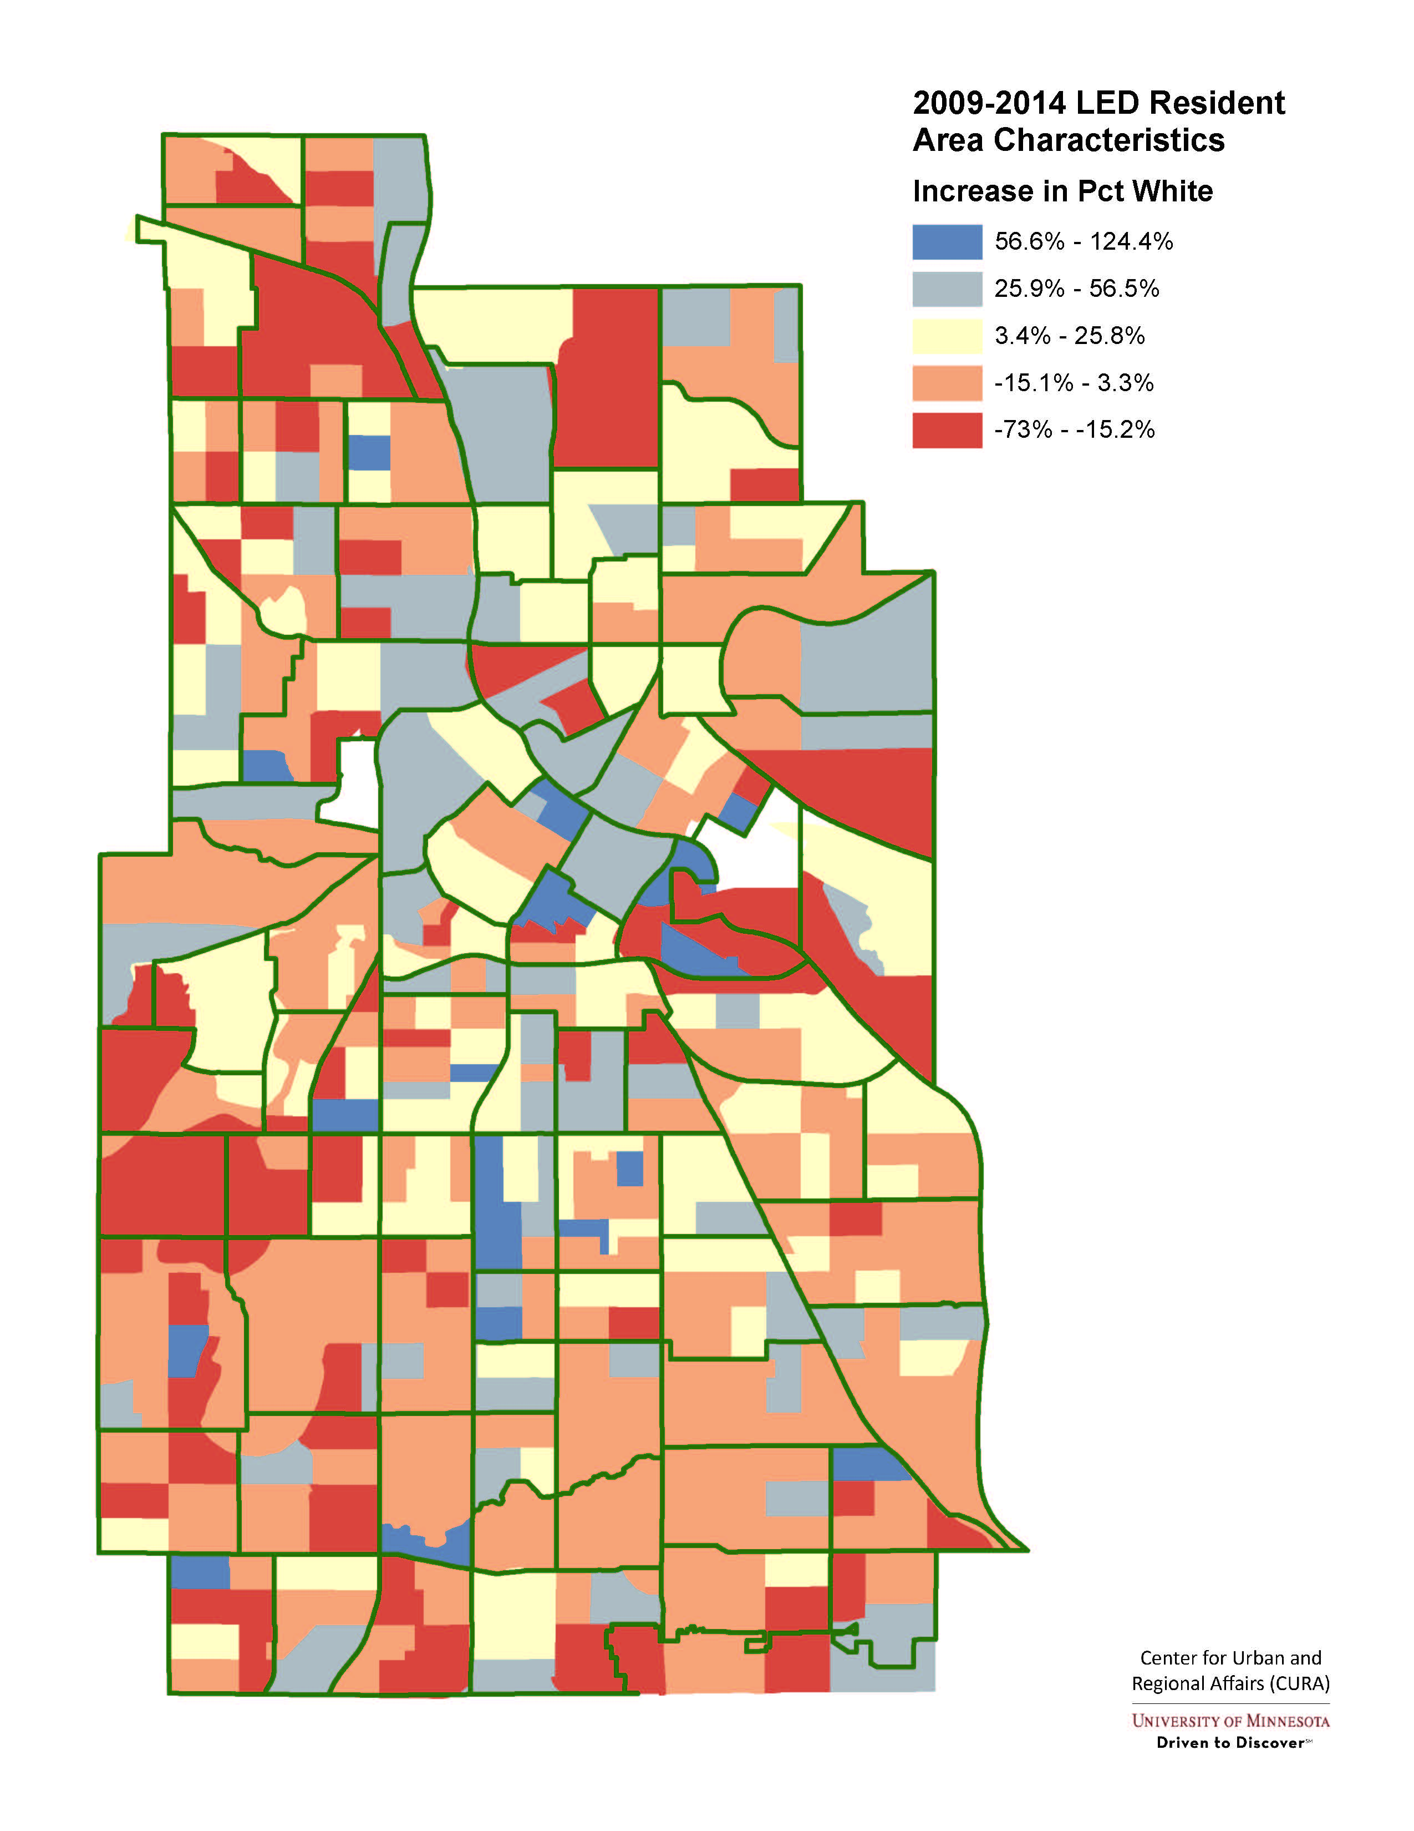
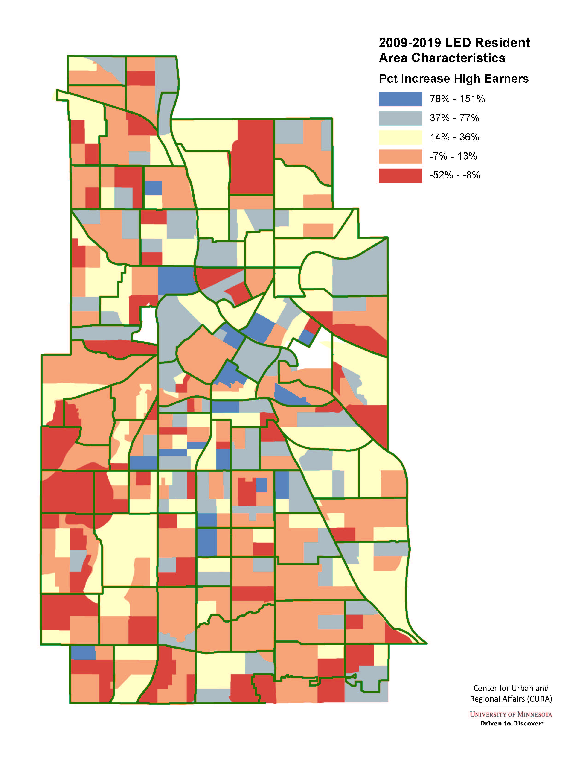
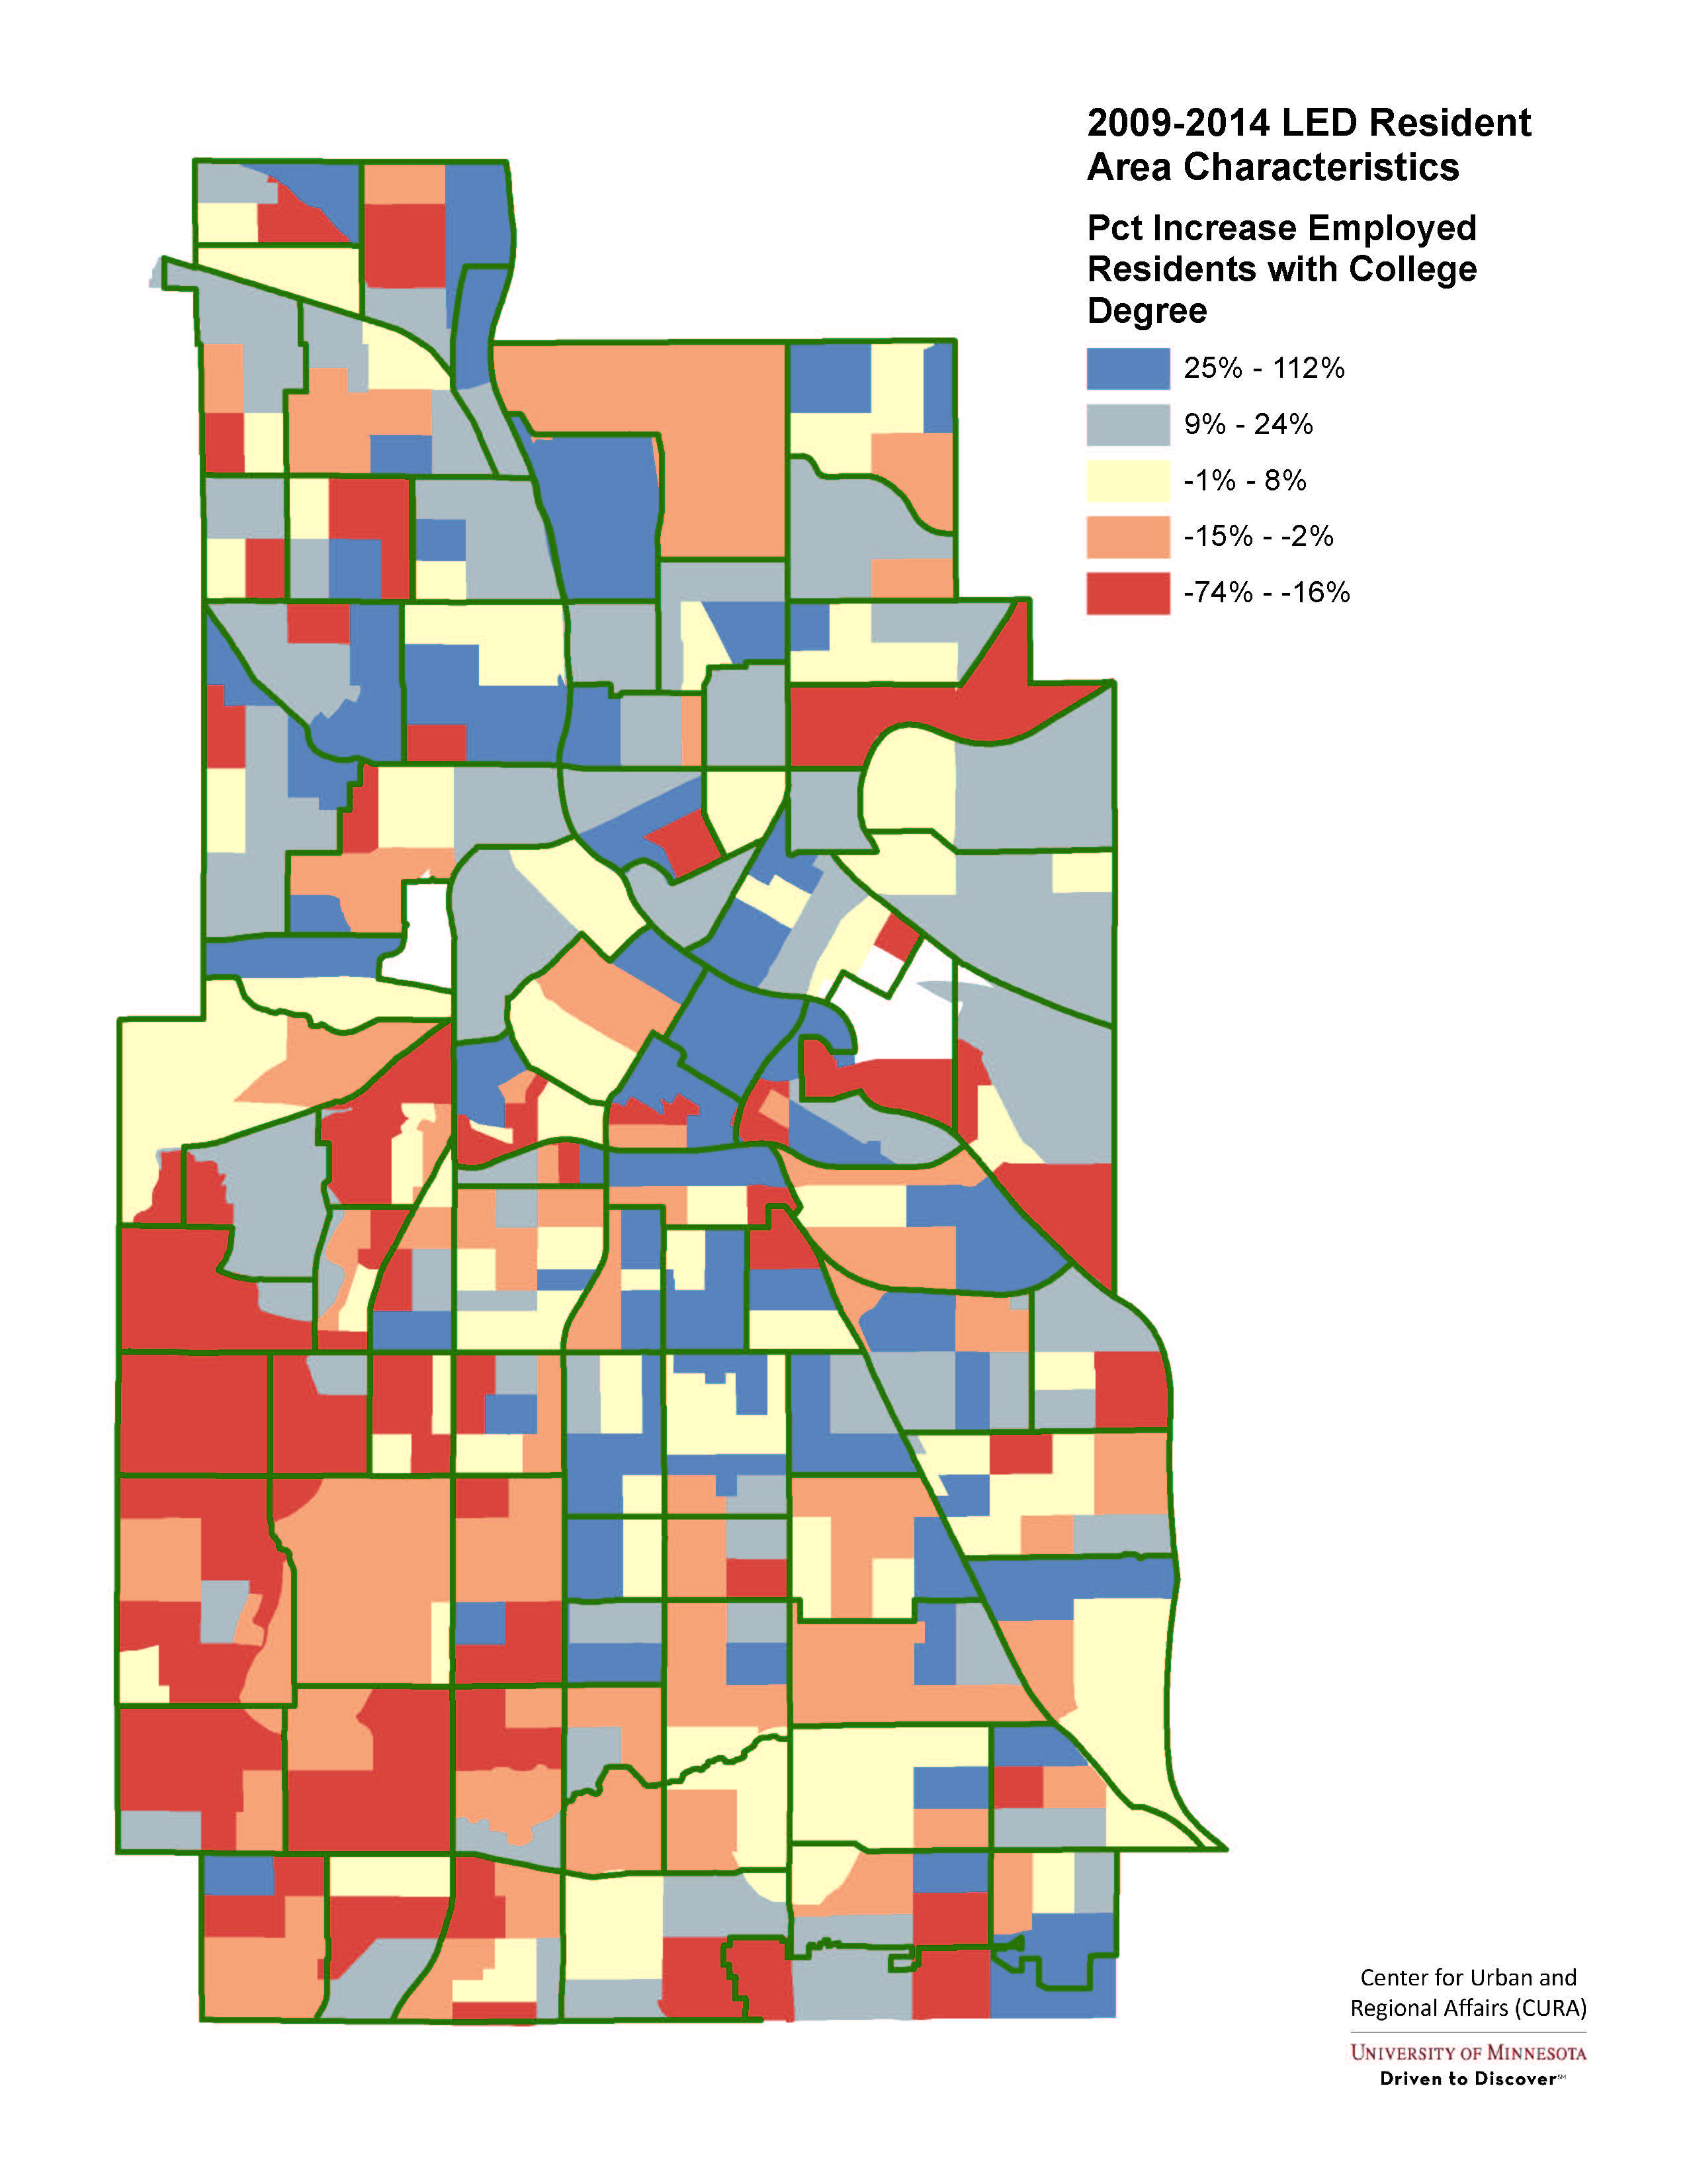
Local Employment Dynamics

Slide 10
The Role of Data
Bates Gentrification Typology, etc.
LEHD Analysis
Crime / Block Club analysis
HMDA & Race of post-foreclosure owners
Fed data on replacement owners
Business Licensing (cultural displacement)
Notes:
Turning the Corner will help with on-going monitoring and more timely data analysis

Slide 11
Green Line LRT & Frogtown-Rondo Housing
Large public investment through a low income neighborhood
New housing opportunity / Access to jobs
At 30/50/60% of AMI is this further concentrating poverty or gentrifying a neighborhood?
Anecdotal Section 8 stories
Notes:
Example of why this is a complicated issue.
What is the income in Frogtown (nh median income is what % of AMI?) $82,400
At $36,000 it’s less than half AMI if you build housing at 50-80% of AMI current residents can’t afford it
Others decry any attempts at funding affordable units in poor neighborhoods

Slide 12
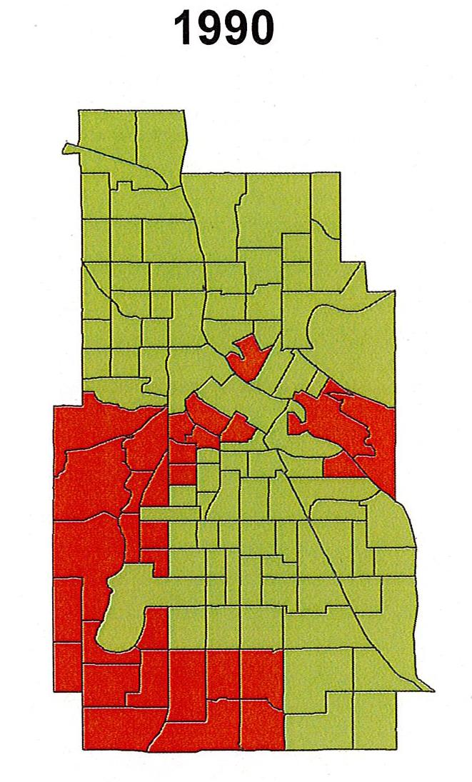
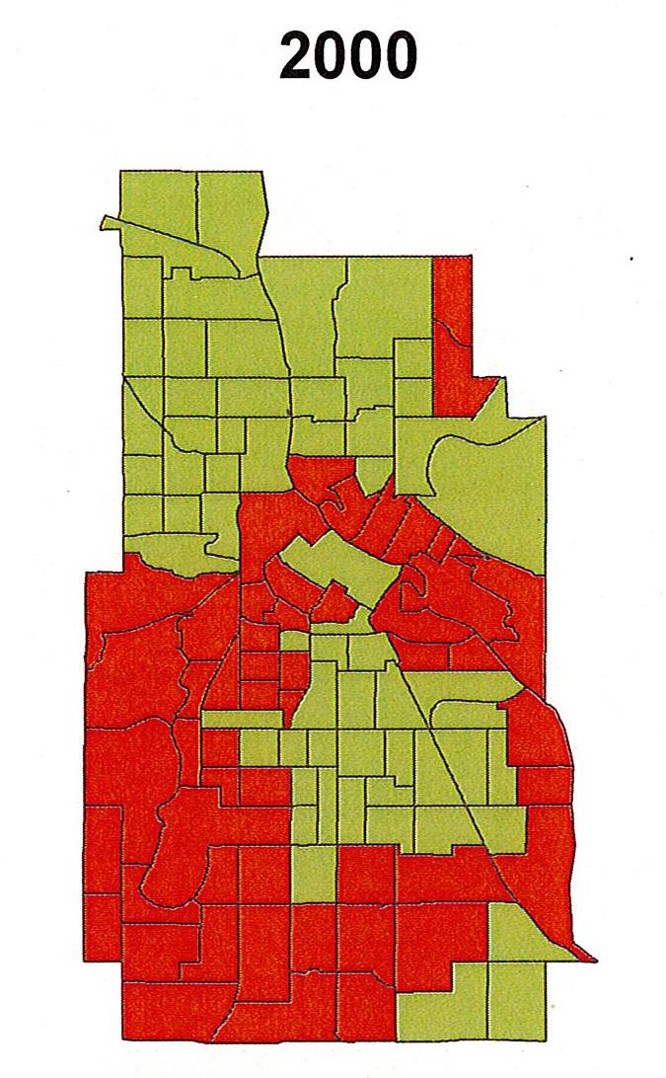
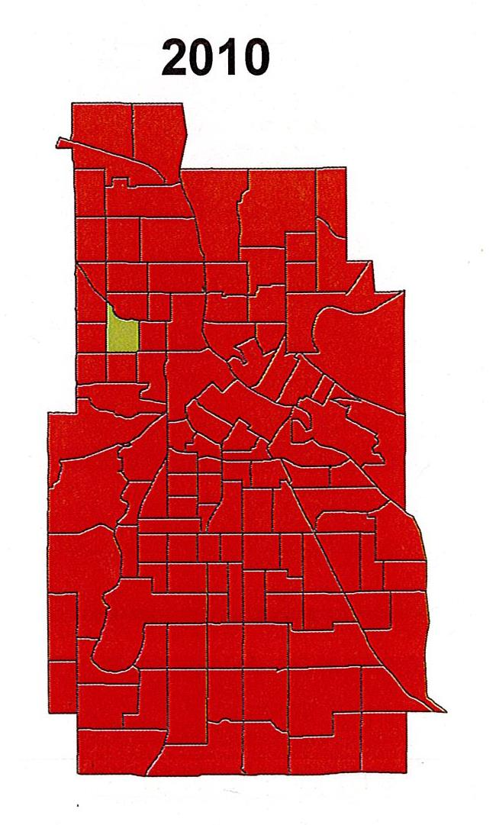
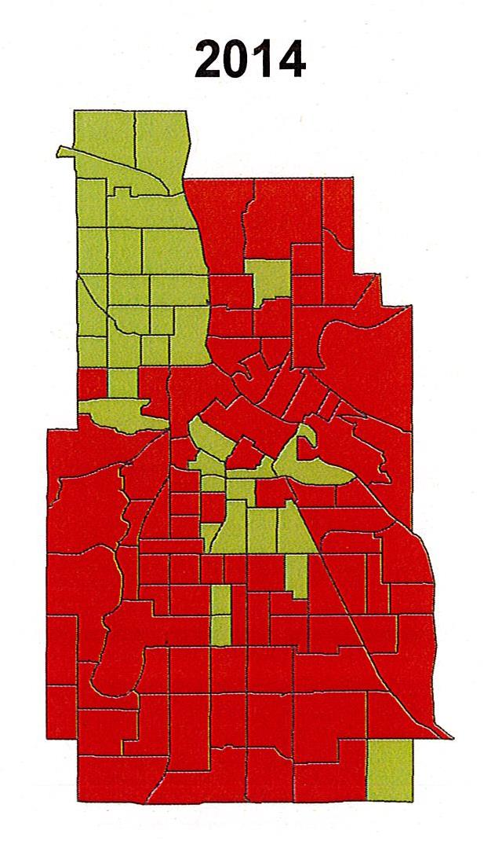
Affordability for Black Households
Notes:
Concept of the Shrinking City
Who gets to live in Minneapolis in 2020 and Beyond?
Median income of black households v. median home price
This is what happens if we do nothing

Slide 13
Thank you!
Jeff Matson
jmatson@umn.edu

