Slide 1
Communicating with Data to Advance Racial Equity
National Neighborhood Indicators Partnership
May 10, 2018
Leah Hendey – Deputy Director NNIP and DC NNIP Partner (Urban-Greater DC)
Julie Nelson – Senior Vice-President of Programs, Co-Director of Government Alliance on Race and Equity, Race Forward / Center for Social Inclusion
Bernita Smith – Director of Neighborhood Nexus (Atlanta NNIP Partner) and NNIP Executive Committee member
Rebecca Hefner – City of Charlotte, Data and Analytics Manager
Notes:
JN (2 to 3 min intros by each of us)

Slide 2
Notes:
JN

Slide 3

Government Alliance on Race and Equity
A national network of government working to achieve racial equity and advance opportunities for all.
Lead network – 70 members
Expand network – 30 states / 150+ cities
Provide tools to put theory into action
Notes:
JN
falls under our institutional change work

Slide 4

Framework for Advancing
Racial Equity
Notes:
JT

Slide 5
Values and realities
All men are created equal
With liberty and justice for all
Government of the people, by the people, for the people, shall not perish from the earth
Notes:
JT

Slide 6
History of government and race
Initially explicit
Became implicit
Discrimination illegal, but “race-neutral” policies and practices perpetuate inequity.
Government for racial equity
Proactive policies, practices and procedures that advance racial equity.
Government explicitly creates and maintains racial inequity.
Notes:
JN

Slide 7
National best practice
Normalize
A shared analysis and definitions
Urgency / prioritize
Organize
Internal infrastructure
Partnerships
Operationalize
Racial equity tools
Data to develop strategies and drive results
Visualize
Notes:
JN

Slide 8
Normalizing –
key concepts about race
Notes:
JN

Slide 9


Equity? Equality?
What’s the difference?
Notes:
JN

Slide 10
Why we lead with race
Racial inequities deep and pervasive
Racial anxiety on the rise – race is often an elephant in the room
Learning an institutional and structural approach can be used with other areas of marginalization
Specificity matters
Notes:
JN

Slide 11
Racial inequity in the U.S.
From infant mortality to life expectancy, race predicts how well you will do…
Notes:
JT

Slide 12
Racial equity means:
“Closing the gaps” so that race does not predict one’s success, while also improving outcomes for all
To do so, have to:
  Target strategies to focus improvements for those worse off
  Move beyond “services” and focus on changing policies, institutions and structures
Notes:
JT

Slide 13

Explicit bias
Expressed directly
Implicit bias
Expressed indirectly
Example – Sign in the window of an apartment building – “whites only”
Aware of bias / operates consciously
Unaware of bias / operates sub-consciously
Example – a property manager doing more criminal background checks on African Americans than whites.
Notes:
JN

Slide 14
Institutional / Explicit
Policies which explicitly discriminate against a group.
Example:
Police department refusing to hire people of color.
Policies that negatively impact one group unintentionally.
Example:
Police department focusing on street-level drug arrests.
Individual / Explicit
Individual / Implicit
Prejudice in action – discrimination.
Example:
Police officer calling someone an ethnic slur while arresting them.
Unconscious attitudes and beliefs.
Example:
Police officer calling for back-up more often when stopping a person of color.
Institutional / Implicit
Notes:
JN

Slide 15
Individual racism:
Bigotry or discrimination by an individual based on race.
Institutional racism:
Policies, practices and procedures that work better for white people than for people of color, often unintentionally or inadvertently.
Structural racism:
A history and current reality of institutional racism across all institutions, combining to create a system that negatively impacts communities of color.
structural
institutional
individual
Notes:
JT

Slide 16
Table Talk:
What examples of implicit bias or institutional or structural racism have you seen play out in your community?
Notes:
JT

Slide 17
Using data to communicate
effectively on race
Notes:
JN

Slide 18
How race gets triggered
Implicit Bias:
Unconscious bias developed through networks of association on race
Symbolic Racism:
The use of images, code words, and metaphors that implicitly signal race
Triggering race
Understanding Implicit Bias. Kirwan Institute for the Study of Race and Ethnicity, 2014. Web. October 14, 2014.
David O. Sears and P. J. Henry, “The Origins of Symbolic Racism”, Journal of Personality and Social Psychology 85, no. 2 (2003): 259-275.
Notes:
JN

Slide 19

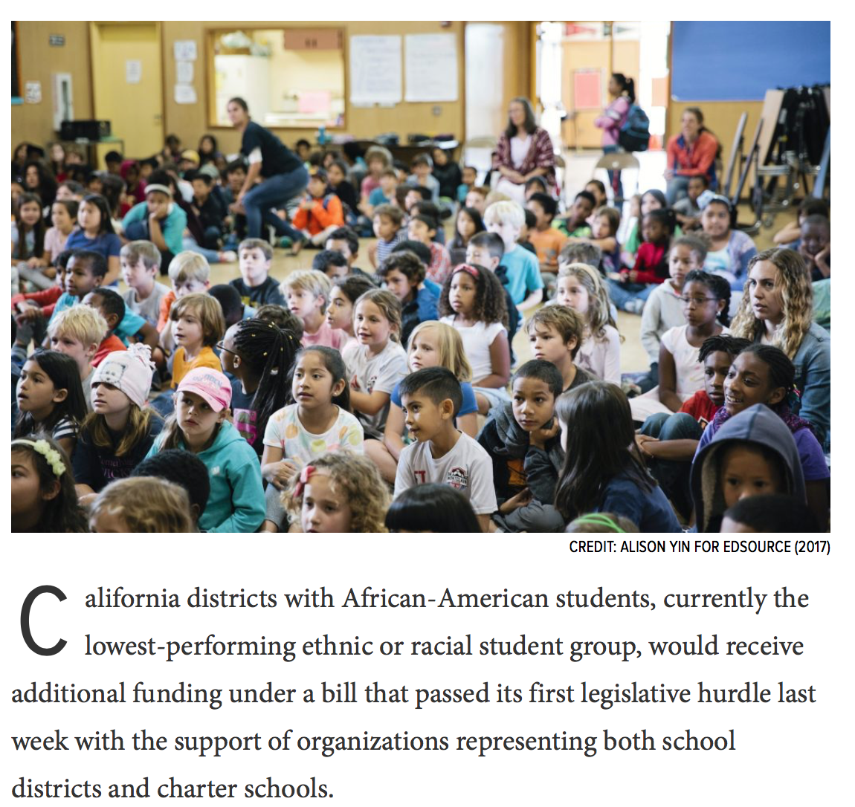
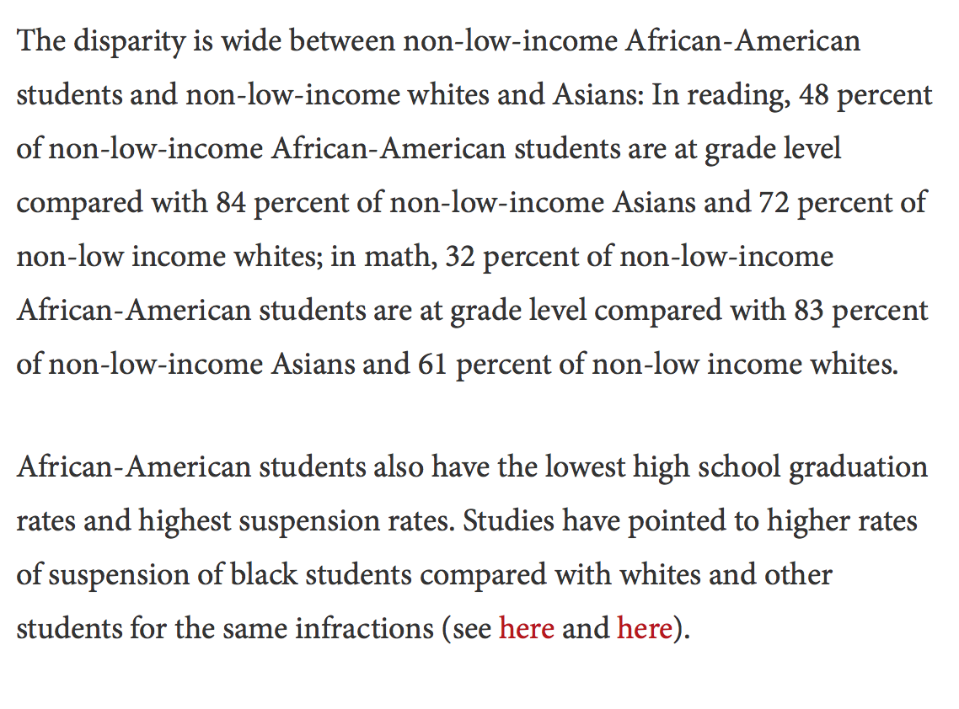
Data – but what does it tell us?

Slide 20
What are common dominant narratives about race?
Failures of individuals / people of color, rather than institutions, structures or systems
People of color “takers”
Lack of historical acknowledgement or understanding
Government inefficiency / bureaucracy
Notes:
JN

Slide 21

Talking about Race Toolkit
https://www.centerforsocialinclusion.org/talking-race-toolkit/

Slide 22
Communicating about race
It’s more than just talk – ACT
Affirm
Counter
Explain why we have the problem
Transform
Reframe winners and losers
End with heart and a solution
Start with the heart
Explain why we are all in this together
Take on race directly
Notes:
JN

Slide 23

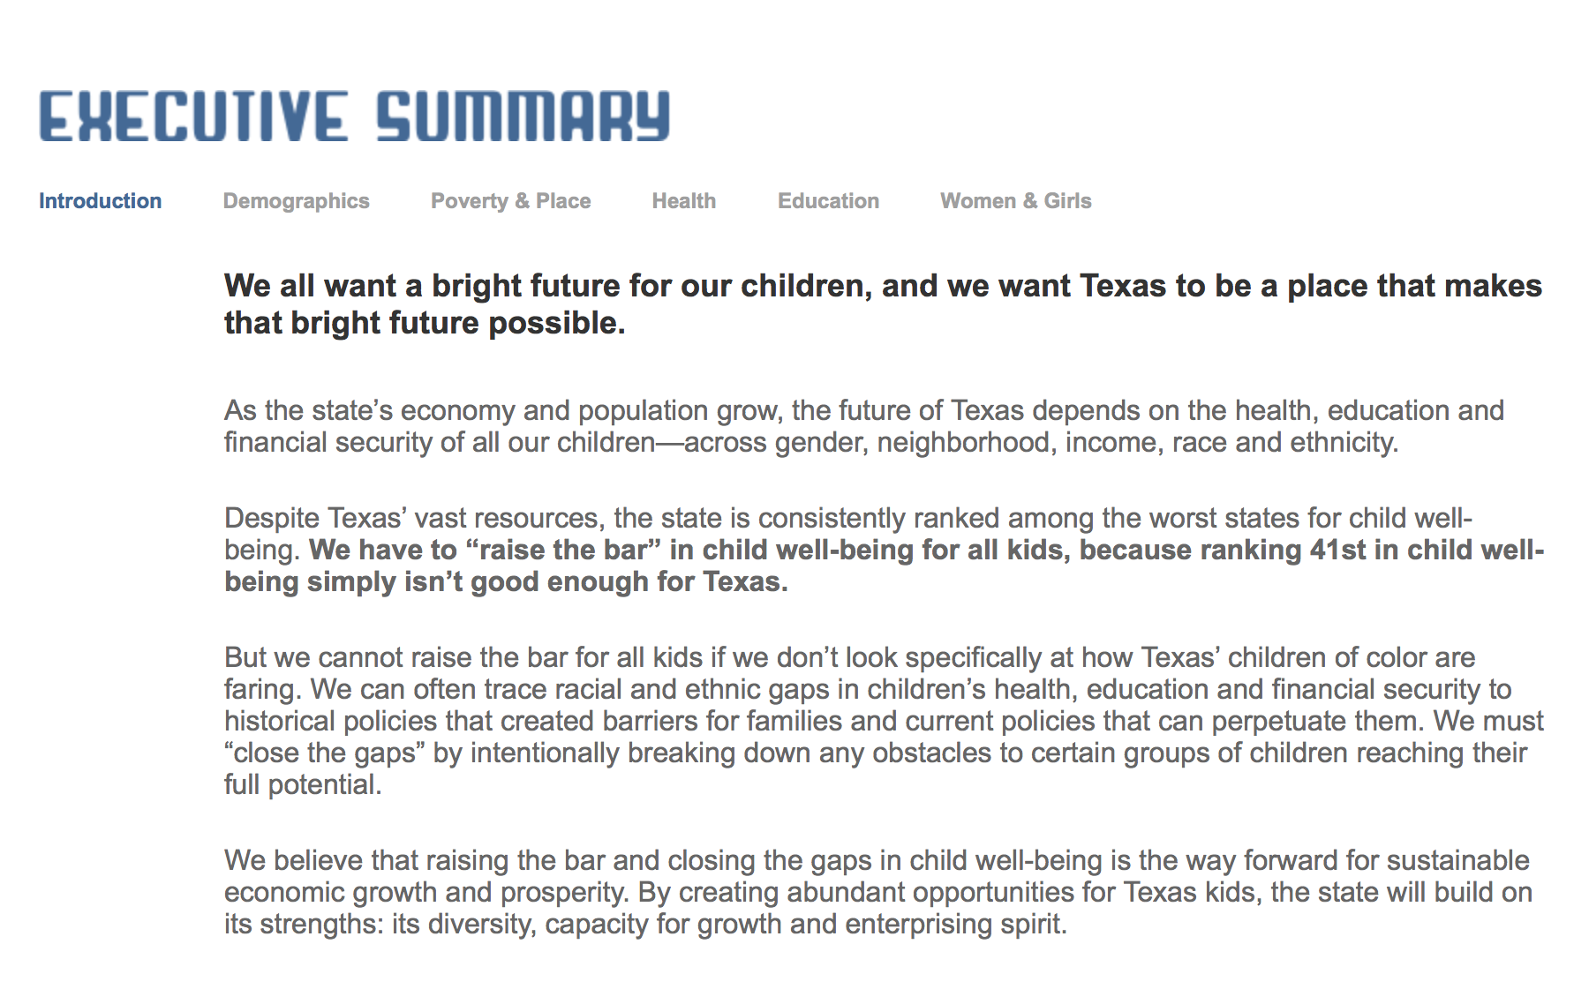

Slide 24
Reflections from Atlanta
Bernita Smith, Director of Neighborhood Nexus (Atlanta NNIP Partner) and NNIP Executive Committee member
Notes:
Julie

Slide 25
Table Talk:
Where have or could you use data to advance racial equity?
Where have or could you tackle a dominant narrative?
What are the strategies that have been successful? Physical products, presentations, briefing, interactions
Notes:
JT

Slide 26
Case study: Charlotte
Rebecca Hefner – City of Charlotte
Data and Analytics Manager
Notes:
Julie

Slide 27
Table Talk: How could Charlotte data be better used to advance racial equity?
What context should be added to the site?
What other mechanisms for communicating could supplement the website?
What community resources, advocates working the issue could be linked to?
What examples do you have from your own experience? What other indicators would you add?
Notes:
JT

Slide 28
Q & A
Notes:
Julie

Slide 29
Contact information
Julie Nelson
(206) 816-5104
Jnelson@thecsi.org
www.racialequityalliance.org

