Slide 1
Health Data for All Allegheny County DASH Project
Sarah Morgan
CountyStat Analyst
sarah.morgan@alleghenycounty.us
Presentation Date: 18 May 2017

Slide 2
DASH Project in Allegheny County
NNIP
2015: Plan for a Healthier Allegheny
Led by an Advisory Committee with 70 stakeholders
Important relationships built through this process
DASH and the FRED Model
Project Scope: Apply a predictive model to cardiovascular disease in Allegheny County
Specific Outcome: Predict the effectiveness of possible interventions and develop targeted intervention plans.

Slide 3
DASH Datasets
NNIP
Partners stayed engaged because of the specific purpose of the project and a vested interest in the results
Making the data public was possible because of the work we had already done on the open data infrastructure
The Health Department served as an impartial intermediary for the sensitive datasets.

Slide 4
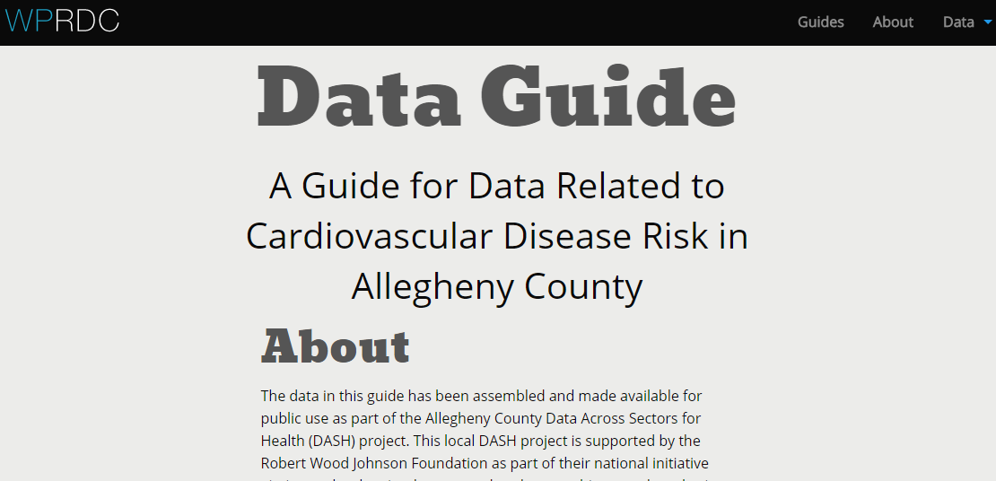
Data Guide- tools.wprdc.org/guides/dash-data-guide
NNIP

Slide 5
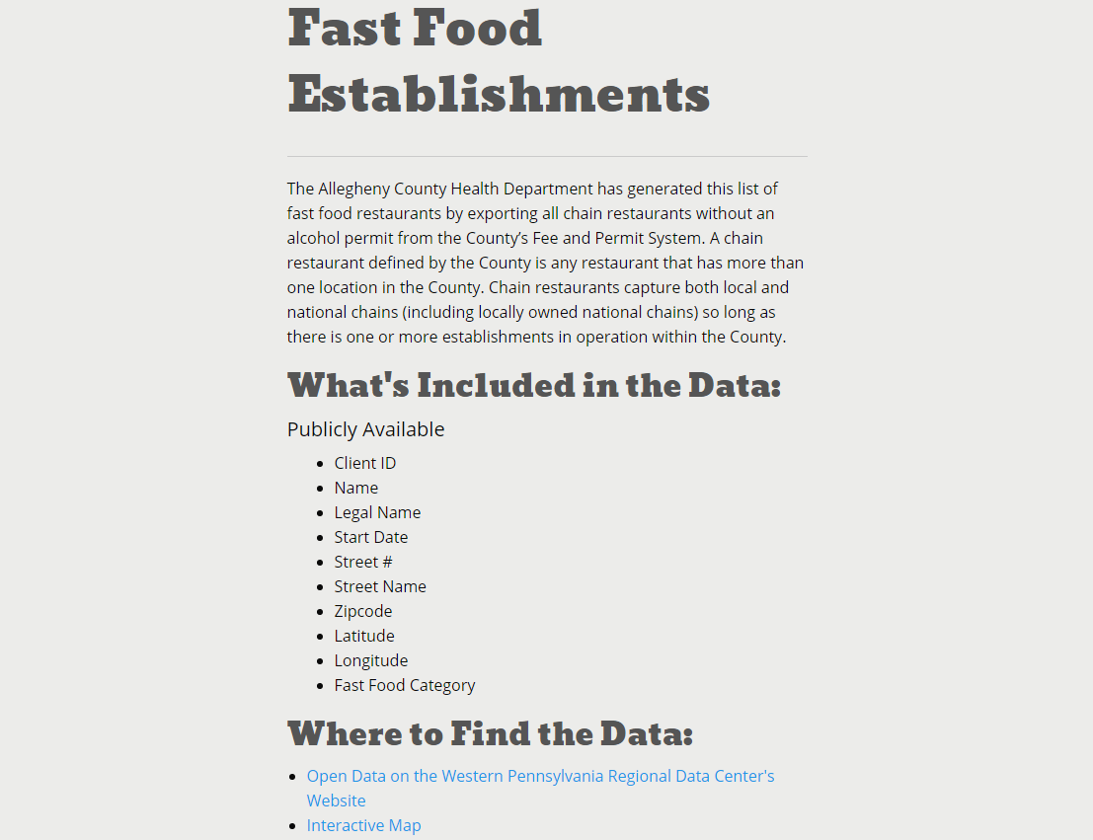
Data Guide- Dataset example
NNIP

Slide 6
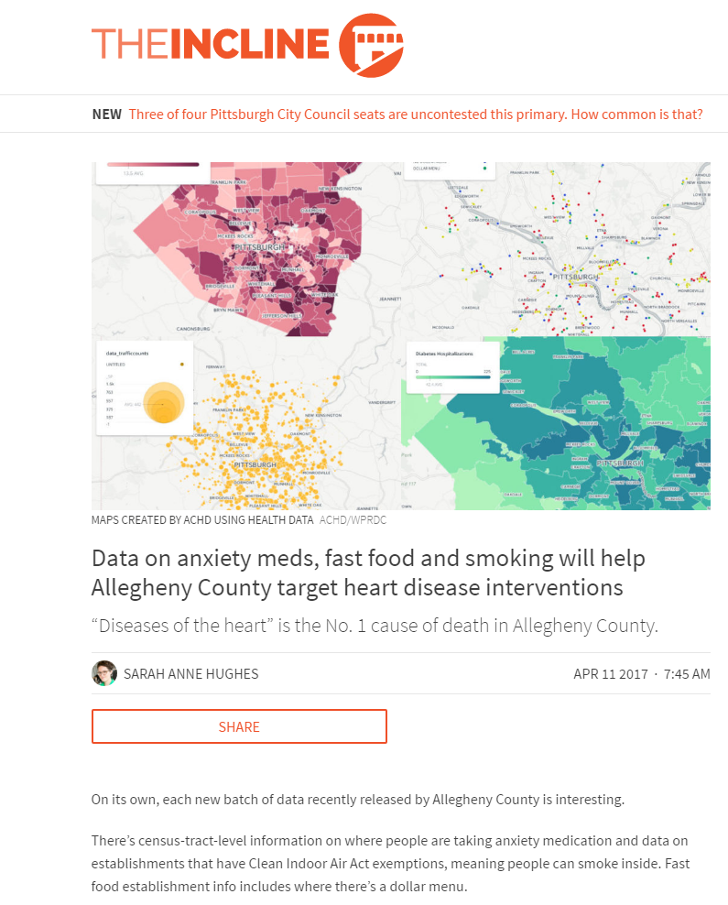
“There’s an exceptionally helpful guide
that accompanies the data and details
what it is and best practices for using it.”
-The Incline

Slide 7
Data Engagement
NNIP
The work we have done is all about providing infrastructure and context
These resources are meant to be living documents
Next Steps
Bring this data into new spaces
Community/Library/Organizations/Classroom
Community Profiles
Framework for future work

