Slide 1
Collaborating with HIEs
Laura McKieran, DrPH
Director, Community Information Now (CI:Now)
Associate Professor, UTHealth School of Public Health in San Antonio
May 18, 2017

Slide 2
What’s an HIE?
Health information exchange
Essentially an Integrated Data System (IDS) specific to health care
Hospitals, primary and specialty care clinics, labs, pharmacies
Primary driver has been care coordination, but moving into analytics
Image credit: Wikipedia
https://en.wikipedia.org/wiki/Health_information_exchange

Slide 3
What kind of data do HIEs have?
Utilization, diagnoses, demographics, meds & allergies, assessments, etc., represented as
Sometimes billing/claims data
More usually EHR/patient record data
Great variation in data…
completeness (for patient, organization, region; over time)
quality
normalization and standardization
queryability
metadata and other supports for analytics
Notes:
Note how PR data different from claims data

Slide 4
Quick irreversible descent into Acronym Hell (AH)
CDA: Clinical Document Architecture

Slide 5
Quick irreversible descent into Acronym Hell (AH)
CDA: Clinical Document Architecture, an XML-based electronic standard formerly called PRA. Conforms to HL7 ITS which based on the HL7 RIM

Slide 6
Quick irreversible descent into Acronym Hell (AH)
CDA: Clinical Document Architecture, an XML-based electronic standard formerly called PRA. Conforms to HL7 ITS which based on the HL7 RIM
Readable by human eye and machine; any document that might have a signature
HL7: Health Level Seven
ADT message: Admit Discharge Transfer – demographics, “trigger events”
CCD/CCR: Continuity Care Document/Record – critical “meaningful use” patient info for continuation of care among providers
demogs, problems/Dx, meds, allergies, labs, vitals, care plan

Slide 7
Working with HIEs
Expect the Red Hand of HIPAA and be prepared to work within rules
Depending on ask, may need extra patient consent
If you operate an IDS, make that connection (carefully)
Work to understand the dataset opportunities and limitations
Develop a good ask that’s:
Clear, well-defined, compelling – not exploratory
Minimizes risk – ask first for aggregate info, not record-level data
Has some kind of payoff for the HIE (visibility, better data, resources)
Sit down over results before publicizing
Notes:
If you run an IDS, do stress that you live with the same technical, legal, human challenges
ALSO stress that you aren’t looking to combine the IDS and HIE into a single IDS

Slide 8
CI:Now collaborations with HASA HIE
System-level evaluations of innovative interventions
Local research and intervention targeting
Community assessment – applying place lens to person-based clinical data
MACRA quality measures
Hospitalization and ER visit rates
Patient care and population health – applying person/clinical lens to place-based social determinants of health
Notes:
Types of projects we do together – quick examples on subsequent slides

Slide 9
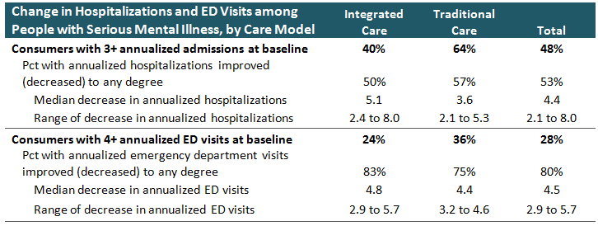
CHCS Mental Health Auth: ED visits & admissions

Slide 10
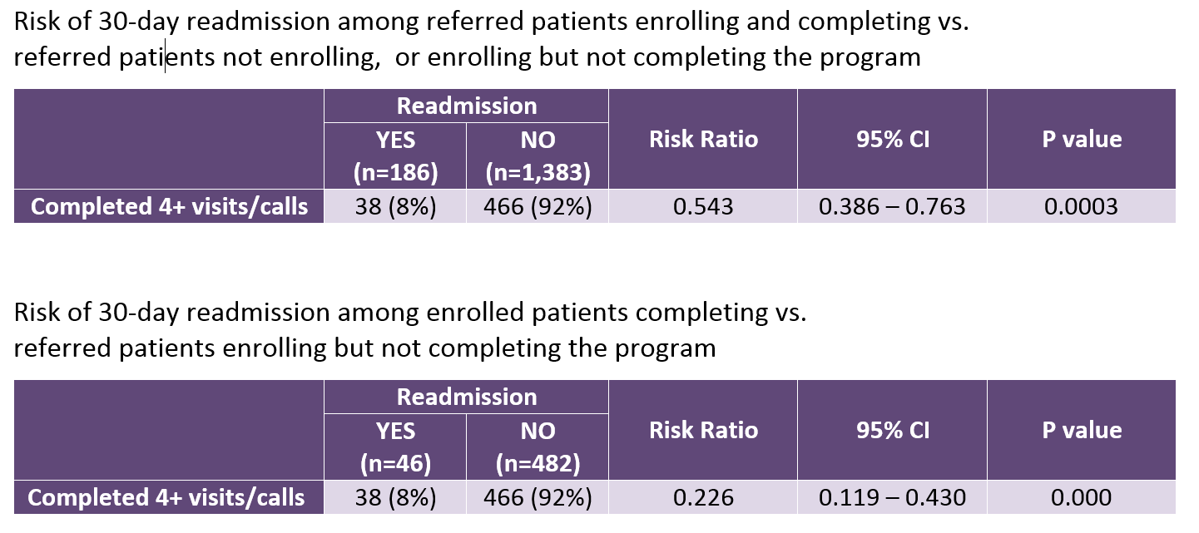
Presa Project Puente: change in readmissions

Slide 11
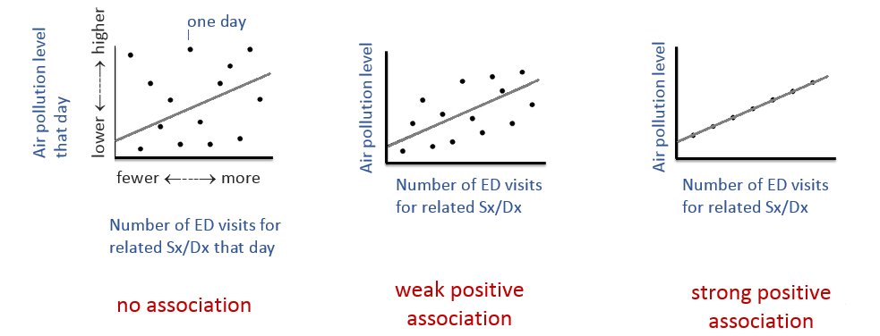
The power of combining datasets Air quality and ED visits
Notes:
Only aggregated data required – no PII/PHI must be shared

Slide 12
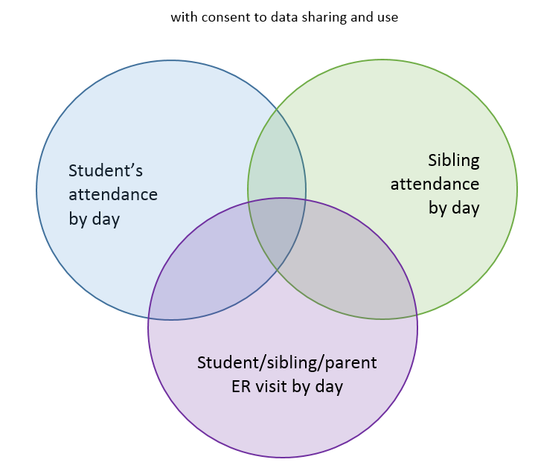
School absence and student/ family ED visits
Notes:
PII/PHI must be shared

Slide 13
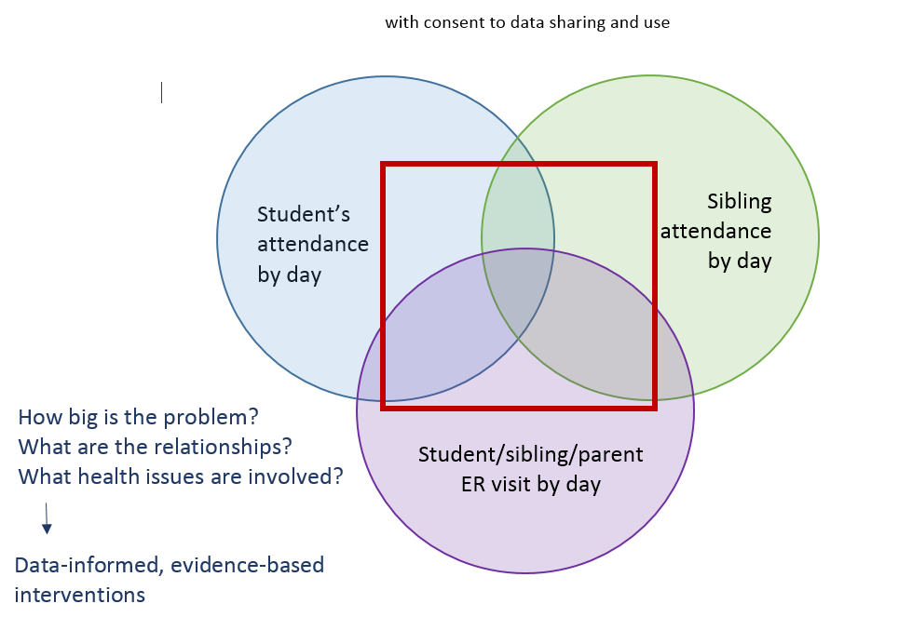
School absence and student/ family ER visits

Slide 14
Community and performance indicators
Percent of all visits by area residents that have a substance abuse diagnosis (trendable underestimate) (Promise Zone)
Rate of ER visits and hospitalizations for opioid-related poisoning/overdose (Bexar Community Health Improvement Plan?)
Rate of ER visits and hospitalizations for/with injury (SALSA collective impact initiative for older pop quality of life) by age group for pop 60 and older
Medicare Access & CHIP Reauth Act (MACRA) quality payment program
Percent of people with diabetes with blood sugar controlled
Percent of people with schizophrenia adhering to meds
Notes:
Medicare

Slide 15
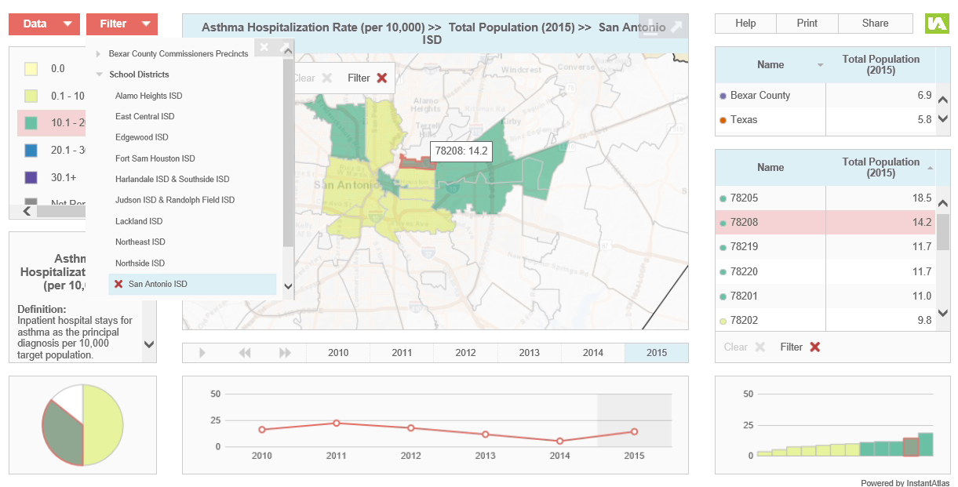
Notes:
Here’s new platform where indicators calc’d from HIE data can live

Slide 16
Place-based risk in clinical care
Add place-based SDOH “health risk index” to patient record via HIE rather than each individual provider
Classic SDOH (<HS diploma, <100% FPL)
Newer (proximity to jobs? violent crime rate? housing affordability?)
By census tract, classed in tertiles for low/medium/high risk
Rolled up into single index – green/yellow/red
Also create person-based SDOH risk index based on info in partner EHRs

Slide 17
Trustworthy. Neutral. Timely.
How can we help you?
Laura.C.McKieran@uth.tmc.edu
CINow.info
210.276.9007
http://cinow.info/newsletter-signup/

