Slide 1


Partnering with Public Health and Health Care to Improve Neighborhood Health
Amy Carroll-Scott, PhD, MPH
Drexel University Dornsife School of Public Health
Department of Community Health & Prevention
Urban Health Collaborative

Slide 2
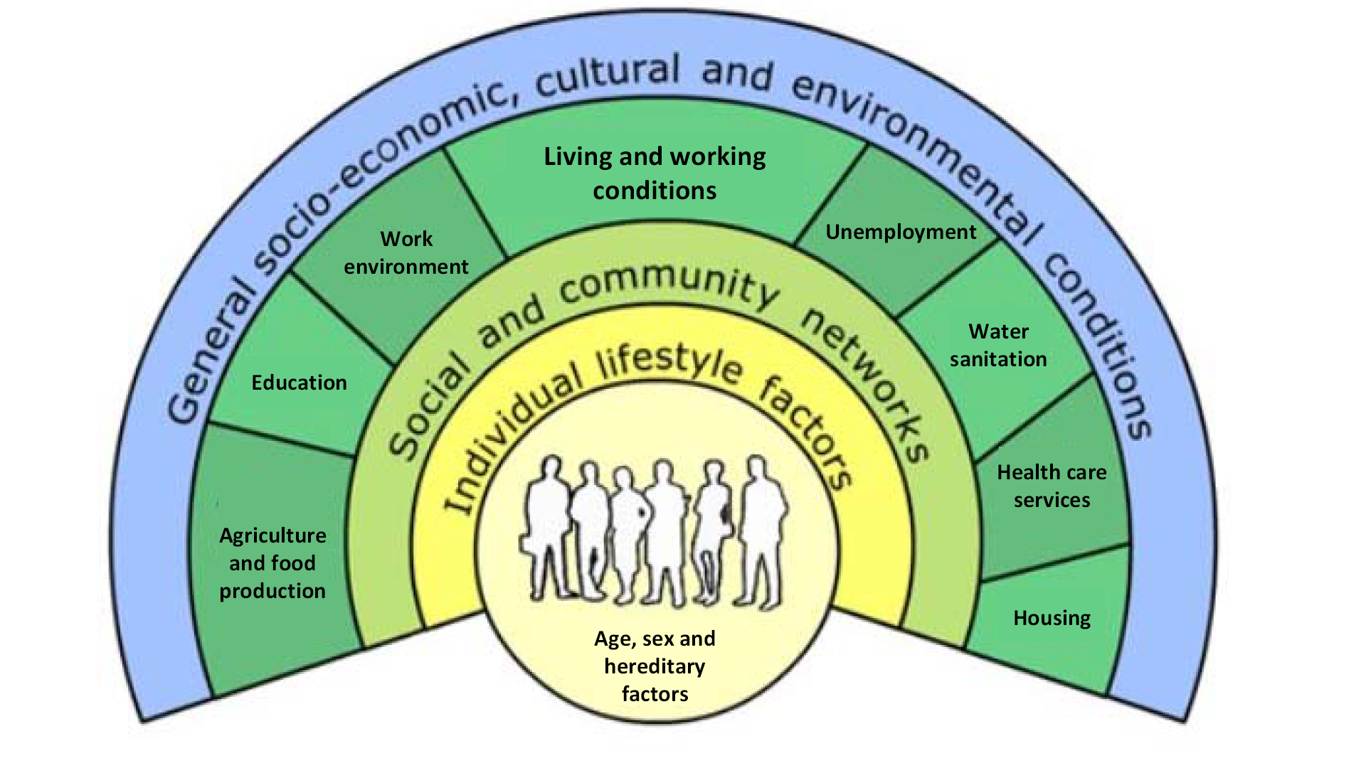
Moving beyond the medical model: Social determinants of health
30%
Clinical care 10%
10%

Slide 3
Sources of health data
Health care data: utilization, services provided, outcomes
National, state, local surveys about health behaviors, status, diagnosis, social determinants
Disease/injury surveillance data
Insurance claims data
Vital statistics: births, deaths
Hospitalizations
More population-based

Slide 4
Two Views of Population Health
Public health views population health as the health of human populations (e.g., general population, demographic subgroups, geographically defined)
  Focuses on the continuum of health and wellness
  Addressing SDOH involves population-wide or environmental solutions
Medicine (hospitals, health systems) views population health as patient populations
  Focuses on improved delivery, costs, and health outcomes
  If able to address SDOH, usually involves charity care or referral to social services or benefits

Slide 5
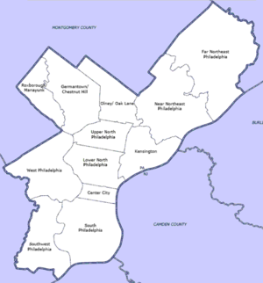

Public Health’s Population Health

Slide 6
Two Views of Population Health
Public health views population health as the health of human populations (e.g., general population, demographic subgroups, geographically defined)
  Focuses on the continuum of health and wellness
  Addressing SDOH involves population-wide or environmental solutions
Medicine (hospitals, health systems) views population health as patient populations
  Focuses on improved delivery, costs, and health outcomes
  If able to address SDOH, usually involves charity care or referral to social services or benefits

Slide 7
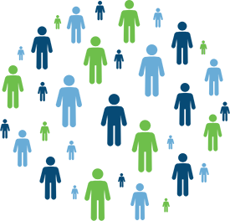
Health Care’s Population health

Slide 8
Opportunities for bringing a neighborhood lens to health data
Examine the spatial patterning of health data:
  Geographic clustering of good/poor health, disease, injury, disability, birth outcomes, mortality
  Social causes of geographic clustering
  Structural economic and policy causes of geographic clustering
Predict expected health changes when spatial and contextual factors change – e.g., demographic shifts, gentrification
Examine changes over time

Slide 9
Opportunities for bringing a neighborhood lens to health data
Creating neighborhood-level or other small area estimates for any of these sources of health data
  Extracting EHR data; Combining EHR data across health systems
  Integrating all of these data sources for a more complete picture
Integrating neighborhood data with health data to understand social causes and consequences of poor health (e.g., census, crime, housing, economic, education, built environment, air quality, health care access, policy, etc.)
  Identifying important neighborhood or other contextual data to merge with EHR to improve care

Slide 10
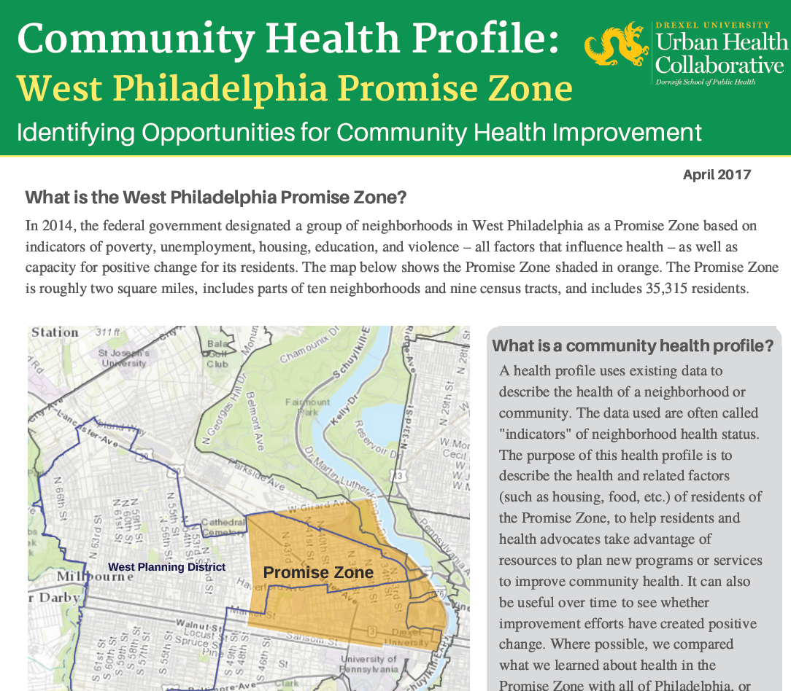

Slide 11
Then What?
What can be done with this information
Tailor health interventions that address the underlying social inequities that lead to social-spatial clustering of health inequities
The vast majority of health funding goes to healthcare delivery
  But this will take more than just delivery of quality care
Solution: “health in all policies”. All policies impact health.

Slide 12
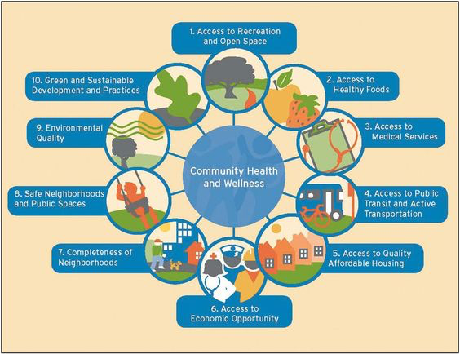

Slide 13
Thank you amy.carroll-scott@drexel.edu

Slide 14
Please get in touch… amy.carroll-scott@drexel.edu

