Slide 1
Delivering Civic Tech & Data Training
Survey Results + Four Workshops (Microsoft sponsor)
Moderated by Steve Spiker, Urban Strategies Council
Survey: Maia Woluchem & Kathy Pettit, Urban Institute
Data 101 / Data Storytelling: Bob Gradeck, U of Pittsburgh
Civic Data and Excel: Adam Hecktman, Microsoft
Nonprofit Evaluation: Jodi Petersen, Grand Valley State
Accessing and Mapping External Data: Peter Tatian, Urban Institute

Slide 2
Community Data & Technology Training: Survey Results
Maia Woluchem
NNIP Cleveland Pre-session
September 13, 2016

Slide 3
Expanding Training on Using Data and Technology to Improve Communities
Project Goal: To expand the quantity and quality of training available to help resident leaders and staff in nonprofits and government agencies better use data and technology to benefit their communities.
Stages so far
Survey of NNIP partners and a few external contacts
Today’s workshop
Notes:
As you may have heard at last conference, we’re embarking on a project with Microsoft called “Expanding Training on Using Data and Tech to Improve Communities”
We’re working with the Technology and Civic Engagement or TCE division on this work, which has 5 local offices around the country, including Adam’s Chicago office
As you heard from Adam, the TCE team understand the importance of building local capacity to use data and technology to improve community outcomes. (can be tweaked or dropped based whatever Adam says)
Read project goal
Stages:
Scanned the field with our survey of nnip partners and external folks
Today’s workshop is a part of the data collection for that project

Slide 4
Survey Results
Responses from 27 partners (+ 5 friends), yielding >60 trainings.
Most partners are already training their communities; most of the others are interested.
Topical interests are broad, and include:
Identifying need/interest when starting a social enterprise
Data analysis with R
Machine learning
Notes:
So we got a much stronger response than we imagined.
Nearly all of our partners responded, with 27 total.
[kp added]: All but 4 had done some training before, and only 1 of those didn’t want to build training into their services
We also have responses from five external contacts brought to us by the TCE team at Microsoft.
Between all the responses, we have a grand pool of 59 trainings. You guys have been very busy, much to our delight. The handout lists all of the trainings and descriptions that we received so far.

Slide 5
What does the field look like?
Most trainings focus on:
How to use a local data website to access data
Using data/tech to complete a work-related task (grant-writing, story-telling)
Using data about a specific issue area
Using a tool to manipulate or visualize data
Using local & national data sources
Trainings can range from basic to highly technical.
Notes:
Most everyone falls into one or more of the following categories – definitely a pleasant surprise for us!
How to use a local website (like many of your own data dashboards or open data portals)
Work-related tasks (grantwriting or storytelling)
Specific issue area (housing, or environment, etc)
Tools (like GIS, Excel or Tableau)
Data sources (ACS, local crime data)

Slide 6
Reach Matters
Trainings are reaching important audiences:
Nonprofit staff
Government staff
Funders
Resident leaders
Most trainings can be given to those at “beginner” levels.
Notes:
Besides the nonprofit audience intended by this project, many of you are reaching incredibly important individuals, including government staff, funders, and interested residents. An important takeaway is that by doing so, many of you are really democratizing these data concepts, particularly since the vast majority of this work can be given to people new to using data.

Slide 7
Where Would You Like to Go?
Gaps:
Using technology tools to manipulate or visualize data
Understanding data concepts
Completing work-related tasks
Data related to specific issues
Using a local data source
Notes:
One of the most revealing points from the survey was noting the gaps that many of you hope to fill by additional training. By a large margin, the most sought-after trainings were those that pertained to understanding new technology tools or data concepts. Close contenders were the ever-popular “data as it can be used for work-related tasks”, “data for specific issues”, or using local data sources like ACS.
As it turns out, there’s significant overlap in the gaps and the offerings elsewhere in the network. We hope that the handout we shared help you locate partners who are already training in the areas you see as gaps ☺
Additionally, many of you are looking to tweak or adjust your trainings to fit your audiences more closely or try new subject areas. Things we heard were “I’d like to target my training to a particular level of expertise” or “I’d like to think more about funding”. Hopefully this workshop will allow you guys to trade ideas and learn from your partners.

Slide 8
Personal training revelations
“Pivot tables changed my life.”
Practice what you’ve learned soon after training.
“The people in the room know more than we do.”
“No one wants to hear about fundamentals of nominal and ordinal scales.”

Slide 9
Common Themes / Reflections
Consider distributing materials in advance.
Engage participants with hands-on data exercises.
Tailor trainings to audience interests, needs, and skills. Use relevant examples. Avoid jargon.
Focus on tools that are widely available and free.
Encourage curiosity about data.
Work with partners. Embed data training in local curricula.
Encourage OPEN data folks to improve usability.

Slide 10
Wrap-up comments and questions
1/3 of participants ready to implement within next 6 months.
Detailed training materials VERY helpful.
Appreciation of demo of easy Excel set-up.
How do existing modules work with different kinds of audiences? How do we modify them for unique audiences?
What modules are missing? (data collection)
Can we effectively “train the trainers”?
Short videos can supplement (not replace) in-person training.

Slide 11
Data 101
Data Literacy Training with the Carnegie Library of Pittsburgh and the Western Pennsylvania Regional Data Center

Slide 12
Data 101 is a series
To date, we’ve had four workshops in the Data 101 Series
Introduction to Data Visualization
Finding Stories in Data
Introduction to Mapping with Carto
Introduction to Charts and Graphs with Google Sheets
Today we’re teaching the second lesson “Finding Stories in Data,” which is inspired by the Data Therapy “Find a Story in Data” activity

Slide 13
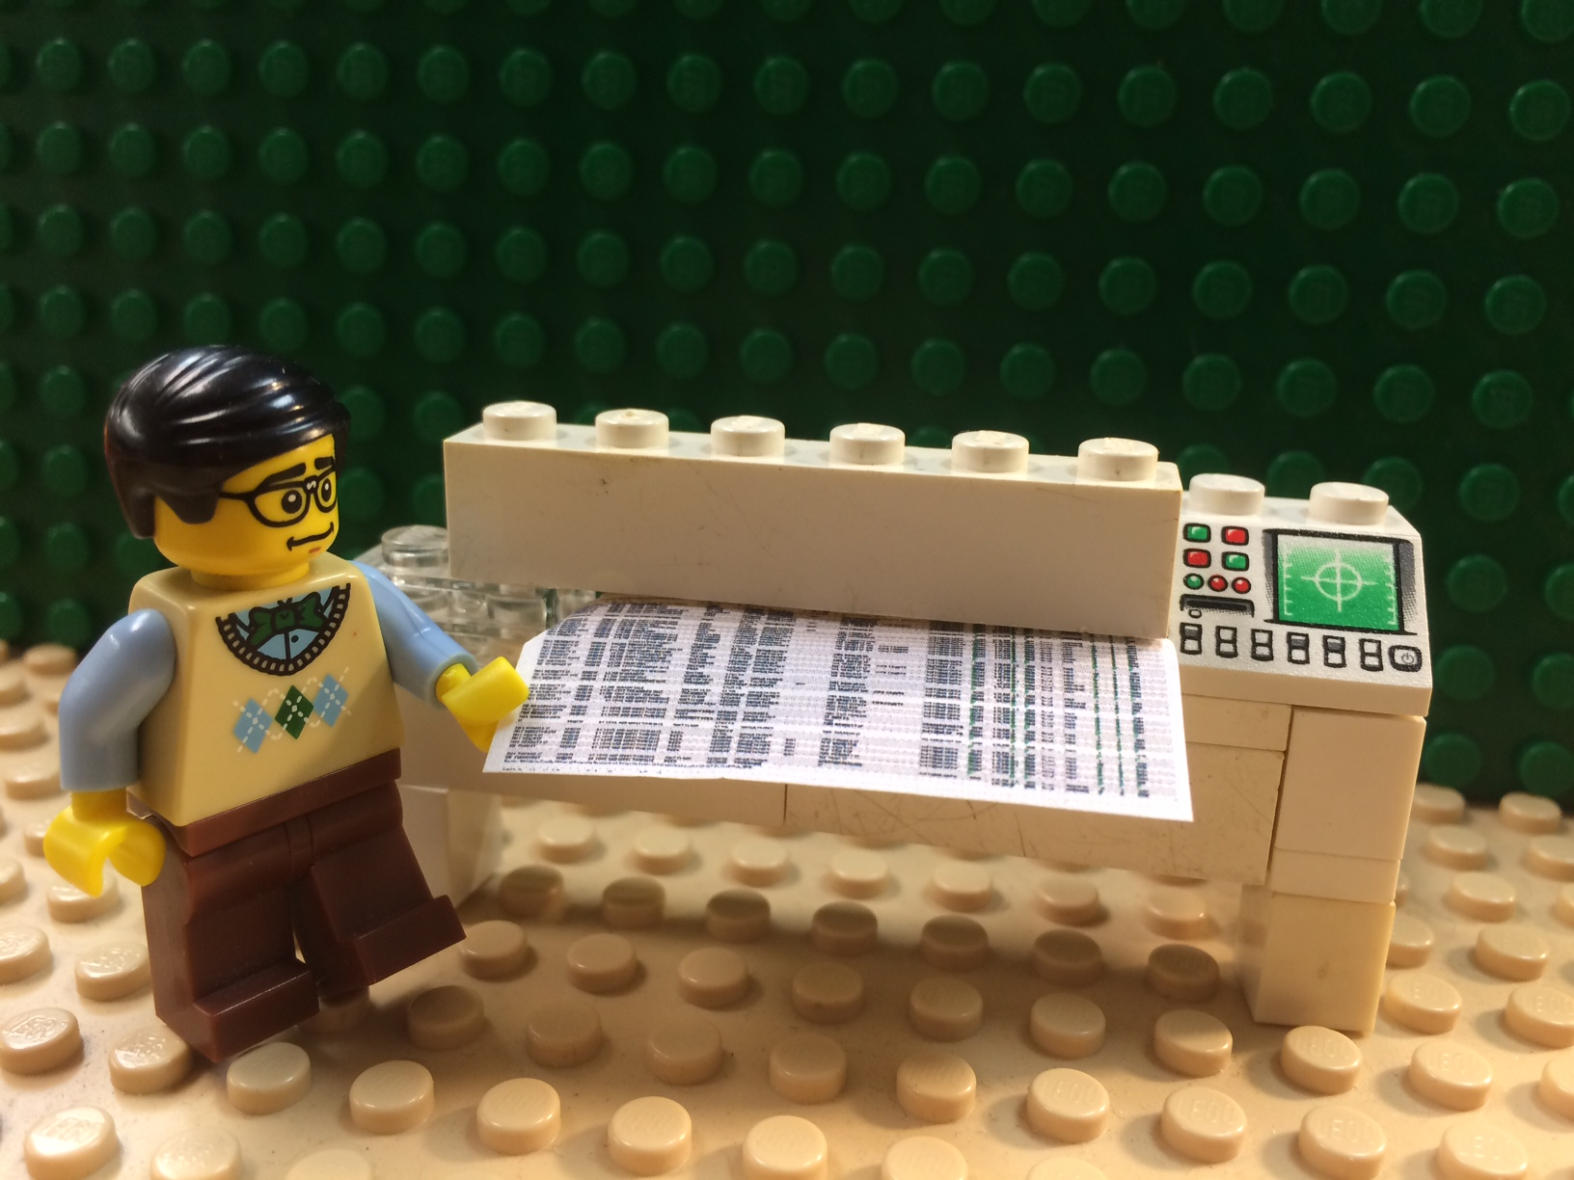
1. Prepare Materials

Slide 14
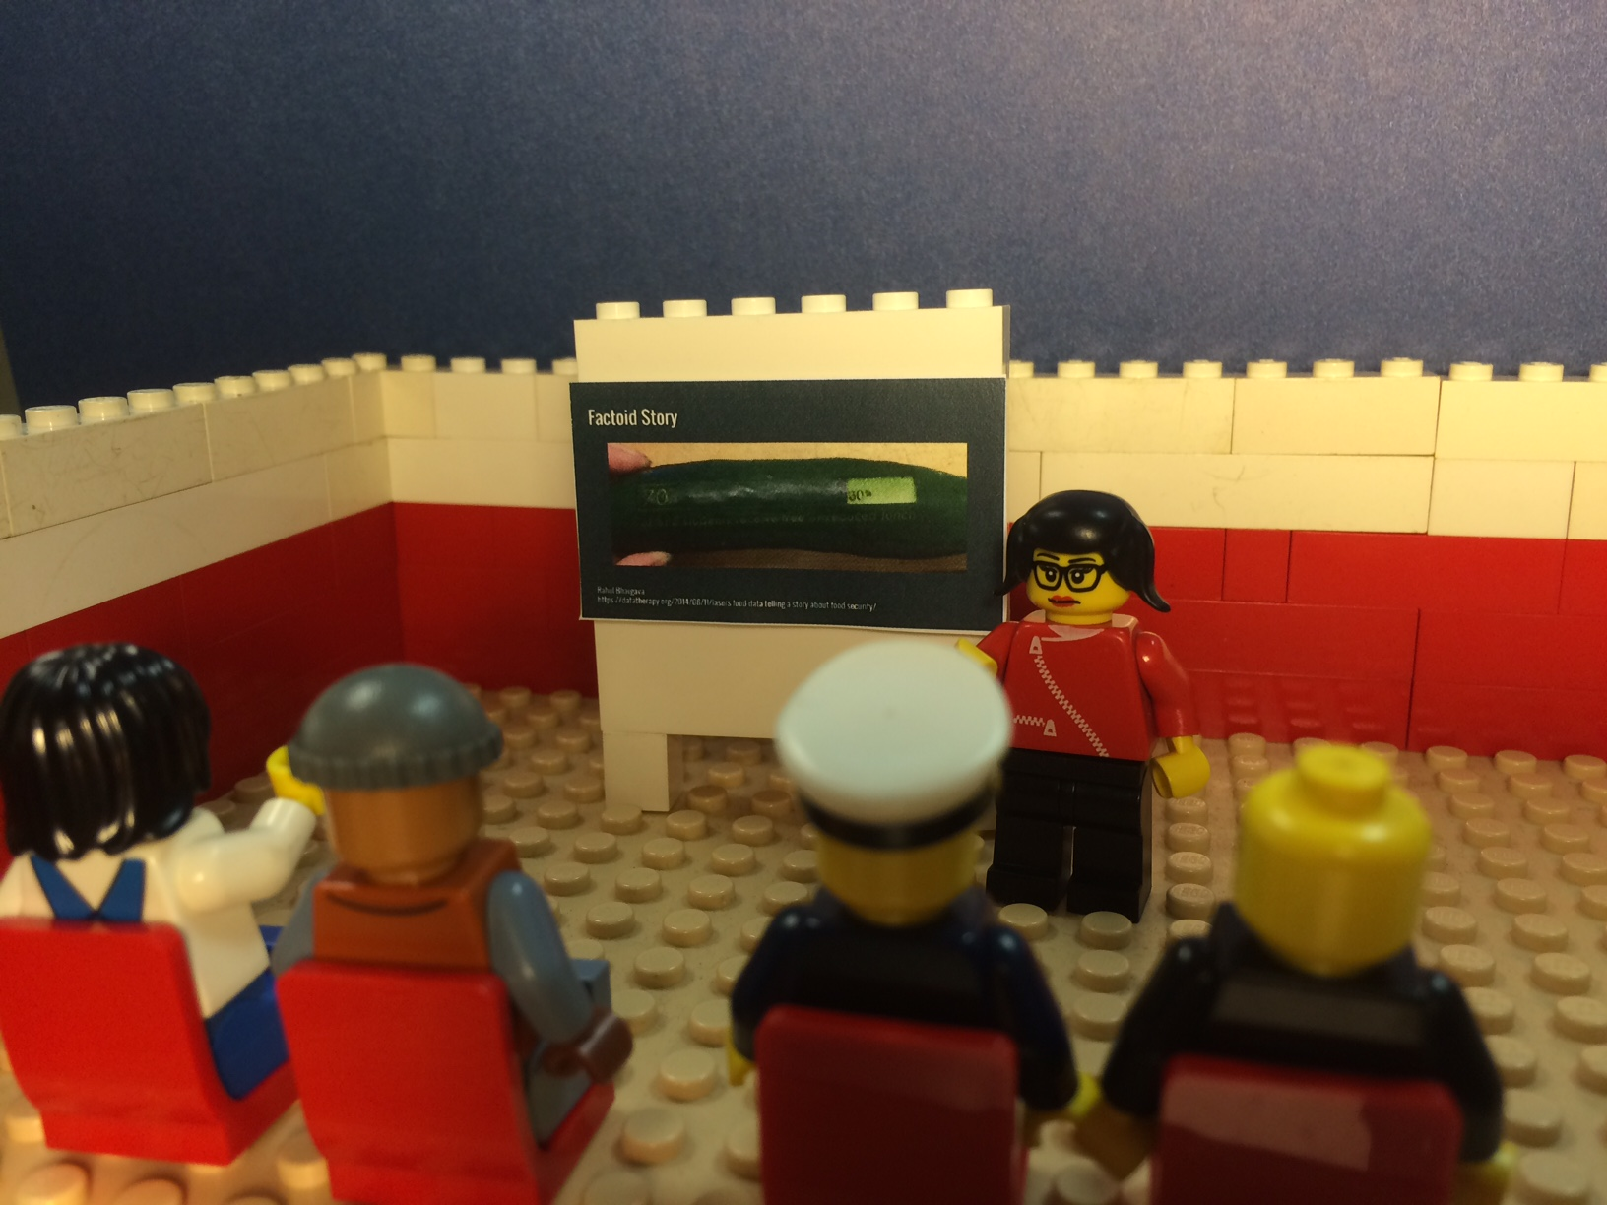
2. Presentation

Slide 15
3: Group work

Slide 16
4. Storytelling

Slide 17
Data 101
Tree Data for Data 101 Training Introduction
Tree ID | Species | Condition | Year Planted
1 | Maple | Good | 1987
2 | Oak | Fair | 1966
3 | Ash | Dead | 1990
4 | Sycamore | Fair | 1993
5 | Maple | Fair | 1944
6 | Maple | Good | 2009
7 | Ash | Poor | 1977
8 | Oak | Good | 2001
9 | Ash | Poor | 1971
10 | Maple | Fair | 1999
11 | Maple | Poor | 1955
12 | Maple | Good | 1955
13 | Ash | Fair | 1967
14 | Sycamore | Good | 1990
15 | Maple | Fair | 1939
16 | Oak | Good | 2013
17 | Oak | Fair | 1949
18 | Sycamore | Fair | 1929
19 | Ash | Dead | 1993
20 | Maple | Good | 2004
Data Literacy Training with the Carnegie Library of Pittsburgh and the Western Pennsylvania Regional Data Center

Slide 18
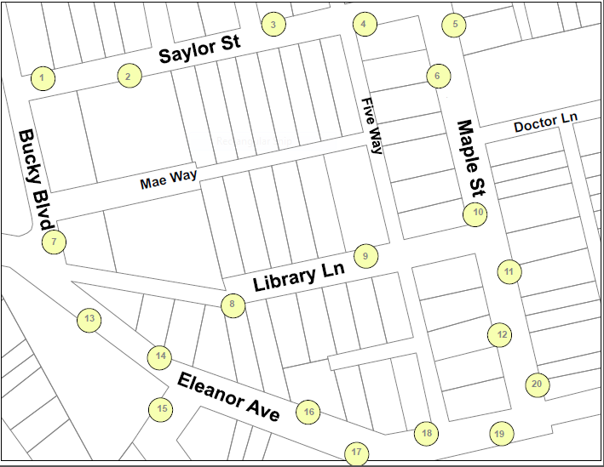
Data 101
Data Literacy Training with the Carnegie Library of Pittsburgh and the Western Pennsylvania Regional Data Center

Slide 19
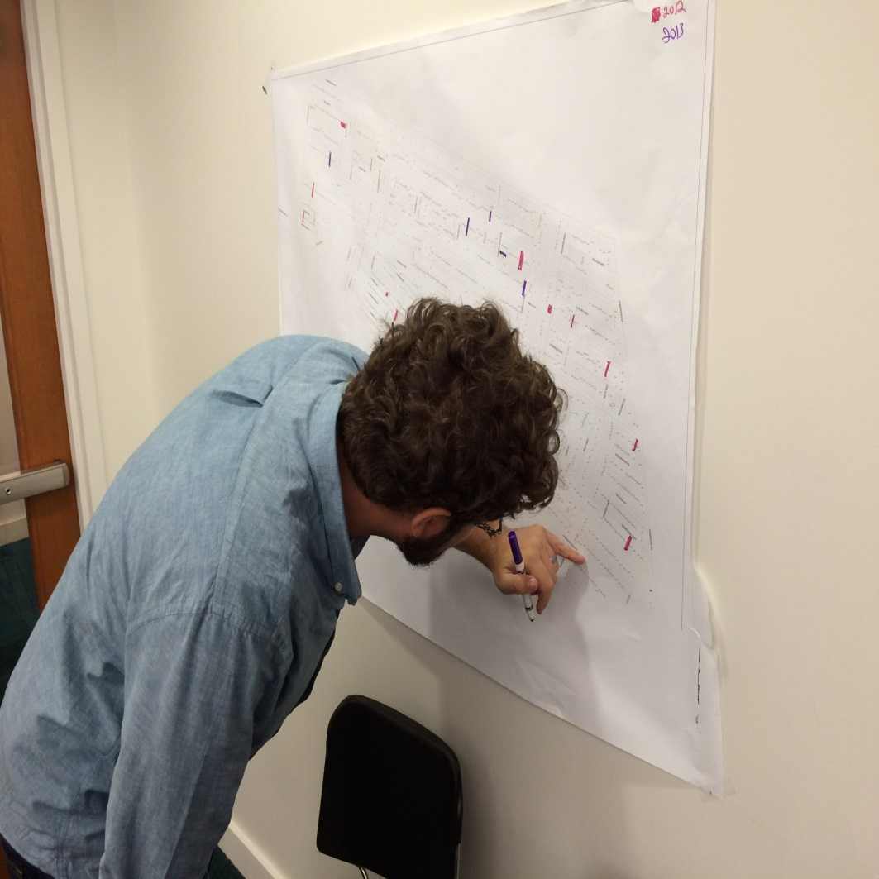
Necessary Context
Very few classes for beginners
Big difference between teaching data literacy and teaching software
Even those with more experience can benefit from going back to the basics

Slide 20
Things we learned
Paper has no barrier to entry, allows people of different skills/experiences to collaborate.
Teach data literacy concepts and software separately.
Having a plotter helps.
Anticipate needs for supplemental materials.
Be prepared with prompts to get groups started.
Flexible spaces and moveable furniture are helpful.
Ratio of 1 helper for every 2 to 3 tables is ideal.

Slide 21
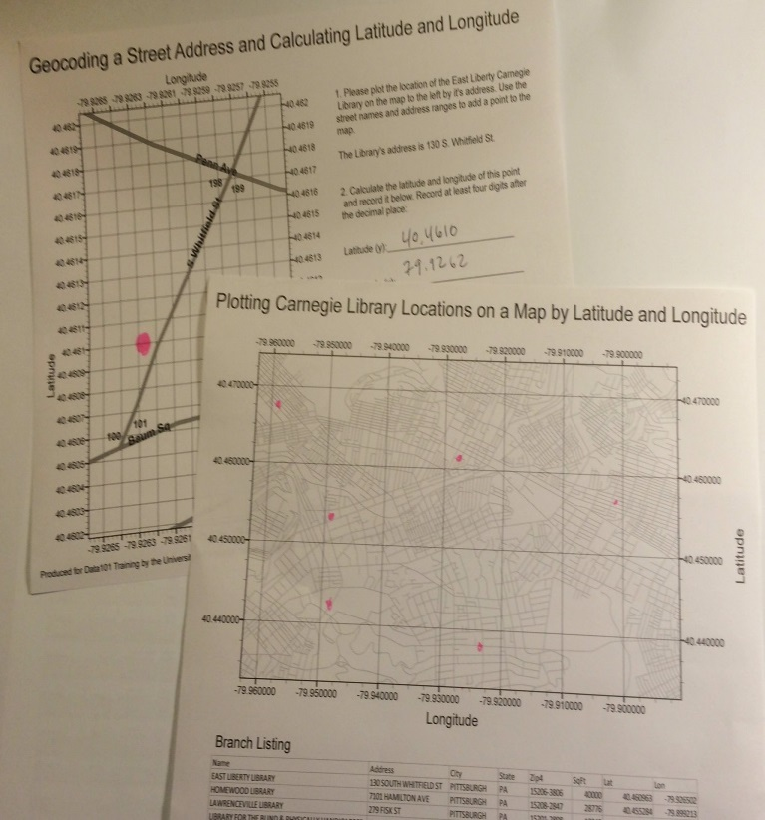
Advice for others?
Find a partner
Use consultants to supplement your own capacity
Open source everything
Invite data providers to participate

Slide 22
Excel and Civic Data
Adam Hecktman
Director of Technology and Civic Innovation for Chicago
Notes:
* What are the major learning goals? Help people understand that the tools they use every day, like Excel, can be applied to open data related to civic topics.
* What was the motivation for creating the training? When I understood just how much I could do with Excel alone, and that there was almost an endless number of use cases where Excel can be used, especially in scenarios where I saw people actually creating custom coded apps, I knew that there were a lot of people who just needed a shove into the water to try it.
* What is the format of training (such as slide presentation then exercise, or small group projects, etc.) Usually no slides, almost all demo and hands-on.
* What other essential context (if any) do people need to know to adapt it for themselves? Mac vs. Excel
* What is 1 piece of advice for others? (one thing you wished you had known, most important thing to remember for delivery, etc.) If your audience is sophisticated, push the boundaries a little and introduce them to some of the more advanced features.

Slide 23
Essential Context
Audience/users should have basic knowledge of Excel
If hands-on
Datasets downloaded first (in CSV)
Helps to have problem statement
Either Excel running Windows or on Windows VM if using Mac
Many more functions, visualizations, and statistics – find the ones relevant to your dataset
Also explore Power BI (PowerBI.com)
Free
More data management and visualization focused

Slide 24
One piece of advice I wished I had
Your non-Data Scientist audience is more capable than you think!
Don’t be afraid to go beyond “beginner "stage
But do know your audience

Slide 25
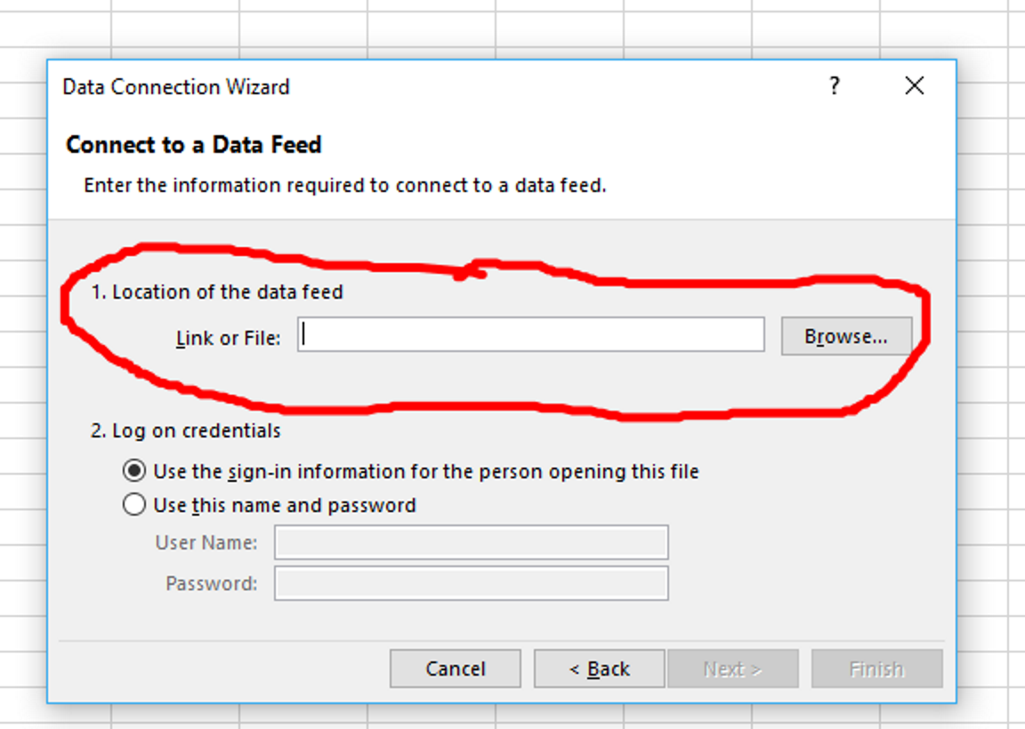
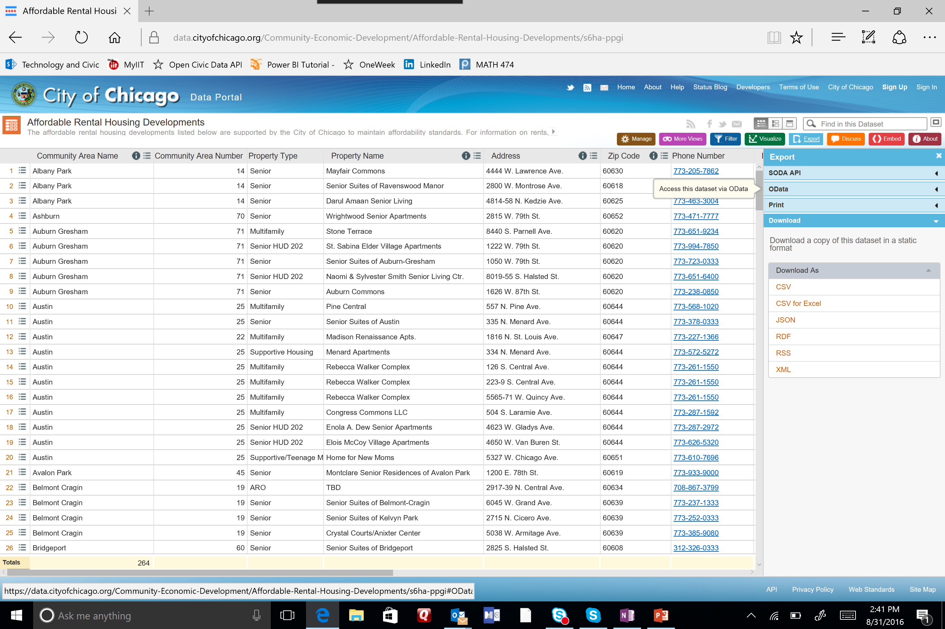
Accessing Data Sources
Format tips
Subscribe to data

Slide 26
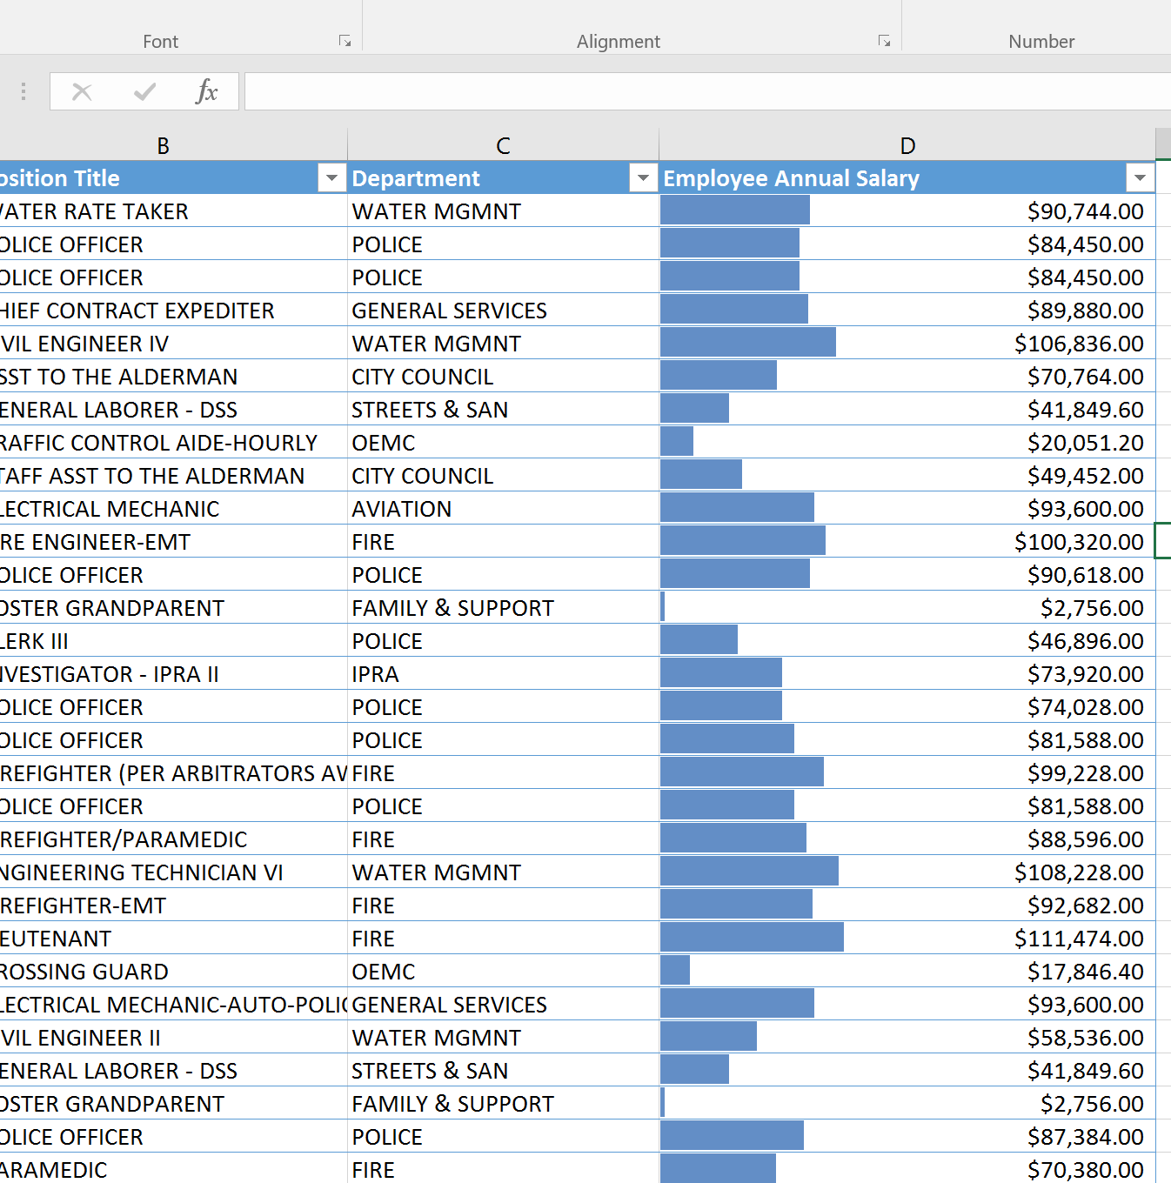
Analyzing Data
Data bars
Basic filter and sort
Quick Analysis

Slide 27
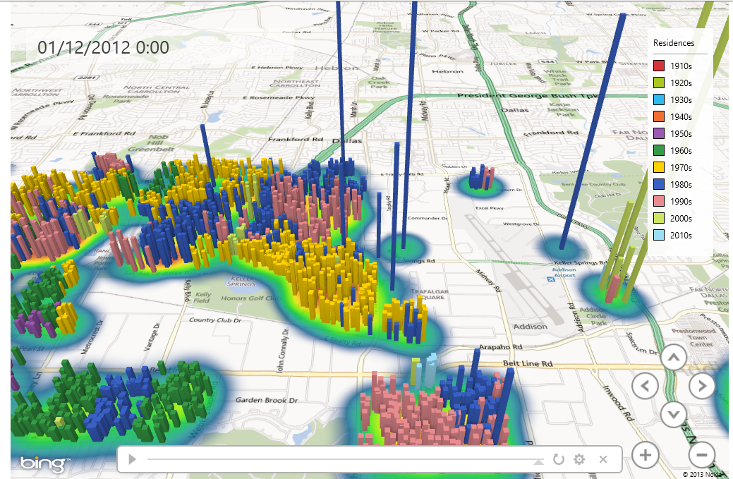
Mapping Data

Slide 28
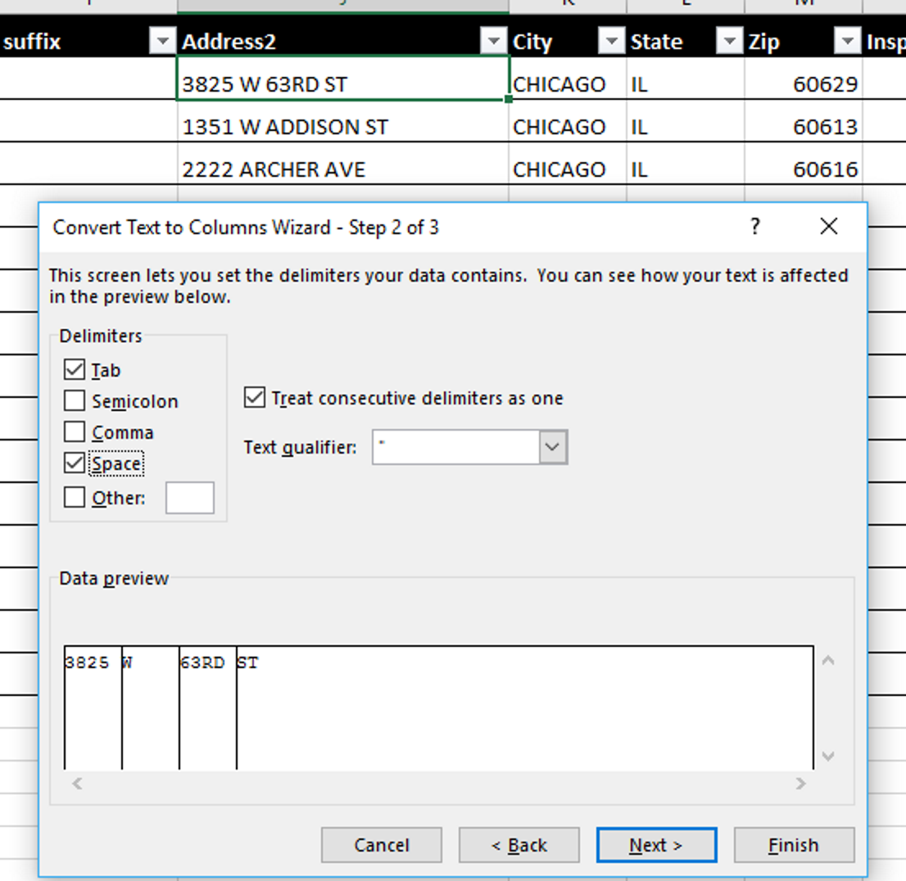
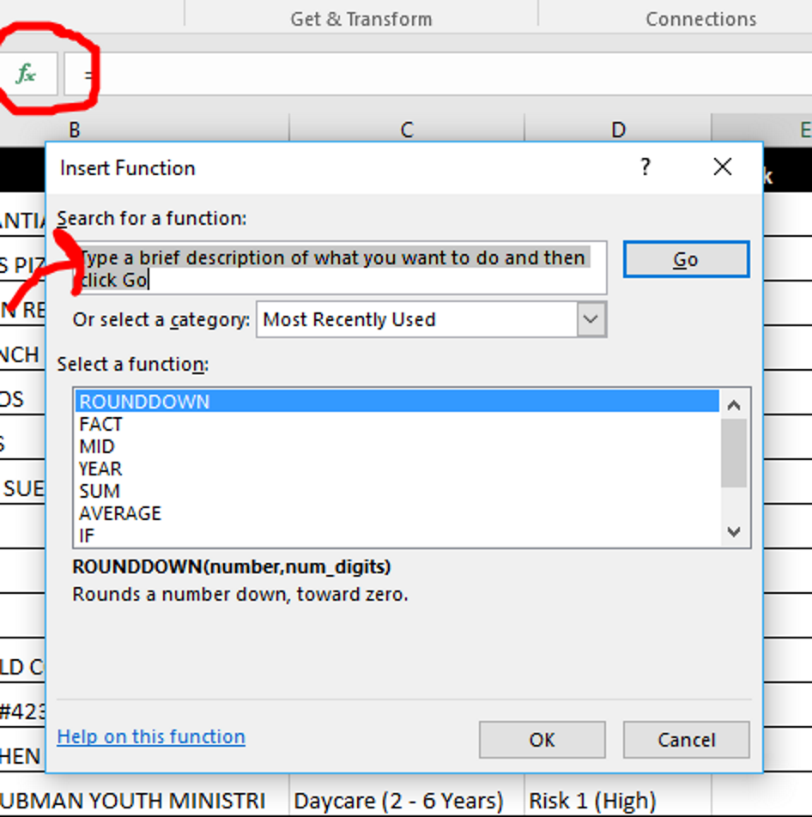
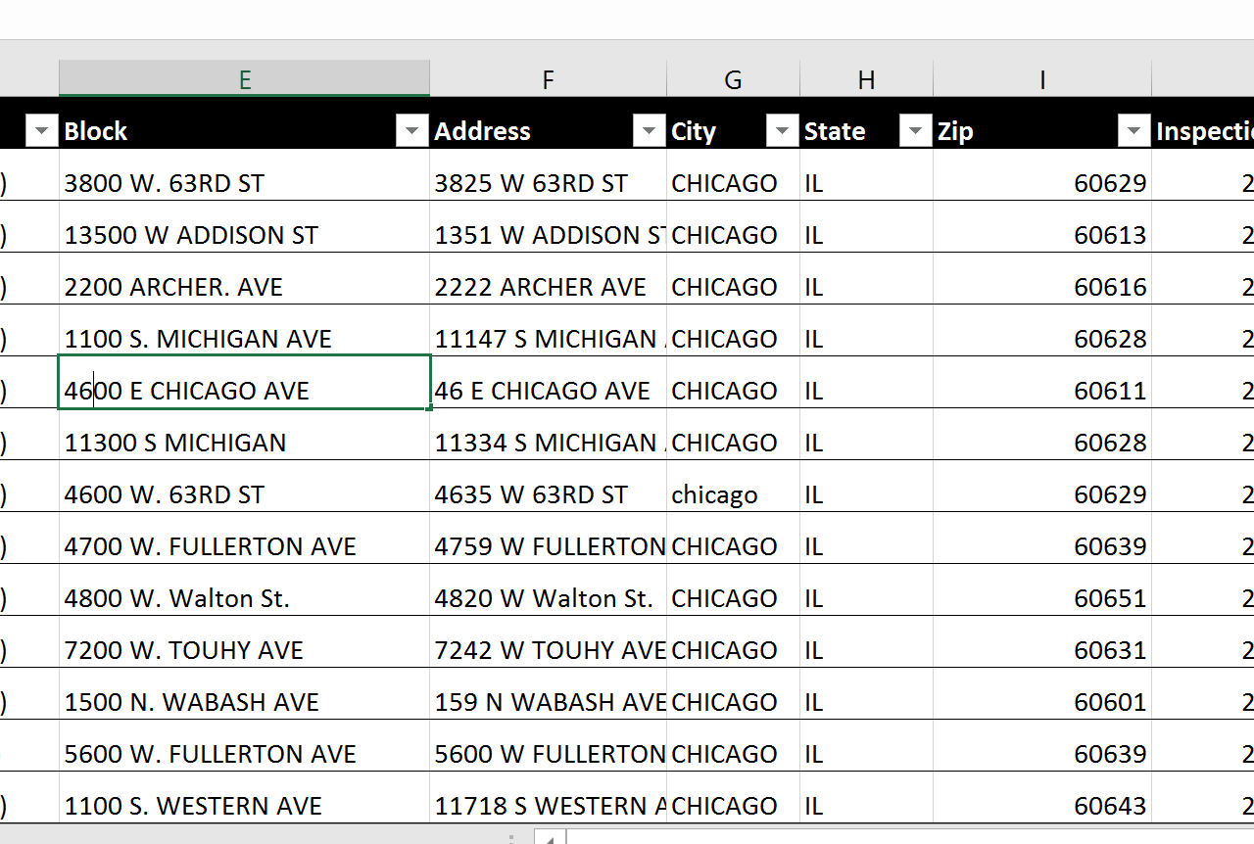
Transforming Data
Using functions
Convert street address to block address
Breaking up data

Slide 29
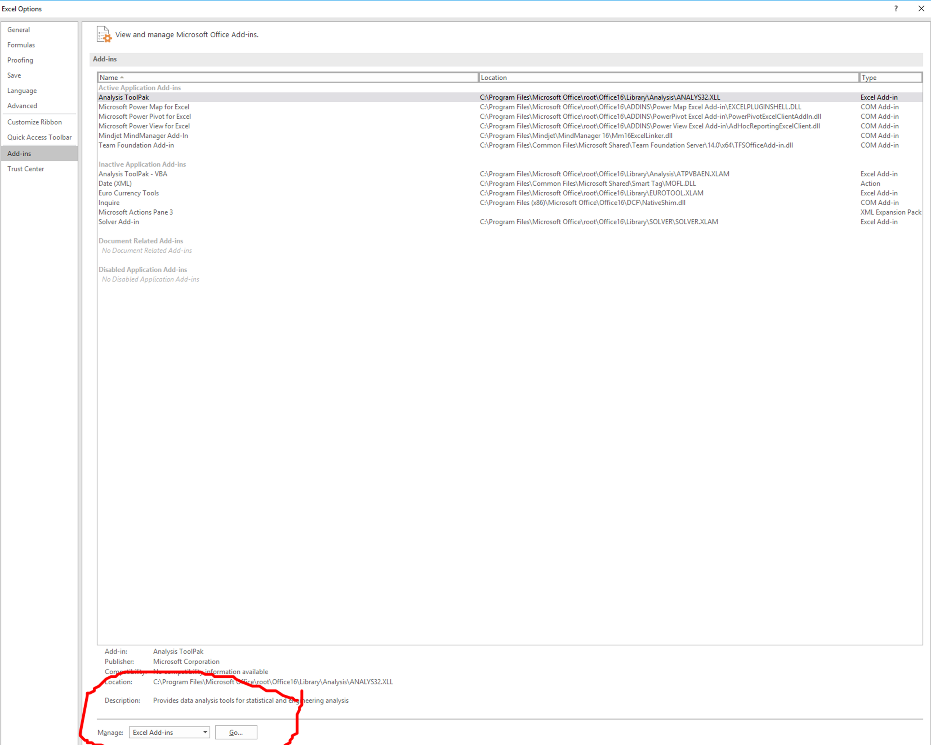
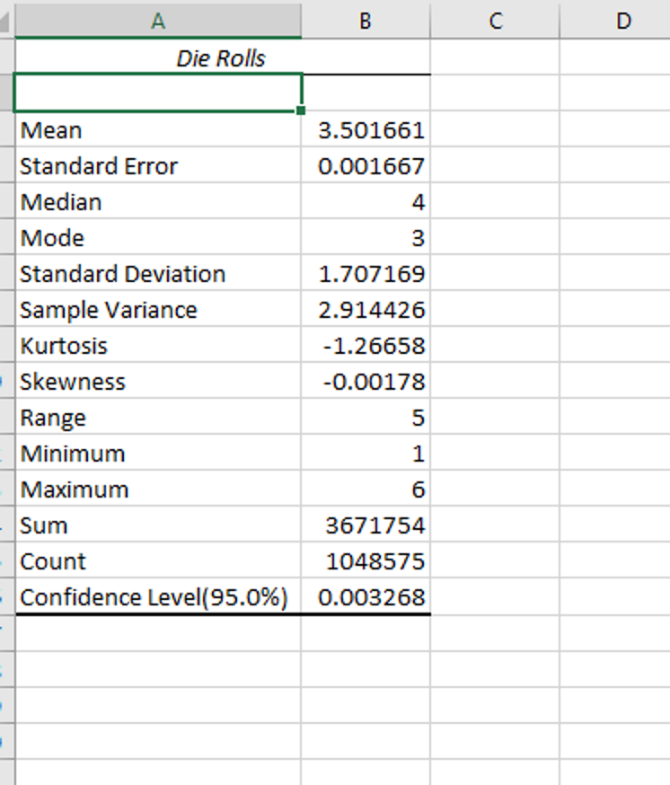
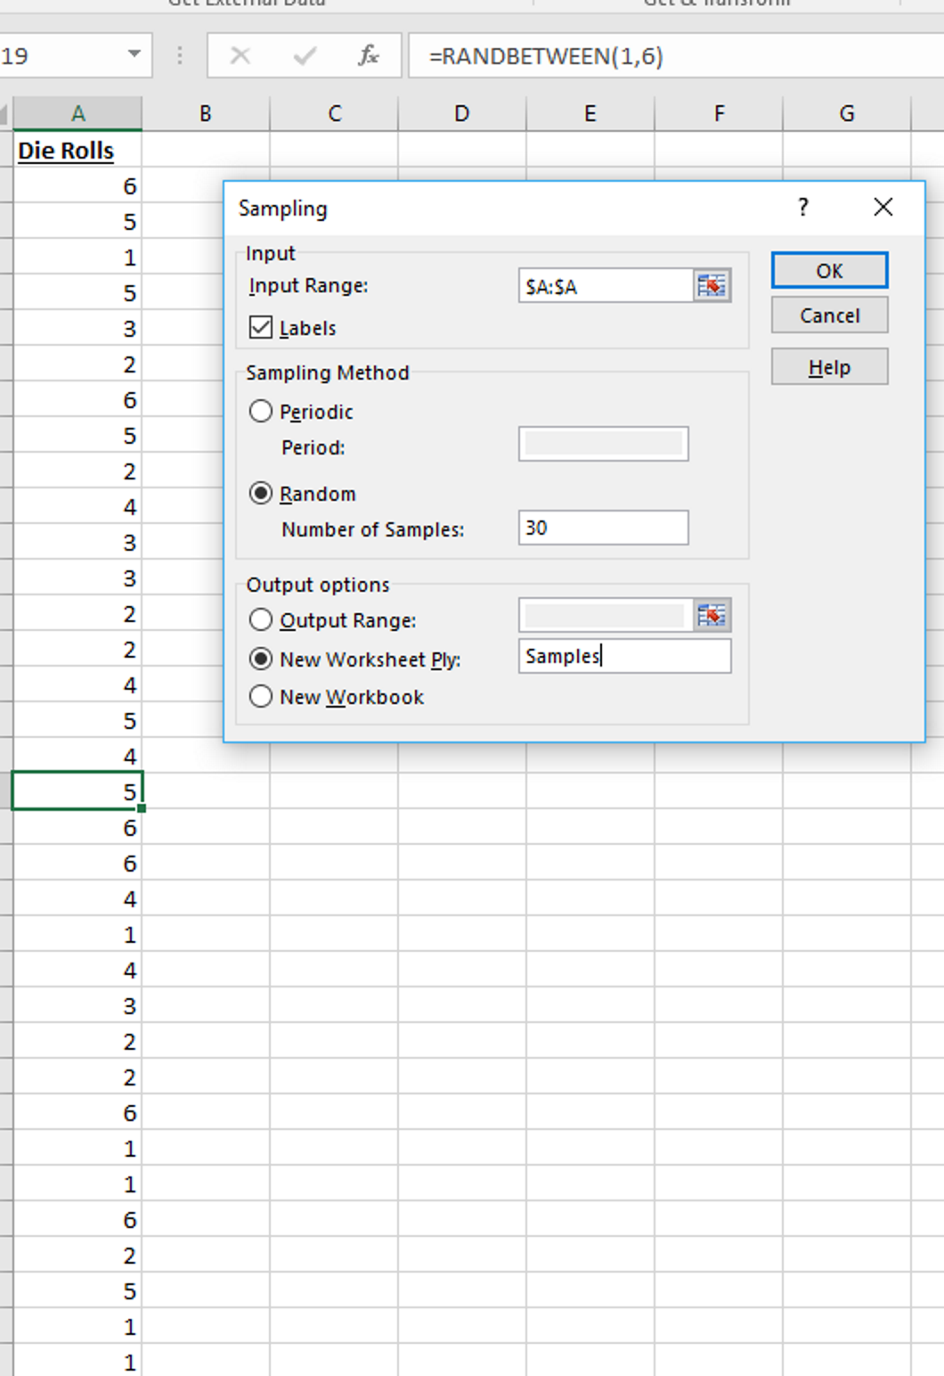
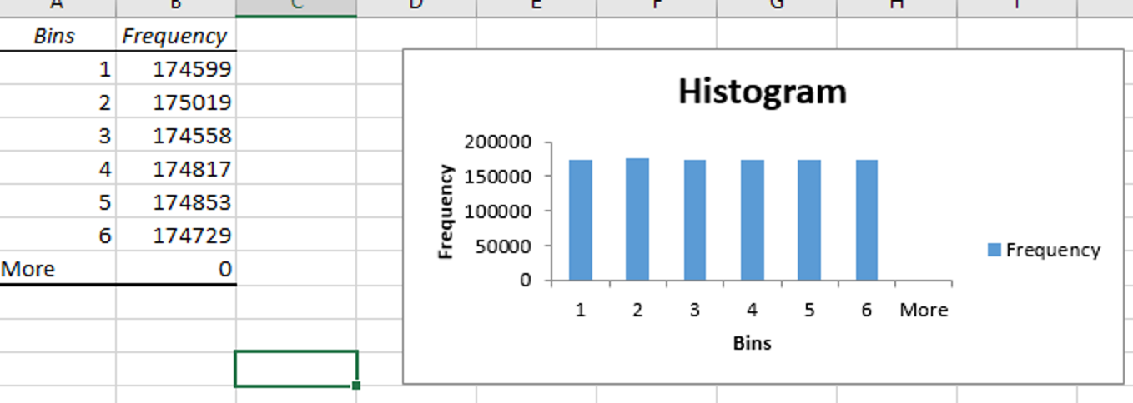
Advanced Topic: Analysis Tool Pack
Enabling
Histogram
Easy Descriptive Stats
Descriptive Stats
Sampling

Slide 30
Building Data Capacity for Nonprofits
Jodi Petersen, PhD

Slide 31
Why Capacity Building?
Most of our work is funder-driven
Nonprofits and funders often don’t communicate well with one another
Nonprofits often “chase the money” and worry about the report later
Data and evaluation are often (understandably) a low priority for nonprofits

Slide 32
Learning Goals for Trainings
Understand how program activities do/do not match up to outputs, outcomes, and measures
Think through grant report requirements in time to allow for data collection
Draw the connection between data collection and funding
Encourage a culture of curiosity and strive for measurable effectiveness

Slide 33
How do we train about data?
Funder driven and public trainings
Evaluation capacity assessment
Training topics
Public data and data tools
Logic model development
Talking about the evaluation report in your grant report
Data sharing, storage, & consent

Slide 34
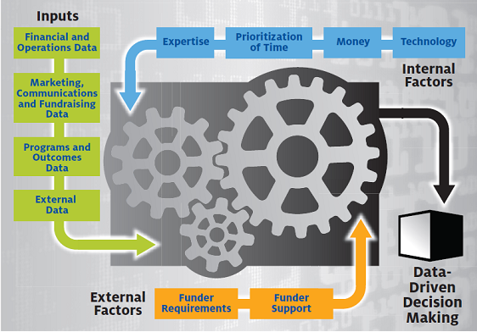
So why do we need data?

Slide 35
Data in and of itself is not useful. Untouched, unmanipulated, unchanged, it’s valueless, but once transformed, it can serve any number of purposes. The nonprofit sector is still trying to figure out how to transform its data into something valuable. Nonprofit leaders need to continue to mature and invest in the resources necessary to help their staff navigate this process.
Collected Voices: Data-Informed Nonprofits, 2014, p. 6

Slide 36
Recommendations
Start somewhere
Begin with small measures, acknowledge small successes
Connect your goals to your mission with your metrics
Data is useful when it measures the organizational success
Don’t start with obsessing over outcomes
Learn from others
Change your culture to value data
Share meaningful information to get staff comfortable with the data
Train staff

Slide 37
Accessing and Using External Data
NeighborhoodInfo DC Training

Slide 38
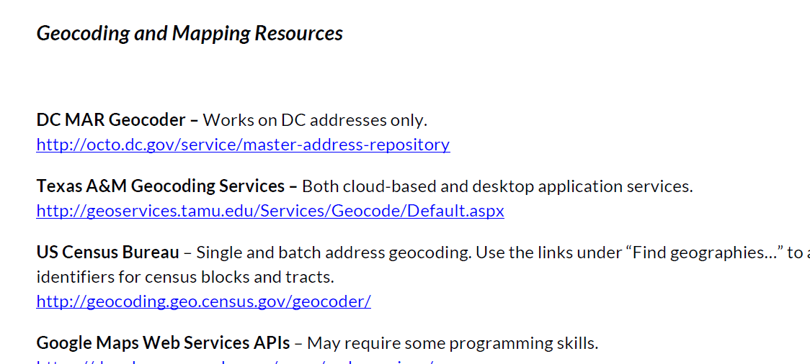
Notes:
Handouts:
Resource lists
Step-by-step instructions for geocoding/mapping example

Slide 39
Demo: Getting shapefiles to display small areas
Notes:
Live demonstration of mapping exercise
How to get shapefiles for displaying small areas (neighborhood clusters here)

Slide 40
Geocoding client addresses, importing into map
Notes:
How to geocode client addresses and import them into a map

Slide 41
Import & join small-area data to create choropleth map overlaid with client points
Notes:
How to import and join small area data (poverty rates here) and create choropleth map overlaid with client points

Slide 42
Next Steps in Project
Debrief from the workshop
Interview key external informants
Draft Guide on Training (Fall/Winter)
Develop Materials for Catalog (Fall/Winter)
Notes:
Please answer the evaluation we’ll send you to improve any future editions of this workshop and pre-sessions in general
Interview key external informants, such as people from Bloomberg’s What Works and MIT Media Lab. If you have recommendations of others we should talk to, let us know.
Guide: We’d love input on what you think should be in the guide, and will be contacting many of them about being included in the catalog.

