Slide 1
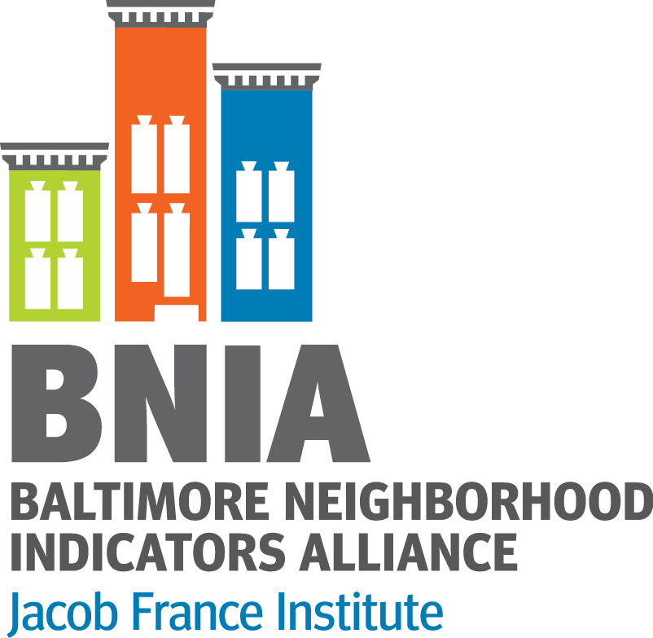

What’s Next for Open Data in Baltimore?
The Next Generation of Open Data—NNIP Meeting in Cleveland
September 2016
Seema D. Iyer, PhD
Associate Director, Jacob France Institute
    #VitalSigns14
    @bniajfi
    www.bniajfi.org

Slide 2

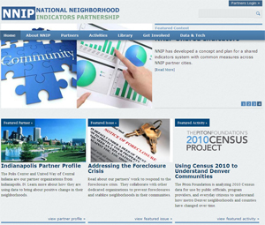
A Bit of History
BNIA-JFI formed through local foundations in Baltimore in 2000. Mayor Martin O’Malley issued a memo to agencies to provide data.
Early partner in NNIP. Mission has been around “Democratization of Data” and to overcome the resistance of local public agencies to sharing data.
Long-time CIO had established fee-based data release for City data.
BNIA-JFI moved to the Jacob France Institute
in 2007. Started releasing open data in 2009.
Open Baltimore created in 2011. Routine data in 2013.

Slide 3


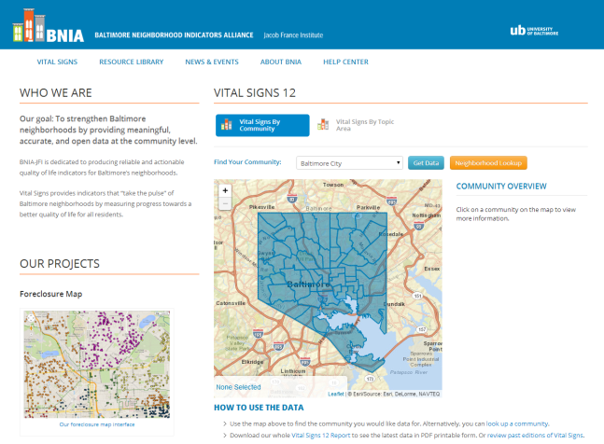
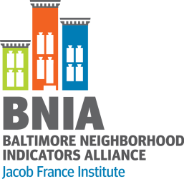
postgreSQL
postGIS Geodatabase
CitiStat
Library
Housing
Police
Schools
Vital Statistics
3

Slide 4
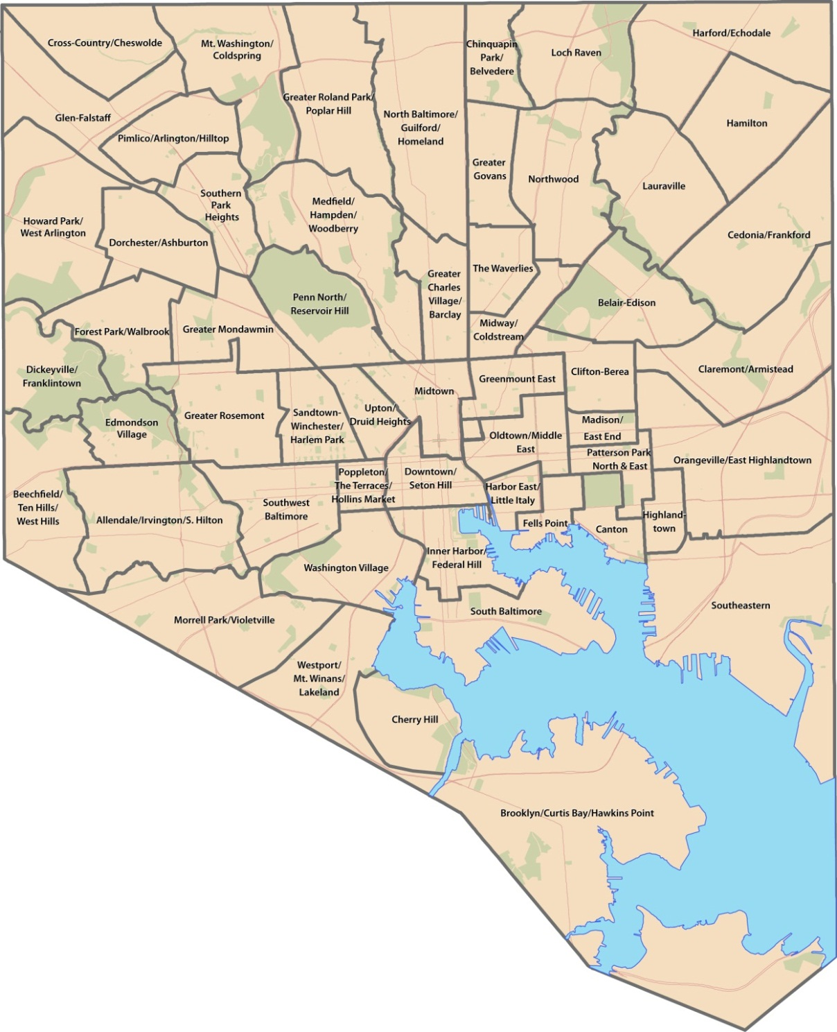
Baltimore City
Community Statistical Areas (CSAs)
Number - 55
Based on 2010 Census boundaries
Aggregations of Census tracts (respectful of neighborhoods)
Notes:
Here are the boundaries of the CSAs moving from 2010 forward. While the number remains the same, 5 CSAs have changed due to Census changes – all around the central part of the City. The map you might have seen this morning describes these changes in greater detail. The new map will soon be placed on our website and Facebook page for people to view and we hope to get your comments and feedback.

Slide 5
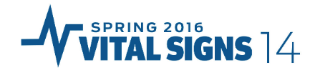
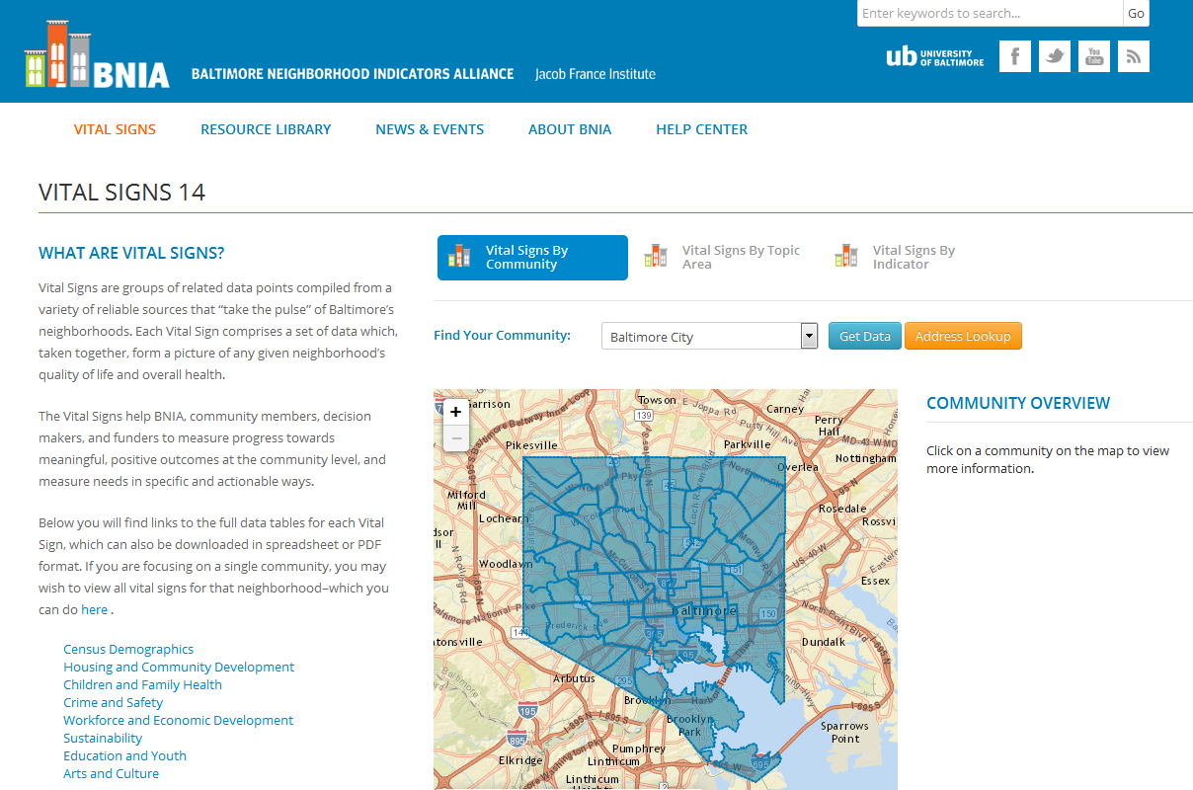
  Project funded by the Annie E. Casey Foundation
  Many new indicators in Vital Signs 11, continued tracking for Vital Signs 13
  Available at the CSA data FREE on BNIA-JFI website

Slide 6
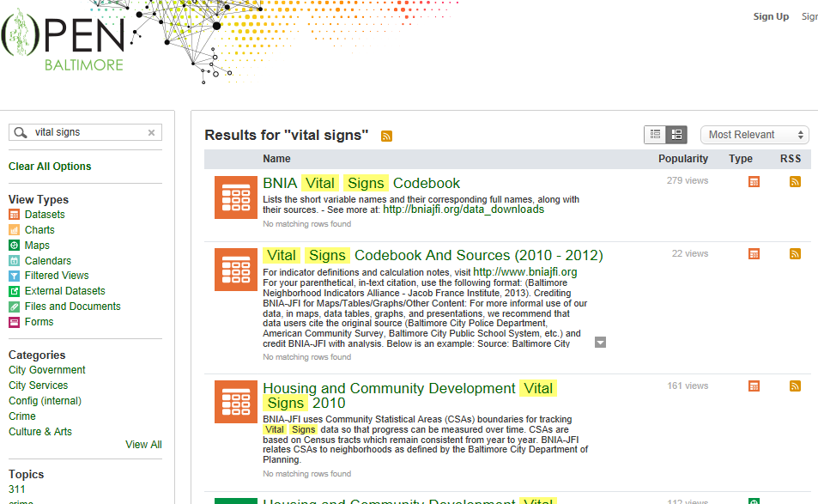
Open Baltimore

Slide 7
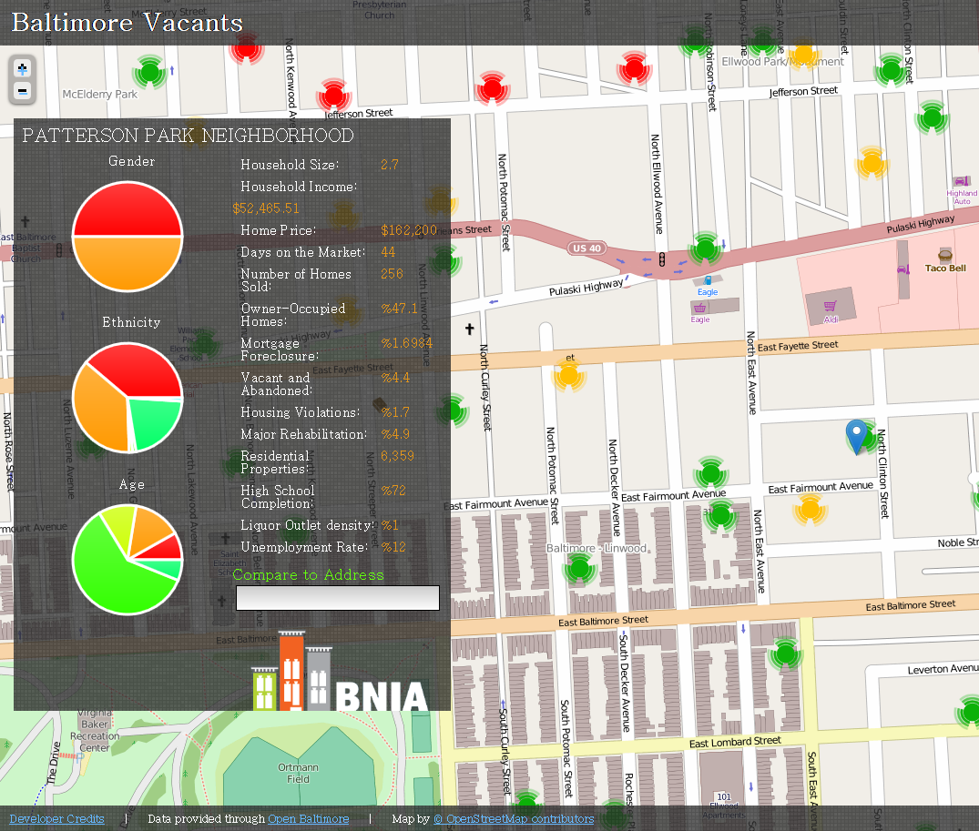
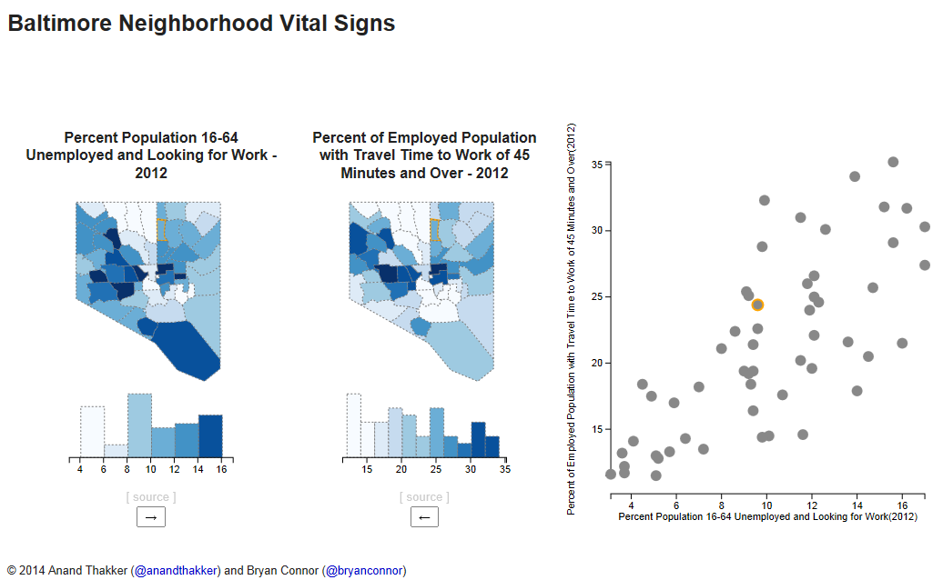
Civic Hackers

Slide 8
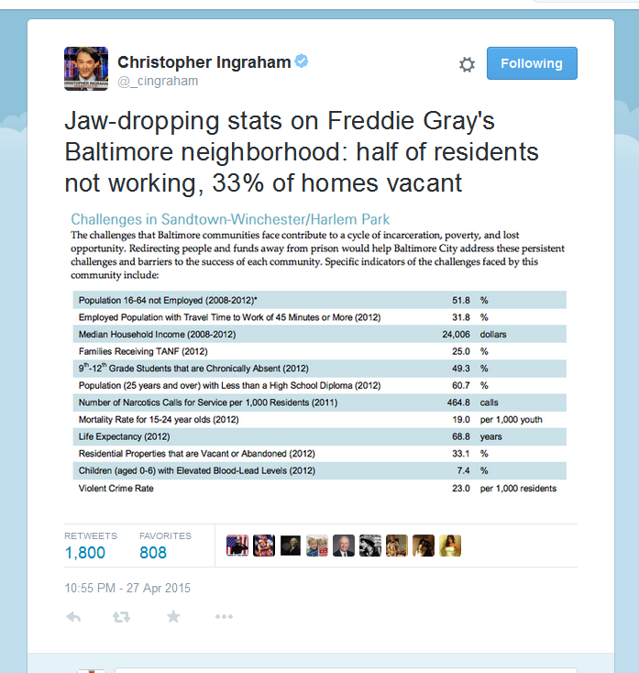
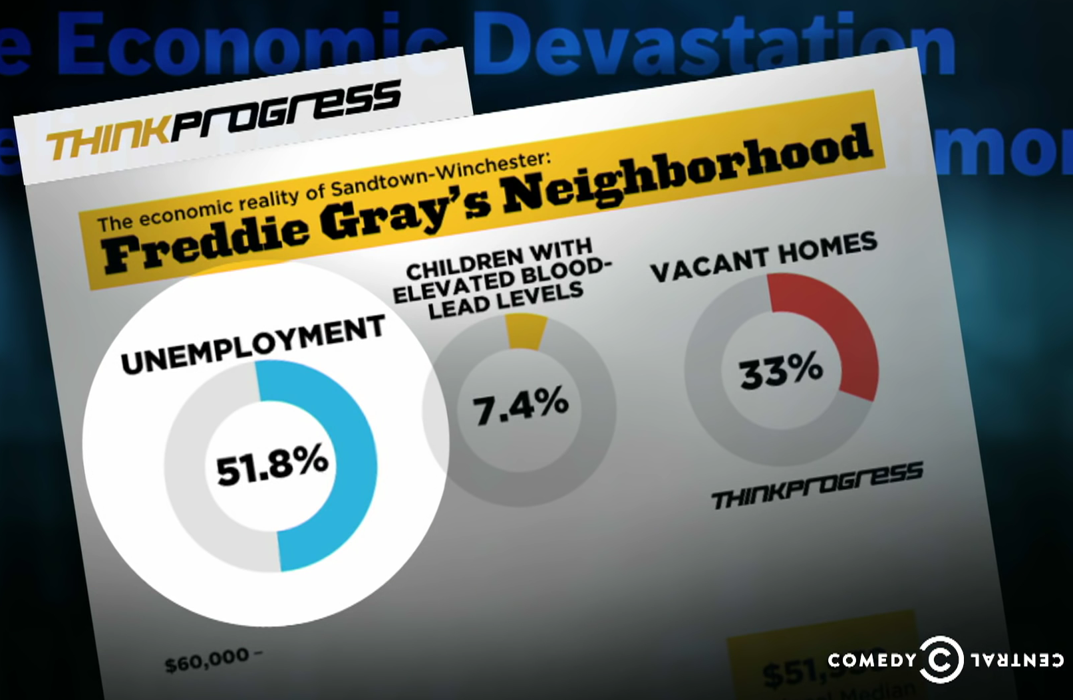
After Freddie Gray

Slide 9
Role of the Data Intermediary in Open Data

Slide 10
What Do We Know About Open Data
Open Data ≠ All the Data
    We are cognizant of what data exists and what data communities want
Data becomes more valuable over time
Access to information by itself doesn’t change people’s minds; need to present the data in a compelling way
Working with the City of Baltimore to understand and organize the ecosystem of open data providers, users and technologists

Slide 11
Questions?
    #VitalSigns14
    @bniajfi
    www.bniajfi.org

