Slide 1
Twelve things NNIP partners can do to support open data in their city
NNIP Cleveland September, 2016
Bob Gradeck, University of Pittsburgh
Western Pennsylvania Regional Data Center
@BobGradeck @WPRDC

Slide 2
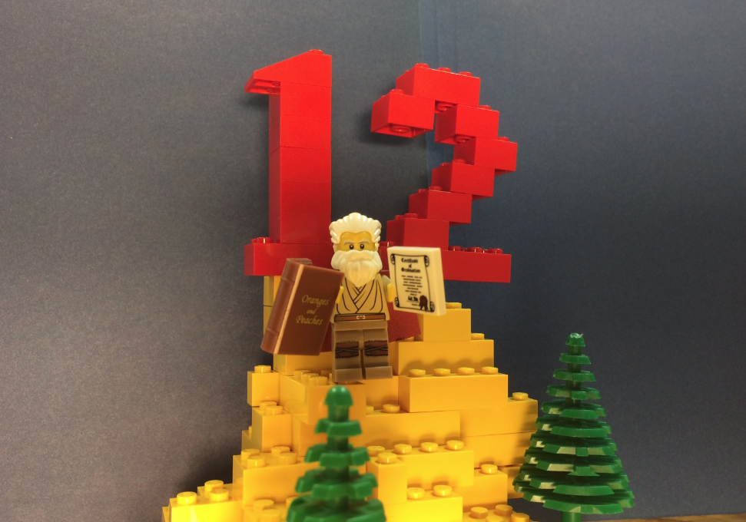
12 Things, Four Major Categories
1. Build Community
2. Build Capacity
3. Improve Data
Quality and Usefulness
4. Demonstrate Value
Notes:
Mention quote by Erica Raleigh - approach from a place of helpfulness and respect. None of these things involve hosting data or running a hackathon. You all probably do most of these things already

Slide 3
Build Community

Slide 4
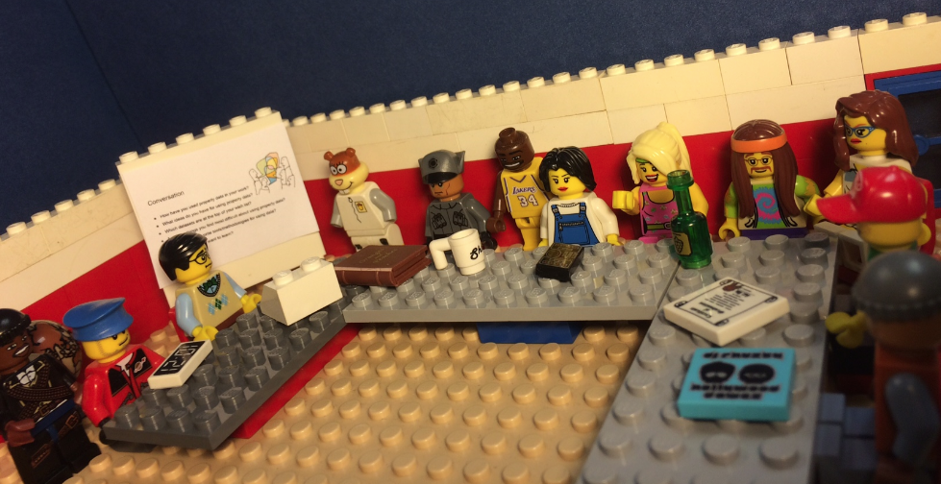
1. Organize users
Notes:
Data User Groups create space for data conversations. Starts with a listening session, then build based on demand - follow up critical or meetings will be seen as a waste of time. I will talk about follow-through from our meetings.Organizing the community builds an audience for additional events. Demonstrate there are data users.

Slide 5
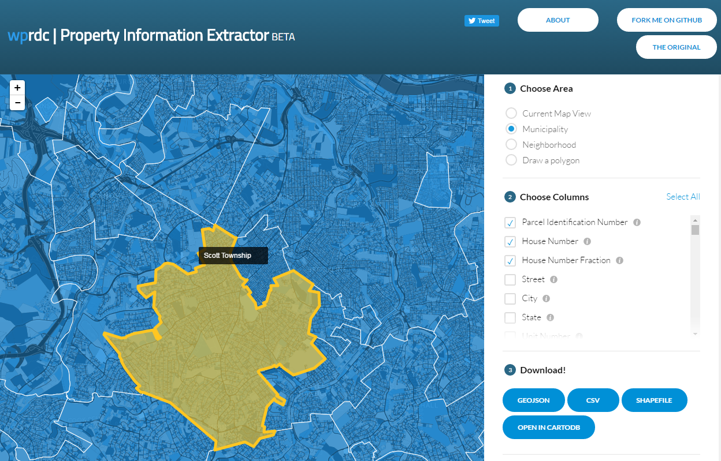
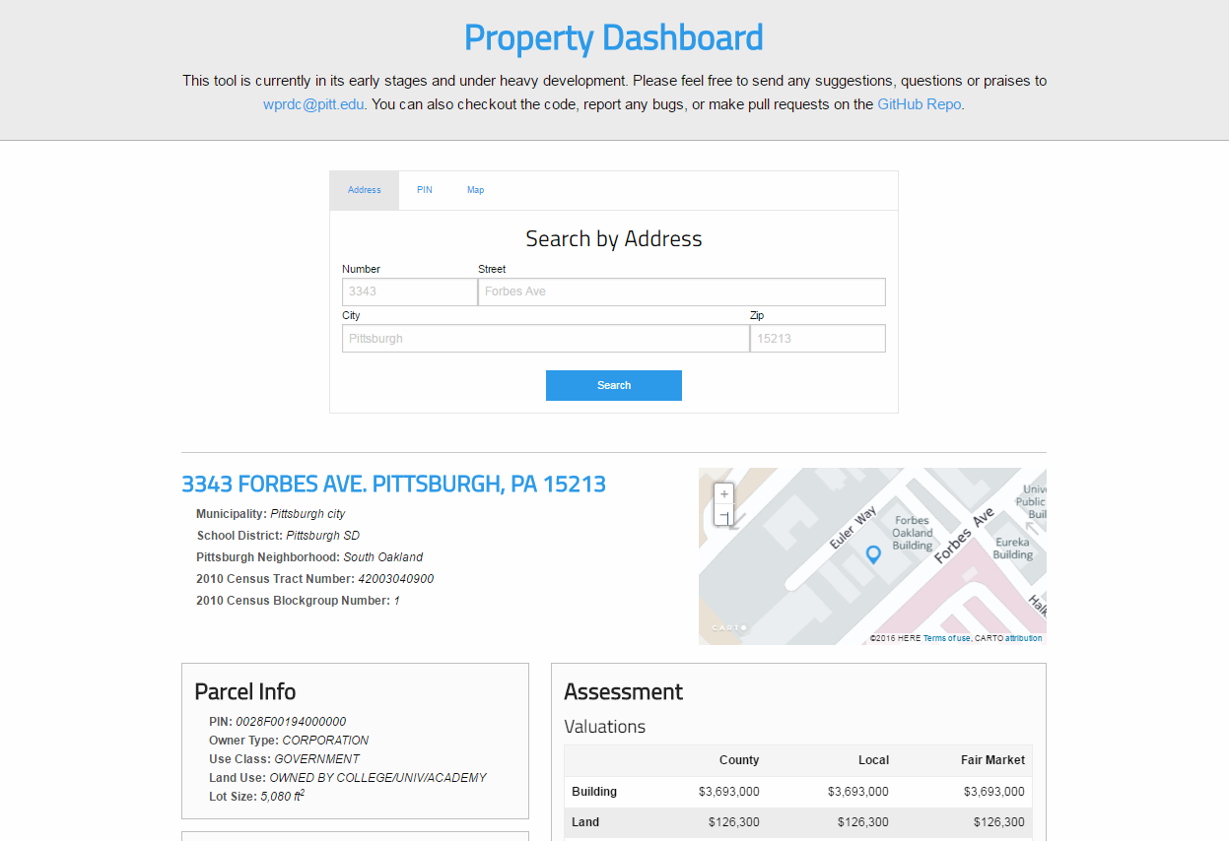
…and build based on their feedback

Slide 6
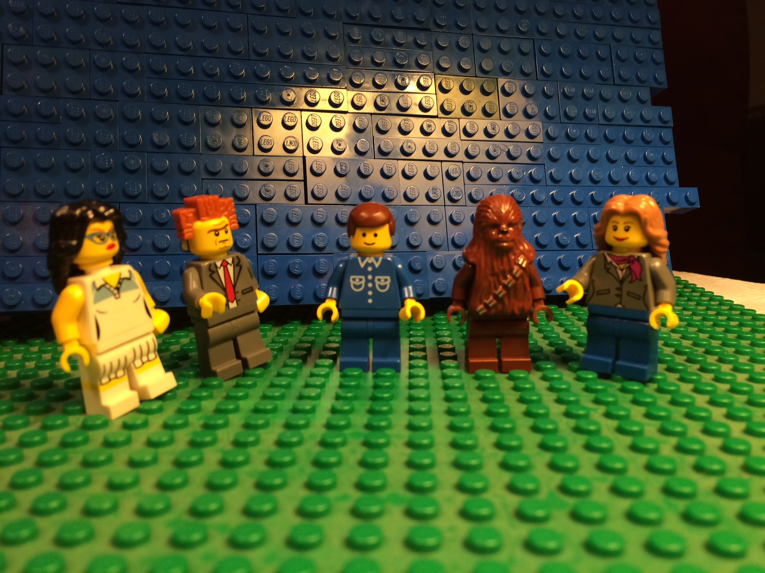
2. Connect users, experts, and publishers
Notes:
Matchmaker: Connect practitioners and researchers/experts - example - Digital Scholarship Services at Pitt Library helps City of Pittsburgh with data management
Events - City Camp (see Spike)

Slide 7
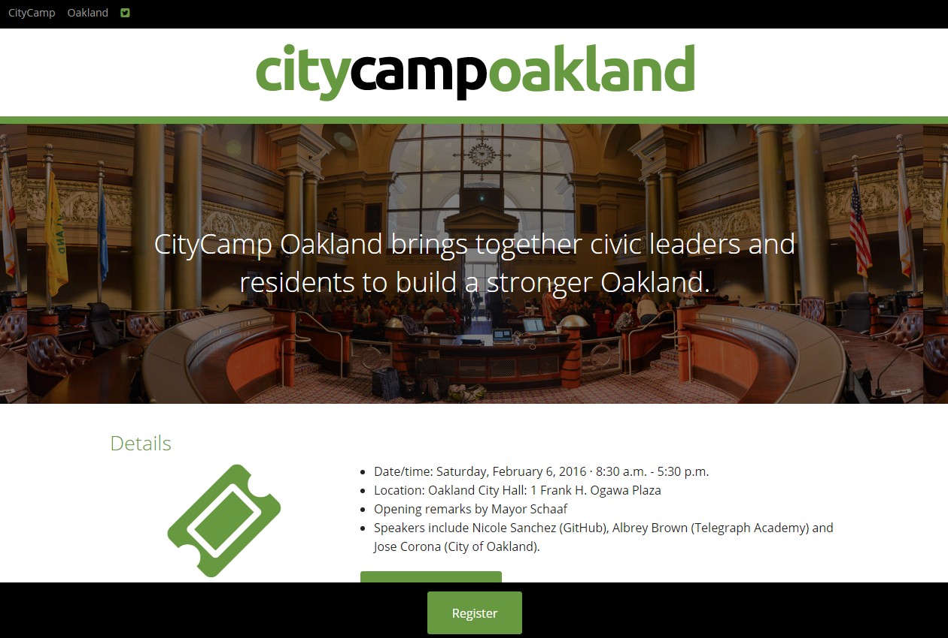

Slide 8
Build Capacity

Slide 9
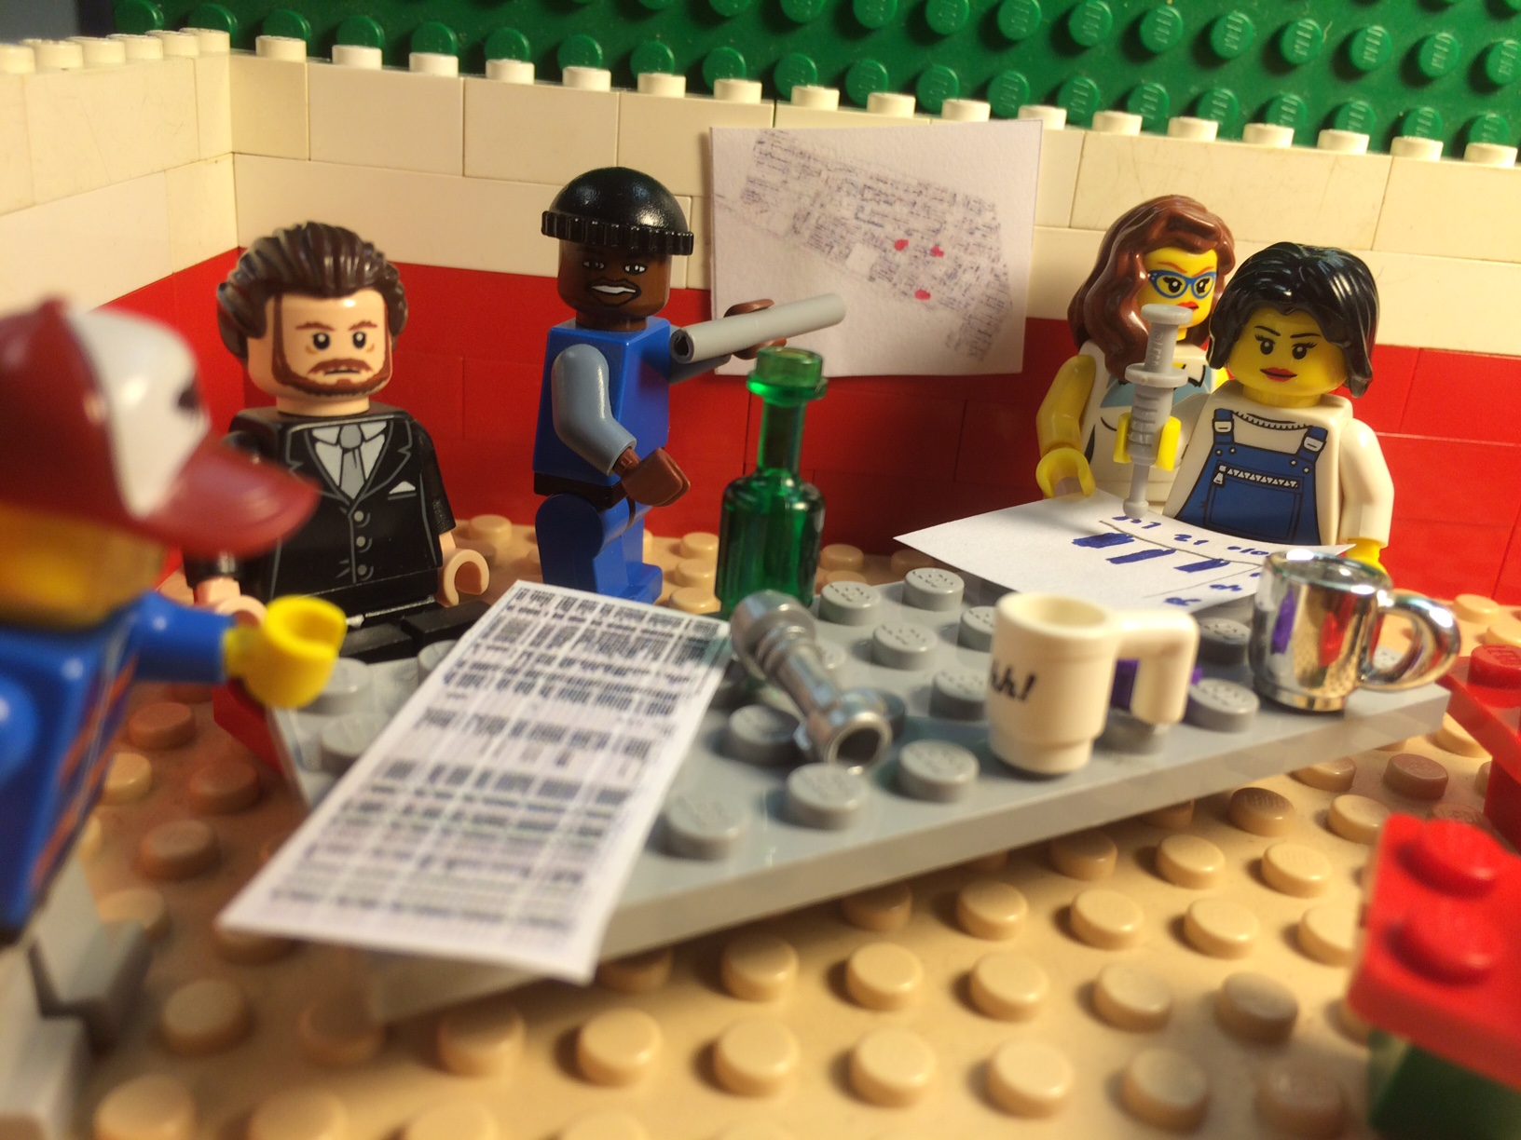
3. Data literacy training
“Data 101”
Notes:
Build demand for data - more data users is a great thing.
Data 101 class with the Carnegie Library of Pittsburgh

Slide 10
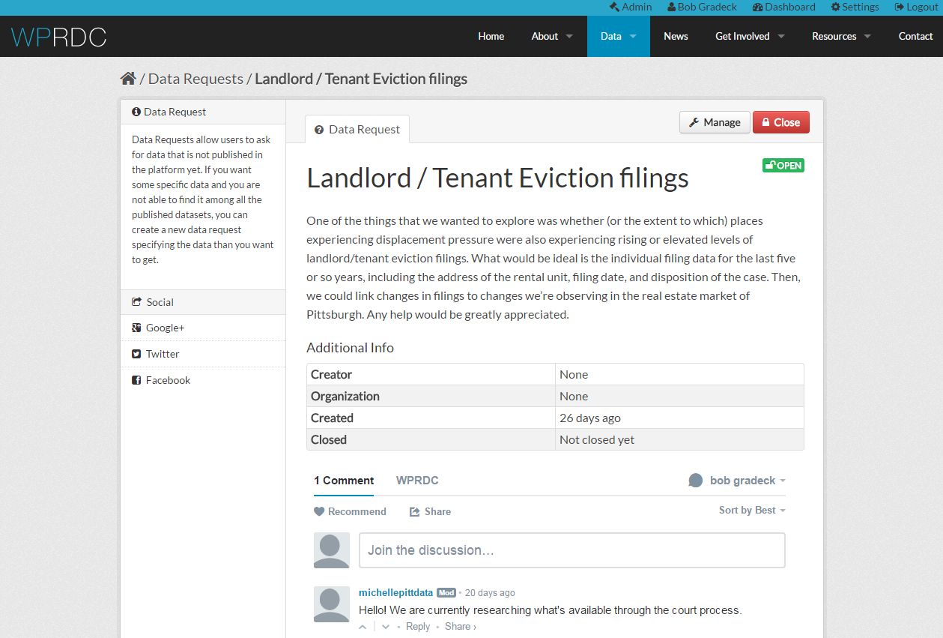
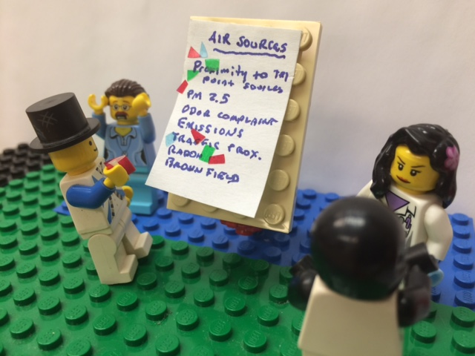
4. Enable people to easily make data requests
Notes:
Many open data sites lack this feature!!!
We have a data request feature - it is great if it lives on the data portal, but not essential - It’s hard for people to know who to ask for data. NNIP partner can serve as an intermediary for data requests - not all of these will be for the City.
Great for this feature to be in the open
Provide feedback to users to show updates/comments and when requests are fulfilled - this is not a black hole, but is actively managed.

Slide 11
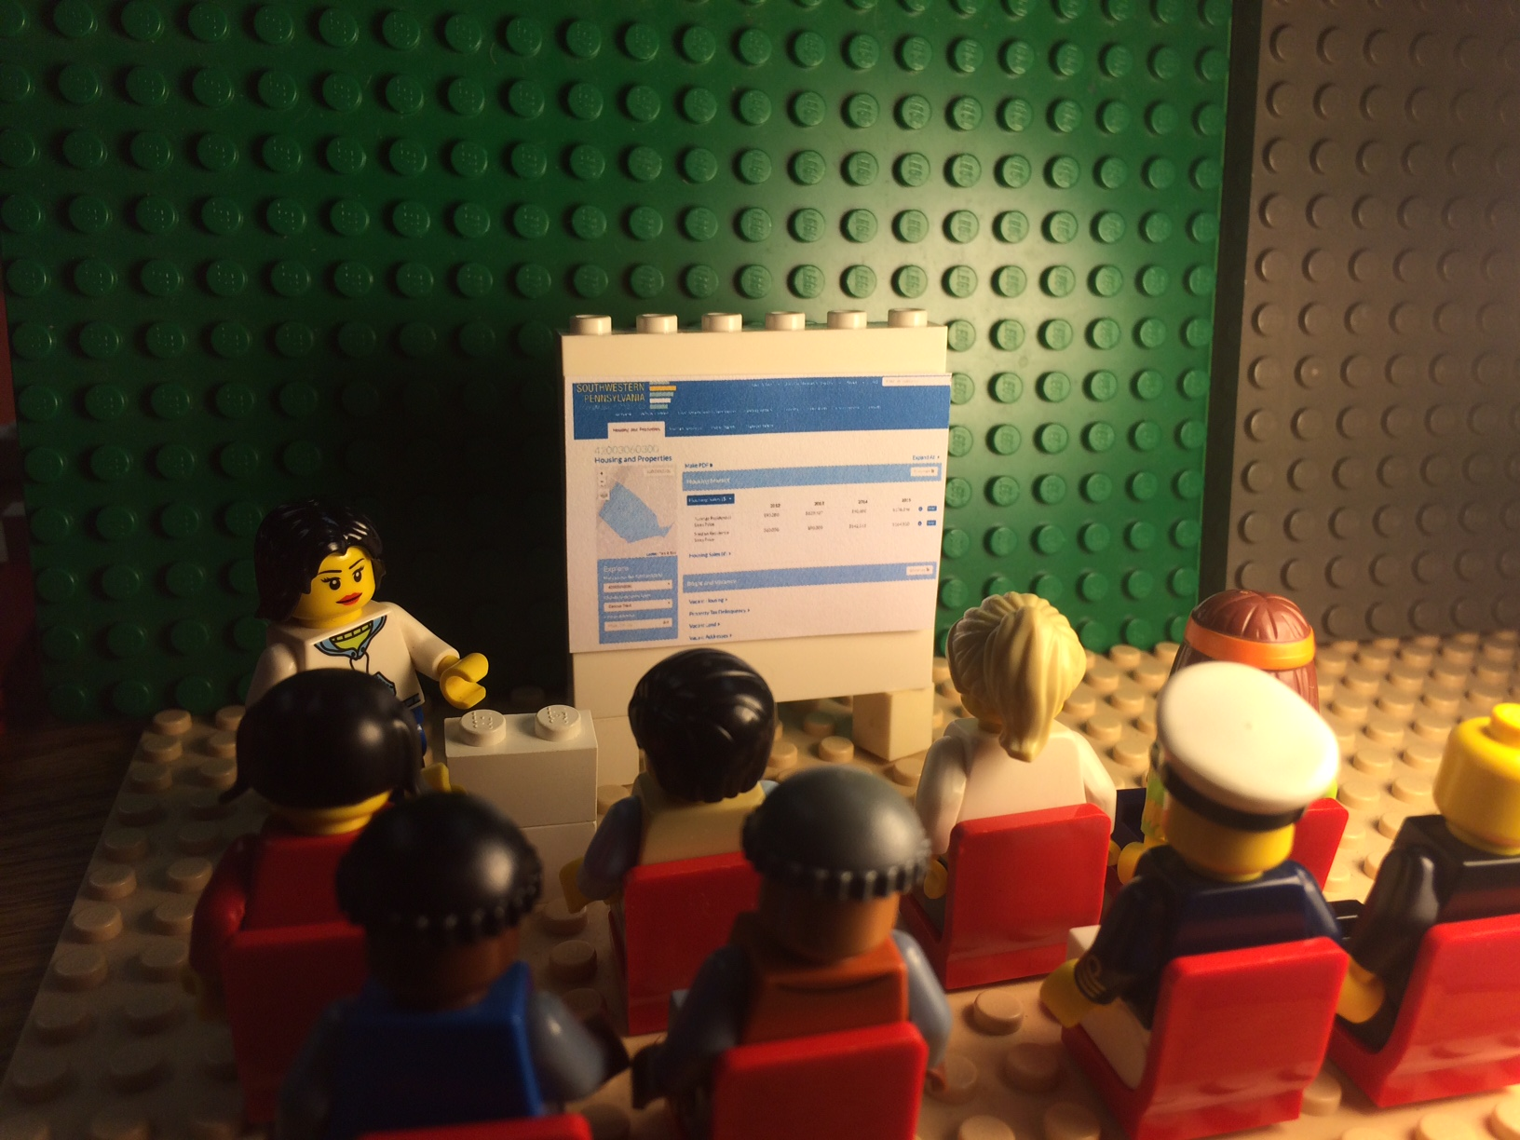
5. Support data use in the classroom
Notes:
Guest lectures,
lesson plans
Assignments, Teach a class

Slide 12
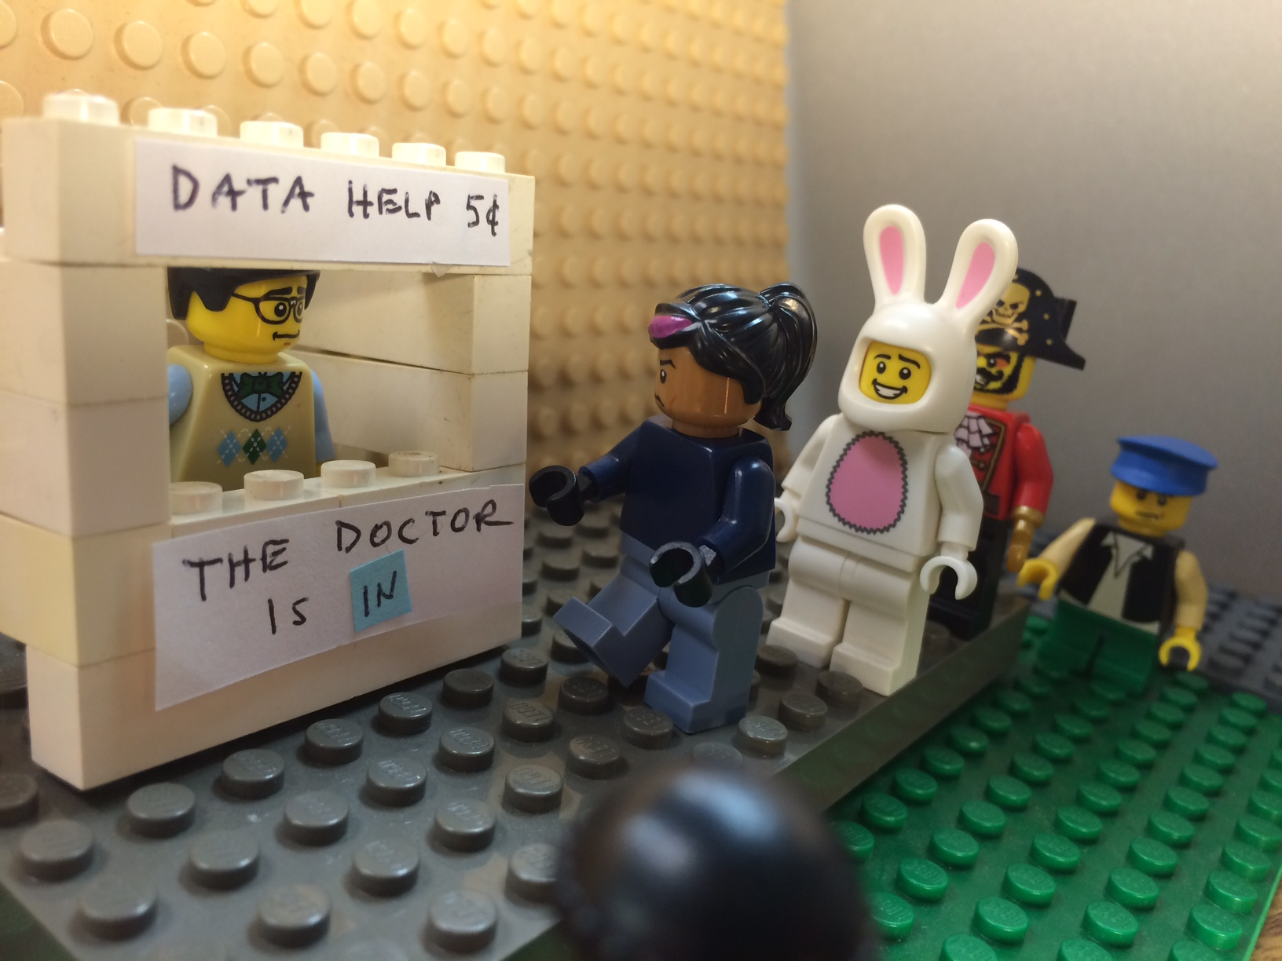
6. Technical assistance
Notes:
Ad-hoc requests, Office hours, Interactions offer in-depth chance to learn more about data users and be seen as an expert, Provide capacity that gov’t doesn’t have - they do appreciate it.

Slide 13
Improve Data Quality and Usefulness

Slide 14
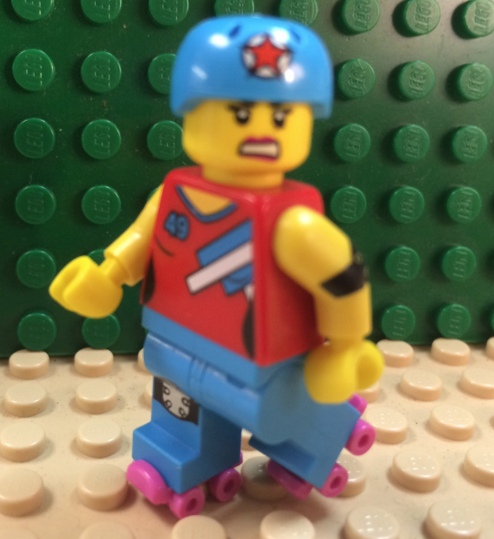
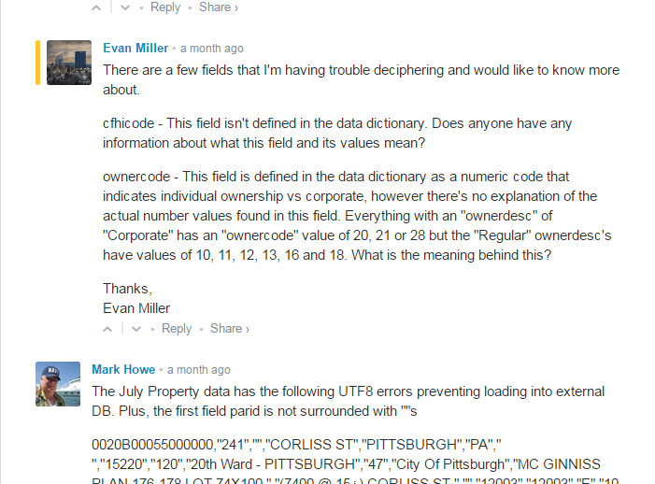

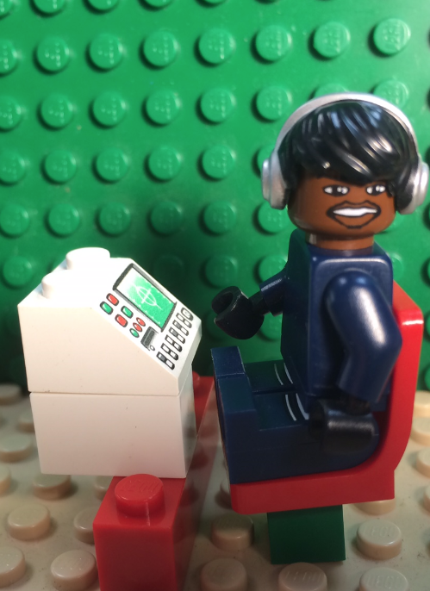
7. Provide feedback to data publishers
I have an idea!
I found a mistake.
I have a question.
Notes:
Direct + indirect mechanisms for feedback- data quality improvements, and ideas for use
We do it through comments on the portal + less-formal mechanisms
Content analysis: highlight three types of commenters (profile them to make slides less-boring):
I found a problem
I have a suggestion
Helper: I want to help make data better or have a legitimate question.

Slide 15
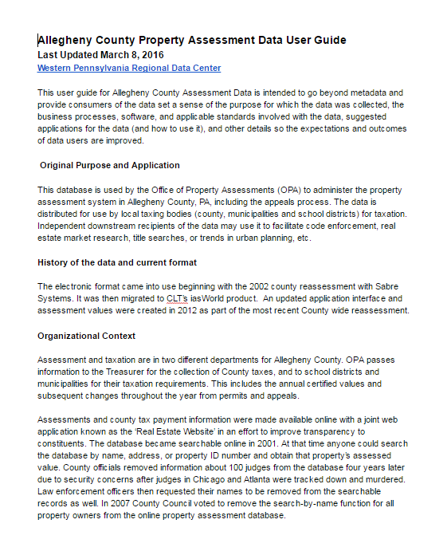
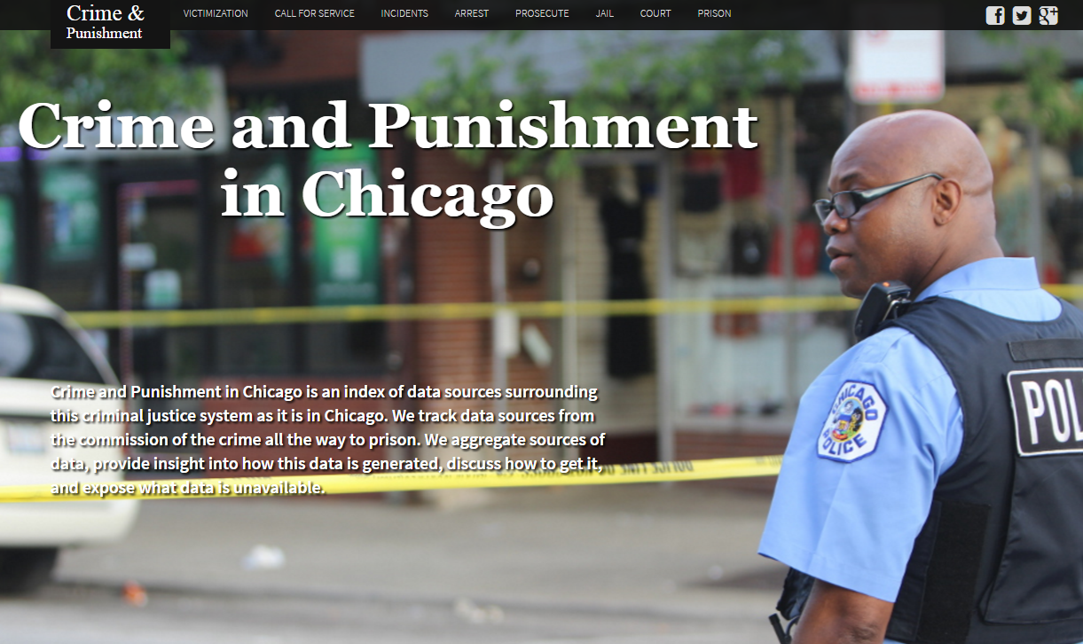
8. Enhanced documentation
Notes:
User guides
Metadata catalog

Slide 16
Demonstrate Value

Slide 17
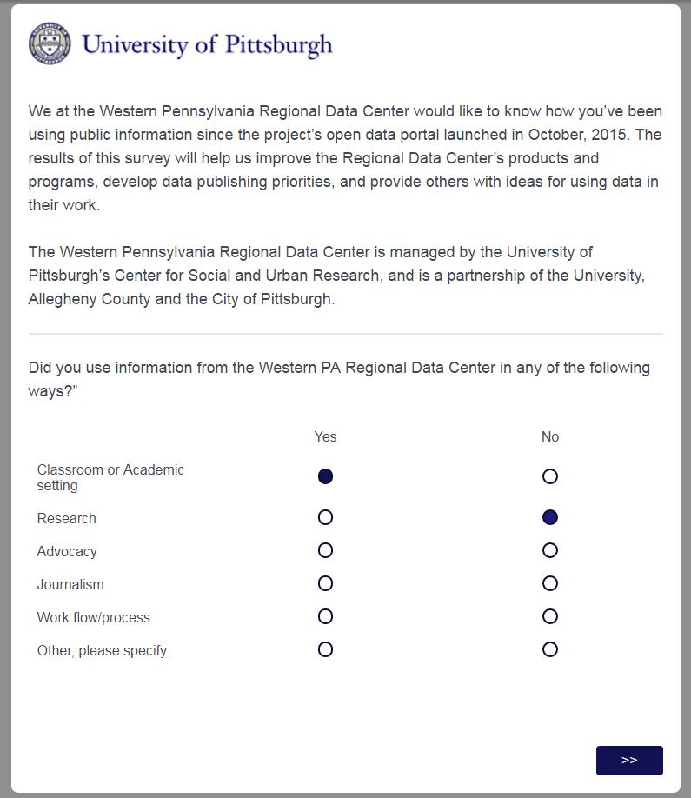
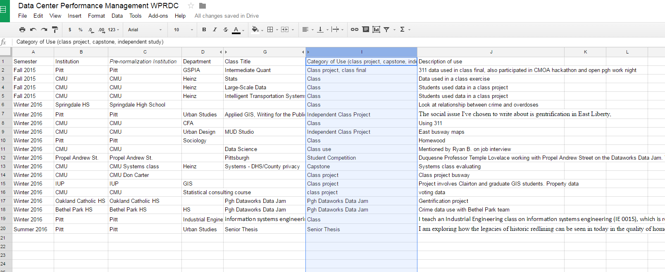
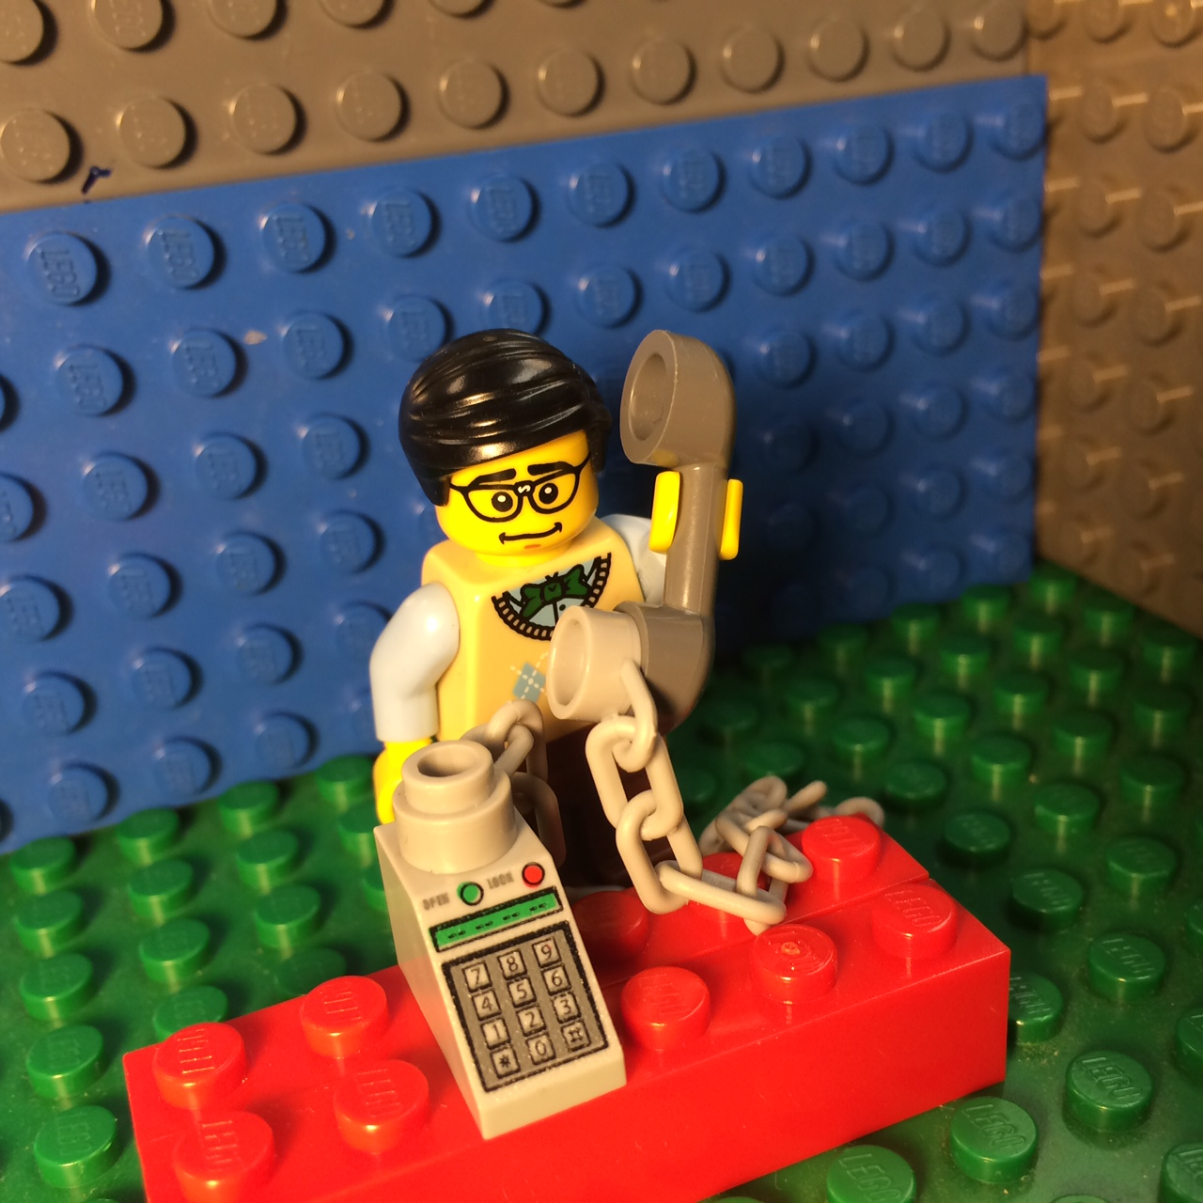
9. Collect data stories
Notes:
Helps to justify open data investments - people love stories - Always ask people you interact with how they’re using data - build mechanisms to collect and share stories regularly, or they’ll be lost - Survey - Case studies - Spreadsheet

Slide 18
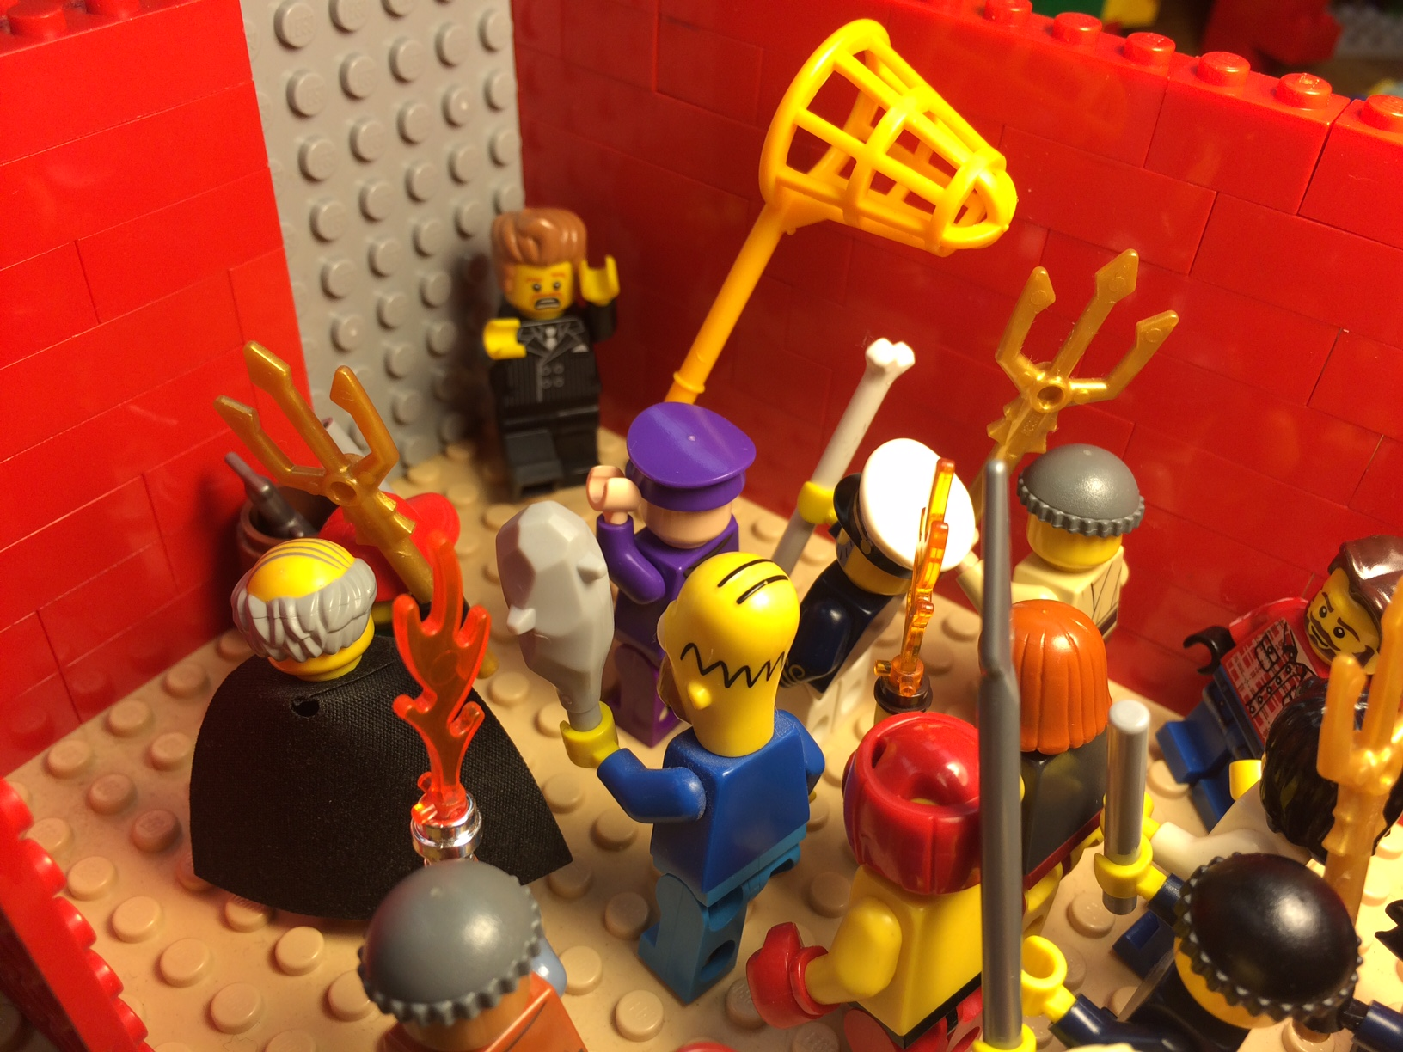
10. Be an ally for your city’s open data team
Notes:
Support your open data team when involved in internal political struggles to free data - These battles may be due to power, resource allocation, privacy risks (or perceived risks), etc.- Promote value of data sharing in general, but highlight specific examples and anticipated outcomes. For example - sharing tax delinquency data will allow the permit office to deny a permit to a property owner until all delinquent taxes are paid, etc.- NNIP partners able to bridge inside and outside games - talk about both here… - Highlight examples from other cities. They’re doing it - why can’t we.

Slide 19
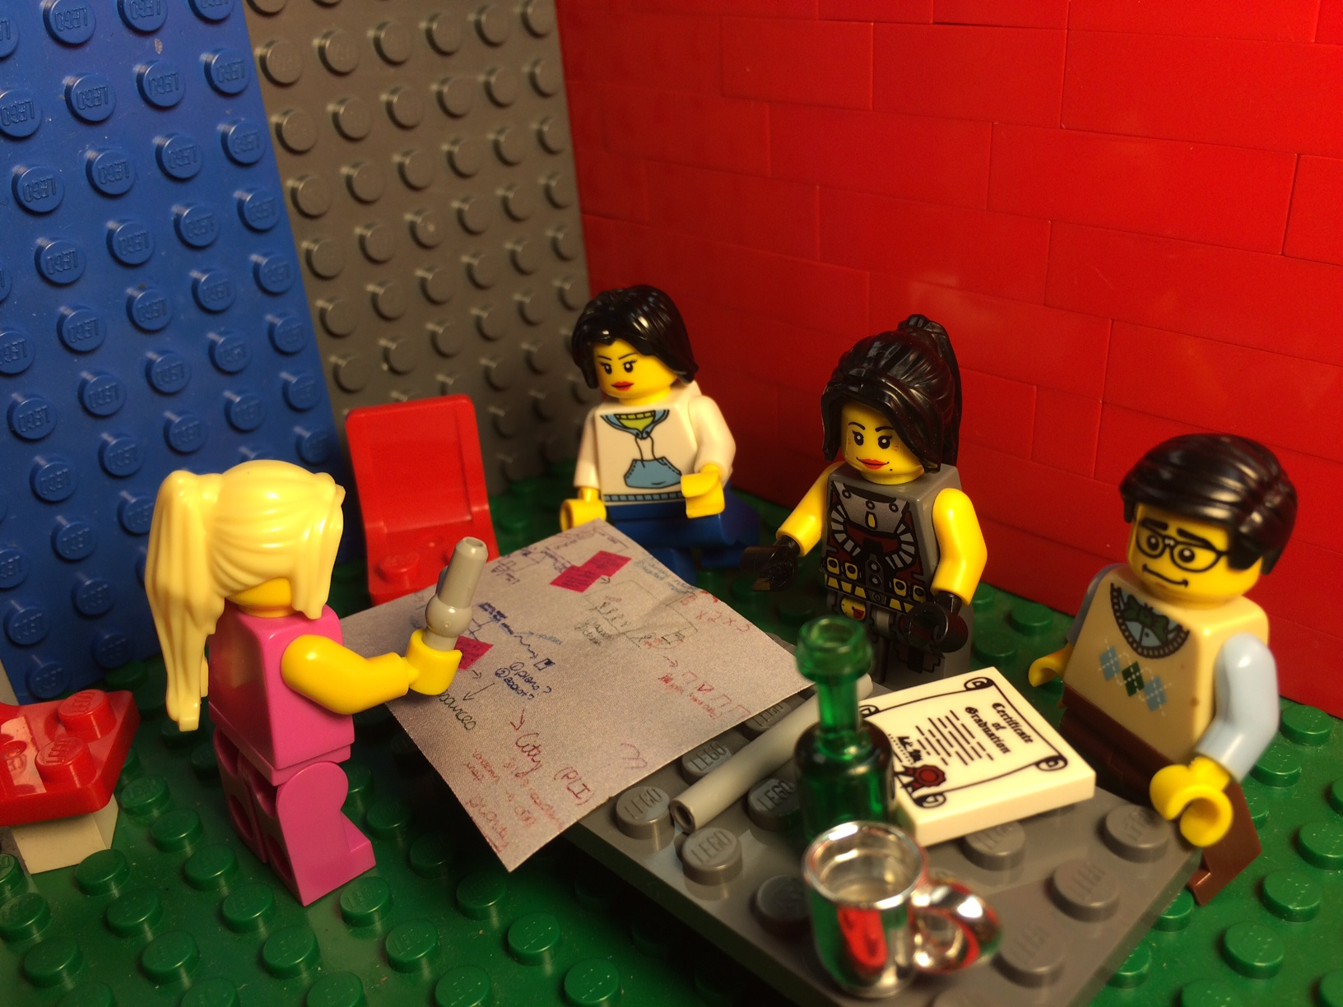
11. Uncover opportunities to use data in the community
Notes:
Be able to point out opportunities where more / improved data, technology, process improvements, or training can help organizations achieve their mission - Curate ideas, connect ideas with community capacity staff, civic tech and students to be able to help an organization - Talk about our forthcoming narrative inquiry workshop

Slide 20
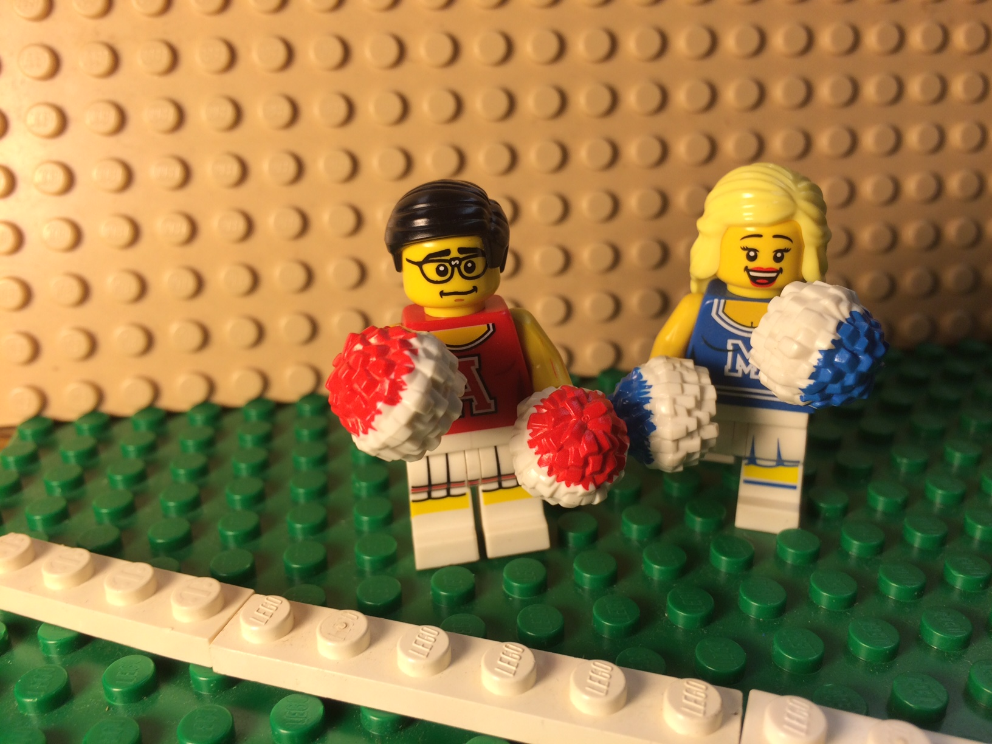
12. Be a cheerleader for data

Slide 21

Contact
Me
Bob Gradeck
Western Pennsylvania Regional Data Center
@BobGradeck
@wprdc
www.wprdc.org
Notes:
Me punching a mime.

