Slide 1

Open Data in San Francisco:
Countering the
Open
Joy Bonaguro
Chief Data Officer
City and County of San Francisco
NNIP, Cleveland, Ohio
Sep 15, 2016

Slide 2
Our Rate of Publication
Tabular data posted by quarter
(cumulative %)
~50% of tabular datasets posted by June 30, 2012

Slide 3

Eye roll effect

Slide 4
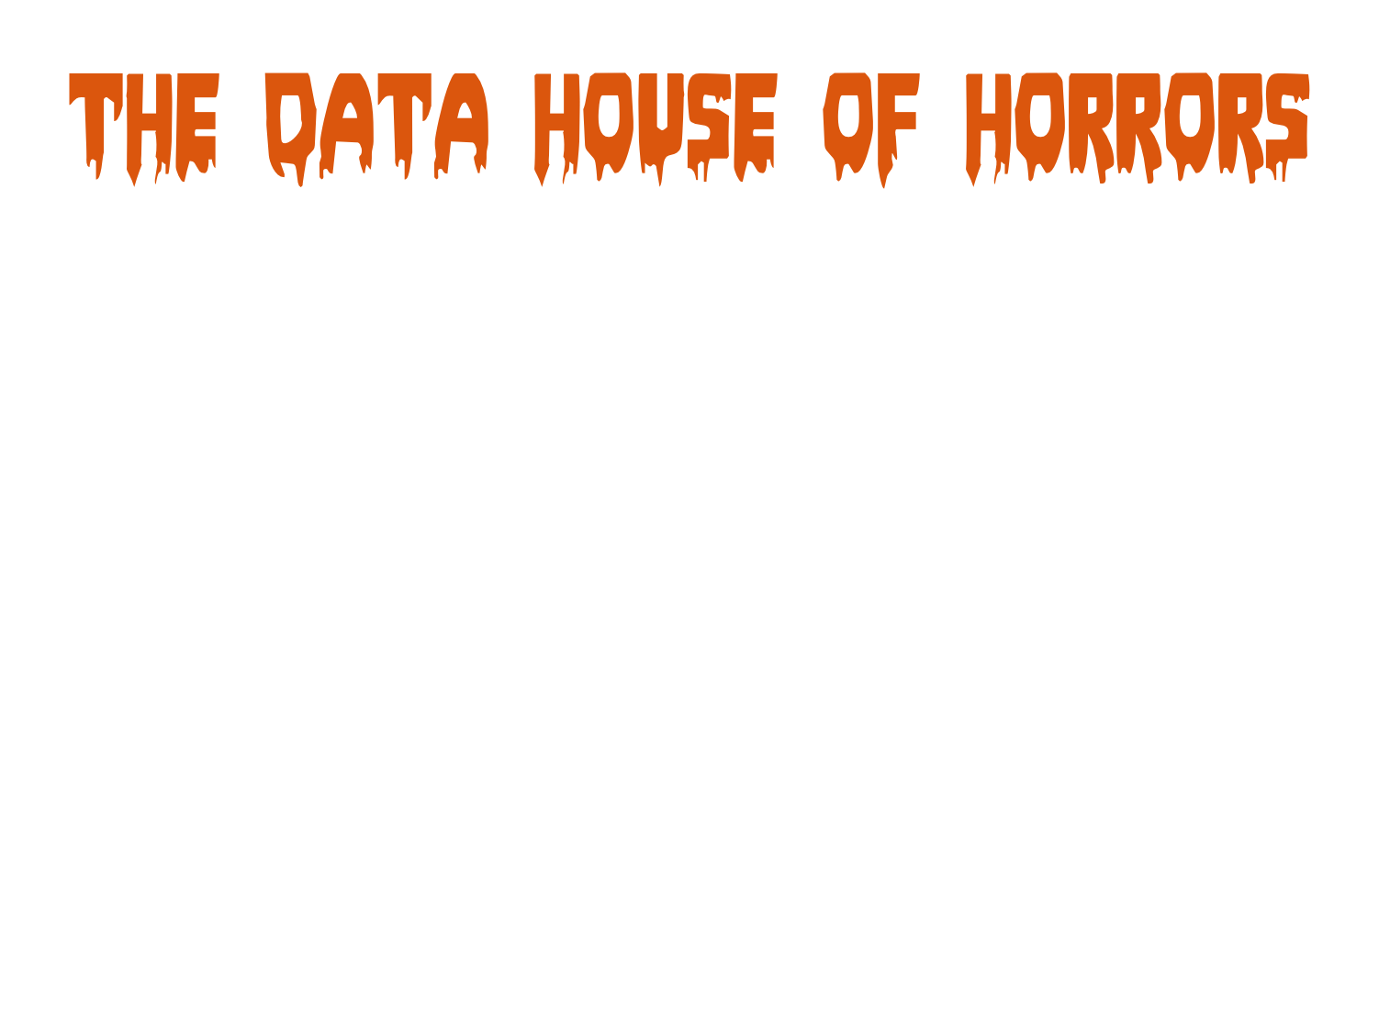


Slide 5
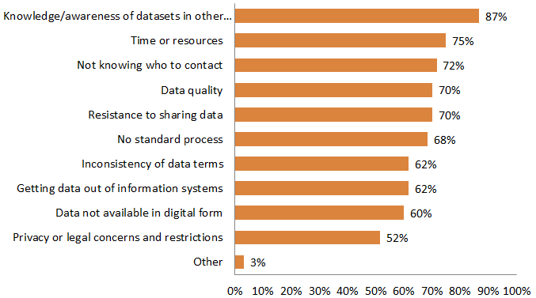
Inter-Dept Barriers: 2015
% indicating Medium and Major Barriers

Slide 6


Slide 7

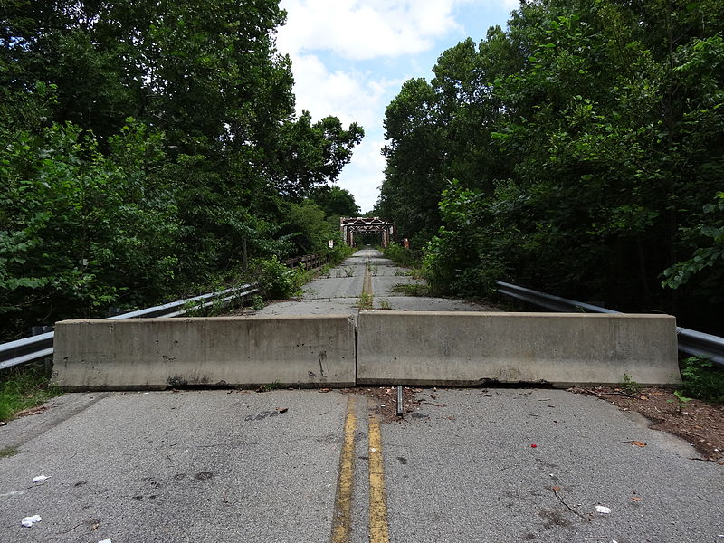
knowledge and awareness of datasets in other departments was a medium or major barrier
© Emw / Wikimedia Commons / CC-BY-SA-3.0

Slide 8
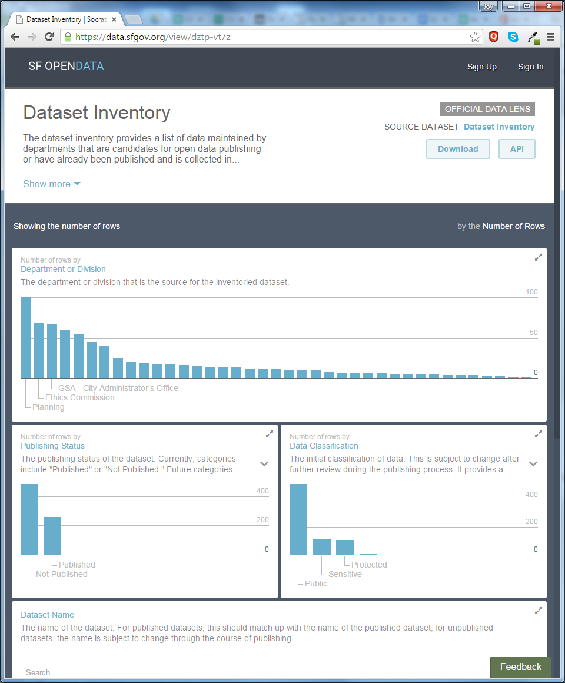
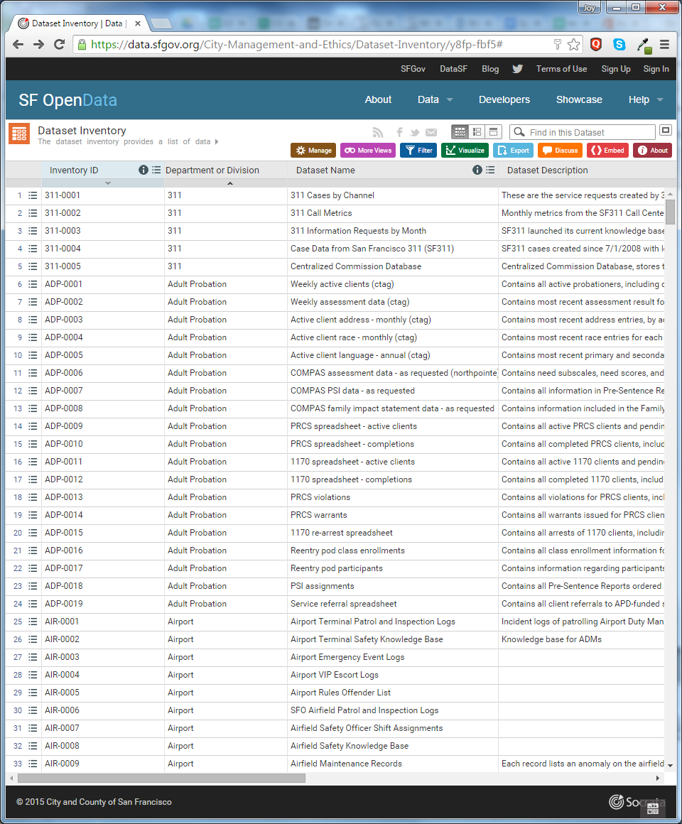
Data Inventory

Slide 9
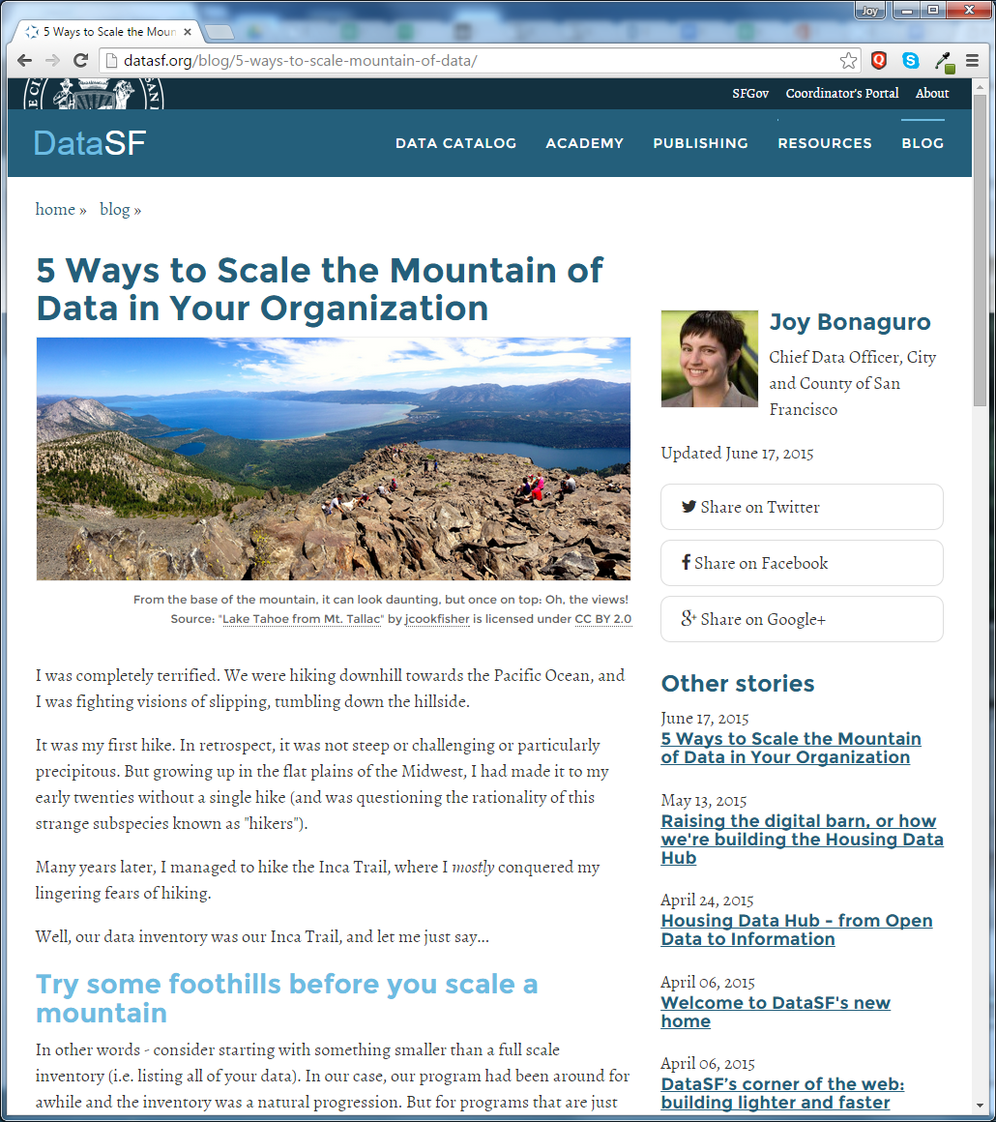

Slide 10


Slide 11
Obtain Data
Hey! You got this data?
Here it is…
Hello????
Maybe…
Thanks! Some ?s…
Question death spiral
Can I have it?
Update Data
See previous

Slide 12
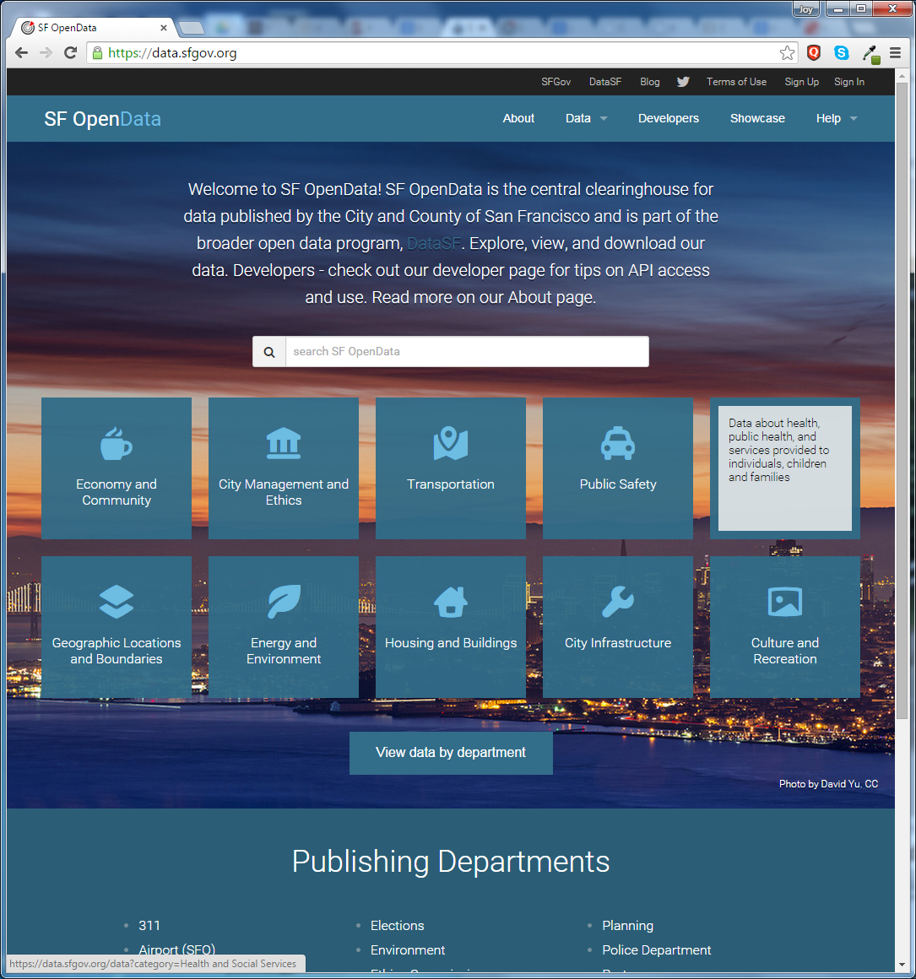

Slide 13
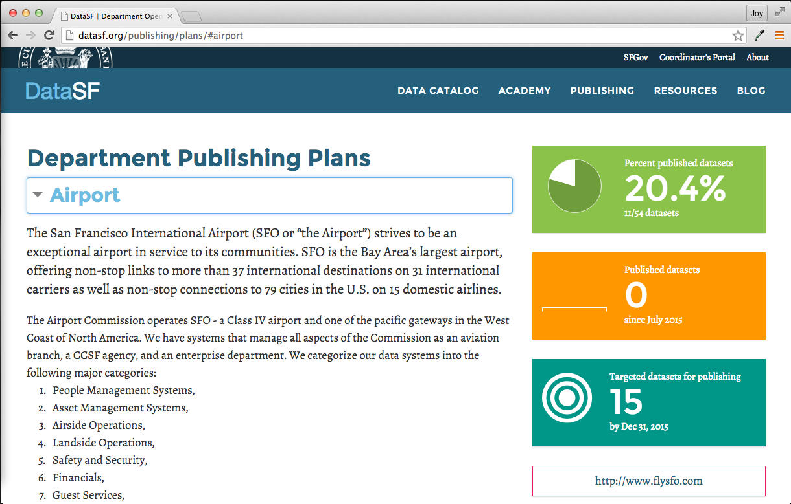
Publishing Plans reduce open data uncertainty

Slide 14
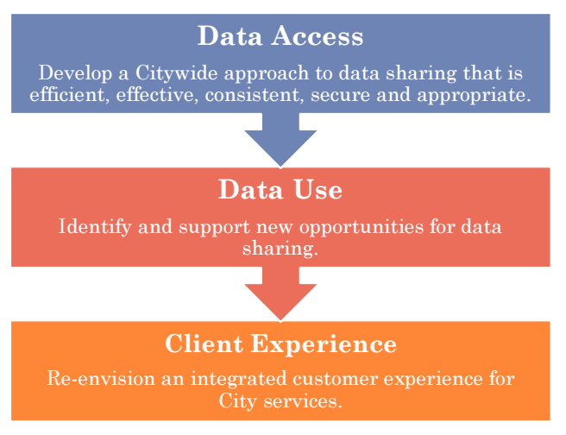
ShareSF facilitates internal confidential data sharing

Slide 15
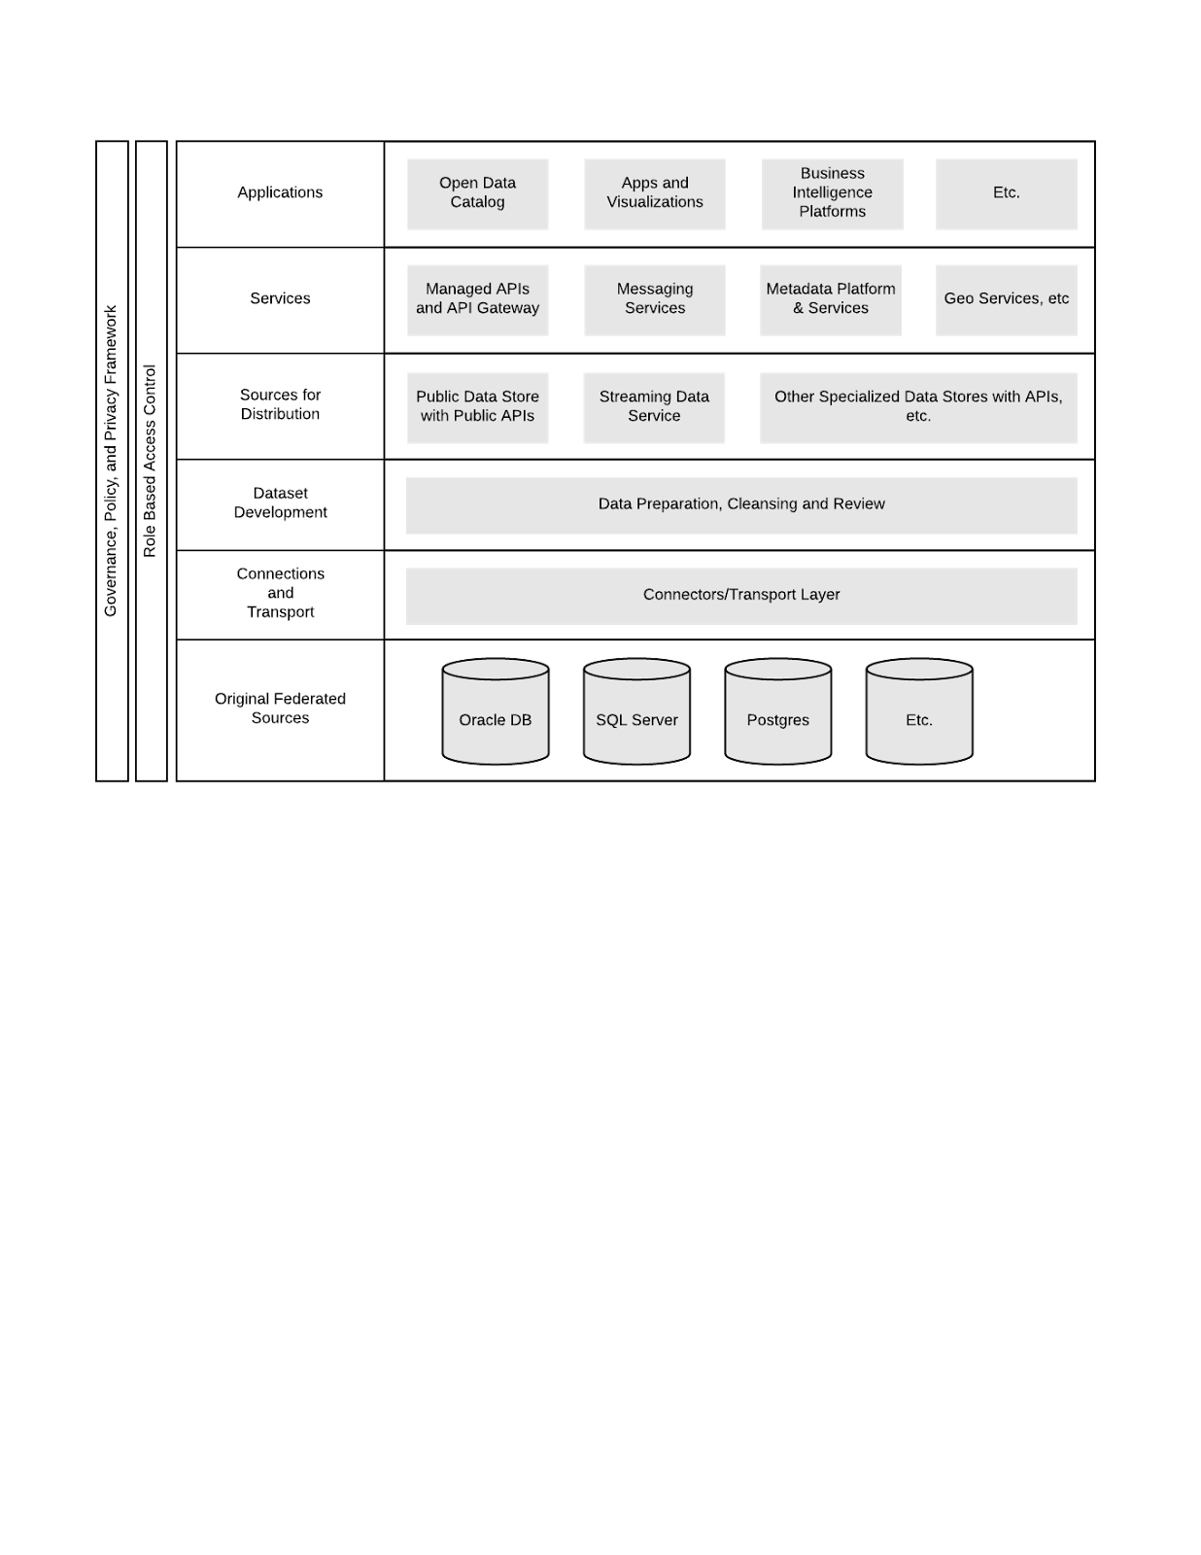
Generalized data architecture goal state defines roadmap for future

Slide 16


Slide 17
Obtain Data
Hey! You got this data?
Here it is…
Hello????
Maybe…
Thanks! Some ?s…
Question death spiral
Can I have it?
Update Data
See previous

Slide 18
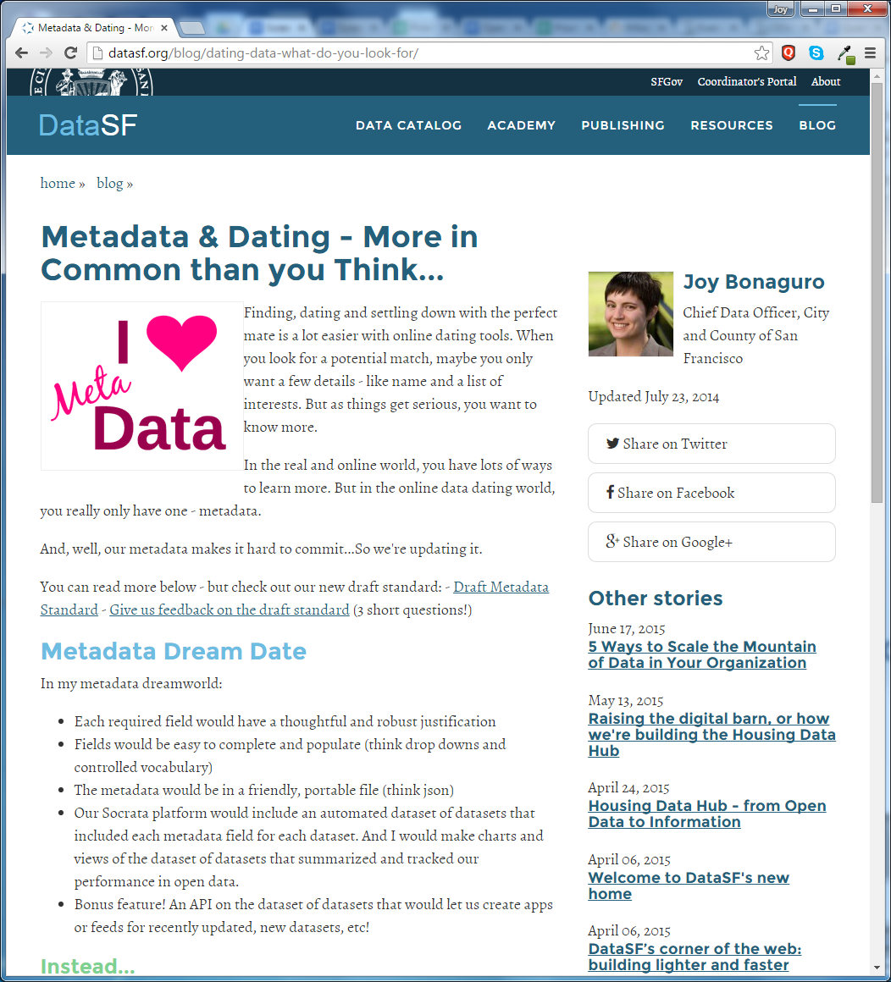
Metadata (including data dictionaries) diverts common questions

Slide 19
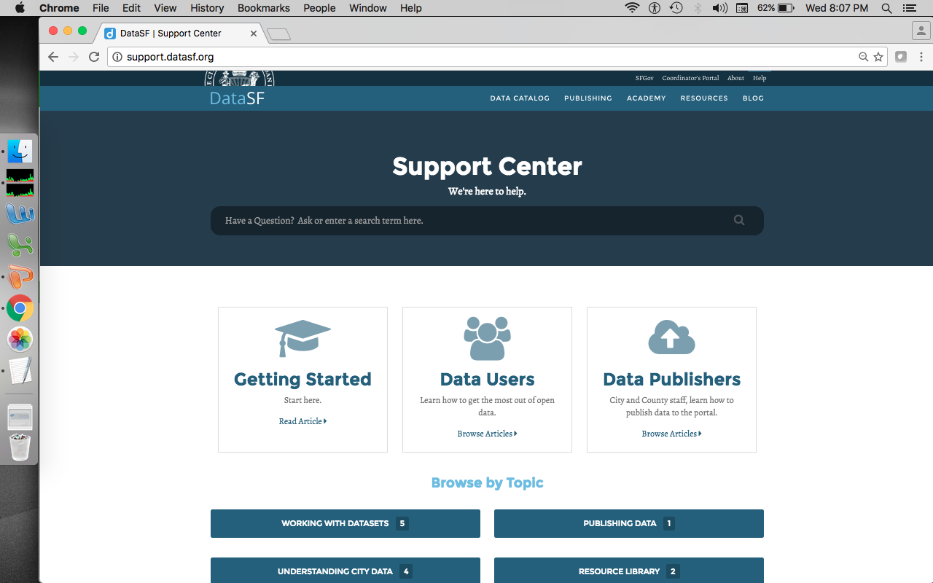
Knowledge base and help desk handle the rest

Slide 20


Slide 21
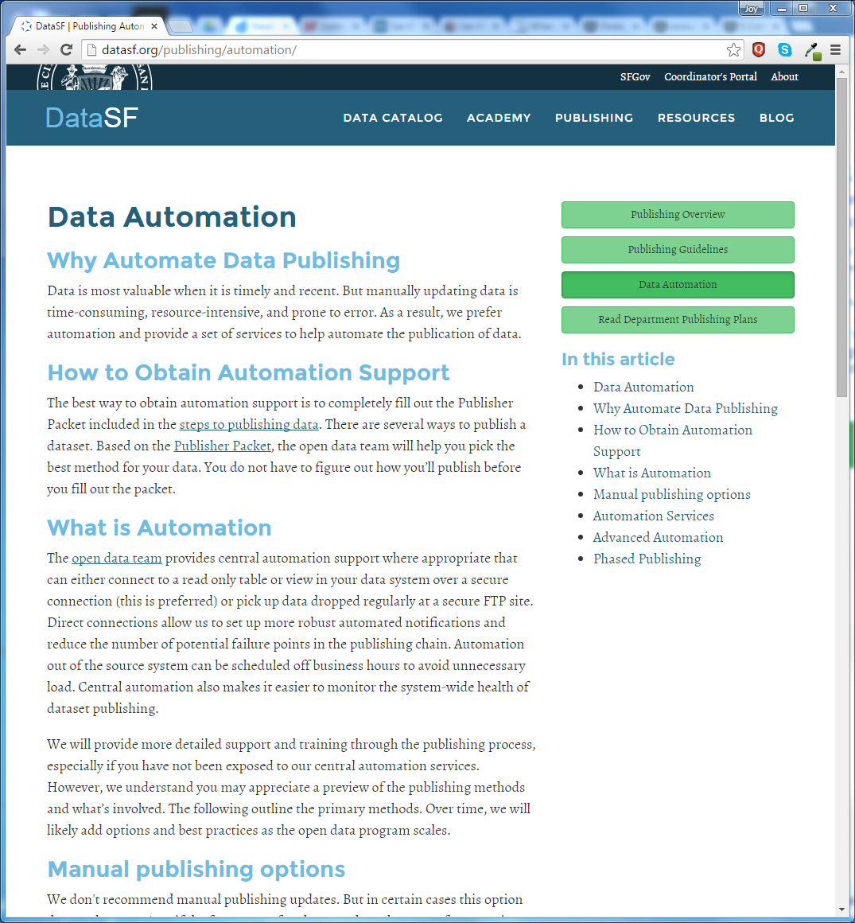
Enhance data during publication

Slide 22
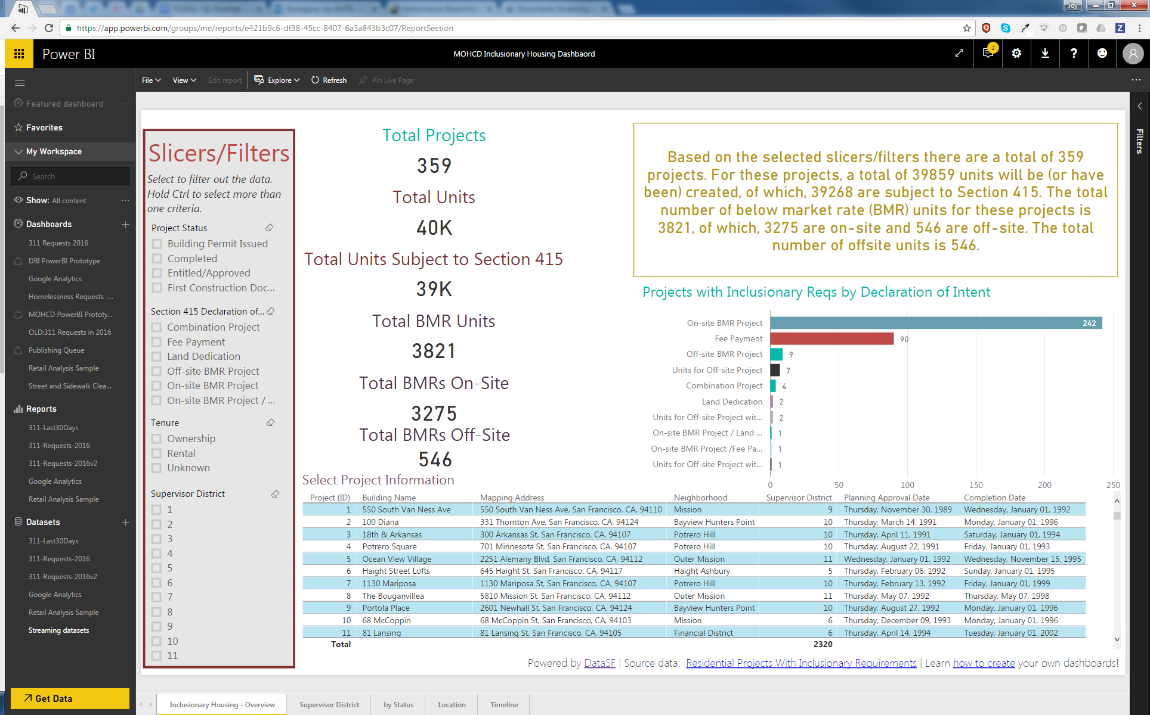
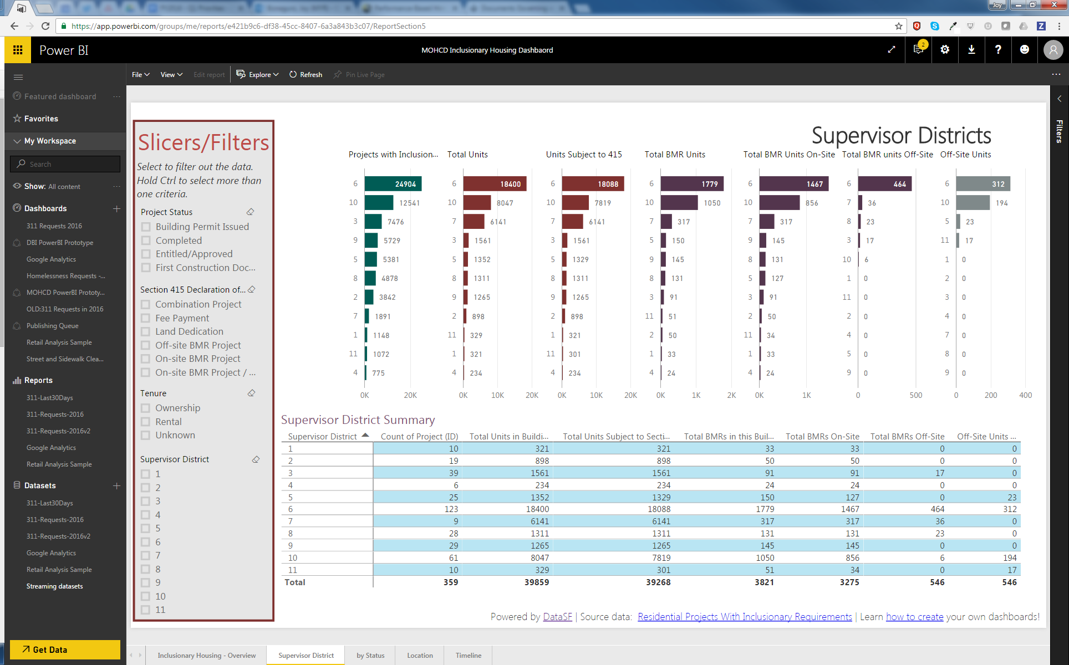
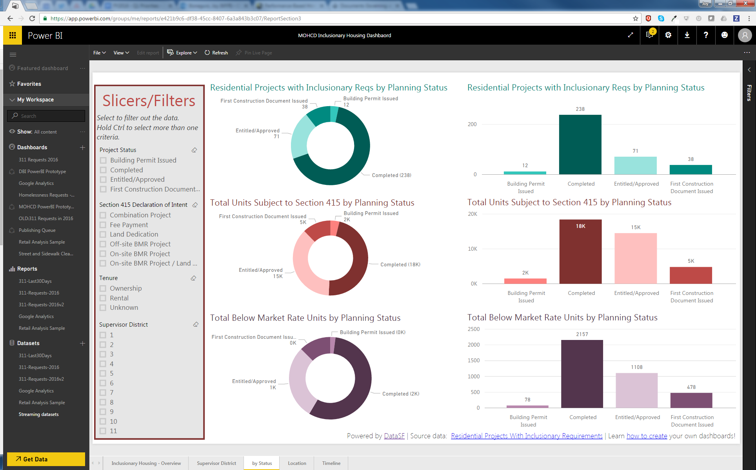
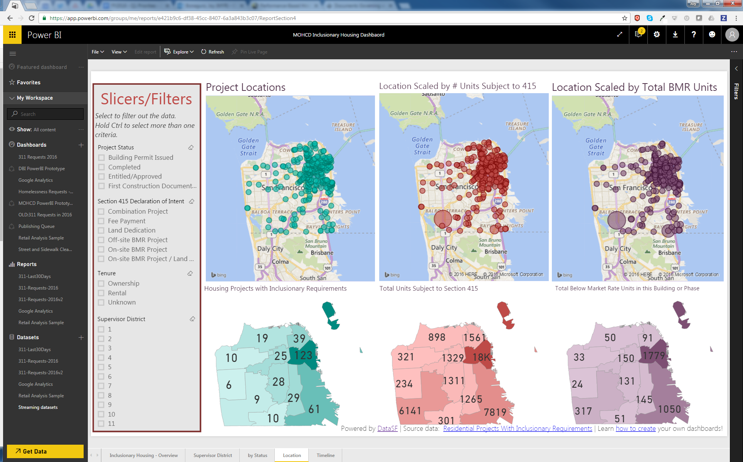
Develop dashboards for standard & ad hoc reporting
Notes:
Can quickly generate standard reports, but also respond to ad hoc requests from supervisors or other groups. And for once, have easy ready maps at their disposal.

Slide 23
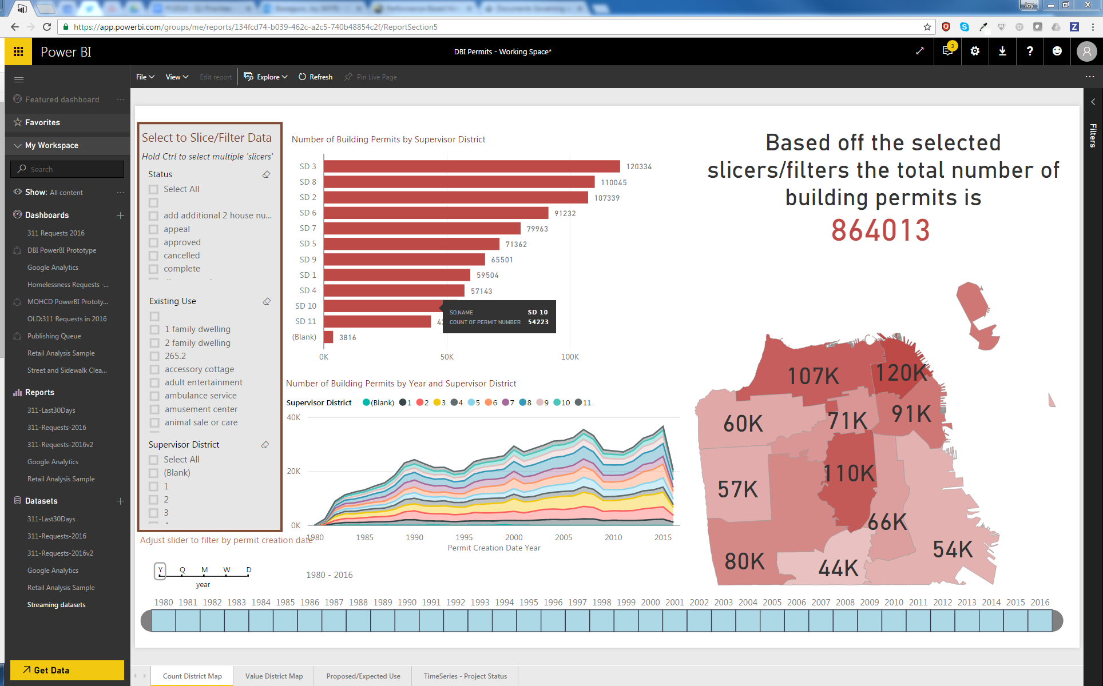
Reduce IT staff burden and migrate to self-service

Slide 24
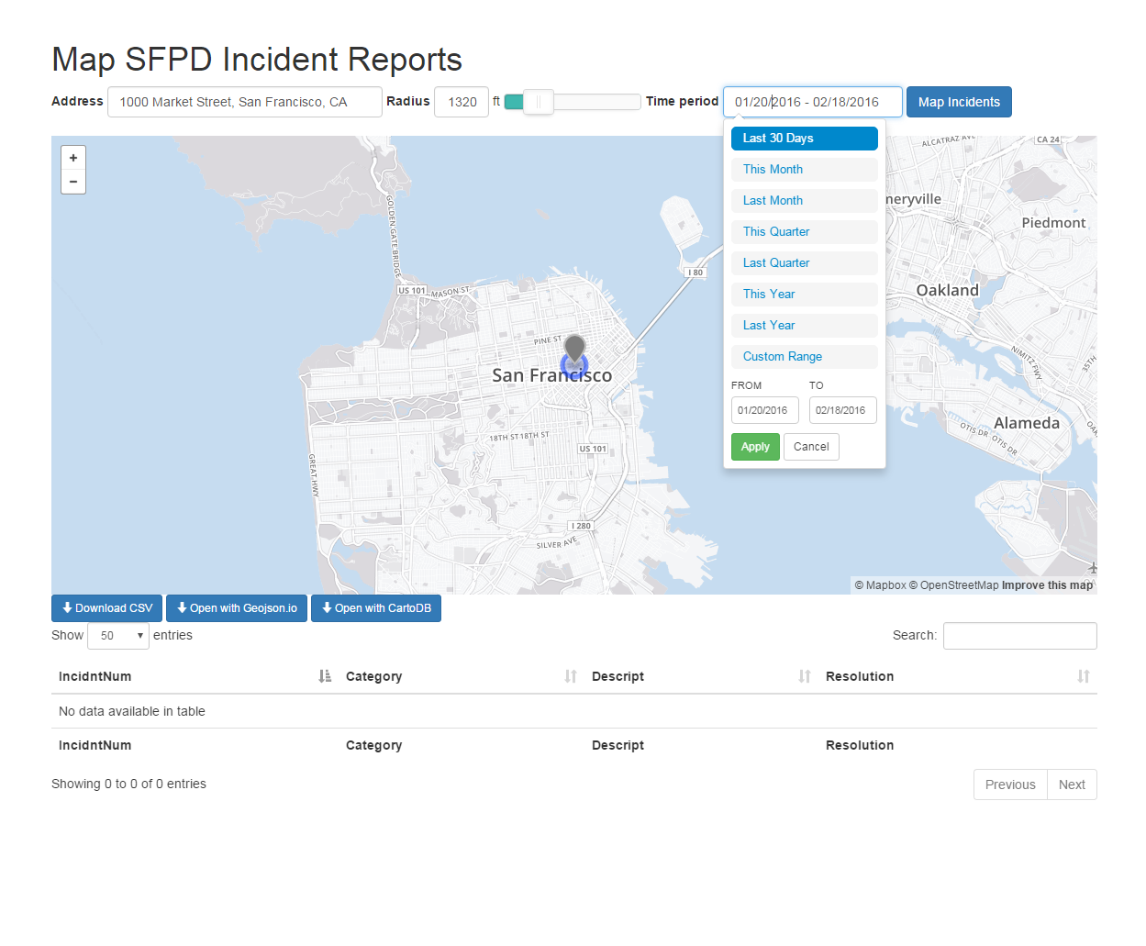
Use simple query tools to divert public requests

Slide 25


Slide 26
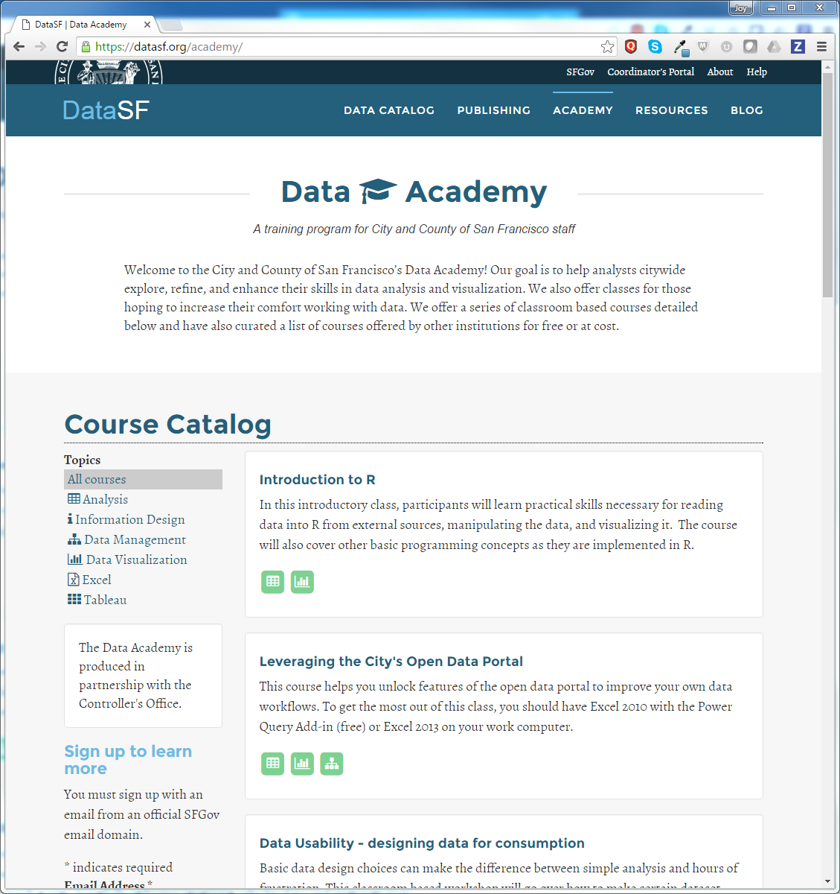
Build Individual Capacity

Slide 27

Schedule friendly
Demand driven
Free ;-)

Slide 28
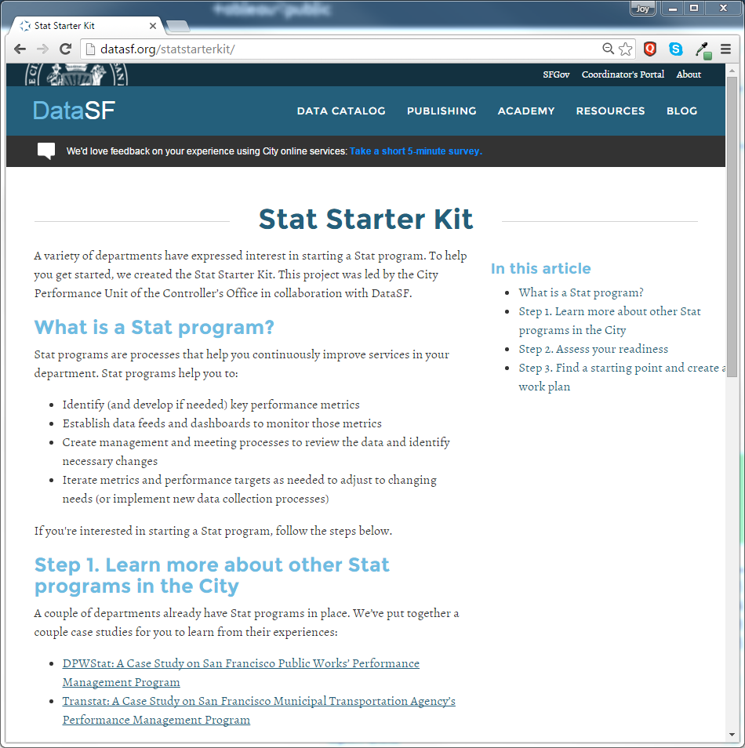
Build Department Capacity

Slide 29
Enhance Capacity with
Analytics Services
Notes:
Do some buildings or landlords exhibit unusual patterns of eviction?
What can we learn from unusual tax filing behaviors?
Can we better predict risky buildings?
Building out dashboard tools / comfort]
Show don’t tell

Slide 30


Slide 31
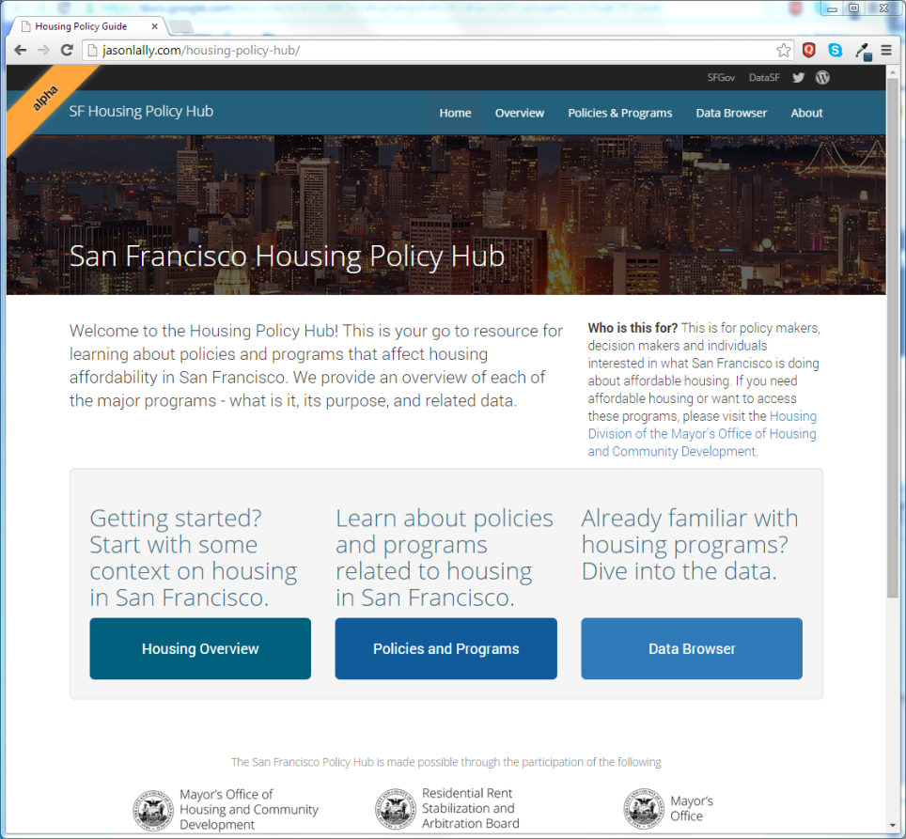
What…does the city do about affordable housing?
Where…do you go for reliable data about affordable housing?
The answers are the problem…
not sure
X and Y and Z and Q and…
Not possible!
The solution…Housing Data Hub
Single place:
Housing overview
Description of policies and programs
Supporting data & viz

Slide 32
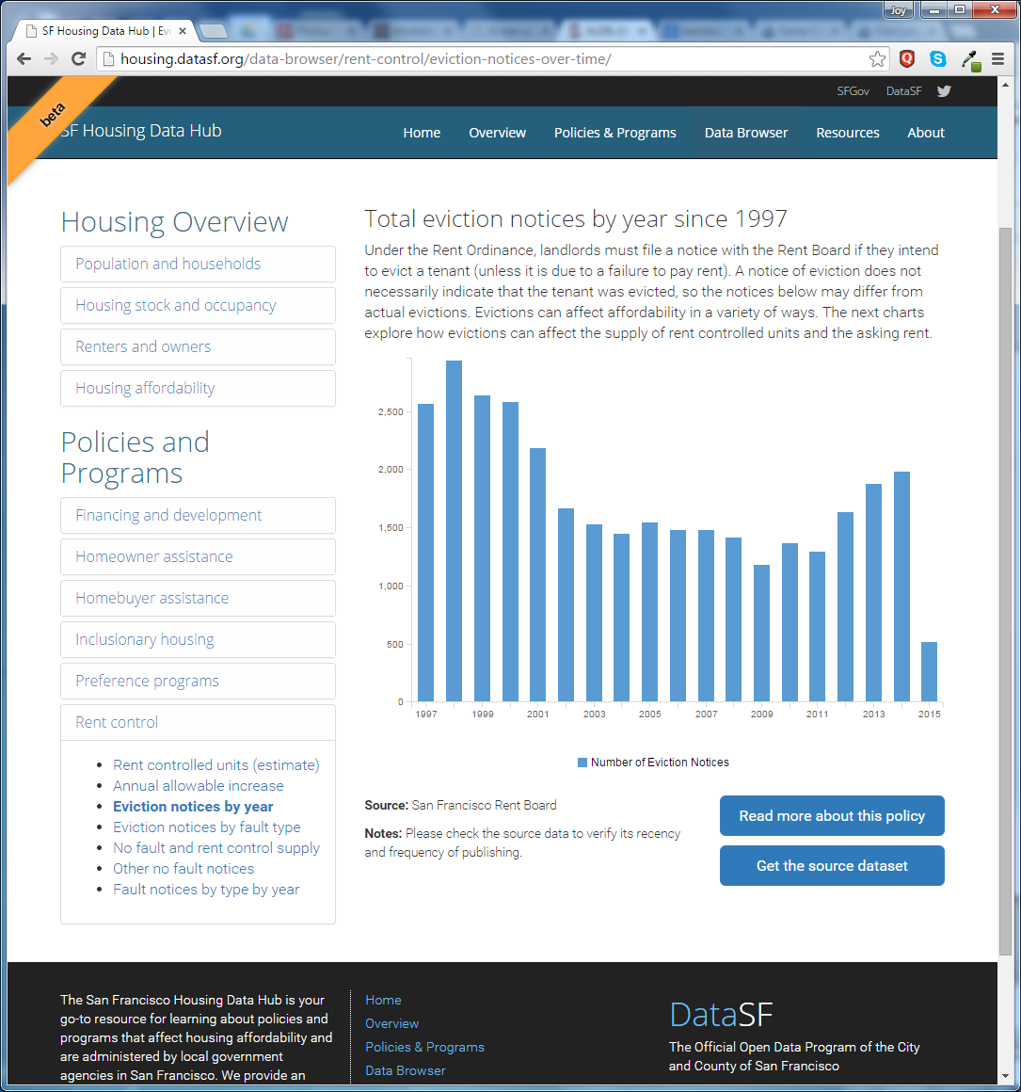
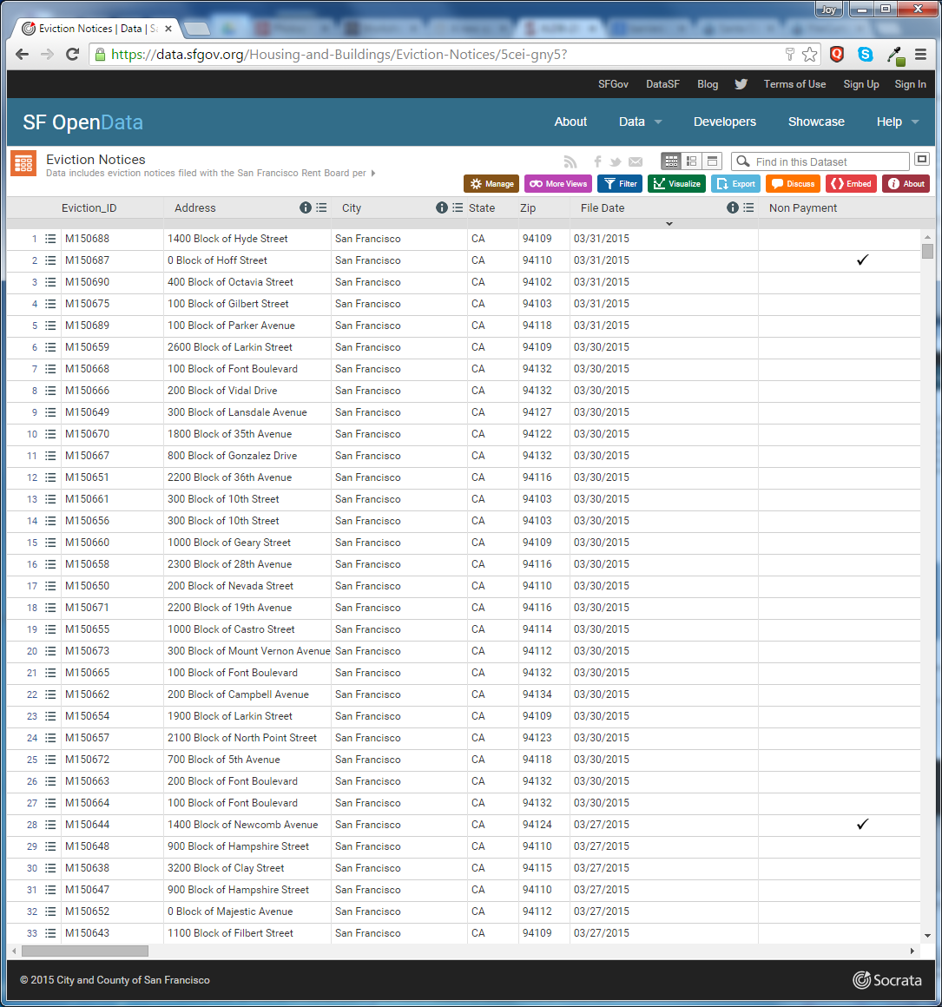
enduring sources of truth
&
unbroken data lineages

Slide 33
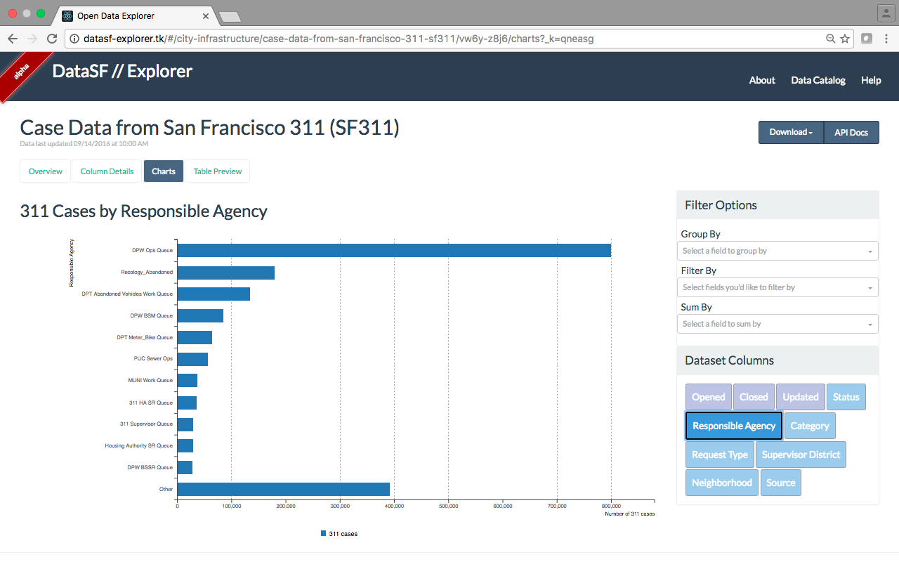
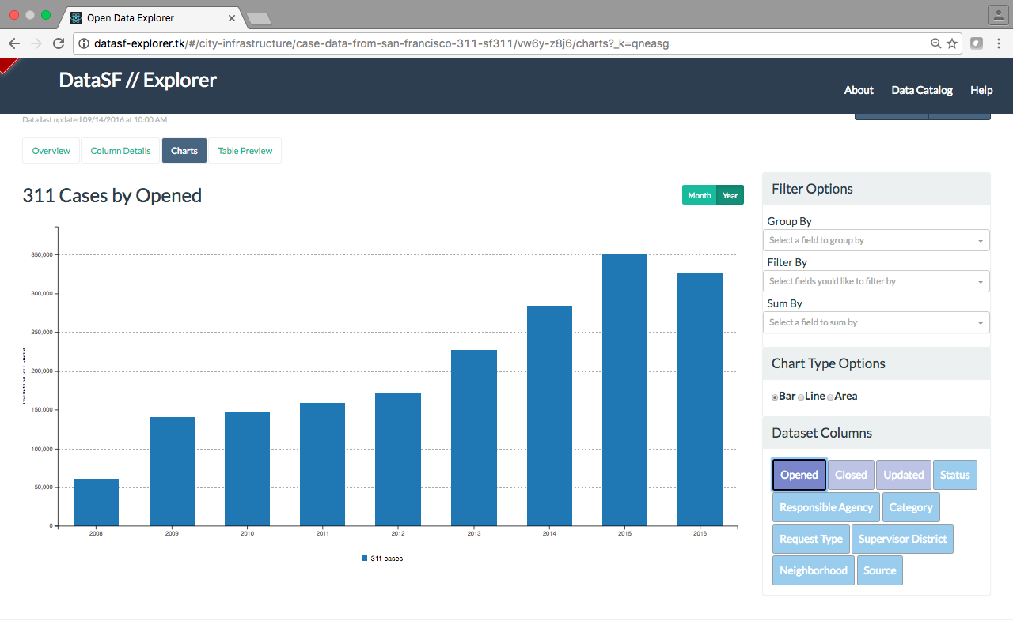

Making open data more fun, playful and accessible

Slide 34
Ultimate Goal: Use open data to add value throughout the data lifecycle
Plan & Define
Obtain
Manage
Access & Use
Dispose

Slide 35
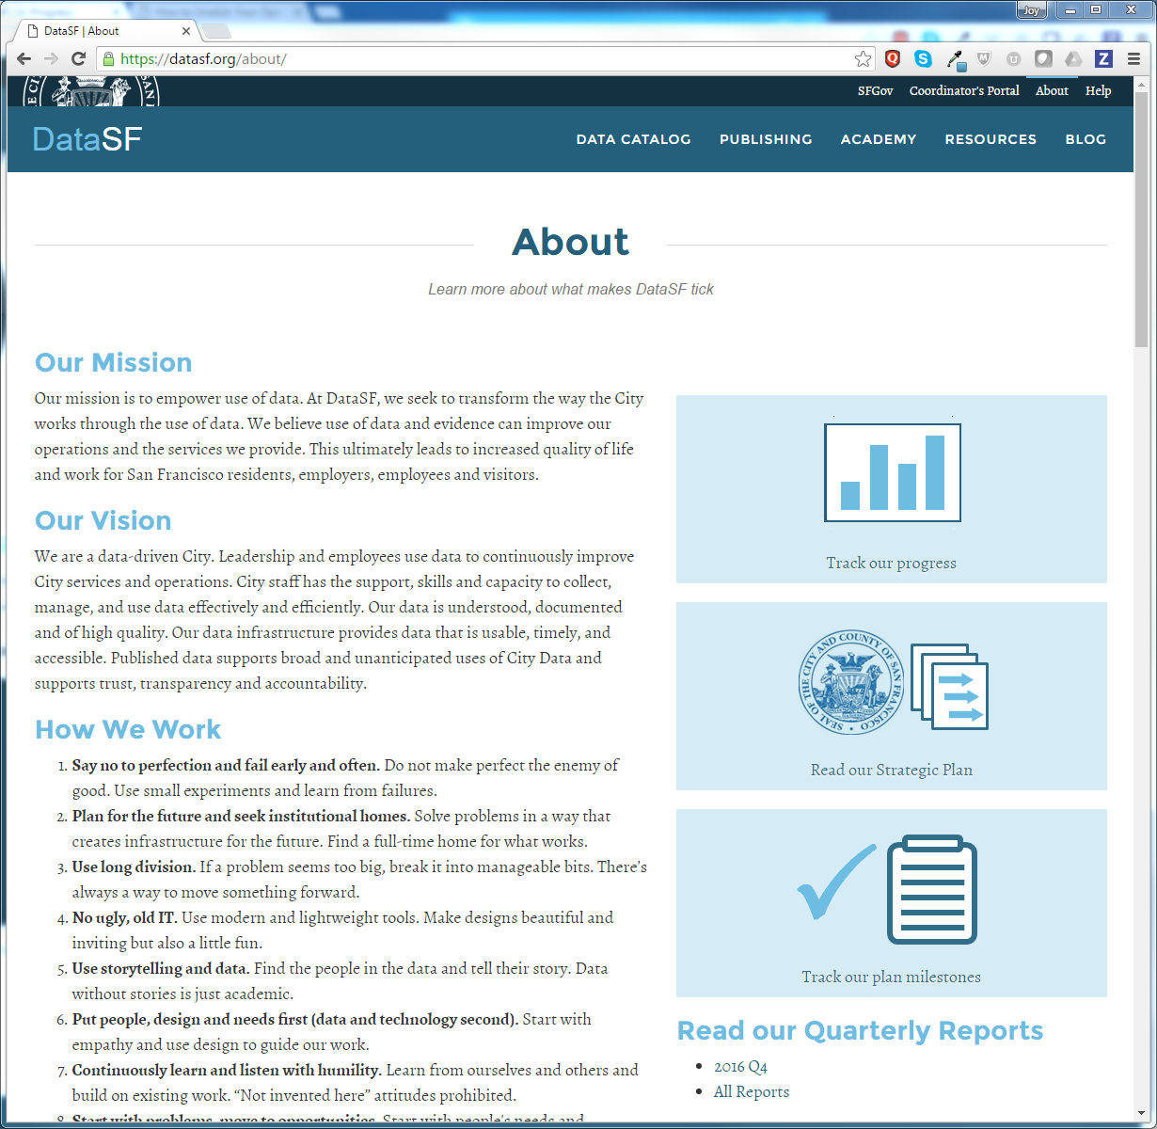


Slide 36

Thank yoU
@datasf | datasf.org |datasf.org/blog

Slide 37
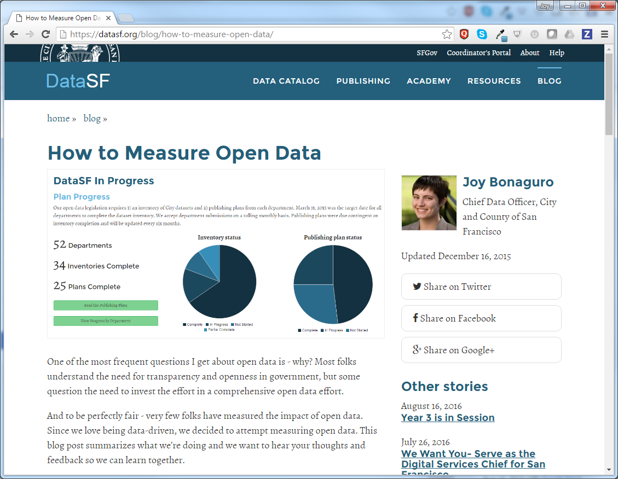

Slide 38
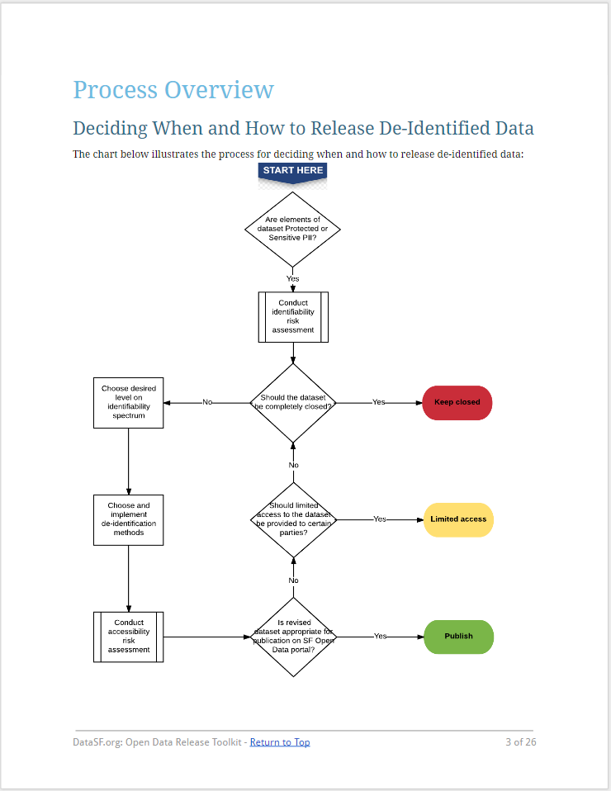
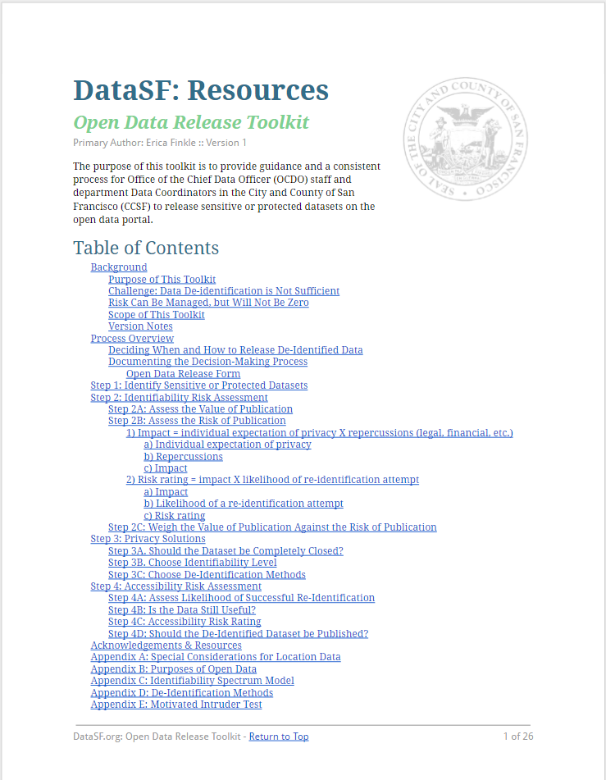
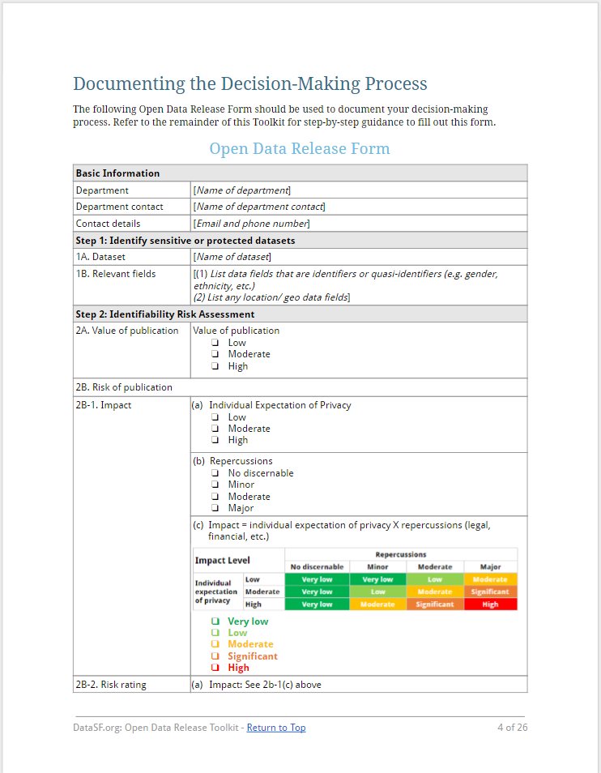
Open Data Release Toolkit

Slide 39
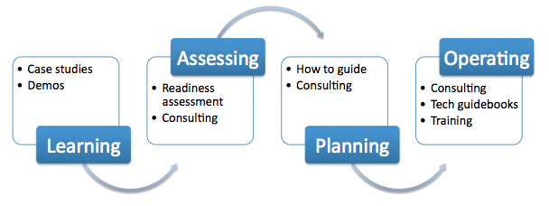
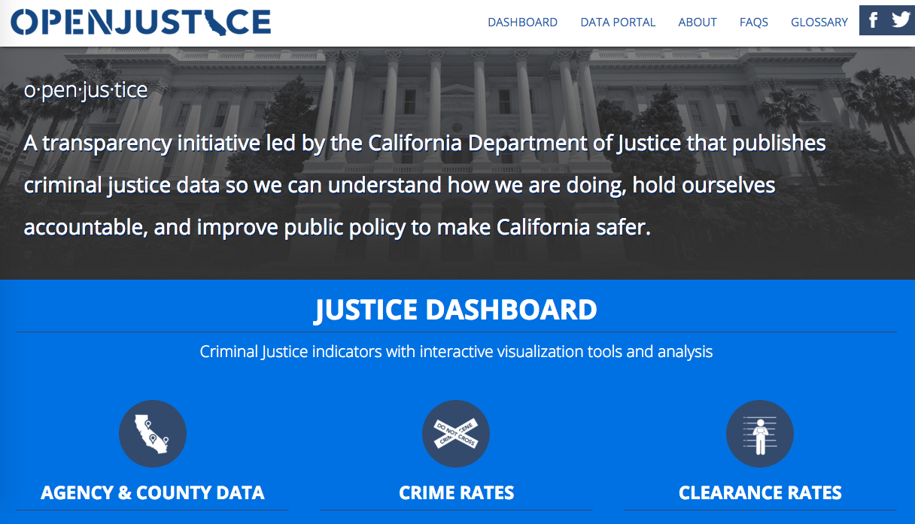
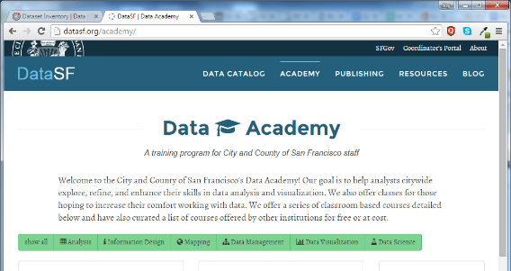
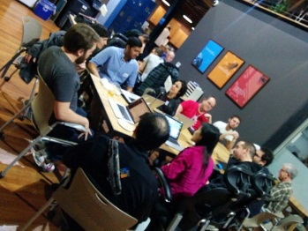
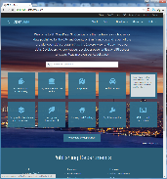

Data: the fuel for good decisions
Platforms for
Decision-Making
Analytics Services
Platforms for
Engagement
Platforms for
Raw Data
Open
Protected
Gov, Standards & Quality

Slide 40
How do you access data?

Slide 41
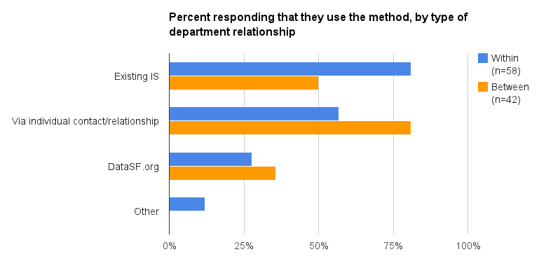

Slide 42
What are your barriers when you access data from other departments?

Slide 43
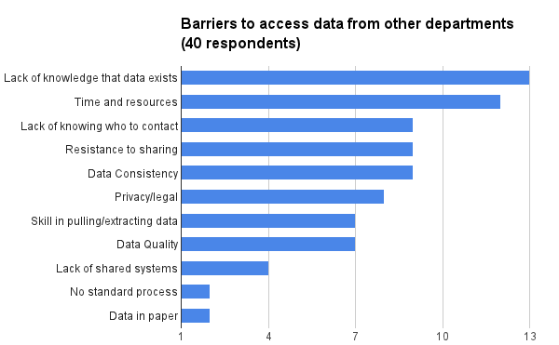

Slide 44
Demos
  http://sfcrimedata.org/
  https://adoptadrain.sfwater.org/
  https://housing.datasf.org/
  https://datasf.org/progress/ & plans
  OD release kit
  DQ guidebook
  Metadata platform
  Enduring learning materials (resource library)
  Metrics
  Inventories
  1 page strategy map

Slide 45
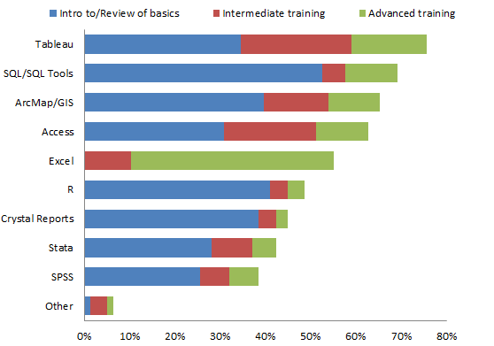
Desired training

