Slide 1
Katrina 12 years out
@denicewross
Denice W. Ross
Public Interest Tech Fellow

Slide 2
Before the
Storm
Immediate
Response
Short-term Recovery
Long-term Recovery
Resilience for Future
User-centered approach
Local credibility
Search engine optimization
Focus on federal data
Notes:
And just as the New Orleans Index has tracked progress over time.

Slide 3
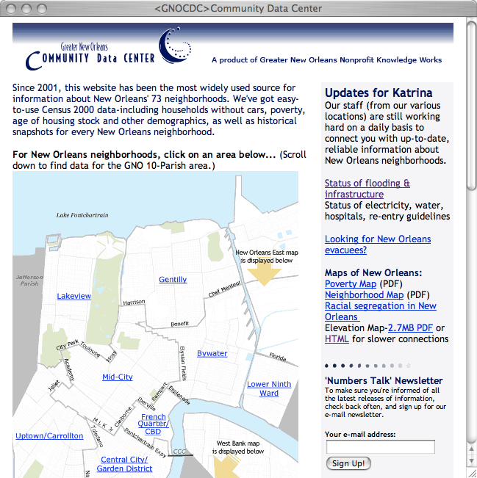

Slide 4
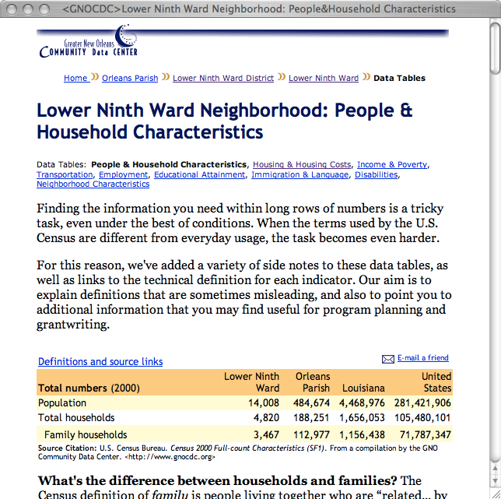
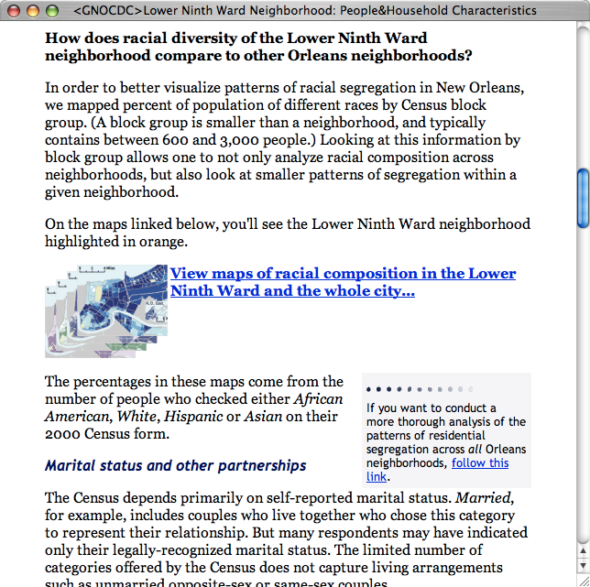
Notes:
Before the storm, we had Census 2000 data organized into New Orleans 73 official neighborhoods, and locals loved it and used it.

Slide 5
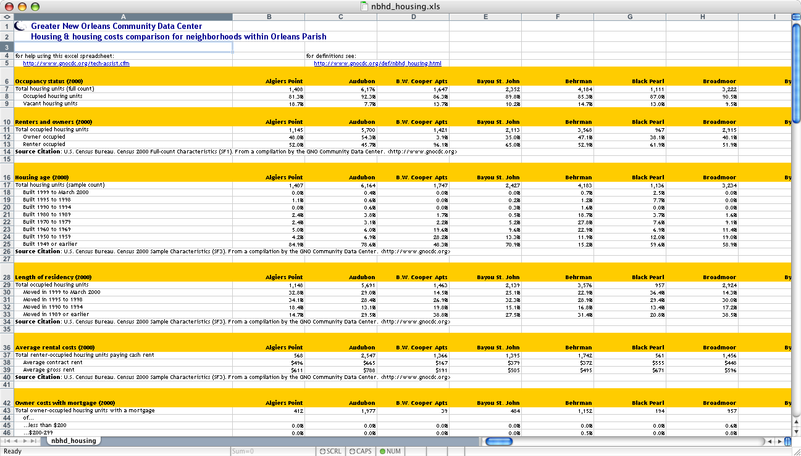
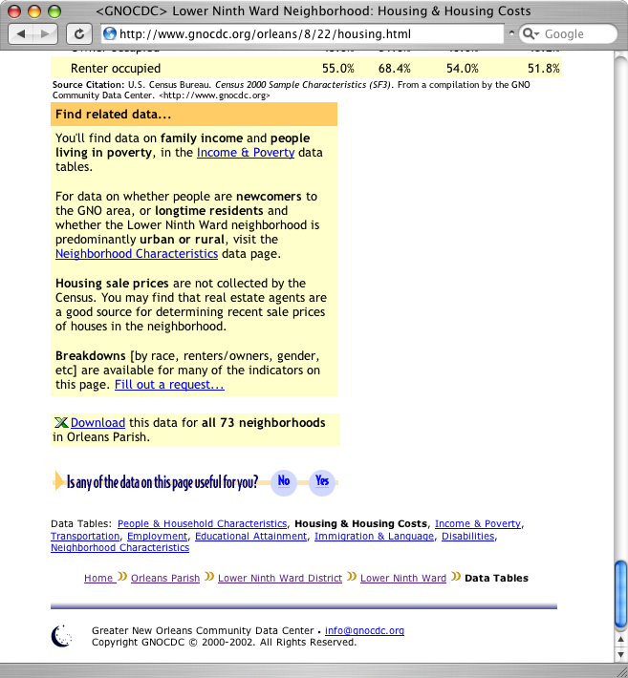
Notes:
This may look deceptively simple. But there was a great deal of rigor behind our selection of the data. We studied various data sources to determine what would be most credible and usable. And we talked to decision makers to find out what data they used for grant making and funding distribution.

Slide 6
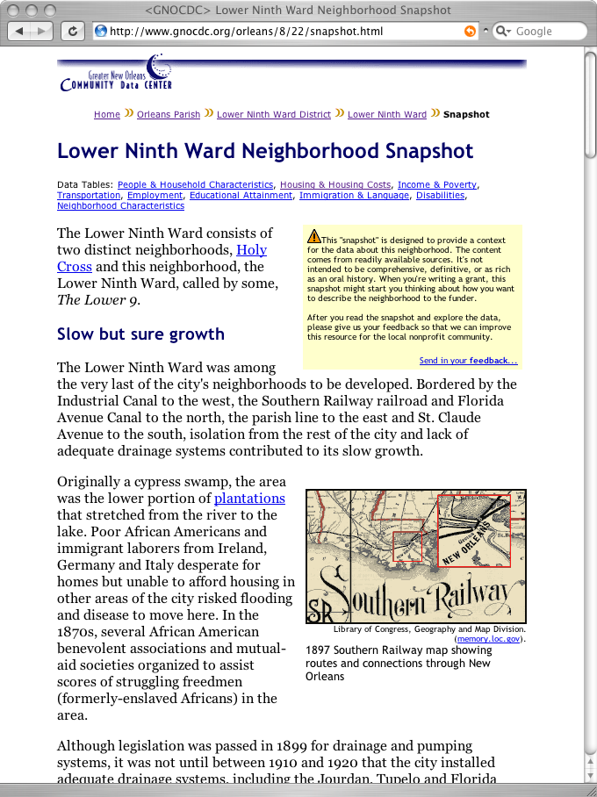
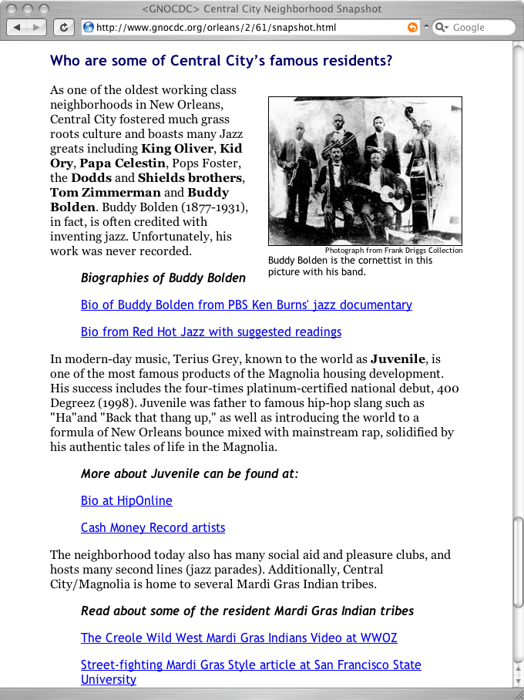
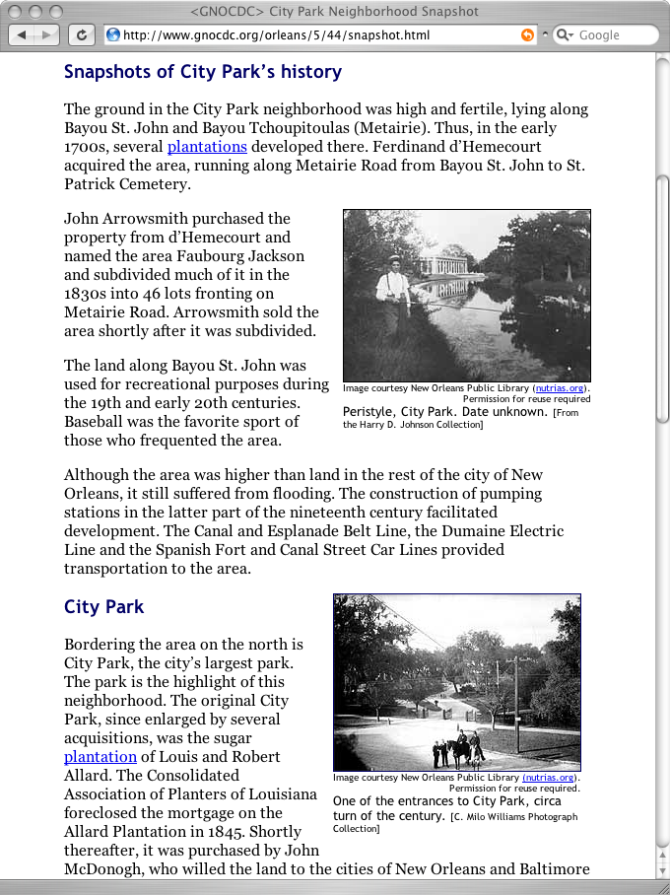
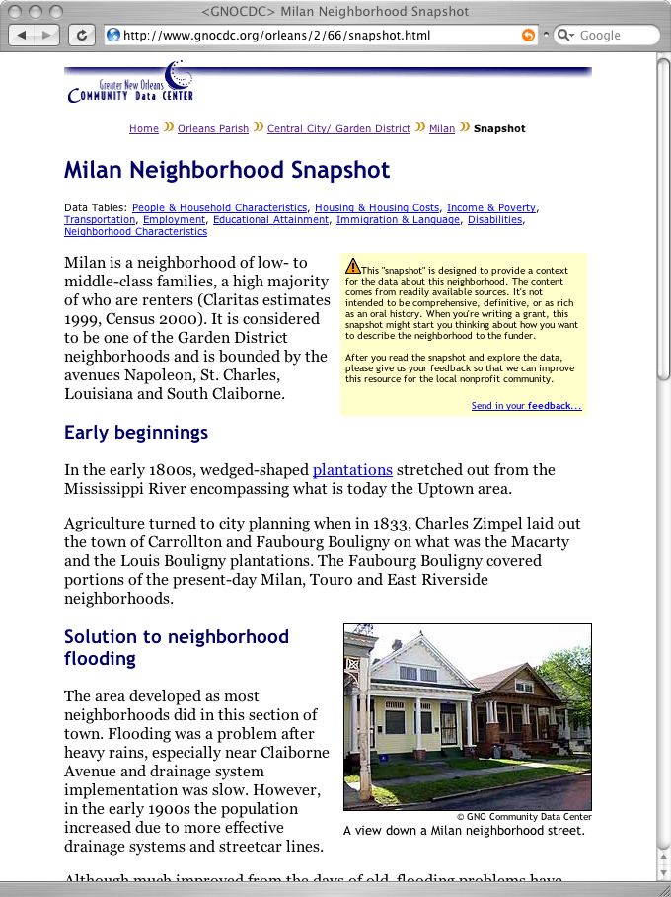
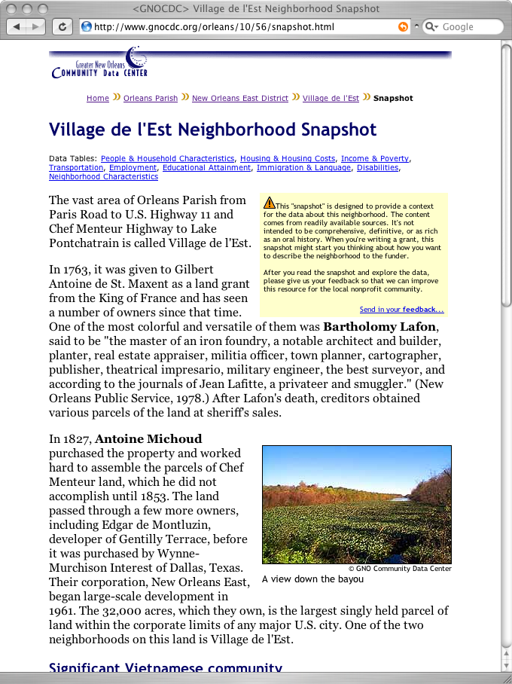

Slide 7
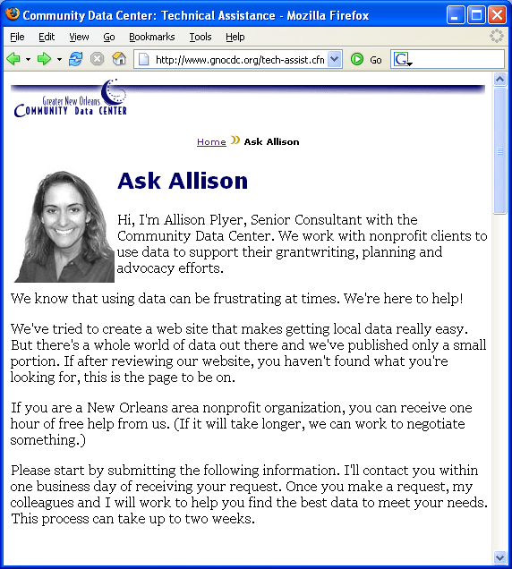

Slide 8
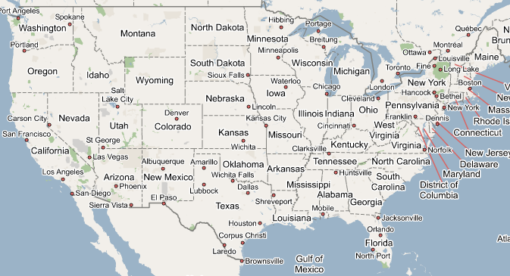

Slide 9
Before the
Storm
Immediate
Response
Short-term Recovery
Long-term Recovery
Resilience for Future
Continuity of Operations
Tech
People
Monitor emergent user needs
Bump up relevant data
Answer media requests
Notes:
And just as the New Orleans Index has tracked progress over time.

Slide 10
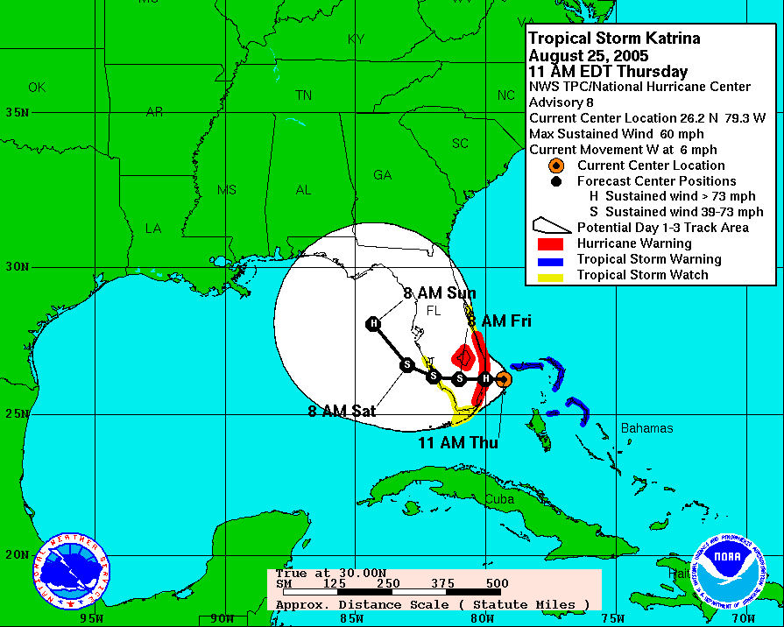
Thursday

Slide 11
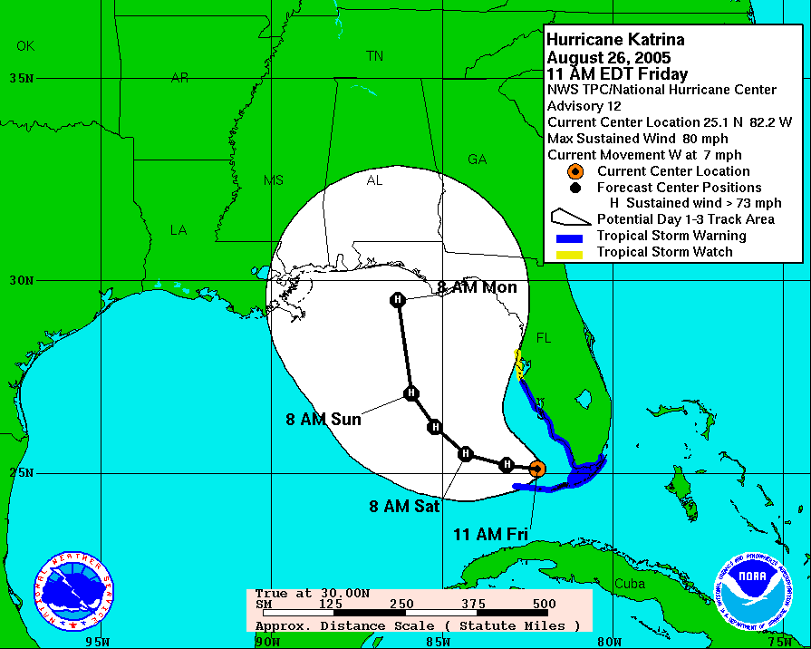
Friday

Slide 12
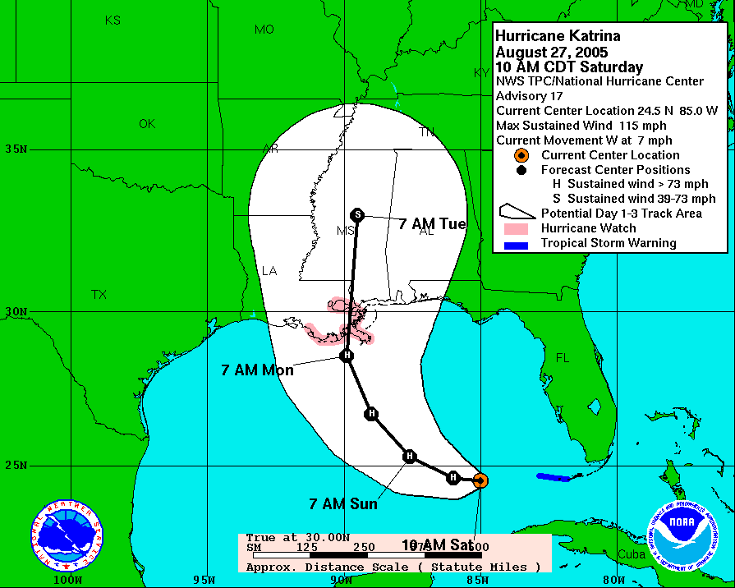
Saturday

Slide 15
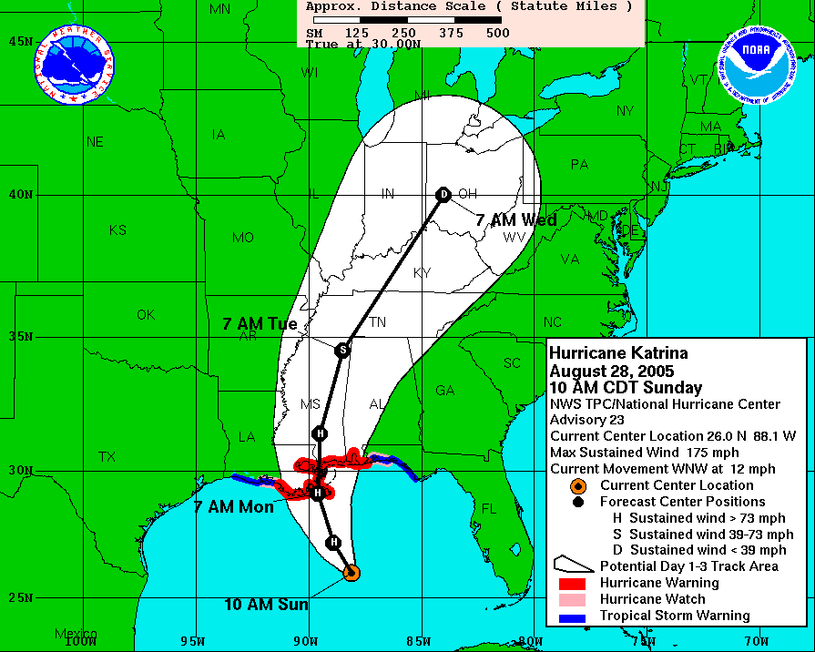
Sunday

Slide 16
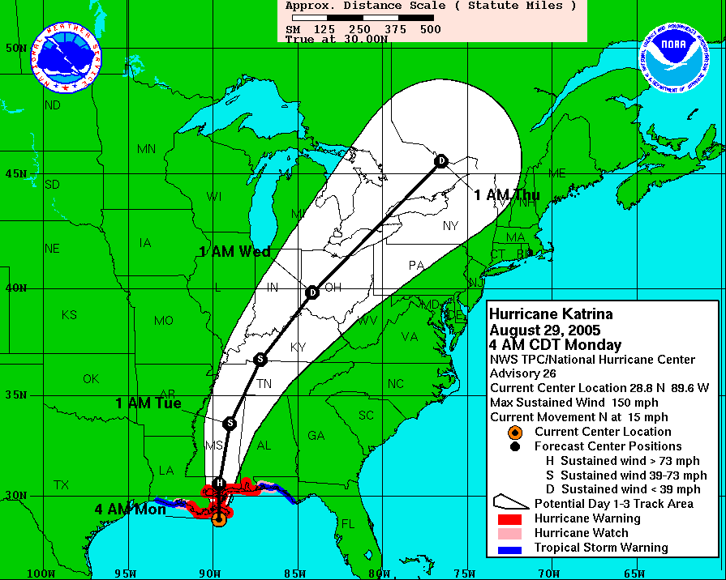
Monday
Notes:
Secured add’l bandwidth, web site tracking

Slide 17
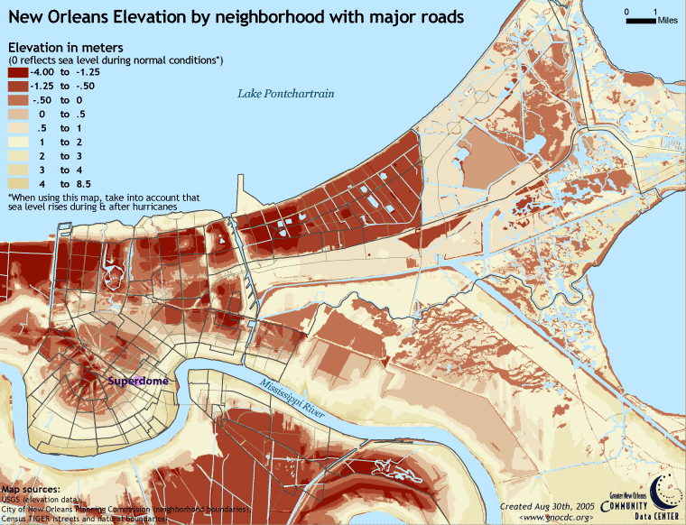

Slide 18
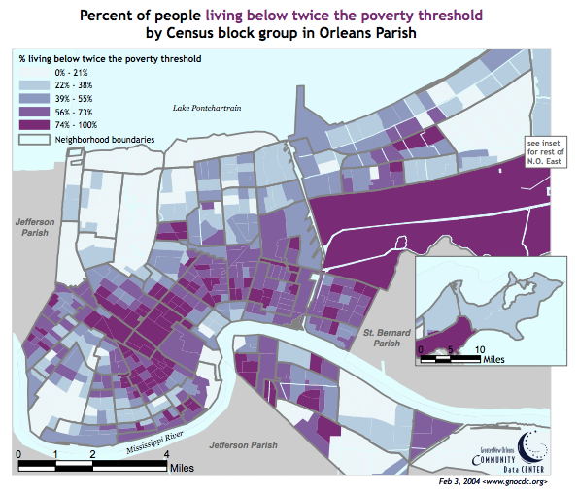

Slide 19
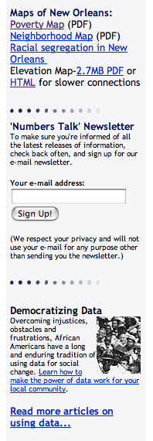

Slide 20
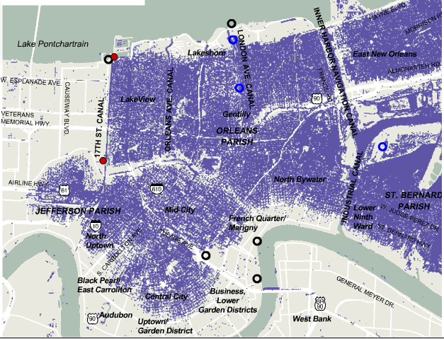
Tuesday-Friday

Slide 21
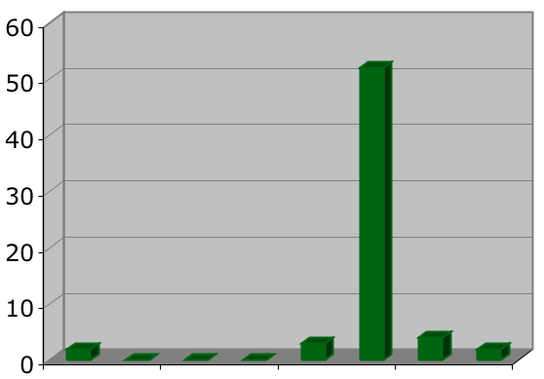
Questions coming in…
26
27
28
29
30
31
1
2

Slide 22
“I am involved in mapping and analysis for EPA. The neighborhood map you have (and all the other maps) are great.
I am trying to help build our spatial library for the response and would like to get a shapefile of the neighborhood boundaries.“

Slide 23
“Hello, folks
We're finding your Web site incredibly useful as we try to learn a lot in a short period of time about the neighborhoods in New Orleans - many, many thanks.
A very basic question: Is the 9th Ward, the Lower 9th Ward, the Old 9th Ward all the same neighborhood to the east of the Industrial Canal?
Thanks, and best,
Jessica Mintz The Wall Street Journal.”

Slide 24
“I need elevation data on Jefferson Parish - we evacuated for Katrina!!!!!!!!!!!!!!!!!
PLEASE HELP - I live in Metairie on Jeannette Dr.”

Slide 25
“Was there flooding at 4672 Painters Street in the Gentilly area? My sister is there alone and did not evacuate. It is a 3 level home, but if you know of anything please, in God's name, please email us.”

Slide 26
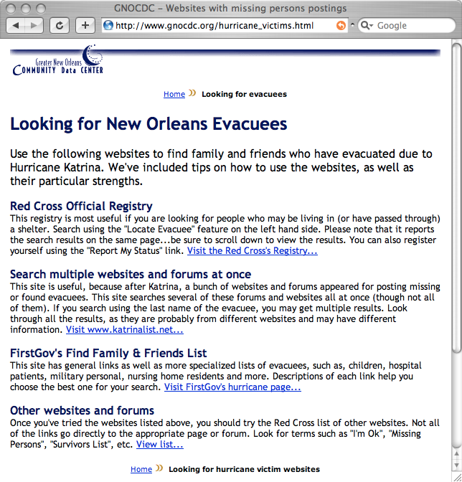
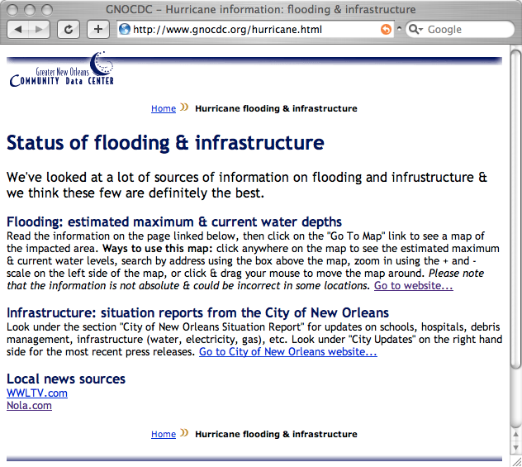
Best resources for FAQs

Slide 27
From New Orleans to the nation…

Slide 28
Daily visits to gnocdc.org Aug 22-Sep 27, 2005
Baseline: 200 visits/day
1,000 visits/day

Slide 29
2005 visits to gnocdc.org
Baseline 5,000 visits/month
40,000 visits
By 2008: 2x baseline traffic
80,000 visits

Slide 30
Notes:
And suddenly our audience and stakeholders exploded.

Slide 31
Notes:
Meanwhile, neighborhood associations, nonprofits, foundations, researchers, media, policymakers and elected officials from City Hall to the White House turned to us to help them understand the dynamics of the repopulation and rebuilding at the neighborhood level.

Slide 32
Going forward…
Define new audience
Determine their info needs
Inventory emerging data sets

Slide 33
Before the
Storm
Immediate
Response
Short-term Recovery
Long-term Recovery
Resilience for Future
Increased focus on state & local data sources
Open data advocacy
Partner with national think tanks
Sharpened our skills
Gave us a national platform
Notes:
And just as the New Orleans Index has tracked progress over time.

Slide 34
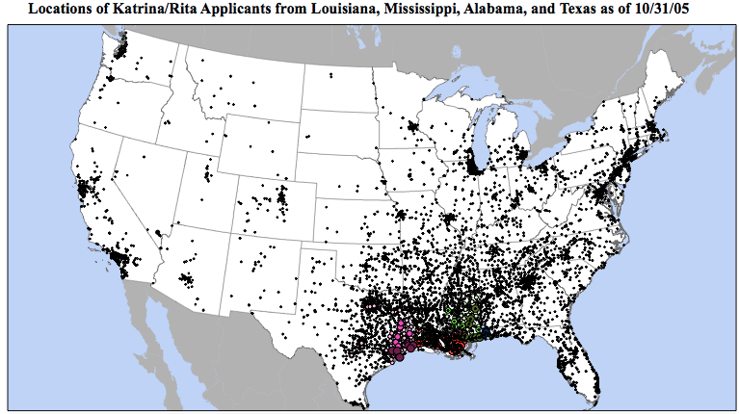
Notes:
Immediately after Katrina, New Orleanians were scattered throughout the U.S.

Slide 35
…Matt Fellowes of the Brookings Institution in Washington, which will soon begin publishing a Katrina Index on the rebuilding effort, said it had been easier gathering data for Iraq than for New Orleans.

Slide 36
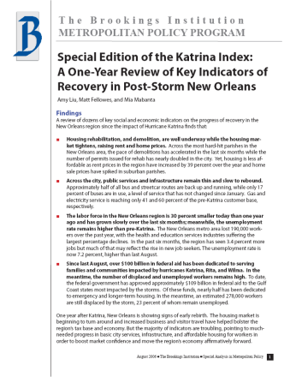
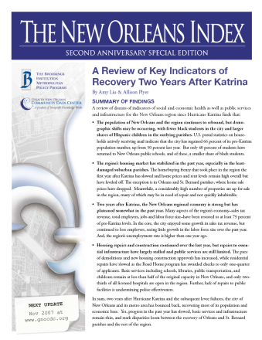
Katrina/New Orleans Index with Brookings
2006
2007
2008
2009
2010
Notes:
And just as the New Orleans Index has tracked progress over time.

Slide 38
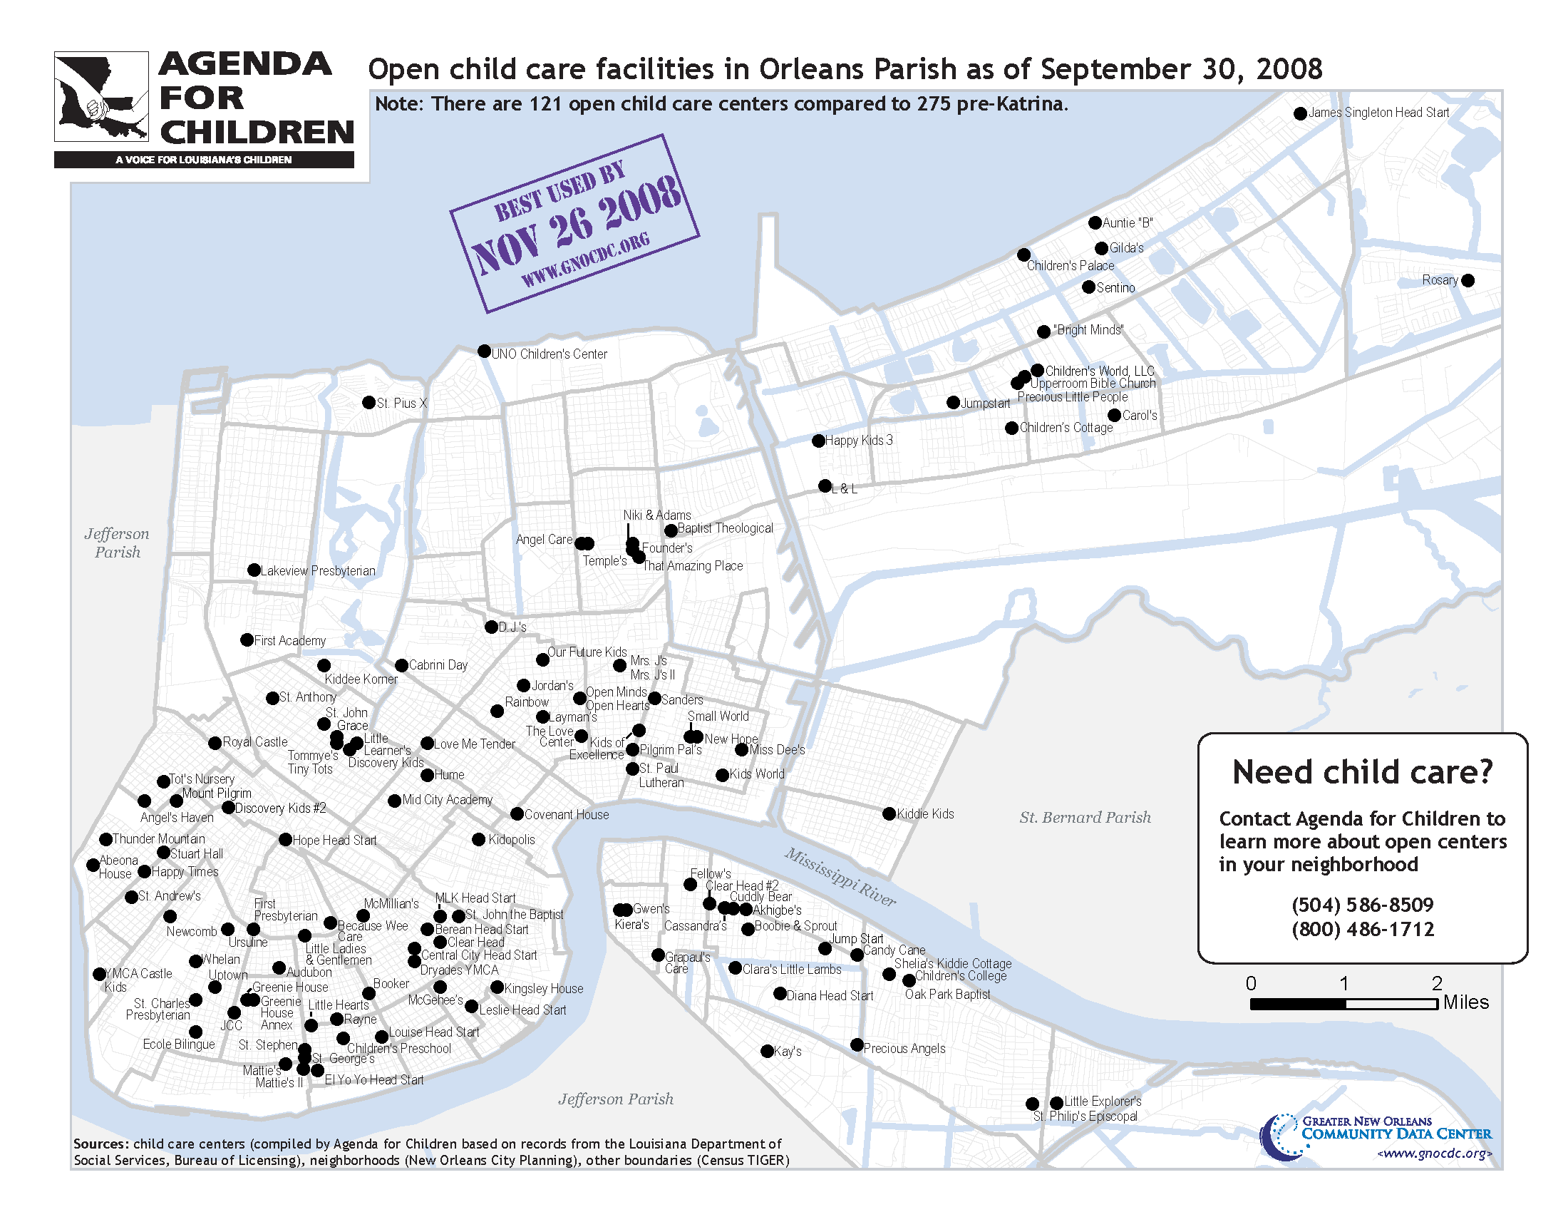

Slide 39
Before the
Storm
Immediate
Response
Short-term Recovery
Long-term Recovery
Resilience for Future
Work with more innovative data sets
Decommission data products as needed
Some staff moved to local gov
Ramp up media + social media strategy
Anniversary journalism
Notes:
And just as the New Orleans Index has tracked progress over time.

Slide 40
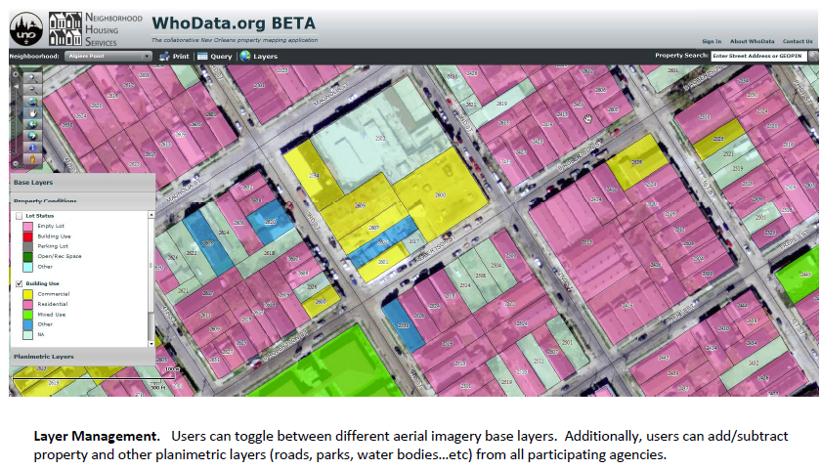
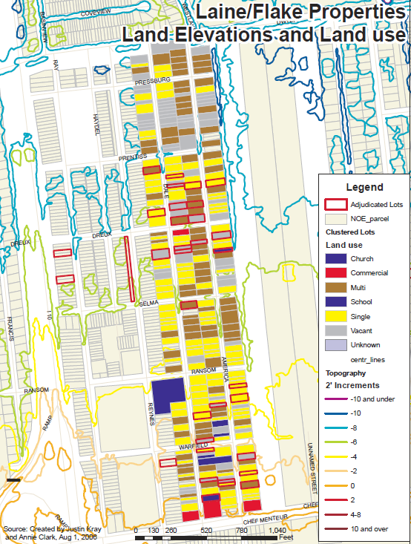
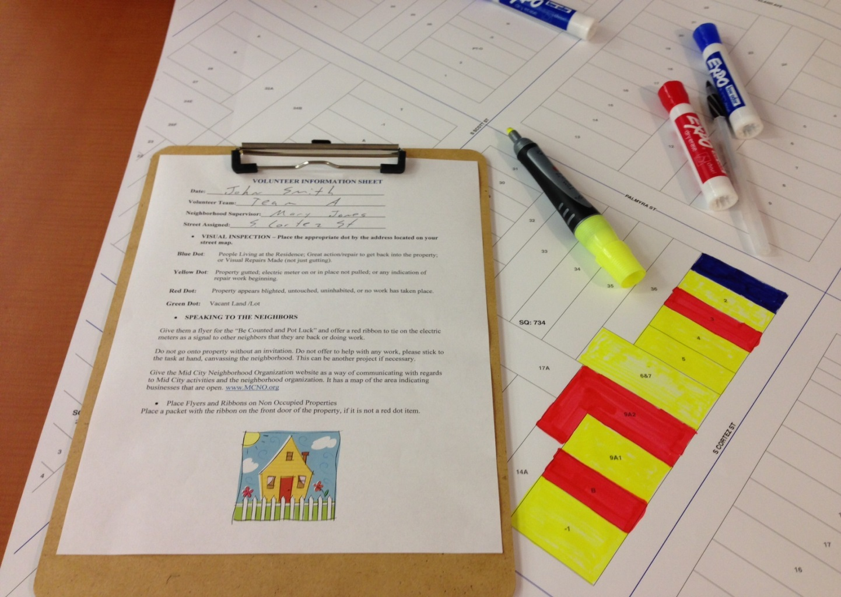
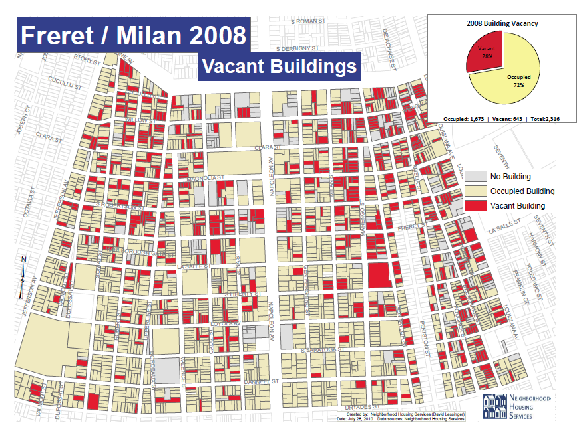

Slide 41
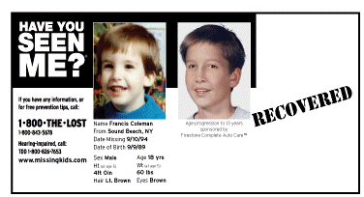
Notes:
As part of our mission to democratize information, we also take the data we’ve developed and make it easy for neighborhood groups and small nonprofits to visualize and use. Here is a screen shot of our repopulation mapper, zoomed in to show blocks in the Village de L’Est neighborhood in New Orleans East. The dark areas represent higher density of active households. Note the darkest block in the middle has 92 active households, compared to around 50 in the surrounding blocks. Why the density?

Slide 42
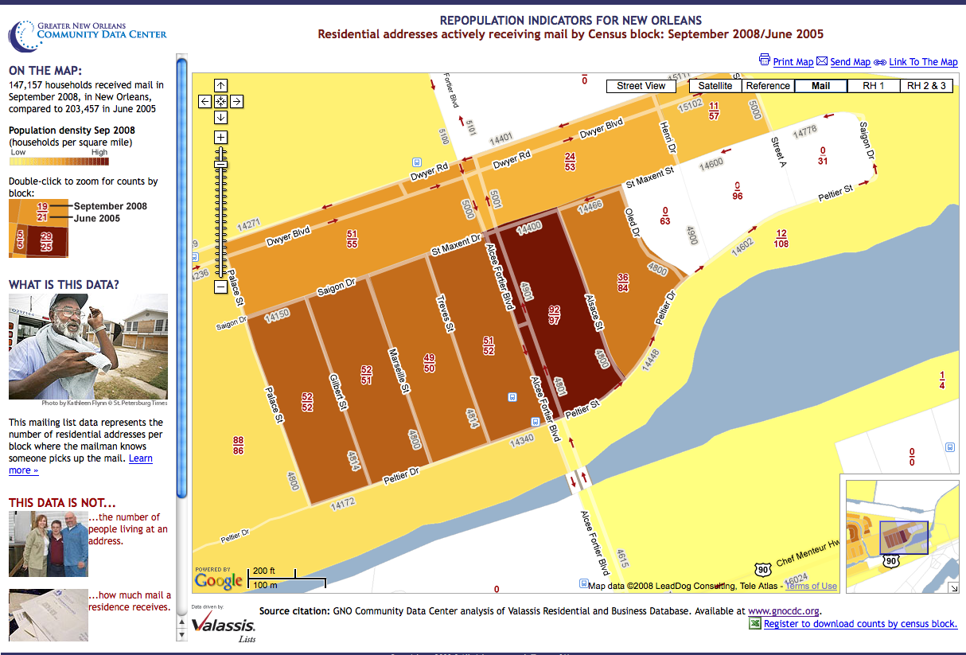
Notes:
As part of our mission to democratize information, we also take the data we’ve developed and make it easy for neighborhood groups and small nonprofits to visualize and use. Here is a screen shot of our repopulation mapper, zoomed in to show blocks in the Village de L’Est neighborhood in New Orleans East. The dark areas represent higher density of active households. Note the darkest block in the middle has 92 active households, compared to around 50 in the surrounding blocks. Why the density?

Slide 43
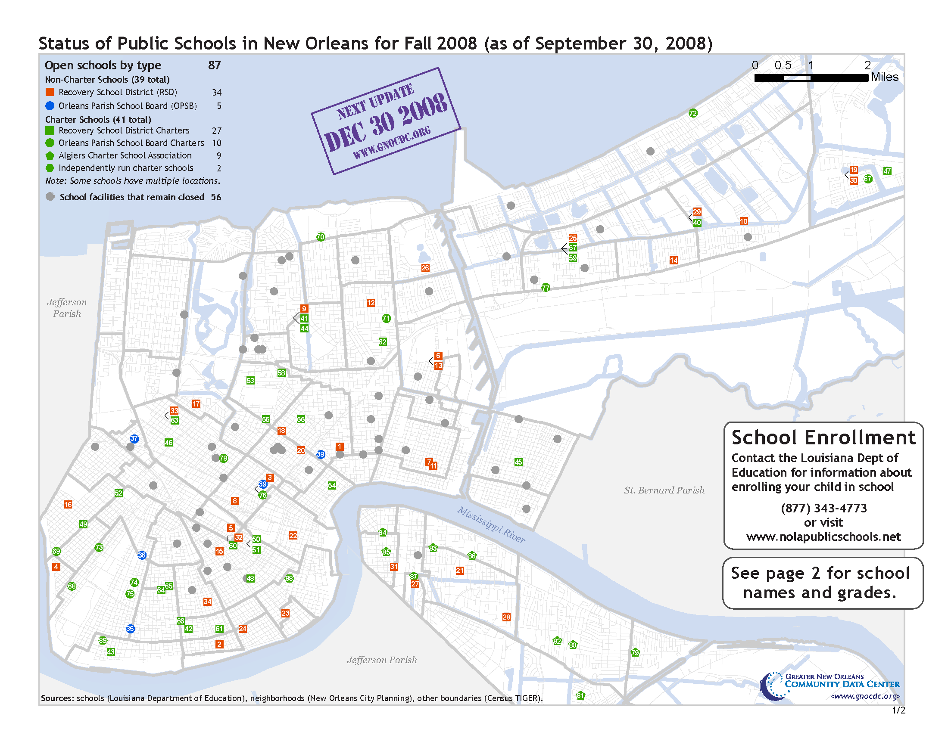
Notes:
What we know is that right now the market looks at the maps we publish of transporation, schools,

Slide 44
>
PDFs
Printed reports
Blog posts
Social Media
Notes:
As part of our mission to democratize information, we also take the data we’ve developed and make it easy for neighborhood groups and small nonprofits to visualize and use. Here is a screen shot of our repopulation mapper, zoomed in to show blocks in the Village de L’Est neighborhood in New Orleans East. The dark areas represent higher density of active households. Note the darkest block in the middle has 92 active households, compared to around 50 in the surrounding blocks. Why the density?

Slide 45
Before the
Storm
Immediate
Response
Short-term Recovery
Long-term Recovery
Resilience for Future
Keep user-centered design, traditional media engagement, local credibility, and add…
More savvy use of social media
Focus on new data frontiers – IoT, digital inclusion, citizen science/crowdsourcing
Address the hard issues head-on
Notes:
And just as the New Orleans Index has tracked progress over time.

