Slide 1
About IMLS

Slide 2
About IMLS
Who are we?
The Institute of Museum and Library Services is the primary source of federal support for the nation's libraries and museums.
What do we do?
We advance, support, and empower America’s museums, libraries, and related organizations through grantmaking, research, and policy development.

Slide 3
Strategic Goals
Access. IMLS invests in strategic opportunities that sustain and increase access to information and ideas.
Learning. IMLS supports lifelong learning through museums and libraries, preparing people to become active participants in their communities.
Community. IMLS strengthens the capacity of museums and libraries to support and transform communities.
Excellence. IMLS advises the President and Congress on plans, policies, and activities that sustain and increase public access to information and ideas.
Notes:
Could split these out and add photos, but the information is here.
Access: How do we do it?
1. Supporting the stewardship of the nation’s collections that represent local and national significance
2. Investing in technology, tools, and training to increase the variety of people who find, access and use museum and library collections resources
3. Creating community narratives and identifying relevant societal and sector trends to inform decision-making
4. Fostering a supportive policy environment and advising Federal leadership to promote museums and libraries as essential resources for society
Learning: How we do it?
1. Enhancing the use of sector's resources to improve literacy in all its forms including early, digital, information, health and wellness, financial, media, and civic
2. Advancing evidence-based and innovative uses of cross-disciplinary, inquiry-based-learning
3. Leveraging the potential of museums and libraries as distinctive, trusted spaces for community and family learning
4. Strengthening continuous learning opportunities and technologies tailored to adults of varying needs and interests including caregivers, veterans, the displaced, and those re-entering the workforce
Community: How we do it?
1. Promoting the adoption of best practices by sharing successes and encouraging innovation for both practitioners and their organizations
2. Supporting recruitment, education, and retention of staff, boards, and volunteers to build resilient and diverse organizations
3. Weaving robust cross-sector networks through partnerships and collaborations to improve and sustain community wellbeing
4. Collecting data and developing data resources to help the sector identify and respond to community needs (especially those individuals making transitions, the underserved, the newly arrived, and the entrepreneurs)
Excellence: How we do it?
1. Attracting, developing, and maintaining an effective and diverse IMLS workforce
2. Maintaining a balanced and adaptable funding portfolio that allows for new ideas and invests in proven approaches for our sector 3. Using Agency resources to leverage community investments in combination with grantees’ institutional, knowledge-based, and goodwill assets 4. Working with other government and private sector collaborators to drive the narrative about the public value of museums and libraries 5. Effectively communicating Agency knowledge about trends across the field, grantee accomplishments, and assessments of Agency performance

Slide 4
IMLS Authorization & Funding
IMLS was authorized in 1996 by the Museum and Library Services Act, which includes:
Library Services and Technology Act
Museum Services Act
African American History and Culture Act
Notes:
IMLS also administers the African American History and Culture Grant through the African American History and Culture Act (AAHCA) funding.

Slide 5
189M: Library Services and Technology Act
32.5M: Museum Services Act
24.7M: African American History and Culture Act
2M: Museum and Library Services Act
FY 2018 = $240M
Notes:
189M: Library Services and Technology Act
32.5M: Museum Services Act
24.7M: African American History and Culture Act
2M: Museum and Library Services Act
= $240M

Slide 6
Grant Eligibility
Eligible: not-for-profit libraries and museums located in the United States, its territories and freely associated states.
Not eligible: federally funded institutions, for-profit organizations, individuals, and foreign countries and organizations.
International institutions: encouraged to apply through a partnership with an eligible U.S. institution.

Slide 7
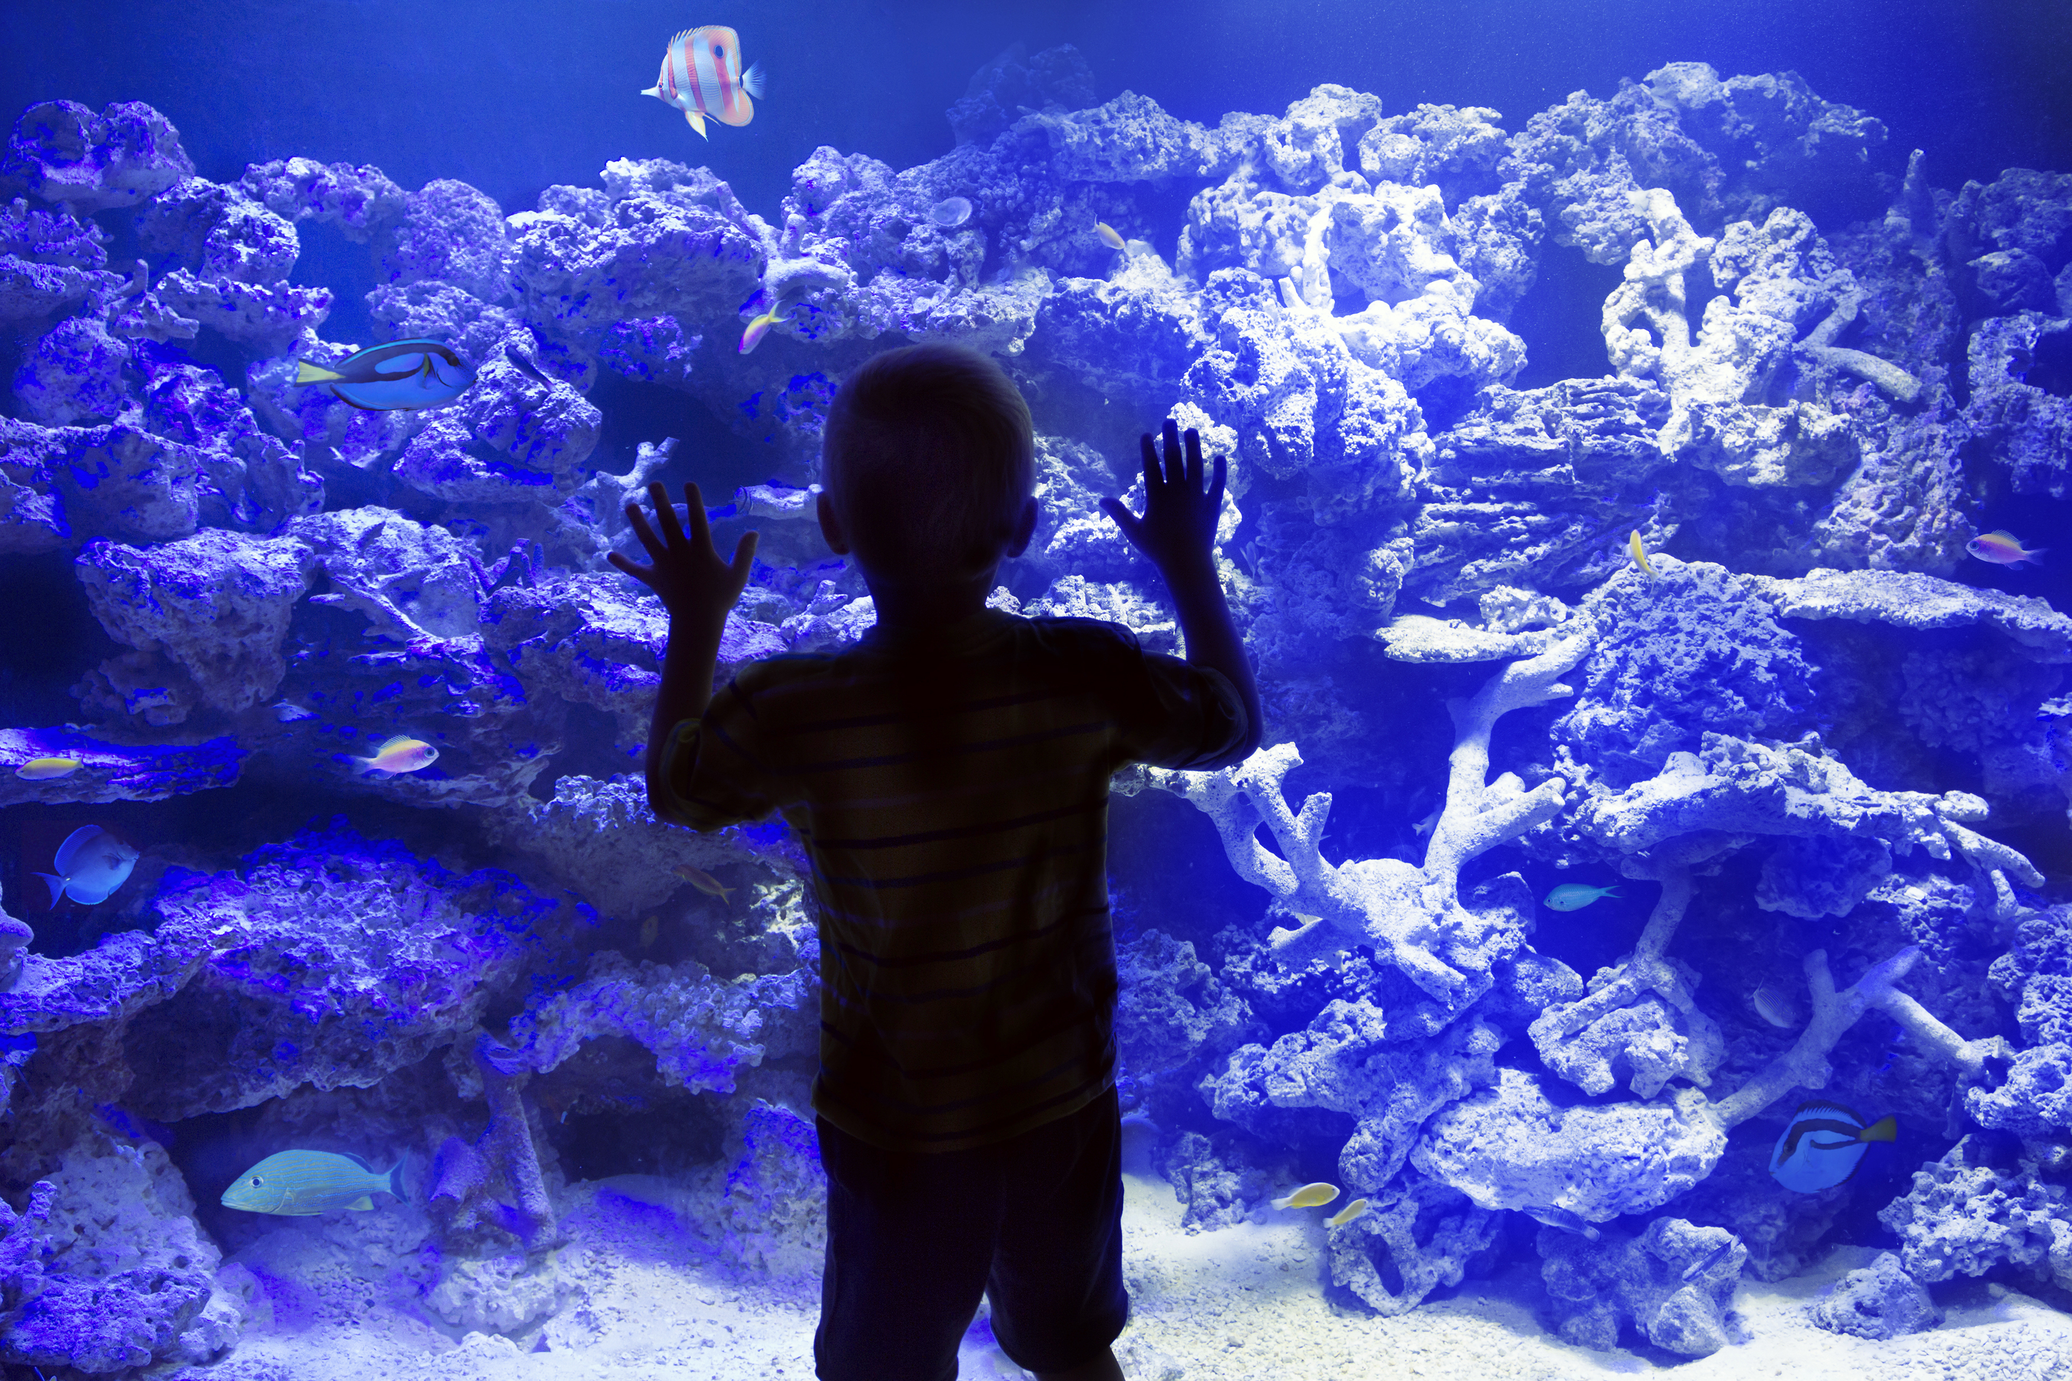
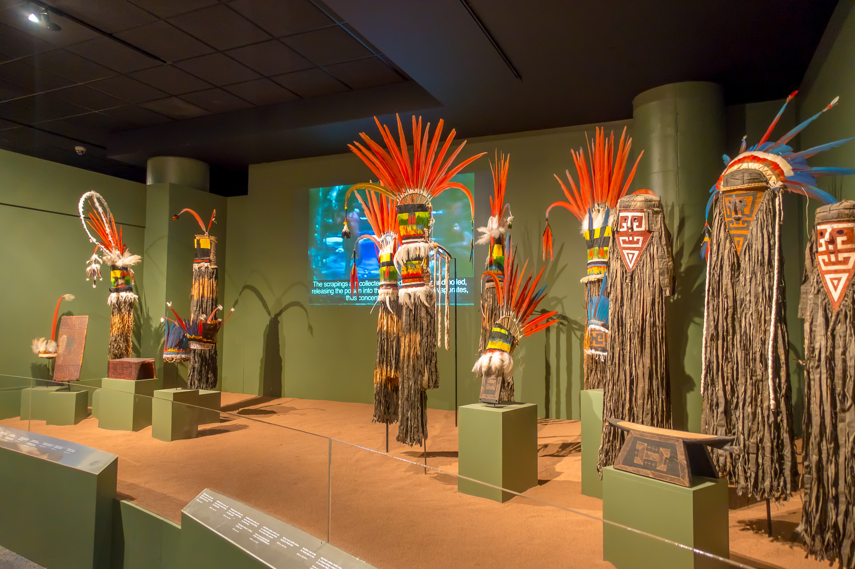
Museums
Art
History
Science
Youth
Aquariums
Planetariums
Arboretums
Zoos
Botanical Gardens
Notes:
Libraries and museums are IMLS’s key stakeholders

Slide 8
Libraries
Public
Academic
School
Research
Archives

Slide 9
Successful Grants
National impact: Your proposal should address key needs, high priority gaps, and challenges that face libraries or archives.
Current significance: Your proposal should appropriately address a critical emergent issue facing libraries and archives.
Strategic collaborations: Your proposal should involve key stakeholders and partners necessary to ensure it can succeed and have broad impact from a variety of domains and sectors.
Demonstrated expertise: Your proposal should articulate a thorough understanding of current theory and practice.

Slide 10
IMLS Activities
Grant Programs
Research, Statistics, and Publications
National Initiatives and Partnerships
Policymaking and Convening

Slide 11
Grants to States
Every year, each State Library Administrative Agency receives a population-based formula grant
The grant is distributed in accordance with each state’s approved five-year plan
States are required to evaluate success in meeting the goals of their five-year plans

Slide 12
Nationally Competitive Library Programs
Laura Bush 21st Century Librarian Program
National Leadership Grants for Libraries
Native American and Native Hawaiian Library Services
Notes:
The IMLS discretionary library programs include several grant programs to strengthen the education of library professionals, to support model projects with potentially broad impact for libraries, to test innovative practices, and to expand services for underserved American Indian and Native Hawaiian communities. The National Leadership, Sparks, and the Laura Bush 21st Century Librarian grants are highly competitive grants programs with a peer review process.

Slide 13
Discretionary Grant Funding Categories
Planning Grant
National Forum Grant
Project Grant
Research Grant

Slide 14
Discretionary Grant Example
University of Georgia Research Foundation, Inc.
Award: $49,839.00
Program: National Leadership Grants for Libraries
The University of Georgia Alexander Campbell King Law Library, in partnership with the UGA Terry College of Business Department of Management Information Systems (MIS) and Georgia School of Law, will plan and prototype an open-source open government digital transparency platform. This platform will provide data access and visualization of the U.S. legislative process. For this prototype phase, the project will focused on the passage of the Jumpstart Our Business Startups Act of 2012 (JOBS Act). This interactive, informative tool will aid citizens in becoming more engaged, allowing them to form their opinions in a quick, fact-based, and safe online environment. By combining text analysis, network analysis, and visualization the project will provide insights into how libraries can take on new roles supporting access to government and legislative information and data.

Slide 15
Discretionary Grant Example
Kent State University
Award: $458,319.00
Program: National Leadership Grants for Libraries
Kent State University's KNEXT project will bring advanced data analytics and business intelligence (DA&BI) services to public libraries in order to support small businesses, entrepreneurs, and community advocates. This project will further develop a coalition of academic, public libraries, small business development centers, small businesses, and community advocates by identifying sources of useful data (national, state, county); consolidating data in a repository for long-term access and delivery; and creating a platform and dashboard for libraries to provide DA&BI services to the community using machine learning, data mining, web mining, and text analytics.

Slide 16
Discretionary Grant Example
University of North Texas
Award: $87,000.00
Program: National Leadership Grants for Libraries
The University of North Texas, in collaboration with the University of North Carolina at Greensboro, the University of California at Santa Barbara, the University of Missouri, the University of Pennsylvania, Stanford University, Yale University, the Center for Research Libraries (CRL), the Educopia Institute, and the Scholarly Publishing and Academic Resources Coalition (SPARC) will hold national forums in 2018 to address national concerns regarding the preservation of electronic government information (PEGI) by cultural memory organizations for long term access by citizens of the United States. By convening a series of expert groups and key stakeholders the project will identify and surface a broadly shared national consensus and agenda on specific future steps needed to preserve and provide long term access to electronic government information in the United States.

Slide 17
Ongoing Initiatives
Future of national digital capacity building
Strengthening early childhood-family learning
Deepening STEM learning through the engagement of experts
Technical assistance to help build capacity among small and medium-sized museums
Building networks to efficiently impact the museum field

Slide 18
Exploratory Projects
Open Educational Resources (OER)
Digital inclusion – broadband access
Reflecting the changing demographics of America’s communities
Research and modeling activities
Professional development for museum and library staff

Slide 19
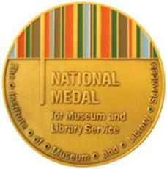
National Medal
The National Medal for Museum and Library Service is the nation’s top honor for institutions that make outstanding institutions contributions to their communities

Slide 20
Connect With Us
www.imls.gov
www.facebook.com/USIMLS
Twitter: @US_IMLS
www.youtube.com/USIMLS
www.imls.gov/rss.xml
Notes:
You can check out our blog and sign up for our monthly e-newsletter, Primary Source.

Slide 21
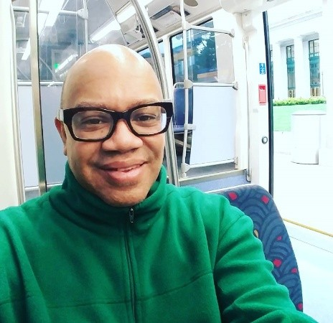
Thank you!
James Neal
@james3neal
jneal@imls.gov
Notes:
Optional contact information

Slide 22
Photo Credits
All images are Shutterstock

Slide 23
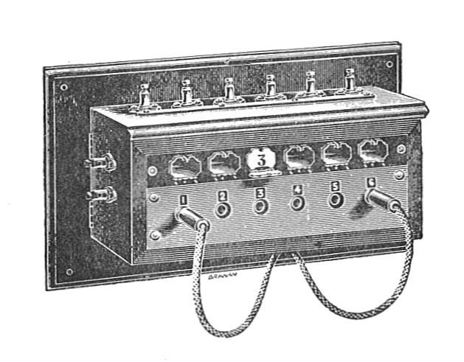
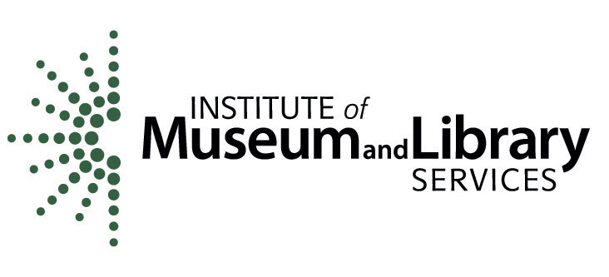
Civic Switchboard Developing Public and Academic Libraries as Key Participants in Civic Open Data Ecosystems LG-70-17-0146-17

Slide 24
Context - What are libraries doing now?
Turning to
what’s local
the full lifecycle of information production, use, and management
data
enabling social connections within communities and across disciplines
The mission of librarians is to improve society through facilitating knowledge creation in their communities
- R. David Lankes

Slide 25
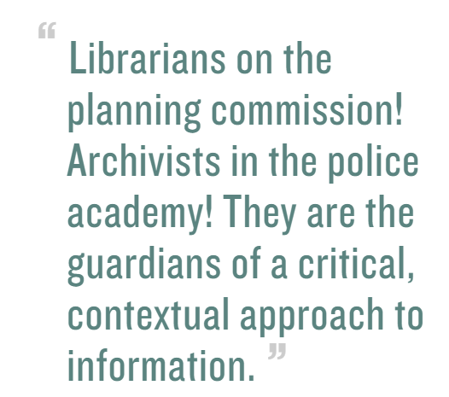
Mattern, S. (2016). Public In/Formation.
Places Journal. https://doi.org/10.22269/161115

Slide 26
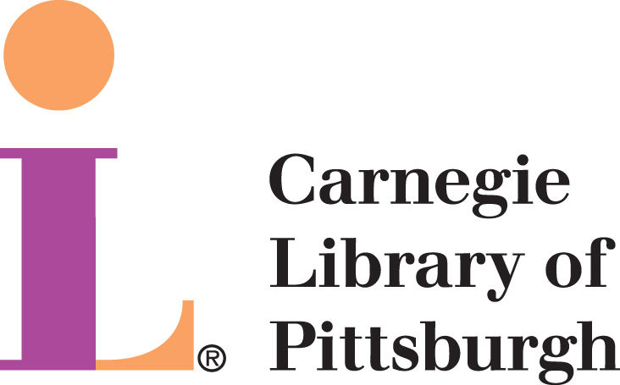
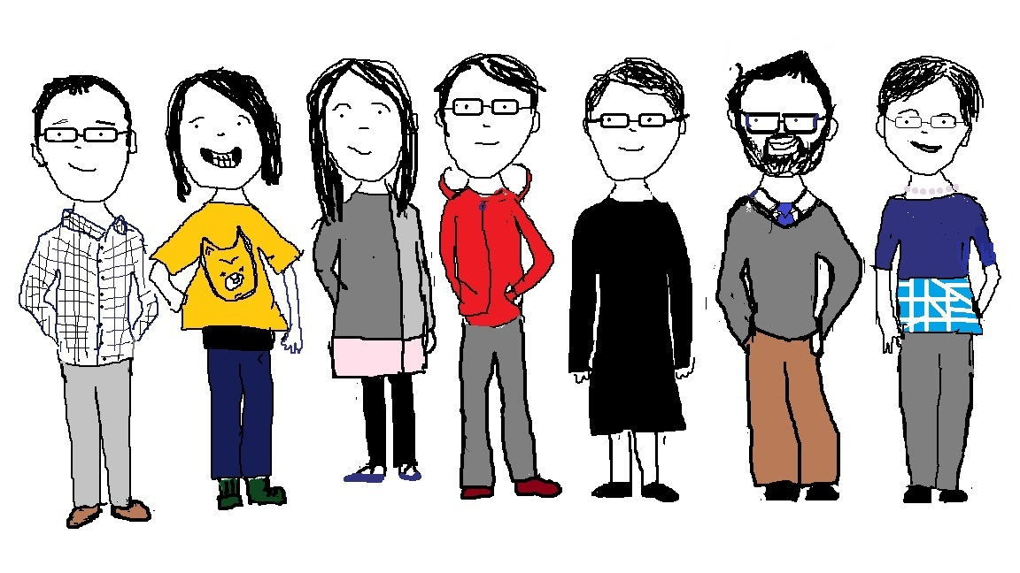
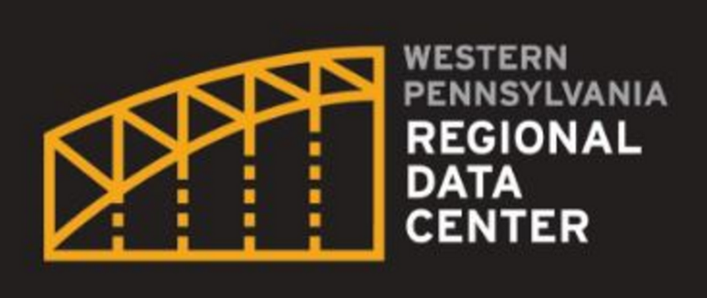
Aaron Brenner
Eleanor Mattern
Toby Greenwalt
Eleanor Tutt
Liz Monk
Bob Gradeck
Kathryn Pettit

Slide 27
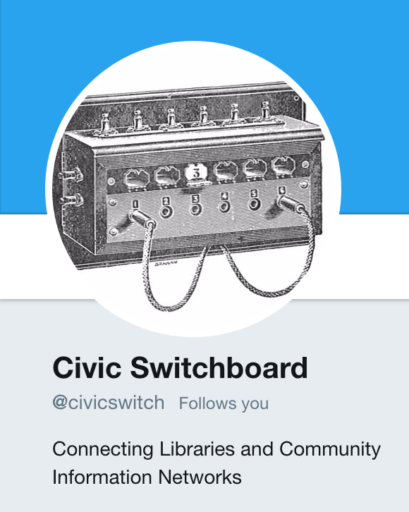
http://civic-switchboard.github.io
@civicswitch

Slide 28
https://civic-switchboard.gitbooks.io/guide/

Slide 29
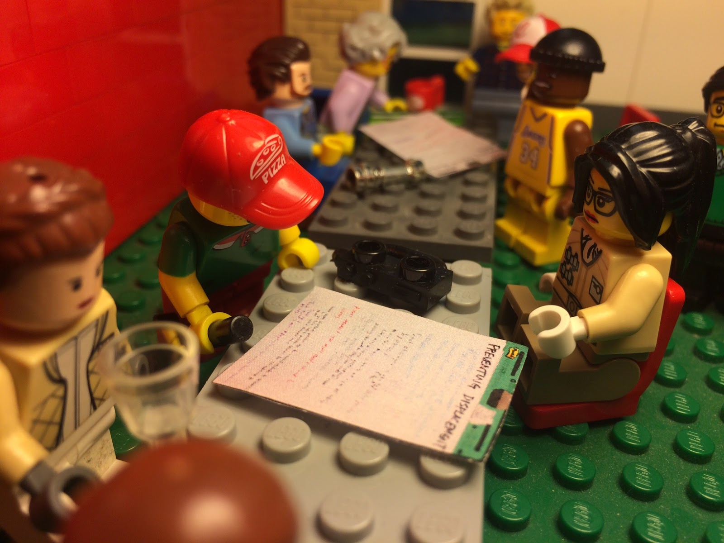
Building Social Infrastructure and Capacity
Civic Switchboard Workshops,
for regional teams made up of a library worker and a civic data intermediary

Slide 30
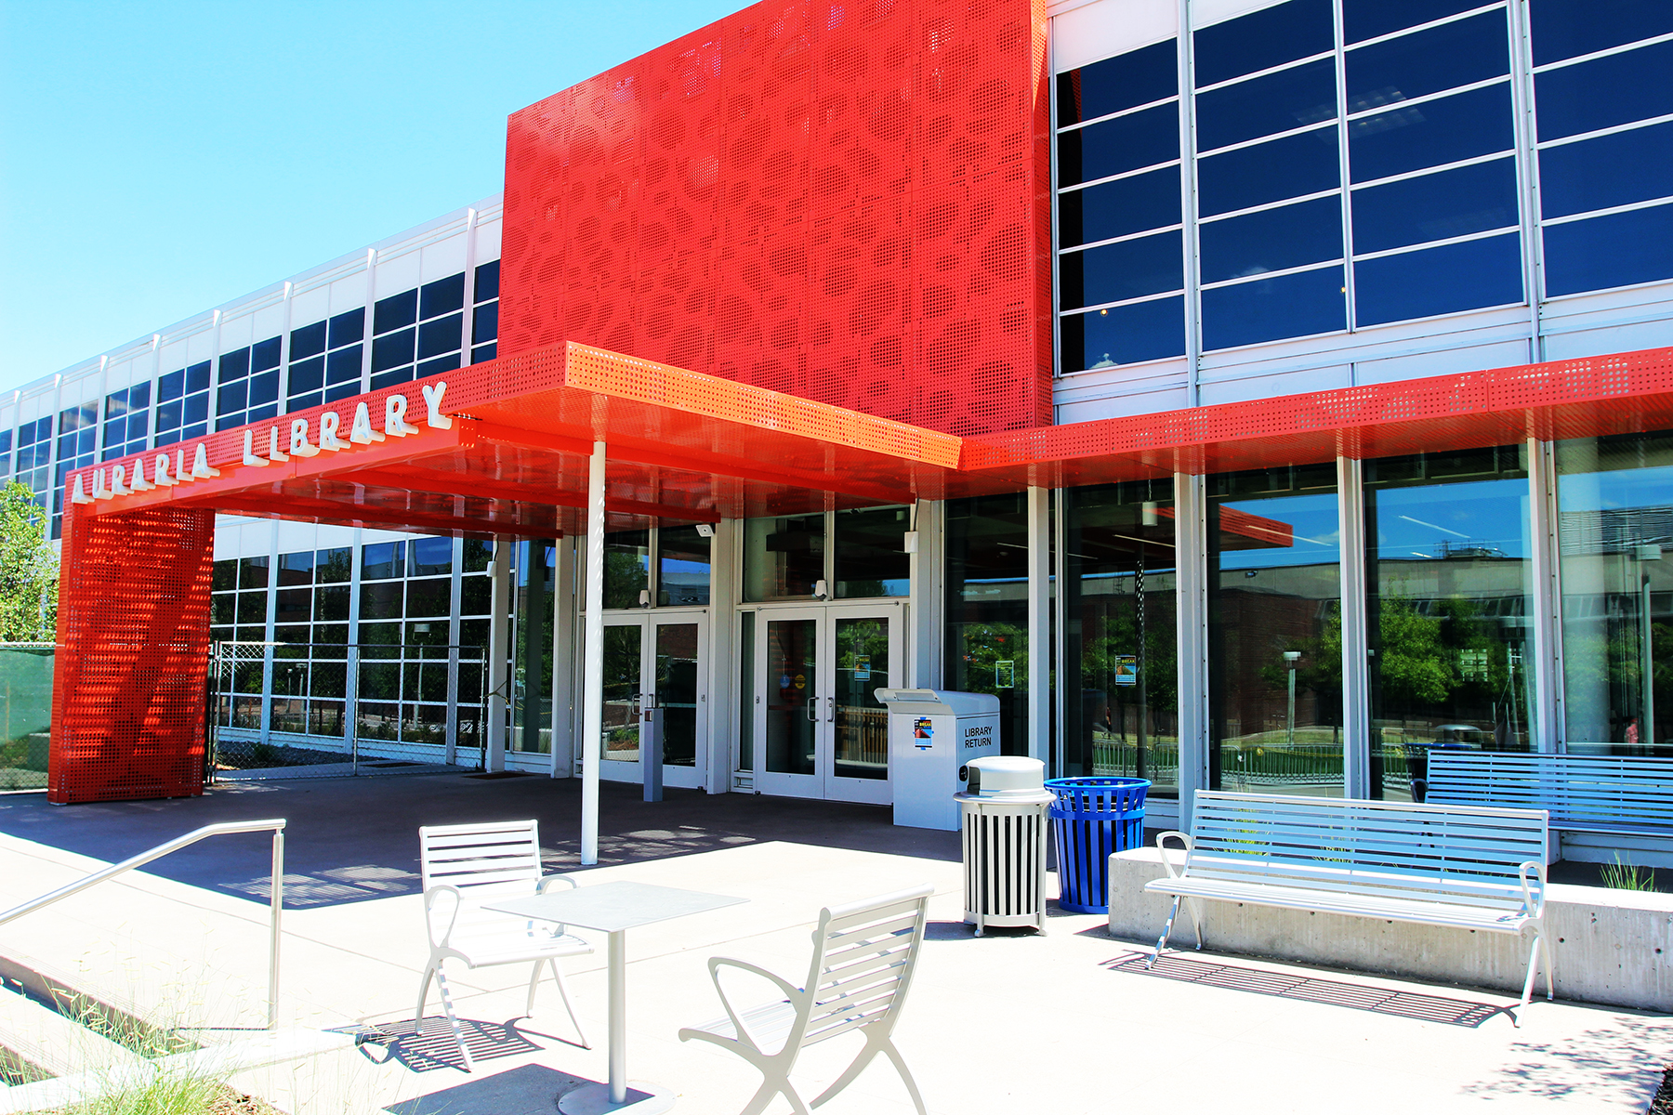
A view from this week’s workshop
+

