Slide 1
Civic Tech and Data Collaborative
May 10, 2018
Notes:
CTDC
Acknowledge Elizabeth, Crystal, Olivia
And MacArthur
Christopher Whittaker couldn’t be here – Veronica Young

Slide 2
Motivating question
How can we harness the power of
data and technology to increase
the efficiency, equity, and effectiveness
of policies and programs that will
benefit low-income urban residents?

Slide 3
Local participating sites
Implementation Sites
Boston
St. Louis
Washington DC
Learning Partners
Cleveland
Pittsburgh
San Antonio
Seattle
Notes:
Competitive process
Learning partners – Cleveland Data Days, newsletter in Pitt
Ecosystem mapping

Slide 4
Intentional connections & collaborations
NNIP Partners
Civic technologists
Local government

Slide 5
Lessons from local partners
Variety of ways to successfully:
structure teams
tap civic technologists
Exposure to new allies, approaches, perspectives
Technology as a catalyst for relationships and action
Experience in user-centered design
Notes:
Trying

Slide 6
Lessons from national partners
Different approaches to community change
New strategies for supporting local members and peer learning
How to amplify messages and reach new audiences
Ways to experiment with cross-site project structure
Notes:
Value of aligning with other organizations around common goals
All

Slide 7
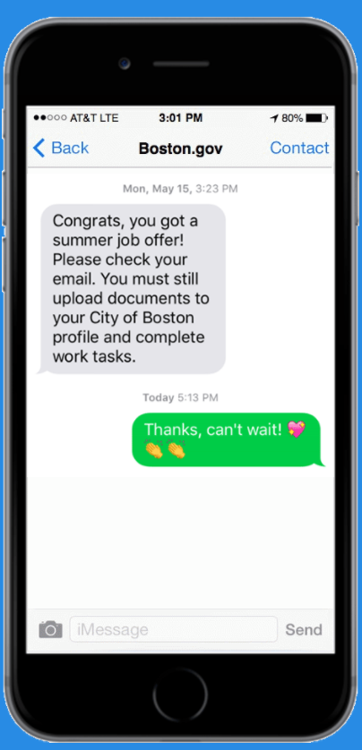
CTDC products
Collaborating for 21st Century Solutions
Ecosystem Mapping Guide
Local Case Studies
National and Local Blogs
Partners’ Guide to Civic Tech
Toolkit
Notes:
Early June – we can make drafts available for anyone interested

Slide 8
Civic Tech and Data Collaborative
http://www.neighborhoodindicators.org/ctdc

