Slide 1
St. Louis’ Civic Tech and Data Collaborative
John Cruz, Rise Community Development St. Louis, Missouri

Slide 2
The Civic Issue in St. Louis
Fractured municipal system with 90 municipalities and 80+ courts
Working with a team of social work students from UMSL, we were able to identify problems people faced with going to court.
St. Louisans are getting trapped in a cycle of being unable to pay traffic fines, which compound exponentially.
Many feel frustrated, trapped by justice system.
Missouri judges will often issue a warrant for “failure to appear” if a court date is missed.
This results in people becoming victims when they need help (such as getting into a car collision or having their home broken into), when police are called.
People felt that they didn’t have the information to go to court, or in many times where court was if they lost their ticket.
Notes:
All of this work builds off of problems identified in the Ferguson Commission Report

Slide 3
Ultimate Goal: A single online web portal available to all court users in the region to look up their information

Slide 4
Product:
Online web portal with
Information on courts (locations, maps, etc.)
Ticket lookup system
Ability to find information on your own
Ability to learn if you have a warrant out for your arrest
Desktop and mobile friendly
Text message system with
All the lookup features of the web portal
Text message reminder system to go to court
Notes:
YourSTL Courts was the product of this effort. The pilot was launched in May of 2017 with unincorporated St. Louis county and includes a mobile friendly website and companion text message based system.
The program architecture is built in a way that if we wanted to create apps that access our court data, we could do so with funding.

Slide 5
YourSTLCourts Web Portal and Partners
Notes:
The screenshot shows the YourSTLCourts web portal and various partners in the project: St. Louis Economic Development Partnership UMSL School of Social Work Hands Up United GlobalHack OpenData STL

Slide 6
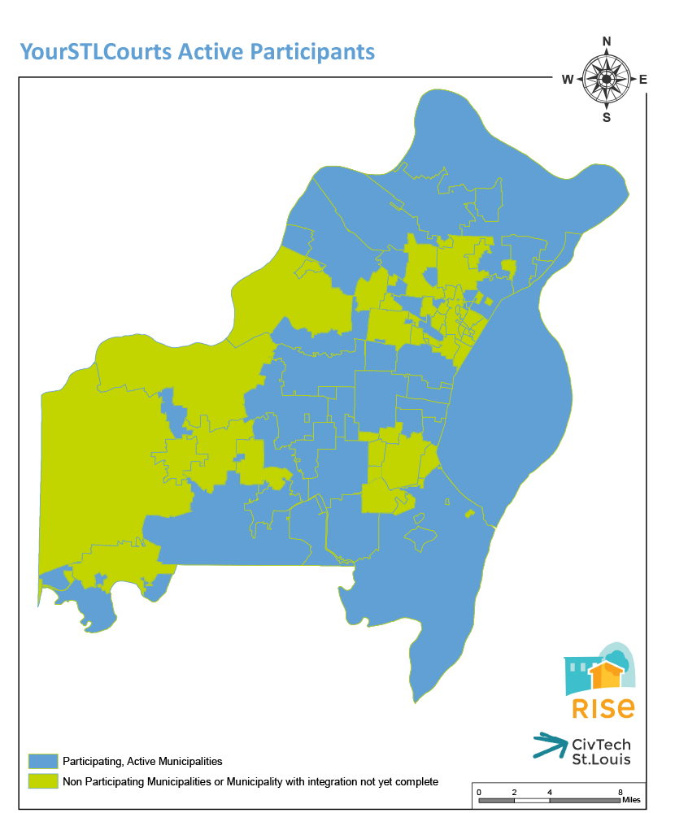
There are over 80 courts in St. Louis, with various software vendors serving them.
Now that we have partnered with two of those vendors with data agreements, aprox. 75% of St. Louisans live in an area covered by YourSTLCourts.
Our goal is to have the entire region under one online system.
We currently support all of the City of St. Louis, unincorporated St. Louis County, and over 40 county municipalities.
Notes:
Our expansion with court system software provider REJIS last month took our program out of the “pilot” stage and into the full on stage of work. If you get a traffic ticket (or any civil infraction) in the green areas, you will be able to use our tool to look up your ticket information, learn if you have a warrant for your arrest, or get text message reminders about going to court.
The system has court information for all municipal courts in the city and county, so even if you cannot look up your info you can get information about the court and expected conduct.

Slide 7
Stakeholder Outreach
Public
Surveys outside court
Student focus group training
User testing
St. Louis County Library
Print materials
Police officer training
Judges and Clerks
Monthly newsletters/email blast (MailChimp)
Monthly steering committee meetings to gather input on outstanding questions and make decisions
Presentations at courts and monthly task force meetings
Distribution of marketing materials
Labor Day BBQ
E-survey
Coding Community
GlobalHack V
Hands Up United Tech Institute
LaunchCode
OpenDataSTL
Notes:
These are some of the various entities that were engaged with during the process in order to do outreach and bring all stakeholders to the table.

Slide 8
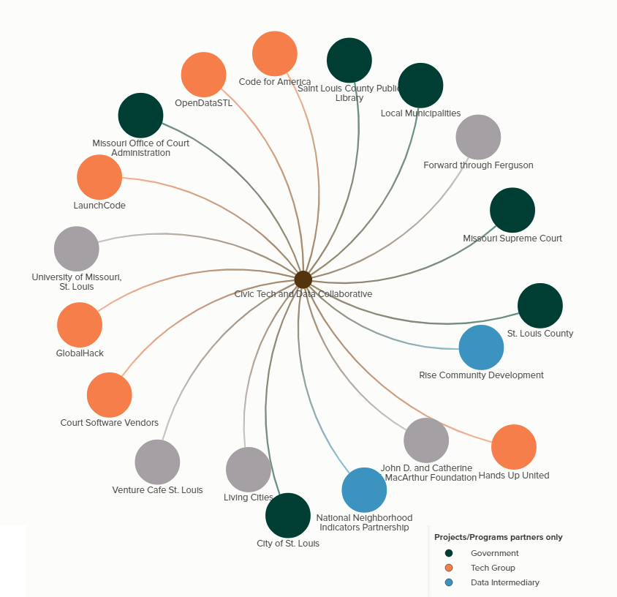
Civic Tech St. Louis Ecosystem
Notes:
This shows our collaborative ecosystem and many of the numerous partners that are involved with the project.

Slide 9
Challenges
Over 90 municipalities, multiple major court software vendors handing their databases.
Getting vendors and municipalities to agree to share their data.
Staff turnover and change of roles, both internally and externally.
Software development time.
Building political alliances to make the project work.
Working with all of our ecosystem partners. There are many but they were all essential to the process.
To ensure confidence among government partners, our data collaborative became a 501(c)(3) nonprofit organization.
Notes:
This is a very complicated software project with many “moving parts” and various players. As a result, there were a lot of challenges that ranged from personnel changes to timeline changes to having to completely re-think our approach when new details came together. The success of this project hinged on the team’s ability to make needed changes as they came up.

Slide 10
Lessons Learned
Engaging hard to reach communities requires patience, time, and trust building.
Team had to test software with people waiting in line at court.
Needed to change goals, objectives, etc. with the project as more information becomes available. Flexibility is key.
So many budget revisions.
Revisions in the goals and scope of grant based on what we later learned was possible.
Need to be flexible with internal and external staff changes.

Slide 11
Indicators Developed
Number of persons incarcerated with infractions related to traffic tickets | Number of bench warrants issued for infractions related to traffic tickets
Percentage of municipal revenue received from traffic tickets | Number of persons who do not attend court dates
Number of arrests for outstanding bench warrants | Number of persons who receive traffic tickets in a municipality
Amount of court costs related to traffic infractions per court user | Number of people utilizing YourSTL Courts technology
Number of people who experience extreme negative life effects as a result of traffic ticket originated court experiences. | Number of people paying traffic fines through payment plans, community service hours, or another non-traditional payment method.
Number of people who feel empowered when they go to court. | Number of people who feel well prepared when going to court.
Volume of informative calls to court clerks | Overall percentage of tickets resolved in a timely fashion

Slide 12
Thank you!
Download our whitepaper at civtechstl.com/wp
Questions, comments, concerns?
johnc@risestl.org
314-333-7017

